Slide 1
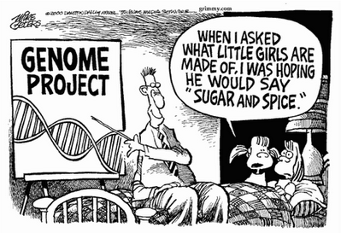
We Are All Mutants
BIO*300/CMPSC*300 – SPRING 2016
CRASH COURSE IN MOLECULAR BIOLOGY

Slide 2

What is Mutation?
a natural process that changes the DNA sequence
a common process
  during replication of the human genome a “typo” occurs every 100,000 or so nucleotides
  that’s about 120,000 typos each time one of our cells divides
  most are repaired

Slide 3
What is Mutation?
a natural process that changes the DNA sequence
most mutations are neutral – no consequence
some mutations are beneficial – provides advantage in particular environment
some mutations are harmful

Slide 4
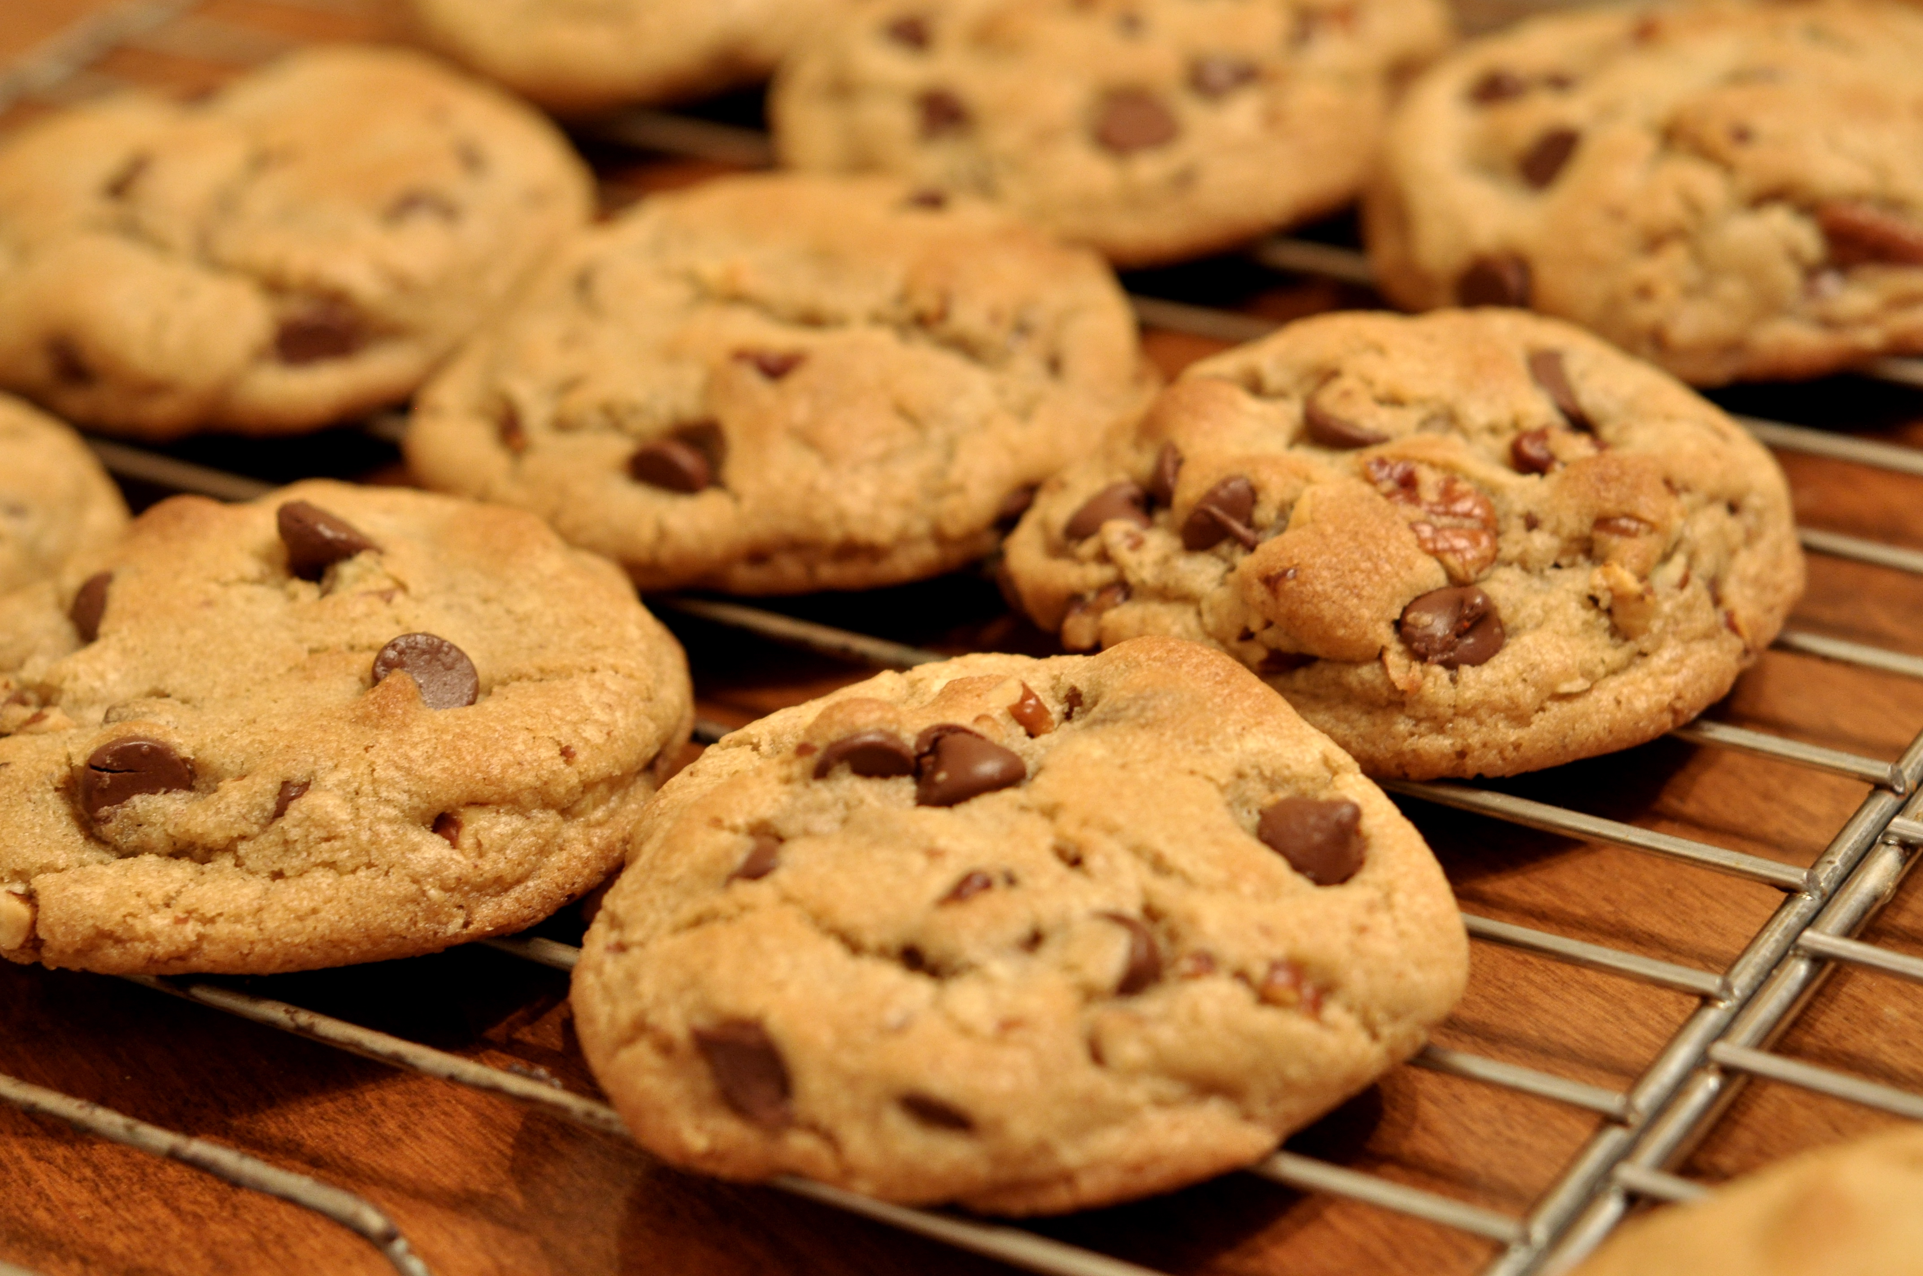
Chocolate Chip Cookies
Ingredients
2 ¼ cups all purpose flour
1 teaspoon baking soda
1 teaspoon salt
1 cup (2 sticks) butter, softened
¾ cup granulated sugar
¾ cup packed brown sugar
1 teaspoon vanilla extract
2 large eggs
2 cups chocolate chips
PREHEAT over to 375°F
COMBINE flour, baking soda, and salt in a small bowl. Beat butter, sugars, and vanilla extract in a larger mixer bowl until creamy. Add eggs, one at a time, beating well after each addition. Gradually beat in flower mixture. Stir in chocolate chips. Drop by rounded tablespoons onto ungreased baking sheets.
BAKE for 9 to 11 minutes or until golden brown. Cool on baking sheet for 2 minutes; remove to wire rack to cool completely

Slide 5
Chocolate Chip Cookies
Ingredients
2 ¼ cups all purpose flour
1 teaspoon baking soda
1 teaspoon salt
1 cup (2 stqcks) butter, softened
¾ cup granulated sugar
¾ cup packed brown sugar
1 teaspoon vanilla extract
2 large eggs
2 cups chocolate chips
PREHEAT over to 375°F
COMBINE flour, baking soda, and salt in a small bowl. Beat butter, sugars, and vanilla extract in a larger mixer bowl until creamy. Add eggs, one at a time, beating well after each addition. Gradually beat in flower mixture. Stir in chocolate chips. Drop by rounded tablespoons onto ungreased baking sheets.
BAKE for 9 to 11 minutes or until golden brown. Cool on baking sheet for 2 minutes; remove to wire rack to cool completely

Slide 6
Chocolate Chip Cookies
Ingredients
2 ¼ cups all purpose flour
1 teaspoon baking soda
1 teaspoon salt
1 cup (2 stqcks) butter, softened
¾ cup granulated sugar
¾ cup packed brown sugar
1 teaspoon vanilla extract
2 large eggs
2 cups chocolate chips
Point Mutation
PREHEAT over to 375°F
COMBINE flour, baking soda, and salt in a small bowl. Beat butter, sugars, and vanilla extract in a larger mixer bowl until creamy. Add eggs, one at a time, beating well after each addition. Gradually beat in flower mixture. Stir in chocolate chips. Drop by rounded tablespoons onto ungreased baking sheets.
BAKE for 9 to 11 minutes or until golden brown. Cool on baking sheet for 2 minutes; remove to wire rack to cool completely

Slide 7
Chocolate Chip Cookies
Ingredients
2 ¼ cups all purpose flour
1 teaspoon baking soda
1 teaspoon salt
1 cup (2 sticks) butter, softened
¾ cup granulated sugar
¾ cup packed brown sugar
1 teaspoon vanilla extract
2 large eggs
2 cups chocolate chips
PREHEAT over to 375°F
COMBINE flour, baking soda, and salt in a small bowl. Beat butter, sugars, and vanilla extract in a larger mixer bowl until creamy. Add eggs, one at a time, beating well after each addition. Gradually beat in flower mixture. Stir in chocolate chips. Drop by rounded tablespoons onto ungreased baking sheets.
BAKE for 9 to 11 minutes or until golden brown. Cool on baking sheet for 2 minutes; remove to wire rack to cool completely

Slide 8
Chocolate Chip Cookies
Ingredients
2 ¼ cups all purpose flour
9 teaspoon baking soda
1 teaspoon salt
1 cup (2 sticks) butter, softened
¾ cup granulated sugar
¾ cup packed brown sugar
1 teaspoon vanilla extract
2 large eggs
2 cups chocolate chips
PREHEAT over to 375°F
COMBINE flour, baking soda, and salt in a small bowl. Beat butter, sugars, and vanilla extract in a larger mixer bowl until creamy. Add eggs, one at a time, beating well after each addition. Gradually beat in flower mixture. Stir in chocolate chips. Drop by rounded tablespoons onto ungreased baking sheets.
BAKE for 9 to 11 minutes or until golden brown. Cool on baking sheet for 2 minutes; remove to wire rack to cool completely

Slide 9
Chocolate Chip Cookies
Point Mutation
Ingredients
2 ¼ cups all purpose flour
9 teaspoon baking soda
1 teaspoon salt
1 cup (2 sticks) butter, softened
¾ cup granulated sugar
¾ cup packed brown sugar
1 teaspoon vanilla extract
2 large eggs
2 cups chocolate chips
PREHEAT over to 375°F
COMBINE flour, baking soda, and salt in a small bowl. Beat butter, sugars, and vanilla extract in a larger mixer bowl until creamy. Add eggs, one at a time, beating well after each addition. Gradually beat in flower mixture. Stir in chocolate chips. Drop by rounded tablespoons onto ungreased baking sheets.
BAKE for 9 to 11 minutes or until golden brown. Cool on baking sheet for 2 minutes; remove to wire rack to cool completely

Slide 10
Chocolate Chip Cookies
Ingredients
2 ¼ cups all purpose flour
1 teaspoon baking soda
1 teaspoon salt
1 cup (2 sticks) butter, softened
¾ cup granulated sugar
¾ cup packed brown sugar
1 teaspoon vanilla extract
2 large eggs
2 cups chocolate chips
PREHEAT over to 375°F
COMBINE flour, baking soda, and salt in a small bowl. Beat butter, sugars, and vanilla extract in a larger mixer bowl until creamy. Add eggs, one at a time, beating well after each addition. Gradually beat in flower mixture. Stir in chocolate chips. Drop by rounded tablespoons onto ungreased baking sheets.
BAKE for 9 to 11 minutes or until golden brown. Cool on baking sheet for 2 minutes; remove to wire rack to cool completely

Slide 11
Chocolate Chip Cookies
Ingredients
2 ¼ cups all purpose flour
1 teaspoon baking soda
1 teaspoon salt
1 cup (2 sticks) butter, softened
¾ cup granulated sugar
¾ cup packed brown sugar
1 teaspoon vanilla extract
2 large eggs
2 cups chocolate chips
COMBINE flour, baking soda, and salt in a small bowl. Beat butter, sugars, and vanilla extract in a larger mixer bowl until creamy. Add eggs, one at a time, beating well after each addition. Gradually beat in flower mixture. Stir in chocolate chips. Drop by rounded tablespoons onto ungreased baking sheets.
BAKE for 9 to 11 minutes or until golden brown. Cool on baking sheet for 2 minutes; remove to wire rack to cool completely
PREHEAT over to 375°F

Slide 12
Chocolate Chip Cookies
Ingredients
2 ¼ cups all purpose flour
1 teaspoon baking soda
1 teaspoon salt
1 cup (2 sticks) butter, softened
¾ cup granulated sugar
¾ cup packed brown sugar
1 teaspoon vanilla extract
2 large eggs
2 cups chocolate chips
Inversion
COMBINE flour, baking soda, and salt in a small bowl. Beat butter, sugars, and vanilla extract in a larger mixer bowl until creamy. Add eggs, one at a time, beating well after each addition. Gradually beat in flower mixture. Stir in chocolate chips. Drop by rounded tablespoons onto ungreased baking sheets.
BAKE for 9 to 11 minutes or until golden brown. Cool on baking sheet for 2 minutes; remove to wire rack to cool completely
PREHEAT over to 375°F

Slide 13
Chocolate Chip Cookies
Ingredients
2 ¼ cups all purpose flour
1 teaspoon baking soda
1 teaspoon salt
1 cup (2 sticks) butter, softened
¾ cup granulated sugar
¾ cup packed brown sugar
1 teaspoon vanilla extract
2 large eggs
2 cups chocolate chips
PREHEAT over to 375°F
COMBINE flour, baking soda, and salt in a small bowl. Beat butter, sugars, and vanilla extract in a larger mixer bowl until creamy. Add eggs, one at a time, beating well after each addition. Gradually beat in flower mixture. Stir in chocolate chips. Drop by rounded tablespoons onto ungreased baking sheets.
BAKE for 9 to 11 minutes or until golden brown. Cool on baking sheet for 2 minutes; remove to wire rack to cool completely

Slide 14
Chocolate Chip Cookies
Ingredients
2 ¼ cups all purpose flour
1 teaspoon baking soda
1 teaspoon salt
1 cup (2 sticks) butter, softened
¾ cup granulated sugar
¾ cup packed brown sugar
1 teaspoon vanilla extract
2 large eggs
2 cups butterscotch chips
PREHEAT over to 375°F
COMBINE flour, baking soda, and salt in a small bowl. Beat butter, sugars, and vanilla extract in a larger mixer bowl until creamy. Add eggs, one at a time, beating well after each addition. Gradually beat in flower mixture. Stir in chocolate chips. Drop by rounded tablespoons onto ungreased baking sheets.
BAKE for 9 to 11 minutes or until golden brown. Cool on baking sheet for 2 minutes; remove to wire rack to cool completely

Slide 15
Chocolate Chip Cookies
Ingredients
2 ¼ cups all purpose flour
1 teaspoon baking soda
1 teaspoon salt
1 cup (2 sticks) butter, softened
¾ cup granulated sugar
¾ cup packed brown sugar
1 teaspoon vanilla extract
2 large eggs
2 cups butterscotch chips
Substitution
PREHEAT over to 375°F
COMBINE flour, baking soda, and salt in a small bowl. Beat butter, sugars, and vanilla extract in a larger mixer bowl until creamy. Add eggs, one at a time, beating well after each addition. Gradually beat in flower mixture. Stir in chocolate chips. Drop by rounded tablespoons onto ungreased baking sheets.
BAKE for 9 to 11 minutes or until golden brown. Cool on baking sheet for 2 minutes; remove to wire rack to cool completely

Slide 16
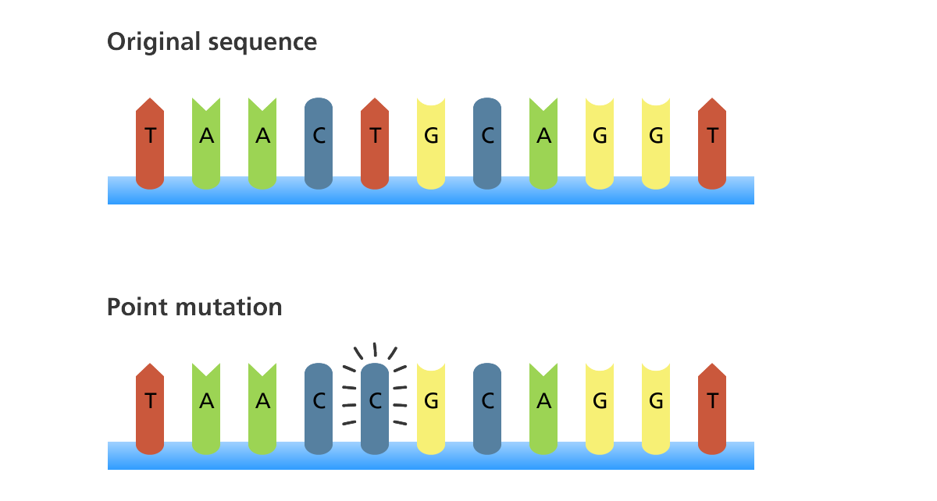
Mutation – Point Mutation
A point mutation is a mutation that exchanges one base for another

Slide 17
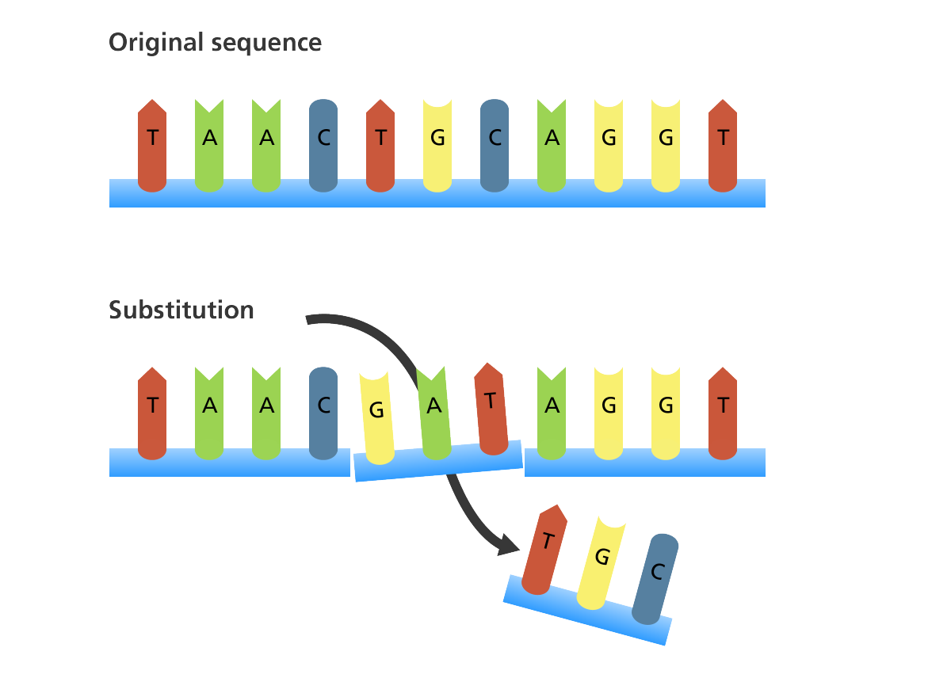
Mutation - Substitution
A substitution is a mutation where one or more bases in the sequence is replaced by the same number of bases

Slide 18
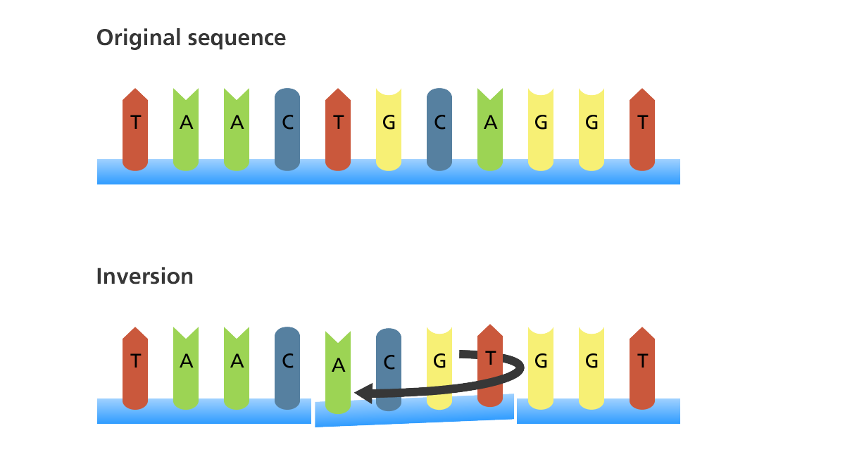
Mutation - Inversion
An inversion is a mutation where a segment of DNA is reversed

Slide 19
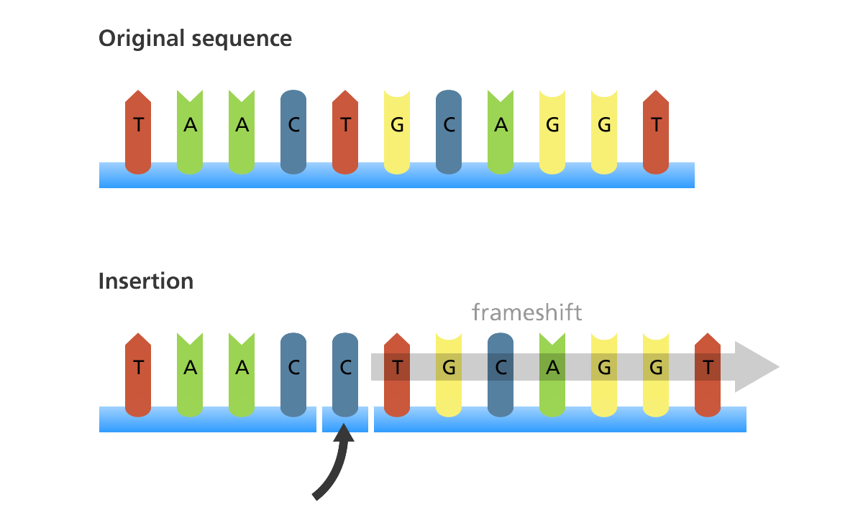
Mutation - Insertion
An insertion is a mutation in which one or more nucleotides are added into the DNA

Slide 20
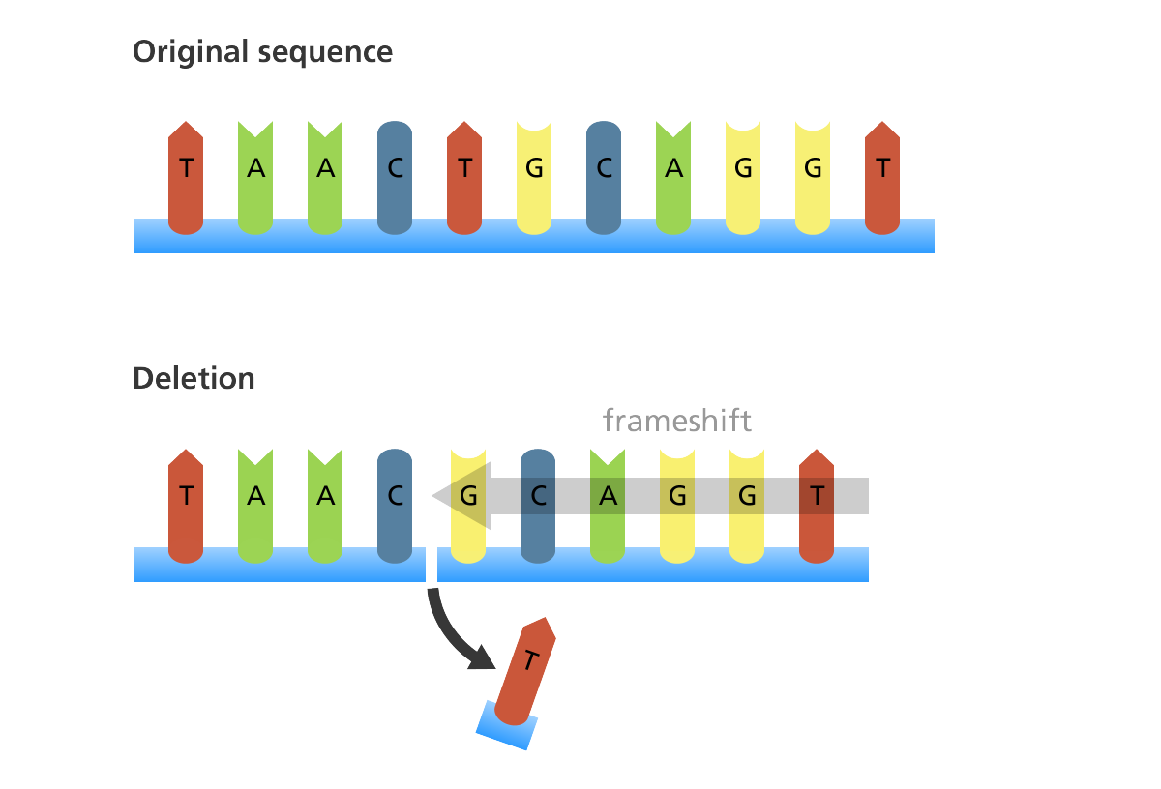
Mutation - Deletion
A deletion is a mutation in which one or more nucleotides are removed from the DNA sequence

Slide 21

Where do mutations come from?
Cell division (meiosis)
Usually okay as long as gene sequence is not interrupted

Slide 22
Where do mutations come from?
Mistakes by the DNA polymerase during replication
  Can be repaired by repair enzymes – not always perfect
A C T G C G T A C
| | | | | | | | |
T G A T G C A T G

Slide 23
Where do mutations come from?
Mistakes by the DNA polymerase during replication
  Can be repaired by repair enzymes – not always perfect
A C T G C G T A C
| | | | | | | | |
T G A T G C A T G

Slide 24
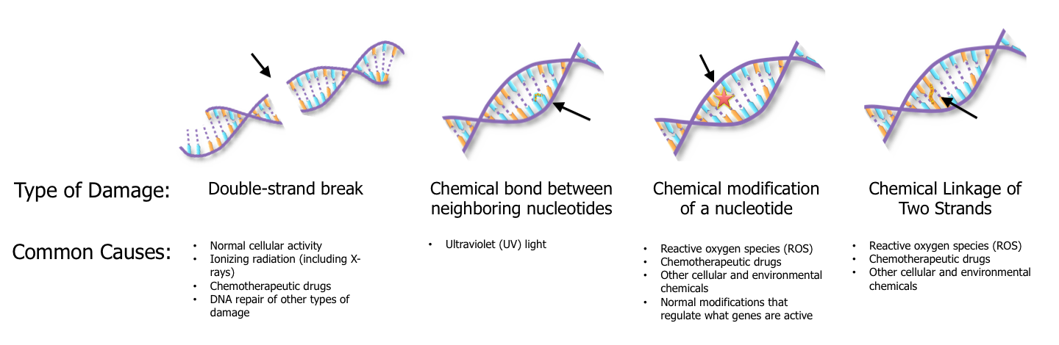
Where do mutations come from?
DNA damage and imperfect repair
  Cell can still divide but DNA sequence has changed

Slide 25
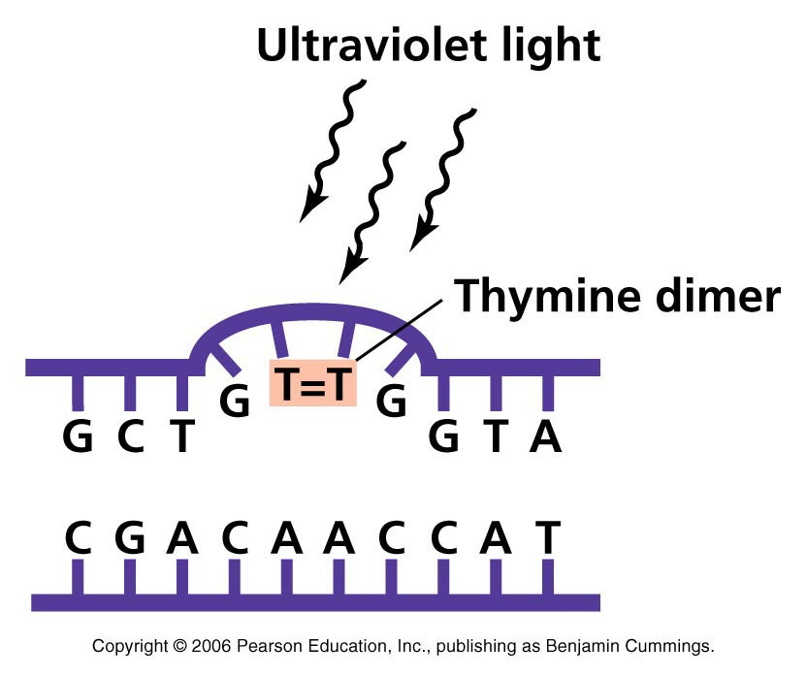
Where Do Mutations Come From?
UV light causes bond to form between adjacent Ts
If left unrepaired, polymerase “guesses”
  25% chance per site
  cell can still divide
  hopefully not in a gene
Chance of mistakes during repair process
  polymerase isn’t perfect
  cell can still divide
  hopefully not in a gene

Slide 26

Consequences of Mutation?
nothing
  mutation does not occur in a gene
    Humans, just 1.5% of the genome
  silent change
    occurs in gene, but does not change message
    genetic code is redundant

Slide 27
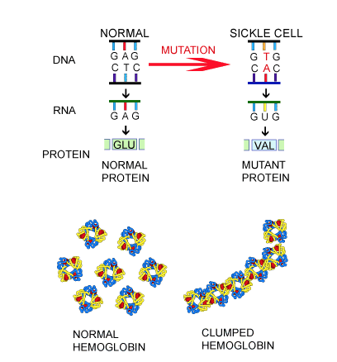
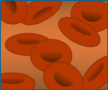

Consequences of Mutation?
HBB gene - Sickle cell anemia – missense mutation
Normal RBC
Sickle RBC
Sickled RBCs are abnormally shaped and ridgid
Sickle shape can interrupt blood flow

Slide 28
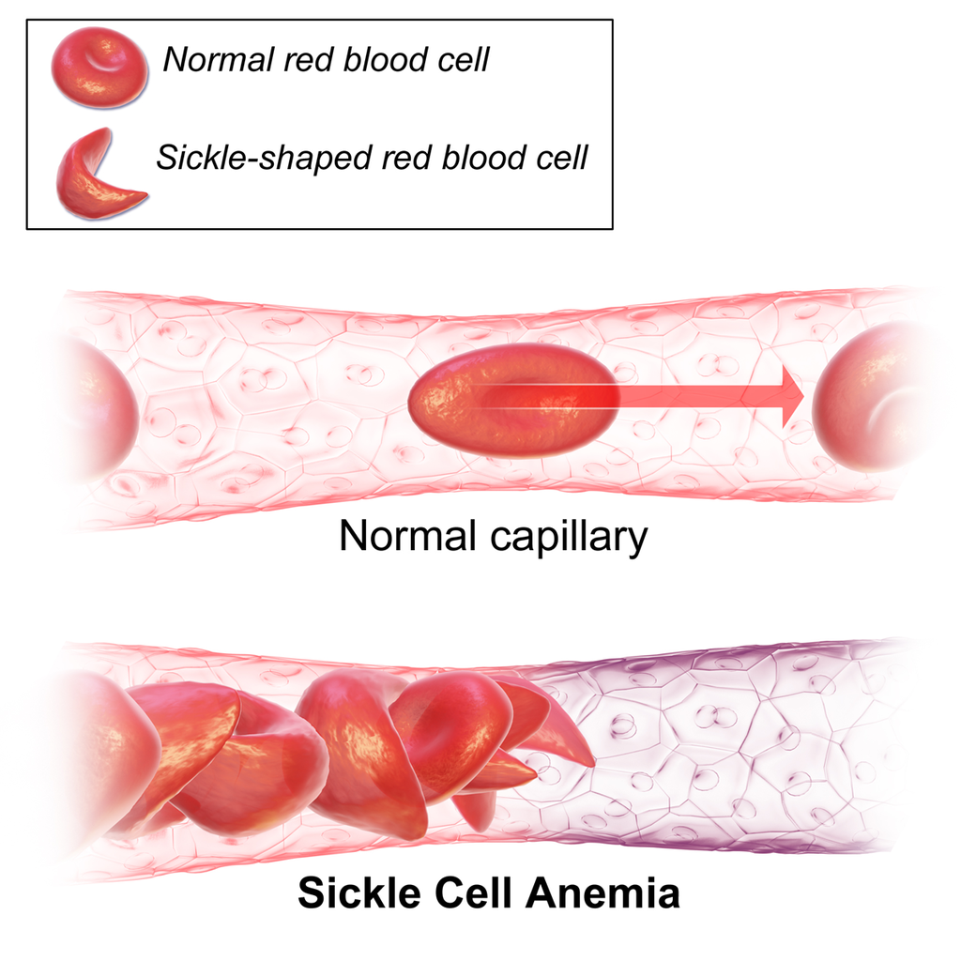
Consequences of Mutation?
HBB gene - Sickle cell anemia – missense mutation

Slide 29
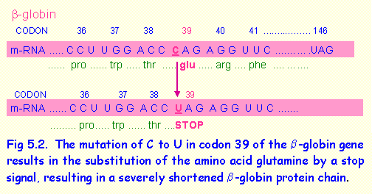
Consequences of Mutation?
HBB gene – Thalassemia – Nonsense mutation

Slide 30
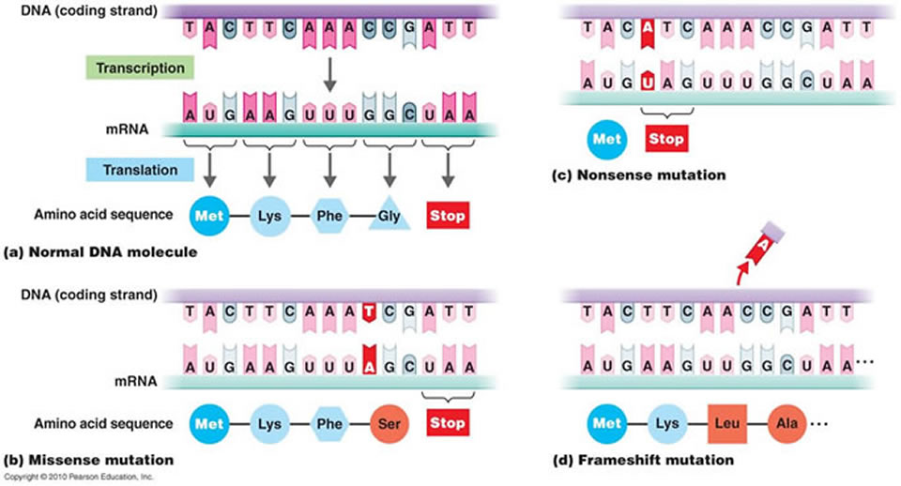
Frame shift mutation
Caused by an Insertion or a Deletion
Changes codons and corresponding amino acids after mutation site

