Slide 1
Bioinformatics
CS300
Chapter 1:
Using Bioinformatics to
study genetic disorders
Fall 2017
Oliver Bonham-Carter

Slide 2

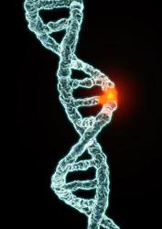
Genetic Disorder
a disorder/disease with a genetic component
caused by one or more abnormalities in the genome
  substitutions
  insertions
  deletions
  rearrangements

Slide 3
Genetic Disorder
a disorder/disease with a genetic component
caused by one or more abnormalities in the genome
single gene disorders
  mutation(s) in the sequence of a single gene
  alters or eliminates protein product

Slide 4
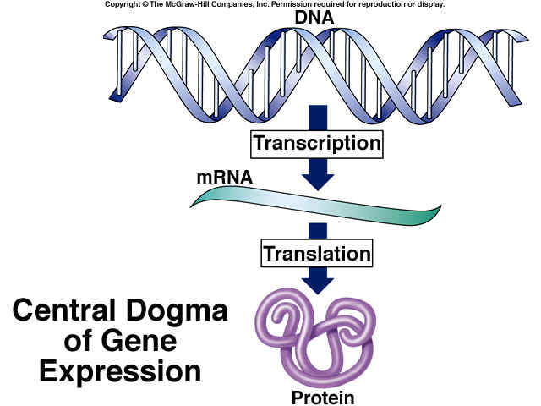
Central Dogma of
Gene Expression

Slide 5
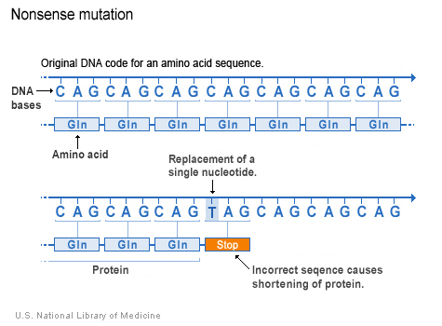
Mutations and Their Potential Effects
Mutations that Alter Protein Products and Mutations that Eliminate Protein Products
Mutations that Eliminate Protein Products
Missense substitutions
Nonsense substitutions
Insertions/Deletions
Missense substitutions
Nonsense substitutions
Insertions/Deletions

Slide 6
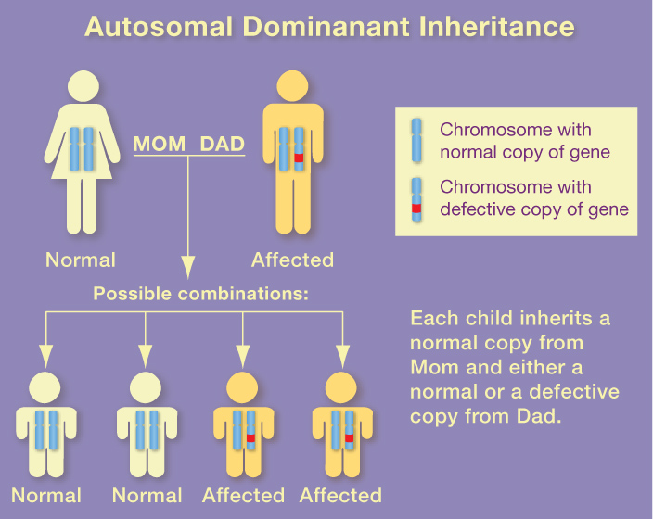

Slide 7
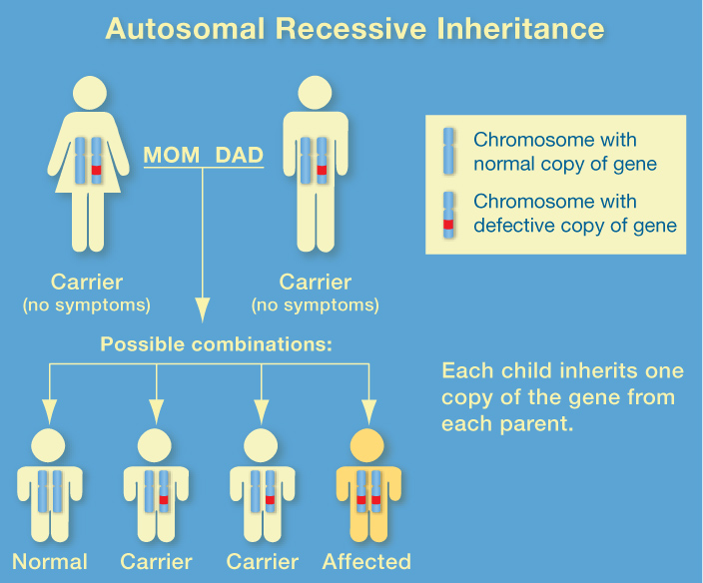

Slide 8
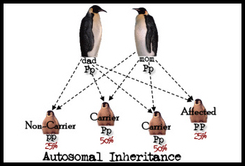
Single Gene Disorders
Inheritance patterns relatively simple
Chance of inheritance in the text generation can be predicted by studying patterns in past generations.

Slide 9
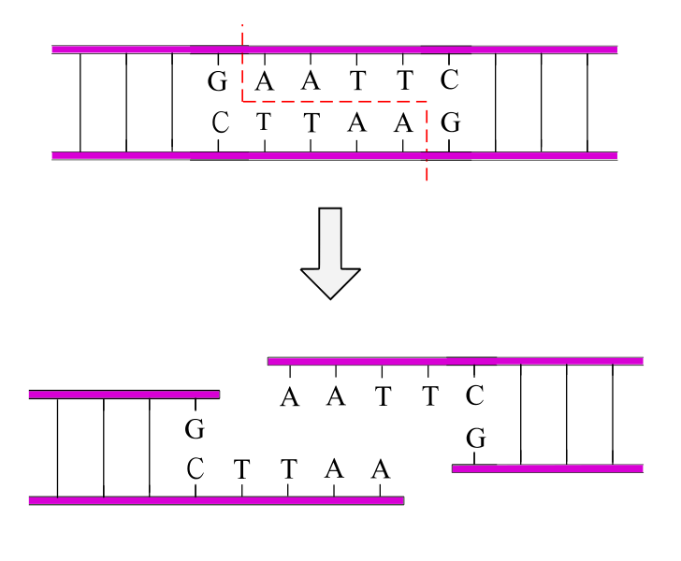
Single Gene Disorders
Most genes identified in the 1980s-1990s
  Pre-Bioinformatics: biological wet-lab work
Restriction enzymes to cut sequences
cut DNA at specific sequence
  100s of different patterns
  Disorder-breading sequences could be studied

Slide 10
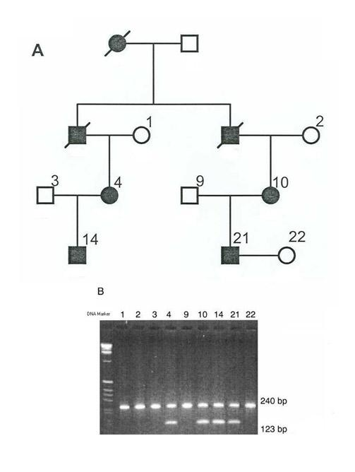
Single Gene Disorders
Pedigree analysis + Restriction Digest Analysis

Slide 11
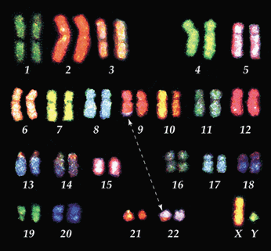
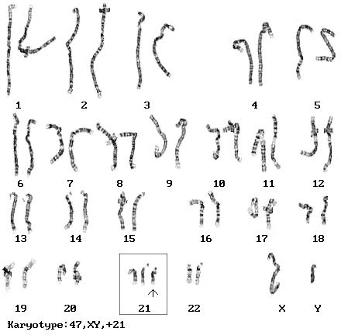
Single Gene Disorders
Cytogenetics
field of biology concerned with mapping genes to specific locations on chromosomes

Slide 12
Genetic Disorder
a disease with a genetic component
caused by one or more abnormalities in the genome
complex or multifactorial disorders
  do not have a single genetic cause
  likely associated with the effects of multiple genes in combination with lifestyle and environmental factors
  do not have a clear cut pattern of inheritance

Slide 13
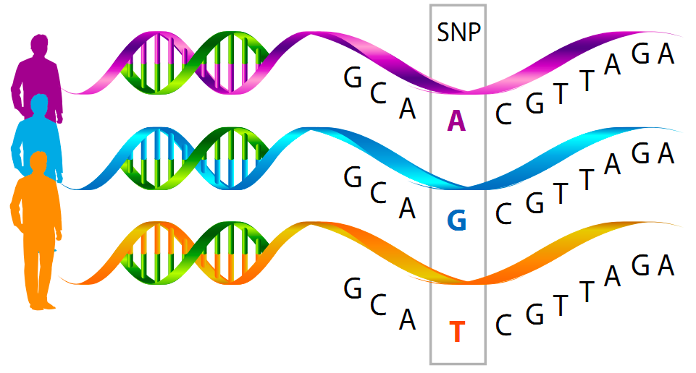
Genome-Wide Association Studies
new technology/analysis - early 2000s
  bioinformatics
screen 1000s of genomes at once for SNPs
  single nucleotide polymorphisms
  Some SNPs may indicate disorders

Slide 14
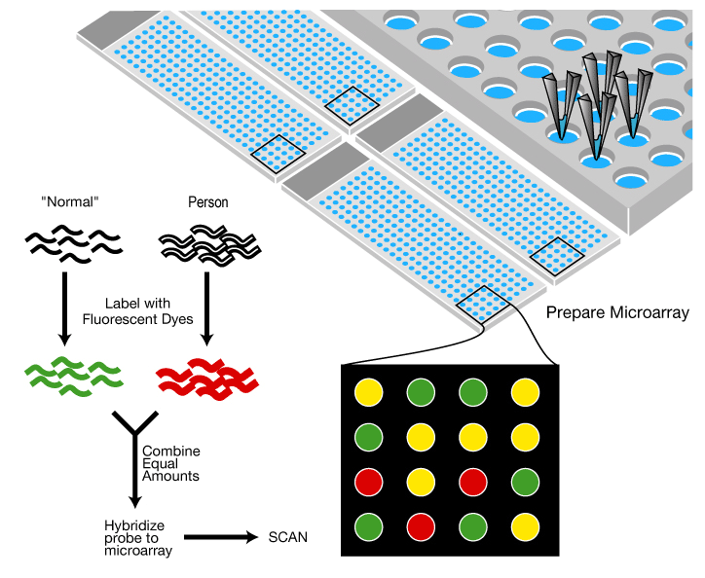
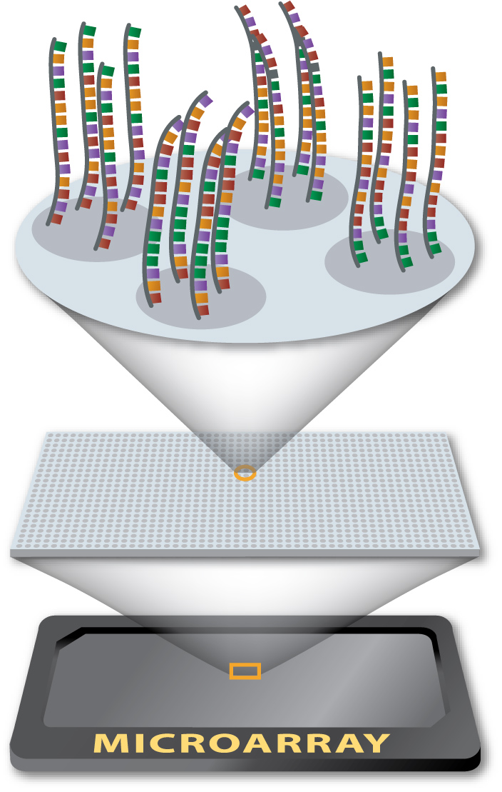
DNA Microarray
“Disease”

Slide 15
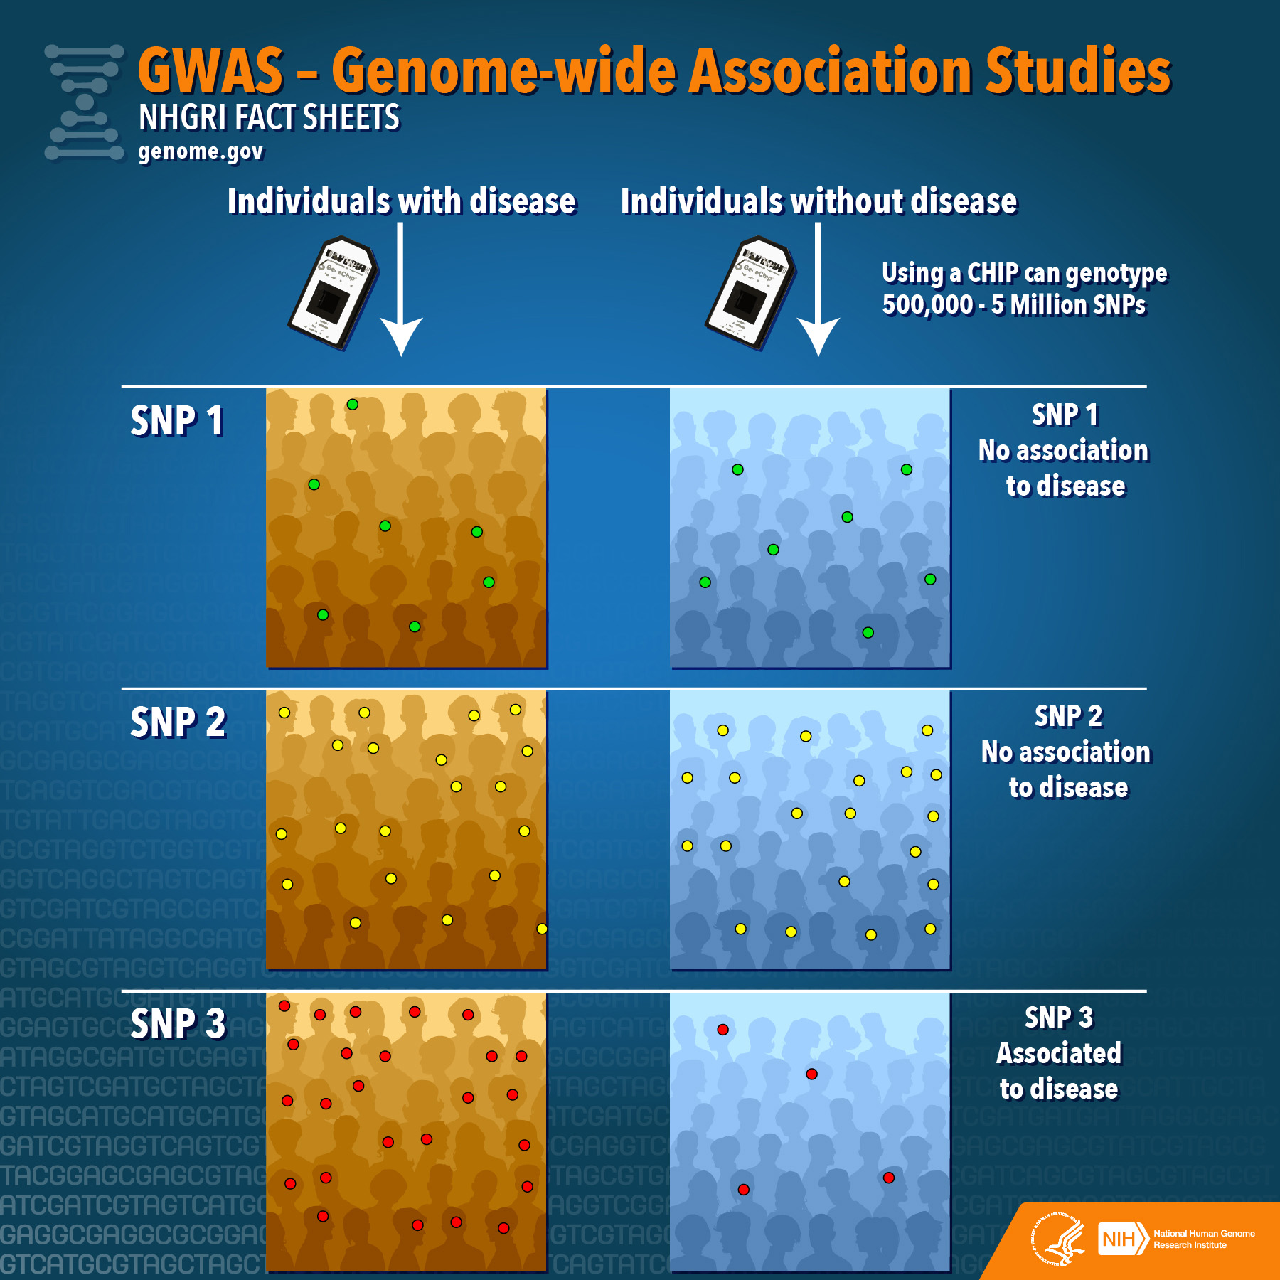

Slide 16
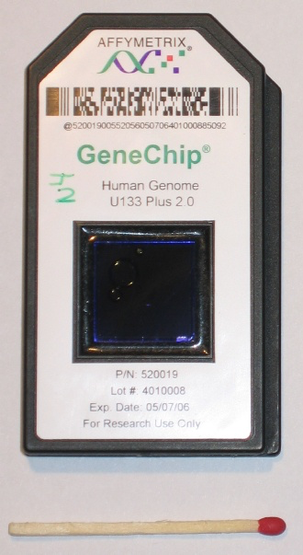
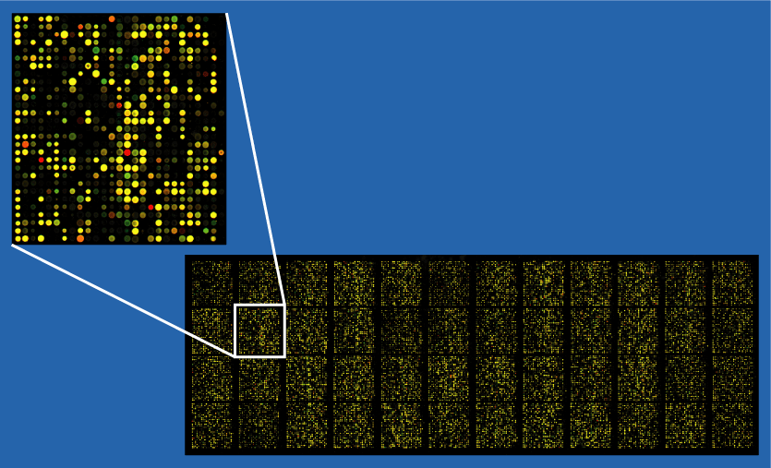
DNA Microarray

Slide 17
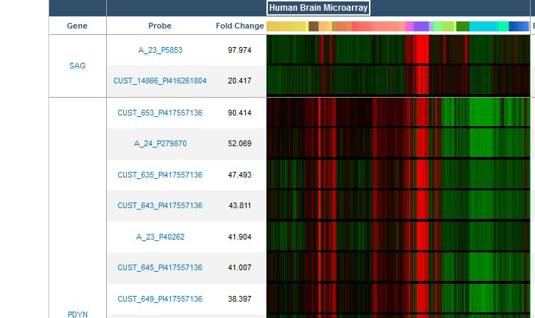
DNA Microarray

Slide 18
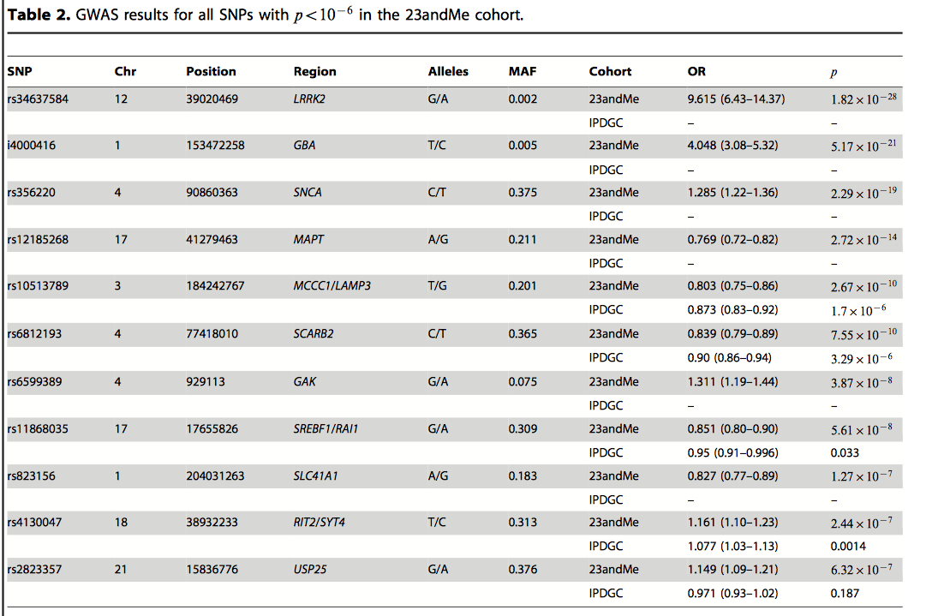
Candidate SNPs that May Be Correlated with Disorder Using Genome-Wide Association Studies (GWAS)

Slide 19


Data for Research
Free data in public databases
Typically Protein: Uniprot
http://www.uniprot.org/
Search: Pink1 (protein)
Typically DNA and Genes: National Center for Biotechnology Informatics (NCBI)
https://www.ncbi.nlm.nih.gov/
Search: “orchid” (nucleotide)

Slide 20

Python Programming
Loading, Writing files
Biopython
Fasta files
Follow along in
class and save
your notes in
a text file!!
  Follow along and Save your notes in a text file.

Slide 21
Header
This
This

