Slide 1
Bioinformatics
CS300
Chap 2
Computational Manipulation of DNA
Fall 2017
Oliver Bonham-Carter

Slide 2

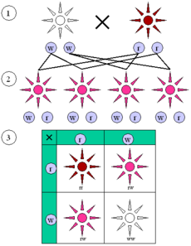
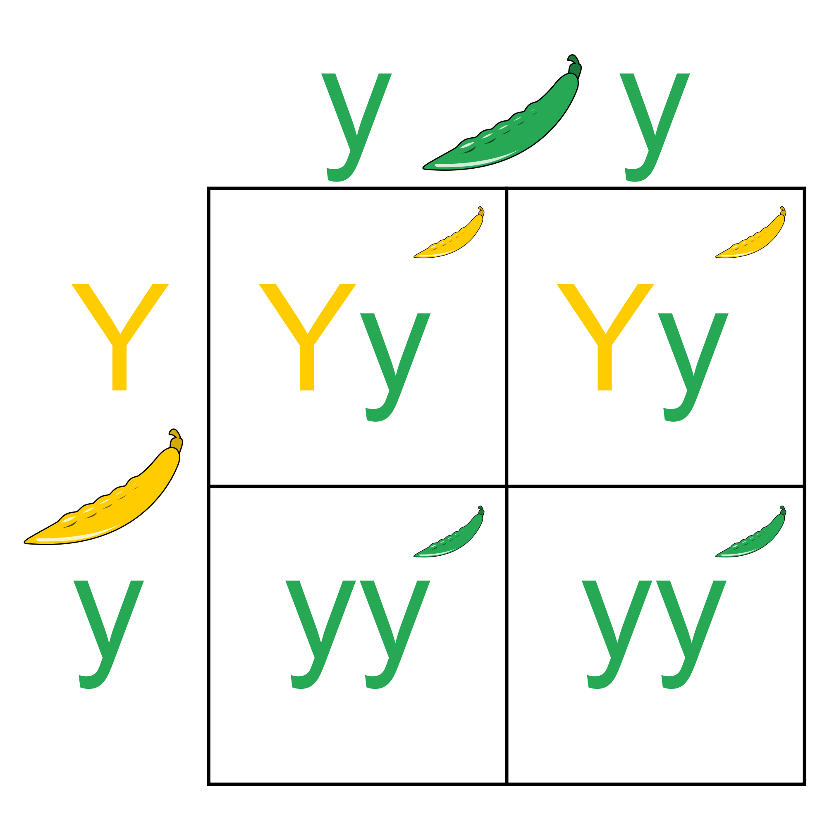
Consider this...
What is the difference between a gene and an allele?
Answer in the context of cystic fibrosis and the CFTR gene
Hint: Think Mendelian Genetics

Slide 3
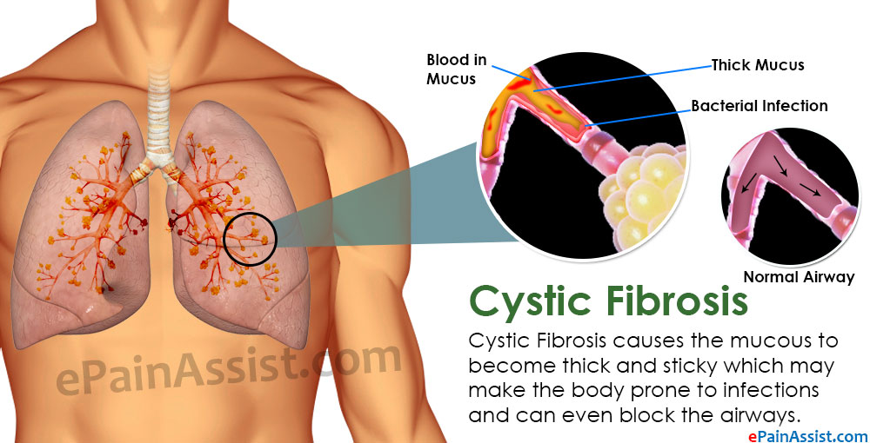
Cystic Fibrosis
Inherited medical condition of the secretory glands (producers of mucous and sweat)

Slide 4
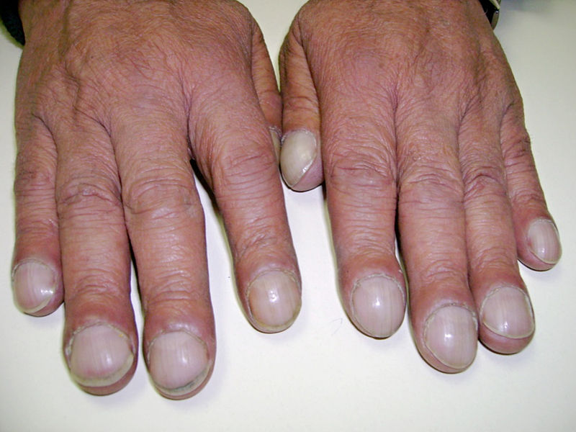
Cystic Fibrosis
Clubbed fingers: occurs in heart and lung diseases that reduce the amount of oxygen in the blood

Slide 5
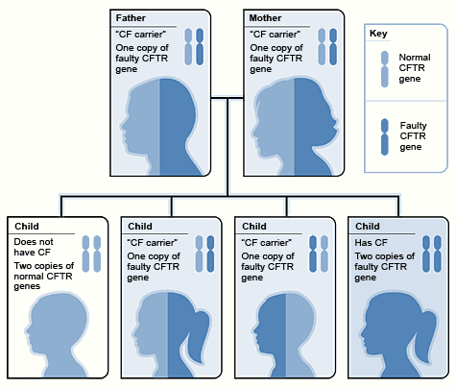
Cystic Fibrosis
Autosomal recessive type condition: one faulty gene is inherited from both parents (together) in order for the offspring to get this condition
Mendelian Genetic
Impossible to know that someone is sure to get a condition.

Slide 6
The Cystic Fibrosis Gene
Cystic Fibrosis Transmembrane conductance: CFTR
Gene product is a bad regulator which fails to move water after displacing chloride ions in epithelial (thin tissue) cells
Water follows chloride ions by osmosis.
What if water regulation were not possible in the cells and organs?

Slide 7
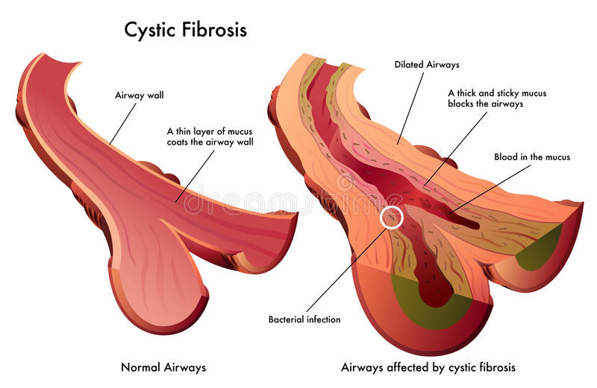
Cystic Fibrosis
Restricted flow in airways from mucous build-ups.
Suffocation

Slide 8
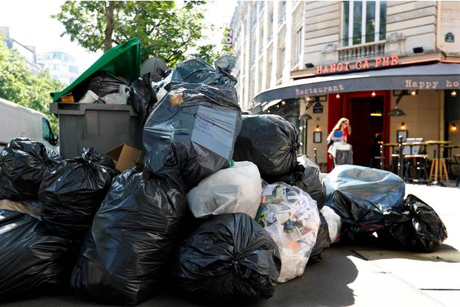
A Build-Up of Anything is Bad
What if the the garbage collection crews in Paris went on strike (as they did in 2016)?

Slide 9
The Cystic Fibrosis Gene
Cystic Fibrosis Transmembrane conductance: CFTR
Gene product is a bad regulator which fails to move water after displacing chloride ions in epithelial (thin tissue) cells
Water follows chloride ions by osmosis.
https://www.youtube.com/watch?v=EuLVCYrurok
What if water regulation were not possible in the cells and organs?

Slide 10
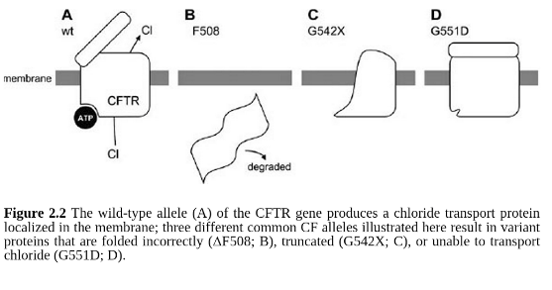
Three Bad Proteins From the Four

Slide 11
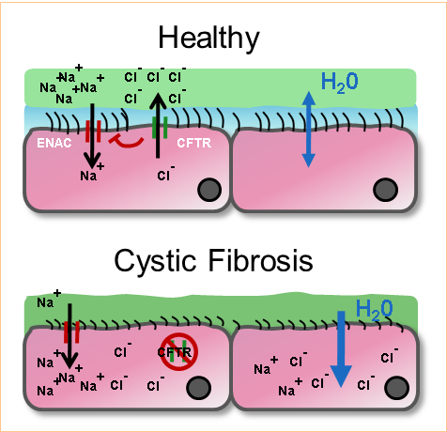
The Cystic Fibrosis Gene
Gene codes for four different proteins: only one working type to move chloride ions and enable water displacement.
Mucous build-up

Slide 12
Open Reading Frames:
Explaining Disorders?
Pam Can See The Man and Dog
Frame shift by one letter!
P amC anS eeT heM ana ndD og
Frame shift by two letters!
Pa mCa nSe eTh eMa nan dDo g
Frame shift by three letters!
Pam Can See The Man and Dog
Notice how the code
changes depending
on where you start
reading?

Slide 13
Open Reading Frames
Note: RF means reading frame, where you start reading the words.
Original: CAATGGCGAATCGACGTGTATAAA
RF1 - 5’ - CAA TGG CGA ATC GAC GTG TAT AAA – 3’
RF2 - 5’ - C AAT GGC GAA TCG ACG TGT ATA AA – 3’
RF 3 - 5’ - CA ATG GCG AAT CGA CGT GTA TAA A – 3’
3’ - CAA TGG CGA ATC GAC GTG TAT AAA - 5’ – RF 4
3’ - C AAT GGC GAA TCG ACG TGT ATA AA - 5’ – RF 5
3’ - CA ATG GCG AAT CGA CGT GTA TAA A - 5’ – RF 6

Slide 14
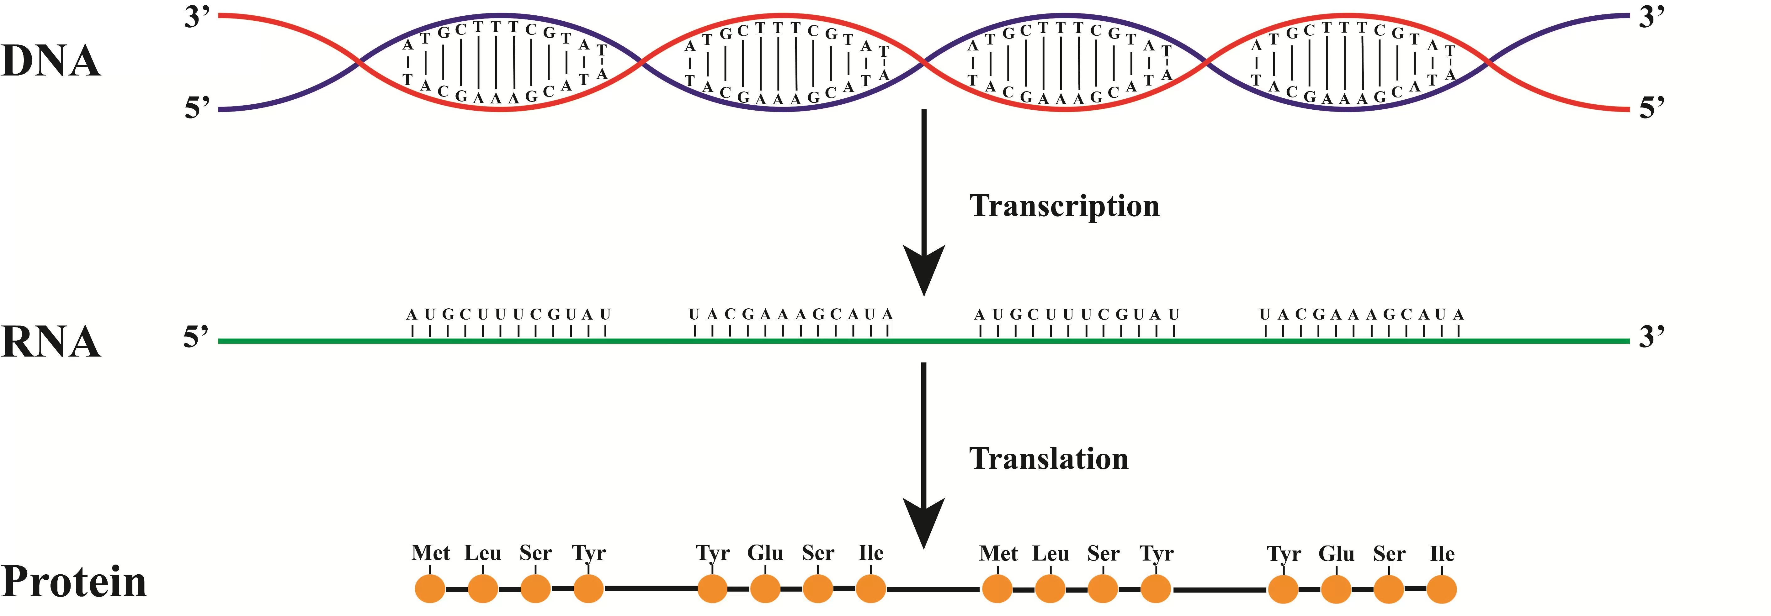
Sequence is Carrier?
How do we determine if a sequence carries the CF allele?
Get DNA sample
Translate DNA to protein: Compare this seq to seq of a “working protein”
Is difference found between both proteins?
?
?
?

Slide 15
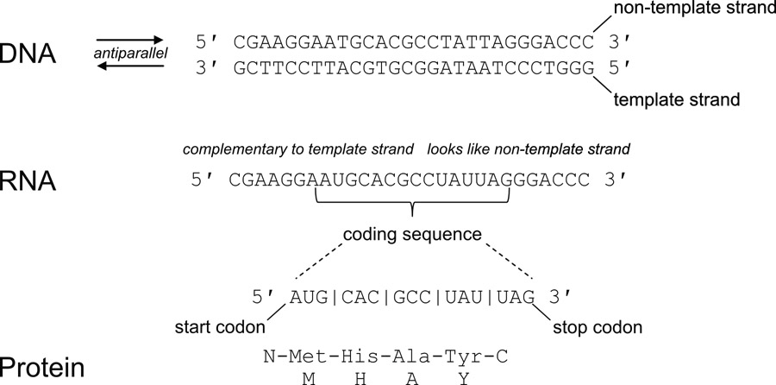
Analyze the Protein
Translating DNA to find defects

Slide 16
The Unnamed Sequence
Unlabeled strands of DNA are assumed to be in the 5’ to 3’, (left to right) direction.
A new sequence is given to us for analysis.
What are the steps to place this sequence into a format for use with bioinformatics tools?
In 5’ to 3’?
DNA sequence
Place into 5’ to 3’
Do nothing

Slide 17
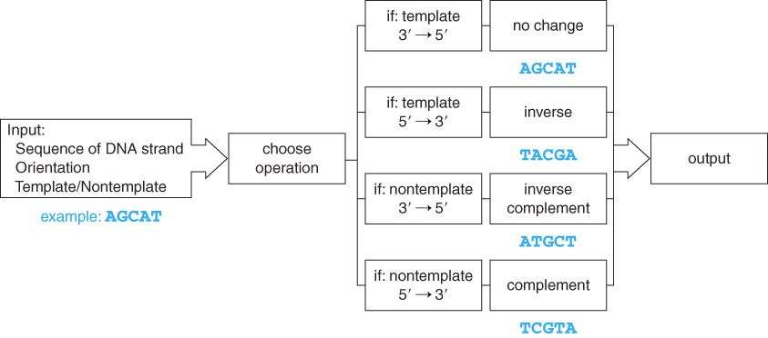
DNA Manipulation Algorithm
A series of steps when handling DNA
Output DNA in 3’ to 5’

Slide 18
The DNA Manipulation Algorithm
Input a DNA sequence, including details of being a template or non-template strand as well as its orientation
Convert to all uppercase
Choose the appropriate operation:
  If it is the template strand and oriented 3’ -> 5’, simply output the same sequence
  If it is the template strand and oriented 5’ -> 3’, inverse the sequence (traverse the string from right to left and add each character to output the string)
  If it is the non-template strand and oriented 3’ -> 5’, generate the inverse complement sequence ((i.) traverse the string from right to left and (ii) for each character, add the complement to the output string)
  If it is the non-template strand and oriented 5’ -> 3’, generate the complement ((i.) traverse the string from left to right and (ii) for each character add the complement to the output string)
Output the completed sequence, including 5’ and 3’ end labels

Slide 19
Transcription Algorithm
Input: template strand in the 3’ → 5’ orientation
Output: mRNA strand in the 5’ → 3’ orientation
  Traverse the string from left to right
    add complementary base to the output string
    (note T is now U)

Slide 20
Alternative Transcription Algorithm
Input: non-template strand in the 5’ → 3’ orientation
Output: mRNA strand in the 5’ → 3’ orientation
  Traverse the string from left to right
    Replace all the T’s with U’s

Slide 21
Translation Algorithm
Input: mRNA strand in the 5’ → 3’ orientation
Output: amino acid sequence
  Traverse the string looking at one codon at a time
  Add one amino acid corresponding to the protein sequence.

Slide 22
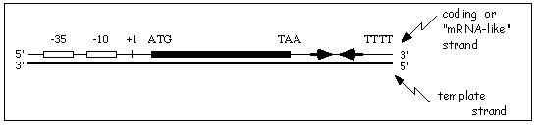
Template vs nonTemplate
Input:
  DNA sequence – AGCAT
  Strand – template (used to make mRNA) or non-template (the compliment of this strand that looks like mRNA)
  Orientation – 3’ -> 5’ or 5’ -> 3’
Output:
  Template strand in 3’ -> 5’ orientation ready for transcription

Slide 23

Codon Table to Translate the Protein Product
DNA triplets read in groups of three called codons and represent an amino acid

Slide 24

Python Programming
Biopython
Translation functions
  DNA → RNA
  RNA → DNA
  RNA → Protein
Gives a protein sequence to compare to the wild type protein sequence
Follow along in
class and save
your notes in
a text file!!
  Follow along and Save your notes in a text file.

Slide 25
Header
This
This

Slide 26
Header
This
This

Slide 27
Header
This
This

