Slide 1
Computational Manipulation of DNA: Genetic Screening for Disease Alleles
BIO 300/CMPSC 300
Dr. Kristen Webb
Spring 2016

Slide 2
What is the difference between a gene and an allele?
  Answer in the context of cystic fibrosis and the CFTR gene

Slide 3
The coding sequence of CFTR is nearly 4,500 base pairs long, approximately how many potential alleles exist?

Slide 4
Are all alleles biologically possible?
If not, what determines whether or not an allele can persist in a population

Slide 5
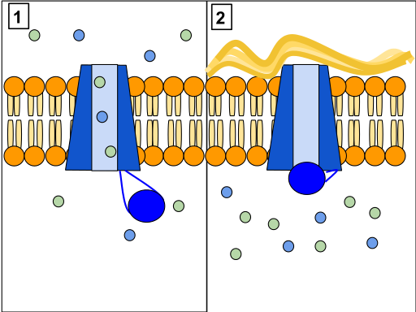
CFTR alleles and cystic fibrosis

Slide 6
Open Reading Frames
CAATGGCGAATCGACGTGTATAAA

Slide 7
Open Reading Frames
CAATGGCGAATCGACGTGTATAAA
RF1 - CAA TGG CGA ATC GAC GTG TAT AAA

Slide 8
Open Reading Frames
CAATGGCGAATCGACGTGTATAAA
RF1 - CAA TGG CGA ATC GAC GTG TAT AAA
RF2 - C AAT GGC GAA TCG ACG TGT ATA AA

Slide 9
Open Reading Frames
CAATGGCGAATCGACGTGTATAAA
RF1 - CAA TGG CGA ATC GAC GTG TAT AAA
RF2 - C AAT GGC GAA TCG ACG TGT ATA AA
RF 3 - CA ATG GCG AAT CGA CGT GTA TAA A

Slide 10
Open Reading Frames
CAATGGCGAATCGACGTGTATAAA
RF1 - CAA TGG CGA ATC GAC GTG TAT AAA
RF2 - C AAT GGC GAA TCG ACG TGT ATA AA
RF 3 - CA ATG GCG AAT CGA CGT GTA TAA A

Slide 11
Open Reading Frames
CAATGGCGAATCGACGTGTATAAA
RF1 - 5’ - CAA TGG CGA ATC GAC GTG TAT AAA – 3’
RF2 - 5’ - C AAT GGC GAA TCG ACG TGT ATA AA – 3’
RF 3 - 5’ - CA ATG GCG AAT CGA CGT GTA TAA A – 3’

Slide 12
Open Reading Frames
CAATGGCGAATCGACGTGTATAAA
RF1 - 5’ - CAA TGG CGA ATC GAC GTG TAT AAA – 3’
RF2 - 5’ - C AAT GGC GAA TCG ACG TGT ATA AA – 3’
RF 3 - 5’ - CA ATG GCG AAT CGA CGT GTA TAA A – 3’
3’ - CAA TGG CGA ATC GAC GTG TAT AAA - 5’ – RF 4

Slide 13
Open Reading Frames
CAATGGCGAATCGACGTGTATAAA
RF1 - 5’ - CAA TGG CGA ATC GAC GTG TAT AAA – 3’
RF2 - 5’ - C AAT GGC GAA TCG ACG TGT ATA AA – 3’
RF 3 - 5’ - CA ATG GCG AAT CGA CGT GTA TAA A – 3’
3’ - CAA TGG CGA ATC GAC GTG TAT AAA - 5’ – RF 4
3’ - C AAT GGC GAA TCG ACG TGT ATA AA - 5’ – RF 5

Slide 14
Open Reading Frames
CAATGGCGAATCGACGTGTATAAA
RF1 - 5’ - CAA TGG CGA ATC GAC GTG TAT AAA – 3’
RF2 - 5’ - C AAT GGC GAA TCG ACG TGT ATA AA – 3’
RF 3 - 5’ - CA ATG GCG AAT CGA CGT GTA TAA A – 3’
3’ - CAA TGG CGA ATC GAC GTG TAT AAA - 5’ – RF 4
3’ - C AAT GGC GAA TCG ACG TGT ATA AA - 5’ – RF 5
3’ - CA ATG GCG AAT CGA CGT GTA TAA A - 5’ – RF 6

Slide 15
Open Reading Frames
CAATGGCGAATCGACGTGTATAAA
RF1 - 5’ - CAA TGG CGA ATC GAC GTG TAT AAA – 3’
RF2 - 5’ - C AAT GGC GAA TCG ACG TGT ATA AA – 3’
RF 3 - 5’ - CA ATG GCG AAT CGA CGT GTA TAA A – 3’
3’ - CAA TGG CGA ATC GAC GTG TAT AAA - 5’ – RF 4
3’ - C AAT GGC GAA TCG ACG TGT ATA AA - 5’ – RF 5
3’ - CA ATG GCG AAT CGA CGT GTA TAA A - 5’ – RF 6

Slide 16
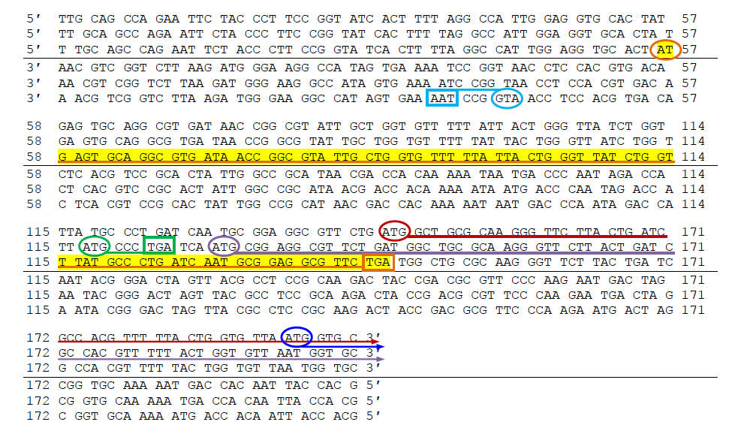

Slide 17
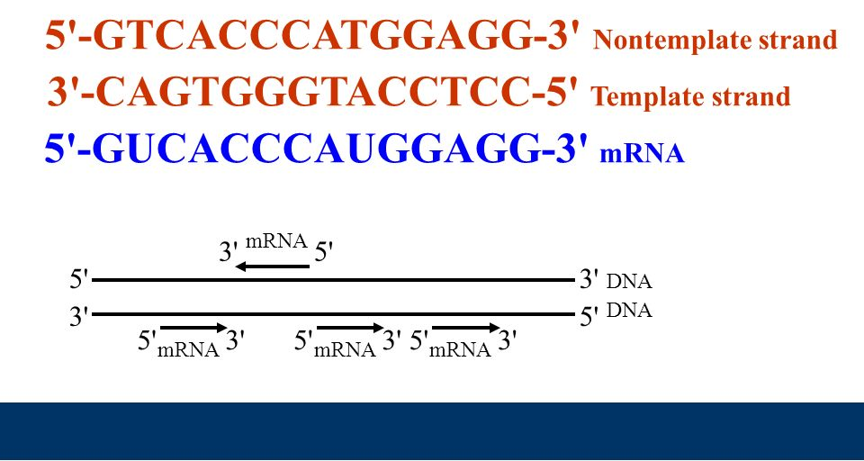
DNA “read” 3’ → 5’, RNA created 5’ → 3’

Slide 18
DNA Manipulation Algorithm
Input:
  DNA sequence – AGCAT
  Strand - template or non-template
  Orientation – 3’ → 5’ or 5’ → 3’
Output:
  Template strand in 3’ → 5’ orientation ready for transcription

Slide 19
DNA Manipulation Algorithm
Input a DNA sequence, including whether or it template or non-template strand and orientation
Choose the appropriate operation:
  If it is the template strand and oriented 3’ → 5’, simply output the same sequence
  If it is the template strand and oriented 5’ → 3’, inverse the sequence (traverse the string from right to left and add each character to output string)
  If it is the non-template strand and oriented 3’ → 5’, generate the inverse complement sequence ((i.) traverse the string from right to left and (ii) for each character add the complement to the output string)
  If it is the non-template strand and oriented 5’ → 3’, generate the complement ((i.) traverse the string from left to right and (ii) for each character add the complement to the output string)
Output the completed sequence, including 5’ and 3’ end labels

