Slide 1
Bioinformatics
CS300
Horizontal Gene Transfer
Database, Tools, Multiseq Alignment
Fall 2017
Oliver Bonham-Carter

Slide 2

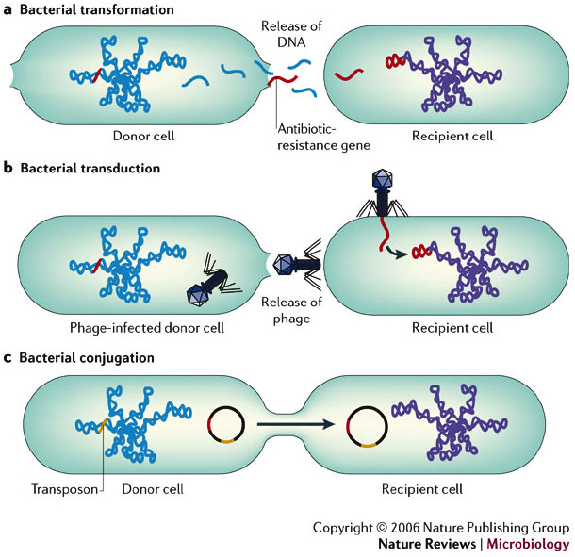
Horizontal Gene Transfer
Horizontal gene transfer (HGT) refers to the transfer of genes between organisms in a manner other than traditional reproduction.

Slide 3
What is HGT
(Horizontal Gene Transfer)
The transmission of portions of genomic DNA between organisms
A process decoupled from vertical inheritance (no mating).
Various fragments of the genome are the result of different evolutionary histories and come from un-related organisms.
This can therefore complicate the investigations of evolutionary relatedness of lineages and species

Slide 4
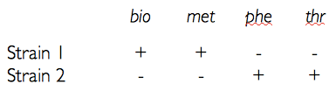
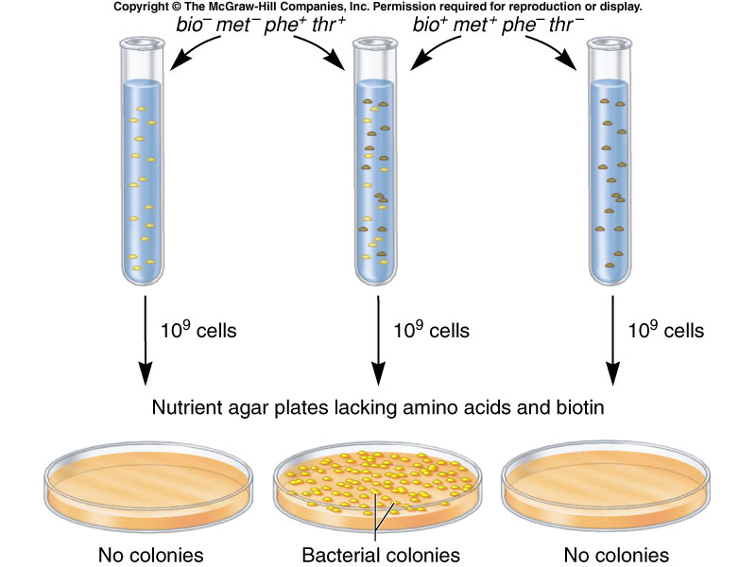
Genetic Sharing
Colonies have opposing growth requirements
Each colony requires two extra genes to survive under conditions.
In the experiment, colonies randomly share missing genes with each other.
Cells with HGT survive to make a new colony.

Slide 5
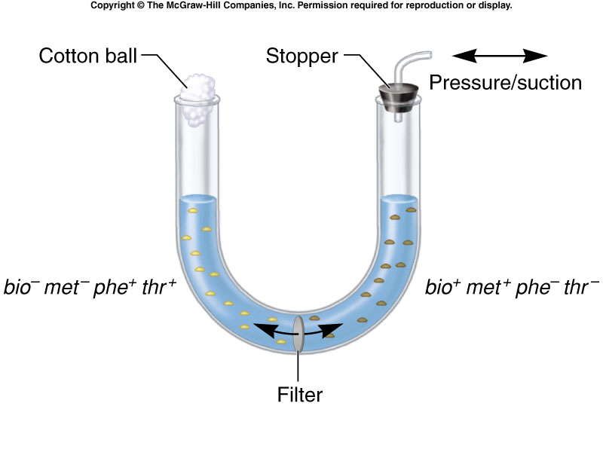
Transfer of Genes From
Physical Contact

Slide 6
Mechanisms of DNA Transfer
Conjugation
  Physical interaction between cells
Transduction
  Virus mediated transfer of DNA between bacteria
Transformation
  Requires release of DNA into the environment and then the manual take-up of the DNA by bacteria

Slide 7
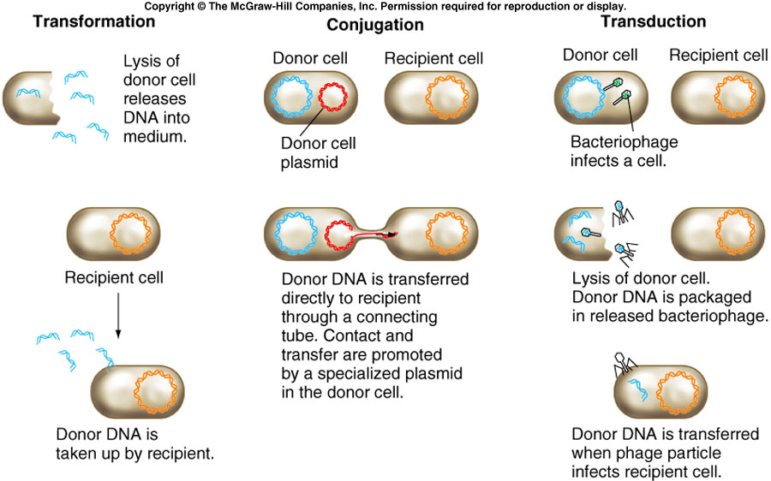
Mechanisms of DNA Transfer

Slide 8
Bacterial Conjugation
Only specific bacteria can serve as donors
  Arber, Werner. "Horizontal gene transfer among bacteria and its role in biological evolution." Life 4.2 (2014): 217-224.
Five per cent of E. coli are naturally donors
Can be converted when incubated first with a donor strain.
+
=
Donor +
Donor -
Donor+
Transfer of genetic material

Slide 9
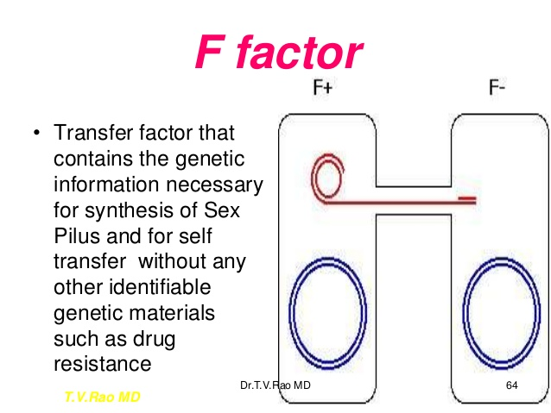
F Factor

Slide 10
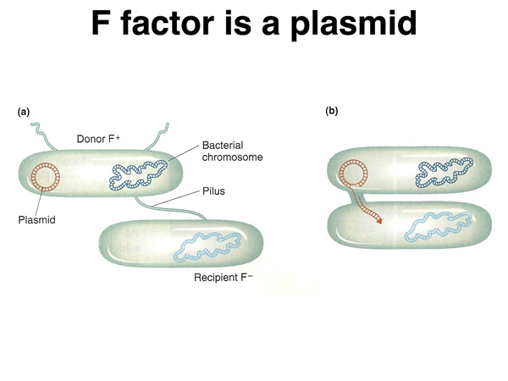
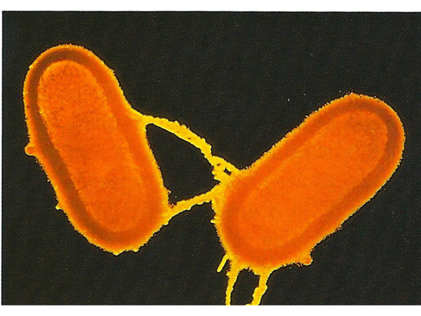
F Factor Is a Plasmid
http://www.discoveryandinnovation.com/BIOL202/notes/lecture15.html

Slide 11
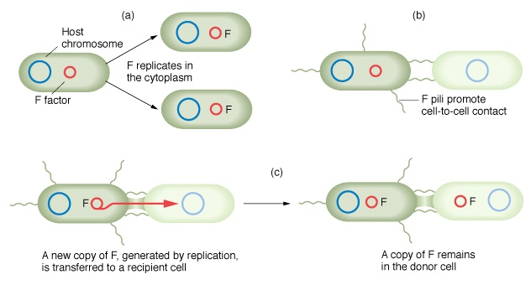
Conjugation Mechanism
F-Factor: a material that is encoded on the plasmid (bacterial DNA). F+ (has) F- (does not have)
Plasmids are transferred containing genes of sender to receiver

Slide 12
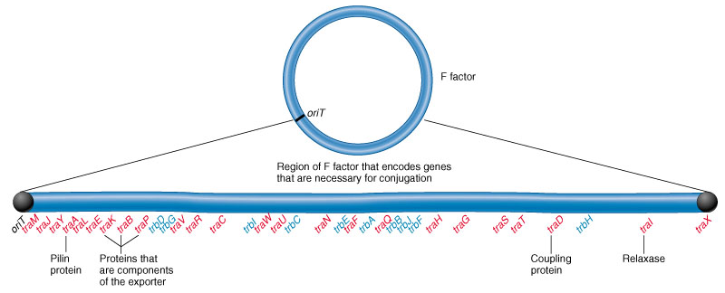
Conjugation Apparatus
Physical contact is made between strains and the bacteria are brought together.
Gene sharing possible if F Factor present.

Slide 13
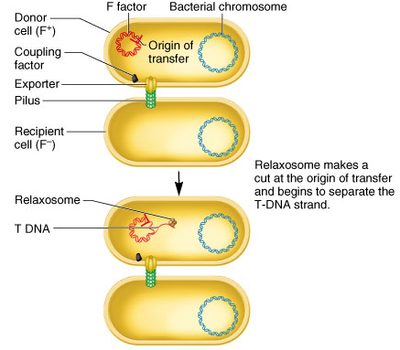
Mechanism of Transfer
Relaxosome is produced
Relaxosome recognizes the origin of the transfer
One DNA strand is cut and transferred over the conjugation tube (T DNA).

Slide 14
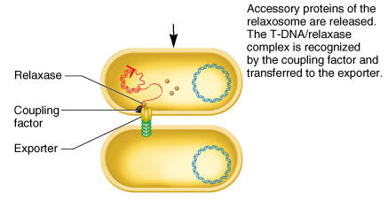
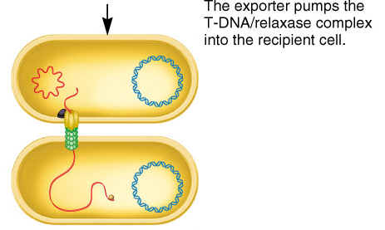
Mechanism of Transfer
T DNA is separated but bound to relaxase protein.
Complex called nucleoprotein
Complex is recognized by a coupling factor, fed through exporter (conjugation tube)

Slide 15
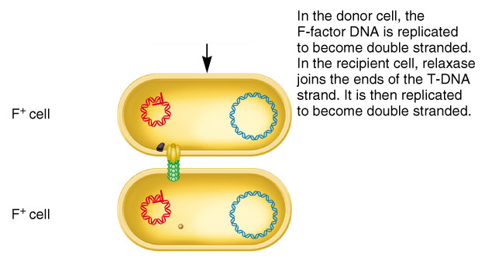
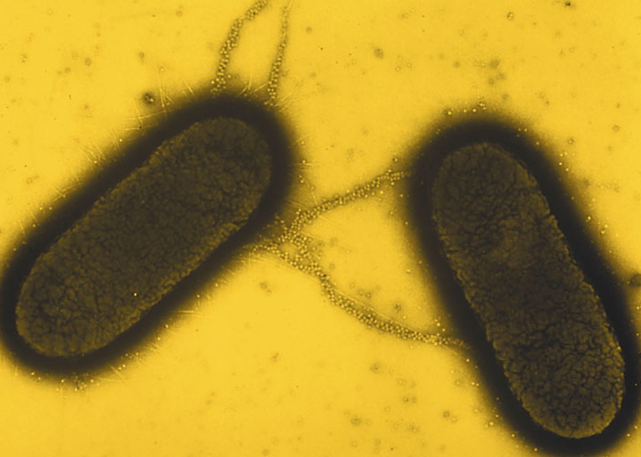
F Factor Transfer
Relaxase joins ends to produce circular molecule
Single strande of F Factor are in both cells (DNA replication)

Slide 16
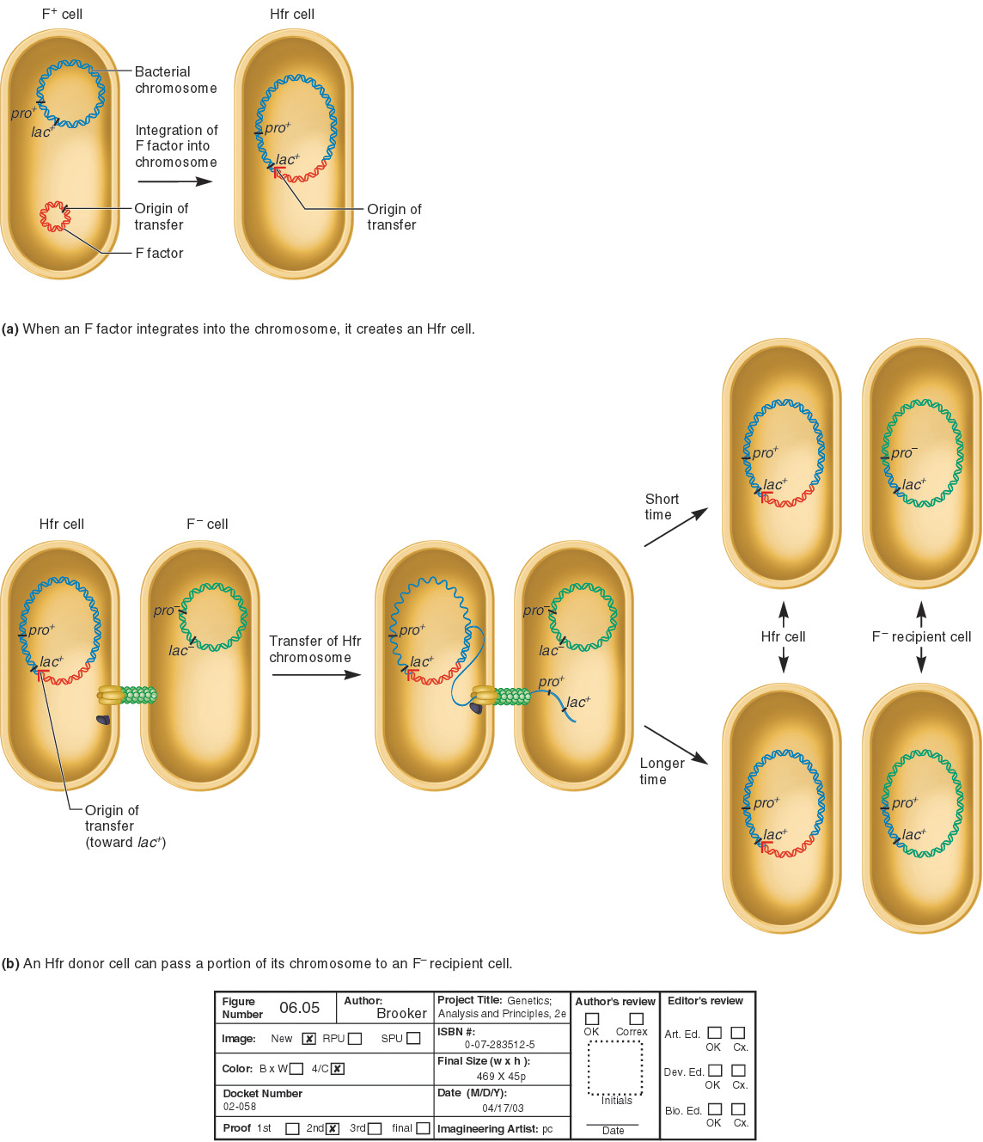
Integration of DNA into Chromosome
Genes encoded on F Factor can integrate into host DNA and alter its genotype (genetics) and phenotype (look-like)
An Hfr strain was derived from an F+ strain
Episome:
DNA fragment that
can exist as a plasmid
and integrate into chromosome

Slide 17
Did You Say, Hfr Strain?
E. Coli strain discovered as Hfr (high frequency of recombination)
Hfr strain transfers chromosomal DNA from F- strains
Transfer begins at the origin of the transfer
The amount of DNA transferred depends on the time allowed for conjugation

Slide 18
Known Instances of HGT
Antibiotic resistance genes on plasmids
Insertion sequences
Pathogenicity islands
Toxin resistance genes on plasmids
Viruses and viroids
Organelle to nucleus transfers

Slide 19
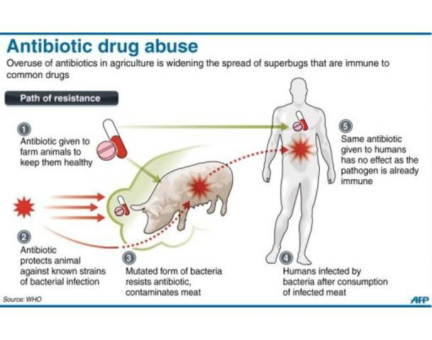
From Farm-to-Fork Spread of Antibiotic Resistance

Slide 20
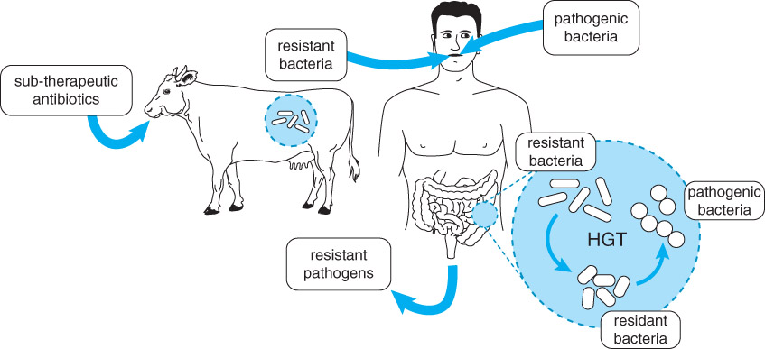
Horizontal Gene Transfer of Antibiotic Resistance

Slide 21
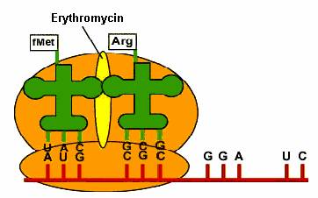
Why Use Multi-Sequence Alignment?
To searching for Resistance Genes
Erythromycin – binds to bacterial ribosome and blocks translation

Slide 22

Supporting Video
Horizontal gene transfer (4mins)
  https://www.youtube.com/watch?v=Nunq1yg9Ea0
Antibiotic Resistance (4mins)
  https://ed.ted.com/lessons/how-antibiotics-become-resistant-over-time-kevin-wu

Slide 23
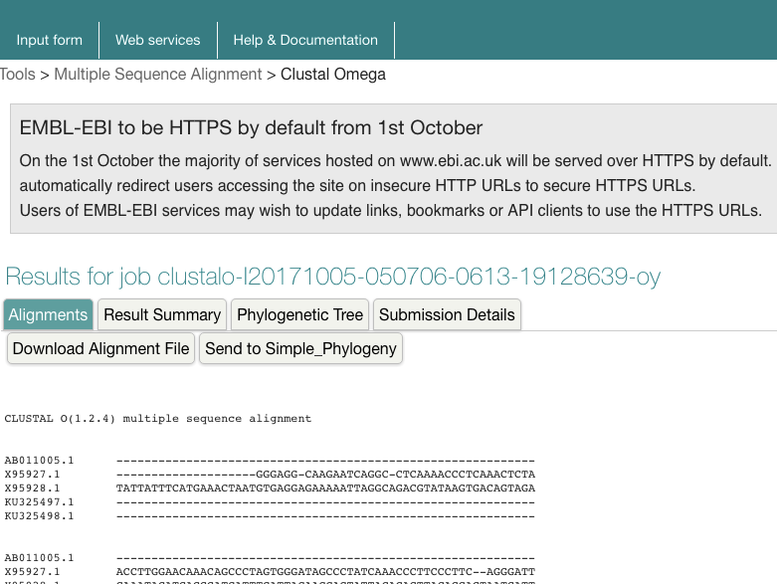
Multi-Sequence Alignment
Clustal Omega: MultiSequence Alignment
https://www.ebi.ac.uk/Tools/msa/clustalo/
Where are the
chucks of
common
genes?
Are these
chunks from
horizontal gene
transfers?

Slide 24
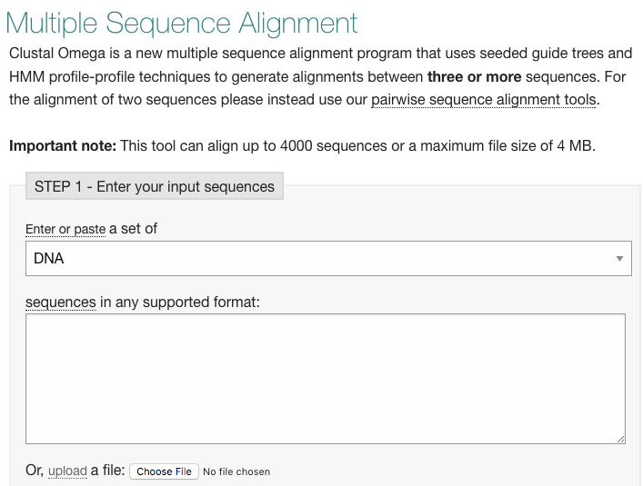
Clustal: Load input sequences
What is the likelihood that agricultural use of antibiotics is resulting in resistant human gut bacteria and/or resistant human pathogens?
ermB gene

Slide 25

BLAST: A Heuristic Approach to Database Searching
https://blast.ncbi.nlm.nih.gov/Blast.cgi
Basic Local Alignment Search Tool
  NCBI – DNA and protein sequence
  Compares one sequence to database of > 100 million
  Finds best hits (optimal alignments) in a matter of seconds
  (would take >3 years using Needlman-Wunsch algorithm)

Slide 26
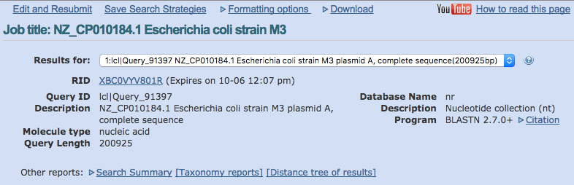
BLAST: A Heuristic Approach to Database Searching

Slide 27
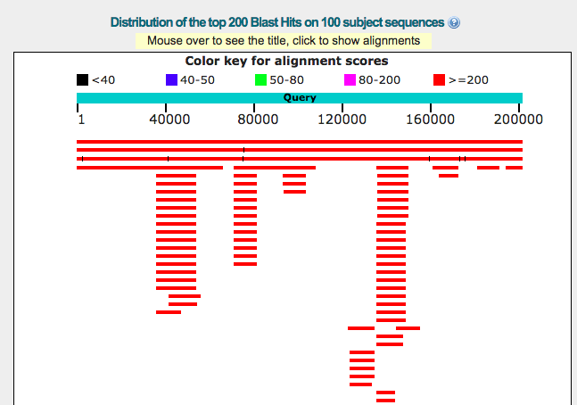
BLAST: Output

Slide 28
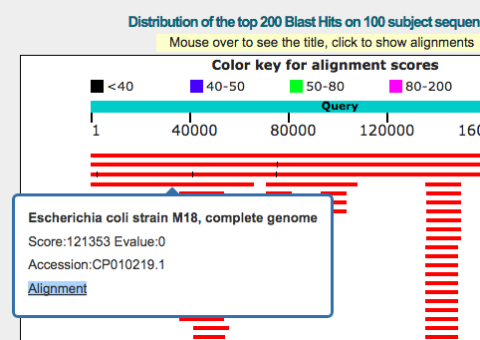
BLAST: Output

Slide 29
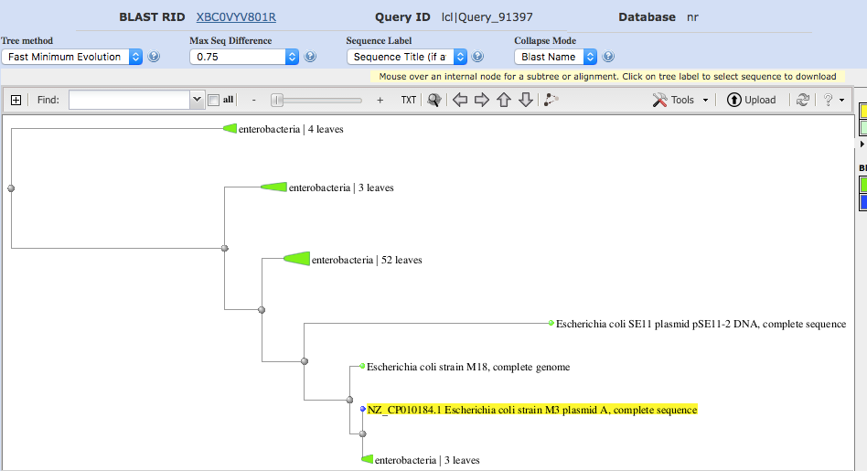
BLAST: Tree of Relations

Slide 30
On Exam 1
Questions similar to those on worksheets
Central Dogma of Biology
  Transcription, Translation
Mutations: types, causes and effects
Genetic disorders and their inheritance
Algorithms: design and implementation in python
Basic python programming: syntax, keywords and definitions
Tracking influenza by sequence study
Sequence alignment
Topics from recent lessons

Slide 31
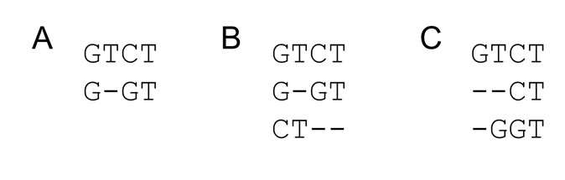
Multiple Sequence
Alignment: Clustal
Order matters
Solutions?
Needleman-Wunsch L x M x N matrix
  Impractical for long sequences
Heuristic
  Progressive alignment via a guide tree

Slide 32
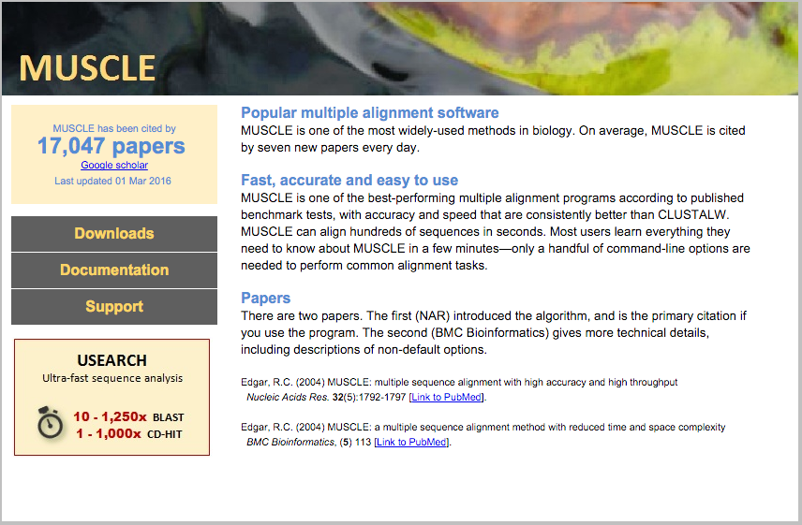
Multiple Sequence
Alignment: MUSCLE

Slide 33

Python Programming
Biopython
DNA Manipulation Algorithm
Translation functions
  DNA → RNA
  RNA → DNA
  RNA → Protein
Follow along in
class and save
your notes in
a text file!!
  Follow along and Save your notes in a text file.

Slide 34
Header
This
This

