Slide 1
Horizontal Gene Transfer
The movement of genetic material between two organisms. Once incorporated it is then ‘vertically’ inherited.

Slide 2
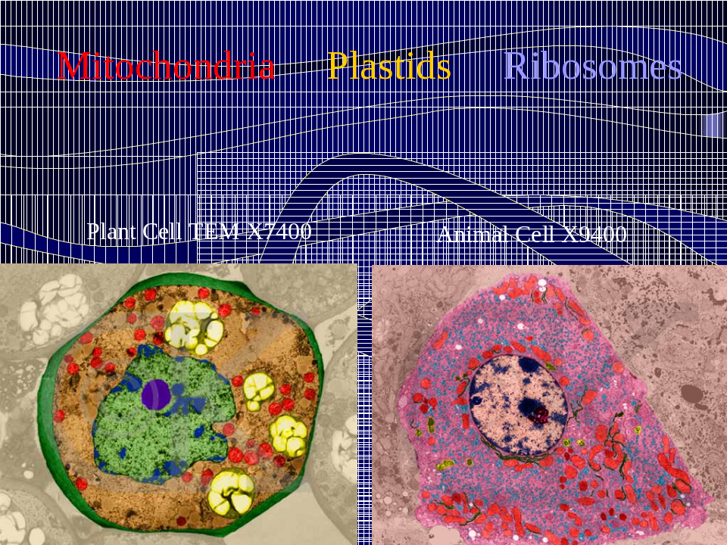
HGT in Eukaryotes
Eukaryotes - membrane bound, nucleus
Exchange of genetic material during sexual reproduction
Recombination

Slide 3
One other instance of HGT in Euks
Endosymbiosis, happened at least 2 billion years ago.
Transfer of genes from mitochondria, plastids to nuclear genome over that time
  Mitochondria have about 40 genes
  Plastids have about 120 genes

Slide 4
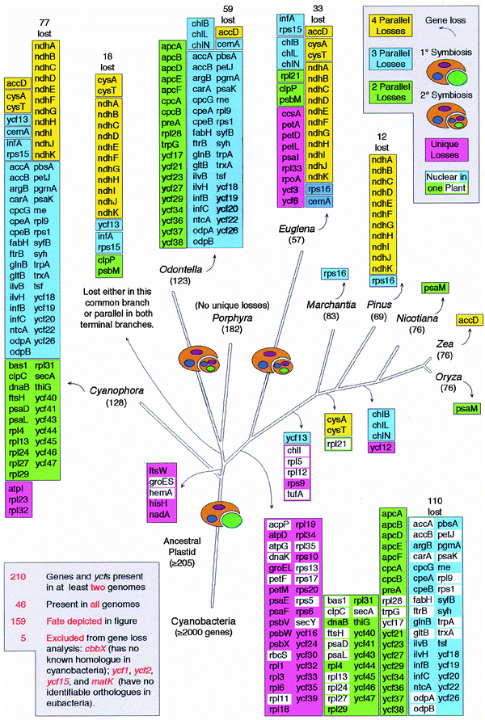
Figure 2 Phylogenetic distribution of gene loss from chloroplast genomes. Colour keys designating frequency of parallel gene losses are given at top right. Numbers below species names indicate the number of proteincoding genes and ycfs in the corresponding chloroplast genome. Numbers above gene columns represent thenumber of genes lost which are accounted for in the figure for the given genome. The symbols for primary and secondary symbiosis are indicated. Five genes were excluded from gene-loss analysis for reasons indicated at the lower left. Some highly divergent proteins may have escaped detection with BLAST searches. Functional, transferred nuclear homologues of chloroplast origin are indicted in white rectangles. In Pinus, four ndh genes are completely missing (ndhA, ndhF, ndhG, ndhJ), the other seven are
pseudogenes23 and are scored as losses here.
Martin et al, Nature, 1998

Slide 5
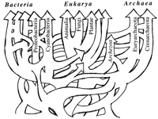
Horizontal Gene Transfer
The movement of genetic material BETWEEN prokaryotes
Common in prokaryotes. Useful for environmental adaptation (better than point mutations)
Doolittle, 1997

Slide 6
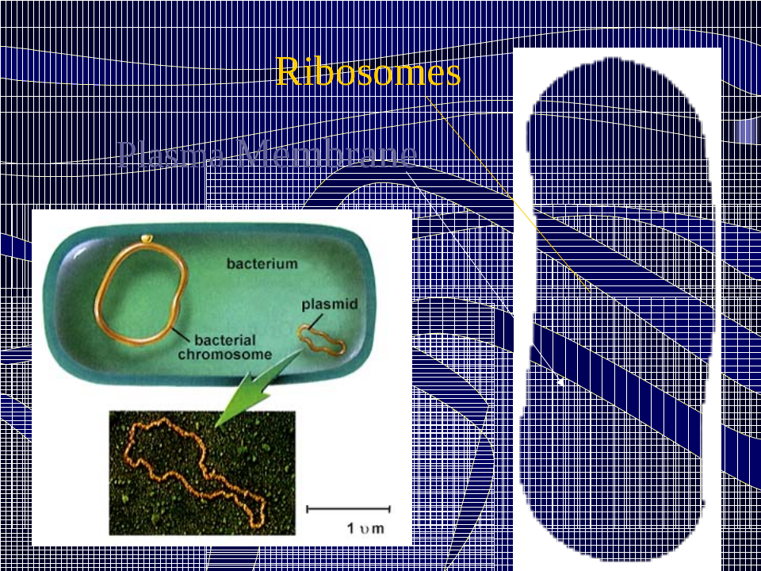
Prokaryotes
Different kind of cell organization
Sex as you don’t know it

Slide 7

Horizontal Gene Transfer
Also called Lateral Gene Transfer
HGT and LGT for short
3 ways to do it
  Transformation- naked DNA, short pieces, common in bacteria that transform
    Clay –28 hrs; ocean surface - 45-83 hrs; ocean sediment-235
  Transduction – phage, donor/recipient share receptors, closely related bacteria, DNA: amount in phage head
  Conjugation-plasmids/transposons, cell to cell contact, distant relations, long DNA

Slide 8
Known Instances of HGT
Antibiotic resistance genes on plasmids
Insertion sequences
Pathogenicity islands
Toxin resistance genes on plasmids
Agrobacterium Ti plasmid
Viruses and viroids
Organelle to nucleus transfers

Slide 9
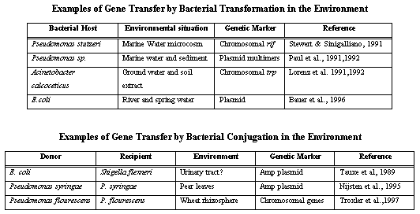

Slide 10
Requirements for Transfer
Proximity to donor DNA
Stability of DNA in environment
Vector transmission
Uptake and insertion
Maintenance
Stabilization
Selection
What Limits/Prevents Transfer
Instability in new host
Restriction systems
GC/Codon usage incompatibility
Splicing and other signals incorrect
RNA editing
Lack of appropriate interacting genes

Slide 11
The question: how much HGT really goes on?
Rare going from prokaryotes into multi celled euks because must go into egg/sperm
Exception is mitochondria, plastids
Instances of Euks ->Proks ?!?!
How often does it happen in proks?

Slide 12
Lateral Gene Transfer and the nature of bacterial innovation
Ochman, Lawrence, and Groisman, Nature 405:299-304
Single celled organism, genome varies only by an order of magnitude.
Narrow taxonomic groups, phenotypic diversity is remarkable.
Usually have a unique set of physiological characters to define its particular ecological niche.

Slide 13
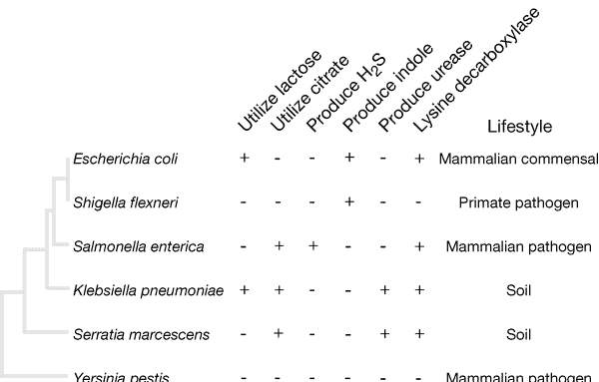

Slide 14
How can you detect HGT’s?
DNA sequence information
  Phylogenetic trees
  G+C Content
  Codon bias
  Sequences new to a genome will retain (for a while) the signatures of the donor genome and distinguished from ancestral DNA

Slide 15
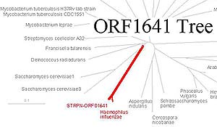
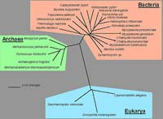
Comparing a gene tree with the rRNA tree

Slide 16
G+C Content
DNA is double stranded, G pairing with C
Measure the amount of G+C content in regions
If one region varies from most of the genome, than likely HGT
52% 47% 52%

Slide 17
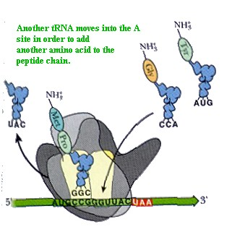
Codon Usage

Slide 18
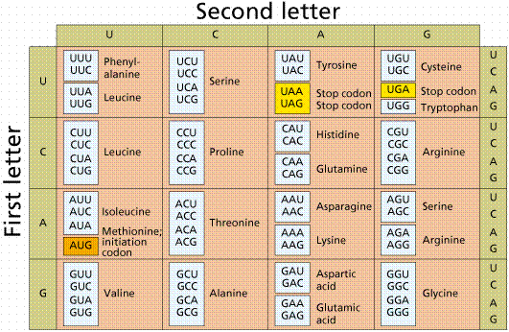

Slide 19
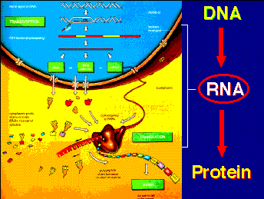

Slide 20
Bacterial recombination
It does happen
The action of bacterial mismatch correction systems greatly reduces the efficiency of homologous recombination
Must be closely related DNA then
Affects existing genes, not than unique traits
No big role in ecology and physiology

Slide 21
Scope of HGT in bacteria
19 Complete genomes across wide phylogenetic lines
ORFS whose sequence characteristics depart from the resident genome

Slide 22
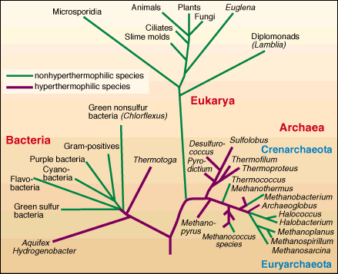

Slide 23
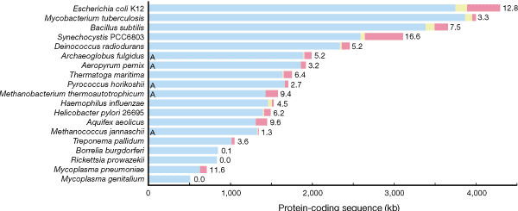
Length of bars represent amount of coding DNA, native is blue,
Foreign due to mobile elements is yellow, other is red. Numbers
Are the % of foreign DNA
Ochman, et al 2000

Slide 24
Rate of Sequence acquisition
In E. coli – examined he amelioration of atypical sequence characters (eg nucleotide composition) towards equilibrium values in the genome
Estimation of time of arrival for each segment of foreign DNA
~16 kb per million year

Slide 25
What about GM?!
Transgenes differ from native genes
They contain DNA seq homology to proks so can be integrated widely.
Modified for broad expression in variety of hosts
Regulation elements that work across a broad range of hosts.
No extensive interactions.
BUT do these provide a genetic variability that is advantageous?

