Slide 1
Bioinformatics
CS300
Substitution Matrices and
Protein Alignments
Fall 2017
Oliver Bonham-Carter

Slide 2

Header
This
This

Slide 3
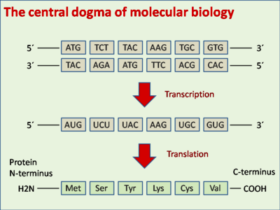
https://en.wikipedia.org/wiki/DNA_codon_table

Slide 4
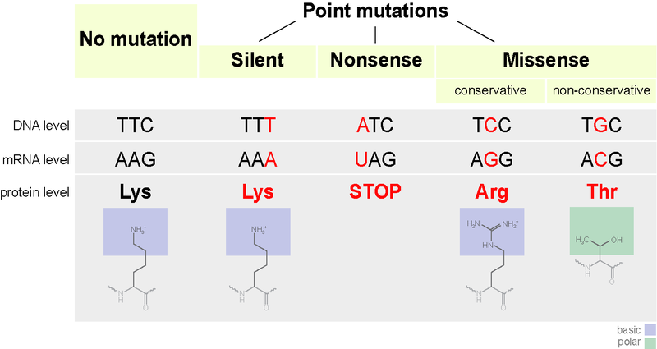
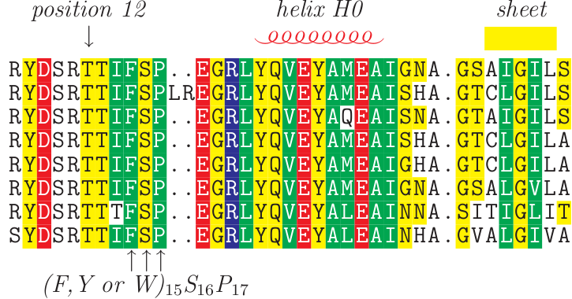
Silent Mutations
Redundant codons mean ~1/3 of DNA mutations often do not alter protein sequence
https://en.wikipedia.org/wiki/Silent_mutation

Slide 5
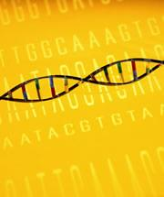

Silent Mutations
Are these mutations really so subtle?
Are there dangers involved?
  While the protein may be fine, the RNA has still has dangerous folding issues
Nature: Silent Mutations Speak Up: Overlooked genetic changes could impact on disease
  http://www.nature.com/news/2006/061221/full/news061218-12.html

Slide 6
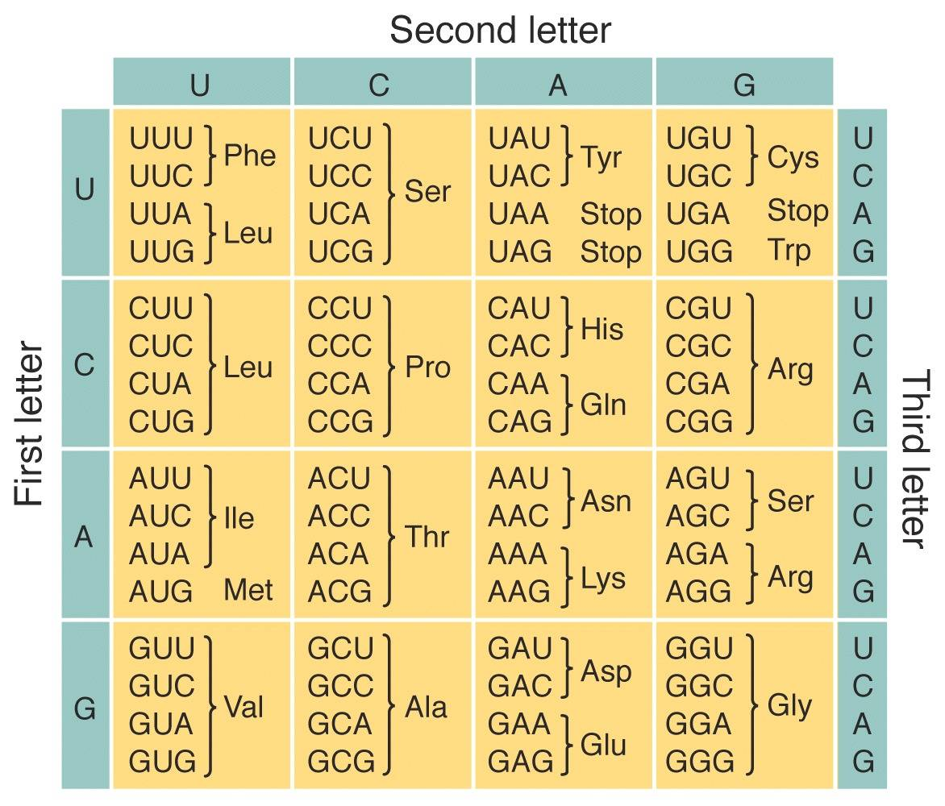
Notes:
Examples of codons from book/notes

Slide 7


Alphabetical Interests
With a larger protein “alphabet” (20 amino acids), it is much less likely to get matches by chance.
Matches are likely to be statistically significance
Amino acid changes are not equally harmful to protein structure
  Chemical complexes being replaced by similar chemical complex.
  Ex: Arginine (Arg) and Lysine (Lys)

Slide 8
Amino Acid Substitutions
Nucleotides – any substitution is “different”
Amino Acids
  Substituting similar ones is likely to retain protein structure and function
  Substituting dissimilar ones is likely to change protein structure and disrupt function

Slide 9
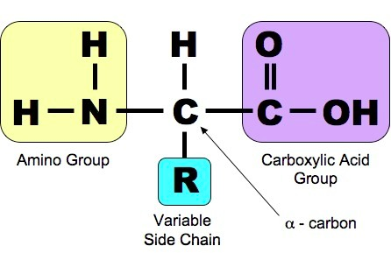
Amino Acid Substitutions

Slide 10
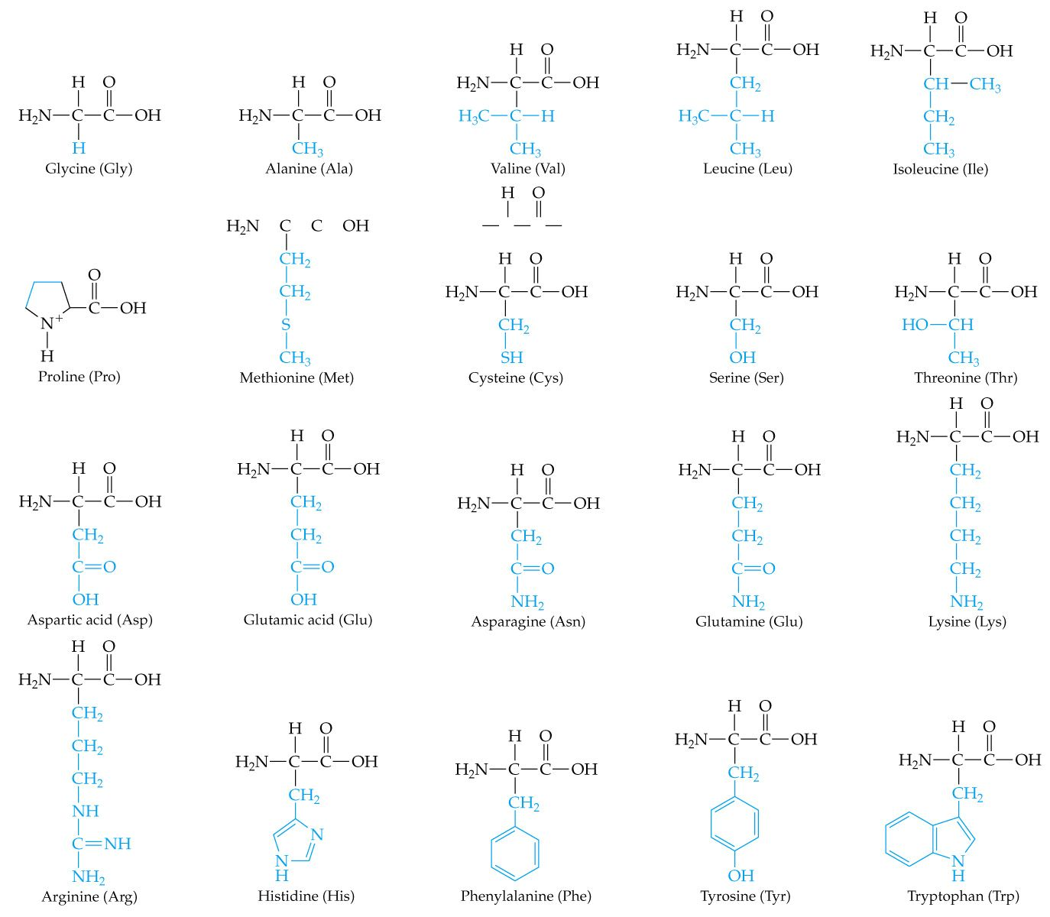
Amino Acid Substitutions

Slide 11
Amino Acid Components
Similarity of amino acids means
  Similar physicochemical properties (Physics + chemistry)
    Polar vs nonpolar
    Hydrophobic vs hydrophilic
    Positive electric charge vs negative electric charge
    Basic vs Acidic
Amino Acid Table: http://www.bio.davidson.edu/courses/genomics/jmol/aatable.html
Roles in Protein Structures
http://www.proteinstructures.com/Structure/Structure/amino-acids.html

Slide 12
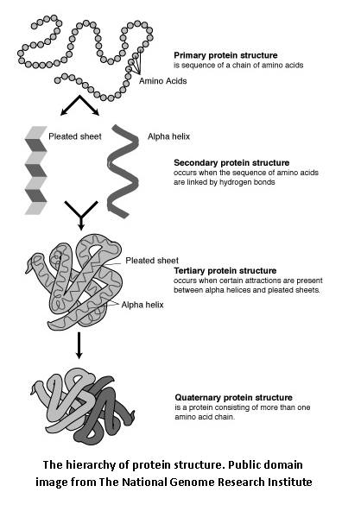
Amino Acids Determine
Protein’s Shape and Function

Slide 13
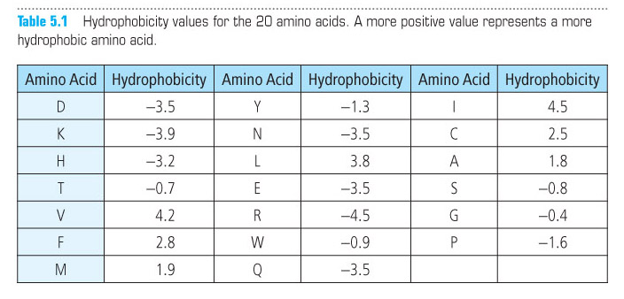
Scoring Amino Acid Substitutions
  Could we quantify sequence by physicochemical properties? (yes!)

Slide 14
Scoring Amino Acid Substitutions
Better to study evolution of real proteins from closely related organisms
Minimizes likelihood that an observed difference represents a series of >1 individual mutations
Species A – Ala Species B – Ile
Ala x Ile – 1 mutation
Ala x Pro x Ser x Ile – 3 mutations

Slide 15
A Model of Evolutionary
Change in Proteins, Dayhoff et al., 1978
Global Pairwise Alignment
Observed frequency of each possible amino acid substitution:
10 log₁₀ (M_{ij}/f_{j})
M_{ij} - the probability of a mutation replacing amino i with j
f_{j} - the frequency of amino acid j in a large set of sequences

Slide 16
A Model of Evolutionary
Change in Proteins, Dayhoff et al., 1978
Global Pairwise Alignment
Observed frequency of each possible amino acid substitution:
10 log₁₀ (M_{ij}/f_{j})
Odds ratio
= 1 - substitution of j for i is no more likely than the chance of finding j randomly
> 1 - substitution is evolutionarily conserved
< 1 – substitution is selected against

Slide 17
A Model of Evolutionary
Change in Proteins, Dayhoff et al., 1978
Global Pairwise Alignment
Observed frequency of each possible amino acid substitution:
10 log₁₀ (M_{ij}/f_{j})
log-odds ratio – easier for scoring
More positive for likely (conservative) substitutions
More negative for unlikely (non-conservative) substitutions
Multiplied by 10 and rounded to nearest integer

Slide 18
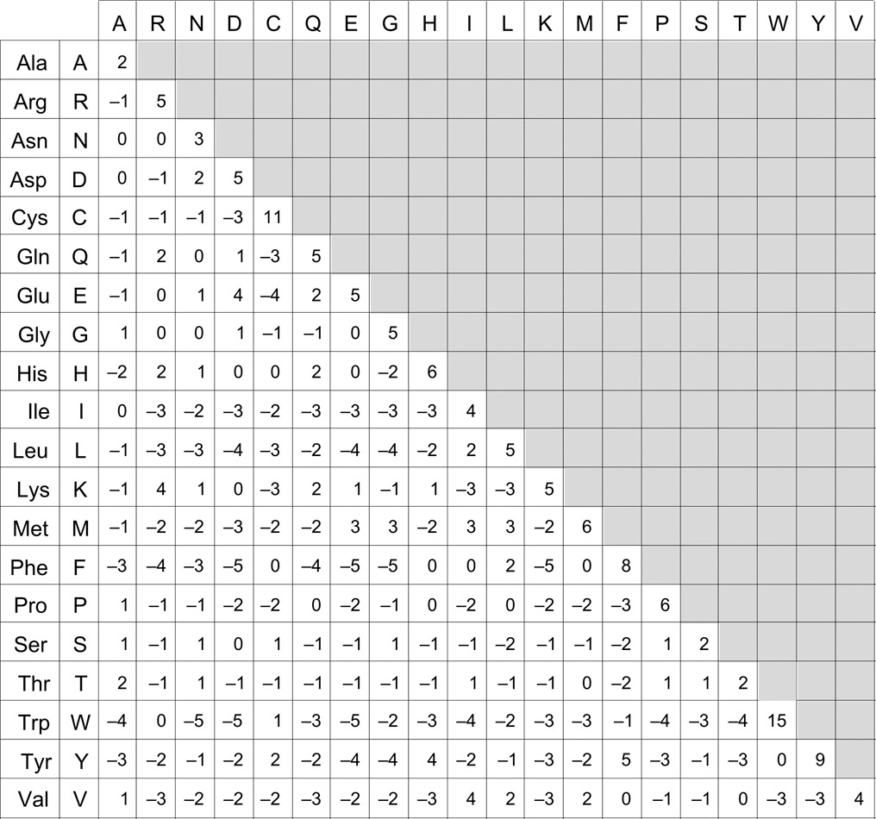
The
PAM
Matrix

Slide 19
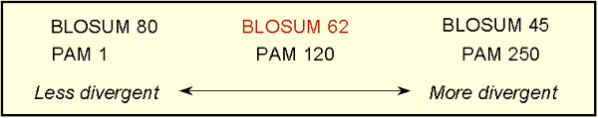
PAM matrices
Point Accepted Mutation
Family of matrices PAM 1, PAM 80, PAM 120, PAM 250
The number with a PAM matrix (the n in PAM n) represents the evolutionary distance between the sequences on which the matrix is based

Slide 20
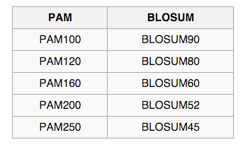
PAM vs BLOSUM
General Use
  PAM 120
  BLOSUM 62*
Closely Related Species
  PAM 60
  BLOSUM 80
Distantly Related Species
  PAM 250
  BLOSUM 45
*BLOSUM 62 – used by BLAST – computed by choosing blocks of local alignments more than 62% identical

Slide 21
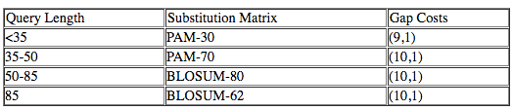
Blast Subst Matrices
Scoring for possible residue pair alignment
Different substitution matrices are for detecting similarities according to degrees of divergence.
BLOSUM-62 matrix good for detecting most weak protein similarities
Provisional table of recommended substitution matrices and gap costs for various query lengths is
https://www.ncbi.nlm.nih.gov/blast/html/sub_matrix.html

Slide 22

BLOSUM matrix
Heinkoff and Heinkoff, 1992
BLOcks SUbstition Matrix - Blocks of local alignments
p_{ij} - probability j replacing i
q_{i} and q_{j} - probabilities of finding the amino acids i and j in any protein sequence
λ - scaling factor, set such that the matrix contains easily computable integer values.
BLOSUM # - # = minimum % similarity of sequences compared

Slide 23
Needleman-Wunsch Algorithm:
Nucleotide Alignment – Chap 3
Create N x M matrix
Place each sequence along one axis
Place score 0 at the up-left corner
Fill in 1st row & column with gap penalty multiples
Fill in the matrix with max value of 3 possible moves:
  Vertical move: Score + gap penalty
  Horizontal move: Score + gap penalty
  Diagonal move: Score + match/mismatch score
The optimal alignment score is in the lower-right corner
To reconstruct the optimal alignment, trace back where the max at each step came from, stop when hit the origin.

Slide 24
Needleman-Wunsch Algorithm:
Protein Alignment – Chap 5
Create N x M matrix
Place each sequence along one axis
Place score 0 at the up-left corner
Fill in 1st row & column with gap penalty multiples
Fill in the matrix with max value of 3 possible moves:
  Vertical move: Score + gap penalty
  Horizontal move: Score + gap penalty
  Diagonal move: Score + match/mismatch score from sub. matrix
The optimal alignment score is in the lower-right corner
To reconstruct the optimal alignment, trace back where the max at each step came from, stop when hit the origin.

Slide 25
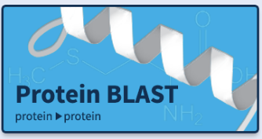

Blast-Off!!
Let’s blast some protein sequences
https://blast.ncbi.nlm.nih.gov/Blast.cgi#dtr_Query_98931

Slide 26

Python Programming
Biopython
DNA Manipulation Algorithm
Translation functions
  DNA → RNA
  RNA → DNA
  RNA → Protein
Follow along in
class and save
your notes in
a text file!!
  Follow along and Save your notes in a text file.

