Slide 1
Database search and pairwise alignments
“It is a capital mistake to theorize before one has data. Insensibly one begins to twist facts to suit theories, instead of theories to suit facts.”
(A. Conan Doyle, A scandal in Bohemia, Strand Magazine, July 1891)

Slide 2
Table of contents
Dot plots
Simple alignments
Gap
Score matrices
Dynamic programming: The Needleman-Wunsch algorithm
Global and local alignments
Database search
Multiple sequence alignments

Slide 3

Introduction − 1
Each alignment among two or more nucleotide or amino acid sequences is an explicit assumption about their common evolutionary history
Comparisons among related sequences have facilitated many advances in understanding their information content and their function
Techniques for sequence alignment and sequence comparison, and similarity search algorithms in biological databases are fundamental in Bio-informatics

Slide 4
Introduction − 2
Sequences closely related to each other are usually easy to align and, conversely, the quality of an alignment is an important indicator of their level of correlation
Sequence alignments are used to:
determine the function of a newly discovered genetic sequence (comparison with similar sequences)
determine the evolutionary relationships between genes, proteins, and entire species
predict the structure and the function of new proteins based on known “similar” proteins

Slide 5
Dot plots − 1
Probably, the simplest method to reveal analogies between two sequences consists in displaying the similarity regions using dot plots
The dot plot is a graphical method to display pairwise similarities
Less intuitive is its close relationship with pairwise alignments
The dot plot is represented by a table or a matrix or, alternatively, in a Cartesian plane
The rows or the x−axis correspond to the residues of a sequence, and the columns or the y−axis to the residues of the other

Slide 6
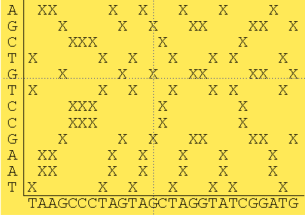
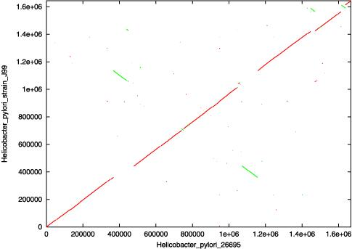
Dot plots − 2
(a)
(b)
Dot plots: (a) matrix representation and (b) graphical representation in the Cartesian plane

Slide 7
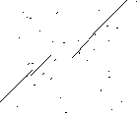
Dot plots − 3
The similarity regions will thus be viewed as diagonal lines, that proceed from South−West to North−East; repeated sequences will produce parallel diagonals
Therefore, dot plots capture, in a single image, not only the overall similarity between two sequences, but also the complete set and the relative quality of the different possible alignments
Often, some similarity may be shifted, so as to appear on parallel, but not collinear, diagonals
This indicates the presence of insertion/deletion phenomena occurred in the segments between the similarity regions

Slide 8
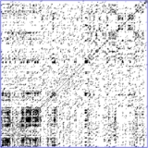
Dot plots − 4
In the dot plot matrices, random identities produce a high background noise (especially for long sequences)
This happens almost always in the alignments between nucleic acids, due to the alphabet composed by only four letters
To reduce the noise, short sequences (in sliding windows) should be compared instead of single nucleotides
In this case, the dot is reported only when s residues coincide within a window of dimension w

Slide 9
Dot plots − 5
Increasing s values ​​corresponds to increase the requested precision (maximum for s = w)
Obviously, the variation of w and s has a significant influence on the background noise
The best experimental values ​​for w and s, with respect to nucleotide and protein sequences, are empirically determined by a trial−and−error procedure

Slide 10
Dot plots − 6
A dot plot matrix, that actually considers only identities, does not provide a true indication of the similarity relations between proteins, since the non−identity among amino acids can have very different biological implications
In fact:
In some cases the replacement of a residue with a different one, but with very similar properties (e.g.: leucine and isoleucine), can be almost irrelevant
In other cases, two non−identical residues can have very different properties

Slide 11
Simple alignments − 1
A simple alignment between two sequences consists in matching pairs of characters belonging to the two sequences
The alignment of nucleotide or amino acid sequences reflects their evolutionary relationship, namely their homology, i.e. the presence of a common ancestor
A score for homology does not exist: at any given position of an alignment, the two sequences may share an ancestor character or not
The overall similarity can instead be quantified by means of a rational value

Slide 12
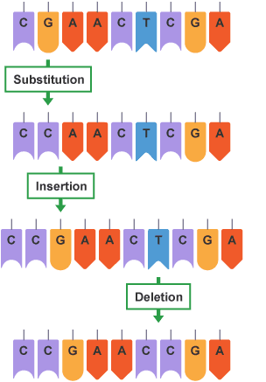
Simple alignments − 2
In particular, in any given position within a sequence, three types of changes may occur:
A mutation (or a substitution) that replaces one character with another
An insertion, which adds one or more characters
A deletion, which eliminates one or more characters
In Nature, insertions and deletions are significantly less frequent than mutations
Since there are no homologues of nucleotides inserted or deleted, gaps are commonly added in the alignments, in order to reflect the occurrence of this type of changes

Slide 13
Simple alignments − 3
In the simplest case, in which gaps are not allowed, the alignment of two sequences is reduced to the choice of the starting point for the shorter sequence
AATCTATA AATCTATA AATCTATA
AAGATA AAGATA AAGATA
To determine which of the three alignments is “optimal”, it is necessary to establish a score to comparatively evaluate them
where n is the length of the longest sequence
For a score of no−matching/matching equal to 0/1, the three alignments are evaluated respectively 4, 1 and 3
Σ{
n
Correspondence score, if seq1_{i}=seq2_{i}
i=1
Non−correspondence score, if seq1_{i}≠seq2_{i}

Slide 14
Gaps
Considering the possibility that insertion and deletion events can occur, significantly increases the number of possible alignments between pairs of sequences
For example, the two sequences AATCTATA and AAGATA that can be aligned without gaps in only three ways, admit 28 different alignments, with the insertion of two gaps within the shorter sequence
Example
AATCTATA AATCTATA AATCTATA
AAG−AT−A AA−G−ATA AA−−GATA

Slide 15
Simple penalties for gap insertion
Introduction, in the alignment evaluation score, of a penalty term for a gap insertion (gap penalty)
Assuming a score of no−matching/matching equal to 0/1 and a gap penalty equal to −1, the scores for the following three alignments with gaps (out of 28) would be 1, 3, 3
AATCTATA AATCTATA AATCTATA
AAG−AT−A AA−G−ATA AA−−GATA
Σ{
n
Penalty for a gap insertion, if seq1_{i}=“−” o seq2_{i} =“−”
Correspondence score, if seq1_{i}=seq2_{i}
i=1
Non−correspondence score, if seq1_{i}≠seq2_{i}

Slide 16
Penalties for the presence and the length of a gap − 1
Using a simple gap penalty, it is common to evidence many “optimal” alignments (depending on the chosen criterion)
Choose different penalty values for single gaps and gaps that appear in sequence
Concretely, any pairwise alignment represents a hypothesis about the evolutionary path that the two sequences have undertaken from the last common ancestor
When considering several competing hypotheses, the one that invokes the fewest number of improbable events is, by definition, the most probably correct

Slide 17
Penalties for the presence and the length of a gap − 2
Let s₁ and s₂ be two arbitrary DNA sequences of length 12 and 9, respectively
Each alignment will necessarily have three gaps in the shorter sequence
Assuming that s₁ and s₂ are homologous sequences, the difference in length can be caused by the insertion of nucleotides in the longer sequence, or by the deletion of nucleotides in the shorter sequence, or by a combination of the two events
Since the sequence of the ancestor is unknown, no methods exist able to determine the cause of a gap, which is attributed generally to an indel event (insertion/deletion)
Moreover, since sequential insertions/deletions are not uncommon, it is statistically more likely that the difference in length between the two sequences was due to a single indel of three nucleotides, rather than to three distinct indels

Slide 18
Penalties for the presence and the length of a gap − 3
The scoring function has to reward alignments that are most plausible from the evolutionary point of view
By assigning a penalty on the length of the gap (which depends on the number of sequential characters missed) lower than the penalty for the creation of new gaps, the scoring function rewards the alignments that have sequential gaps
Example: using a gap creation penalty equal to −2, a length penalty of −1 (for each gap), and no−matching/ matching values equal to 0/1, the scores in the three cases below are respectively −3, −1, 1
AATCTATA AATCTATA AATCTATA
AAG−AT−A AA−G−ATA AA−−GATA

Slide 19
Score matrices − 1
Just as the gap penalty, that can be adapted to reward alignments evolutionarily more plausible, so the no−matching penalty can be made ​​non−uniform, based on the simple observation that some substitutions are more common than others
Example: Let us consider a protein sequence, which has an alanine at a given position
A substitution with another small and hydrophobic amino acid, such as valine, has a lower impact on the resulting protein with respect to a replacement with a large and charged residue such as, for example, lysine

Slide 20

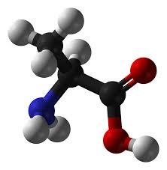

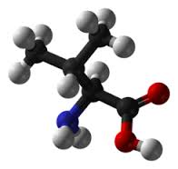

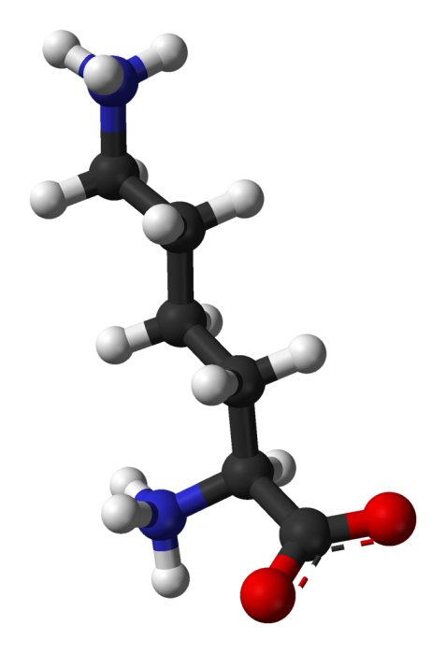
Score matrices − 2
Alanine
Valine
Lysine

Slide 21
Score matrices − 3
Intuitively, a conservative substitution, unlike a more drastic one, may occur more frequently, because it preserves the original functionality of the protein
Given an alignment score for each possible pair of nucleotides or residues, the score matrix is used to assign a value to each position of an alignment, except gaps
Example
Nucleotide matches are moderately rewarded, while a small penalty is given to transition events (substitution between purines or pyrimidines, A-G/C-T); instead, a more severe penalty is assigned for transversions, in which a purine replaces a pyrimidine or vice versa
 | A | T | C | G
A | 1 | −5 | −5 | −1
T | −5 | 1 | −1 | −5
C | −5 | −1 | 1 | −5
G | −1 | −5 | −5 | 1

Slide 22
Score matrices − 4
Several criteria can be considered in setting up a scoring matrix for amino acid sequence alignments
Physico−chemical similarity
Observed replacement frequencies
In similarity based matrices, the substitution between two amino acids, which, however, have both functional aromatic groups (hydrophobic amino acids, with a side chain containing a benzene ring, such as phenyl-alanine, tyrosine and tryptophan) could receive a positive score, while substituting non−polar with charged amino acids could be penalized

Slide 23
Score matrices − 5
Score matrices can be derived according to the hydrophobicity, the presence of charge, the electronegativity, and the size of the involved residues
Alternatively, similarity criteria based on the encoding genome can also be used: the assigned score is proportional to the minimum number of nucleotide substitutions necessary to convert a codon to another
Difficulty in combining, in a single “significant” matrix, chemical, physical and genetic scores

Slide 24
Score matrices − 6
The most common method to derive score matrices consists in observing the actual frequencies of amino acid substitutions in Nature
If a replacement which involves two particular amino acids is frequently observed, their alignment obtains a favorable score
Vice versa, alignments between residues which, during evolution, are rarely observed must be penalized

Slide 25
PAM matrices − 1
PAM matrices exploit the concept of Point (or Percent) Accepted Mutation; they were proposed in 1978, by M. Dayhoff et al., on the basis of a study on molecular phylogeny involving 71 protein families
PAM matrices were developed by examining mutations within superfamilies of closely related proteins, also noting how observed substitutions did not happen at random
Some amino acid substitutions occur more frequently than others, probably because they do not significantly alter the structure and the function of a protein
Homologous proteins need not to be necessarily constituted by the same amino acids in each position

Slide 26
PAM matrices − 2
Two proteins are “distant” 1 PAM unit if they differ for a single amino acid out of 100, and if the mutation is accepted, i.e. it does not result in a loss of functionality
In other words… two sequences s₁ and s₂ are distant 1 PAM if s₁ can be transformed into s₂ with a point mutation per 100 amino acids, on average
Since the amino acid at a certain position may change several times and then may return to the original character, the two sequences that are 1 PAM may be the evolutionary product of a set of unobservable mutations that involved more than one amino acid out of 100

Slide 27
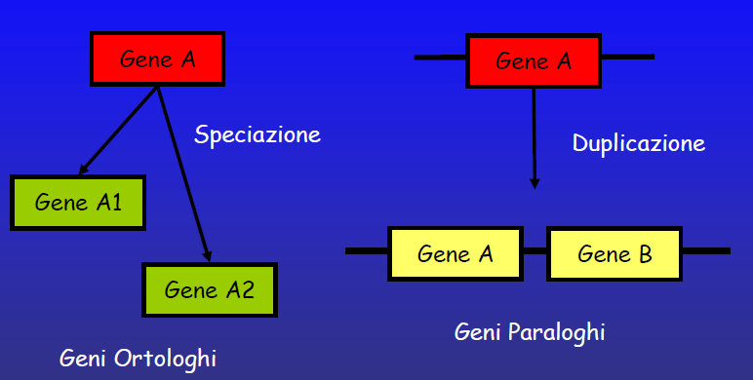
PAM matrices − 3
Protein families used for PAMs collect orthologous proteins (which perform the same function in different organisms); instead, pathological changes, that are associated to loss of functionality, do not belong to this class
To generate a PAM 1 matrix, we consider a pair (or more) of very similar protein sequences (with
an identity >85%), for which the alignment can be defined without ambiguity
Speciation
Duplication
Paralogous genes
Orthologous genes

Slide 28
PAM matrices − 4
Based on this set of proteins, a PAM 1 score matrix can be defined as follows:
Calculation of an alignment among sequences with very high identity
For each pair of amino acids i and j, calculation of F_{ij}, the number of times that the amino acid j is replaced by i
For each amino acid j, evaluation of the relative mutability n_{j} (the number of substitution of such amino acid, appropriately normalized)
Evaluation of M_{ij}, the mutation probability for each amino acid pair j → i
Finally, each PAM 1 element, P_{ij}, is evaluated by applying the logarithm to M_{ij}, previously normalized w.r.t. the frequency of the residue i (PAM 1 is also called the log−odds matrix)

Slide 29
PAM matrices − 5
Example (to be continued)
Construction of a multiple sequence alignment:
ACGCTAFKI GCGCTLFKI
GCGCTAFKI ASGCTAFKL
ACGCTAFKL ACACTAFKL
GCGCTGFKI

Slide 30
PAM matrices − 6
Example (to be continued)
A phylogenetic tree is created, that indicates the order in which substitutions may have been occurred during evolution
ACGCTAFKI
A→G
I→L
GCGCTAFKI
ACGCTAFKL
A→G
A→L
C→S
G→A
GCGCTGFKI
GCGCTLFKI
ASGCTAFKL
ACACTAFKL

Slide 31
PAM matrices − 7
Example (to be continued)
For each amino acid, we calculate the number of replacements with respect to any other amino acid
It is assumed that the substitutions are symmetric, that is they occur with the same probability with respect to a given pair of amino acids
For instance, in order to determine the substitution frequency between A and G, F_{G,A}=F_{A,G}, we count all the branches A→G and G→A
F_{G,A}= 3

Slide 32
PAM matrices − 8
Example (to be continued)
Calculation of the relative mutability n_{j} of each amino acid
The mutability m_{j} is the number of times an amino acid is replaced by any other in the phylogenetic tree
This number is then normalized by the total number of mutations that may have some effects on the alignment
...that is, the denominator of the fraction is given by the total number of substitutions in the tree, multiplied by two, multiplied by the frequency of the particular amino acid, multiplied by a scale factor equal to 100
The scale factor 100 is used because the PAM 1 matrix represents the substitution probability per 100 residues

Slide 33
PAM matrices − 9
Example (to be continued)
Let us consider the amino acid A (alanine): there are 4 mutations involving A in the phylogenetic tree (m_{A}= 4)
This value must be divided by twice the total number of mutations (6×2=12), multiplied by the relative frequency of the residue f_{A} (10/63=0.159), multiplied by 100
n_{A}=4/(12×0.159×100)=0.0209

Slide 34
PAM matrices − 10
Example (to be continued)
Let us calculate the mutation probability M_{ij}, for each pair of amino acids
M_{ij}=n_{j}F_{ij}/Σ_{i} F_{ij}
and then…
M_{G,A}=(0.0209×3)/4=0.0156
where the denominator Σ_{i}F_{ij} represents the total number of substitutions that involves A in the phylogenetic tree
relative mutability of j
total replacements involving j
total replacements j i

Slide 35
PAM matrices − 11
Example
Finally, each M_{ij} must be divided by the frequency of the residue i; the logarithm of the resulting value constitutes the corresponding element of the PAM matrix, P_{ij}
For G, the frequency f_{G} is equal to 0.159 (10/63)
For G and A, P_{G,A}=log(0.0156/0.159)≈−1.01
By repeating the above procedure for each pair of amino acids we can obtain all the extradiagonal values ​​of the PAM matrix, whereas P_{ii} are calculated posing M_{ii} =1−n_{i} and executing 6)

Slide 36
PAM matrices − 12
High order PAM matrices are generated by successive multiplications of the PAM 1 matrix, since the probability of two independent events is equal to the product of the probabilities of each individual event
While for the PAM 1 matrix it holds that a mutational event corresponds to a difference of ≈1%, this is not true for higher order PAM matrices
Indeed, subsequent mutations have a gradually increasing chance to happen in correspondence of already mutated amino acids
The degree of difference increases with the increase in the number of mutations, but while the number of mutations can tend to infinity, the difference tends asymptotically to 100%

Slide 37
PAM matrices − 13
The choice of the most suitable PAM matrix with respect to a particular alignment of sequences, depends on their length and on their correlation degree
PAM 2 is calculated from PAM 1 assuming another evolutionary step
PAM n is obtained from PAM n−1
PAM 100, therefore, represents 100 evolutionary steps, in each of which there was a 1% of substitutions more compared to the previous step
phylogenetically close sequences
phylogenetically distant sequences
PAM 1
PAM 100
PAM 250

Slide 38
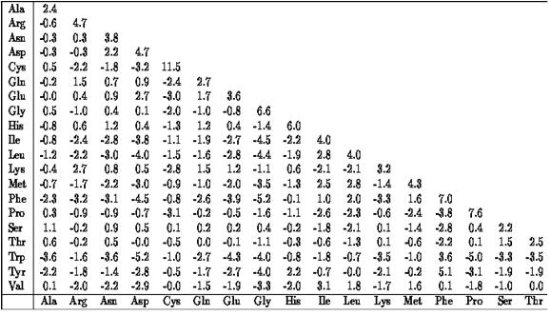
PAM matrices − 14
PAM 250 matrix

Slide 39
PAM matrices − 15
It is worth noting that:
Each PAM matrix element P_{ij} describes how much the substitution of the amino acid A_{j} with the amino acid A_{i} is more (or less) frequent that a random mutation
Therefore:
P_{ij} > 0 more frequent than a random mutation
P_{ij} = 0 frequent as a random mutation
P_{ij} < 0 less frequent than a random mutation

Slide 40
BLOSUM matrices − 1
BLOSUM matrices (BLOcks amino acid SUbstitution Matrices) were introduced in 1992 by S. Henikoff and J. G. Henikoff to assign a score to substitutions between amino acid sequences
Their purpose was to replace the PAM matrices, making use of the increased amount of data that had become available after the work of Dayhoff
They were supposed to work better than PAMs especially with respect to poorly correlated sequences
The BLOCKS database contains multiply aligned ungapped segments corresponding to the most highly conserved regions of proteins
Each alignment block contains sequences with a number of identical amino acids grater than a certain percentage N
From each block, it is possible to derive the relative frequency of amino acid replacements, which can be used to calculate a score matrix
40

Slide 41
BLOSUM matrices − 2
The elements of the BLOSUM matrix, B_{ij}, are evaluated based on the following relation
B_{ij} = ⎣k⋅log(M(A_{i},A_{j})/C(A_{i},A_{j}))⎦, k costant
M(A_{i},A_{j}) is the substitution frequency of the amino acid A_{j} with the amino acid A_{i}, observed in the block of the considered homologous proteins
C(A_{i},A_{j}) is the expected substitution frequency, represented by the product of the substitution frequencies of amino acids A_{i} and A_{j} in all the groups of the considered homologous proteins
Even in this case, the matrix element (i,j) is proportional to the substitution frequency of the amino acid A_{j} with the amino acid A_{i}
phylogenetically distant sequences
phylogenetically close sequences
41
BLOSUM35
BLOSUM62

Slide 42
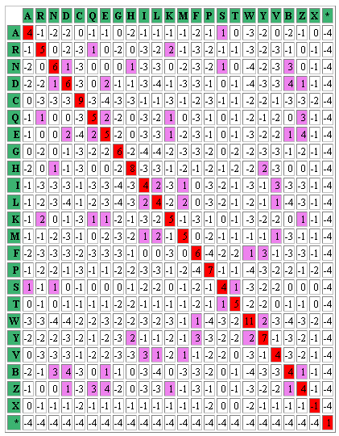
Example: BLOSUM62
42

Slide 43
PAM or BLOSUM − 1
The two types of matrices start from different assumptions
For PAM matrices, it is assumed that the observed amino acid substitutions for large evolutionary distances derive solely by the summing of many independent mutations; the resulting scores express how likely it is that the alignment of a particular couple of amino acids is due to homology rather than to randomness
The BLOSUM matrices are not explicitly based on an evolutionary model of mutations; each block is obtained from the direct observation of a family of related proteins (so probably also evolutionarily related), but without explicitly evaluate their similarity
43

Slide 44
PAM or BLOSUM − 2
An increasing PAM index describes a suitable score for “distant” proteins, expressing also an evolutionary distance; instead, an increasing BLOSUM index represents a suitable score for protein similar to each others, expressing the minimum conservation value for the BLOCK
PAM matrices tend to reward amino acid substitutions resulting from single base mutations, also penalizing substitutions involving more complex changes in the codons; instead, they do not reward structural amino acid motifs, as the BLOSUMs do
44

Slide 45
PAM or BLOSUM − 3
The comparison between PAM and BLOSUM, to a comparable level of substitutions, indicates that the two types of matrices produce similar results
Equivalent PAM and BLOSUM matrices
PAM1 → Blosum100
PAM100 → Blosum90
PAM120 → Blosum80
PAM160 → Blosum62
PAM200 → Blosum52
PAM250 → Blosum45
45

Slide 46
PAM or BLOSUM − 4
Typically, the BLOSUM matrices are deemed most suitable to search for sequence similarity
The BLOSUM62 matrix is normally set as the default in the similarity search software
In any case, it is important to choose the most suitable matrix based on the phylogenetic distance between the sequences to be compared
For phylogenetically close sequences (and organisms) low index PAM or high index BLOSUM must be chosen
For phylogenetically distant sequences, high index PAM or low index BLOSUM are suitable
46

Slide 47
Dynamic Programming: The Needleman-Wunsch algorithm − 1
Once having selected a method for assigning a score to an alignment, it is necessary to define an algorithm to determine the best alignment(s) between two sequences
The exhaustive search among all possible alignments is generally impractical
For two sequences, respectively 100 and 95 nucleotide long, there are ∼55 millions possible alignments, just only in the case of five gaps inserted in the shorter sequence
The exhaustive search approach becomes rapidly intractable
Using dynamic programming, the problem can be divided into subproblems of more “reasonable” size, whose solutions must be recombined to form the solution of the original problem
47

Slide 48
Dynamic Programming: The Needleman-Wunsch algorithm − 2
S. B. Needleman and C. D. Wunsch, in 1970, were the first who solved this problem with an algorithm able to find global similarities, in a time proportional to the product of the lengths of the two sequences
The key for understanding this approach is to observe how the alignment problem can be divided into subproblems
48

Slide 49
Dynamic Programming: The Needleman-Wunsch algorithm − 3
Example (to be continued)
Align CACGA and CGA with the assumption of uniformly penalizing gaps and mismatches
Possible choices to be made with respect to the first character:
Place a gap in the first place of the first sequence (counterintuitive, given that the first sequence is longer)
Place a gap in the first place of the second sequence
Align the first two characters
In the first two cases, the alignment score for the first position will be equal to the gap penalty
In the third case, the alignment score for the first position will be equal to the match score
The rest of the score will depend, in all the cases, on the way in which the remaining part of the two sequences will be aligned
49

Slide 50
Dynamic Programming: The Needleman-Wunsch algorithm − 4
Example (to be continued)
If we knew the score for the best alignment between the remaining parts of the sequences, we could easily calculate the best overall score relative to the three possible choices
First position | Score | Sequences to be aligned
C C | +1 | ACGA GA
− C | −1 | CACGA GA
C − | −1 | ACGA CGA
50

Slide 51
Dynamic Programming: The Needleman-Wunsch algorithm − 5
Example
Starting from the assumption of aligning the two initial characters (without inserting gaps), it remains to calculate the alignment score for the sequences ACGA and GA
In this operation, it will often be necessary to calculate scores for subsequences (e.g.: ACGA and GA)
Dynamic programming is based on constructing a table, in which the partial alignment scores are stored, in order to avoid to recalculate them many times
51

Slide 52
Dynamic Programming: The Needleman-Wunsch algorithm − 6
The dynamic programming algorithm computes the optimal alignment between two sequences filling a table with partial scores
The horizontal and vertical axes describe, respectively, the two sequences to be aligned
Example: table for the alignment of ACAGTAG and ACTCG, with a gap penalty of −1 and a score of mis/ matching equal to 0/1
 |  | A | C | T | C | G
 | 0 | −1 | −2 | −3 | −4 | −5
A | −1
C | −2
A | −3
G | −4
T | −5
A | −6
G | −7
52

Slide 53
Dynamic Programming: The Needleman-Wunsch algorithm − 7
The alignment of the two sequences is equivalent to build a path that goes from the upper left to the lower right corner of the table
A horizontal shift represents a gap inserted in the vertical sequence and vice versa
Moving along the diagonal means aligning the corresponding nucleotides in the two sequences
The first row and the first column of the table are initialized with multiples of the gap penalty (in fact, each gap adds a penalty to the total alignment score)
53

Slide 54
Dynamic Programming: The Needleman-Wunsch algorithm − 8
How can we calculate the other elements in the table?
The element in position (2,2) is calculated by exploring the following three possibilities:
Adding up the gap penalty to the entry in position (2,1), which corresponds to consider a gap in the vertical sequence
Adding up the gap penalty to the entry in position (1,2), which corresponds to consider a gap in the horizontal sequence
Adding up the mis/match score to the entry in the diagonal position (1,1), which corresponds to the alignment of the related nucleotides
The maximum value among those obtained for the three options (−2,−2,1) is then assigned to the element in position (2,2)
54

Slide 55
Dynamic Programming: The Needleman-Wunsch algorithm − 9
We can then proceed to fill the entire second row, then move on to the next row, up to complete the table
 |  | A | C | T | C | G
 | 0 | −1 | −2 | −3 | −4 | −5
A | −1 | 1 | 0 | −1 | −2 | −3
C | −2 | 0 | 2 | 1 | 0 | −1
A | −3 | −1 | 1 | 2 | 1 | 0
G | −4 | −2 | 0 | 1 | 2 | 2
T | −5 | −3 | −1 | 1 | 1 | 2
A | −6 | −4 | −2 | 0 | 1 | 1
G | −7 | −5 | −3 | −1 | 0 | 2
Example
N(3,5) = max{(−1+1),(+1−1),(−2−1)}
= max{0,0,−3)} = 0
55

Slide 56
Dynamic Programming: The Needleman-Wunsch algorithm − 10
After completing the table, the value in the lower right corner is the score for the optimal alignment between the two sequences (2, in the example)
Remark: The score was determined without having to assign a score to all the possible alignments between the two sequences
The table of the partial scores allows to reconstruct the optimal alignments (generally more than one) between the two sequences
Tracing a path from the lower right to the upper left position
56

Slide 57
Dynamic Programming: The Needleman-Wunsch algorithm − 11
Example
The value N(8,6)=2 may have been obtained following three different routes, but the only one that can produce a value of 2 is that coming from N(7,5)=1 (alignment of G in both the sequences)
 |  | A | C | T | C | G
 | 0 | −1 | −2 | −3 | −4 | −5
A | −1 | 1 | 0 | −1 | −2 | −3
C | −2 | 0 | 2 | 1 | 0 | −1
A | −3 | −1 | 1 | 2 | 1 | 0
G | −4 | −2 | 0 | 1 | 2 | 2
T | −5 | −3 | −1 | 1 | 1 | 2
A | −6 | −4 | −2 | 0 | 1 | 1
G | −7 | −5 | −3 | −1 | 0 | 2
Again, for the value N(7,5) exists only one possibility, which leads to the element N(6,4)=1 (with 0 mismatch score between the two nucleotides)
The process must be repeated until all the possible paths are completed, to reach the final position (1,1)
57

Slide 58
Dynamic Programming: The Needleman-Wunsch algorithm − 12
If n and m represent the lengths of the two sequences to be aligned, to convert a path in an alignment, each path from (n+1,m+1) to (1,1) must be traveled backwards, recalling that:
a vertical movement represents a gap in the sequence along the horizontal axis
a horizontal movement represents a gap in the sequence along the vertical axis
a diagonal movement represents an alignment of the nucleotides, belonging to the two sequences, at the current position
58

Slide 59
Dynamic Programming: The Needleman-Wunsch algorithm − 13
Example
G
G
CG
AG
TCG
TAG
 |  | A | C | T | C | G
 | 0 | −1 | −2 | −3 | −4 | −5
A | −1 | 1 | 0 | −1 | −2 | −3
C | −2 | 0 | 2 | 1 | 0 | −1
A | −3 | −1 | 1 | 2 | 1 | 0
G | −4 | −2 | 0 | 1 | 2 | 2
T | −5 | −3 | −1 | 1 | 1 | 2
A | −6 | −4 | −2 | 0 | 1 | 1
G | −7 | −5 | −3 | −1 | 0 | 2
−TCG
GTAG
−−TCG
AGTAG
C−−TCG
CAGTAG
Remark: Following all the paths (n+1,m+1)→(1,1) in the table of the partial scores, all the possible optimal alignments between the two sequences can be reconstructed
AC−−TCG
ACAGTAG
59

Slide 60
The Needleman-Wunsch algorithm Example − 1
Alignment of the sequences CACGA and CGA
 |  | C | G | A
 | 0 | −1 | −2 | −3
C | −1 | 1 | 0 | −1
A | −2 | 0 | 1 | 1
C | −3 | −1 | 0 | 1
G | −4 | −2 | 0 | 0
A | −5 | −3 | −1 | 1
N(2,2) = max{(−1−1),(−1−1),(0+1)} = max{−2,−2,1)} = 1
N(2,3) = max{(1−1),(−2−1),(−1+0)} = max{0,−3,−1)} = 0
N(2,4) = max{(0−1),(−3−1),(−2+0)} = max{−1,−4,−2)} = −1
N(3,2) = max{(−2−1),(1−1),(−1+0)} = max{−3,0,−1)} = 0
N(3,3) = max{(0−1),(0−1),(1+0)} = max{−1,−1,1)} = 1
N(3,4) = max{(1−1),(−1−1),(0+1)} = max{0,−2,1)} = 1
N(4,2) = max{(−3−1),(0−1),(−2+1)} = max{−4,−1,−1)} = −1
N(4,3) = max{(−1−1),(1−1),(0+0)} = max{−2,0,0)} = 0
N(4,4) = max{(0−1),(1−1),(1+0)} = max{−1,0,1)} = 1
N(5,2) = max{(−4−1),(−1−1),(−3+0)} = max{−5,−2,−3)} = −2
N(5,3) = max{(−2−1),(0−1),(−1+1)} = max{−3,−1,0)} = 0
N(5,4) = max{(0−1),(1−1),(0+0)} = max{−1,0,0)} = 0
N(6,2) = max{(−5−1),(−2−1),(−4+0)} = max{−6,−3,−4)} = −3
N(6,3) = max{(−3−1),(0−1),(−2+0)} = max{−4,−1,−2)} = −1
N(6,4) = max{(−1−1),(0−1),(0+1)} = max{−2,−1,1)} = 1
60

Slide 61
The Needleman-Wunsch algorithm Example − 2
Alignment of the sequences CACGA and CGA
 |  | C | G | A
 | 0 | −1 | −2 | −3
C | −1 | 1 | 0 | −1
A | −2 | 0 | 1 | 1
C | −3 | −1 | 0 | 1
G | −4 | −2 | 0 | 0
A | −5 | −3 | −1 | 1
⇨ Two admissible paths
Two optimal alignments with score equal to 1
C−−GA
CACGA
−−CGA
CACGA
61

Slide 62
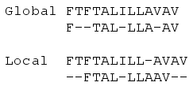
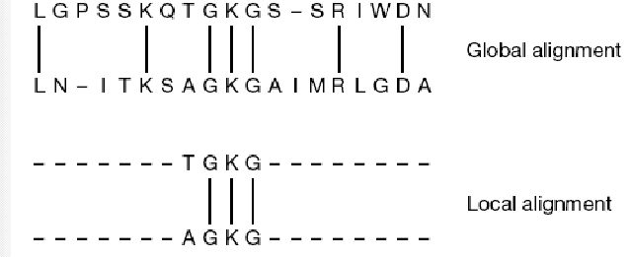
Global and local alignments − 1
Global alignment: obtained by trying to align the maximum number of characters between two sequences; ideal candidates are sequences of similar length
Local alignment: obtained by trying to align “pieces” of sequences with a high degree of similarity; the alignment terminates when “the island of coupling” ends; ideal candidates are sequences with significantly different lengths, which contain highly conserved regions
62

Slide 63
Global and local alignments − 2
The Needleman-Wunsch algorithm performs global alignments, i.e. it compares sequences in their entirety
The gap penalty is fixed, without weighing the gap position (located inside or at the ends of the sequences)
It is not always the best way to perform the alignment
Example: let us suppose to search for an occurrence of the short subsequence ACGT within the longer sequence AAACACGTGTCT (this is a pattern matching approach)
Among several possibilities, the alignment of interest is:
AAACACGTGTCT
−−−−ACG T −−−−
When searching for the best alignment between a short sequence and a whole genome (to isolate a gene, for instance), penalizing the gaps that appear at one or both the ends of a sequence should be avoided
63

Slide 64
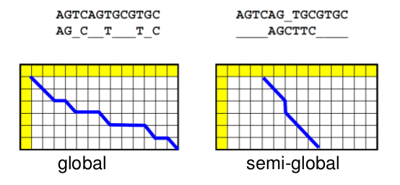
Global and local alignments − 3
The flanking gaps are usually the result of an incomplete data acquisition and have no biological significance
it is appropriate to treat them differently from internal gaps
semiglobal alignment
64

Slide 65
Global and local alignments − 4
How can we change the dynamic programming algorithm to wire this new behavior?
Let us consider again the two sequences ACTCG and ACAGTAG: we can first move vertically towards the bottom row of the table, and then horizontally to the last column, until we reach the last entry, obtaining:
−−−−−−− ACTCG
ACAGTAG−−−−−
Indeed, from the upper left of the table, each downward movement adds an additional gap at the beginning of the first sequence...
...and, since each gap adds a gap penalty to the total score of the alignment, the first column is initialized with the gap penalty multiples
65

Slide 66
Global and local alignments − 5
Conversely, if we want to allow the presence of initial gaps in the first sequence without assigning any penalty
The first column entries should be set to zero
Likewise, initializing the first row of the table with all zeroes, we allow the presence of initial gaps in the second sequence without assigning penalties
Moreover, to admit no gap penalties at the end of a sequence, the meaning of some movement within the table must be differently reinterpreted
66

Slide 67
Global and local alignments − 6
Example: Let us suppose to have the following alignment:
ACACTGATCG
ACACTG −−−−
Using Needleman-Wunsch algorithm to build a path in the table of partial scores, after aligning the first six nucleotides, we reach the bottom row
Then, to reach the lower right corner, we should perform four horizontal movements
Allow horizontal movements in the last row to have no gap penalties
Similarly, vertical movements on the last column should not be penalized
67

Slide 68
Global and local alignments − 7
 |  | A | C | A | C | T | G | A | T | C | G
 | 0 | 0 | 0 | 0 | 0 | 0 | 0 | 0 | 0 | 0 | 0
A | 0 | 1 | 0 | 1 | 0 | 0 | 0 | 1 | 0 | 0 | 0
C | 0 | 0 | 2 | 1 | 2 | 1 | 0 | 0 | 1 | 1 | 0
A | 0 | 1 | 1 | 3 | 2 | 2 | 1 | 1 | 0 | 1 | 1
C | 0 | 0 | 2 | 2 | 4 | 3 | 2 | 1 | 1 | 1 | 1
T | 0 | 0 | 1 | 2 | 3 | 5 | 4 | 3 | 2 | 1 | 1
G | 0 | 0 | 0 | 1 | 2 | 3 | 6 | 6 | 6 | 6 | 6
68

Slide 69
Global and local alignments − 8
In summary:
By initializing the first row and the first column of the table with all zeroes…
…and allowing non−penalized horizontal and vertical movements, respectively, in the last row and in the last column of the table
A semiglobal alignment is performed
Unfortunately, not even semiglobal alignments offer sufficient flexibility to address all the possible issues related to sequence alignments
69

Slide 70
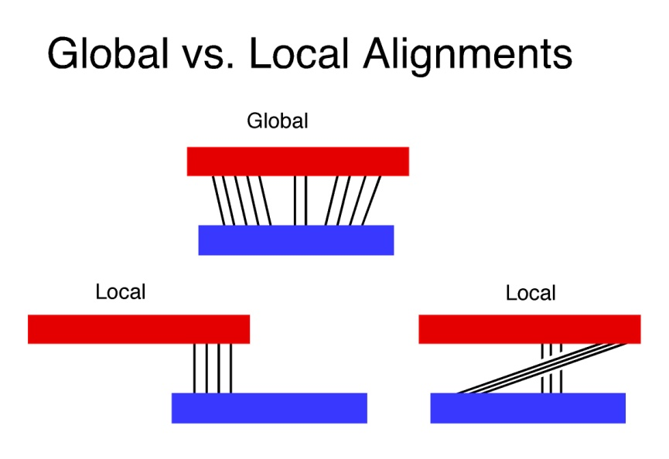
The Smith-Waterman algorithm − 1
In 1981, T. F. Smith and M. S. Waterman developed a new algorithm capable of detecting also local similarity
Example: Let us suppose to have a long DNA sequence and want to isolate each subsequence similar to each part of the yeast genome
A semiglobal alignment is not sufficient because it will however penalize each non−correspondence position
Even if there were an interesting subsequence, partly coincident with the yeast genome, all non−correspondent nucleotides will contribute to generate an unsatisfactory alignment score
Local alignment
70

Slide 71
The Smith-Waterman algorithm − 2
Example: Let us consider the two sequences AACCTATAGCT and GCGATATA
By using a semiglobal alignment with a −1 gap penalty and non/correspondence scores equal to −1/1, we will obtain the following alignment:
AAC−CTATAGCT
−GCAATATA−−−
which is pretty poor, given that four of the top five positions are mismatches or gaps, as well as the last three positions
However, there is a “correspondence region” within the two sequences: the TATA subsequence
Change the algorithm in order to identify matches between subsequences, ignoring mismatches and gaps before and after the region of correspondence
71

Slide 72
The Smith-Waterman algorithm − 3
For the local alignment of two sequences:
Initialize the first row and the first column to zero (as in the semiglobal alignment)
Set the mismatch penalty to −1
Enter a zero entry in the table wherever all the other routes return a negative score
After having built the table:
Find the maximum partial score
Proceed backwards, to rebuild the alignment, until a zero entry is reached
The resulting local alignment represents the best matching subsequence between the two given sequences
72

Slide 73
The Smith-Waterman algorithm − 4
 |  | A | A | C | C | T | A | T | A | G | C | T
 | 0 | 0 | 0 | 0 | 0 | 0 | 0 | 0 | 0 | 0 | 0 | 0
G | 0 | 0 | 0 | 0 | 0 | 0 | 0 | 0 | 0 | 1 | 0 | 0
C | 0 | 0 | 0 | 1 | 1 | 0 | 0 | 0 | 0 | 0 | 2 | 1
G | 0 | 0 | 0 | 0 | 0 | 0 | 0 | 0 | 0 | 1 | 1 | 1
A | 0 | 1 | 1 | 0 | 0 | 0 | 1 | 0 | 1 | 0 | 0 | 0
T | 0 | 0 | 0 | 0 | 0 | 1 | 0 | 2 | 1 | 0 | 0 | 1
A | 0 | 1 | 1 | 0 | 0 | 0 | 2 | 1 | 3 | 2 | 1 | 0
T | 0 | 0 | 0 | 0 | 0 | 1 | 1 | 3 | 2 | 2 | 1 | 2
A | 0 | 1 | 1 | 0 | 0 | 0 | 2 | 2 | 4 | 3 | 2 | 1
In summary… when working with long sequences, of several thousands, or millions, of nucleotides, local alignment methods can identify common subsequences, impossible to be found by means of global or semiglobal alignments
73

Slide 74
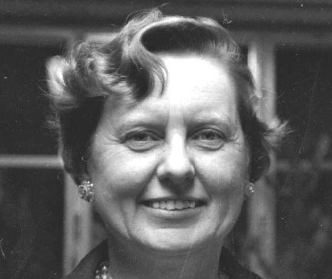
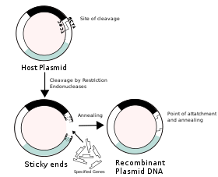
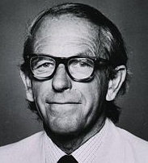
Biological data − 1
1965: Margaret Dayhoff defines an atlas of homologous proteins, studying the relationships among their primary sequence; the collected data were distributed in 1970, in the database NBRF (National Biomedical Research Foundation)
Early ‘70s: The recombinant DNA technology (fundamental for cloning) is established, which allows the manipulation of the nucleotide sequences, guaranteeing the comprehension of the DNA structure, function and organization
Late ‘70s: Publication of the first genomic data (F. Sanger), with a small number of nucleotide encoding sequences, freely accessible via the network (restricted to few universities)
74

Slide 75


Biological data − 2
1980 [Kurt Stueber]: Birth of the first genomic database, at the European Molecular Biology Laboratory (EMBL) in Heidelberg
1982 [Walter Goad]: Birth of a similar database in the USA, which will converge later in GenBank
1986: A mirror of GenBank, DDBJ (DNA DataBank of Japan), was set up at the National Institute of Genetics in Mishima (Japan)
2001: The International Public Consortium and Celera Genomics provide the complete human genome
75

Slide 76
Biological databases − 1
Molecular biotechnology developments have led to the production of a huge amount of biological data
Biological databases are designed as containers, constructed to store data in an efficient and rational way, and to make them easily accessible to the users
Their ultimate goal consists in collecting data and in providing ad hoc tools − available within each database − to analyze them
76

Slide 77
Biological databases − 2
Numerous biological databanks exist today:
Primary Databanks
Nucleotide and amino acid sequences
Specialized databanks
Genes
Protein structures
Protein domains and motifs − protein domains are compact semi−independent regions with distinctive functions, linked to the rest of the protein by a portion of the polypeptide chain that serves as a hinge
Transcriptome expression profiles − transcriptome (a term analogous to genome, proteome or metabolome) means the set of all transcripts (messenger RNA or mRNA) of a given organism or cell type
Metabolic pathways − a metabolic pathway (or simply a pathway) is the set of chemical reactions involved in one or more processes of anabolism or catabolism within a cell
…
77

Slide 78
Biological databases − 3
Biological databases collect information and data derived from:
the literature
laboratory analyses (in vitro and in vivo)
bioinformatic analyses (in silico)
Many biological data are freely downloadable in flat format, i.e. in the form of sequential file in which each record is described by one or more consecutive text lines, identified by a particular unique code (a key)
These files are therefore text files, that can be analyzed by means of suitable tools, able to extract the information of interest
Alternative: data in HTML or XML format, easy to be consulted via browsers
78

Slide 79
Biological databases − 4
Each database is characterized by a central biological element that constitutes the object around which the database records are built
Therefore, each record collects the information that characterizes the central element (i.e., its attributes)
A record of a DNA database may contain, in addition to the sequence of a DNA molecule,
the name of the organism to which the sequence belongs
its functional characteristics (i.e., if it corresponds to a gene or a to a non−coding sequence)
a list of scientific papers reporting data on that sequence
other interesting information
79

Slide 80
Biological databases − 5
Biological databases provide bioinformatics tools for processing the data they contain, including:
Query systems (ENTREZ, associated with GenBank, SRS, for EMBL, DBGET, for DDBJ)
Screening tools (BLAST, FASTA)
Multiple sequence alignment tools (ClustalW, AntiClustal, T−Coffee, ProbCons)
Tools for the identification of exons and regulatory elements that characterize a gene (GenScan, Promoser)
…
80

Slide 81
Primary biobanks − 1
Primary databases contain nucleotide (DNA and RNA) or amino acid (protein) sequences
The main primary databases are:
GenBank (NCBI − National Center for Biotechnology Information, founded in 1982 in Bethesda, USA, http://www.ncbi.nlm.nih.gov); the standard database contains 217971437647 bases belonging to 196120831 sequences (August 2016)
EMBL datalibrary (founded in 1980 at EMBL − European Molecular Biology Laboratory, in Heidelberg, Germany, http://www.embl.de)
DDBJ (DNA DataBase of Japan, constituted in 1986 by the National Institute of Genetics in Mishima, Japan, http://www.ddbj.nig.ac.jp/index-e.html)
81

Slide 82
Primary biobanks − 2
Among the three main biological databanks, an international agreement has been established to ensure that DNA data are kept consistent (daily updates made ​​in each bank are automatically transferred to the others)
Moreover, the three institutions cooperate to share and make publicly available all the data they collect, that differ only in the format in which they are released
82

Slide 83
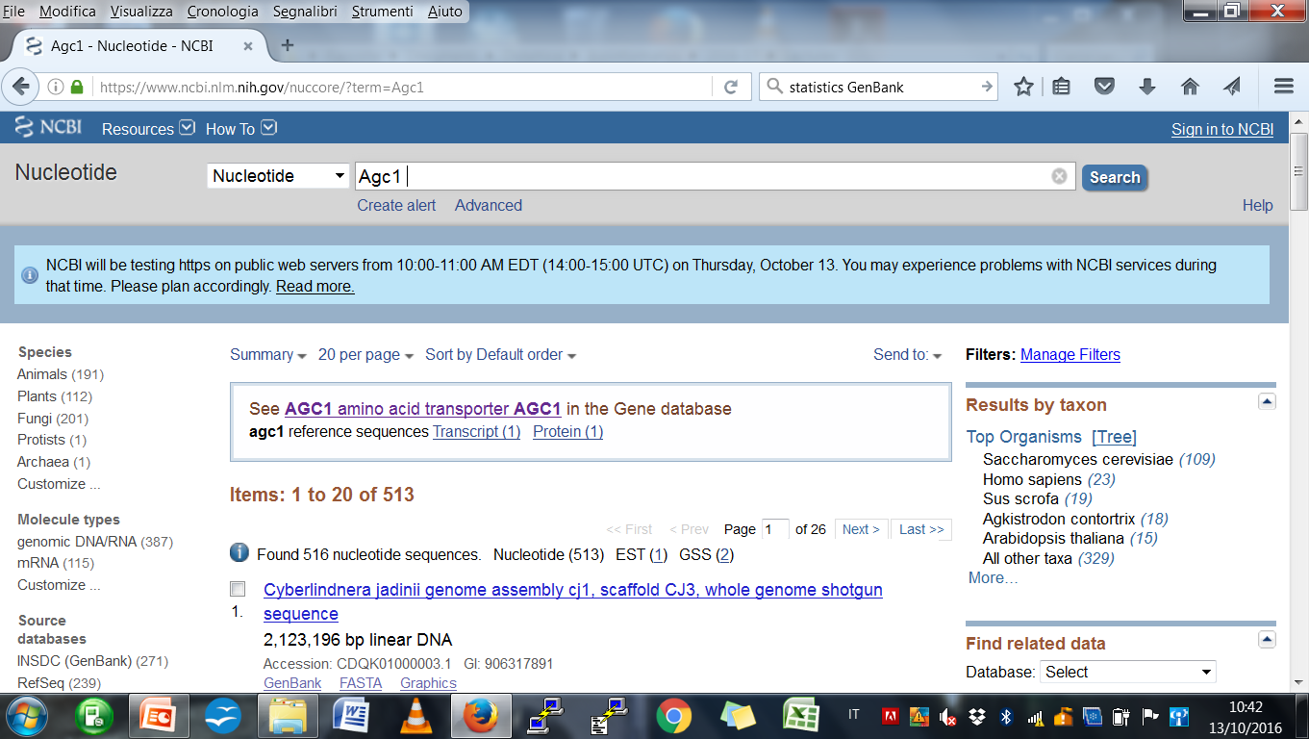
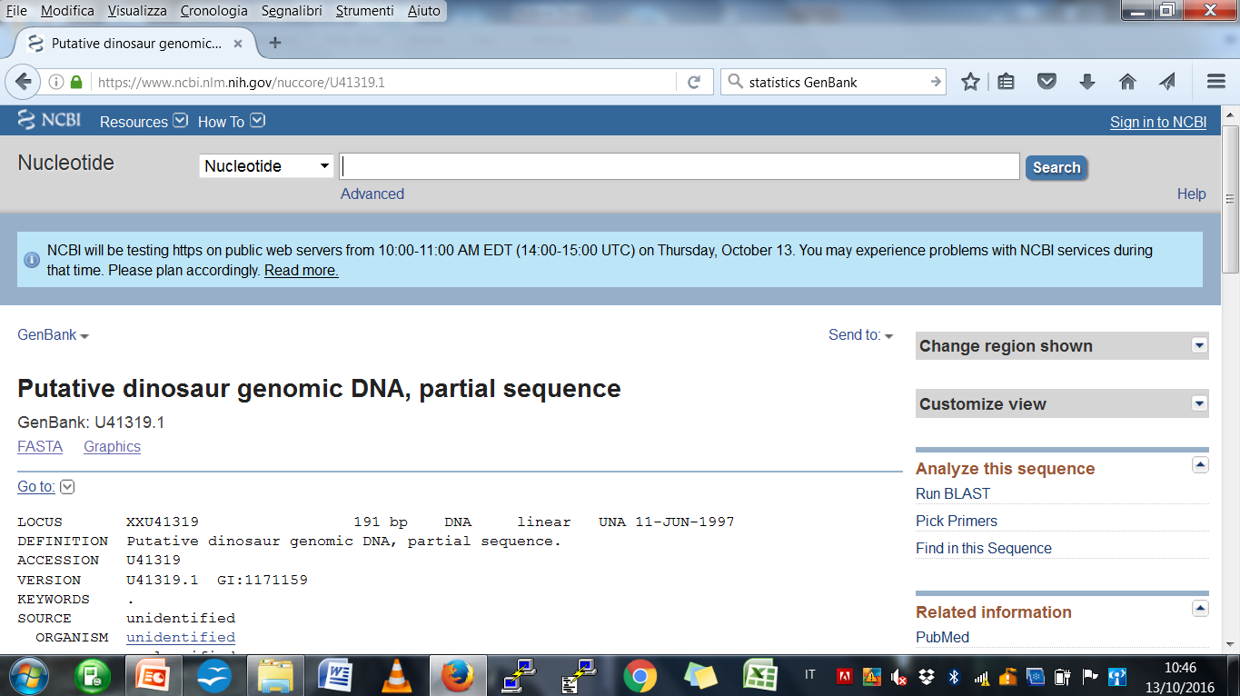
NCBI − 1
The Agc1 deficit is a neuro-degenerative syndrome that causes a reduction of the content of myelin, the sheath surrounding nervous cells in the brain. Since the very first months of life, it implies severe psychomotor problems, seizures and difficulties in breathing and in movements controlling.
83

Slide 84
NCBI − 2
NCBI is a database of genetic sequences, owned by the USA National Institute of Health; it contains an annotated collection of all publicly available DNA sequences
Access to data through ENTREZ, the query system used for all the different databases managed by NCBI, which therefore constitutes a complete hub to search for information
Available via web, for the search and the extraction of information from databases of nucleotide and protein sequences, from the bibliographic database PubMed, the database of Mendelian diseases OMIM, and any database developed by NCBI
Closed system: the software that runs the system cannot be downloaded
84

Slide 85
NCBI − 3
Main databases in NCBI:
Gene: It contains data related to the genes of all the characterized species, such as gene structure and genomic context, ontologies, interactions with other genes and links to related sequences and scientific publications
Nucleotide: It contains the nucleotide non/coding sequences of all the characterized species
Protein: It shares the same structure of Nucleotide, but it contains amino acid sequences
PubMed: It is the database of scientific biological and biomedical publications; the abstract is available for each paper; PubMed Central contains full−text articles available for free download
85

Slide 86
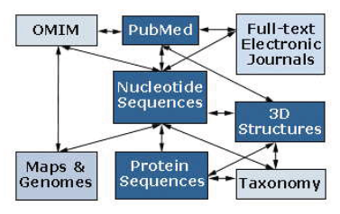
NCBI − 4
Entrez also provides the possibility to make cross−searching, for collecting information from the various NCBI databases (sequence−structure−genetic map−literature)
86

Slide 87
Protein databanks − 1
Protein sequences may be obtained in the following ways:
Directly determining the protein sequence
Translating the nucleotide sequences for which the function of the encoding gene has been identified or predicted
Studying gene expressions
Via crystallography, by the determination of secondary and tertiary structures
87

Slide 88
Protein databanks − 1
SWISS-PROT (Protein knowledgebase, 1986): reference database developed at the Swiss Institute of Bioinformatics (SIB) in Geneve, Switzerland; it contains carefully annotated protein information (often hand−made)
TrEMBL (Translated EMBL): it results from the automatic translation − into amino acid sequences − of all the DNA sequences belonging to the EMBL database and annotated as encoding proteins; supplementary to SWISS-PROT
PIR (Protein Information Resource): mainly devoted to define the annotation standards
TrEMBL and PIR together (2002) formed the UniProt consortium, the centralized repository of all the protein sequences (http://www.uniprot.org)
88

Slide 89
Specialized databases
Specialized databases have been developed later
They collect sets of homogeneous data from the taxonomic and/or functional point of view, available in primary databases and/or in literature, or derived from experimental approaches, revised and annotated with more information
Examples:
wwPDB (world wide Protein Data Bank), the reference database for 3D protein data, equipped with the atomic coordinates determined through X−ray cristallography, NMR analysis, etc.
Database of genomic sequences: GDB (man), MGI (mouse), SGD (yeast)
Database of genes and transcripts: UniGene, LocusLink, dbEST, etc.
89

Slide 90
Database search − 1
Sequence alignments can be a valuable tool for comparing two known sequences
A more common use of alignments, however, consists in the search within a database, containing biological data, of the sequences that are similar to a particular sequence of interest
The search results, which consist of other sequences that align well with (and thus are similar to) the query sequence, may in fact provide:
a suggestion on the functional role of the sequence at hand
some clues about its regulation and expression in connection with similar sequences in other species
90

Slide 91
Database search − 2
Example:
sequencing of a part of the human genome that could constitute a gene not previously identified
comparison of the “putative” gene with millions of sequences deposited in the database GenBank at the NCBI
During searching in a biological database, both the size of the database and of the individual data often preclude the obvious approach to align the query sequence to all other sequences, in order to obtain the highest alignment scores
Special indexing and search techniques, guided by heuristics, are normally employed
91

Slide 92
Database search − 3
Most of the commonly used algorithms do not guarantee to obtain the maximum, but they do provide some statistical confidence on the retrieval of the majority of the sequences that align well with the query sequence
BLAST (Basic Local Alignment Search Tool)
FASTA (Fast−All, an extension of FAST−N and FAST−P, respectively dedicated to alignments in nucleotide and polypeptide chains)
The efficiency is a prerequisite and a fundamental feature for these bioinformatics methods, which are of essential support to molecular biologists
92

Slide 93
BLAST and its variants
Probably the most popular and commonly used tool to search for sequences in biological databases is BLAST, introduced by S. Altschul et al. in 1990
The original BLAST software looked for long local alignments without gaps, detecting subsequences belonging to the database similar to subsequences of the query sequence
BLAST can run thousands of comparisons between sequences in few minutes and, in a short time, a query sequence can be compared with the entire database to search for all the similar sequences
There are different variants and versions of BLAST, to search for nucleotide and protein sequences
BLASTN, BLASTP, BLASTX, TBLASTN (Translated BLAST Nucleotide), PSI−BLAST, etc.
93

Slide 94
BLASTN
It searches for correspondences among nucleotide sequences, using the simple score matrix:
with uniform penalties for transitions and transversions, in order to assign scores to alignments without gaps
 | A | T | C | G
A | 5 | −4 | −4 | −4
T | −4 | 5 | −4 | −4
C | −4 | −4 | 5 | −4
G | −4 | −4 | −4 | 5
94

Slide 95
BLASTP − 1
It searches for correspondences of protein sequences, using PAM or BLOSUM matrices to assign a score to alignments without gaps
It divides the query sequence into words, or subsequences, of fixed length (4 being the default length)
It uses a sliding window, with size equal to the word length, along the entire sequence
Example: the query sequence AILVPTV produces four different words − AILV, ILVP, LVPT, VPTV
The words consisting mainly of common amino acids are not considered for searching
The remaining words are searched in the database
95

Slide 96
BLASTP − 2
When a correspondence is found, the matched subsequence is extended in both the directions until the alignment score drops below a given threshold
The extension corresponds to the addition of new residues to the matching subsequence with the recalculation of the alignment score in accordance with the scoring matrix
The choice of the threshold value is an important parameter because it determines the probability that the resulting sequences are biologically relevant counterparts of the query sequence
Example: Search for AILVPTV
AILV
MVQGWALYDFLKCRAILVGTVIAML…
AILVPTV
MVQGWALYDFLKCRAILVGTVIAML…
96

Slide 97
BLAST and its variants (cont.)
Numerous algorithms for sequence alignment and database search have been developed for specific types of data
BLASTN, BLASTX allow, respectively, to search in nucleotide databases and to translate the nucleotide sequence into the protein sequence before searching
TBLASTN compares the query protein with the nucleotide sequence database; in order to make this kind of comparison, the database sequences are dynamically translated into amino acid sequences and then compared with the query protein
BLAST from 2.0 on (now 2.5.0, September 23rd, 2016) inserts gaps to optimize the alignment
PSI−BLAST summarizes the search results into scoring, position−dependent matrices, useful in detecting remote homologous, and for modeling and predicting the protein structure
97

Slide 98
FASTA and its variants − 1
FASTA algorithms constitute a different family of alignment and search tools
They perform local alignments with gaps between sequences of the same type
They are more sensitive than BLAST−like algorithms, especially for repetitive query sequences
They are computationally more expensive
Also in this case the sequence is divided into words
of length 4−6 for genomic sequences
of length 1−2 for polypeptide sequences
Successively, a table for the query sequence is constructed, that shows the positions of each word within the sequence
98

Slide 99
FASTA and its variants − 2
Example (to be continued)
Let us consider the amino acid sequence
FAMLGFIKYLPGCM
which, for a word of length 1, produces the following table:
The column relative to phenylalanine (F) contains the values ​​1 and 6, which correspond to the positions of F in the query sequence
A | C | D | E | F | G | H | I | K | L | M | N | P | Q | R | S | T | V | W | Y
2 | 13 |  |  | 1 | 5 |  | 7 | 8 | 4 | 3 |  | 11 |  |  |  |  |  |  | 9
 |  |  |  | 6 | 12 |  |  |  | 10 | 14
99

Slide 100
FASTA and its variants − 3
Example (to be continued)
To compare the query sequence with the target sequence TGFIKYLPGACT, a second table is built, with respect to this sequence, that correlates the respective positions of the amino acids
Let us consider the position 2, relative to the glycine residue (G)
In the query sequence, G occupies the positions 5 and 12
The distances between 5 and 12 and the position of the first G in the target sequence (2) produce the two values ​​3 and 10
Similarly, in correspondence of the second G in position 9, we obtain the values (5−9)=−4 e (12−9)=3
1 | 2 | 3 | 4 | 5 | 6 | 7 | 8 | 9 | 10 | 11 | 12
T | G | F | I | K | Y | L | P | G | A | C | T
 | 3 | −2 | 3 | 3 | 3 | −3 | 3 | −4 | −8 | 2
 | 10 | 3 |  |  |  | 3 |  | 3
100

Slide 101
FASTA and its variants − 4
Example
Amino acids that are not found in the query sequence, such as threonine (T), have not assigned values ​​(the columns in the target table can be deleted)
The high number of elements with a distance equal to 3 suggests that a shifting of three positions to the left for the query sequence (or of three positions to the right for the target sequence) can produce a reasonable alignment
FAMLGFIKYLPGCM
TGFIKYLPGACT
101

Slide 102
FASTA and its variants − 5
Comparing the tables, after the ad hoc shift of one of the sequence, the identity areas can be found quickly
These areas are then joined, to form longer sequences, which are aligned using the Smith-Waterman algorithm with the sequences contained in the database
However, since the alignment starts from a known region within two similar sequences, FASTA is much faster than the direct use of dynamic programming, which implies to find a complete alignment between the query sequence and all the possible targets
102

Slide 103
Alignment scores − 1
Although a database search will always produce a result, without additional information, the extracted sequences cannot always be considered to be related with the query sequence
The alignment score is the main indicator of how much the search results are similar to the query sequence
The alignment scores vary according to the particular search tool
They do not represent, by themselves, an adequate indicator to establish the actual (evolutionary) correlation between the extracted sequences
103

Slide 104
Alignment scores − 2
If the search result gives an alignment score S, we can then ask:
Given a set of sequences unrelated to the query sequence, which is the probability to randomly find a match with an alignment score equal to S?
To address this problem, search engines in biological databases provide additional scores, known as E (or E−value) and P, for each output
E and P are different because:
E is proportional to the expected number of random sequences with an alignment score ≥ S
P represents the probability that the database contains one or more random sequences with score ≥ S
They are closely related and often they have “similar” values
104

Slide 105
Alignment scores − 3
Small values for E and P indicate a very low probability that the result of a search has been obtained casually
Values of E ≤ 10⁻³ are considered indicative of statistically significant results
Often, the alignment algorithms provide results with E ≤ 10⁻⁵⁰
There is a strong likelihood of evolutionary relationship between the query sequence and the search results
105

Slide 106
Multiple alignments − 1
Multiple alignments are useful when observing a certain number of “similar” sequences, for example to determine the frequencies of substitution
A multiple alignment can summarize the evolutionary history of a protein family
Therefore, we can obtain information about:
The conservation of residues dependent on the protein function
The conservation of residues dependent on the protein structure
Examples of functional/structural information that can be obtained from a multiple alignment:
In enzymes, the most conserved regions probably correspond to the active site
A conserved pattern of hydrophobic residues alternating with hydrophilic residues suggests a β−sheet
A conserved pattern of hydrophobic residues every four residues suggests the existence of an α−helix
Multiple alignments are also extremely useful for creating score matrices, like PAM and BLOSUM
106

Slide 107
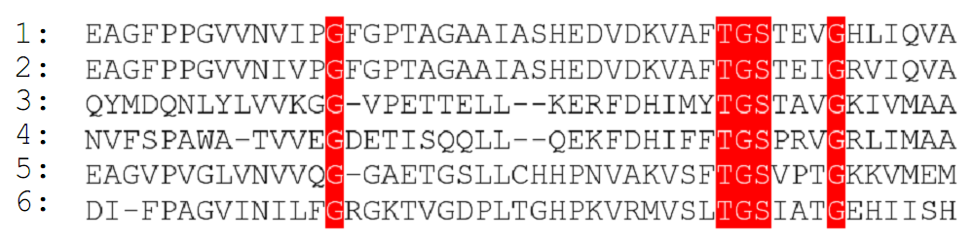
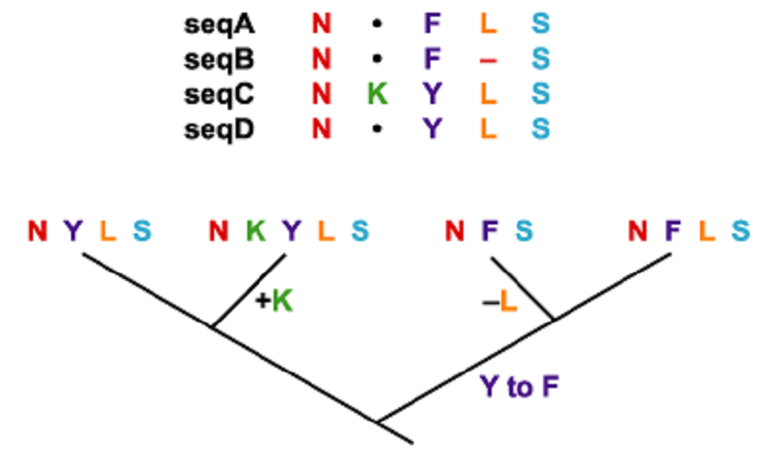
Multiple alignments − 2
An example of a multiple alignment among sequences
Evolutionary significance of a multiple alignment
107

Slide 108
Multiple alignments − 3
The simplest multiple alignment techniques are logical extensions of the dynamic programming methods (like Needleman-Wunsch)
In order to align n sequences an n−dimensional grid is needed
The computational complexity of multiple alignment methods grows rapidly with the number of sequences to be aligned
Even with a considerable computing power based on massive parallelism, multiple alignments of more than twenty sequences, of average length and complexity, represent an intractable problem
Alignment methods guided by heuristics
Clustal
108

Slide 109
Multiple alignments − 4
The Clustal algorithm, proposed by Higgins and Sharp in 1988, implements a progressive alignment, trying to match closely related sequences first, and then adding sequences with growing divergence
A phylogenetic tree is constructed to determine the degree of similarity among the sequences to be aligned
Using the tree as a guide, closely related sequences are aligned in pairs via dynamic programming, to reach the complete multiple alignment
109

Slide 110
Multiple alignments − 5
The selection of an ad hoc score matrix is fundamental in the case of multiple alignments
The use of an inappropriate score matrix will generate a poor alignment
Use of a priori knowledge on the similarity degree of the sequences to be aligned
In ClustalW, the sequences are weighed according to their divergence from the pair of sequences most closely related and the gap penalties and the choice of the score matrix are based on the weight related to each sequence
Another strategy for multiple alignment is that of not penalizing aligned gaps
110

Slide 111
Multiple alignments − 6
Multiple alignments, as well as simple alignments, are based solely on the similarity between nucleotide or amino acid sequences
The similarity between sequences is an important indicator of functional similarities, even if molecular biologists often have additional knowledge about the structure or the function of a particular protein or gene
Information on the secondary structure, on the presence of superficial loops, on the localization of active sites may be used to adjust multiple alignments “by hand”, in order to produce biologically significant results
111

Slide 112
Concluding… − 1
An alignment of two or more genetic or polypeptide sequences represents a hypothesis on the pathway through which homologous sequences have evolved by diverging from a common ancestor
While the evolutionary path cannot be deduced with certainty, alignment algorithms can be used to identify “similarities” that have a low probability to occur at random
The choice of the score function is crucial for the quality of the resulting alignment
Use of score matrices, such as PAM and BLOSUM
112

Slide 113
Concluding… − 2
The Needleman-Wunsch algorithm, for realizing global alignments, and the technique by Smith and Waterman, for local alignments, constitute the fundamental basis on which numerous database search algorithms were built
BLAST
FASTA
Clustal
These algorithms use indexing techniques, heuristics, and fast comparative methods to get a quick comparison between a query sequence and an entire database
113

