Slide 1
Bioinformatics
CS300
Genome annotation
and sequence-based
gene prediction
Fall 2017
Oliver Bonham-Carter

Slide 2

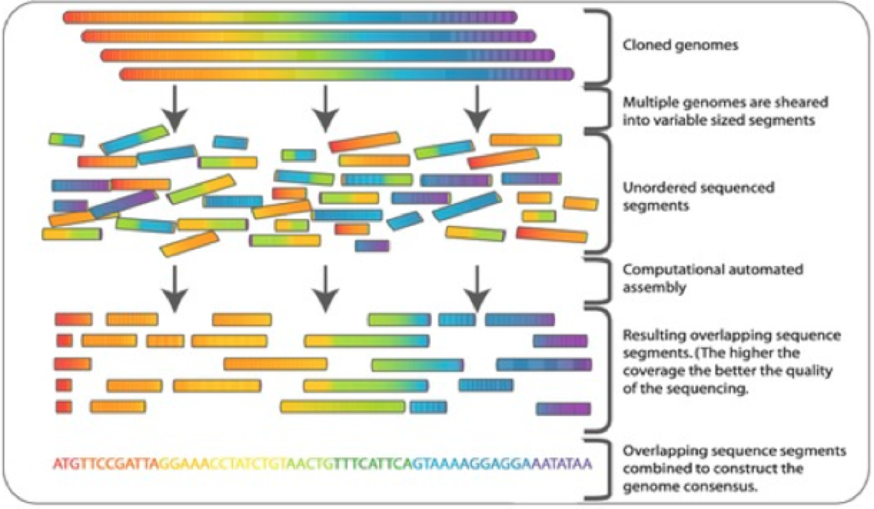
Genome Projects
Goals:
  Determine complete genome sequence of an organism
  Annotate protein-coding genes and other important genome-encoded features
    find
    identify
    characterize
    describe
    computational predictions later confirmed at the lab bench

Slide 3
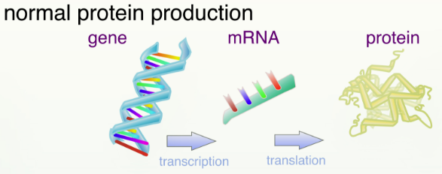
Gene Prediction
Sequence-based – find features based on specific sequences
What does a gene look like?
  Qualities?
  Behaviors?
  Sequence trends?

Slide 4
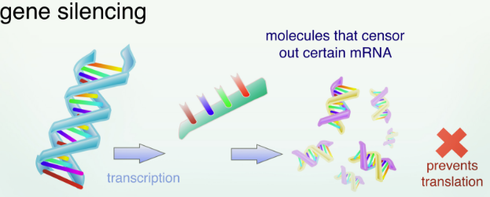
Gene Prediction
Two obvious questions:
Why not just look to see what proteins are available?
Could that tell us what gene must be there to make the protein?

Slide 5
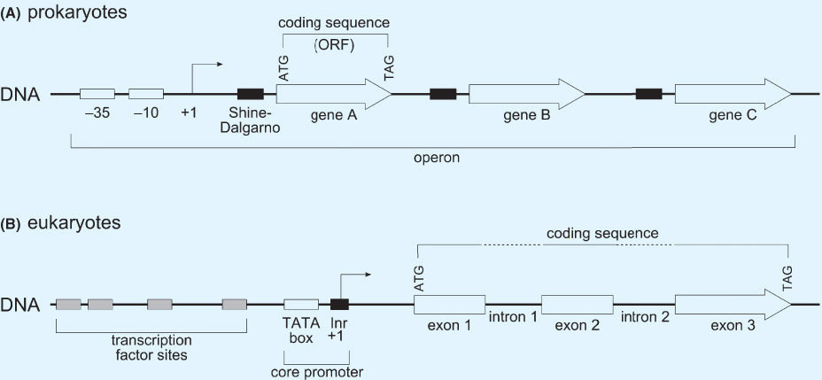
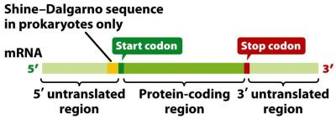
Gene Prediction
We look for specific features or land-marks in a sequence that may suggest that there is a gene at play.
  The Shine-Dalgarno: found of a upstream of a DNA start codon: ATG

Slide 6
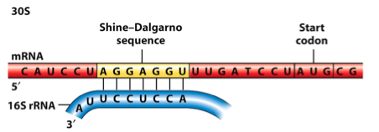
Shine-Dalgarno Sequence
Shine and Dalgarno showed that the nucleotide tract at the 3' end of E. coli 16S ribosomal RNA (rRNA) is pyrimidine-rich and has the sequence: Py-ACCUCCUUA-3'OH.
They proposed that these ribosomal nucleotides recognize the complementary purine-rich sequence AGGAGGU, which is found upstream of the start codon AUG in a number mRNAs found in viruses that affect E. coli.

Slide 7
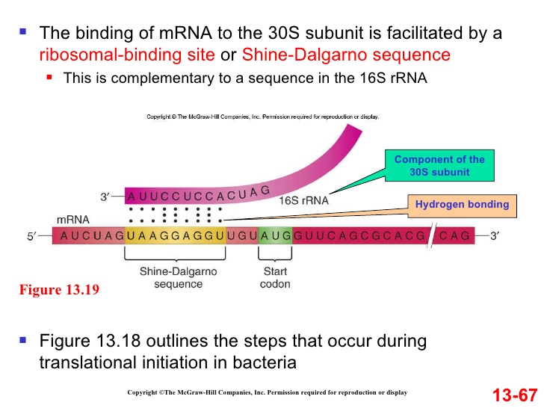
Shine-Dalgarno Sequence

Slide 8
Prediction Algorithms
Alignment-based – find genes/features based on conserved sequences is well-studied organisms (database searching)
  Automatic assignment based on sequence similarity (best BLAST hit): gene name, protein name, function
  Quality vs Quantity

Slide 9
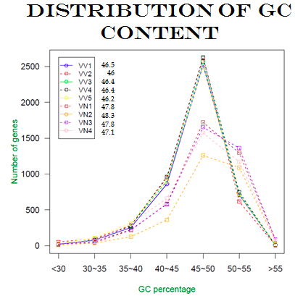
Prediction Algorithms
Content-based – consider overall properties of the sequence when making predictions
nucleotide frequency
Codon frequency/codon bias
GC Content for all V. vulnificus and V.naverensis gene predictions
Most of the genomes contained a high percentage of genes with GC contents between 45-50%.

Slide 10
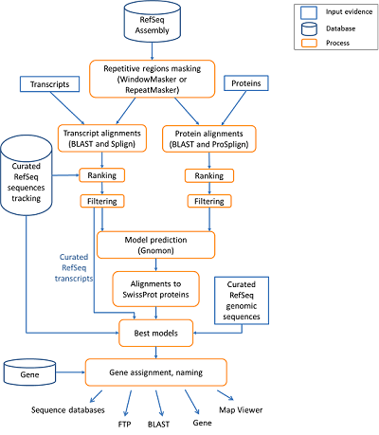
Prediction Algorithms
Probabilistic – combination of sequence-based and content-based plus probability
“annotation pipeline”

Slide 11
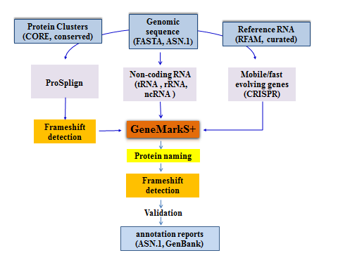
NCBI Prokaryotic
Annotation Pipeline
Combines sequence-based algorithm with alignment-based approach
  Protein-coding genes
  Structural RNAs (5S, 16S, 23S)
  Transfer RNAs
  Small non-coding RNAs
Rely only on properties of DNA and training set of genes
http://www.ncbi.nlm.nih.gov/genome/annotation_prok/process/

Slide 12
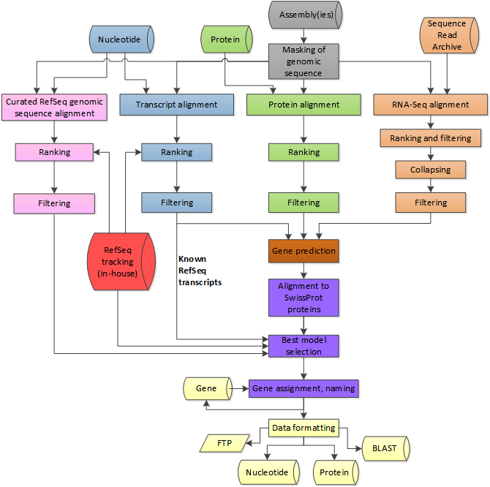
NCBI Eukaryotic
Annotation Pipeline
Masking
  try to identify and ignore non-coding regions
Alignment-based predictions
  Where have we seen this sequence before?
Sequence/content-based predictions from alignment-based
Best selected (probability), named, and released
https://www.ncbi.nlm.nih.gov/genome/annotation_euk/process/#assemblies

Slide 13
NCBI Eukaryotic
Annotation Pipeline
The best models are selected among the RefSeq and the predicted models, named and accessioned (purple).
At the end, the annotation products are formatted and deployed to public resources (yellow).
https://www.ncbi.nlm.nih.gov/genome/annotation_euk/process/#assemblies

Slide 14


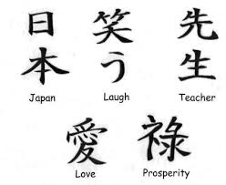
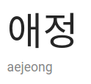

Natural Differences
We can use the general differences in genetic presentation between types of organisms to find meaningful regions (which could be genes)
“Love” in Chinese, Japanese and Korean

Slide 15
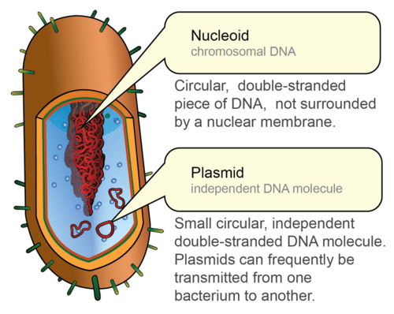
Prokaryotic versus
Eukaryotic Genomes
Prokaryotes
  A circular chromosome
    “Genome”
  Extra DNA in plasmids
    smaller, self-replicating

Slide 16
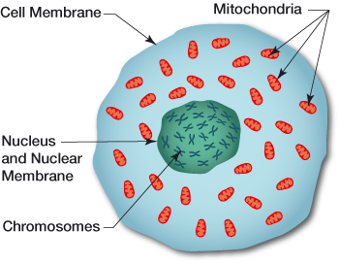
Prokaryotic versus
Eukaryotic Genomes
Eukaryotes
  Multiple linear Chromosomes
    “Genome”
  Extra DNA in Mitochondria/chloroplast

Slide 17
Need to know feature structure
Comparison of Prokaryotes vs Eukaryotes
transcription unit structures

Slide 18
Prokaryotic versus
Eukaryotic Genomes
Organism | Amount of DNA (bp) | # of genes | Genes per million bases
Escherichia coli | 4,600,000 | 4,400 | 950
Saccharomyces cerevisiae | 12,000,000 | 5,800 | 480
Drosophila melanogaster | 180,000,000 | 13,700 | 76
Mus musculus | 2,600,000,000 | 25,000 | 11
Homo sapiens | 2,900,000,000 | 25,000 | 10
Eukaryotic cells
Prokaryotic cells

Slide 19
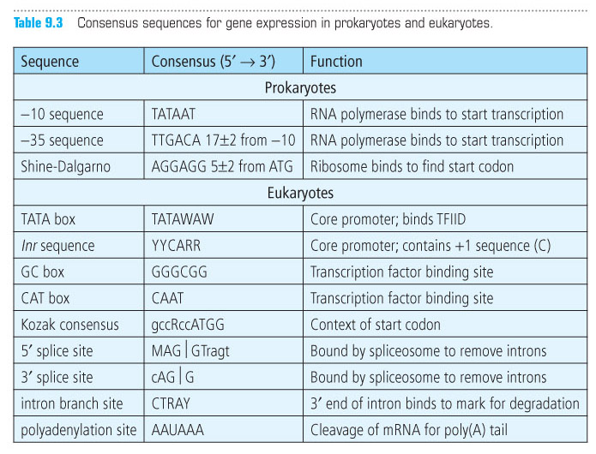
Consensus Sequences

Slide 20
Open Reading Frame
Notes:
ORF – open reading frame – sequence that has the potential to code for a protein
Starts with a start codon – ATG – ends with a stop codon – TGA, TAG, TAA

Slide 21
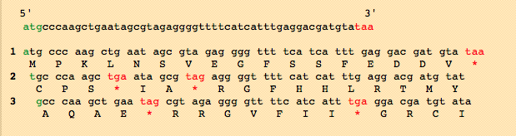
Open Reading Frame (ORF)
Online tools:
  NCBI:
  https://www.ncbi.nlm.nih.gov/orffinder/
Sequence Manipulation Suite:
  http://www.bioinformatics.org/sms2/orf_find.html
Notes:
Every region of DNA has six possible reading frames, three in each direction. Usually longest open reading frame is the one that codes for the gene

Slide 22
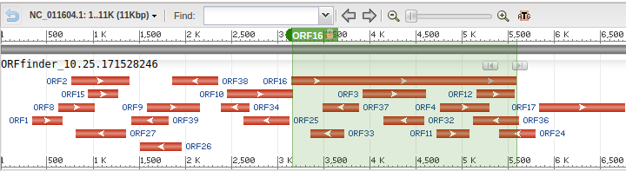
Class Activity: NCBI – ORFfinder
Use NCBI ORF Finder to annotate a plasmid
  https://www.ncbi.nlm.nih.gov/orffinder/
Try: NC_011604
  Salmonella enterica subsp. enterica serovar Westhampton plasmid pWES-1, complete sequence
  What are the red rectangles with the arrows?

Slide 23
Header
This
This

Slide 24
Header
This
This

