Slide 1
Bioinformatics
CS300
Prediction and
Modeling Protein Structure
Fall 2017
Oliver Bonham-Carter

Slide 2

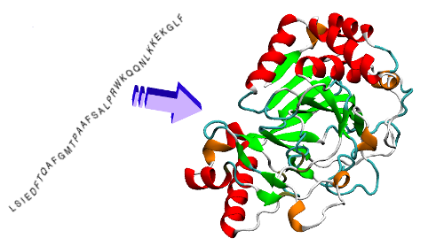
Protein Folding
linear chain of amino acids produced by ribosome during translation
folds into functional, 3D state based on properties of amino acids and structure

Slide 3
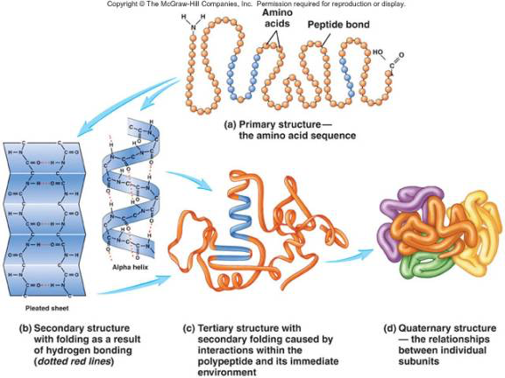
Protein Folding
linear chain of amino acids produced by ribosome during translation
folds into functional, 3D state based on properties of amino acids and structure

Slide 4

Supporting Videos
Protein Folding (3 mins)
  https://www.youtube.com/watch?v=yZ2aY5lxEGE
What is a protein? (3D shape and function, 3 mins)
  https://www.youtube.com/watch?v=qBRFIMcxZNM
Protein folding simulation (3 mins)
  https://www.youtube.com/watch?v=meNEUTn9Atg

Slide 5

Protein Folding - Applications
Protein must fold correctly to function
Misfolded proteins
  Accumulation – Huntington’s and Parkinson’s disease
  Tagged for degradation – emphysema, cystic fibrosis
    Pharmaceutical chaperones – fold mutated proteins to render them functional
Antiviral drug development
  Antibiotics vs antivirals
    Bacteria – cells
    Viruses – invade host’s cells

Slide 6
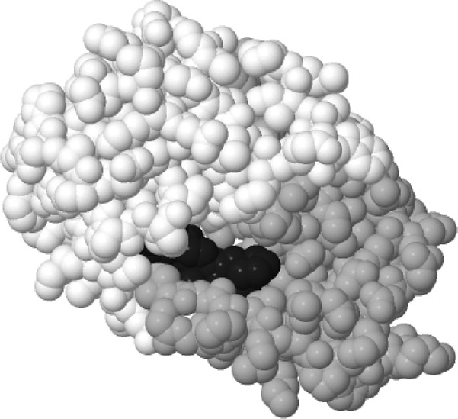
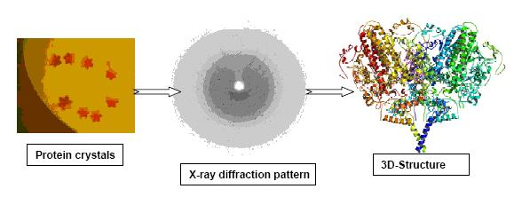
Protein Folding - Applications
Antimicrobial Drugs: helps to...
Be effective against the disease-causing agent
Be selectively toxic
  kill or inhibit the microbe without harming the host
Rational Drug Design: helps to...
  Understand 3-D structure of viral proteins
  Design drugs to fit protein and block function
Laboratory – challenging to predict 3-D structure

Slide 7
Genomics & Computational Structural Biology
Genomics
  Determines the ordered sequence of nucleotides in a genome
  Assigns predicted functions to regions of nucleotides via annotation
Computational Structural Biology
  Takes predicted gene sequence for translation into primary amino acid sequence
  Predicts 3-D protein structure based on primary amino acid sequence
  Note: this step is very difficult because the number of possible outcomes to process and consider is enormous
  The study of structural rules and their contribution to the final mature protein.

Slide 8
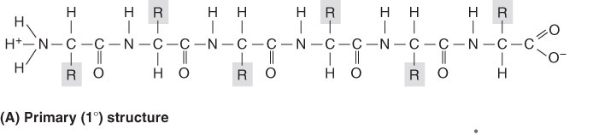
Structural Rules for Protein Folding
Linus Pauling – Studied the limitations on protein folding
  Nature of chemical bonds between amino acids
  Bond angles
  Rotation of atoms
  Flexibility of side chains
Christian B. Anfisen – Studied the influence of thermodynamics of cellular environment

Slide 9
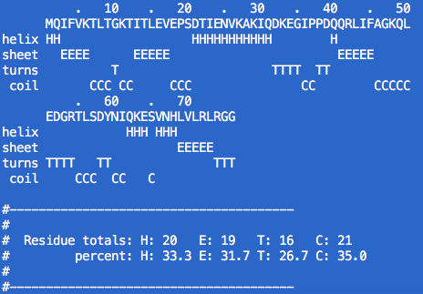
Protein folding : an idea of structure
Garnier (a text-based, command-line tool)
  Inputs protein sequence in fasta format
  Outputs a model of folding in text base
  Usage: garnier file.fasta
H: Helices
E: Sheets
T: Turns
C: Coils

Slide 10
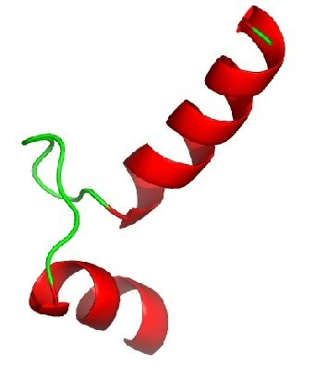
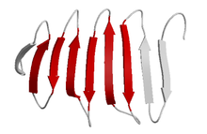
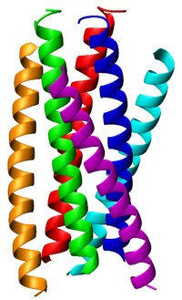
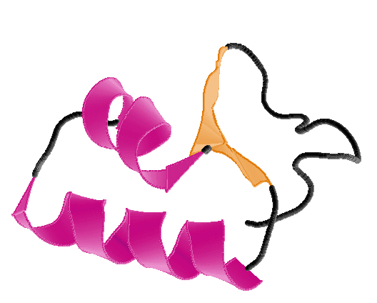
Parts of Protein (Structures)
Helices Sheets
Coils Turns

Slide 11
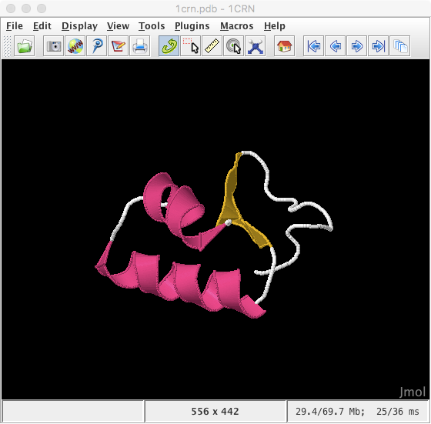

Jmol: A Graphical Viewer
For Protein Sequences
http://jmol.sourceforge.net/
http://wiki.jmol.org/index.php/Jmol_Application#Installing_Jmol_Application

Slide 12
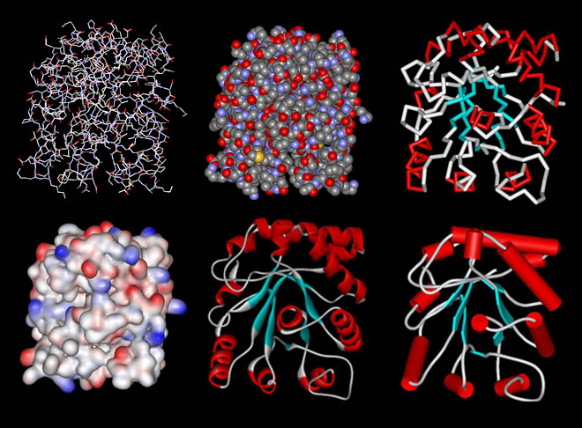
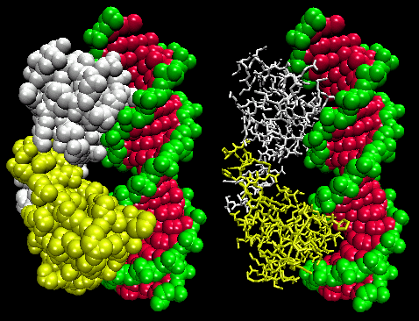
Protein DataBase (PDB)
Database for 3-D structural data of large biological molecules
https://www.rcsb.org/
Data is viewable using jmol.

Slide 13

Python Programming
Biopython
DNA Manipulation Algorithm
Translation functions
  DNA → RNA
  RNA → DNA
  RNA → Protein
Follow along in
class and save
your notes in
a text file!!
  Follow along and Save your notes in a text file.

Slide 14
Header
This
This

