Slide 1
Bioinformatics
CS300
Domains according
to UniProt and String
Fall 2017
Oliver Bonham-Carter

Slide 2

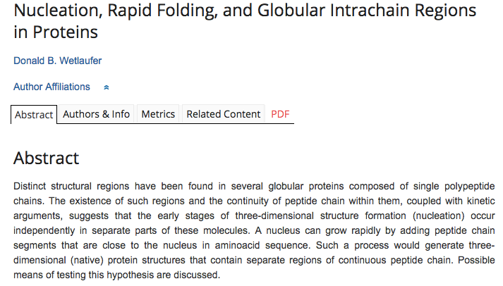

Proteins Fold Into Specific
Structures for Functionality
Different regions in same protein (domains) performing specific tasks.

Slide 3
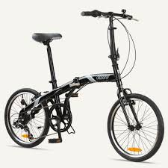
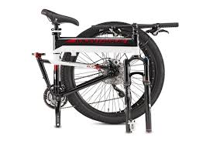
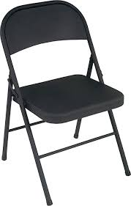

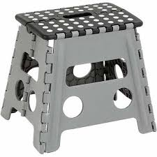
Structures For Functions
This
This

Slide 4

Structures for Functions
Windows to allow driver to see
out while driving
Ventilation
for cooling
Headlights for
driving at night
License plate:
for Identification
Door for letting
driver into the car
Wheels,
necessary
for mobility

Slide 5
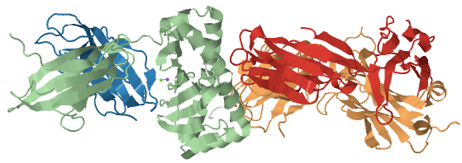
Proteins Also Have Specific
Functional Regions, Too!
Protein Data Bank:
5WLG

Slide 6
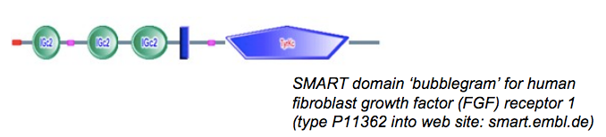
Domains
A protein domain is a conserved part of a given protein sequence and (tertiary) structure.
Can evolve, function, and exist independently of the rest of the protein chain
Each domain forms a compact three-dimensional structure
Often can be independently stable and folded.
http://slideplayer.com/slide/6923398/

Slide 7
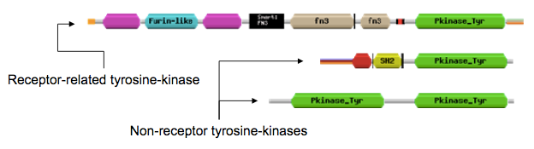
Protein Modularity
Discrete functional units
Found domains do not occur in the same order across proteins.
Domains are considered separately in protein function predictions
http://slideplayer.com/slide/6923398/

Slide 8
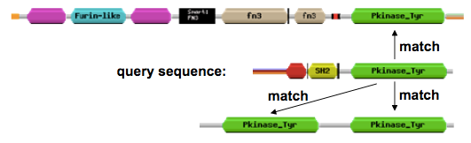
Finding a Domain?
Alignment across proteins may show domains
Use databases to match similar parts of proteins
  Pfam, Smart, Interpro and others

Slide 9
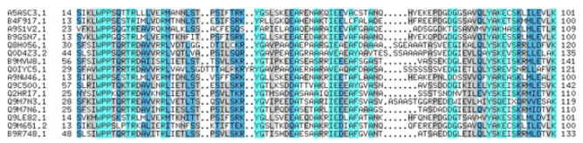
Alignment?!
Provide more info about a protein’s family, relatedness and other details.
Domain landmarks include: low-complexity or disorder to suggest that these regions may have a specific syntax or pronounced grammar.
http://slideplayer.com/slide/6923398/

Slide 10
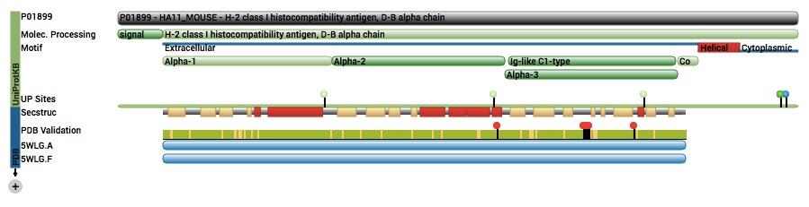
Domains By PDB
Domains give the protein special qualities:
  Domain Names: Alpha1, Alpha2, Alpha3, Ig-like C1-type
  Protein Data Bank ID: 5WLG
  https://www.rcsb.org/pdb/explore/explore.do?structureId=5WLG

Slide 11
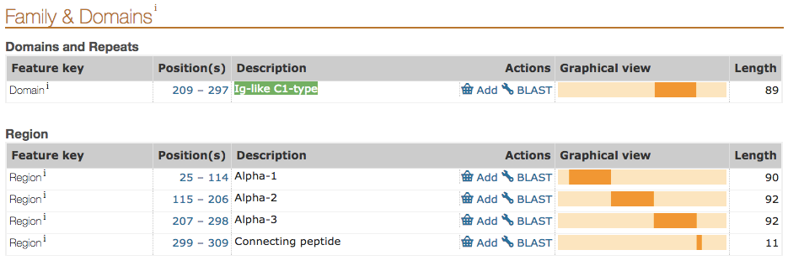
Domains By Uniprot
Domains give the protein special qualities:
  Domain Names: Alpha1, Alpha2, Alpha3, Ig-like C1-type
  UniProt ID: P01899
      A Protein Knowledge Base
      http://www.uniprot.org/uniprot/P01899#family_and_domains

Slide 12
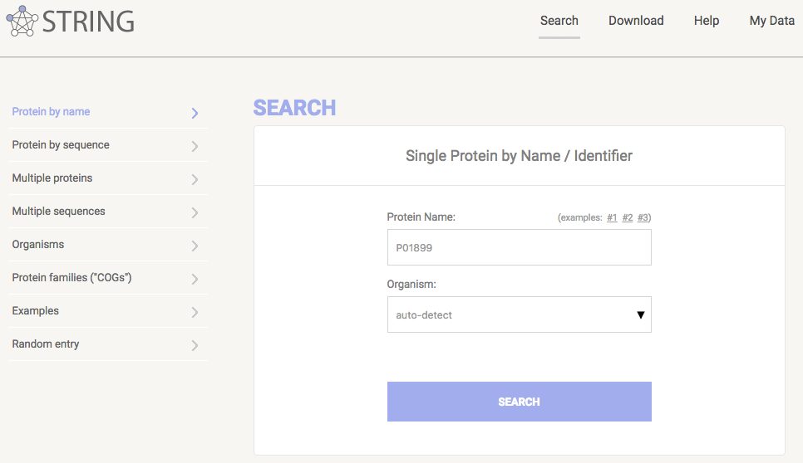
The String Database
For Analysis
String DB ID P01899
http://string-db.org/
https://string-db.org/

Slide 13
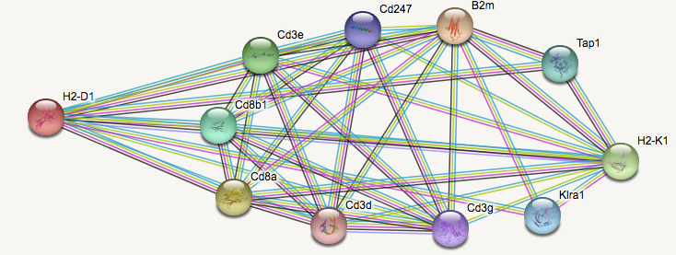
The String Database
For Analysis
How is a particular protein related to others?
Can we determine this by criteria?

Slide 14
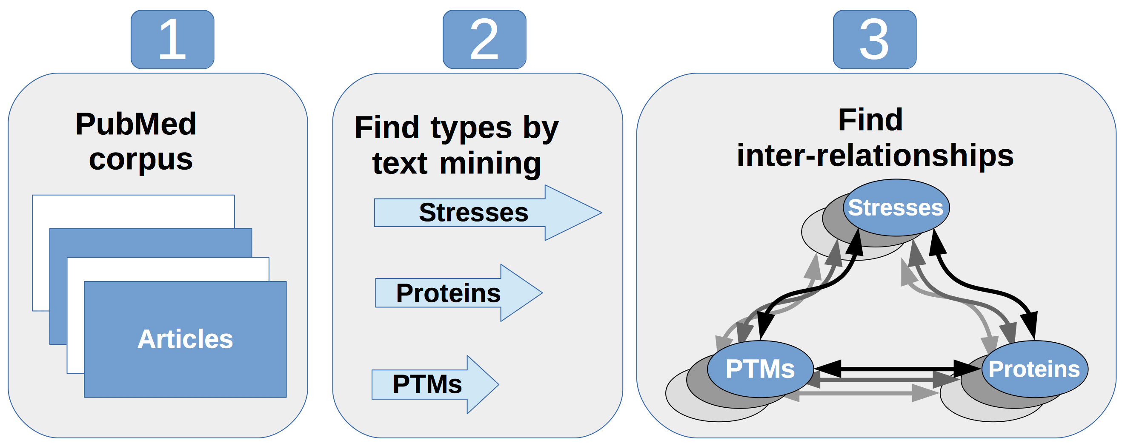
Criteria to Determine Relations
There are many ways to measure the distance
between two different proteins
  Text Mining

Slide 15
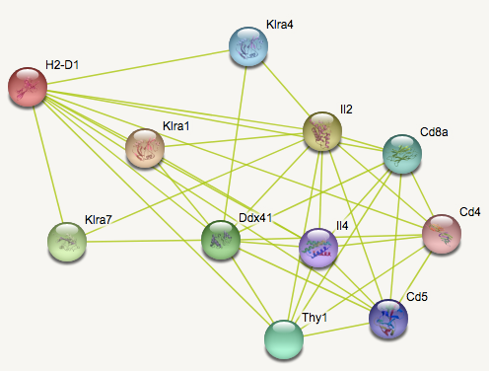
String: by Text Mining
Mentioned by name in articles

Slide 16
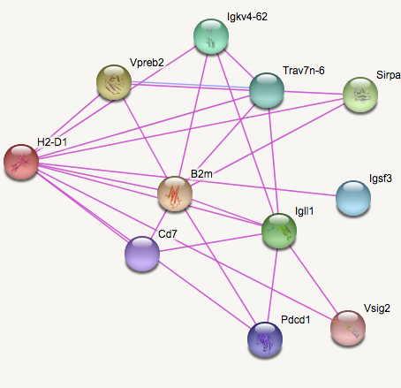
String: Linked Experimentally
Experiments performed to show one protein is related to another

Slide 17
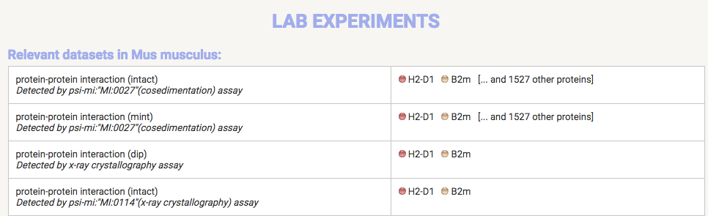
String: Linked Experimentally
Learn about the experiments

Slide 18
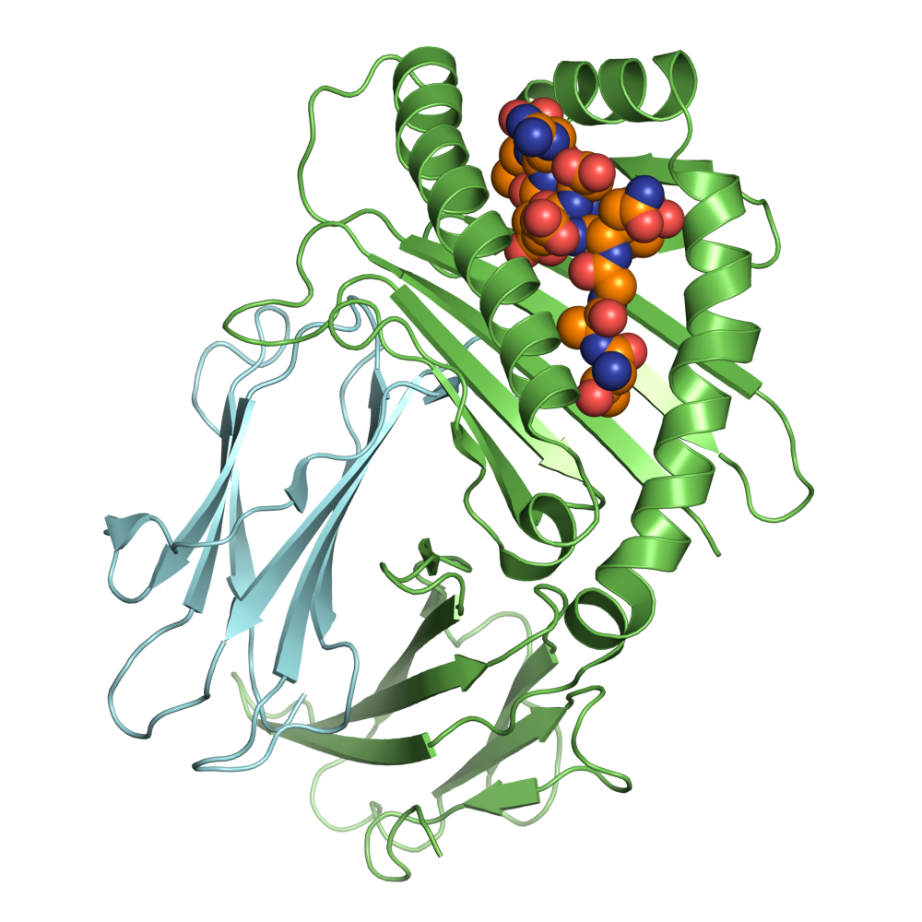
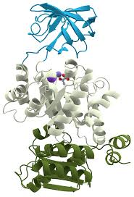
Criteria to Determine Relations
Other ways to measure the distance
between two different proteins
  Neighborhood
  Experiments
  Databases
  Co-Expression
  And others...

Slide 19


Header
Pick your favorite protein and head over to:
  http://www.uniprot.org/
  example: P01899
Then check out the networks at:
https://string-db.org/

Slide 20

Python Programming
Biopython
DNA Manipulation Algorithm
Translation functions
  DNA → RNA
  RNA → DNA
  RNA → Protein
Follow along in
class and save
your notes in
a text file!!
  Follow along and Save your notes in a text file.

Slide 21
Header
This
This

