Slide 1
Bioinformatics
CS300
Exam 3
Fall 2017
Oliver Bonham-Carter

Slide 2

On Exam 3
Thursday, 30th November 2017
Gene prediction algorithms
  Qualities and applications for each
Prokaryote / Eukaryote gene structure general differences
Intron and Exon structures, differences and similarities
Codon usage across organisms
CpG Islands
GCPlot coding concepts
Protein folding concepts
Jmol
Website major tools and applications
  Protein Data Bank: www.rcsb.org
  String data base: string-db.org
  UniProt: www.uniprot.org

Slide 3
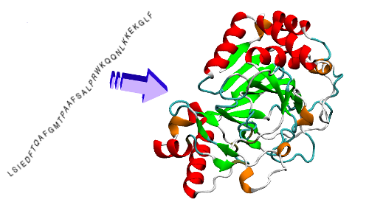
Protein Folding
linear chain of amino acids produced by ribosome during translation
folds into functional, 3D state based on properties of amino acids and structure

Slide 4

Python Programming
Biopython
DNA Manipulation Algorithm
Translation functions
  DNA → RNA
  RNA → DNA
  RNA → Protein
Follow along in
class and save
your notes in
a text file!!
  Follow along and Save your notes in a text file.

Slide 5
Header
This
This

