Slide 1
Bioinformatics
CS300
The Great Review
Fall 2017
Oliver Bonham-Carter

Slide 2

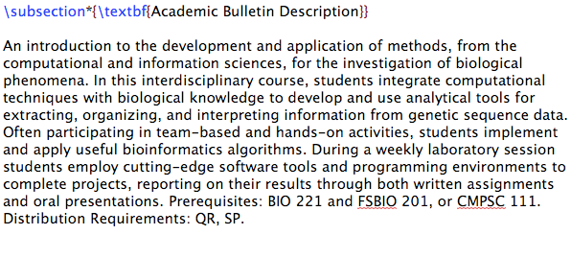
Course Summary
This
This

Slide 3
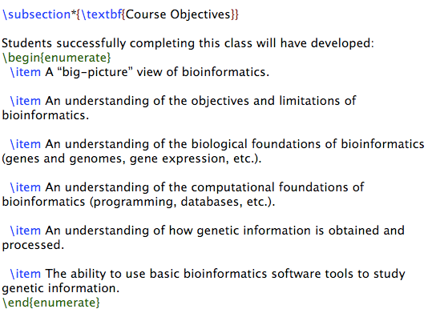
Course Objectives
This
This

Slide 4

How Did We
Meet Our Objectives?
Let’s go back and
revisit some of our
discussions and slides.

Slide 5
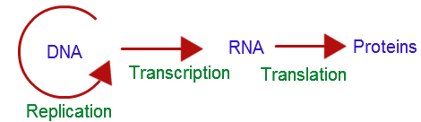
The Central Dogma
Fundamental
“the coded genetic information hard-wired into DNA is transcribed into individual transportable cassettes, composed of messenger RNA (mRNA); each mRNA cassette contains the program for synthesis of a particular protein (or small number of proteins)“ - NCBI

Slide 6
We Started With ...
The Central Dogma
Of Biology

Slide 7


The Central Dogma of Molecular Biology

Slide 8

Transcription
Transcribe specific regions of DNA – genes
  Human genome ~25,000 genes (just 1.5% of genome)
RNA is the direct product of transcribing a gene (DNA)
  DNA -> RNA
  same language (nucleotides)
Messenger RNA (mRNA)
Transfer RNA
(tRNA)
Ribosomal RNA (rRNA)

Slide 9

The Genetic Code: RNA into Protein
Triplet code
  Combinations of three nucleotides code for one amino acid
  Three nucleotides = codon
Redundancy
  Sometimes >1 codon codes for same amino acid
  20 amino acids, 64 possible codons
Start and Stop codons
  First codon of many transcripts is “AUG”, which codes for methionine
  Codons UAA, UAG, and UGA indicate the end of the transcript

Slide 10

Translation
The information from DNA is rewritten in a new language: RNA
Antisense strand
Sense strand

Slide 11
We Talked About...
Data Generation:
Or where the data
comes from for research
in bioinformatics

Slide 12
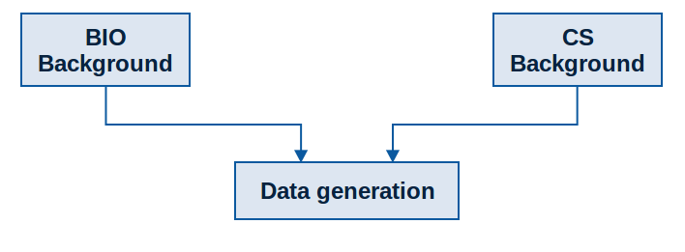
Course Outline
The Central Dogma of
Biology makes-up lots
of data.

Slide 13
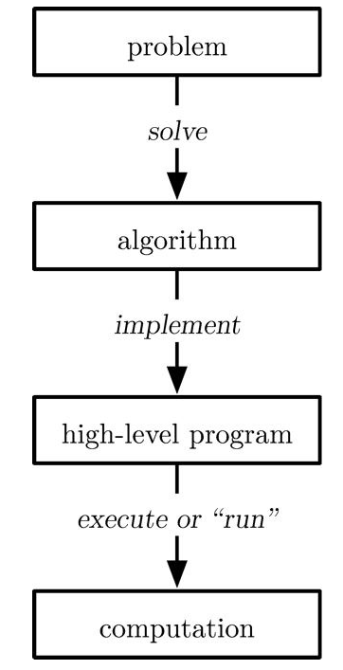
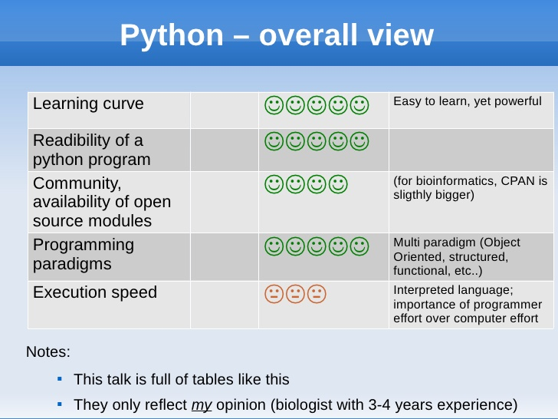
Computation

Slide 14



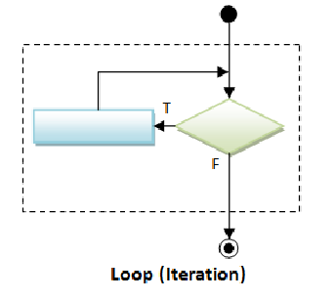
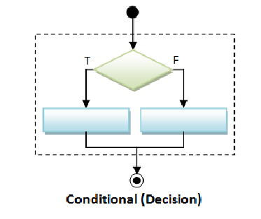
Computation: How to Use

Slide 15
We Talked About...
Databases:
Places where data
is stored for further
research

Slide 16
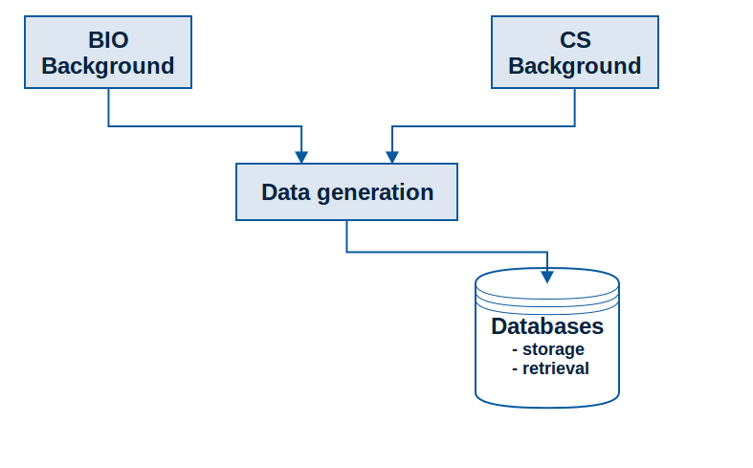
Course Outline

Slide 17
Biological Data and Databases
To learn how to use a Web-based genomic databases and tools.
To understand the types of information stores in genomic databases.
To learn how to use different interfaces to find and retrieve genomic information.
Write Python program to find patterns (start and stop codons) in DNA sequences

Slide 18
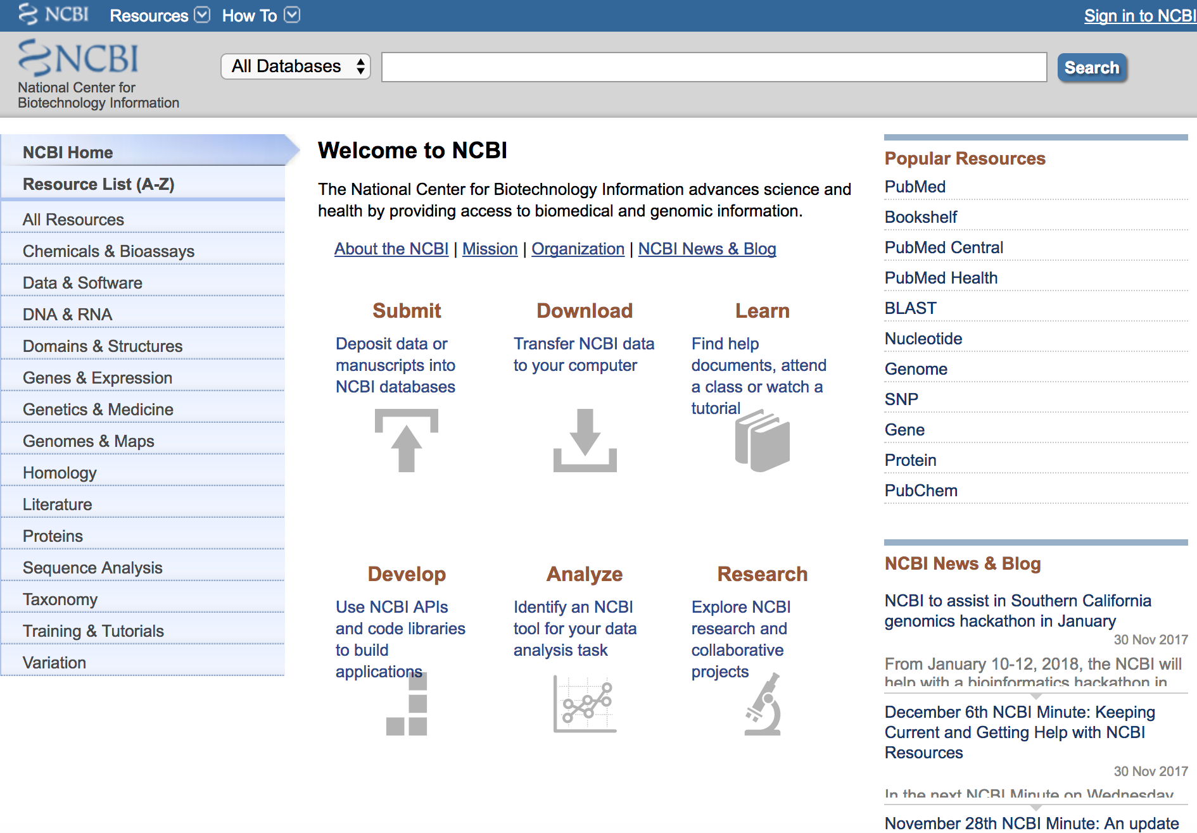
Biological Databases
NCBI Browser

Slide 19
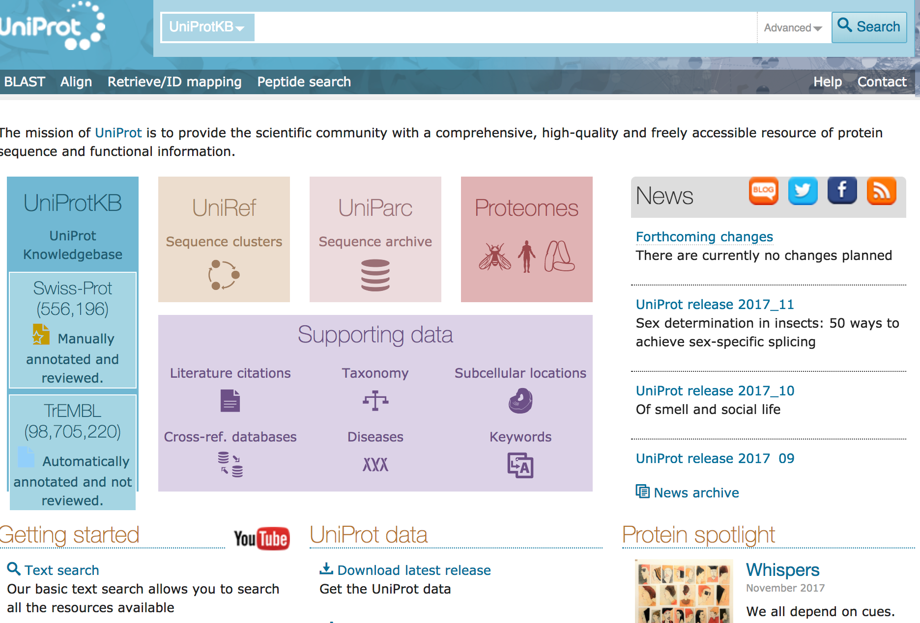
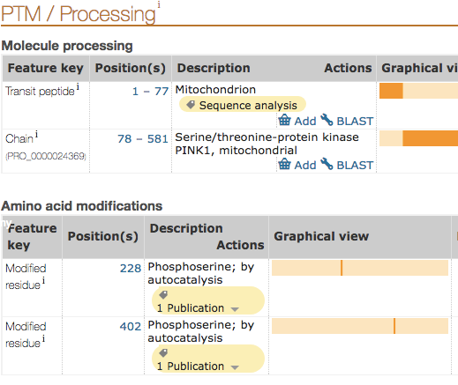
Biological Databases
UniProt Browser

Slide 20
We Talked About...
Data Manipulation:
How we begin to find
meaning in the data

Slide 21
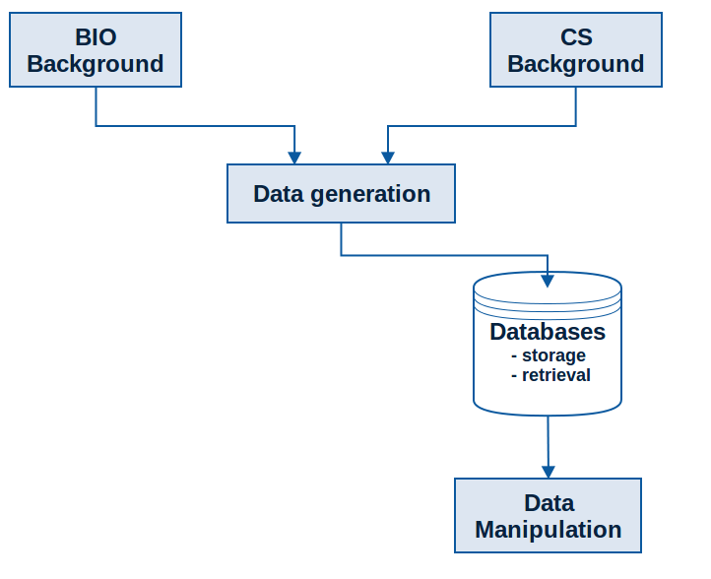
Course Outline

Slide 22
Data Manipulation
To become familiar with tools that can be used to manipulate sequences in a variety of ways and make basic comparisons between sequences
Understand the structure and orientation of string representations of DNA and protein sequences
Gain experience with string manipulation using Python and its application to DNA and protein sequence data.
Understand how genetic information is computationally decided and appreciate the important complications in working with sequences (introns/exons, start codons, template/nontemplate strand orientation, etc)

Slide 23
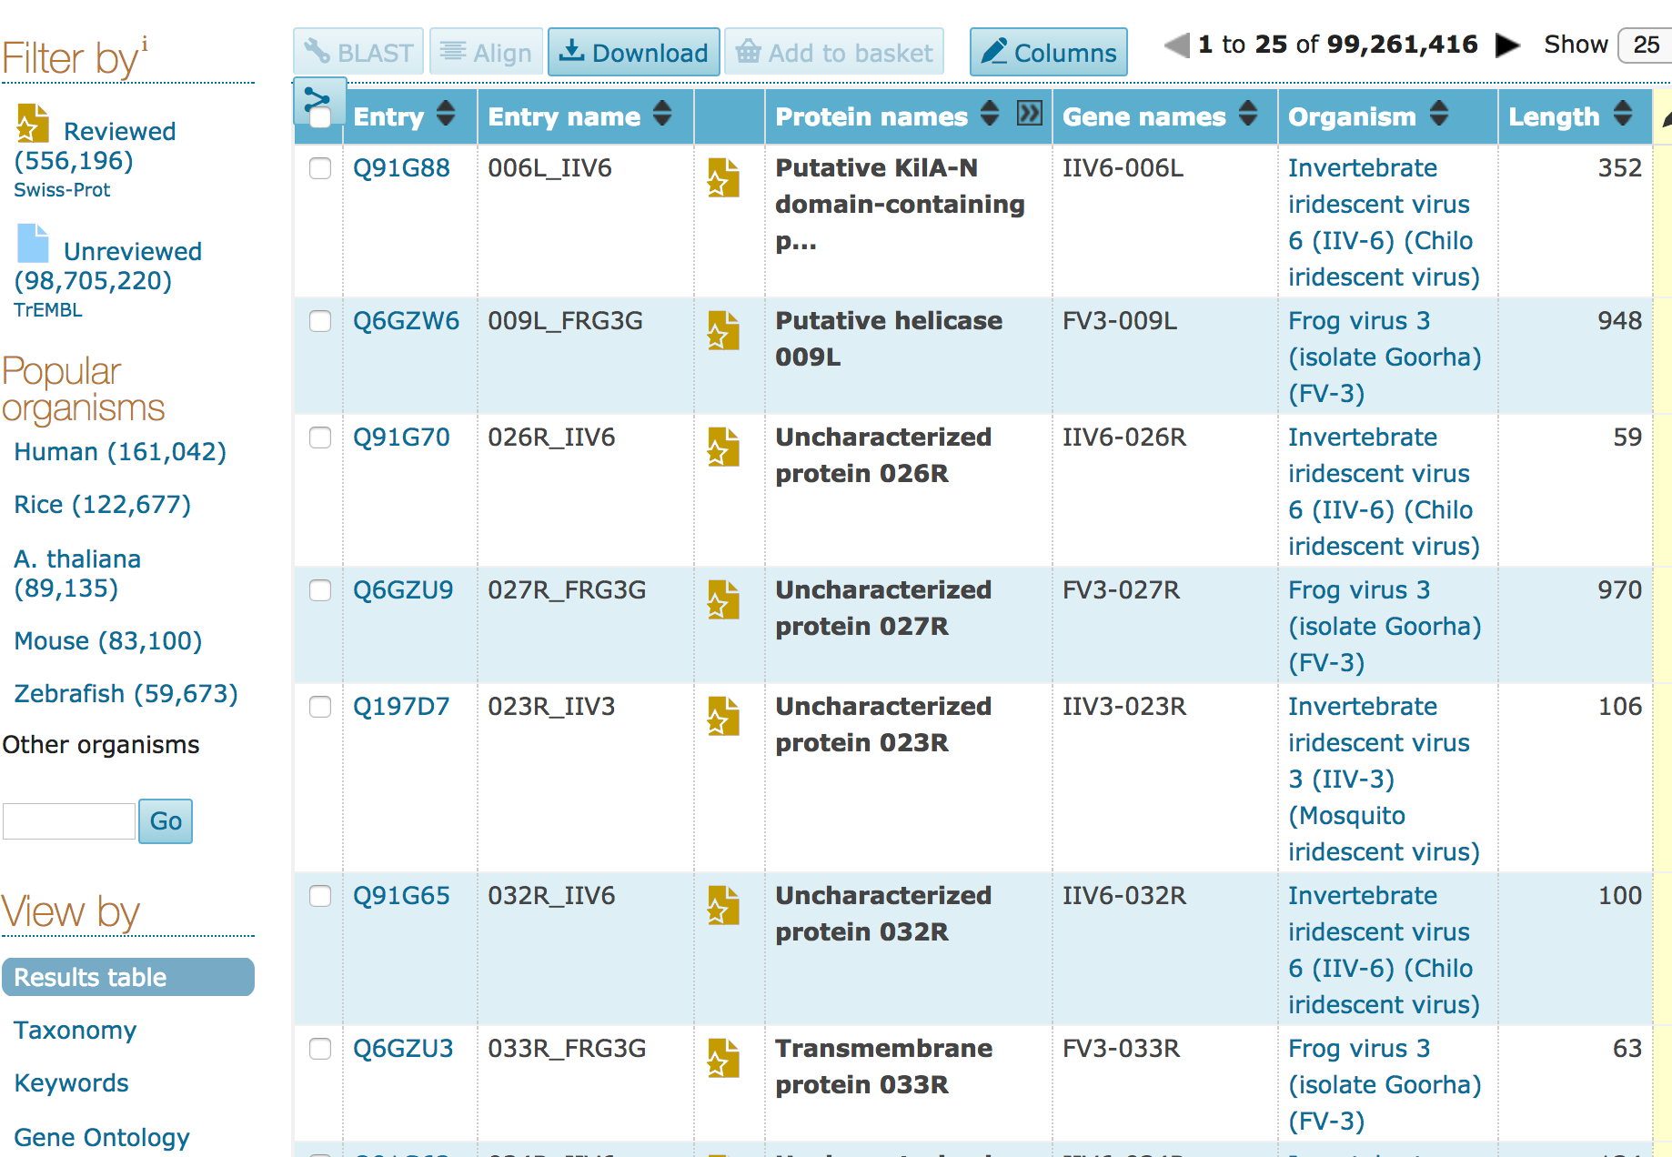
Databases...
UniProt Browser

Slide 24
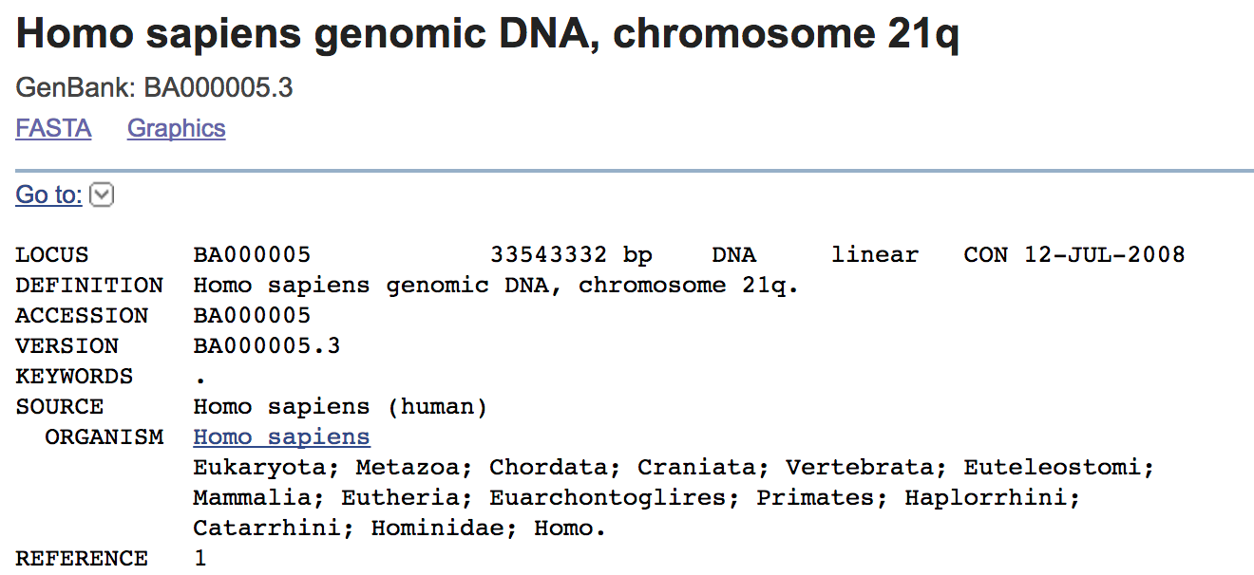
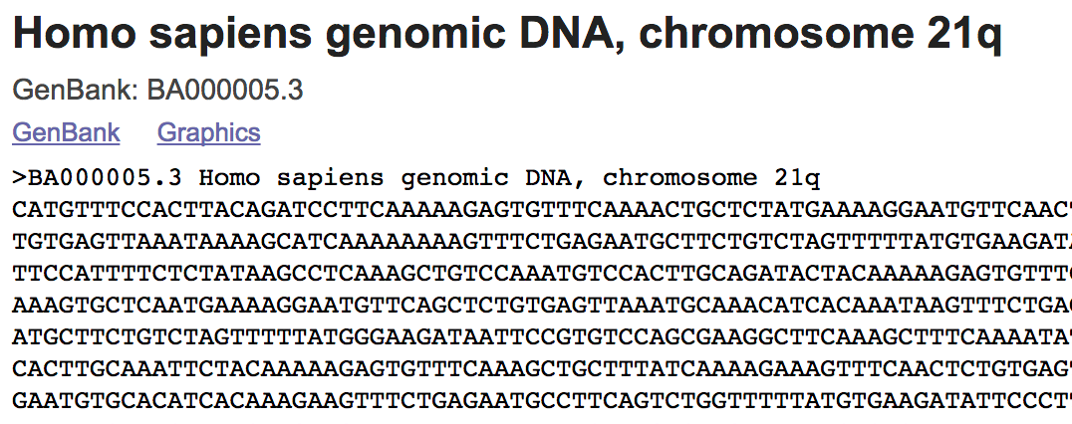
Pulling Data From Databases...

Slide 25
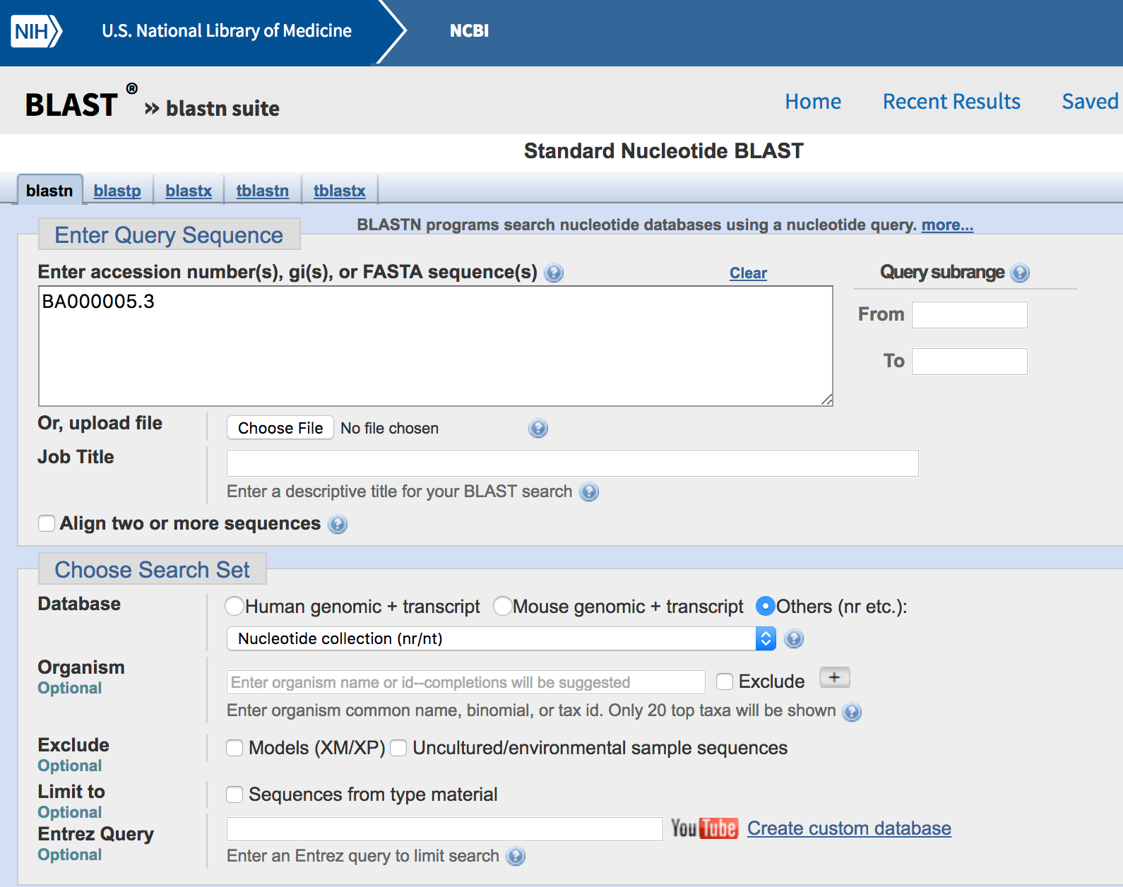
Tools from Databases

Slide 26
We Talked About...
Sequence Alignment:
Comparing sequences
to discover similarities
and differences

Slide 27
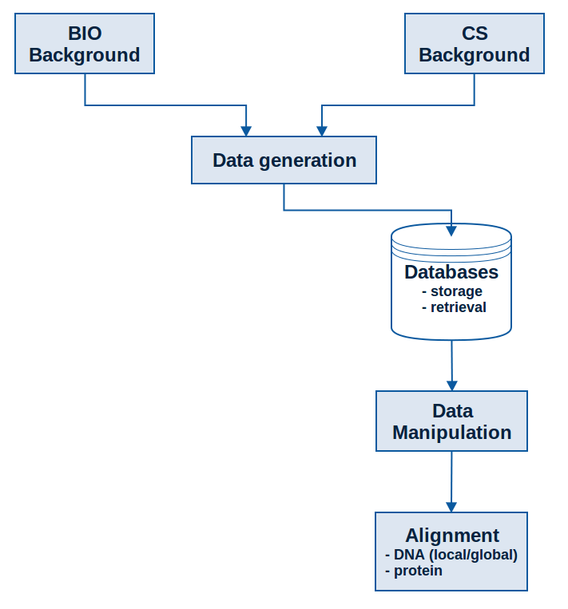
Course Outline

Slide 28
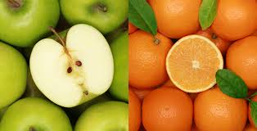
Alignment to Compare ...
DNA sequences
Genes
Proteins
Organisms
Why do we compare these things?
What is there to learn when we find that two things are the same? Not the same?

Slide 29
Sequence Alignment
DNA - Nucleotides
To understand the value of aligning genes and recognize the practical applications of this technique.
To gain familiarity with the use of Web-based alignment tools to explore sequence similarity and understand how to modify their parameters.
To know how the Needleman-Wunsch algorithm optimally aligns any two sequences.
Understand how the Needleman-Wunsch algorithm can be modified to yield other alignments.

Slide 30
Example Alignment score = 0
Let:
Match = +1
Mismatch = 0
Gap = -1
 |  | C | A | C | G | T | A | T
 | 0 | -1 | -2 | -3 | -4 | -5 | -6 | -7
C | -1 | 1 | 0 | -1 | -2 | -3 | -4 | -5
G | -2 | 0 | 1 | 0 | 0 | -1 | -2 | -3
C | -3 | -1 | 0 | 2 | 1 | 0 | -1 | -2
A | -4 | -2 | 0 | 1 | 2 | 1 | 1 | 0
CACGTAT
--CGCA-
CACGTAT
C--GCA-
CACGTAT
CGC--A-

Slide 31
Alignment to Compare Regions
We learn to scan millions of unknown DNA sequences to find familiar genes.
Does gene have same function in each sequence? Same origin?
Gene A
Seq1
Seq2
Gene A is found in this unknown sequence

Slide 32
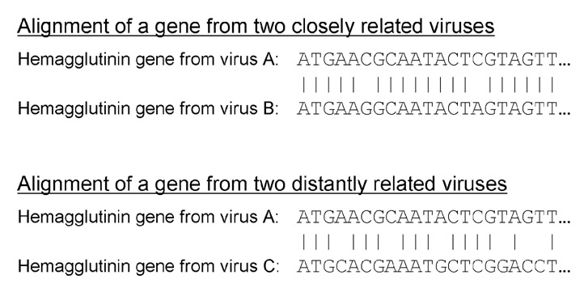
Pairwise Alignment
Similarity and Relatedness
This
Few Mismatches
Lots of Mismatches

Slide 33
Sequence Alignment
Protein – Amino Acids
Understand the use of a substitution matrix to score amino acid similarity in a protein sequence alignment.
Gain experience using protein alignment to develop hypotheses about protein function based on sequence similarity.
Know how protein alignment differs algorithmically from DNA alignment.
Know how substitution matrix is developed and how different matrices might be used to produce better alignments in particular situations.

Slide 34
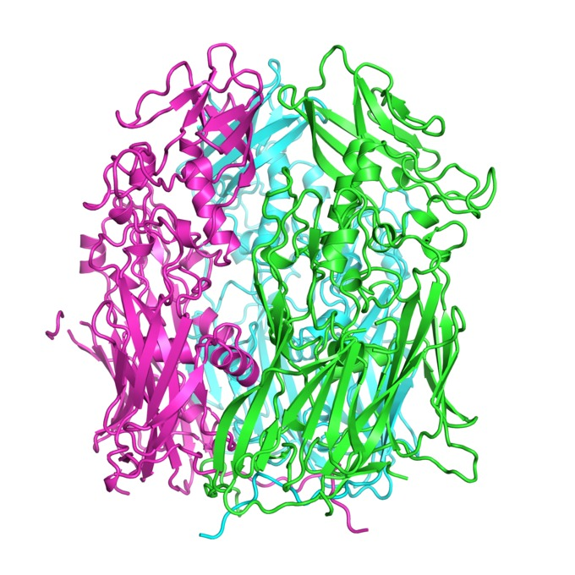
Comparing Protein
Two proteins (wildtype, non-wildtype) are compared to find causes of disorder.
Healthy
Unhealthy

Slide 35
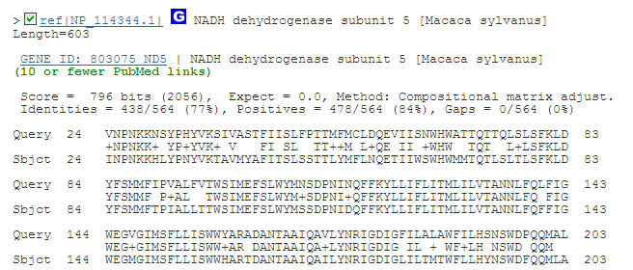
Aligning Sequences
NCBI – PROTEIN BLAST

Slide 36

What is Mutation?
Aligning Sequences
To Locate Mutations
A natural process that changes the DNA sequence
A common process
  during replication of the human genome a “typo” occurs every 100,000 or so nucleotides
  that’s about 120,000 typos each time one of our cells divides
  most are repaired

Slide 37
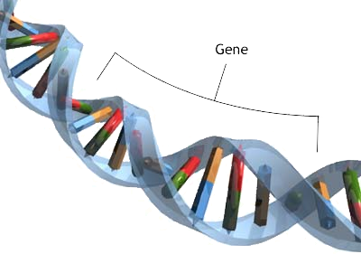
Bioinformatics:
The Study of DNA
DNA is the genetic material that houses genetic information.
Genes are written in this language
Understanding DNA allows us to understand how genes work.

Slide 38
We Talked About...
Genome annotation:
Finding relevant
regions in sequences

Slide 39
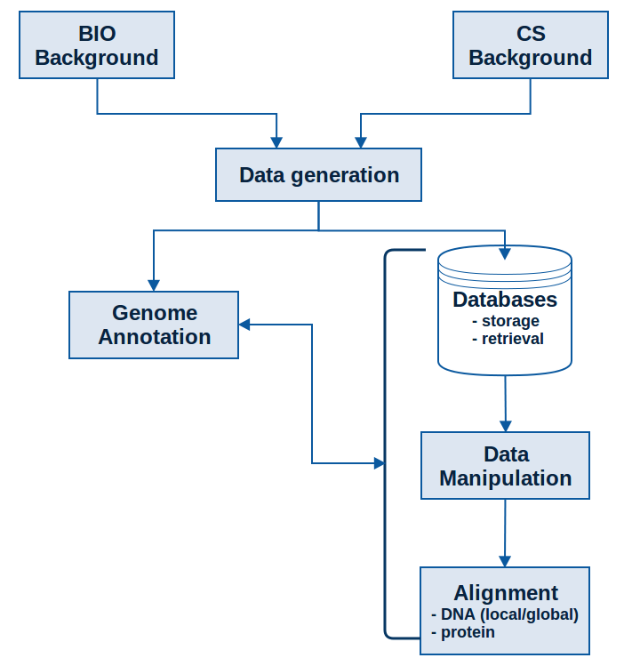
Course Outline

Slide 40
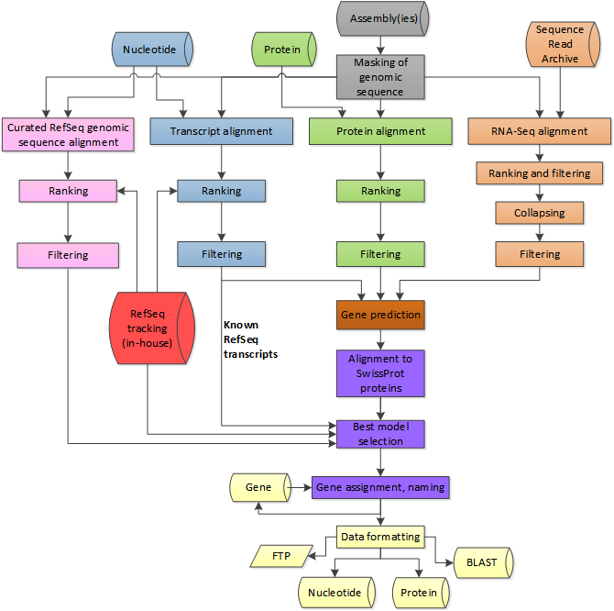
Genome Annotation: Algorithms
Alignment-based
Sequence-based
Content-based
Probabilistic
Be able to combine content-based and probabilistic methods of gene discovery to identify the most probable locations of introns and exons in a eukaryotic DNA sequence

Slide 41
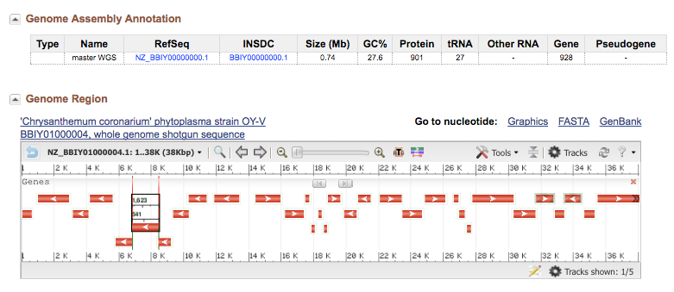
Genome Annotation
Locate genes for proteins in sequences.
https://www.ncbi.nlm.nih.gov/genome/browse/

Slide 42
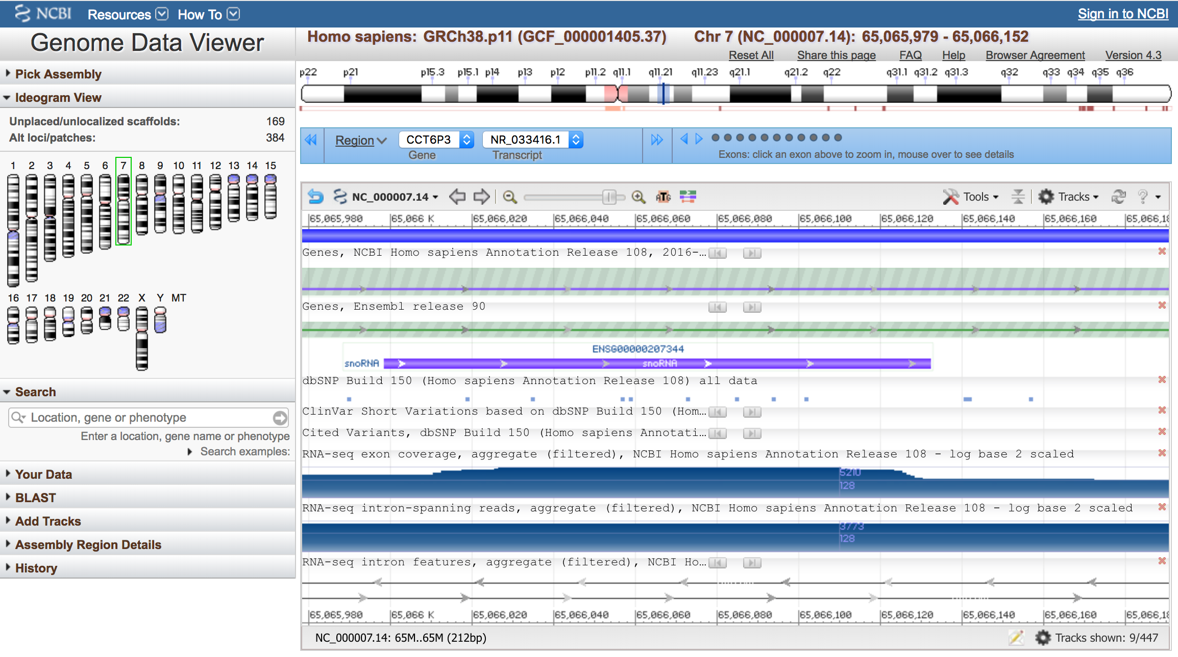
Genome Annotation
https://www.ncbi.nlm.nih.gov/genome/gdv/browser/?context=Nucleotide&acc=NR_145729.1

Slide 43
Genome Annotation
alignment-based
sequence-based
content-based
probabilistic
New data – deposited into databases such as NCBI

Slide 44
We Talked About...
Protein Prediction:
Determining what
protein exist in a
sequence and how they
might behave.

Slide 45
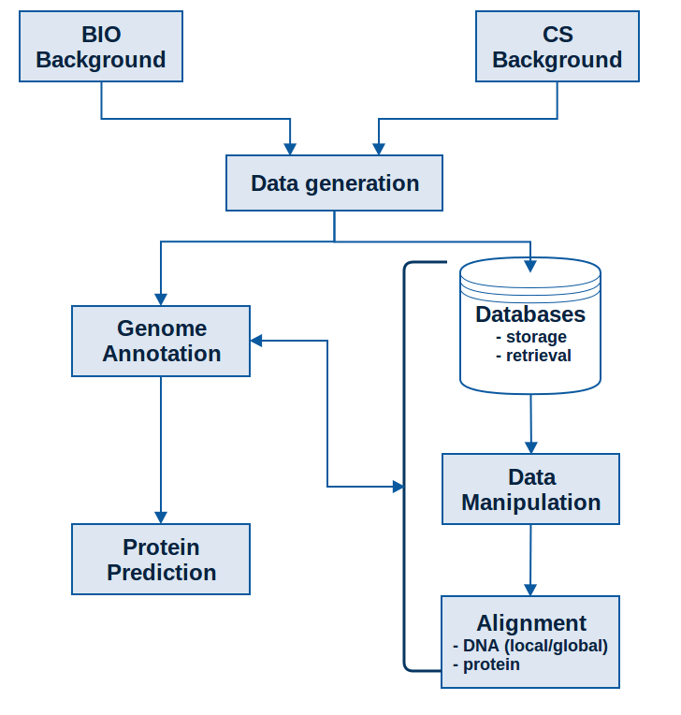
Course Outline

Slide 46
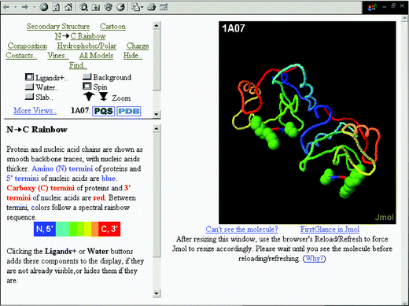
Protein Prediction
Know how to use available tools to examine the experimentally determined structures of proteins and visualize structural an functional features
Appreciate the value and limitations of predicting 3-D structure from sequence alone

Slide 47
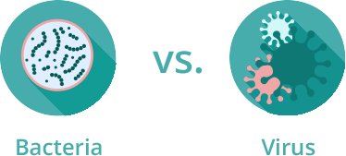
Protein Folding - Applications
Protein must fold correctly to function
Misfolded proteins
  Accumulation – Huntington’s and Parkinson’s disease
  Tagged for degradation – emphysema, cystic fibrosis
    Pharmaceutical chaperones – fold mutated proteins to render them functional
Antiviral drug development
  Antibiotics vs antivirals
    Bacteria – cells
    Viruses – invade host’s cells

Slide 48
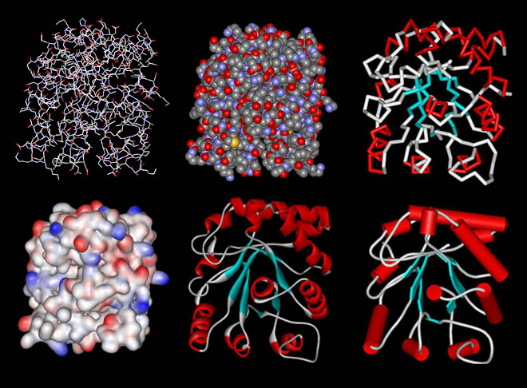
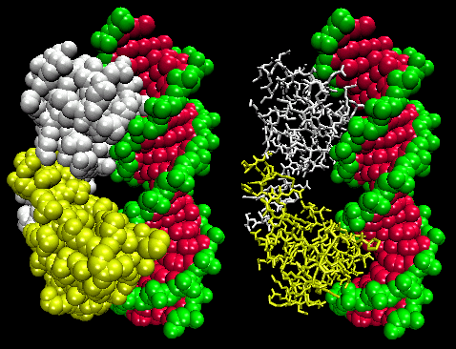
Protein DataBase (PDB)
Database for 3-D structural data of large biological molecules
https://www.rcsb.org/
Data is viewable using jmol.

Slide 49
In Closing ...
Bioinformatics
is diverse
and exciting!

Slide 50
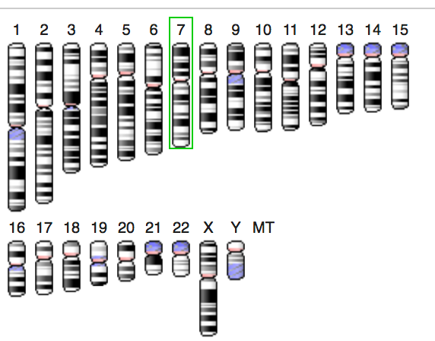
Bioinformatics Accomplishments
A “big-picture” view of bioinformatics.
An understanding of the objectives and limitations of bioinformatics.
An understanding of the biological foundations of bioinformatics (genes and genomes, gene expression, etc.).

Slide 51
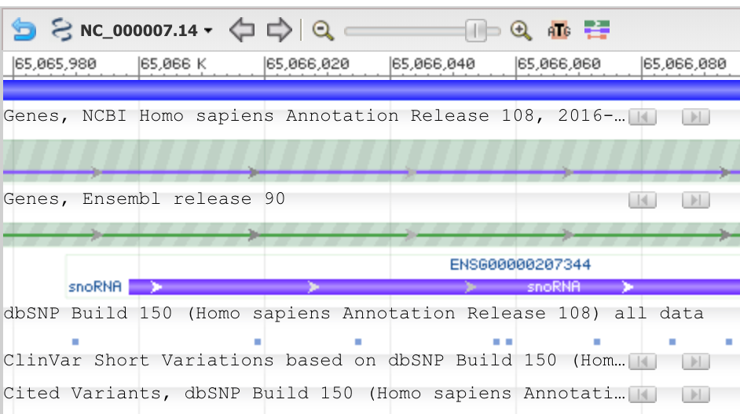
Bioinformatics Accomplishments
An understanding of the computational foundations of bioinformatics (programming, databases, etc.).
An understanding of how genetic information is obtained and processed.
The ability to use basic bioinformatics software tools to study genetic information.

Slide 52
What’s Next?
Bioinformatics could
provide you with a
satisfying career and
plenty of room to
advance

Slide 53
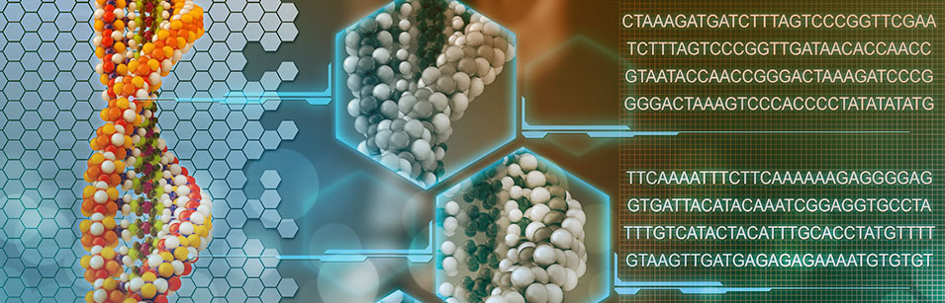
The Value of the
Bioinformatics Skills
There is a great need for Bioinformaticians!

Slide 54

Skills in Careers
Biologists:
  Computational skills
  Mathematical /statistical
  Programming for Automation
Computer scientists
  BioMedical skills
  Understanding of biological systems and mechanisms
  Early detection of disease by data
  Modeling of therapeutic remedies
  Others

Slide 55


Skills in Careers
Software (bioinformatics) engineer
Research scientist in biotechnology
Data scientist
Project manager (pharmaceuticals, medical, etc)
Computational immunologist
Medical doctor (in clinical and research applications)

Slide 56
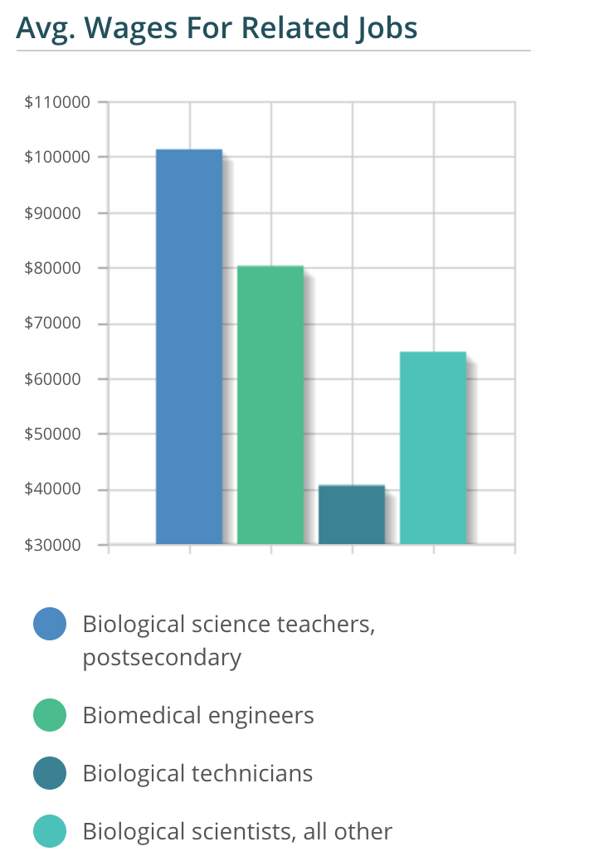
High Paying Careers

Slide 57
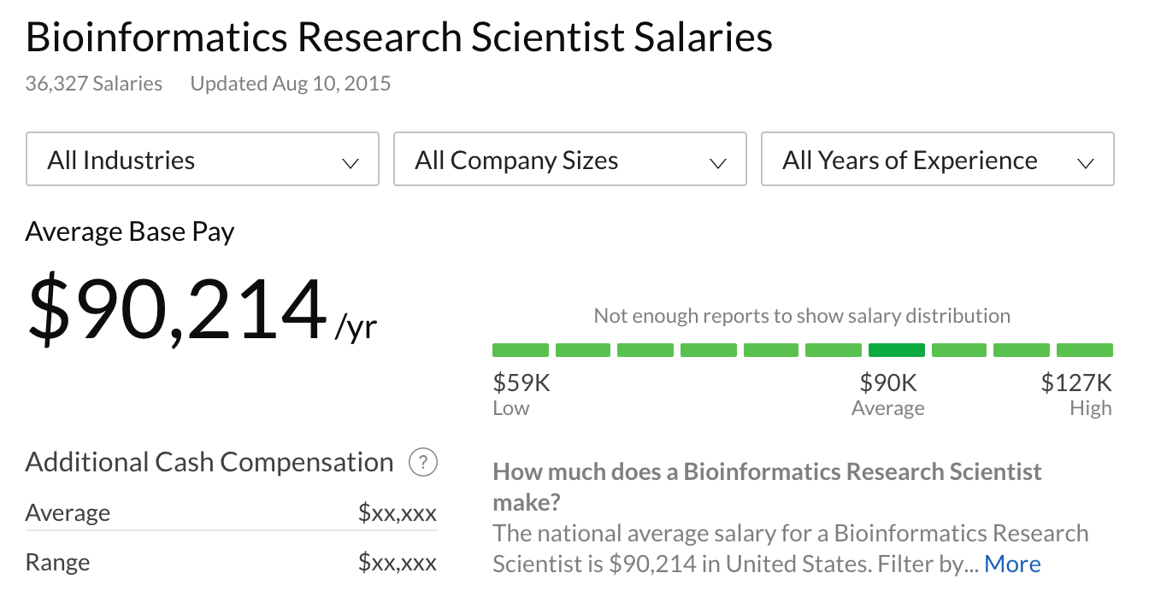
High Paying Careers
https://www.glassdoor.com/Salaries/bioinformatics-research-scientist-salary-SRCH_KO0,33.htm

Slide 58
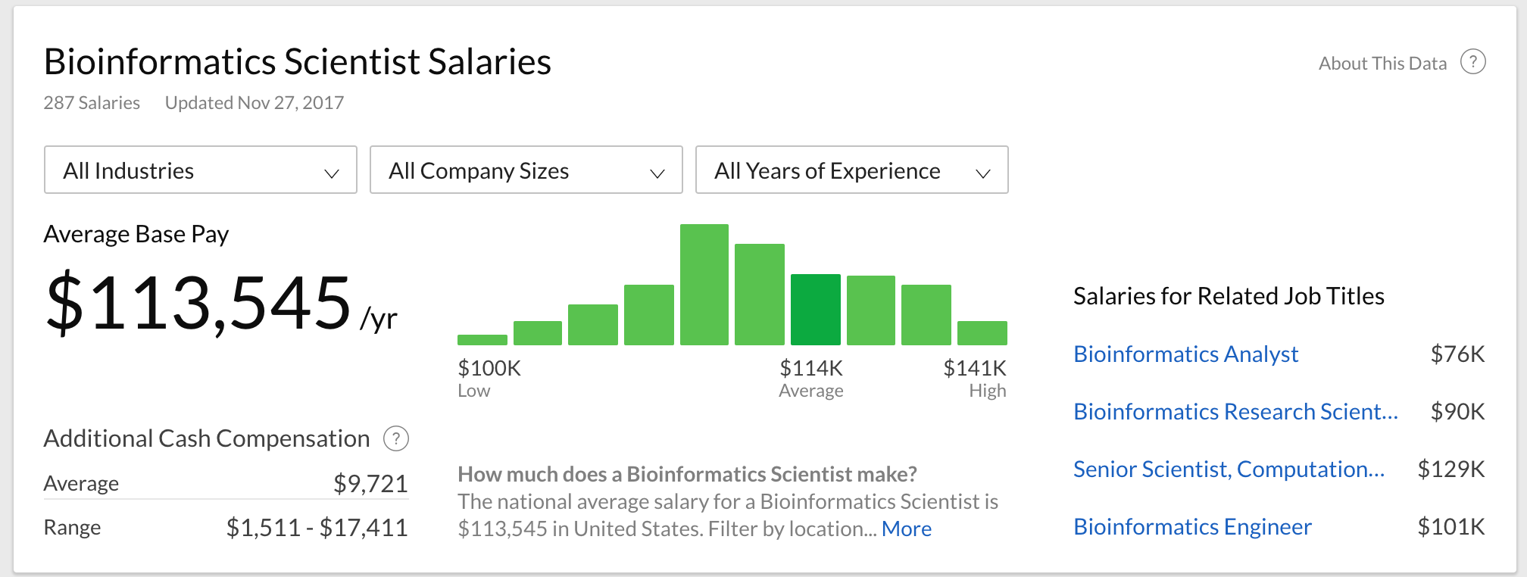
High Paying Careers
https://www.glassdoor.com/Salaries/bioinformatics-scientist-salary-SRCH_KO0,24.htm

Slide 59
Bioinformatician Jobs
Research scientist
Bioinformatician
Bioinformatics programmer
Software Developer
Analyst
Statistician
Physician
Project manager
Database developer and administrator
Technical assistant and technical sales representative
or any jobs where biologists are currently hired
(some of these may require graduate education)

Slide 60
Bioinformatics Jobs
and Internships
Resources
http://www.iscb.org/iscb-careers-job-database
http://www.bioinformatics.org/jobs/
http://www.bioplanet.com/
http://www.bio-itworld.com/BioIT/JobOpenings.aspx
http://www.biospace.com/
www.glassdoor.com
http://www.jobs-salary.com/jobs.php?
Campus Resources

Slide 61
The Value of the
Bioinformatics Skills
BioScientists
Computer
Scientists
Employment Prospects
Computation is becoming essential
for biological/biomedical research
BioSciences provide an increasing
number of problems/challenges

Slide 62

In Bioinformatics,
there is ...

Slide 63
Header
This
This

