Slide 1
Introduction To Bioinformatics
BIO 300/CMPSC 300
Dr. Webb and Dr. Jumadinova
Spring 2016
Notes:
Journey day – distance traveled, how far have our students come over the course of the semester…especially noteworthy and impressive in terms of what you have accomplished in just 15 weeks

Slide 2
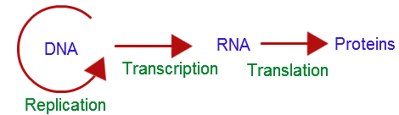
The Central Dogma - Fundamental
“the coded genetic information hard-wired into DNA is transcribed into individual transportable cassettes, composed of messenger RNA (mRNA); each mRNA cassette contains the program for synthesis of a particular protein (or small number of proteins)“ - NCBI

Slide 3
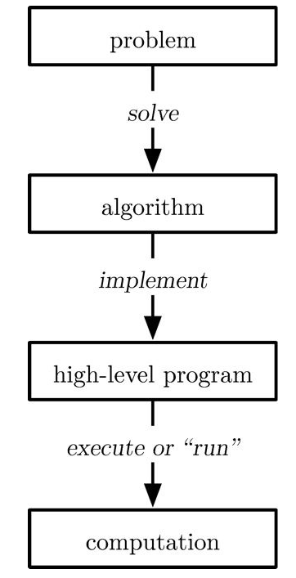

Computation
Computational biologist

Slide 4




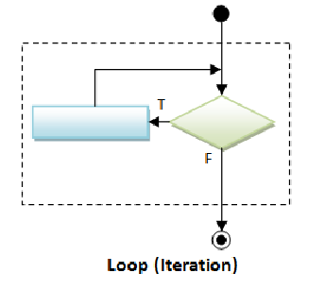
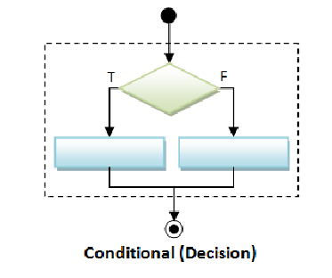
Computation

Slide 5
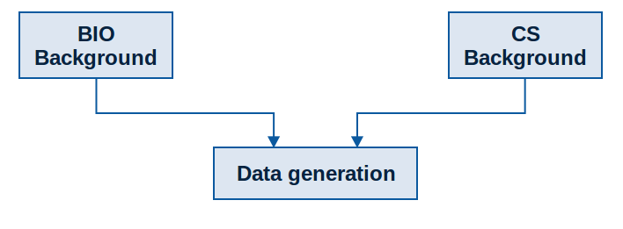
Course Outline

Slide 6
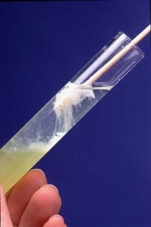
How Biological Data is Generated
Extracted DNA
from own your cells

Slide 7
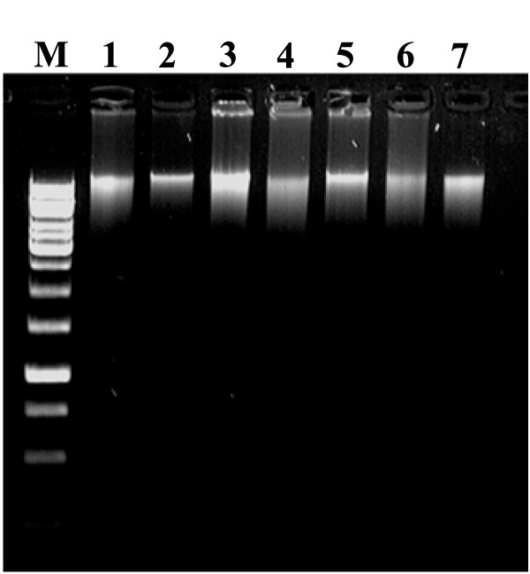
How Biological Data is Generated
Visualized DNA using
Gel Electrophoresis
Extracted DNA
from own your cells

Slide 8
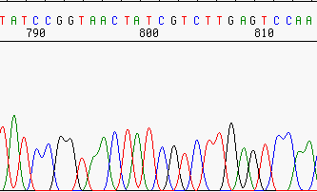
How Biological Data is Generated
Visualized DNA using
Gel Electrophoresis
Extracted DNA
from own your cells
Edited Raw DNA Sequence Data

Slide 9
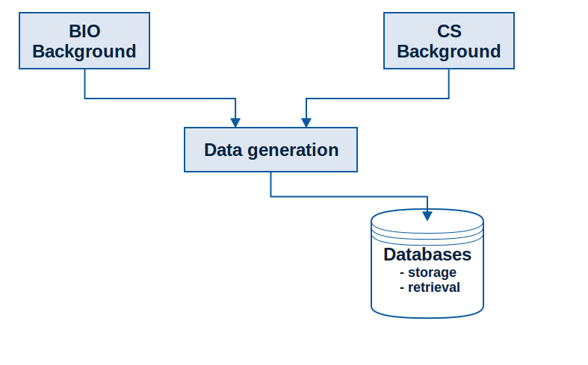
Course Outline

Slide 10
Biological Databases
To learn how to use a Web-based genomic databases and tools.
To understand the types of information stores in genomic databases.
To learn how to use different interfaces to find and retrieve genomic information.
Write Python program to find patterns (start and stop codons) in DNA sequences

Slide 11
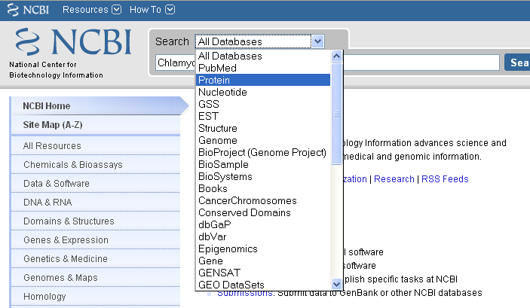
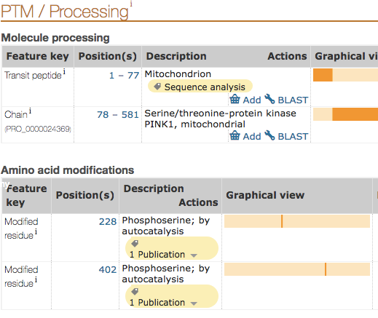
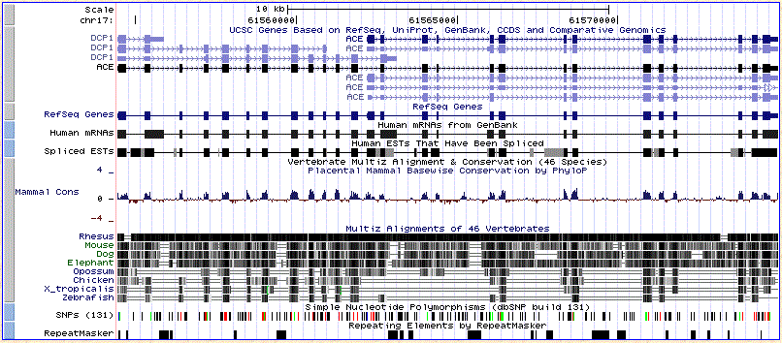
Biological Databases
Data storage, retrieval, and integration of information
UniProt Browser

Slide 12
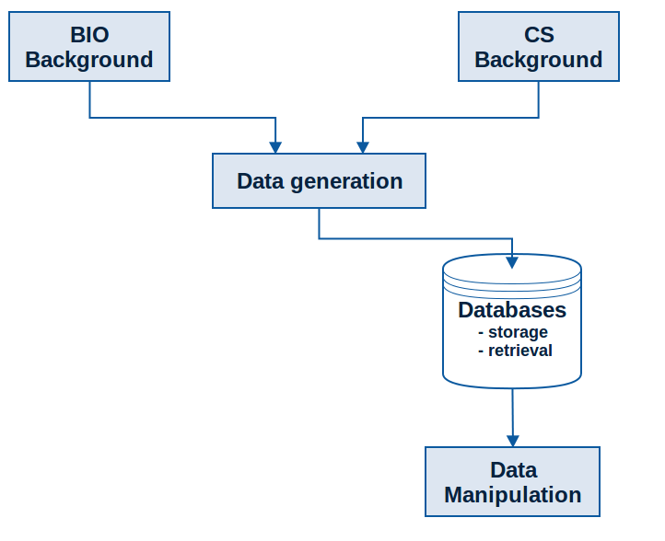
Course Outline

Slide 13
Data Manipulation
To become familiar with tools that can be used to manipulate sequences in a variety of ways and make basic comparisons between sequences
Understand the structure and orientation of string representations of DNA and protein sequences
Gain experience with string manipulation using Python and its application to DNA and protein sequence data.
Understand how genetic information is computationally decided and appreciate the important complications in working with sequences (introns/exons, start codons, template/nontemplate strand orientation, etc)
Notes:
develop a Python program that can manipulate sequences,
transcribe and translate them and find mutations

Slide 14
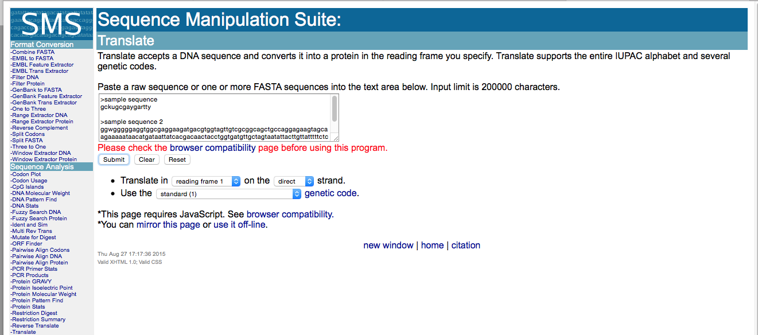
Data Manipulation

Slide 15
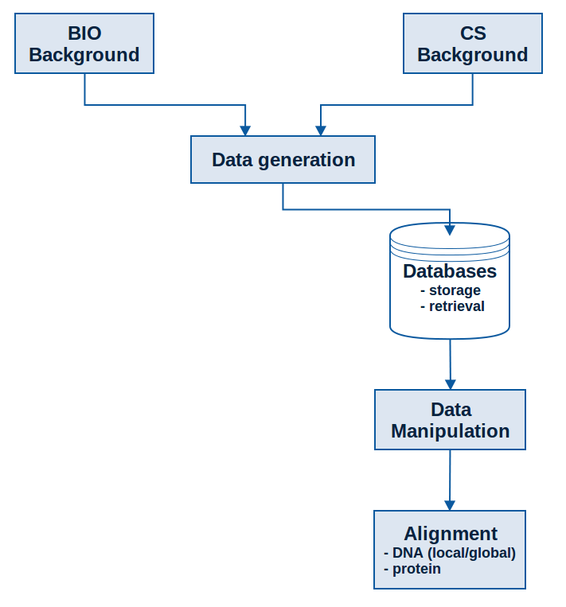
Course Outline

Slide 16
Aligning Sequences
DNA - Nucleotides
To understand the value of aligning genes and recognize the practical applications of this technique.
To gain familiarity with the use of Web-based alignment tools to explore sequence similarity and understand how to modify their parameters.
To know how the Needleman-Wunsch algorithm optimally aligns any two sequences.
Understand how the Needleman-Wunsch algorithm can be modified to yield other alignments.

Slide 17
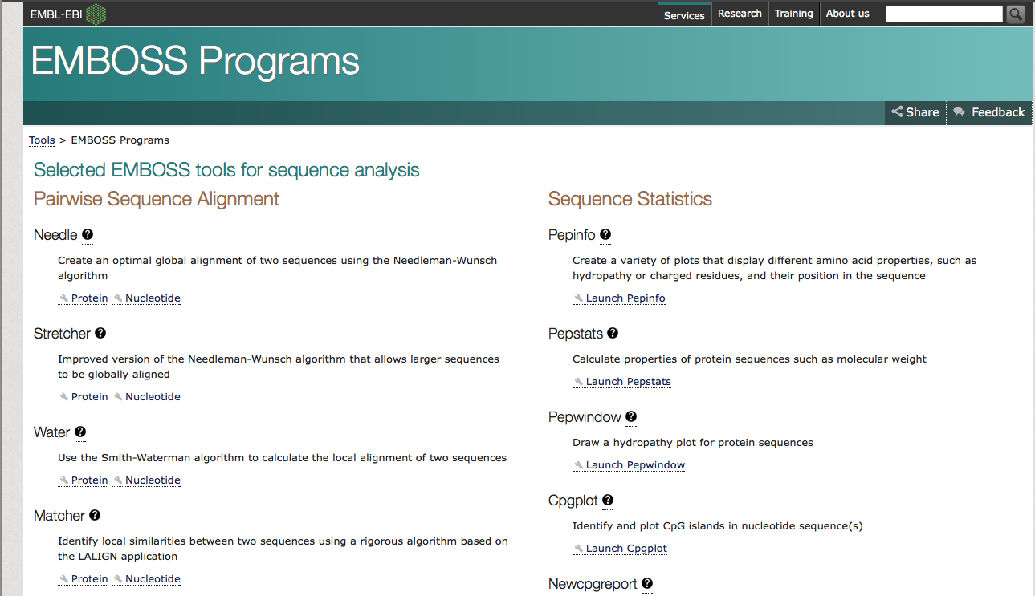
Aligning Sequences

Slide 18
Aligning Sequences
DNA - Nucleotides
Protein – Amino Acids
To understand the value of aligning genes and recognize the practical applications of this technique.
To gain familiarity with the use of Web-based alignment tools to explore sequence similarity and understand how to modify their parameters.
To know how the Needleman-Wunsch algorithm optimally aligns any two sequences.
Understand how the Needleman-Wunsch algorithm can be modified to yield other alignments.
Understand the use of a substitution matrix to score amino acid similarity in a protein sequence alignment.
Gain experience using protein alignment to develop hypotheses about protein function based on sequence similarity.
Know how protein alignment differs algorithmically from DNA alignment.
Know how substitution matrix is developed and how different matrices might be used to produce better alignments in particular situations.

Slide 19
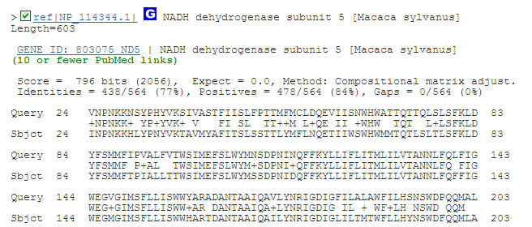
Aligning Sequences
NCBI – PROTEIN BLAST

Slide 20

Aligning Sequences
Notes:
Entrez search and ran BLAST to analyze genes

Slide 21
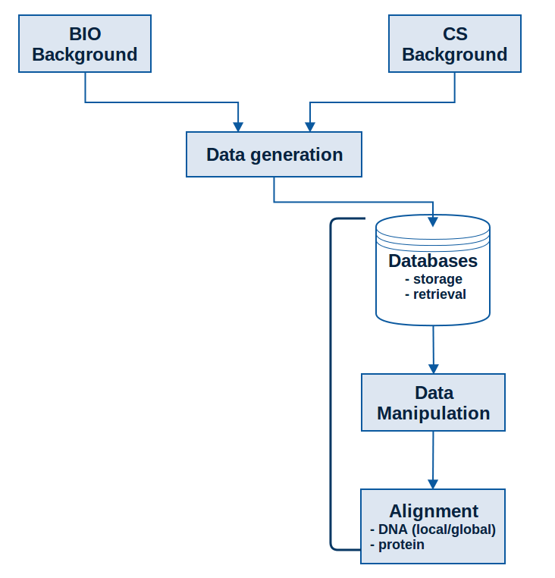
Course Outline

Slide 22
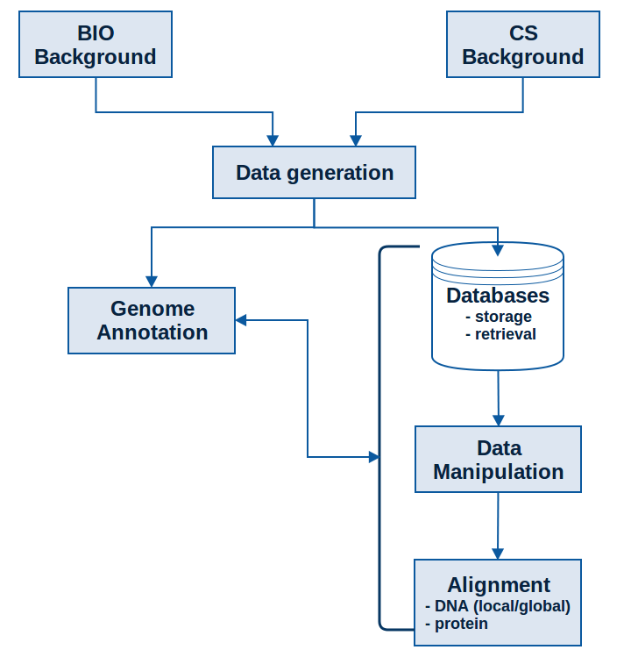
Course Outline

Slide 23
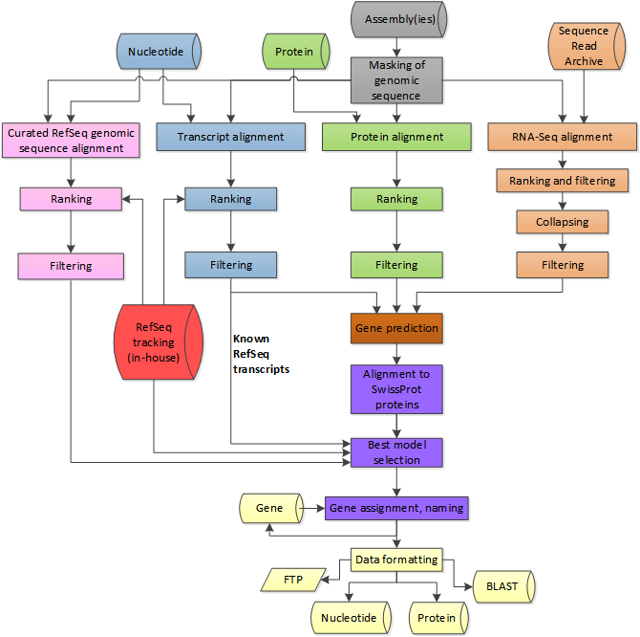
Genome Annotation
alignment-based
sequence-based
content-based
probabilistic
Be able to combine content-based and probabilistic methods of gene discovery to identify the most probable locations of introns and exons in a eukaryotic DNA sequence

Slide 24
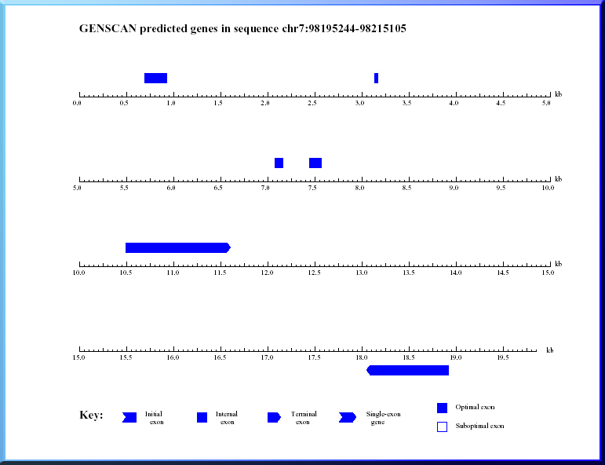
Genome Annotation
Notes:
implement the CpG algorithm in Python given the pseudocode
compare results to those of the CpG island tooll in the Sequence manipulation suite

Slide 25
Genome Annotation
alignment-based
sequence-based
content-based
probabilistic
New data – deposited into databases such as NCBI

Slide 26
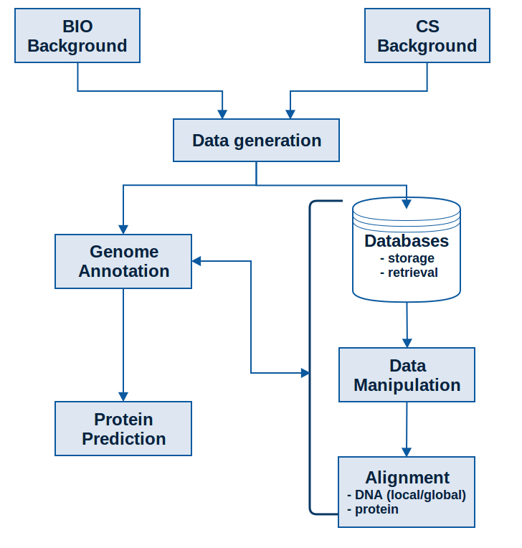
Course Outline

Slide 27
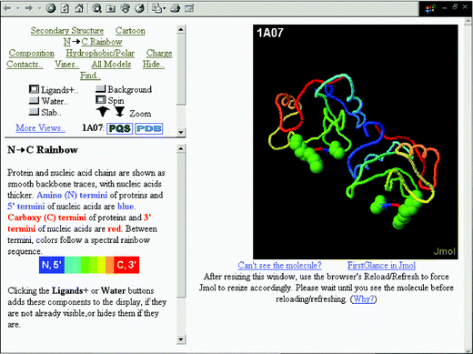
Protein Prediction
Know how to use available tools to examine the experimentally determined structures of proteins and visualize structural an functional features
Appreciate the value and limitations of predicting 3-D structure from sequence alone

Slide 28
Applications and Examples
Data mining to study multifactorial disorders
Parkinson Disease

Slide 29
Applications and Examples
Data mining to study multifactorial disorders
Genetic screening for mutations
Parkinson Disease
Cystic Fibrosis

Slide 30
Applications and Examples
Data mining to study multifactorial disorders
Genetic screening for mutations
Investigating the spread of pathogens
Parkinson Disease
Cystic Fibrosis
Influenza Pandemics

Slide 31
Applications and Examples
Data mining to study multifactorial disorders
Genetic screening for mutations
Investigating the spread of pathogens
Investigating antibiotic resistance
Parkinson Disease
Cystic Fibrosis
Influenza Pandemics
Horizontal Gene Transfer & Agriculture

Slide 32
Applications and Examples
Data mining to study multifactorial disorders
Genetic screening for mutations
Investigating the spread of pathogens
Investigating antibiotic resistance
Understanding pathogen virulence
Parkinson Disease
Cystic Fibrosis
Influenza Pandemics
Horizontal Gene Transfer & Agriculture
Identifying virulence factors in E. coli

Slide 33
Applications and Examples
Data mining to study multifactorial disorders
Genetic screening for mutations
Investigating the spread of pathogens
Investigating antibiotic resistance
Understanding pathogen virulence
Characterizing previously undescribed organisms/genomic regions
Parkinson Disease
Cystic Fibrosis
Influenza Pandemics
Horizontal Gene Transfer & Agriculture
Identifying virulence factors in E. coli
Identify genes possibly involved in susceptibility or resistance to influenza

Slide 34
Applications and Examples
Data mining to study multifactorial disorders
Genetic screening for mutations
Investigating the spread of pathogens
Investigating antibiotic resistance
Understanding pathogen virulence
Characterizing previously undescribed organisms/genomic regions
Drug Design
Parkinson Disease
Cystic Fibrosis
Influenza Pandemics
Horizontal Gene Transfer & Agriculture
Identifying virulence factors in E. coli
Identify genes possibly involved in susceptibility or resistance to influenza
Developing an antiviral to combat HIV

Slide 35
Bioinformatics Accomplishments
Notes:
Syllabus - Students successfully completing this class will have developed:

Slide 36
Bioinformatics Accomplishments
A “big-picture” view of bioinformatics.
Notes:
Syllabus - Students successfully completing this class will have developed:

Slide 37
Bioinformatics Accomplishments
A “big-picture” view of bioinformatics.
An understanding of the objectives and limitations of bioinformatics.
Notes:
Syllabus - Students successfully completing this class will have developed:

Slide 38
Bioinformatics Accomplishments
A “big-picture” view of bioinformatics.
An understanding of the objectives and limitations of bioinformatics.
An understanding of the biological foundations of bioinformatics (genes and genomes, gene expression, etc.).
Notes:
Syllabus - Students successfully completing this class will have developed:

Slide 39
Bioinformatics Accomplishments
A “big-picture” view of bioinformatics.
An understanding of the objectives and limitations of bioinformatics.
An understanding of the biological foundations of bioinformatics (genes and genomes, gene expression, etc.).
An understanding of the computational foundations of bioinformatics (programming, databases, etc.).
Notes:
Syllabus - Students successfully completing this class will have developed:

Slide 40
Bioinformatics Accomplishments
A “big-picture” view of bioinformatics.
An understanding of the objectives and limitations of bioinformatics.
An understanding of the biological foundations of bioinformatics (genes and genomes, gene expression, etc.).
An understanding of the computational foundations of bioinformatics (programming, databases, etc.).
An understanding of how genetic information is obtained and processed.
Notes:
Syllabus - Students successfully completing this class will have developed:

Slide 41
Bioinformatics Accomplishments
A “big-picture” view of bioinformatics.
An understanding of the objectives and limitations of bioinformatics.
An understanding of the biological foundations of bioinformatics (genes and genomes, gene expression, etc.).
An understanding of the computational foundations of bioinformatics (programming, databases, etc.).
An understanding of how genetic information is obtained and processed.
The ability to use basic bioinformatics software tools to study genetic information.
Notes:
Syllabus - Students successfully completing this class will have developed:

Slide 42
Bioinformatics Accomplishments
A “big-picture” view of bioinformatics.
An understanding of the objectives and limitations of bioinformatics.
An understanding of the biological foundations of bioinformatics (genes and genomes, gene expression, etc.).
An understanding of the computational foundations of bioinformatics (programming, databases, etc.).
An understanding of how genetic information is obtained and processed.
The ability to use basic bioinformatics software tools to study genetic information.
Notes:
Syllabus - Students successfully completing this class will have developed:

Slide 43
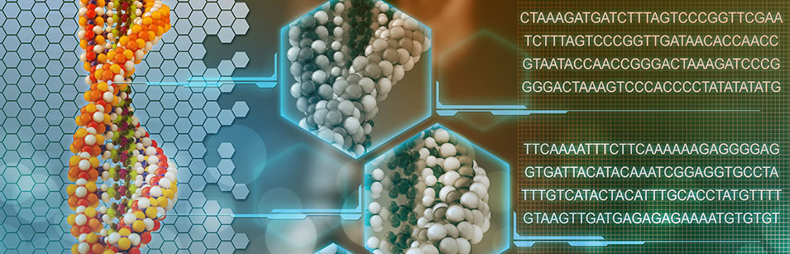
The Value of the Bioinformatics Skills
There is a great need for Bioinformaticians!
Notes:
Syllabus - Students successfully completing this class will have developed:

Slide 44

The Value of the Bioinformatics Skills
SmartMoney has been ranking Bioinformatics as #1 among next Hot Jobs
Many jobs available, exciting research potential!
Important information
waiting to be decoded!
Notes:
Syllabus - Students successfully completing this class will have developed:

Slide 45
The Value of the Bioinformatics Skills
BioScientists
Employment Prospects
Computation is becoming essential
for biological/biomedical research
Notes:
Syllabus - Students successfully completing this class will have developed:

Slide 46
The Value of the Bioinformatics Skills
BioScientists
Computer
Scientists
Employment Prospects
Computation is becoming essential
for biological/biomedical research
BioSciences provide an increasing
number of problems/challenges
Notes:
Syllabus - Students successfully completing this class will have developed:

Slide 47
Bioinformatician Jobs
Research scientist
Bioinformatician
Bioinformatics programmer
Software Developer
Analyst
Statistician
Physician
Project manager
Database developer and administrator
Technical assistant and technical sales representative
or any jobs where biologists are currently hired
(some of these may require graduate education)
Notes:
Syllabus - Students successfully completing this class will have developed:

Slide 48
Bioinformatician Jobs
Jobs and Internships
http://www.iscb.org/iscb-careers-job-database
http://www.bioinformatics.org/jobs/
http://www.bioplanet.com/
http://www.bio-itworld.com/BioIT/JobOpenings.aspx
http://www.biospace.com/
www.glassdoor.com
http://www.jobs-salary.com/jobs.php?
Campus Resources
Notes:
Syllabus - Students successfully completing this class will have developed:

