Slide 1
Genome Annotation: Advanced (Eukaryotic) Gene Prediction
BIO 300/CMPSC 300
Dr. Kristen Webb
Spring 2016

Slide 2
Bioinformatics
CS300
Genome annotation: Advanced
(eukaryotic) gene prediction
Fall 2017
Oliver Bonham-Carter

Slide 3

Prediction Algorithms
Alignment-based – sequence similarity to previously identified gene in another organism (BLAST)
Sequence-based – search for specific sequences - e.g. ORF–finder – searches start and stop codons
Content-based – search for patterns – e.g. nucleotide or codon frequency
Probabilistic – combination of sequence- and content-based plus probability that sequence is part of a gene

Slide 4
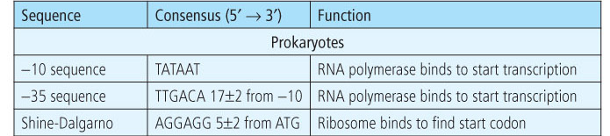
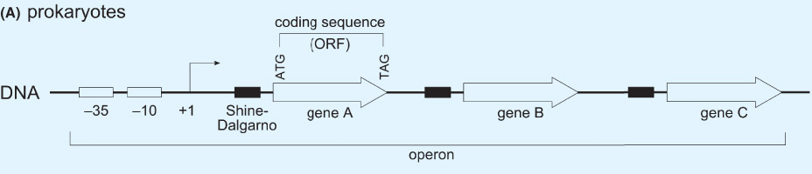
Prokaryotic Gene Structure
Highly conserved sequences 10 and 35 bases upstream (before) start codon
Highly conserved Shine-Dalgarno sequence immediately before start codon

Slide 5
Prokaryotic Gene Structure
Highly conserved sequences 10 and 35 bases upstream (before) start codon
Highly conserved Shine-Dalgarno sequence immediately before start codon
Genes rarely contain introns
  Present as ORFs (start codon through stop codon – all protein-coding sequence)

Slide 6
Prokaryotic
Gene Structure
conserved -10 and -35 promoter sequences
conserved Shine-Dalgarno sequence marks the start codon
few interrupted ORFs (introns are rare)

Slide 7
Prokaryotic Gene Structure
Conserved -10 and -35 promoter sequences
Conserved Shine-Dalgarno sequence marks the start codon
Few interrupted ORFs (introns are rare)

Slide 8
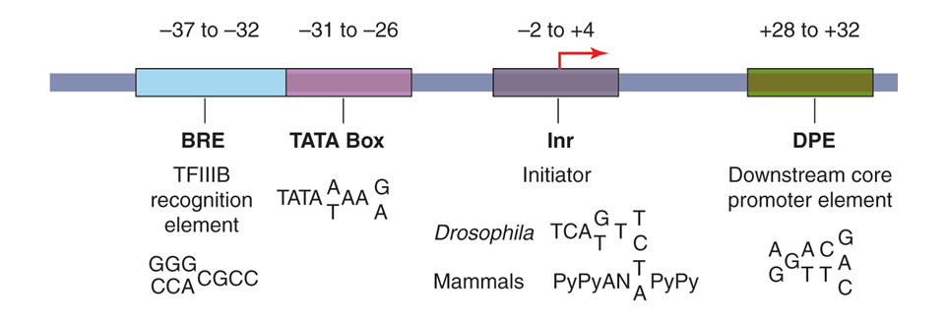
Eukaryotic Gene Structure
Variable promoter structure
  not all promoter elements present in all gene
  promoter element sequence can vary between genes

Slide 9
Eukaryotic Gene Structure
Variable promoter structure
  not all promoter elements present in all gene
  promoter element sequence can vary between genes
  no conserved Shine-Delgarno-like sequence

Slide 10
Eukaryotic Gene Structure
Variable promoter structure
  not all promoter elements present in all gene
  promoter element sequence can vary between genes
  no conserved Shine-Delgarno-like sequence
  makes identifying the start of the gene more difficult

Slide 11
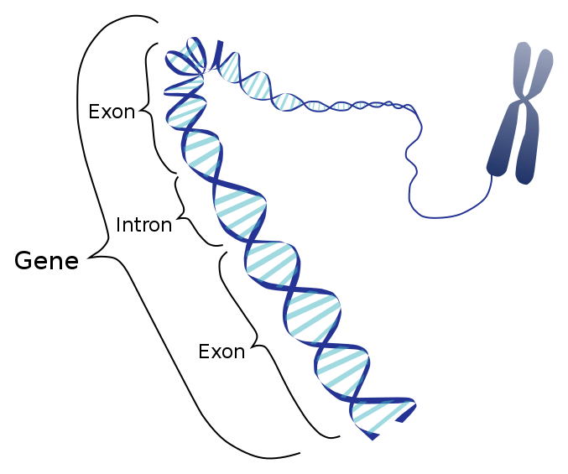
Eukaryotic Gene Structure
An Intron (intragenic region) is any nucleotide sequence within a gene that is removed by RNA splicing during maturation of the final RNA product.
An exon (expressed region) is any part of a gene that will encode a part of the final mature RNA produced by that gene after introns have been removed by RNA splicing.
https://www.youtube.com/watch?v=YtKoTOCJGt4 (1 min)
https://www.youtube.com/watch?v=_asGjfCTLNE (6.5 mins)

Slide 12
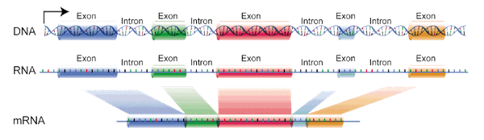
Eukaryotic Gene Structure
Most genes contain introns
Only interested in coding region
  Exons only
    Sequence with codons

Slide 13

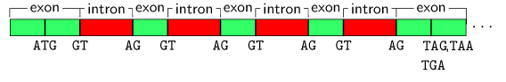
Eukaryotic Gene Structure
Nuclear pre-mRNA introns (spliceosomal introns) are characterized by specific intron sequences located at the boundaries between introns and exons.
These sequences are recognized by spliceosomal RNA molecules when the splicing reactions are initiated.
Exon/Intron boundaries not highly conserved

Slide 14
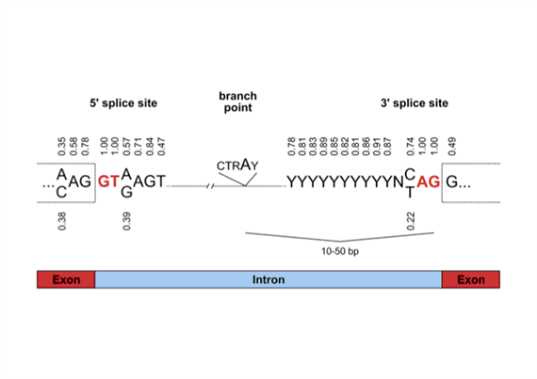
Eukaryotic Gene Structure
Exon/Intron boundaries not highly conserved
In general, codon usage is the same within one org.
However, when the usage fluctuates noticably from the norm, we suspect an intron /exon boundry has been crossed.

Slide 15
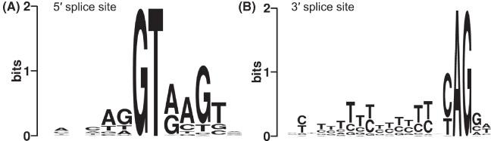
Eukaryotic Gene Structure http://weblogo.berkeley.edu/logo.cgi
Exon/Intron boundaries not highly conserved

Slide 16
Prokaryotic Gene
Structure
Eukaryotic Gene
Structure
-10 and -35 promoter sequences
Shine-Dalgarno sequence marks the start codon
Few interrupted ORFs (introns are rare)
Promoter sequences vary in number and sequence
No Shine-Dalgarno – unambiguous identification of transcriptional start site is difficult
Nearly all genes contain introns
Intron/exon boundaries are hard to discern

Slide 17
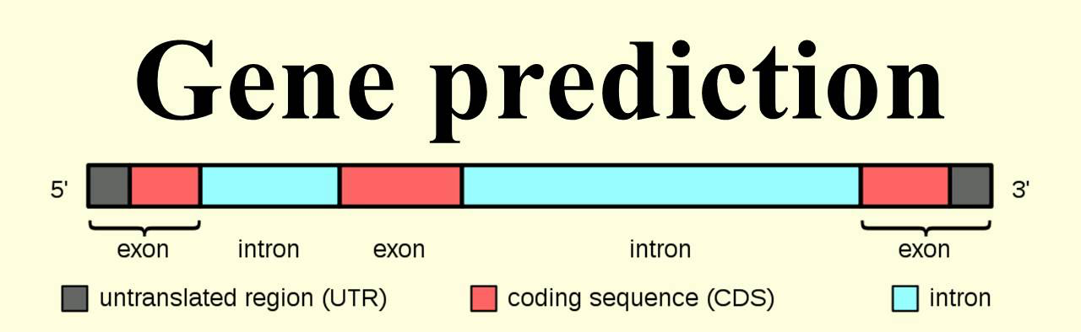
Bioinformatics Solution?
Content- and Probability-Based Gene Prediction
Content-based gene prediction
  Alone not very precise
  Better result when used in combination with other algorithms
Content
  Codon usage
  CpG Islands

Slide 18
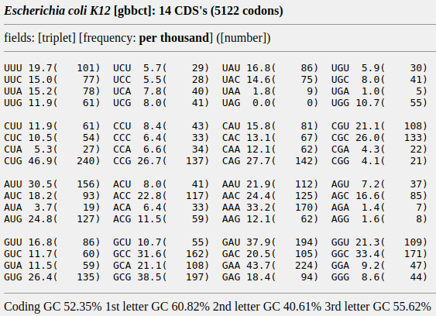
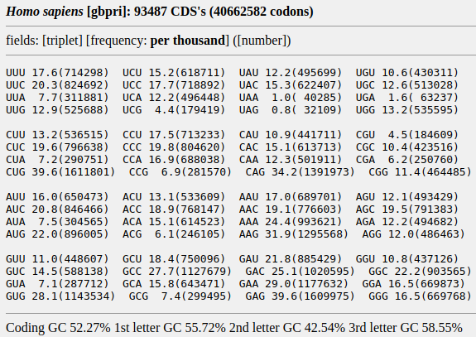
Codon Usage and Frequency
Synonymous codons for same amino
acid not used with equal frequency
E. coli
H. sapiens
http://www.kazusa.or.jp/codon/

Slide 19
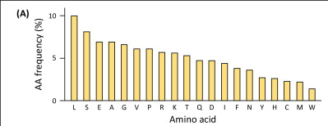
Codon Usage and Frequency
Some amino acids are much more common in proteins than others

Slide 20
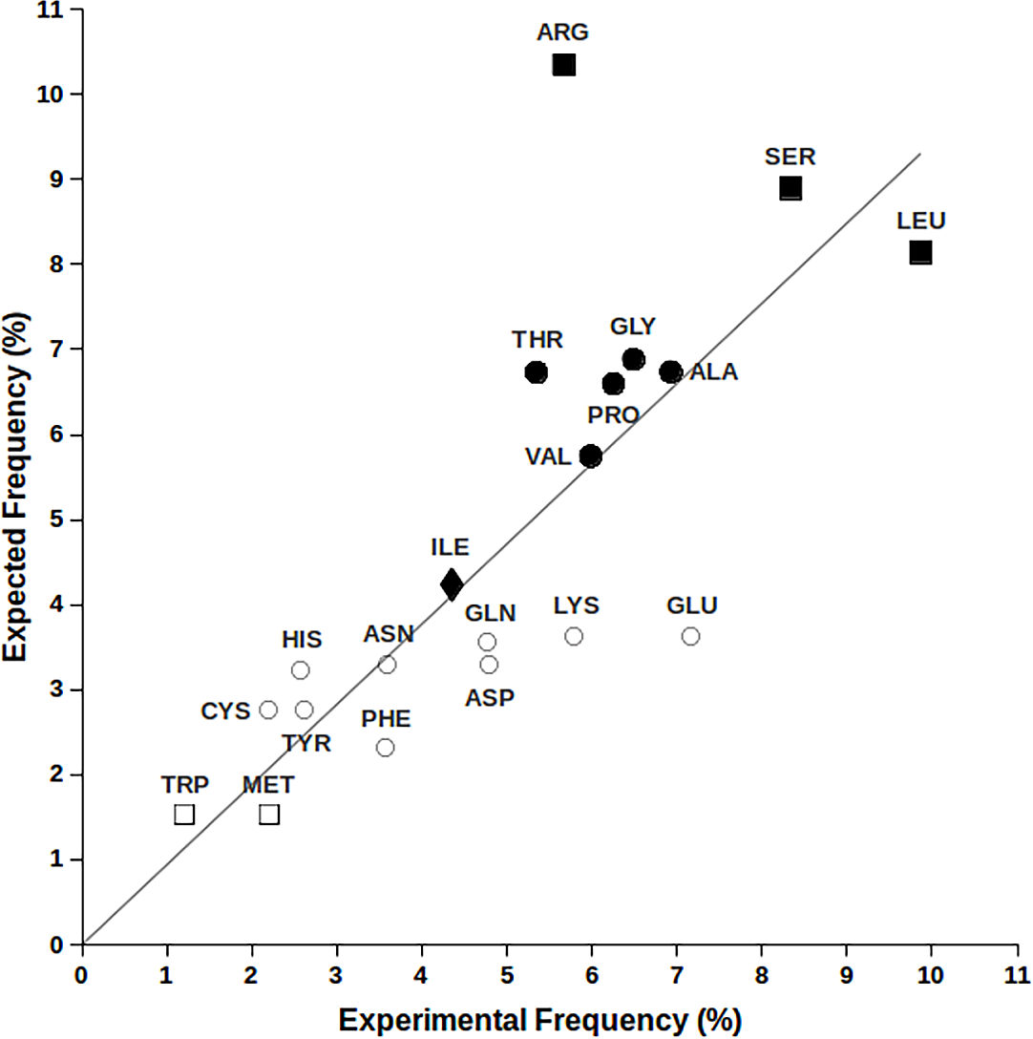
Codon Usage and Number
The sum of the expectation values for each codon of natural amino acids, as resulting from the product of their nucleotide occurrence, is compared to the amino acid frequency found in human protein sequences.
It is possible to note that expected and observed amino acid frequencies exhibit a good correlation with a R2 = 0.91
Amino acids with 6, 4, 3, 2 and 1 codons are labelled respectively with “■”, “●”, “♦”, “○” and “□”.
Gardini, Simone, et al. "On nature’s strategy for assigning genetic code multiplicity." PloS one 11.2 (2016): e0148174.

Slide 21
Using Codon Frequencies to
Find Exon/Intron Boundaries
Expectations:
  Exon – codon frequency closely matches expected frequency for a gene
  Intron – “codon” frequency poorly matches expected frequency for a gene (because not really codons!!)
  Boundary – point where frequencies shift

Slide 22
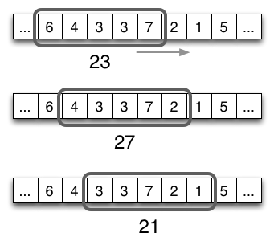
Using Codon Frequencies to
Find Exon/Intron Boundaries
Slide a window along
the sequence to
read the frequency
scores of the codons.
Sliding-Window Approach
As the sliding window advances, the slice of its input data changes. Here the algorithm uses the current sliding window data to compute the sum of the window’s elements.
The CpG island is a short stretch of
DNA in which the frequency
of the CG sequence is
higher than other regions.

Slide 23
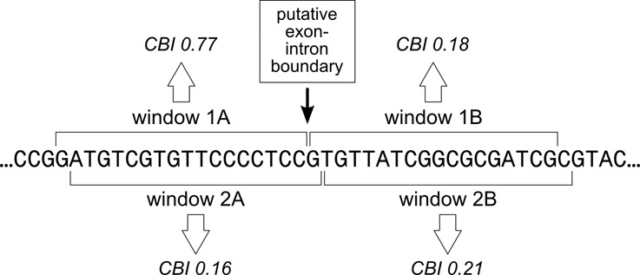
Using Codon Frequencies to
Find Exon/Intron Boundaries
CBI = codon bias index
Compares usage of common codons to the random occurrence of the same codons
The algorithm is in the Exploring Bioinformatics textbook, page 198.
Notes:
General area, not specific bases – need to investigate further – look for known patterns in DNA
Combine this with other information:
the fact that 1st exon must start with ATG and last exon should end with stop codon
exons are normally smaller than introns

Slide 24
Finding Promoters Using CpG Islands
Promoter regions tend to have a higher frequency of C and G nucleotides relative to A and T nucleotides
The CG dinucleotide occurs in promoter regions more frequently than would be expected by chance
CpG targets for methylation and epigenetic regulation of gene expression

Slide 25
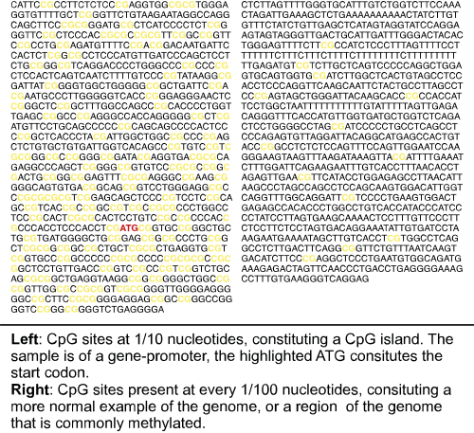
Finding Promoters Using CpG Islands
- a non-coding region
Notes:
Again, need to combine with other evidence
Identify CpG island then start looking for promoter element sequences, a start codon, the first exon, etc

Slide 26
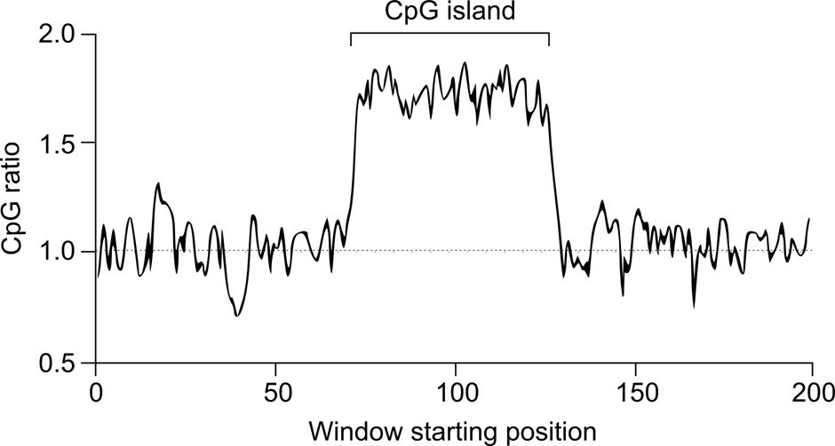
Finding Promoters Using CpG Islands
Sliding-window approach + pattern matching algorithm
  Just one window
CpG ratio = 1 for no difference between random and naturally occurring codons.
observed CG pairs .
C nucleotides x G nucleotides/total nucleotides
Notes:
CpG ratio calculated for each window
CpG = 1 – the number of CpG pairs found in that window is the same as the number that would be expected by chance. >1 CpG island
Again, need to combine with other evidence
Identify CpG island then start looking for promoter element sequences, a start codon, the first exon, etc

