Slide 1


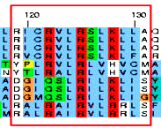
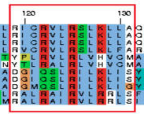
Introduction to Bioinformatics
BIO*300/CMPSC*300
Fall 2017
T/Th 11:00-12:15pm
Wed 2:30-4:20pm
(Alden Hall 109)
Bioinformatics is an emerging, rapidly expanding interdisciplinary discipline that studies how to effectively integrate concepts from computational sciences and biosciences. There is a high demand for scientists who are versed in both biology and computer science in the biomedical industry and research.
BIO 300/CMPSC 300 students will become familiar with the state-of-the-art bioinformatics software and the algorithms behind them. Through hands-on projects, students will explore current biological problems and will develop bioinformatics solutions to these issues.
This course counts as an Area A
Biology Course and an Applications
Course for Computer Science.
Questions? Contact Dr. Bonham-Carter at obonhamcarter@allegheny.edu

