Slide 1

AI Changes the Delivery System
and the Product Itself
New capabilities change what we can delegate.
HOW WE BUILD
WHAT WE BUILD
Judgment during delivery
Judgment at runtime
Vitalii Oborskyi
Head of Delivery & PMO · Author of Uncertainty Architecture
DevCon Romania · 4 November 2026
vitaliioborskyi.ai
01
Notes:
AI can now take on parts of interpretation and judgment. We use that capability while building software, and increasingly inside the products themselves. In both cases, the surrounding system has to adapt. My question is what happens when the capacity to generate or decide grows faster than our capacity to understand, verify and recover.
Sources:
https://github.com/UncertaintyArchitectureGroup/uncertainty-architecture/blob/22639d311d5fb46a23f3d5cdd819800dbe1169d9/assets/presentations/pmday-2026/README.md
https://github.com/UncertaintyArchitectureGroup/uncertainty-architecture/blob/22639d311d5fb46a23f3d5cdd819800dbe1169d9/assets/presentations/pmday-2026/artwork/PROVENANCE.md

Slide 2
We Accelerated a Step. Not the System.
AI can affect every stage. Downstream gains are not automatic.
?
?
?
?
?
?
?
Intent
Design
Code
Review
Test
Integrate
Deploy
Operate
Illustrative team: changes per week; comparable work, fixed downstream capacity.
Code
Review
Integrate
BACKLOG
BEFORE
8
8
8
0
Balanced flow
no accumulation
AFTER AI
100
8
8
+92
Other stages have
not sped up
unfinished / week
THEORY OF CONSTRAINTS
Push system: no WIP limit, no discarded work.
Delivery stays at 8/week. WIP grows; overload can reduce quality.
02
Notes:
Imagine that a team can write, review and integrate eight comparable changes a week. AI raises generation to one hundred, while review and integration stay at eight. In this deliberately simple example, ninety-two changes join the queue each week. We accelerated one stage and exposed the downstream constraints. The effect on delivery depends on the capacity of the whole system.
Sources:
https://github.com/UncertaintyArchitectureGroup/uncertainty-architecture/blob/22639d311d5fb46a23f3d5cdd819800dbe1169d9/assets/presentations/pmday-2026/README.md

Slide 3
The Evidence Is Already Messy
Different studies measure different outcomes — not one universal productivity effect.
NBER · SEP 2026 · >500K GITHUB DEVS
DORA · 2025 · n = 4,867
25.5×
3.4×
1.3×
Respondents reporting improvement:
Productivity >80% · Code quality 59%
changed LOC
commits
releases
Higher adoption ↔ throughput + instability
Cumulative across three tool generations
Instability: failed production changes + unplanned fixes.
Survey association; no causal estimate.
Changed LOC = additions + deletions.
Fig. 1 rounded; async releases not estimated.
GITCLEAR · SHARES OF CHANGED LINES
More apps. Low-usage shares rise.
Metric | 2021¹ | 2026²
Moved code | 24.65% | 3.8% YTD
Copy/paste | 8.66% | 15.7% H1
iOS: <10 ratings
≈78% → 87%
Chrome: <10 downloads
19% → 33%
4 marketplaces; iOS / Chrome shown.
Jan 2025–Apr 2026; first 3 months.
¹2025 report ²2026 report; different samples.
Snapshots only; no comparable trend or causal estimate.
METR · MAY 2026 · n = 349
AGARWAL · JAN 2026 · 1,197 REPOS
1.4–2× self-reported work value
Cognitive complexity after agent adoption
Medians across three questions.
Agent-first +34.85% · Prior AI-IDE +42.87%
Technical workers; no causal estimate.
Matched controls; 19,236 repo-months.
03
Notes:
These studies measure different things, so their numbers do not form one productivity score. The NBER estimates show much larger increases in changed code than in releases. DORA reports perceived productivity gains alongside an association between AI adoption and delivery instability. The other reports add signals about perceived work value and changes in code structure. Together, they motivate a question about system balance, without proving one universal effect.
Sources:
https://github.com/UncertaintyArchitectureGroup/uncertainty-architecture/blob/22639d311d5fb46a23f3d5cdd819800dbe1169d9/assets/presentations/pmday-2026/README.md
https://github.com/UncertaintyArchitectureGroup/uncertainty-architecture/blob/22639d311d5fb46a23f3d5cdd819800dbe1169d9/assets/presentations/pmday-2026/EVIDENCE.md
https://www.nber.org/papers/w35275
https://dora.dev/research/2025/dora-report/
https://gitclear-public.s3.us-west-2.amazonaws.com/GitClear-AI-Copilot-Code-Quality-2025.pdf
https://www.gitclear.com/blog/annual_ai_code_quality_research_2026_diff_digest_git_ai_diff_viewer
https://metr.org/blog/2026-05-11-ai-usage-survey/
https://arxiv.org/html/2601.13597v2

Slide 4
The New Scarcity Is Human Comprehension
Machine generation capacity
Can we explain
the change?
Can we maintain
the dependency?
Potential
comprehension gap
Can we recover
the system?
Adoption / time
Human comprehension capacity
Illustrative overload hypothesis; motivated by the evidence, not measured by those studies.
If AI cannot recover the system, the team still must.
04
Notes:
Faster change becomes a problem when understanding cannot keep pace. A team may ship working code and still lack the expertise needed to explain a failure or restore service. The gap on this slide is a hypothesis we should test in our own systems. AI can help build that understanding, but we need evidence that the capability exists when required. Responsibility becomes operational only when people have sufficient context, authority and time to act.
Sources:
https://github.com/UncertaintyArchitectureGroup/uncertainty-architecture/blob/22639d311d5fb46a23f3d5cdd819800dbe1169d9/assets/presentations/pmday-2026/README.md

Slide 5
We Are Searching for a New
SDLC Equilibrium
CAPABILITIES CHANGE
OPERATING MODEL
MUST ADAPT
WORKING HYPOTHESES
Generation
Review
Integration
Understanding
Work allocation
Ownership
Learning
Feedback
Which constraint does this address?
What must be true for it to work?
What would make us revise it?
Test delivery, quality, full cost and team health.
Proposed operating models remain hypotheses about this context.
05
Notes:
That is why I think we are searching for a new SDLC equilibrium. The bottleneck will differ between teams, and it can move as capabilities change. Each proposed operating model makes assumptions about what can be delegated and how the remaining work gets done. We should treat those assumptions as hypotheses, with evidence that could support or overturn them. A useful approach in one setting does not establish a final recipe for every system.
Sources:
https://github.com/UncertaintyArchitectureGroup/uncertainty-architecture/blob/22639d311d5fb46a23f3d5cdd819800dbe1169d9/assets/presentations/pmday-2026/README.md

Slide 6
When Software Starts Thinking
A system where consequential runtime responsibility
partly depends on probabilistic Model Judgment.
IT ASSISTANT
Intents · Context · Data · Permissions
“Help employees
recover access.”
Boundary cases need contextual judgment
Acceptable outputs / actions
Unauthorized
disclosure
Answer
Clarify
Escalate
Approved guidance
and permitted actions
Prohibited: unauthorized disclosure
Schematic behavioral space; limits are product-specific.
Requirements define acceptable behavior and prohibited effects.
06
Notes:
Now put model judgment inside the product itself. An IT assistant may decide whether to answer an access request, ask for clarification or escalate. I call it a Thinking System when consequential runtime responsibility depends partly on model judgment. We must define its permitted responsibility and evaluate whether its behaviour stays within that boundary. For example, helpful recovery advice cannot compensate for disclosing information the user is not allowed to see.
Sources:
https://github.com/UncertaintyArchitectureGroup/uncertainty-architecture/blob/22639d311d5fb46a23f3d5cdd819800dbe1169d9/assets/presentations/pmday-2026/README.md

Slide 7
Delegation Changes the Sociotechnical System
Evidence, authority and human capability connect both sides.
HOW WE BUILD | WHAT WE BUILD
Review + integration capacity | Evaluation + response capacity
Understanding + recovery | Behavioral criteria + authority
Delivery feedback | Outcome + incident feedback
SHARED DEPENDENCIES
Knowledge · Decision rights · Time and capacity · Feedback
People need the expertise, decision rights and capacity to intervene.
07
Notes:
Both shifts redistribute cognitive work across a sociotechnical system of people, processes and technology. During delivery, someone needs enough understanding to challenge changes and recover the service. During operation, someone needs evidence about behaviour and the authority to change what the product may do. Both depend on expertise and available time, supported by working feedback. Putting a human on a diagram achieves little if that person cannot act when the system needs them.
Sources:
https://github.com/UncertaintyArchitectureGroup/uncertainty-architecture/blob/22639d311d5fb46a23f3d5cdd819800dbe1169d9/assets/presentations/pmday-2026/README.md

Slide 8
Engineering Rigor Moves —
It Doesn’t Disappear
QUESTIONS FOR A WORKING HYPOTHESIS
Which imbalance does this approach address?
By what mechanism should it improve the whole system?
What evidence would demonstrate that improvement?
What would make us revise the hypothesis
or change what we delegate?
More capability still requires engineering responsibility.
08
Notes:
As we search for a new balance, I would ask four questions. Which imbalance does this approach address? By what mechanism should it improve the whole system? What evidence would demonstrate that improvement? What would make us revise the hypothesis or change what we delegate?
Sources:
https://github.com/UncertaintyArchitectureGroup/uncertainty-architecture/blob/22639d311d5fb46a23f3d5cdd819800dbe1169d9/assets/presentations/pmday-2026/README.md

Slide 9
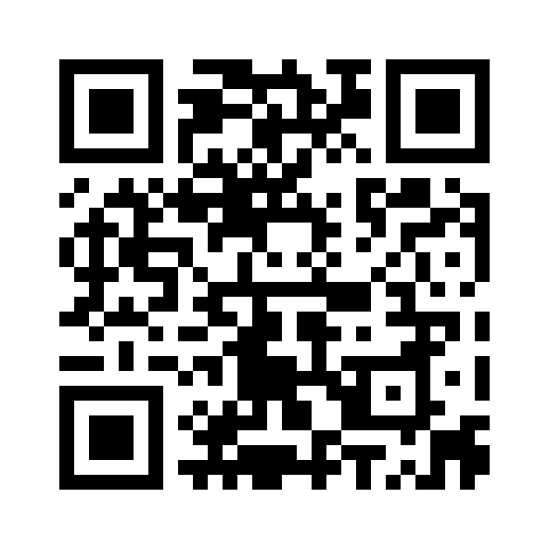
Continue the Conversation
vitaliioborskyi.ai
Research · Articles · Talks
Vitalii Oborskyi
oborskyivitalii@gmail.com
https://www.linkedin.com/in/vitaliioborskyi/
09
Notes:
Thank you for joining me. The QR code takes you to my website, where you can find my research, articles and talks. I would like to hear where your own team feels the balance shifting.
Sources:
https://vitaliioborskyi.ai/

