Slide 1

.crashcourse
Christina Protopapadaki, Damien Picard & Mats Vande Cavey
Christina.Protopapadaki@bwk.kuleuven.be damien.picard@mech.kuleuven.be,
mats.vandecavey@mech.kuleuven.be
October 09, 2014

Slide 2
Modelica.crashcourse Purpose
What is Modelica ?
Syntaxis, language concepts and model structuring
Modelica tools
Use of IDEAS library
Getting started (tutorials, reference docs, libraries, software implementations, ...)
➔ To get you started with Modelica!

Slide 3
Program
09:00 - 09:15 | Introduction
09:15 - 09:30 | Dicussion of assignment
09:30 - 10:30 | Modelica (theory) + Dymola + Programming conventions
10:30 - 10:45 | Break
10:45 - 12:00 | Exercices (concepts checking)
 | Lunch (+licenses)
12:45 - 13:15 | IDEAS + Buildings Libraries: how to use them
13:15 - 14:45 | IDEAS: exercise: set up a building model
14:45 - 15:00 | Break
15:00 - 15:15 | Debugging and common mistakes
15:15 - 15:30 | Basic of tortoiseGit and Github/Bitbucket

Slide 4
Introduction to modelica

Slide 5
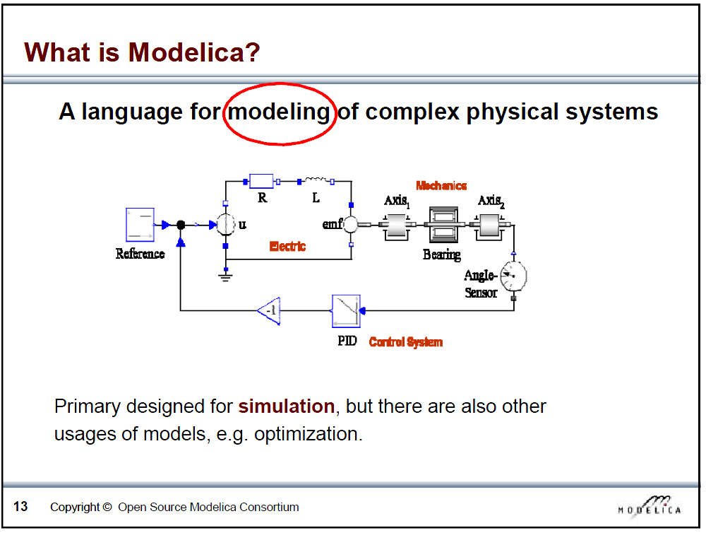
Slide from Peter Fritzson, Introduction to Object-Oriented Modeling, Simulation and Control with Modelica, Tutorial for Modelica Conference 2011, Dresden

Slide 6
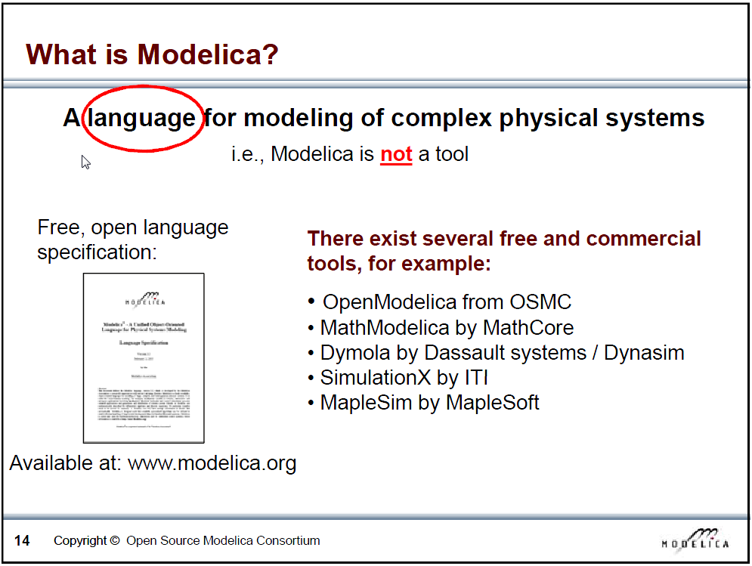
Slide from Peter Fritzson, Introduction to Object-Oriented Modeling, Simulation and Control with Modelica, Tutorial for Modelica Conference 2011, Dresden

Slide 7
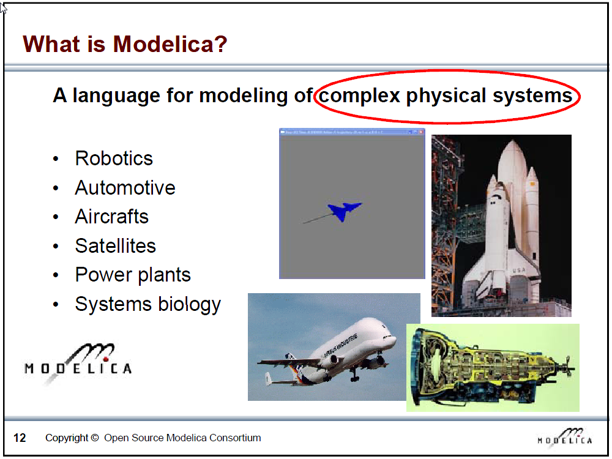
Slide from Peter Fritzson, Introduction to Object-Oriented Modeling, Simulation and Control with Modelica, Tutorial for Modelica Conference 2011, Dresden

Slide 8
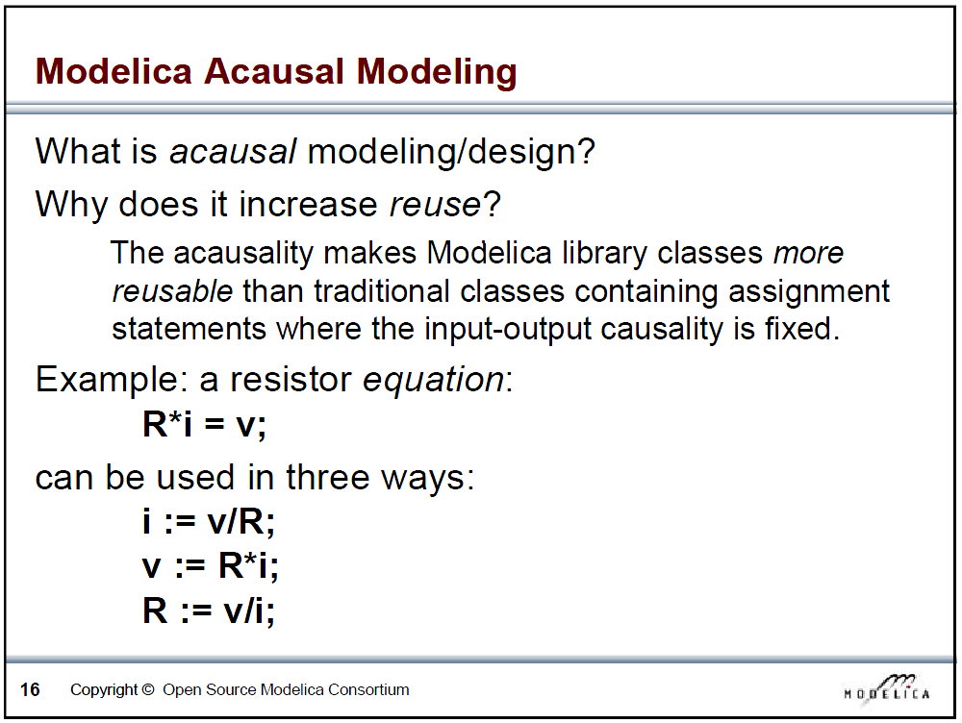
Slide from Peter Fritzson, Introduction to Object-Oriented Modeling, Simulation and Control with Modelica, Tutorial for Modelica Conference 2011, Dresden

Slide 9
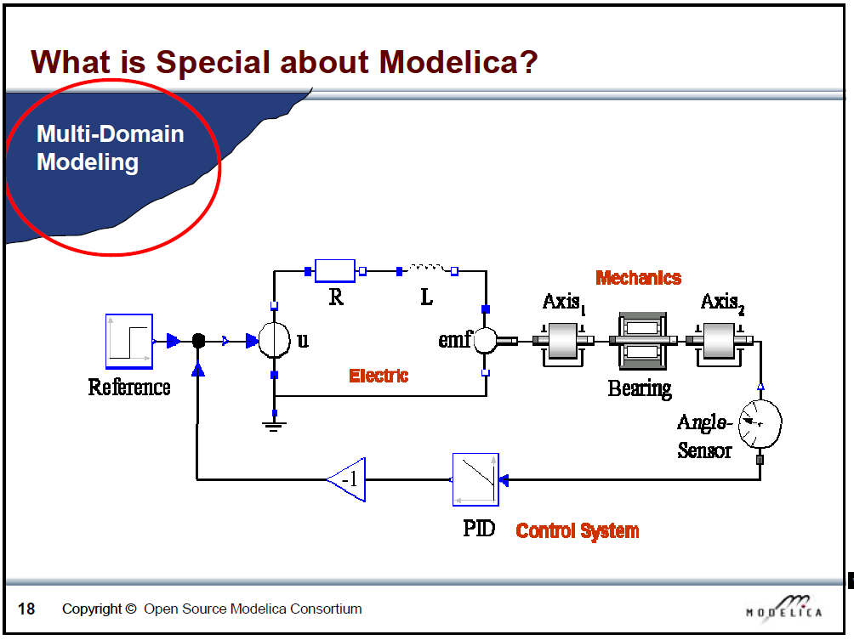
Slide from Peter Fritzson, Introduction to Object-Oriented Modeling, Simulation and Control with Modelica, Tutorial for Modelica Conference 2011, Dresden

Slide 10
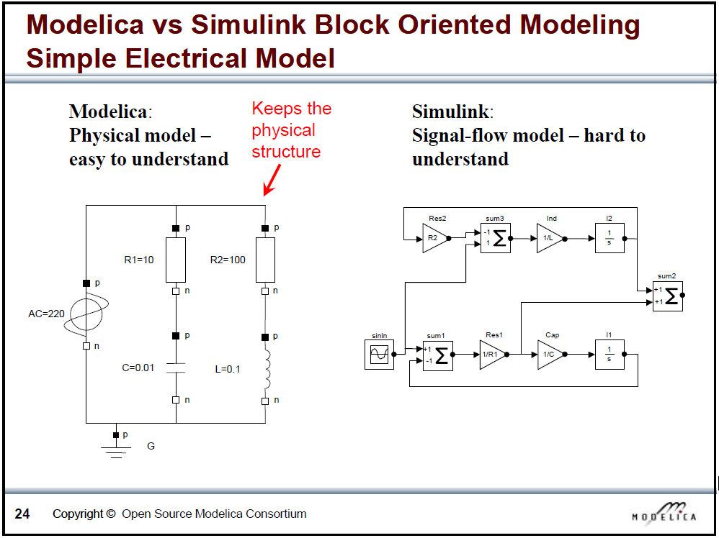
Slide from Peter Fritzson, Introduction to Object-Oriented Modeling, Simulation and Control with Modelica, Tutorial for Modelica Conference 2011, Dresden

Slide 11
What is Modelica
Modelica is a language for modeling of physical systems
open source
object oriented
Acausal modeling (equation based)
multi-domain
primarily for simulation, but usable for optimization
small and large models (> 100 000 equations)
many model libraries (free and commercial)
textual and graphical modeling

Slide 12
Modelica environments
Commercial software tools
Dymola (Dassault Systèmes, Sweden)
MathModelica (MathCore, Sweden)
SimulationX (ITI, Germany)
MapleSim (Maplesoft, Canada)
Free and open source tools
OpenModelica (Open Source Modelica Consortium, Sweden and other countries)
JModelica (Modelon, Sweden)

Slide 13
Websites
General
www.modelica.org
www.openmodelica.org
www.jmodelica.org
http://www.claytex.com/tech-blog/
Modelica language
http://modref.xogeny.com/
KUL modeling conventions
https://docs.google.com/document/d/1MaNKTdLz-YPpEEH3Eg12ECzG0ErK-rIK9IHd6gsBp7Q/edit?usp=sharing
Buildings library:
https://simulationresearch.lbl.gov/modelica

Slide 14
Fora
http://www.openmodelica.org/index.php/forum
http://www.jmodelica.org/forum
www.stackoverflow.com (tag Modelica)
And last but not least: https://groups.google.com/d/forum/modelicans

Slide 15
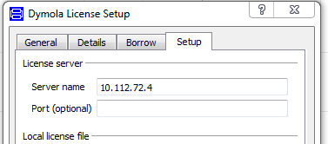
Use of Dymola with KULeuven license
Access to a floating licence (on the building physics server).
Connected physically (cable) to the building physics or mech network
Open Dymola and go to help>licence..
Enter 10.112.72.4 and follow instructions
More information on Modelicans (google groups)

Slide 16
Getting Started
Dymola
What? Modeling + simulating (MSL)
Views
Results, plots
Libraries, syntax
Variables, parameters, selfish (flows)
balanced, encapsulation
Inputs
Partial, replaceable

Slide 17
Exercises
Dymola
Demo version ok for exercises 1 and 2
Demo version + licence (=full version) for exercise 3

Slide 18
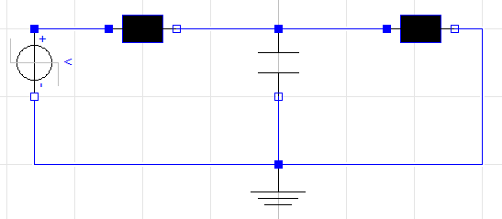

Exercise 1
Create connector with voltage and current (flow)
Create partial class OnePin and TwoPin with variable v, I + Kirchhoff
Create a resistor: v = R*I
Create a capcitor: i = C*der(v)
Create a ground: v = 0
Make the circuit (use StepVoltage of Modelica)

Slide 19
Exercise 2
Look at Lib.Examples
Try to understand the different models
Combine them to make your own model

Slide 20
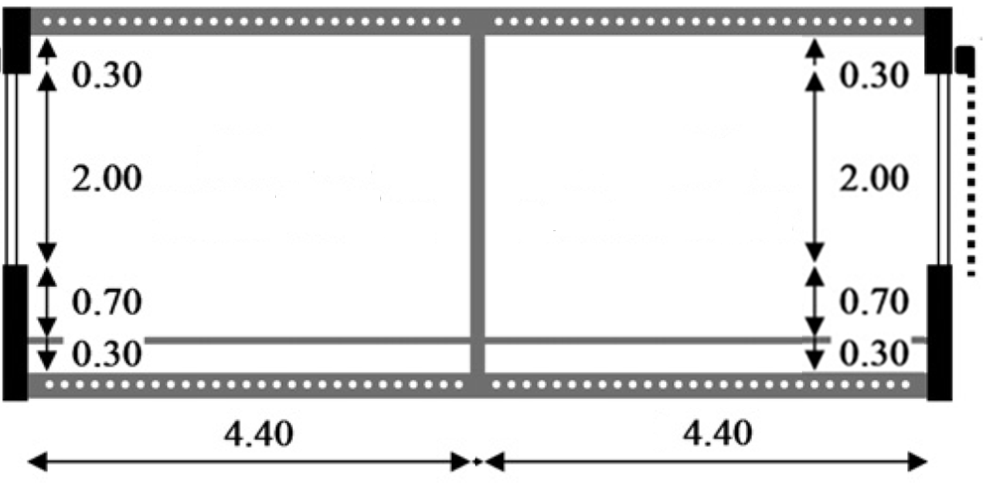
Exercise 3
IDEAS demo
Low energy office building with 2 thermal zones & floor heating
→Simulate for 1 month, check indoor temperatures & heat demand
*In the back and front as well as above and below there are other offices which maintain the same temperature.
NORTH
(depth: 2.7m)
SOUTH
(depth: 2.7m)
Notes:
10’ - JModelica (demo)
5’ - Tutorials and reference documentation (slides)
30’ - Libraries: MSL and own libraries (dymola demo)
10’ - simman and pymosim (python demo)
5’ - Coding conventions (slides)
5’ - Dymola licenses at TME (slides)
1u05 min

Slide 21
Exercise 3
IDEAS demo
Low energy office building with 2 thermal zones & floor heating
Envelope
Materials (to model)
Tile: λ=1.4 W/mK, c=840 J/kgK, ρ=2100 kg/m³
Screed: λ=0.6 W/mK, c=860 J/kgK, ρ=1100 kg/m³
Concrete: λ=1.7 W/mK, c=840 J/kgK, ρ=2400 kg/m³
Windows
Glazing: Saint Gobain Clima Plus Futur (U = 1.4 W/m²K, g = 0.755)
Frame: U-value=2.5 W/m²k , fraction of the window: f=0.15
Infiltration: n₅₀=0.4 ACH. No ventilation.
Geometry: use internal dimensions (not completely right)
 | Composition (out→in or propsBus b→a)
Floor (to model) | Tile (d=0.01m) | Screed (0.06)* | PUR (0.06) | Concrete (0.20) | Plaster (0.02)
Exterior wall | Brick (0.10) | MW (0.16) | Brick (0.14) | Plaster (0.02)
Interior wall | Plaster (0.02) | Brick (0.10) | Plaster (0.02)
Notes:
10’ - JModelica (demo)
5’ - Tutorials and reference documentation (slides)
30’ - Libraries: MSL and own libraries (dymola demo)
10’ - simman and pymosim (python demo)
5’ - Coding conventions (slides)
5’ - Dymola licenses at TME (slides)
1u05 min

Slide 22
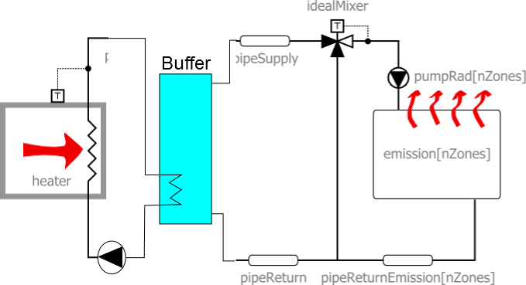
Exercise 3
IDEAS demo
Low energy office building with 2 thermal zones & floor heating
Heating system (use IDEAS heating systems)
Radiators (no floor heating)
Floor heating

Slide 23
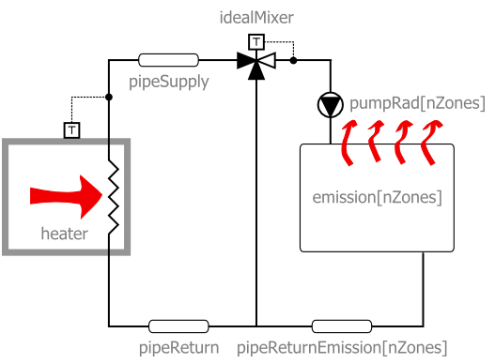
Low-energy office

Slide 24
Exercise 3
IDEAS demo
Low energy office building with 2 thermal zones & floor heating
Ideas for playing around
Change parameters heating (heating curve, type of heater)
Change parameters structure (insulation, windows, materials)
Add internal gains according to schedule
Night temperature set back
Add shading blinds to south windows (+ shading schedule)
More realistic office occupancy profiles
Add ventilation system
Different water set temperature per zone (tough)
Add a thermal zone (tougher)
Include pressure drops (toughest)

Slide 25
Thank you and enjoy!
This presentation, some reference docs and the code used in this crash course can be found on Toledo in the community ‘Thermische systemen in gebouwen’

