Slide 1
K-9 Mail for Android
Jesse Vincent
jesse@fsck.com

Slide 2
Hi!

Slide 3
I'm Jesse

Slide 4
I'm a Perl Hacker

Slide 5
Also, I like to break things

Slide 6
What is “K-9”?

Slide 7
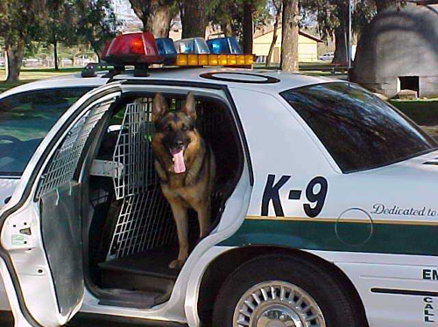

Slide 8
What is “K-9”?

Slide 9
Email client

Slide 10
For Android

Slide 11
Why “K-9”?

Slide 12
My favorite mail client

Slide 13
mutt

Slide 14
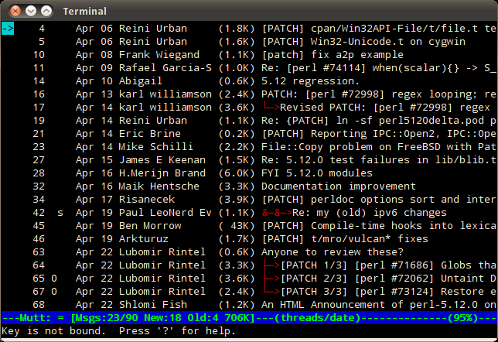

Slide 15
K-9

Slide 16


Slide 17

+
=

Slide 18
Didn't it come with a mail client?

Slide 19
No Search

Slide 20
No “stars”

Slide 21
No Self-Signed Certificate Support

Slide 22
No BCC-Self

Slide 23
No IMAP IDLE

Slide 24
No multi-select

Slide 25
No keybindings

Slide 26
No IMAP Deletes

Slide 27
I almost returned my new phone

Slide 28
It's Open Source

Slide 29
I could fix it

Slide 30
“How hard could it be?”

Slide 31
It's all Java

Slide 32
..the last time I used Java...

Slide 33
I used Mosaic

Slide 34
Applets were new

Slide 35
Internet Explorer 1.0 was brand new

Slide 36
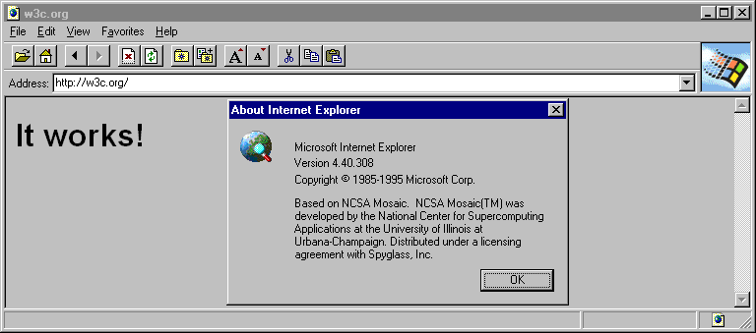

Slide 37
Java is supposed to be “easy” for newbies

Slide 38
How hard could it be?

Slide 39
So I got the code

Slide 40
git clone git://android.git.kernel.org/platform/packages/apps/Email.git

Slide 41
Only one change REALLY mattered

Slide 42
Delete from IMAP Servers

Slide 43
h
--- a/src/com/android/email/MessagingController.java
+++ b/src/com/android/email/MessagingController.java
@@ -455,13 +458,28 @@ public class MessagingController implements Runnable {
for (Message message : remoteMessages) {
Message localMessage = localUidMap.get(message.getUid());
if (localMessage == null ||
(!localMessage.isSet(Flag.X_DOWNLOADED_FULL) &&
+ !localMessage.isSet(Flag.DELETED) &&
!localMessage.isSet(Flag.X_DOWNLOADED_PARTIAL))) {
unsyncedMessages.add(message);
}
}
}
+ for (Message message : localMessages) {
+ Message remoteMessage = remoteUidMap.get(message.getUid());
+ // skip things deleted on the server side
+ if (remoteMessage != null && message.isSet(Flag.DELETED)) {
+ remoteMessage.setFlag(Flag.DELETED, true);
+ }
+ }

Slide 44
8 loc

Slide 45
I'm done!

Slide 46
Building K-9
(First time)

Slide 47
No Makefile

Slide 48
It's Java

Slide 49
No build.xml

Slide 50
“Just build the whole OS”

Slide 51
No

Slide 52
10 Hours

Slide 53
Worked great in emulator

Slide 54
...but not on a real phone

Slide 55
For “security”

Slide 56
What now?

Slide 57
Submit the change to Android?

Slide 58
I tried

Slide 59
They hadn't yet figured out the whole community thing

Slide 60
(It's gotten better)

Slide 61
I like to share

Slide 62
How to share?

Slide 63
Fork!

Slide 64
Fork the OS?!?!

Slide 65
What did it take to fork?

Slide 66
Google Code Project

Slide 67
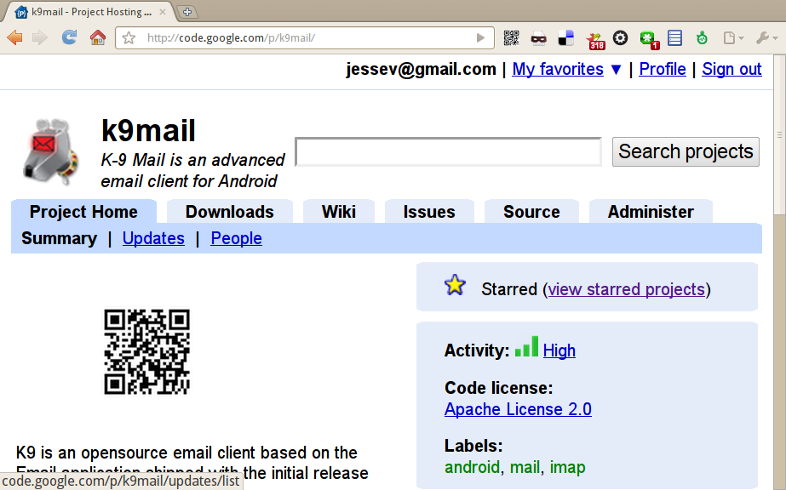

Slide 68
What's next?

Slide 69
Android Developer Account

Slide 70
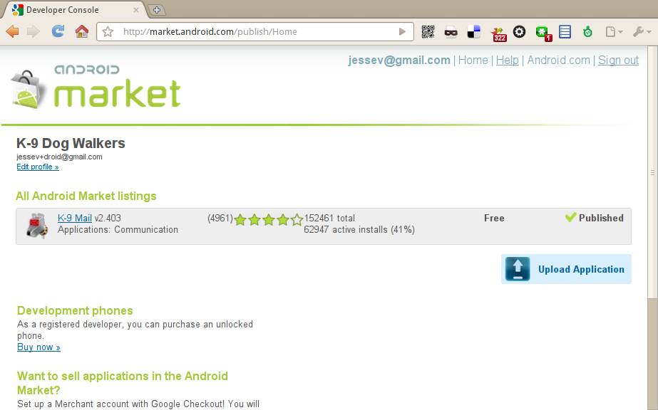

Slide 71
Pay $20 to become an Android Market Publisher

Slide 72
Submit a web form

Slide 73
Wait <10s

Slide 74
Profit!

Slide 75
Oh, wait

Slide 76
(It's free)

Slide 77
Jesse,
[...]
Please inform Motorola tech of this as they have recommended your program but disavow any knowledge of how to fix it, as you are 3rd party. They did though, suggest I contact godaddy, and they did give me your email, so they weren't completely useless.
ALSO, IT WOULD BE HELPFUL IF YOU SOMEHOW HAD A PHONE NUMBER ON YOUR SITE, and an easier way to contact your tech people.
M. A.

Slide 78
Writing end-user software is... different

Slide 79
What did Google think?

Slide 80
Some:

Slide 81
But why couldn't you submit patches?

Slide 82
Most:

Slide 83
Awesome...

Slide 84
...So, there's this feature I want...

Slide 85
K-9 Today

Slide 86
I have co-conspirators!

Slide 87
Authors (by commit count)
505 jessev
256 danapple0
143 baolongnt
45 cketti
31 ismarc31
17 young.bradley
16 brock.tice
5 dumbfile
4 tibbetts
2 sparrowhawk
1 yostinso++

Slide 88
They write features

Slide 89
They fix bugs

Slide 90
They help users

Slide 91
They make K-9 awesome

Slide 92
Over 150,000 Downloads

Slide 93
1500 “Bug” Reports

Slide 94
App Ecosystem

Slide 95
K-9 Mail
Locale Plugin

Slide 96
K-9 Data Killer

Slide 97
Email Popup

Slide 98
K-9 features

Slide 99
Updated UI

Slide 100
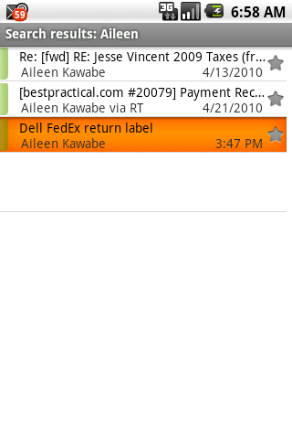

Slide 101
IMAP Push

Slide 102
Configurable polling

Slide 103
Multi-folder sync

Slide 104
“Stars”

Slide 105
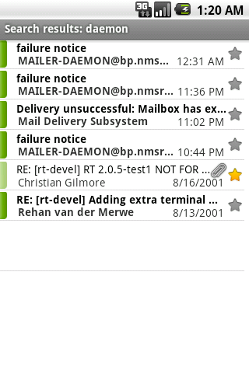

Slide 106
Multi-select

Slide 107
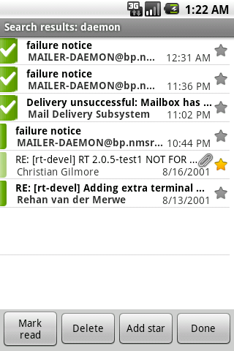

Slide 108
Message Previews

Slide 109
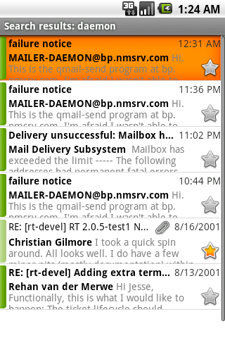

Slide 110
BCC-Self

Slide 111
Signatures

Slide 112
Multiple Identities

Slide 113
CRAM-MD5 Auth

Slide 114
Self-Signed SSL Certificates

Slide 115
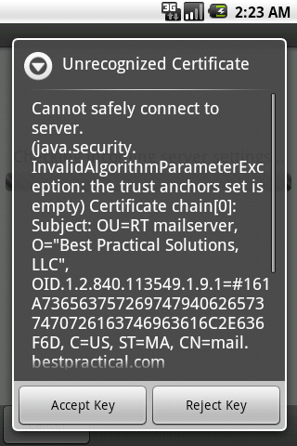

Slide 116
Keyboard shortcuts

Slide 117
Full-text search

Slide 118
Lots more!

Slide 119
Getting started hacking on K-9

Slide 120
Get the SDK

Slide 121
(It's free)

Slide 122
Linux, OSX or Windows

Slide 123
http://developer.android.com/sdk

Slide 124
Create an “AVD”

Slide 125
android create avd --name Fone --target android-7

Slide 126
Start the emulator

Slide 127
emulator -avd Fone

Slide 128
Checking out the code

Slide 129
svn co http://k9mail.googlecode.com/svn/k9mail/trunk/ k9

Slide 130
Create a local.properties file

Slide 131
sdk.dir=/home/jesse/android-sdk-linux

Slide 132
Building K-9

Slide 133
ant debug

Slide 134
Getting K-9 to your device

Slide 135
adb install bin/K9-debug.apk

Slide 136
Send patches!

Slide 137
googlecode.com/k9mail

Slide 138
Time to get hacking!

Slide 139
Come hack on K9 at Frog Cafe tomorrow!

Slide 140
Thanks!

Slide 141
Questions?
Jesse Vincent
jesse@fsck.com

