Slide 1
RT
(Request Tracker)
jesse@bestpractical.com
http://bestpractical.com

Slide 2
Hi, I'm Jesse Vincent
From Boston, MA in the US
Perl Hacker
Former Perl 6 project manager
Current Perl 5 “pumpking”
Kindle Hacker (Savory)
Android Hacker (K-9 Mail)
Notes:
Hidden. Jesse says this page doesn't tend to go over well.

Slide 3
Hi I'm Jesse Vincent
Original Author of RT
Main owner of Best Practical
RT project lead

Slide 4
(All that means is that I don't get to code as much as I want anymore)

Slide 5
Best Practical
We make RT
We sell support
We sell training
We sell consulting
We sell custom development

Slide 6
Where we are
We have “offices” in:
Boston, MA
Moscow, Russia
Hangzhou, China
Taipei, Taiwan

Slide 7
(We're 10 people)
(We're 10 people.)

Slide 8
RT
“Request Tracker”
Really, a generic ticketing system
License: GNU GPLv2
Continuous development since 1996
O(100) downloads per day.

Slide 9
What is a ticketing system?

Slide 10
It keeps track of things that need doing

Slide 11
...along with lots of metadata

Slide 12
...and business logic

Slide 13
...and access control

Slide 14
...It's just a TODO list

Slide 15
On some very serious drugs

Slide 16


Slide 17
not

Slide 18


Slide 19
Important properties of ticketing systems
Everything has a unique ID
Everything has a timestamp
History can't be edited or erased

Slide 20
What do you use a ticketing system for?
Network operations
Bug tracking
Call center
Helpdesk
Customer service
Work orders
Accounts Payable
Accounts Receivable
Vacation rentals
Youth counselling
Workflow

Slide 21
The RT Mindset
No task too small
No task too big
Update often
Low ceremony
Vague tickets are better than no tickets
Use RT to track discussions

Slide 22
What we use RT for

Slide 23
Bug Tracking

Slide 24
Bronze/Silver/Gold support

Slide 25
Customer Development

Slide 26
Resumes

Slide 27
Inbound Sales Inquiries

Slide 28
Sales Leads

Slide 29
Accounts Payable

Slide 30
Accounts Receivable

Slide 31
Who uses RT? http://wiki.bestpractical.com/view/RTUsers

Slide 32
How to set up RT

Slide 33
Requirements:
Perl (5.8.3 or newer)
Database
  MySQL 4.1+
  PostgreSQL 8.0+
  Oracle 9i+
  SQLite (for testing)
Webserver
  FastCGI
  mod_perl
  standalone (for testing)

Slide 34
Download and Install
Latest Tarball
  http://download.bestpractical.com/pub/rt/
    release/rt.tar.gz
Git repository
  git clone git://github.com/bestpractical/rt.git
Instructions in README

Slide 35
The quick start guide
  Wget
  http://download.bestpractical.com/pub/rt/release/rt.tar.gz
  tar xzf rt.tar.gz
  cd rt-3.8.8
  ./configure –enable-layout=inplace –with-my-user-group
  –with-devel-mode --with-db-type=SQLite
  make fixdeps install initdb

Slide 36
Features

Slide 37
Queues
Basic grouping of tickets
Separate business logic
Separate ACLs
Separate notifications

Slide 38
Groups
User defined
Can contain users & other groups
Import from LDAP (Optional)
Used for ACLs and Sharing

Slide 39
Roles
Per ticket
  Requestor
  Cc
  AdminCc
  Owner
Per queue
  Cc
  AdminCc

Slide 40
ACLs
User-based
Group-based
Role-based

Slide 41
Custom Fields
Type one/many values
Pick one/many from list
Upload one/many images
Upload one/many files
Autocomplete from list
Combobox
Type a big block of text

Slide 42
Custom Fields
On tickets, transactions, queues, users, groups
Cascaded fields
Hyperlinked values
External DB sources

Slide 43
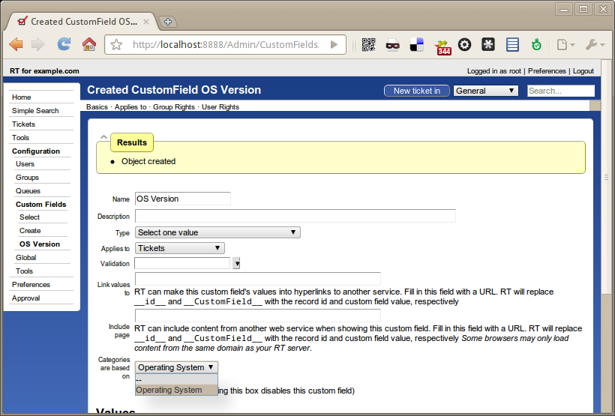

Slide 44
Scrips
Business Logic
“Triggers”
Conditions
Actions
Templates

Slide 45
Email Interaction
Incoming mail gateway
Outbound mail with Scrips

Slide 46
Internationalization
RT speaks about a dozen languages well
Community translations at launchpad.net/rt

Slide 47
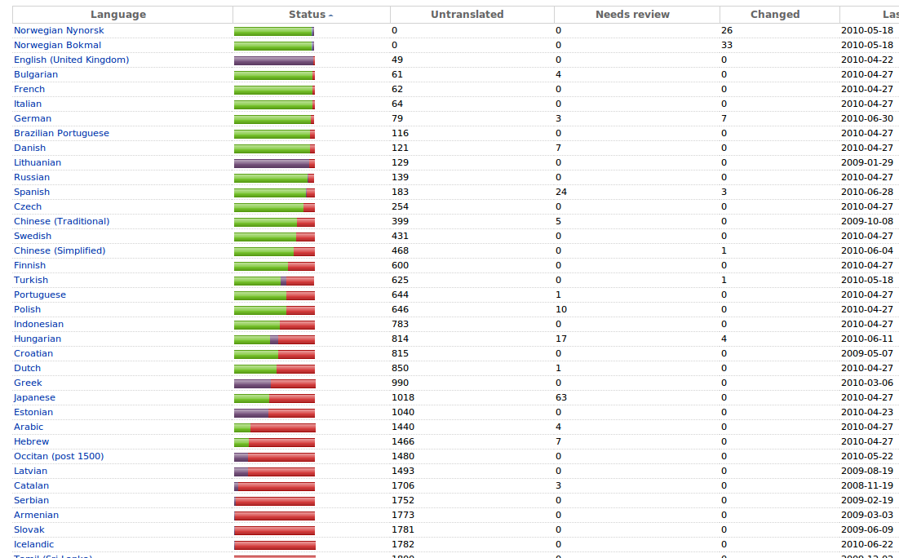

Slide 48
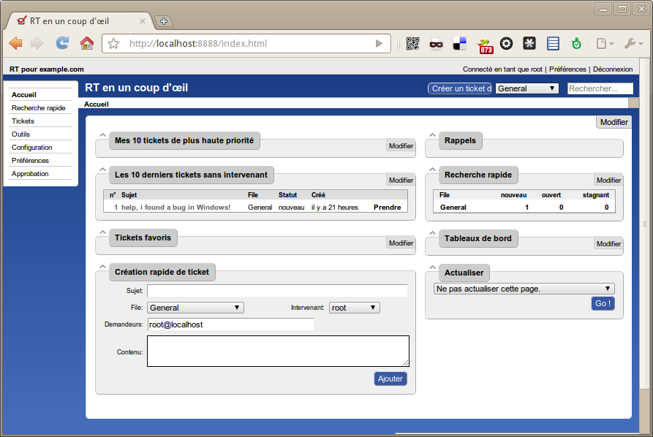

Slide 49
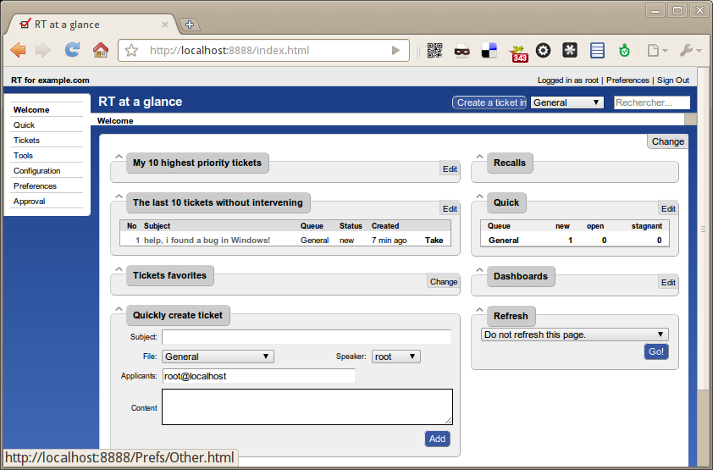

Slide 50
Separate comment / correspondence threads

Slide 51
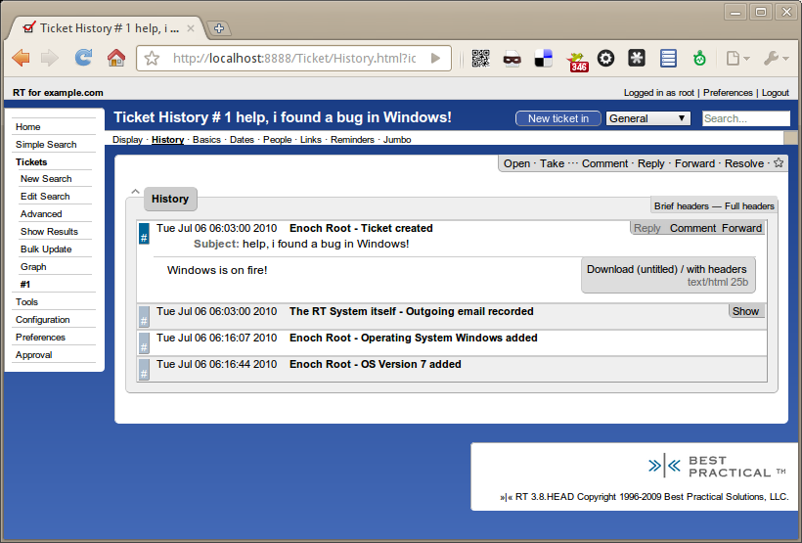

Slide 52
Saved Searches

Slide 53
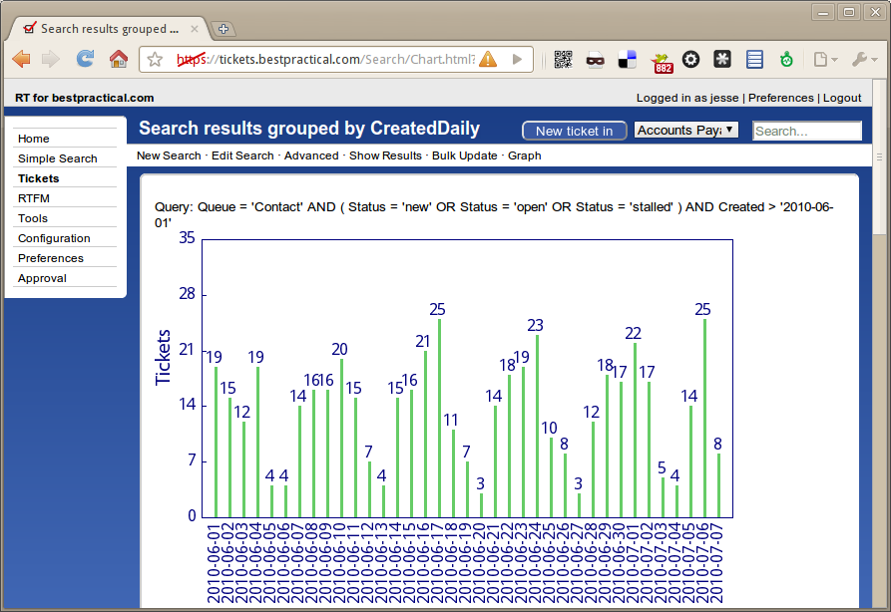
Graphs and Charts

Slide 54
Dashboards

Slide 55
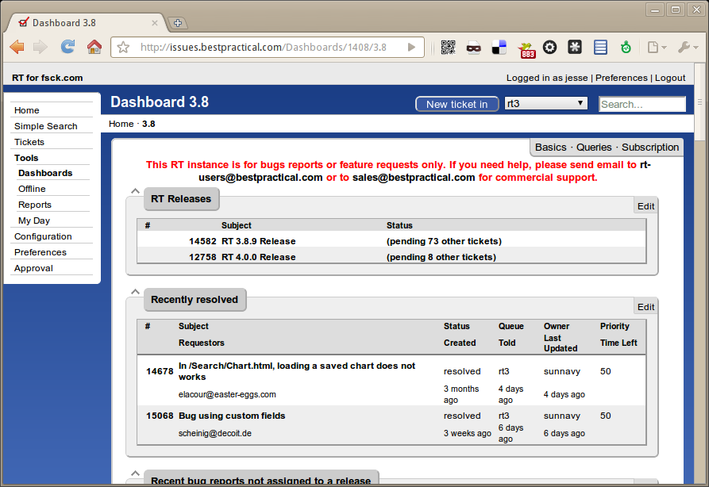

Slide 56
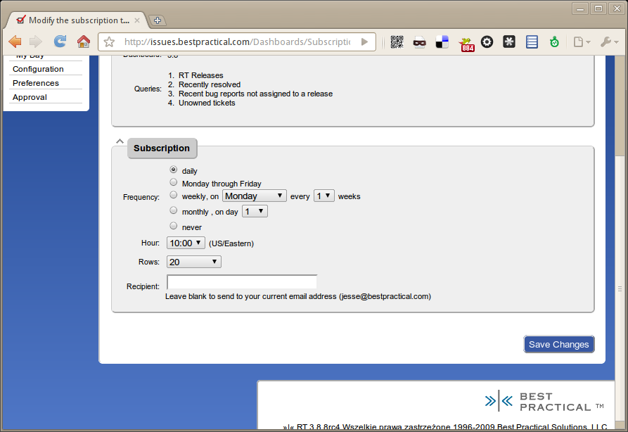

Slide 57
Self-Service interface

Slide 58
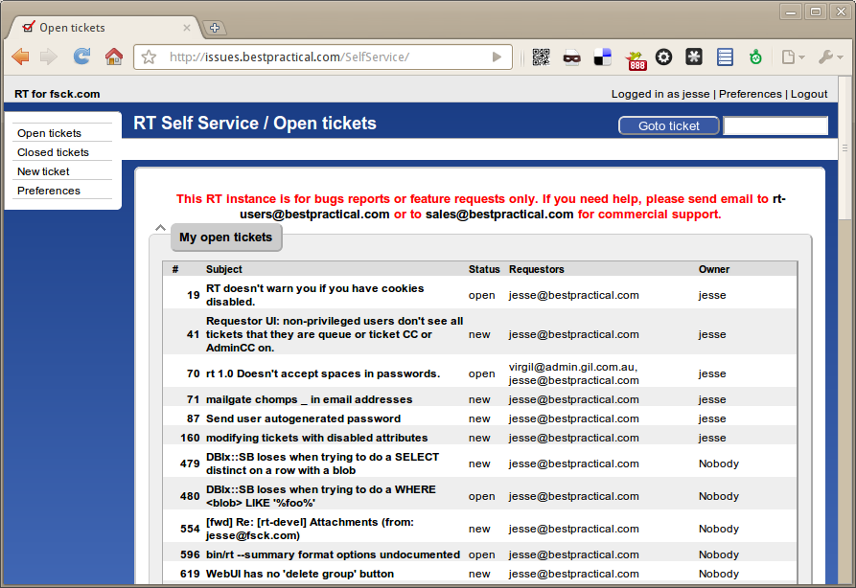
Self-Service interface

Slide 59
Workflow / Approvals

Slide 60
Integration

Slide 61
RT was built to be integrated and customised

Slide 62
CLI / API
CLI has ~no dependencies other than Perl
API – simple REST GET/POST

Slide 63
You can override everything

Slide 64
Code Overlays

Slide 65
Web UI Overlays

Slide 66
Translation overlays

Slide 67
You don't need to override anything

Slide 68
Web UI “Callbacks”

Slide 69
Scrips

Slide 70
Custom Fields
Notes:
(no db schema changes)

Slide 71
Authentication / SSO
LDAP
Active Directory
Kerberos
Apache

Slide 72
Scaling

Slide 73
Scaling Down

Slide 74
(for testing or development)

Slide 75
Run RT on your laptop

Slide 76
SQLite

Slide 77
Standalone webserver

Slide 78
Scaling up

Slide 79
Largest RT I know about

Slide 80
40,000-70,000 tickets per day

Slide 81
Multiple front-end app servers

Slide 82
Big database server with hot standby

Slide 83
(Smart realtime multi-reader is currently a todo)

Slide 84
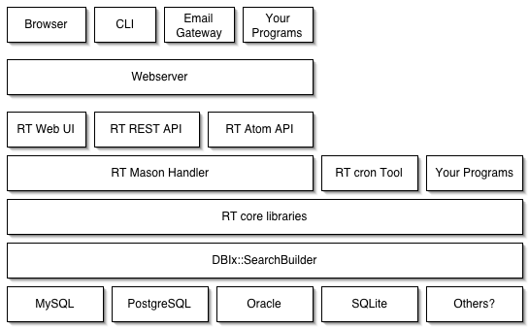
RT Architecture

Slide 85
Plugins

Slide 86
rt-extension-log-memoryusage
rt-extension-menubarsearches
rt-extension-mergeusers
rt-extension-mergeusershistory
rt-extension-nagios
rt-extension-notificationmatrix
rt-extension-priorityasstring
rt-extension-quickcalls
rt-extension-quickdelete
rt-extension-quickupdate
rt-extension-reportspam
rt-extension-rt_cpan_org
rt-extension-spawnlinkedticketinqueue
rt-extension-utils
rtfm
rtfm-extension-articletemplate
rtir
rtx-calendar
rtx-emailcompletion
rtx-ticketlist-transactions
rtx-workflowbuilder
rt-action-linearescalate
rt-action-notifygroup
rt-ajaxyreplypage
rt-authen-bitcard
rt-authen-openid2
rt-bugtracker
rt-bugtracker-public
rt-condition-complex
rt-crypt-smime
rt-extension-activityreports
rt-extension-activityreports-billing
rt-extension-addadminccsonqueuechange
rt-extension-attributewalker
rt-extension-captcha
rt-extension-cloneticket-withdata
rt-extension-commandbyemail
rt-extension-commandbymail
rt-extension-commentoncreate
rt-extension-customfield-hideemptyvalues
rt-extension-datediscordian
rt-extension-extractcustomfieldvalues
rt-extension-formtools
rt-extension-jsgantt
rt-extension-ldapimport

Slide 87
(and a bunch more created by RT users)

Slide 88
Two “bigger” extensions:
RTFM and RTIR

Slide 89
RTFM

Slide 90
Request Tracker FAQ Manager

Slide 91
Knowledge Base

Slide 92
Stock Answers

Slide 93
RTIR
RT for Incident Response
Custom designed for a consortium of 12 European CERT/CSIRT teams
CERT-specific workflows & metadata

Slide 94
Incident Reports

Slide 95
Incidents

Slide 96
Investigations

Slide 97
Network Blockades

Slide 98
RTFM and RTIR are new applications using RT as a platform.

Slide 99
Resources
http://bestpractical.com/rt
http://issues.bestpractical.com
  guest / guest
http://lists.bestpractical.com
  rt-users
  rt-devel
  rt-commit
http://wiki.bestpractical.com
irc://irc.perl.org - #rt

Slide 100
Thank you!
Questions?
jesse@bestpractical.com
http://bestpractical.com

Slide 101
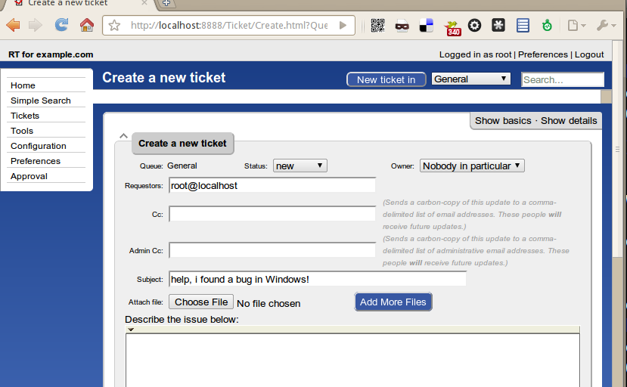
Create a ticket

Slide 102
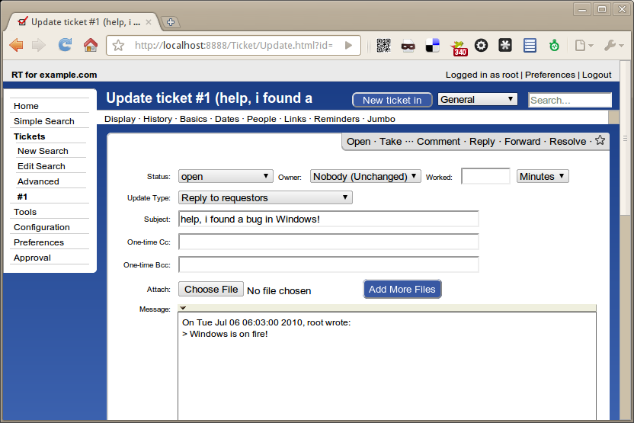
Reply to a ticket

