Slide 1
Topological Deepfake Detection
Can persistent homology on spectrogram fields
separate real speech from fakes — and transfer?
Owen Rempfer · TDA Course Project · April 2026
Notes:
This project asks whether topological summaries of spectrogram fields can detect spoofed or deepfaked audio. The second question is whether the structure transfers across datasets rather than only fitting one benchmark. I'll walk through the method, the main structural findings, and why the low-band / H1 story matters.

Slide 2
The Problem
Deepfakes are improving fast
Modern synthesis (VALL-E, RVC, XTTS, etc.) produces speech that is increasingly hard to tell apart from real recordings.
Current detectors are opaque
End-to-end neural classifiers output a score but cannot say which physical property of the audio is violated.
Our question
Can stable topological structure in speech representations distinguish real from fake — and can we trace the signal to interpretable components?
Notes:
Most audio deepfake detection systems are strong but hard to interpret. I wanted to test whether topological summaries can recover discriminative structure in a way that is easier to probe and ablate. The goal is not only performance — it is to learn something structural about the signal.

Slide 3
Method
Audio
Mel
Spectrogram
Cubical PH
Vectorize
Classify
→
→
→
→
Speech clip
2-D field
H₀ + H₁
Landscapes
SVM / MLP
Key design levers
Low-band masking
Keep only the low mel-frequency region of the spectrogram
Energy gating
Suppress silent frames before computing topology
Homology ablation
Test H₀, H₁, and H₂ separately to isolate which dimension matters
Notes:
I treat the mel spectrogram as a 2-D field, compute cubical persistent homology on that field, vectorize the resulting persistence information, and then classify from those topological vectors. The key levers were low-band masking, energy gating, and homology-dimension ablations. This keeps the method more interpretable than an end-to-end spectrogram model. The next two slides show what these spectrograms actually look like and how the ablation masks change the field before any topology is computed.

Slide 4
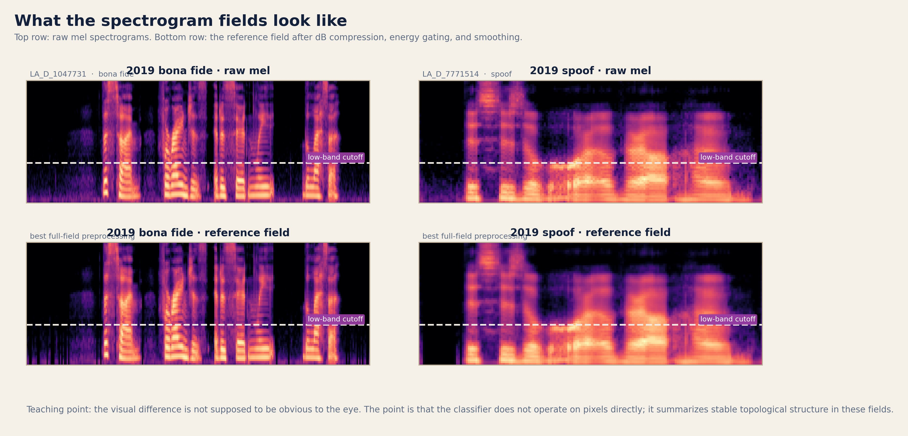
What the Fields Look Like
Bona fide vs. spoof spectrograms, before and after field preprocessing (dB compression + energy gating).
Notes:
This slide is here so everyone knows what the topology is actually being computed on. Top row: raw mel spectrograms — one bona fide, one spoof. The dashed line marks the low-band cutoff. Bottom row: the same samples after field preprocessing — dB compression and energy gating. This is the 'reference field' that goes into cubical PH. Teaching point: the visual difference between real and fake is NOT supposed to be obvious to the eye. The classifier does not operate on pixels directly — it summarizes stable topological structure in these fields. That is the whole point of using PH instead of just a CNN. If someone asks 'can you see the difference?': not reliably by eye, but the topology captures structural patterns across the entire field that are not visible in any single pixel region.

Slide 5
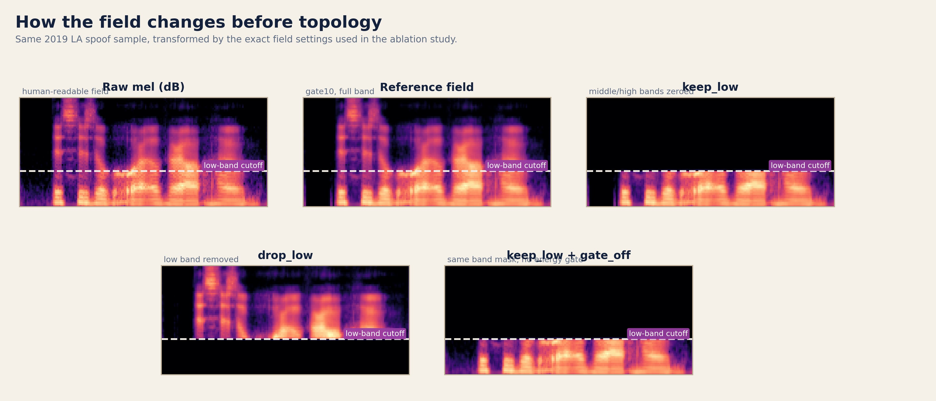
How Ablation Changes the Field
Same spoof sample under the exact field settings used in the ablation study.
Notes:
This slide makes the low-band story visual before you ever mention AUC or EER. Walk through the five panels: 1. Raw mel (dB) — the human-readable spectrogram. 2. Reference field — after energy gating and compression. This is the full-field input to cubical PH. 3. keep_low — everything above the low-band cutoff is zeroed out. Only the bottom third survives. This is the branch that wins. 4. drop_low — the opposite: only the upper bands survive, the bottom is removed. This is the branch that collapses. 5. keep_low + gate_off — same low-band mask but without energy gating, so silent frames are included. You can literally point at the lower third: the successful branch keeps this region, the failing branch deletes it. That makes the low-band story concrete before you even show the numbers. WHAT IS ABLATION? In this context, ablation means deliberately removing one part of the representation — a frequency band, a homology dimension, a preprocessing step — and re-running the full pipeline to see what mattered. It is a controlled subtraction experiment. If removing something causes performance to collapse, that component was carrying real signal. PH is especially well-suited for this because its features have concrete geometric meaning: when you ablate a frequency band and H1 collapses, that tells you the loops in that region were the signal. A CNN ablation would tell you 'this layer mattered,' but not what geometric property of the input was driving the discrimination.

Slide 6
Why Persistent Homology?
PH captures stable structure across scales, not fragile pointwise cues.
H₀
Connected components — clustering structure
That stability is what makes PH uniquely suited for ablation. When you remove a frequency band or a homology dimension and re-run the pipeline, PH tells you whether the stable structure survived or collapsed. Other feature extractors can also be ablated, but their features are either too entangled to localize cleanly or too low-level to carry structural meaning. PH sits in a sweet spot: its summaries are tied to real geometric properties of the input field (connected regions, loops), so a result like "H₁ matters most" is a statement about the data's shape, not about a hidden layer's weights.
H₁
Loops — cyclical, intermediate-scale patterns
H₂
Voids — higher-order cavities (not useful here)
Scale-based
Fakes may differ across thresholds, not at one coordinate.
Robust
Stability theorem: small input change → small persistence change.
Interpretable
Ablation results map to geometry: H₀, H₁, low vs high band.
Notes:
This slide explains WHY topology and not some other feature extraction. The key point: PH produces summaries tied to real geometric properties of the input field. When you ablate a frequency band and the H1 persistence collapses, that tells you something structural: the loop-like patterns in that region were carrying the signal. A CNN ablation might tell you 'layer 3 matters,' but that is about the model, not the data's geometry. PH sits in a sweet spot for explainability: - Its features (components, loops, voids) have concrete geometric meaning. - You can ablate at the representation level (which band? which homology dimension?) and get answers about the signal, not the classifier. - The stability theorem guarantees small perturbations → small persistence changes, so features are robust by construction. H0 = connected components. H1 = loops. H2 = voids (did not help in this 2-D setup). If someone asks 'why not GradCAM?': GradCAM tells you which pixels the model looked at, but not what structural property of the signal matters. PH ablation tells you which geometric motif is carrying the discrimination.

Slide 7
Cubical vs. Vietoris-Rips Complexes
We learned Vietoris-Rips in class. This project uses cubical complexes instead. Here is why.
Vietoris-Rips
Cubical
Input: a point cloud in ℝᵈ
Input: a grid / image (like a spectrogram)
Build simplicial complex from pairwise distances: connect points within radius ε
Build complex from grid cells directly: pixels → vertices, adjacent pixels → edges, 2×2 blocks → squares
Grow ε to track birth/death of features
Sublevel-set filtration: sweep a threshold over pixel values
Good for: unstructured data, embeddings, trajectories
Good for: images, fields, any data on a regular grid
Expensive: O(n²) distances, combinatorial blowup in higher dimensions
Fast: linear in pixel count, no distance matrix needed
A spectrogram is already a grid → cubical PH respects that structure instead of discarding it into a point cloud.
Notes:
This slide bridges from what we learned in class (Vietoris-Rips) to what this project uses (cubical complexes). VIETORIS-RIPS — what we covered in class: - Start with a point cloud in some ambient space. - For each radius epsilon, connect every pair of points within distance epsilon. - Fill in all cliques to get a simplicial complex. - Track how features (components, loops, voids) are born and die as epsilon grows. - Great for unstructured data — embeddings, trajectories, point samples from a manifold. - Downside: O(n²) distance matrix, combinatorial blowup. CUBICAL COMPLEXES — what this project uses: - Input is already on a regular grid — a 2-D spectrogram where each pixel has a value. - Instead of simplices from distances, build cubes from grid cells: vertices are pixels, edges connect grid-adjacent pixels, squares fill in 2x2 neighborhoods. - The filtration is a sublevel-set filtration on pixel values: sweep a threshold from low to high, cells enter the complex when their value falls below the threshold. - Much faster — linear in pixel count, no pairwise distances. - Respects the grid structure of the image, which a VR complex on the same pixels would throw away. WHY CUBICAL WON in this project: - A spectrogram is a structured 2-D field. Cubical PH treats it as such. - Spatial ablations are natural: mask a frequency band in the grid and re-run cubical PH. - I also tried VR on MFCC point clouds — it worked but was weaker and harder to ablate spatially. If someone asks about the filtration: in VR, the parameter is the distance radius epsilon. In cubical, the parameter is the pixel-value threshold. Both sweep from 'nothing' to 'everything,' tracking what topological features appear and disappear along the way.

Slide 8
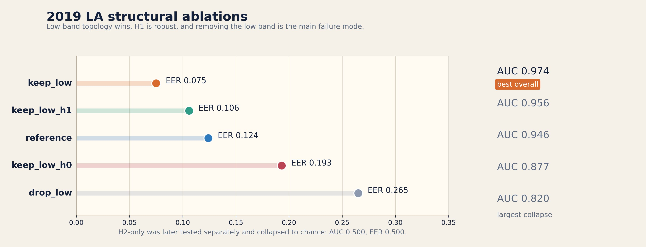
2019 LA: Structural Ablations
Low-band topology wins. H₁ is the most robust component. Removing the low band is the main failure mode.
Notes:
This was the original strongest setup on ASVspoof 2019 LA. Key numbers: - keep_low: AUC 0.974, EER 0.075 — best overall. - keep_low_h1: AUC 0.956, EER 0.106 — H1 alone is strong. - reference (full field): AUC 0.946, EER 0.124. - keep_low_h0: AUC 0.877, EER 0.193 — H0 helps but is much weaker. - drop_low: AUC 0.820, EER 0.265 — the largest degradation. - H2 tested separately: collapsed to chance (AUC 0.500). Low-band structure was the strongest signal. H1 was the most robust component, but H0+H1 combined was best in-domain. Each bar is a full re-run of the pipeline with one component removed or isolated. When keep_low beats the full reference, that means the upper bands were adding noise, not signal.

Slide 9
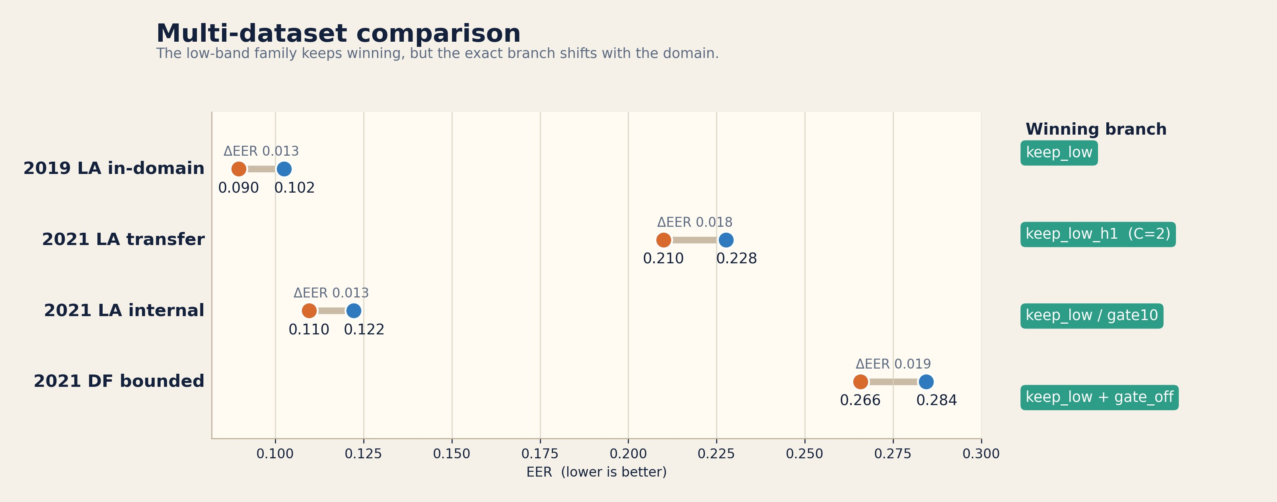
Multi-Dataset Comparison
The low-band family keeps winning, but the exact branch shifts with the domain.
Notes:
This is the main narrative slide. The winner shifts by dataset: - 2019 LA in-domain → keep_low (EER 0.090 vs 0.102) - 2021 LA transfer → keep_low_h1 with C=2 (EER 0.210 vs 0.228) - 2021 LA internal → keep_low / gate10 (EER 0.110 vs 0.122) - 2021 DF bounded → keep_low + gate_off (EER 0.266 vs 0.284) But the low-band family keeps surviving across all four settings. That is more interesting than one config winning everywhere — the structural principle transfers, even if the exact parameterization doesn't.

Slide 10
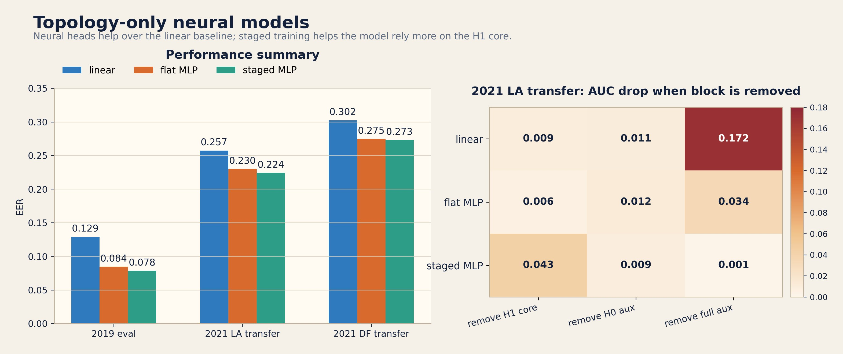
Topology-Only Neural Models
Same topological inputs, more expressive classifier. Staged MLP trains the robust core first.
Notes:
The neural pass was deliberately small and controlled — same topology inputs, more expressive classifier. Three heads: linear baseline, flat MLP, staged MLP. Staged MLP trains low-band H1 core first, then adds H0 auxiliary, then full-field auxiliary. Results (EER): - 2019 dev: 0.078 (staged) vs 0.084 (flat) vs 0.129 (linear). - 2021 LA transfer: 0.224 vs 0.230 vs 0.257. - 2021 DF transfer: 0.273 vs 0.275 vs 0.302. Ablation heatmap (right panel) is the key interpretability result: - Staged MLP depends most on H1 core (AUC drop 0.043 when removed). - Linear baseline depends most on full auxiliary (AUC drop 0.172). Staged training didn't just improve metrics — it improved alignment with the structural hypothesis. Important: staged MLP has not yet beaten the strongest tuned classical transfer config.

Slide 11
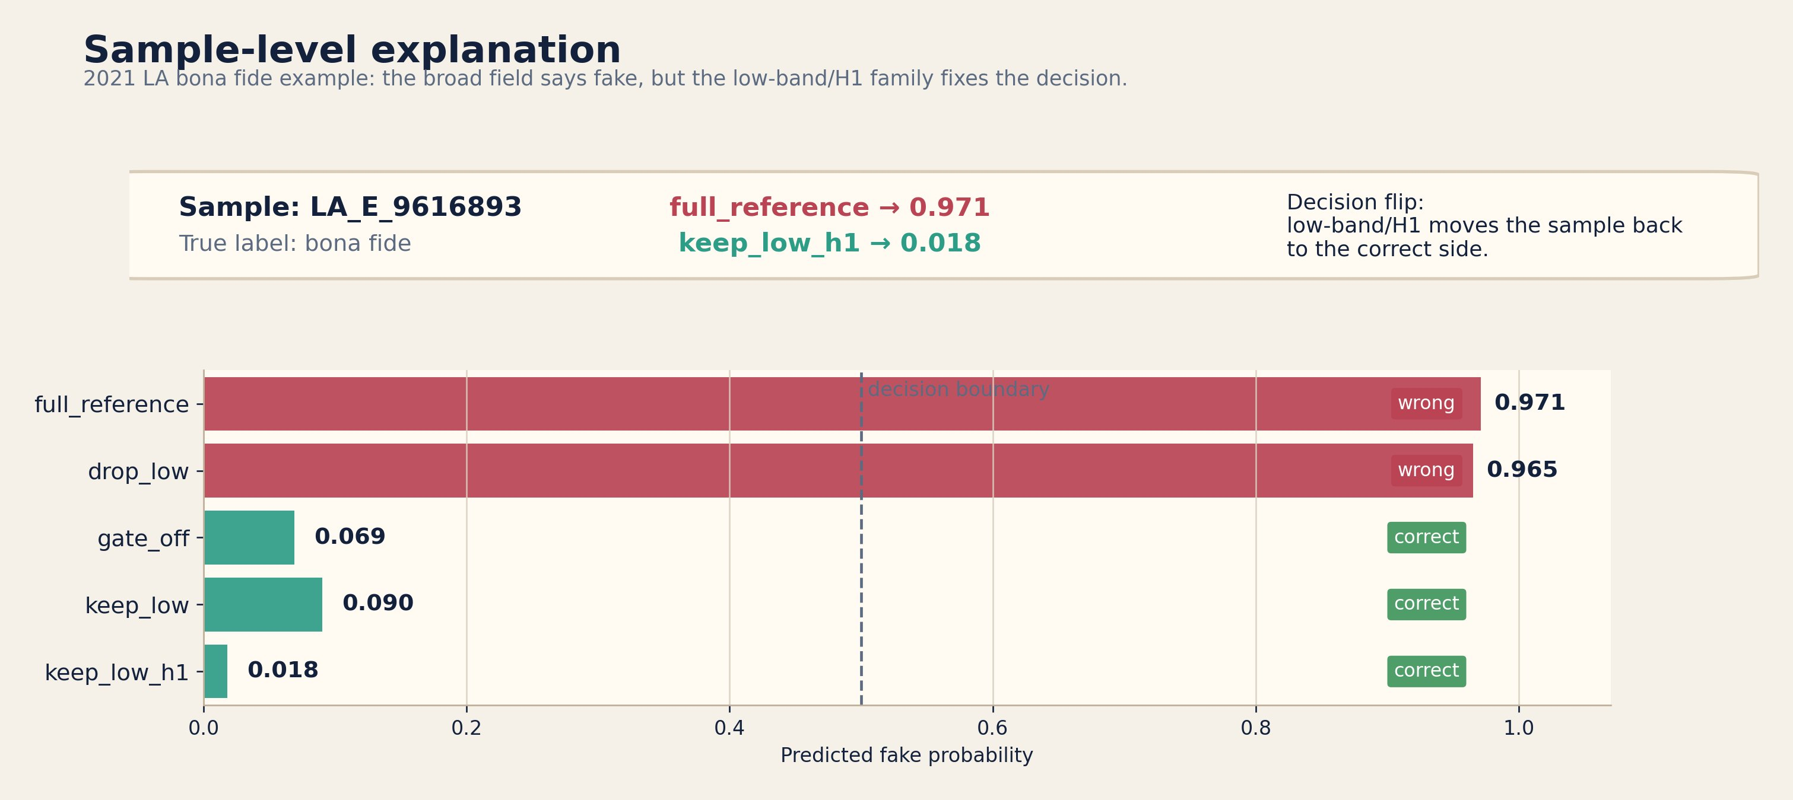
Sample-Level Explanation
A bona fide sample where the full-field model says "fake" — but low-band / H₁ fixes the decision.
Notes:
This is the easiest slide for making the method feel less abstract. Sample LA_E_9616893 from 2021 LA — true label is bona fide. - full_reference: fake probability 0.971 — confident wrong answer. - drop_low: 0.965 — still wrong. - keep_low: 0.090 — correct. - keep_low_h1: 0.018 — most confident correct answer. This shows the structural claim manifests at the individual sample level. This is where the explainability argument lands concretely: the full-field topology was misled by broadband structure, but isolating low-band loops recovers the correct answer. That kind of localized structural explanation is what PH-based ablation uniquely provides.

Slide 12
Limitations & Caveats
Transfer is weaker than in-domain
EER roughly doubles from 2019 in-domain (~0.09) to 2021 LA transfer (~0.21). The structural story survives, but raw metrics degrade.
DF results are bounded
DF transfer used balanced subsets from one archive shard. These are useful evidence, not a definitive DF benchmark claim.
No SOTA claim
The goal is interpretable structural insight, not beating end-to-end neural detectors. A CNN on raw spectrograms would likely score higher.
Neural model hasn't beaten best classical config
The staged MLP beat the linear topology baseline, but has not yet surpassed the strongest tuned classical transfer branch.
Notes:
Be upfront about limitations. These honest caveats strengthen credibility of the structural claims you do make.

Slide 13
Takeaways
Cubical PH on spectrogram fields works for audio deepfake detection.
Low-band topology is the most robust structural motif — it survives across four dataset settings.
H₁ (loop-level persistence) is the most transferable homology component.
PH-based ablation provides explanations tied to the geometry of the signal, not just model internals.
Staged topology-only neural learning preserves the robust core better than flat alternatives.
Topology is not just usable here — it is diagnostically useful.
Notes:
End with the structural story, not just the best metric. Main claims: 1. Cubical PH on spectrogram fields works. 2. Low-band topology is the most robust motif. 3. H1 matters most for transfer. 4. PH-based ablation gives explanations about the signal's geometry, not just which model layer lit up. 5. Staged topology-only learning is a promising direction. Closing line: 'Topology is not just usable here — it is diagnostically useful.'

