Slide 1


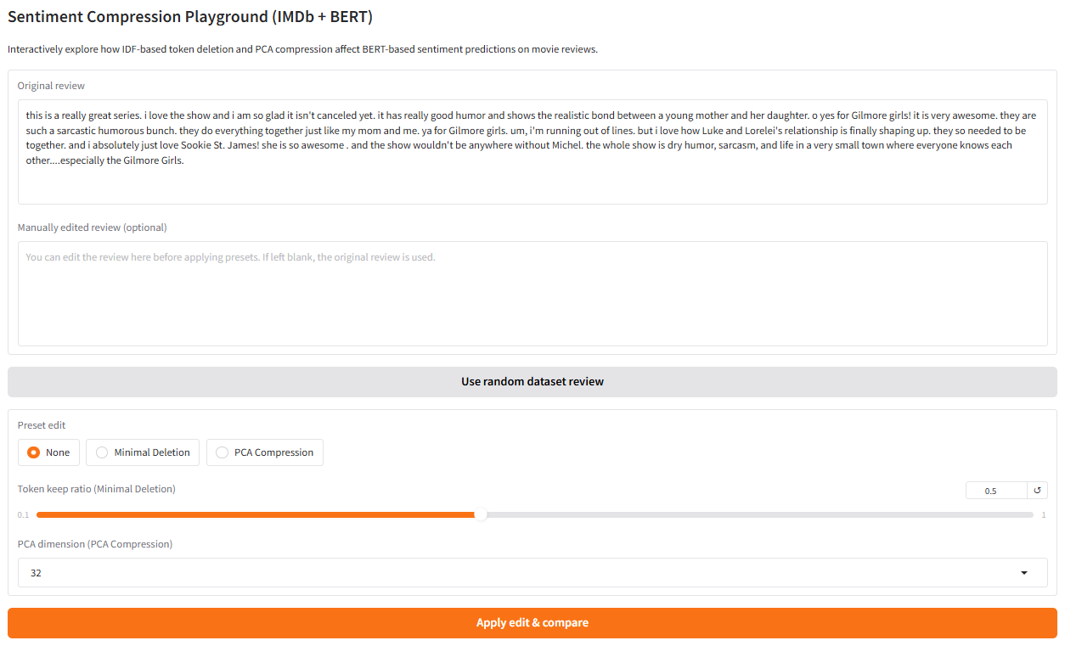
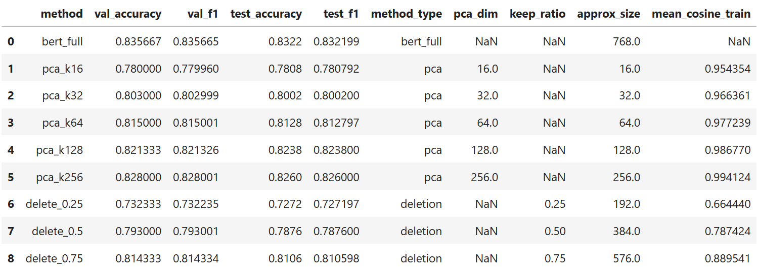
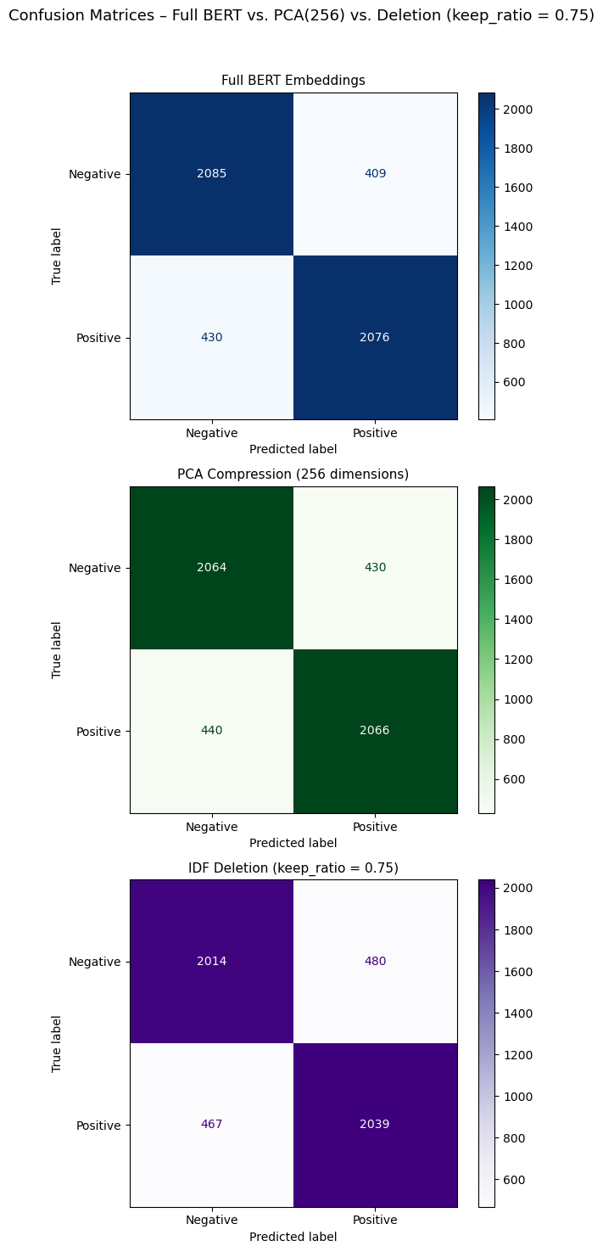
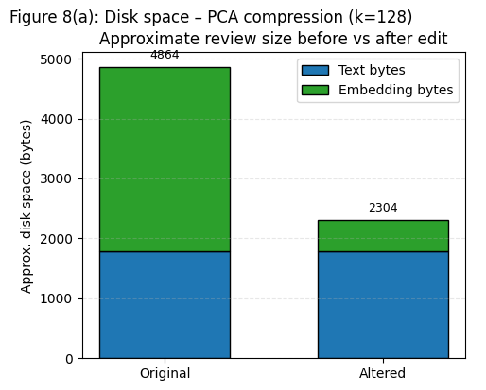
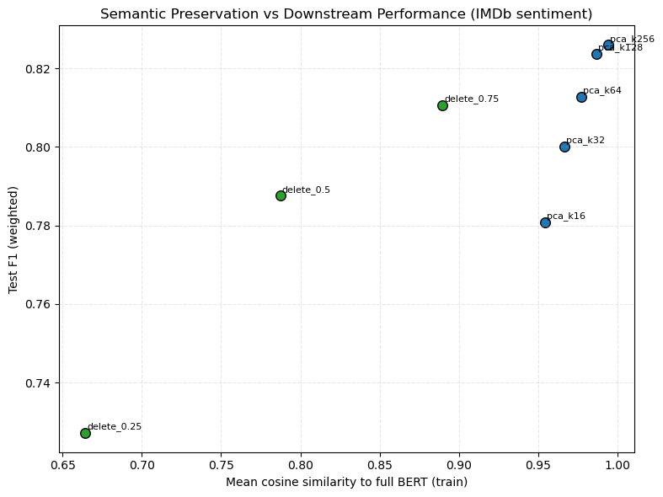
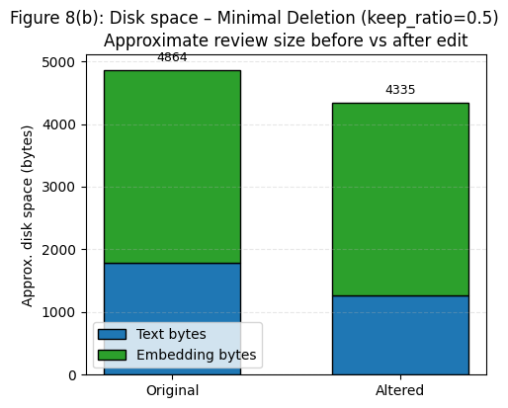
Interactive Analysis of Sentiment Retention under BERT Embedding Compression and Deletion
Link to Project: https://github.com/obriend7atwit/NLP_Project_Dylan_OBrien.git
Dylan OBrien (obriend7@wit.edu)
Wentworth Institute of Technology, School of Computing and Data Science, Boston, Massachusetts
Problem and Motivation
Methodology
Results
Interactive Demo (Gradio)
Goal:
Automatically classify IMDb movie reviews as positive or negative using modern NLP methods.
Baseline:
BERT-based models offer high accuracy but are computationally heavy and memory-intensive.
Real-world constraint:
Many applications run on resource-limited devices (laptops, embedded systems, web dashboards) where full BERT is costly.
Central question:
How much can we compress BERT embeddings or shorten inputs while still preserving sentiment predictions?
Motivation:
Reduce inference cost and storage footprint without severe accuracy loss.
Enable faster, lighter sentiment systems for deployment and teaching.
Provide an interactive tool that helps users see what compression does to text, embeddings, and predictions.
System Overview
Key Results
Input:
Raw IMDb review text.
Encoder:
Pre-trained bert-base-uncased (Hugging Face Transformers).
Sentence representation:
Use the final-layer [CLS] token as a 768-dimensional embedding.
BERT is frozen (no fine-tuning) → acts as a feature extractor.
Compression stage:
PCA-based compression in embedding space.
IDF-based minimal deletion in input space.
Classifier:
Logistic Regression trained on BERT embeddings.
Same classifier architecture used for full and compressed representations
Text → BERT → Embedding → (PCA/Deletion) → Logistic Regression → Sentiment
Full BERT baseline:
Strong accuracy and macro-F1 on IMDb.
Serves as upper bound for compressed variants.
PCA compression:
At 128–256 dimensions, performance remains close to baseline.
Mean cosine similarity stays high, indicating minimal semantic distortion.
At ≤ 32 dimensions, F1 and similarity drop somewhat, showing over-compression.
CM PCA(256): slight increase in errors but similar pattern to baseline.
IDF-based deletion:
Keep ratio 0.75–1.0: modest deletion, small performance loss.
Keep ratio ≤ 0.5: larger drops in accuracy/F1 as important sentiment cues are removed.
CM Deletion (0.75): more false negatives or false positives when key phrases are removed.
Main Takeaways:
PCA mainly reduces embedding size.
Deletion mainly reduces text length.
Approximate disk usage (text bytes + embedding bytes) illustrates different compression benefits.
Confusion matrices highlight how compression changes the types of mistakes, not just the overall score.
Conclusions, Limitations, and Future Work
Key Insights
Compression Strategies
BERT embeddings for sentiment are highly redundant:
Significant dimensionality reduction via PCA is possible before performance collapses.
Embedding-space compression (PCA) is generally safer than input-space deletion:
PCA preserves structure while shrinking representation size.
Deletion can remove critical negation, intensifiers, or context.
Interactivity helps users understand and trust model behavior under compression.
PCA Embedding Compression
Train Principal Component Analysis (PCA) on training embeddings.
Test multiple target dimensions: 𝑘=16,32,64,128,256
For each embedding:
Project to k-dimensional space and reconstruct back to 768-dim.
Feed reconstructed embeddings into the same logistic regression classifier.
Goal: Reduce embedding dimensionality while keeping sentiment information intact.
IDF-Based Token Deletion
Compute inverse document frequency (IDF) for tokens over the training set.
For each review:
Rank tokens by IDF score (higher IDF = rarer, more informative).
Keep only the top tokens according to a keep ratio 𝑟.
Keep ratios explored: 𝑟=1.0,0.75,0.5,0.25 (and others).
Reassemble the shortened review and re-encode with BERT.
Effect: Shorter input, potentially less context, but faster / smaller overall system.
Limitations
Dataset
Single dataset: IMDb, English movie reviews.
Encoder is frozen (no fine-tuning); results may differ for fully fine-tuned transformers.
Only two compression strategies explored:
PCA in embedding space.
Static IDF-based deletion in input space.
Human evaluation is qualitative via GUI usage, not a controlled user study.
Source:
IMDb 50K Movie Reviews dataset (standard binary sentiment benchmark).
https://www.kaggle.com/datasets/lakshmi25npathi/imdb-dataset-of-50k-movie-reviews
Size:
50,000 labeled reviews
25,000 positive, 25,000 negative
Splits used in this project:
Train: 20k reviews → further split into train/validation
Validation: 5k reviews
Test: 5k reviews, held-out for final evaluation
Properties:
Reviews are free-form English text with varied length and style.
Test set contains no overlap in movies with the training set.
Future Work
Investigate learned token pruning, knowledge distillation, and quantization for more advanced compression.
Extend framework to:
Other domains (e.g. social media, product reviews, multi-lingual data, larger texts).
Aspect-based sentiment analysis and other NLP tasks.
Conduct user studies on:
Perceived quality, fairness, and trust in compressed sentiment models.
How interactive tools influence model understanding.
References
[1] Devlin et al., “BERT: Pre-training of Deep Bidirectional Transformers for Language Understanding,” NAACL, 2019.
[2] Wolf et al., “Transformers: State-of-the-art NLP,” EMNLP, 2020.
[3] Maas et al., “Learning Word Vectors for Sentiment Analysis,” ACL, 2011.
[4] Huertas-García et al., “Exploring Dimensionality Reduction Techniques in Text Embedding Spaces,” Appl. Sci., 2022.
[5] Kim et al., “Learned Token Pruning for Transformers,” KDD, 2022.
[6] Abid et al., “Gradio: Hassle-free Sharing and Testing of ML Models in the Wild,” arXiv:1906.02569, 2019.
Macro-averaged F1 – balances performance on positive and negative classes.
Mean cosine similarity – how close compressed embeddings are to original ones.

