Slide 1

Runge -Kutta Method
Shuaizhou Wang
MSSC6030

Slide 2
review
Froward Euler method
Backward Euler method
Trapezoid

Slide 3

Froward Euler method
Backward Euler method
Trapezoid
Def: If an ODE has a true solution
that

Slide 4
Then take integral of ODE
Newton-Cotes formula:
For each y point yn need to be predict from all of point above.

Slide 5
If we take r=1
Where
If we take r=2, the next y value need to be predict from the previous point
Where
So the equation for r=2 is
Also the next y value need to predict from k1 and k2
And so on

Slide 6
Ruuge Kutta equation

Slide 7



r=2
taylor expansion of y(xn+1)
The difference of the approximate value and true value is

Slide 8
So the second order R-K method is

Slide 9
RK3
RK4

Slide 10
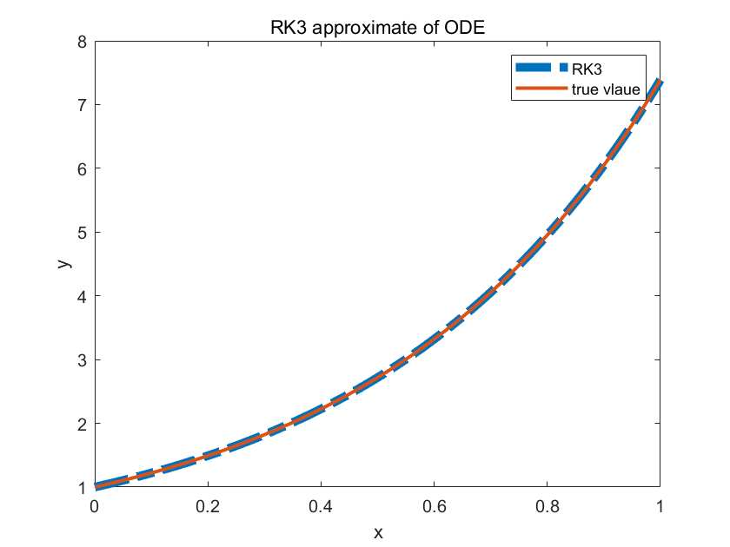
Example
True solution

Slide 11
Activity
For the same ODE:
Making a approximate Using RK4 and see if the RK4 has less error than RK3.

