Slide 1
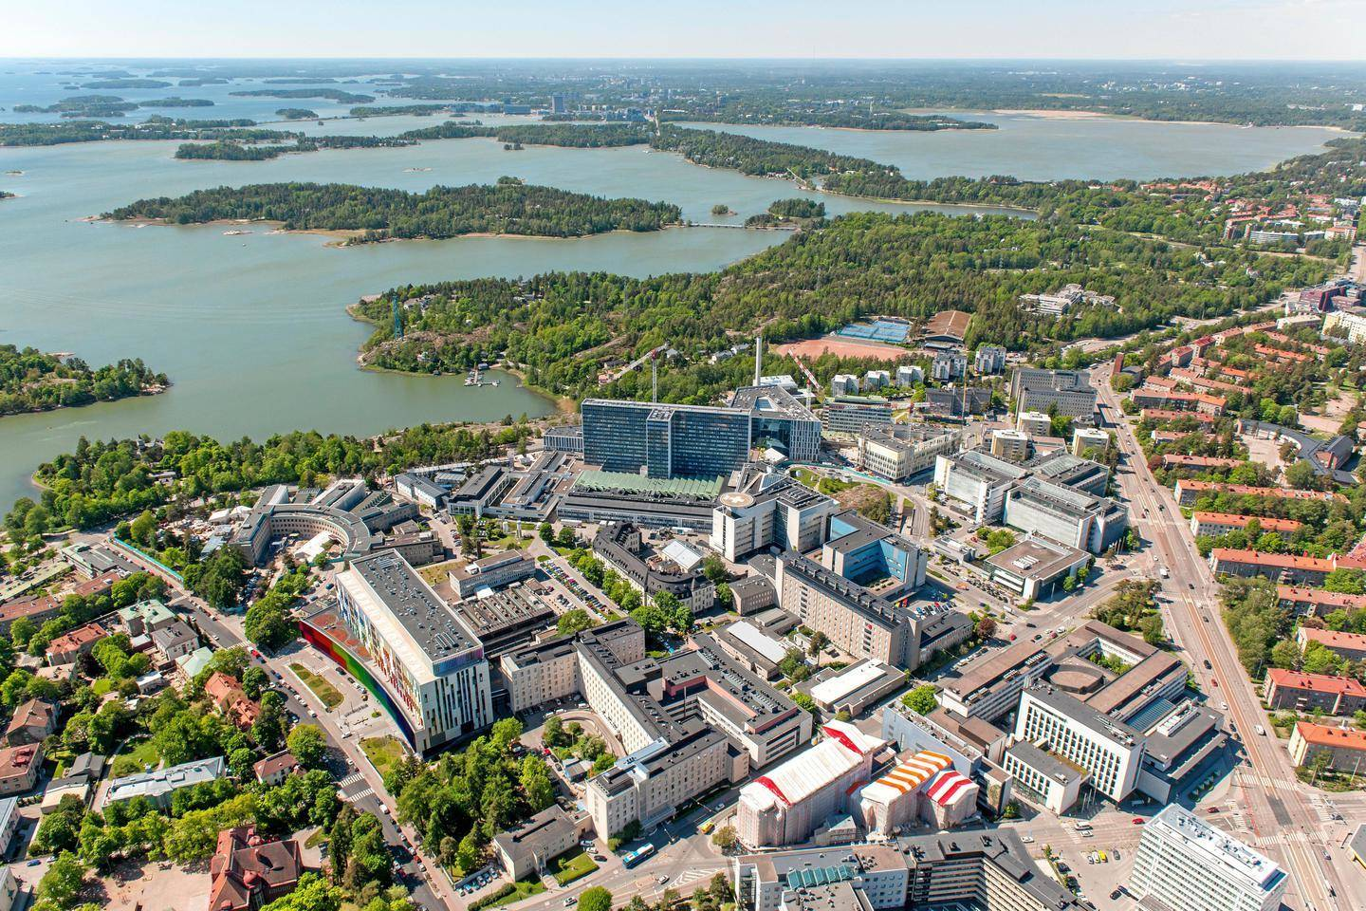
Helsinki University Hospital
Biomedicum
HUSLAB

