Slide 1

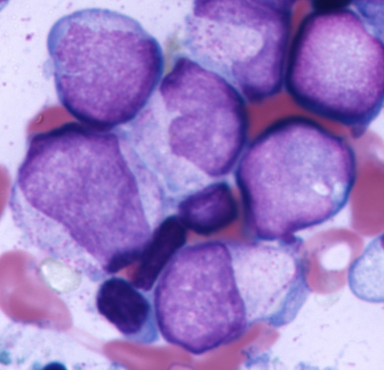

AIM I
AIM II-V
AIM VI
150 | 167 | 181 | 169 | 130
152 | 155 | 189 | 177 | 105
199 | 196 | 143 | 84 | 98
224 | 201 | 98 | 87 | 76
249 | 65 | 94 | 76 | 90
CLINICAL REPORT
DEEP
LEARNING

