Slide 1

Introduction to Tableau Server
Sharing & Collaboration
Dan Jewett
Tableau Software

Slide 2
Tableau Server
Share
Discover
Participate

Slide 3
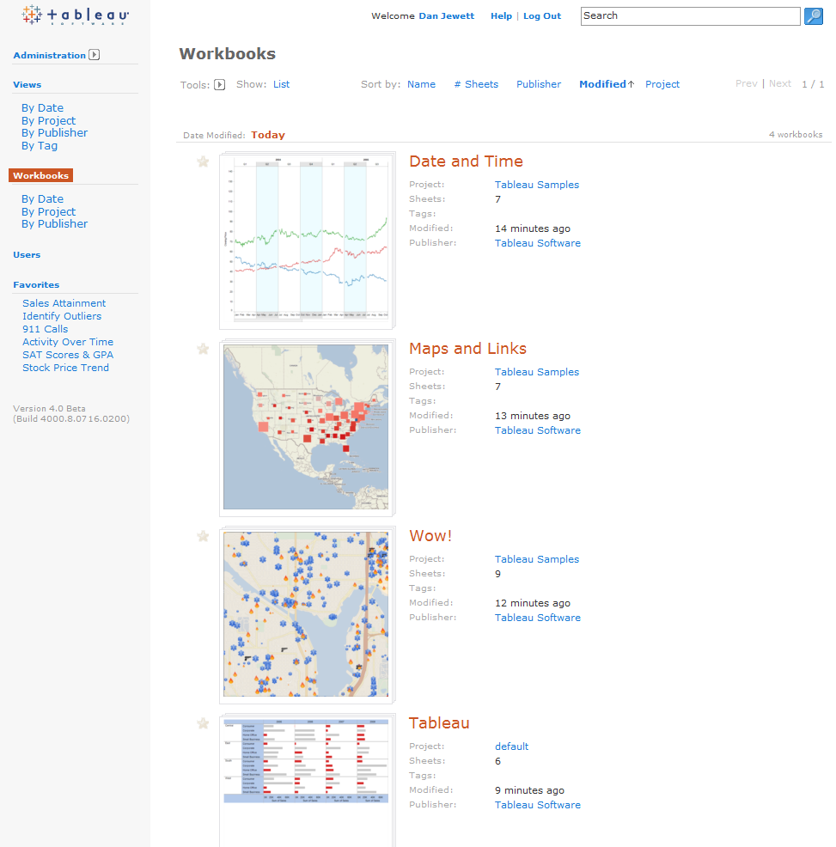
Share | Discover | Participate
Understanding data is not only for a few experts
A library of visual results
    The place to publish
    Share findings with the group
    No more isolated desktops
Analytic templates
    Retrieve and re-purpose
    Centralize data models

Slide 4




Server Basics
Tableau Professional
Tableau Server
Web Browser
publishes to and imports from
the server
interacts with server content
Quick Tour

Slide 5
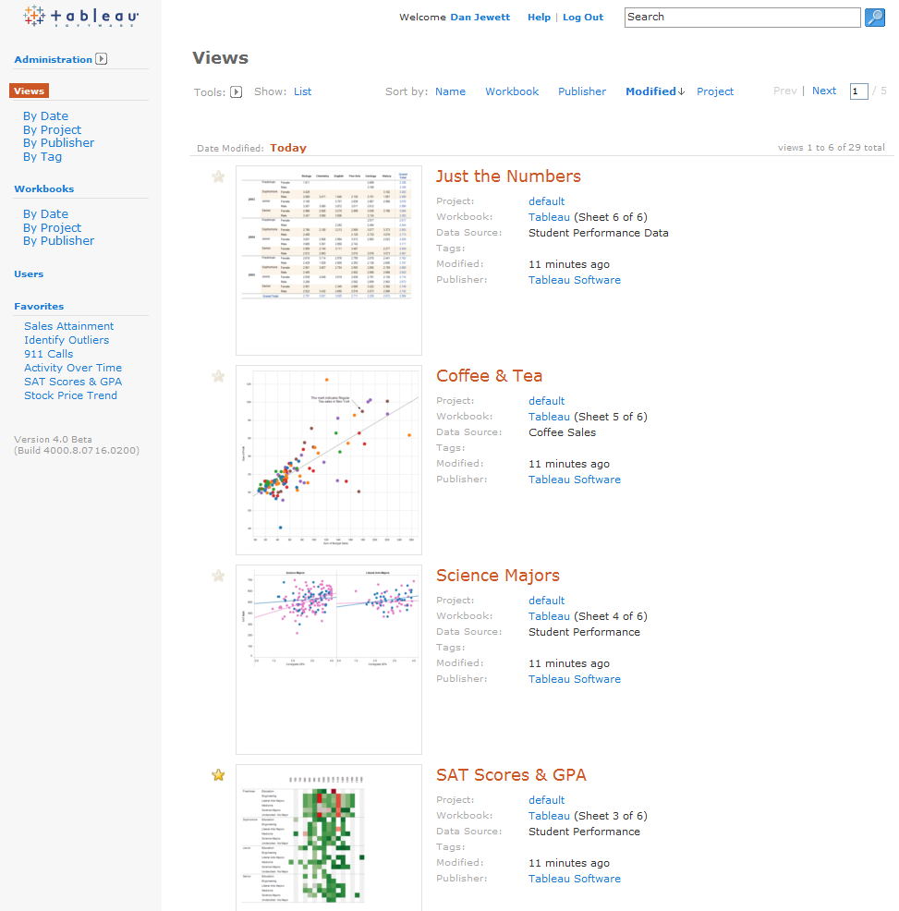
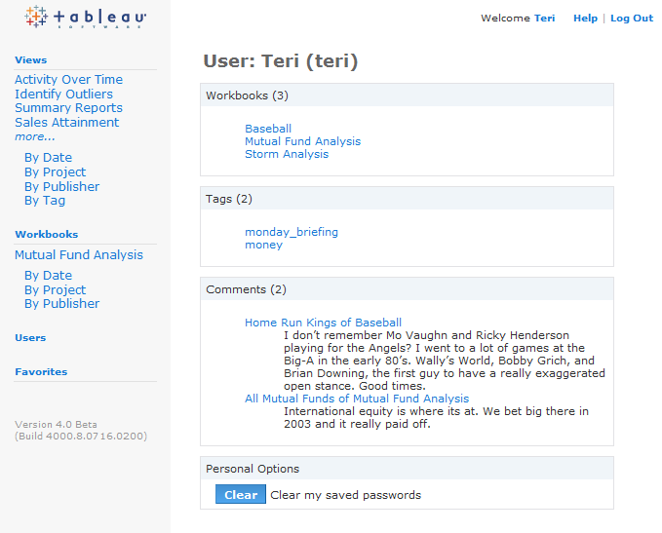
Share | Discover | Participate
Discover what others are discovering
Just browsing…
“What has Teri been working on?”

Slide 6
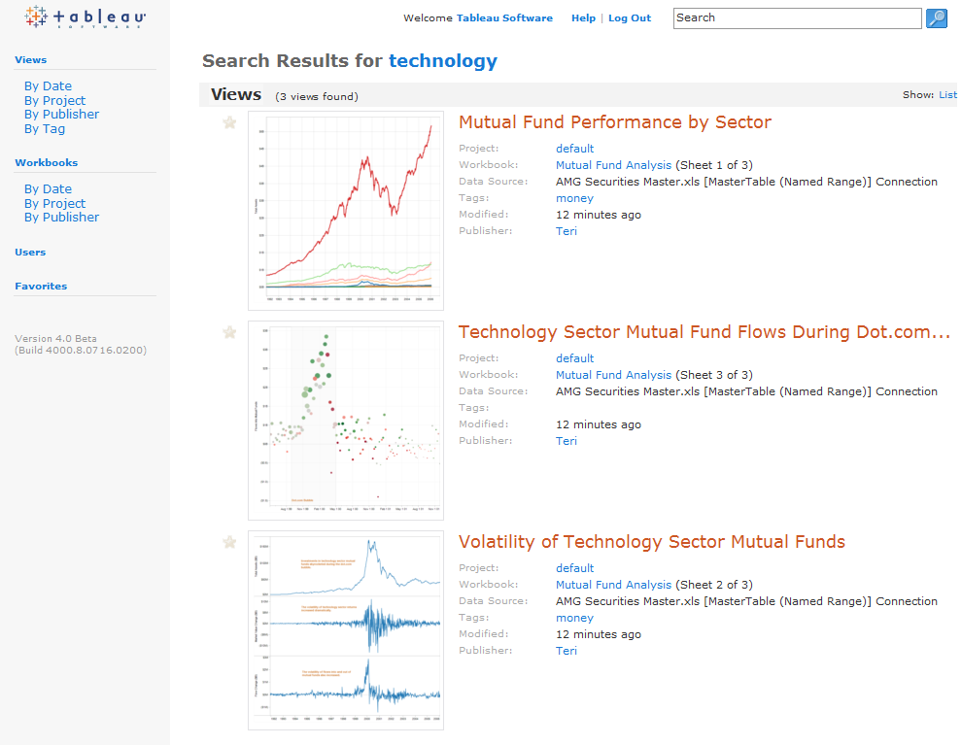
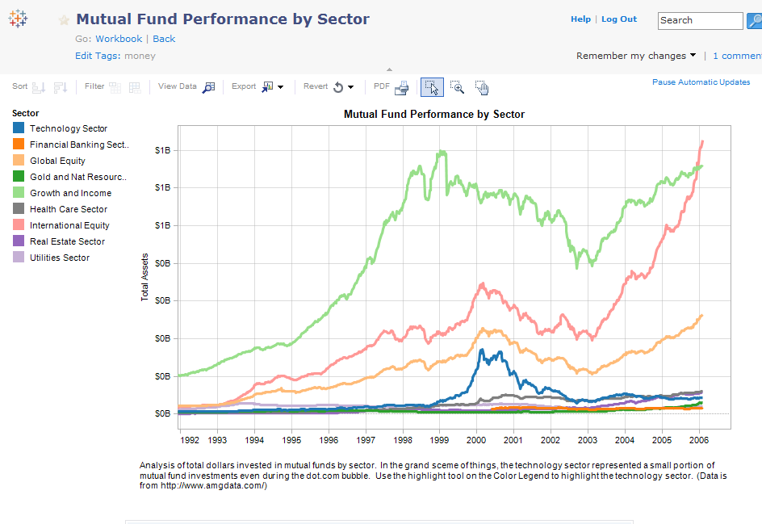
Share | Discover | Participate
Search becomes part of the discovery process
More than a fast way to locate something
Search includes the data elements used in the analysis
“Where is that tech sector analysis I saw last week?”
“What type of analysis of the industry sectors have others performed?”

Slide 7
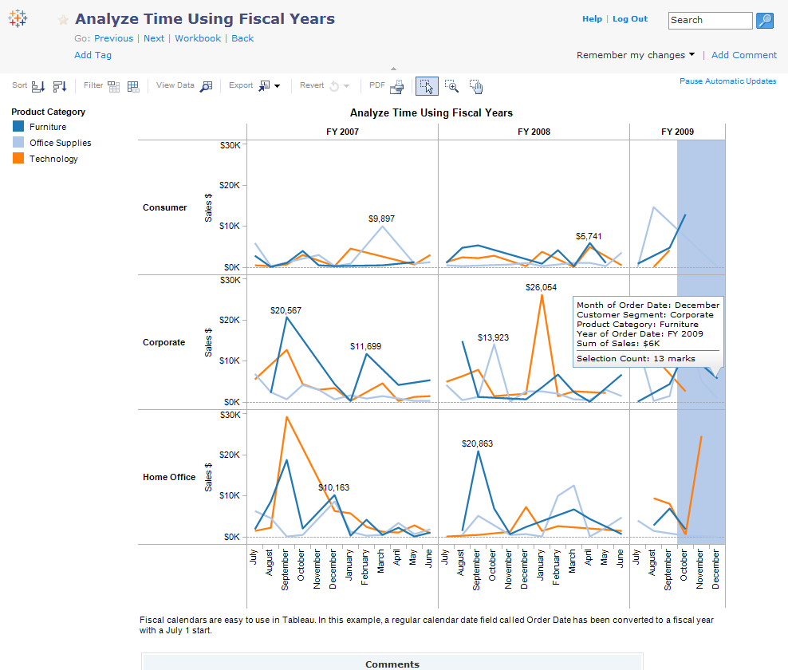
Share | Discover | Participate
Unlock the data analyst inside everyone
Bring data to life
    Filtering, drilling, sorting, paging, and inspecting data values
Explore with live data

Slide 8
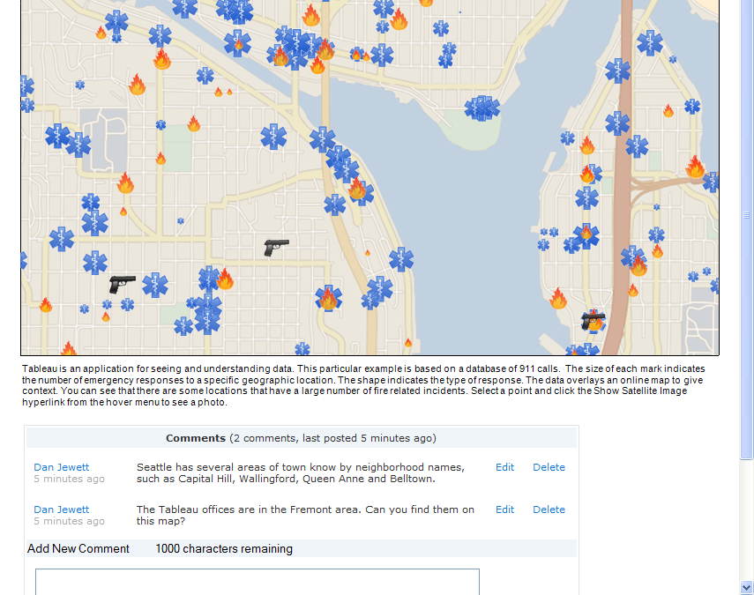
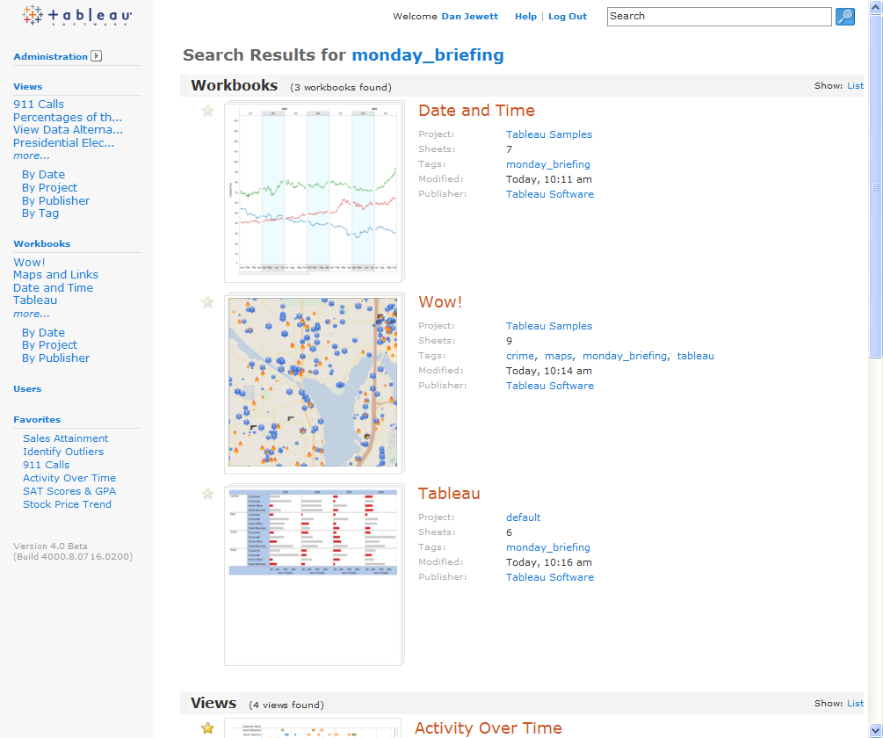
Share | Discover | Participate
Diversity increases the quality of the wisdom
Discussion enhances understanding
The community evolves how content is organized by using tags
Demonstration
Notes:
Quote “Diversity increases the quality of the wisdom” is from Kathy Sierra’s blog “Creating Passionate Users” - http://headrush.typepad.com/creating_passionate_users/2005/03/one_of_us_iisi_.html

Slide 9
Tableau Server
Share
Discover
Participate

Slide 10
Author’s, keep in mind
Web users didn’t build the view, they need your guidance
  Web users…
    can’t see the shelves
    didn’t write the calculations, create the bins or groups
    only filter on what you show them
    won’t know what other filters you’ve set
Make your interpretation of the data clear by…
    having clear names, titles, annotations & comments
    linking thoughts & views together

Slide 11

Authoring Checklist
Does the view have a clear title and caption?
Are the legends shown?
Does it have quick filters?
Are axes labeled with measures and units?
Is the formatting clean and simple?
Would an annotation help identify a key point?
Would a link to a related view provide context or more depth of analysis?
Have you overloaded a dashboard?
Does it look beautiful on a laptop?
Consider adding “director’s cut” text as a comment or annotation
Sheet 1

Slide 12
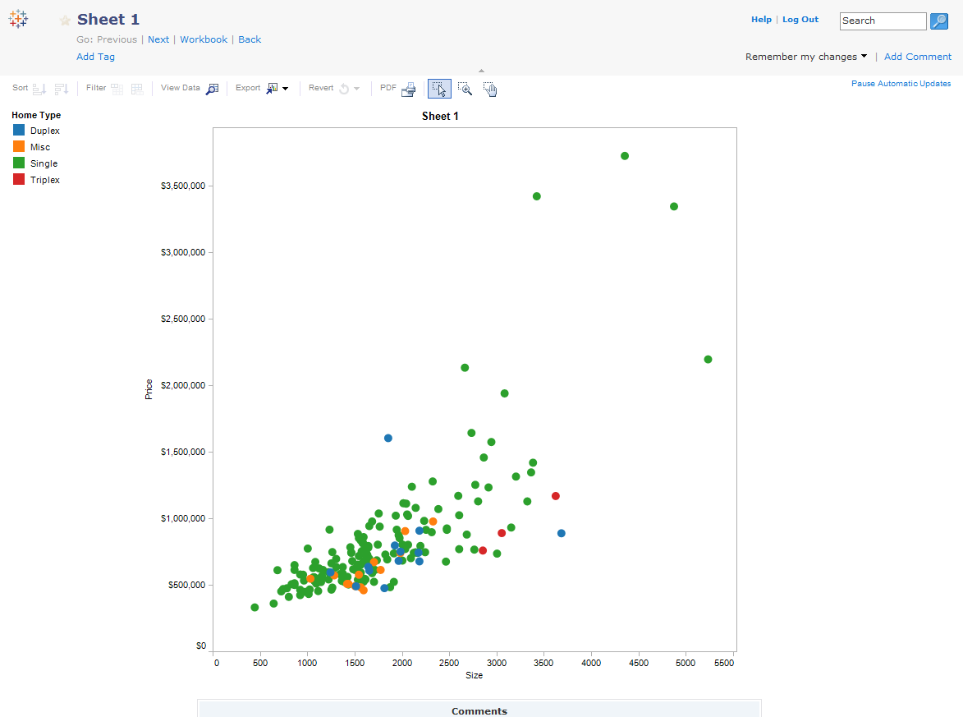

Slide 13
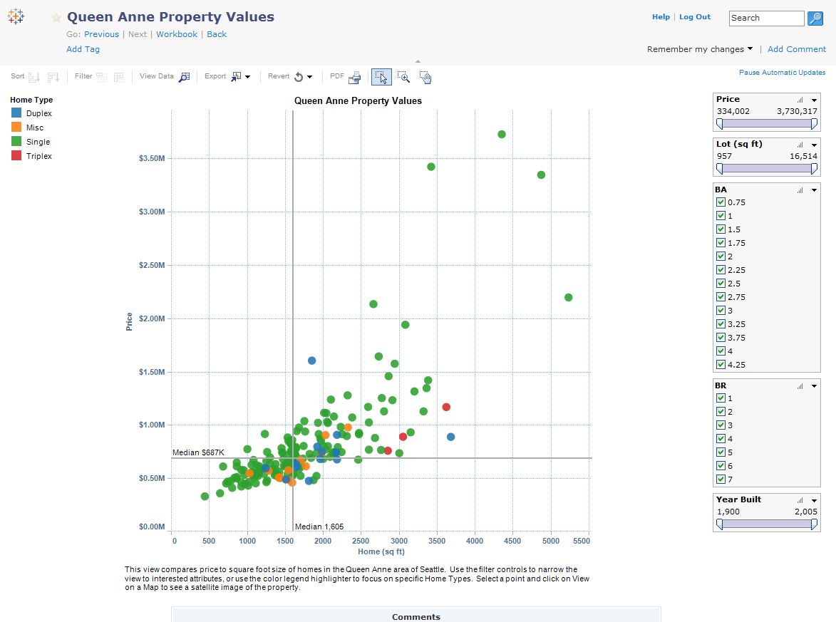

Slide 14
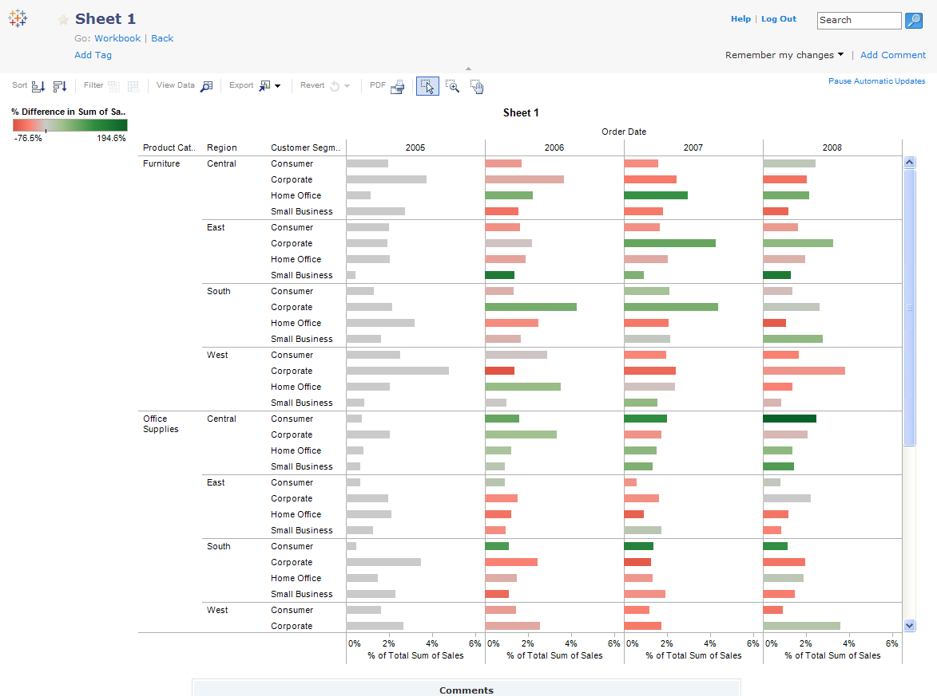

Slide 15
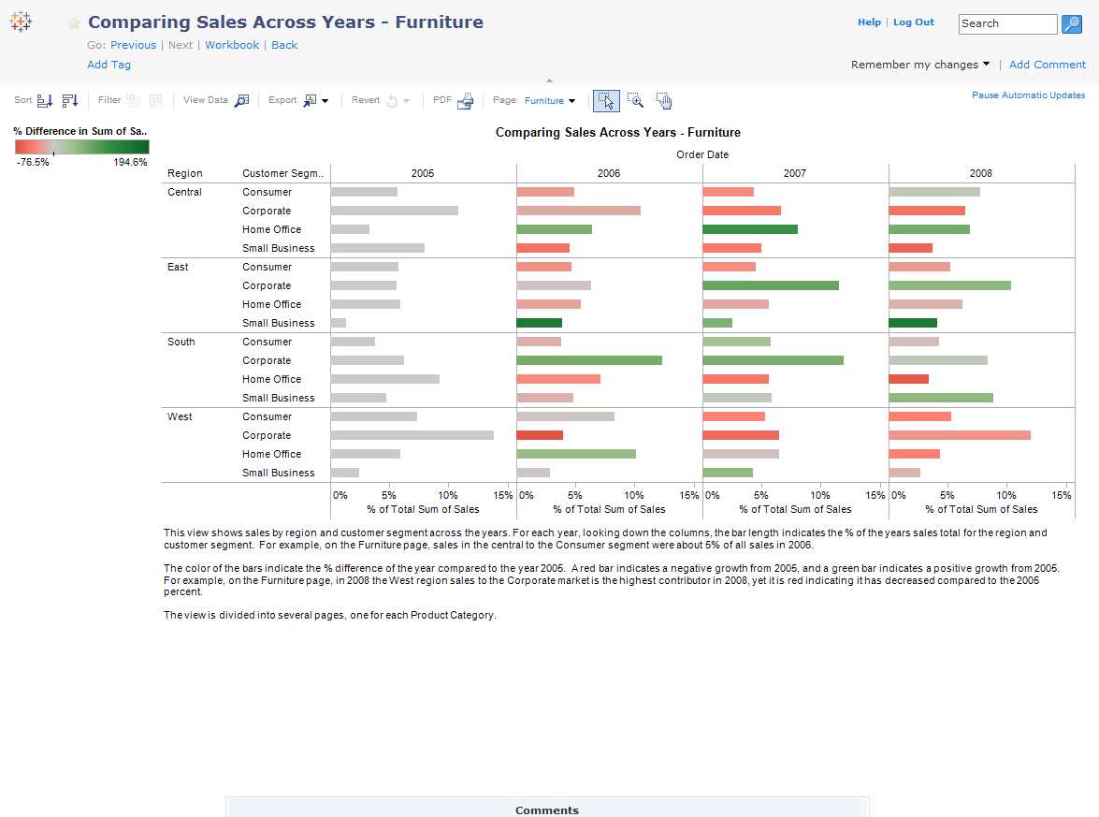

Slide 16
Introduction to Tableau Server
Sharing & Collaboration
Dan Jewett
Tableau Software

