Slide 1
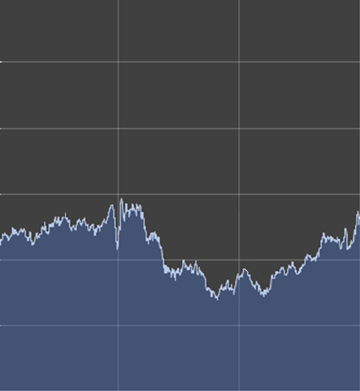

EXR
EXchangeRates

