Slide 1

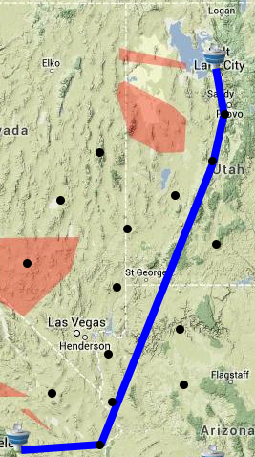
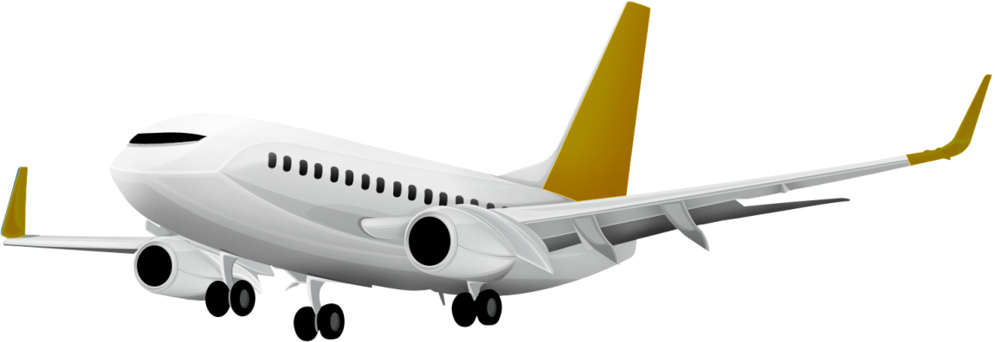
Flight Quest (ID 36)
Alexander Guziel, Atheendra PT, Bo Yuan Zhou, Rene Zhang
What is it?
What’s the plan?
In the modern day, airplanes are a frequently-used means of transportation. However, due to many different factors, such as weather, restricted areas, and jetstreams, it’s very difficult to keep the cost of such transportation at an optimal level. What we aim to do here in Flight Quest is to optimize to the best of our ability the costs of airplane flights using machine learning techniques.
Our task consists of using data obtained from previous flights to try and find optimal paths and conditions (e.g. speed, altitude) for new flights to take.
Our motivation for undertaking this task came from searching for something that would both challenge us to use what we learned in innovative ways and would have an impact on people’s lives.
First, we created a baseline measure that took the most direct distance in between the current and destination points (via great circle calculation) and made that the desired path.
Our next step was to identify and work out a path around restricted areas, since no flights can pass through these areas lest they be shot down. In order to account for this, we consider numerous points in between our current and destination locations and then attempt to construct a path going through points that don’t lie in restricted areas using an A* search (as shown on left).
Afterwards, we focused on finding optimal speeds and altitudes for segments of the flight path in order to find the best balance between fuel consumption and arrival time. In order to do this, we would need to first find the features that would be significant enough to train on and then train our data using a regression model.
How’d it go?
Method | Features Used | Cost
Baseline | None | 25572.58298
Gradient boosted naïve |  | 21634.16113
Gradient boosted A* |  | 18945.93134
RandomForest A* |  | 19800.99899
Partial kNN |  | 20201.64102
Unsmoothed Gradient Boost |  | 19953.01149
We were provided a cost calculator that determined the total cost accumulated through by all of the test flights that we found paths for. We ran several solutions and compared them to each other, as shown in the table to the left.
As we can see, we had the most success using

