Slide 1

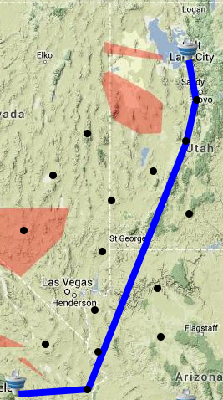
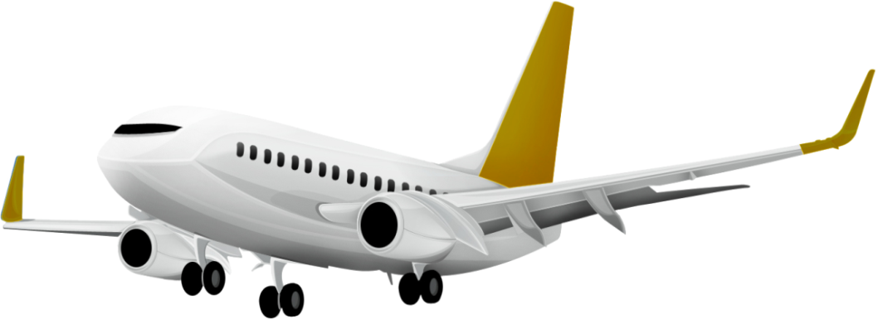
Flight Quest (ID 36)
Alexander Guziel, Atheendra PT, Bo Yuan Zhou, Rene Zhang
What is it?
What’s the plan?
In the modern day, airplanes are a frequently-used means of transportation. However, using it is fairly expensive to manage due to costs of fuel and delay. Due to many different factors, such as weather, restricted areas, and jet streams, it’s very difficult to keep this cost of such transportation at an optimal level; airports are always looking for more ways to optimize their flights. What we aim to do here in Flight Quest is to optimize to the best of our ability the costs of airplane flights using machine learning techniques on large sets of data.
Our task consists of using data obtained from previous flights to try and find optimal paths and conditions (e.g. speed, altitude) for new flights to take. However, since we don’t know exactly what features would be useful to train on, our data set contains many different attributes, making it very large and time-expensive to work with.
Our motivation for undertaking this task came from searching for something that would challenge us to use what we learned in innovative ways, give us experience with working on a real-life machine learning problem, and have an impact on people’s lives. The Flight Quest problem satiates these desires by starting us off at the beginning, giving us a goal, and then telling us to go about solving this problem however we deem necessary.
First, we created a baseline measure that took the most direct distance in between the current and destination points (via great circle calculation) and made that the desired path. Paths are problematic because of their complex structure so we needed a way to reduce down the data.
Our next step was to identify and work out a path around restricted areas, since no flights are allowed through these. In order to account for this, we consider numerous points in between our current and destination locations and then attempt to construct a path going through points that don’t lie in restricted areas using an A* search.
Afterwards, we focused on finding optimal speeds, altitudes, and descent patterns for segments of our new generated flight path in order to find the best balance between fuel consumption and arrival time. In order to do this, we would need to first find the features that would be significant enough to train on and then train our data using a model. Another challenge would be finding out which learning algorithms would be appropriate.
How’d it go?
Method | Features Used | Cost
Baseline | None | 25572.58298
Gradient boosted centroid avoider | Dest, Distance, Time until Arrival | 21634.16113
Gradient boosted A* (single velocity) | Dest, Distance, Time until Arrival | 18945.93134
RandomForest A*(single velocity) | Dest, Distance, Time until Arrival | 19800.99899
Unsmoothed kNN A* | Pos, Dir, Dest | 20201.64102
Unsmoothed Gradient Boost A* | Pos., Dir, Dest | 19953.01149
Smoothed Forest of Random Trees A* | Pos, Dir, Dest | 20560.67523
Smoothed weighted KNN A* | Pos, Dir, Dest | 20525.75794
We were provided a cost calculator that determined the total cost accumulated through by all of the test flights that we found paths for. We ran several solutions and compared them to each other, as shown in the table to the left. In all of them, we used machine learning to predict speed and altitude.
The single velocity algorithms used a single velocity and altitude for the duration of the flight except for the final descent. The smoothing refers to the fact that frequent changes between ascent and descent are penalized. The smoothing function we used was naïve so reducing the changes in ascent and descent did not actually improve the score.
We chose k-nearest neighbors and ensemble methods because k-nearest neighbors maps naturally to the problem and ensemble methods produce good results even when little information is known about which features are important.
Our next steps are to find a better smoothing algorithm. Our current smoothing algorithm is easily led astray by outliers so we plan on training to detect outliers in our sequence of velocities and altitudes. We also plan to train for better paths than the shortest ones using old position data as the shortest path is not the most optimal due to prevailing winds. We also want to extract more features.

