Slide 1
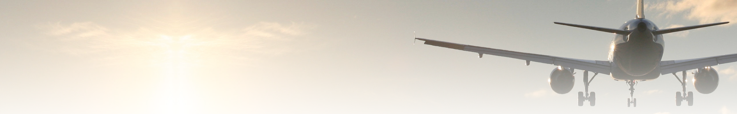
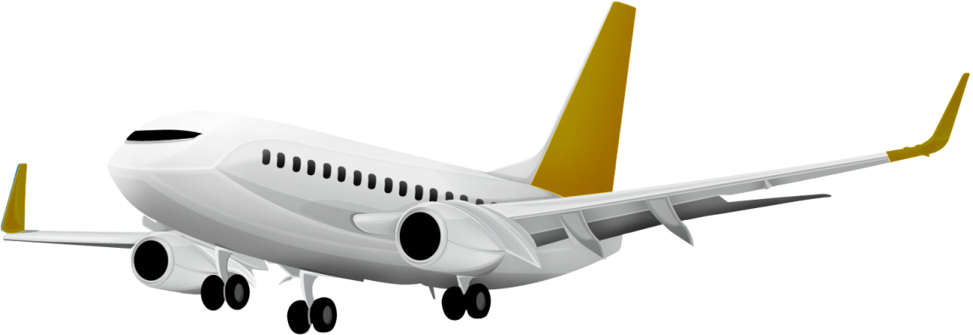
Flight Quest
What is it?
What’s the plan?
How’d it go?

