Slide 1
Identifying User Intent in Public Legal Inquiries
Authors:
Kristin Day
Olga Scrivner
Mohammad Abdul-Mageed

Slide 2
Motivation
Ultimate goal: Develop inexpensive platforms for legal text search that are available to the public.
Why does it matter:
We are all held responsible for the law but we do not have access to it.
one statute = one law
“the law” = all statutes + judicial opinions (also called “case law”)
Judicial opinions clarify the scope and meaning of statutes. They also fill in gaps (called “common law”).
Notes:
Westlaw uses 40 broad categorizations. They are hand crafted (called ”mark-up”) and the mark-up is regularly revised by hand as new opinions come in everyday from across the nation. One estimate stated that around 1000 new opinions are generated per state per day. Also, the average length of a judicial opinion is around 10 pages. (Thompson, 2001, p.70).

Slide 3
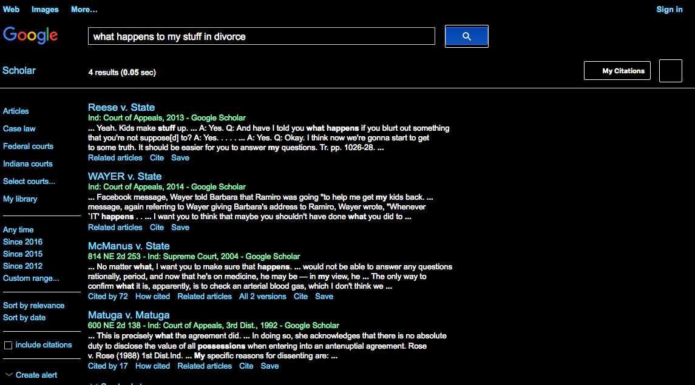
Example

Slide 4
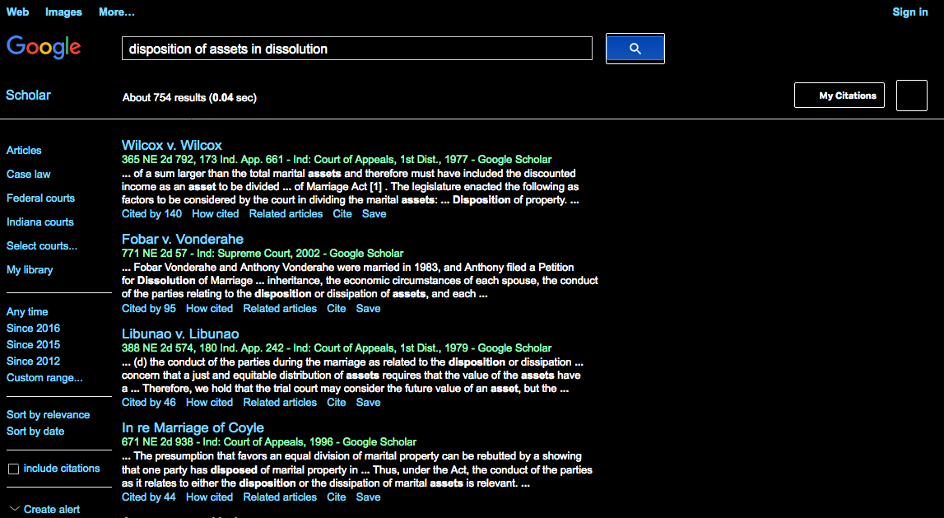
Example

Slide 5
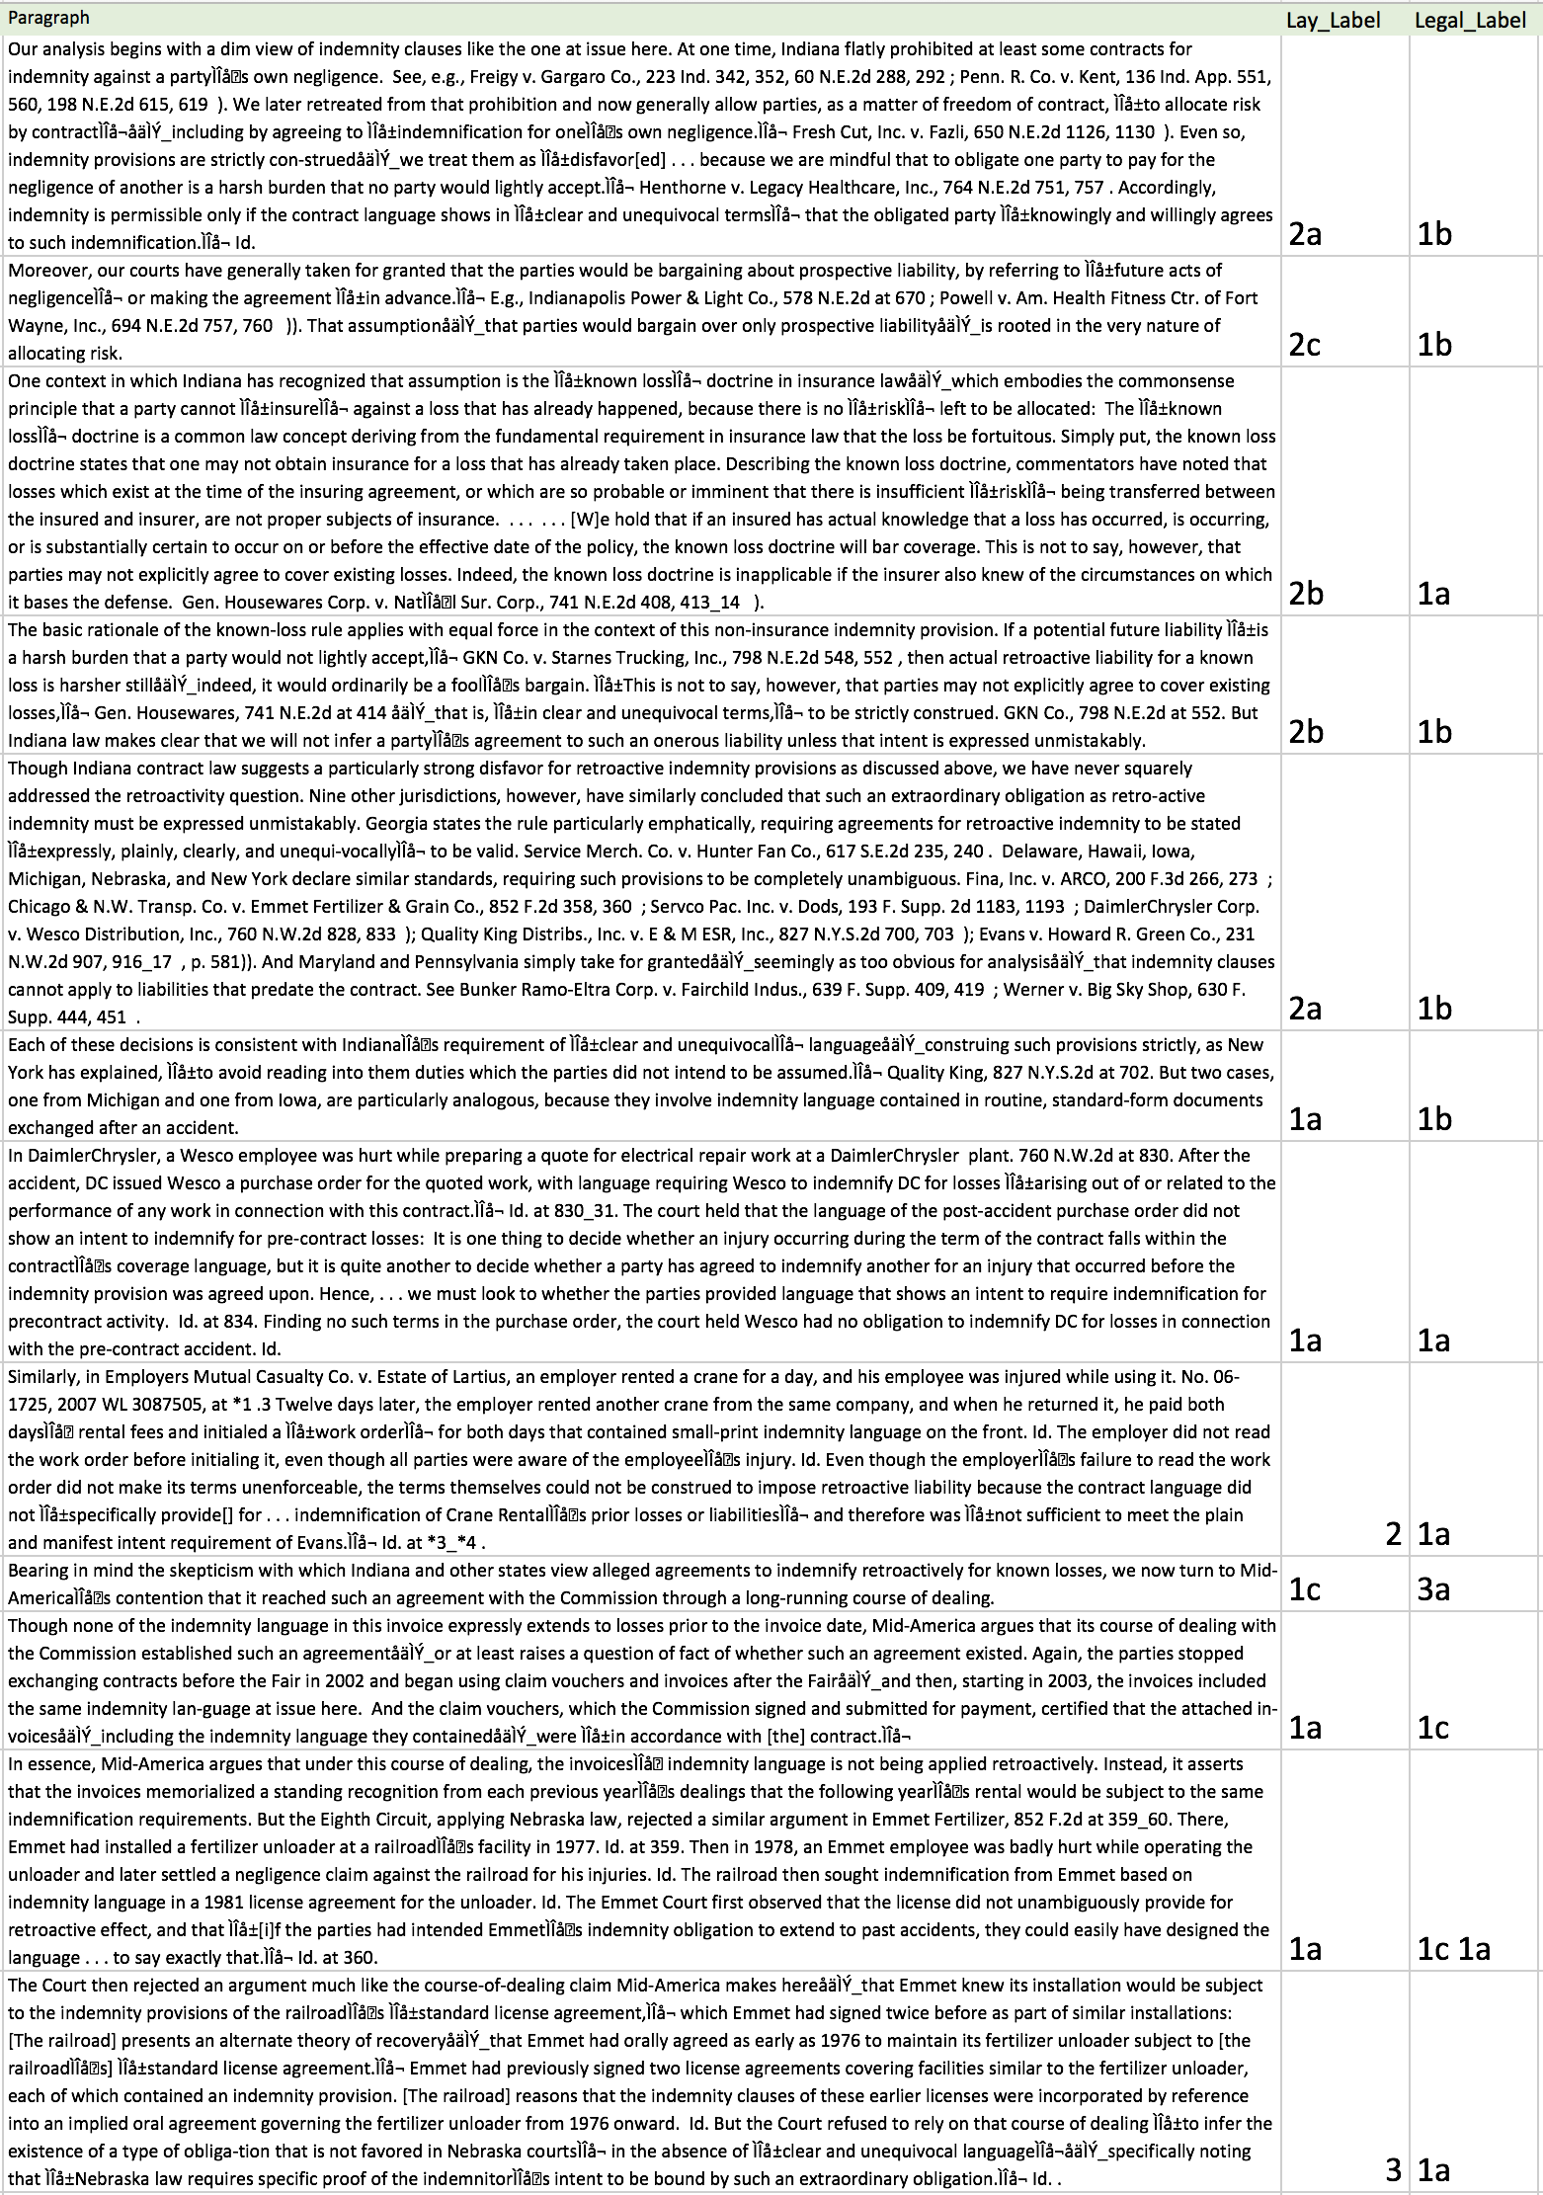
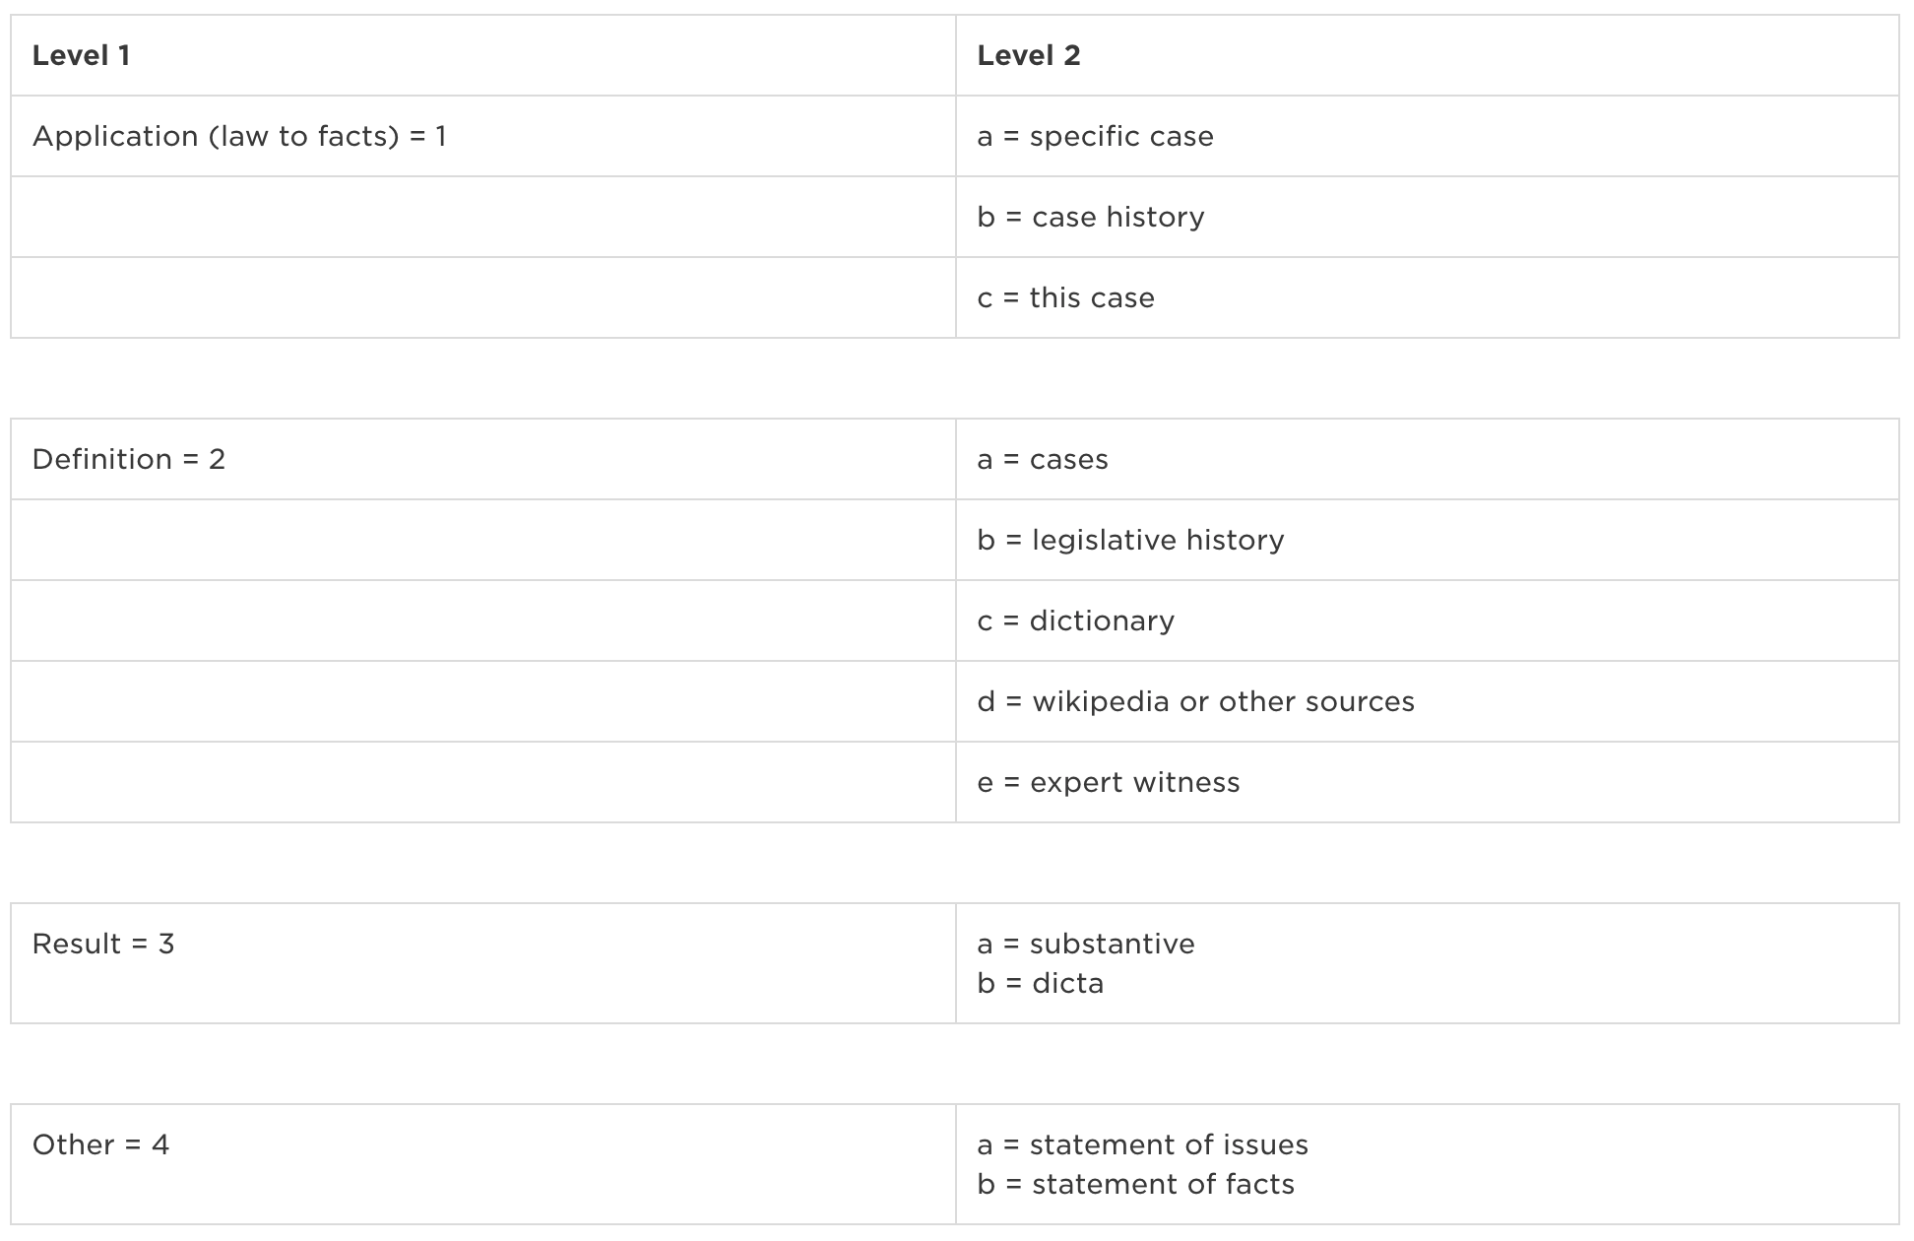
labels by legal professional v. ph.d. linguist without legal training
Of fifteen paragraphs, only full agreement on one paragraph.

Slide 6
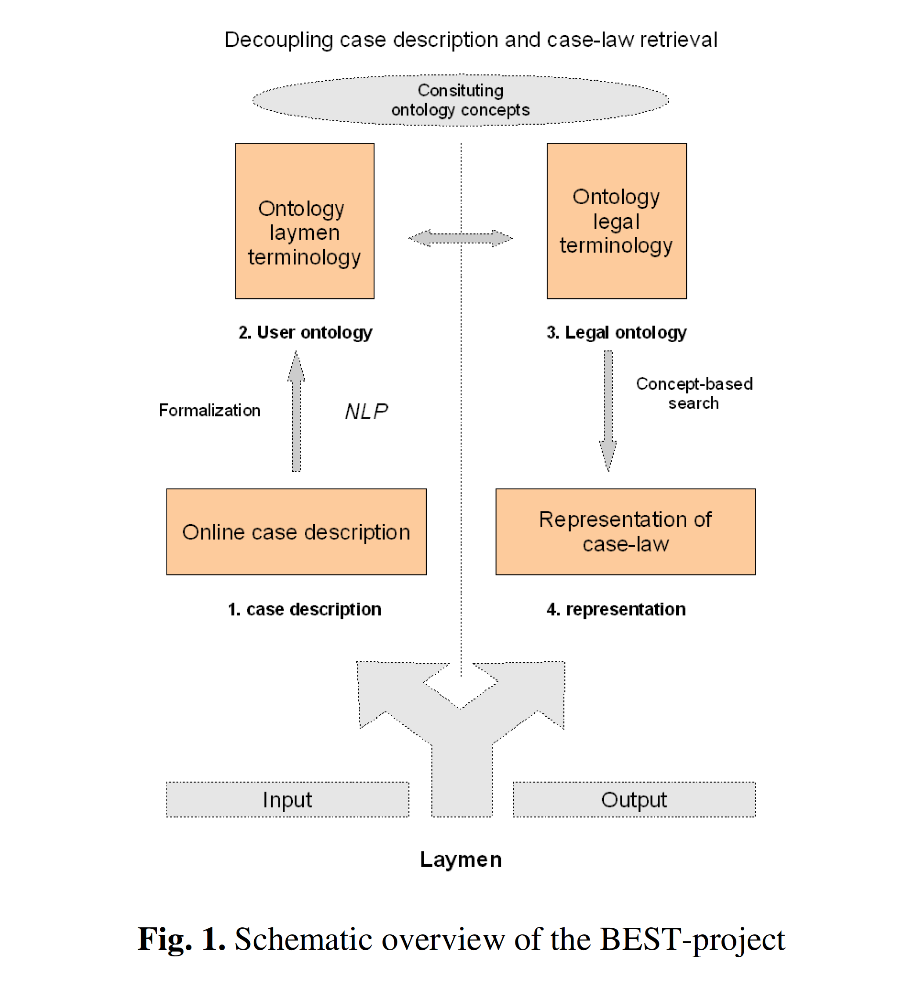
goal
Notes:
(Uijttenbroek, E.M., et al., 2016, p.292). The research in this article was used to attempt to give laypersons a better understanding of their liability based on the facts of their situation. This is often called “subrogation” and is a highly in-demand data analysis skill.

Slide 7
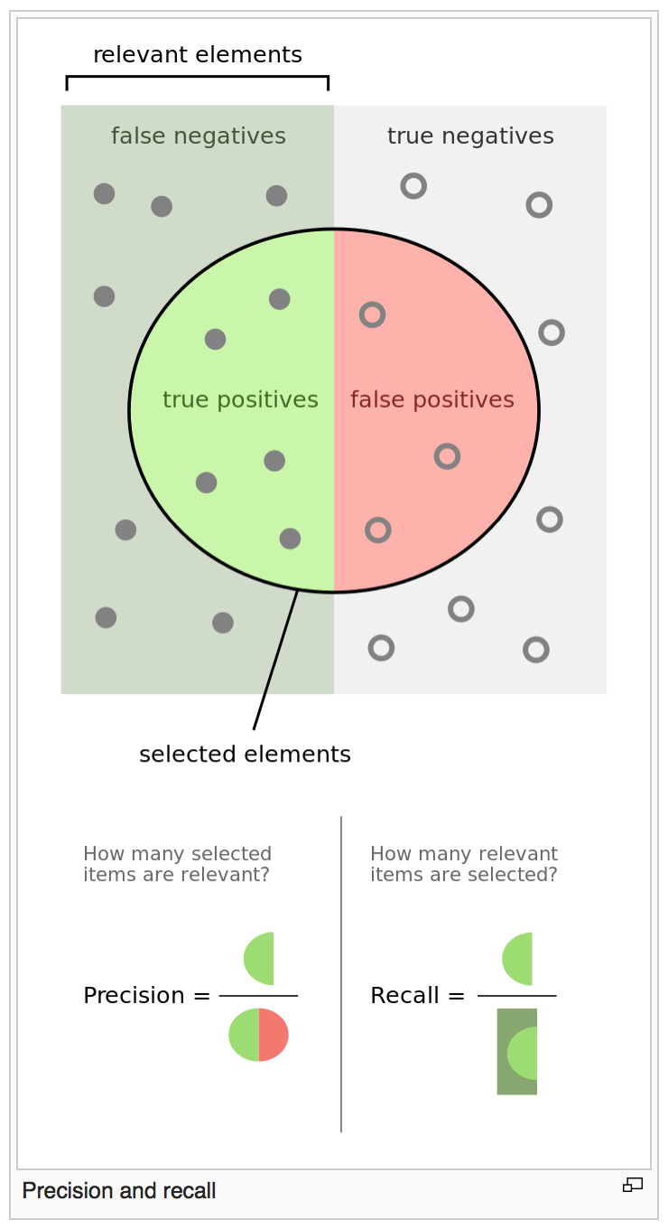
Recall more important than precision
Notes:
In law, it is more important to ensure that you don’t miss important cases than it is to prevent showing you cases that might not be relevant. Too much is better than not enough. (Thompson, 2001, p.71)

Slide 8
Existing methods
Currently all legal search databases controlled by private corporations who only contract for services business-to-business.
These corporations charge excessive fees based on labor intensive manual mark-up of each judicial opinion.
These searches require years of training to product accurate results.

Slide 9
Prior research
Legal language:
Long sentences and subclauses
Diverse language
Structured documents
Important problems:
Natural language understanding of document texts
User’s preferences
Types of Information Retrieval Systems:
Querying the legal database
Browsing/Navigation System
Question-Answer System – “What is the maximum driving speed allowed on a freeway?”
Common Retrieval Models:
Boolean
Vector Space
Probabilistic
Techniques:
SVM
Naïve Bayes
Decision Trees
K-Nearest Neighbors
Hidden Markov Model
Word Embedding

Slide 10
Prior research – ontology allignment
Yi-Hung Liu, et al.
Predicting Associated Statutes for Legal Problems
Rudi & Vitanyi
Google Similarity Distance
Yong Jiang, et al.
A Semantic Similarity Measure Based on Information Distance…

Slide 11
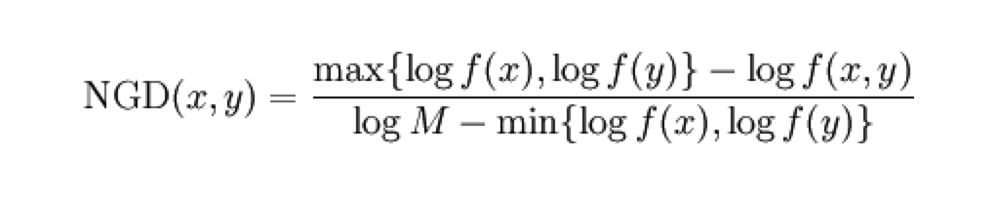
Ontology allignment
Find similarity distance of words using Normalized Google Distance (NGD)
In R (Work in Progress)
In Python (Work in Progress)

Slide 12
data
“Judicial opinions” from Indiana Supreme Court
One case (15 discussion paragraphs) with hand labelsused for initial pragmatic analysis:
One label provided by trained legal professional (Kristin Day)
One label provided by a linguistics Ph.D. professional with no legal training (Olga Scrivner)
Paragraphs were tokenized and POS tagged in Python.
Sentences were parsed using Berkeley parser.

Slide 13
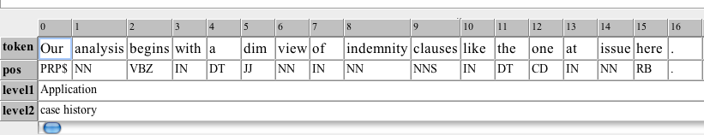
Methods
Exmaralda corpus annotation tool for case labels

Slide 14
Methods
All three levels of annotation (syntactic, pos and case labels) were converted to database format and uploaded to the ANNIS server

Slide 15
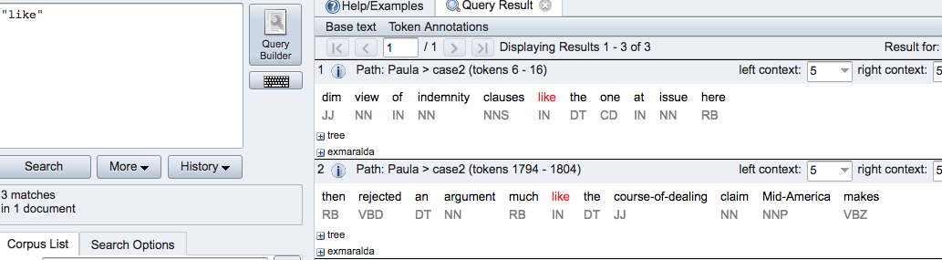
ANNIS QUERY
ANNIS is a web tool for multi-level queries

Slide 16
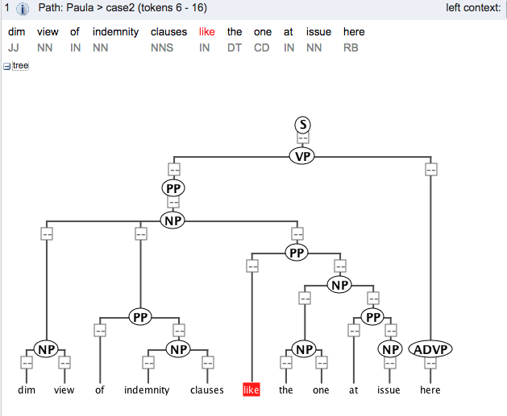
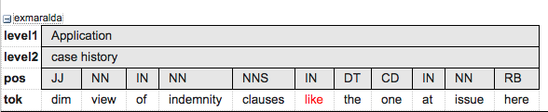
ANNIS visualization

Slide 17
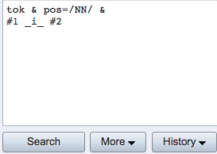
results
Create legal language usage model
Query:

Slide 18
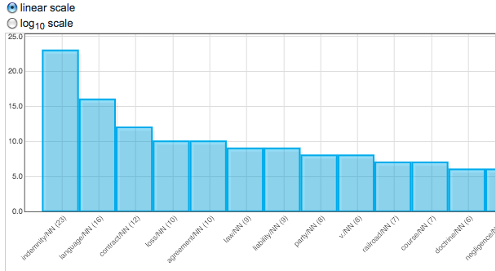
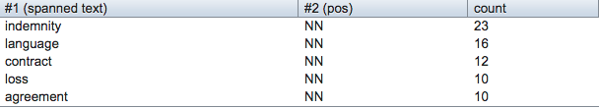
results

Slide 19
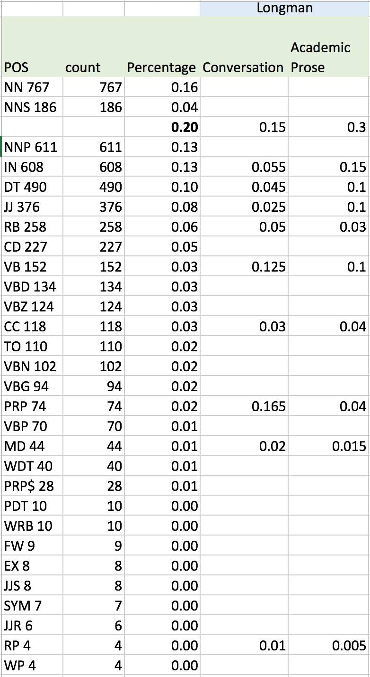
Frequency Analysis of legal text pos compared to other english contexts
Notes:
Biber, Douglas. Longman Student Grammar Of Spoken And Written English / Douglas Biber, Susan Conrad, Geoffrey Leech. Harlow: Longman, 2013. NUKAT. Web. 6 Nov. 2016.

Slide 20
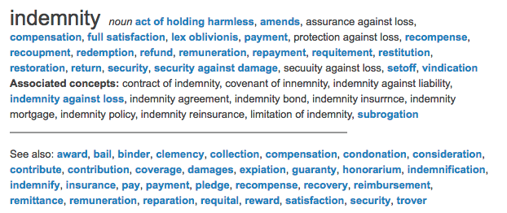
stage ii - dictionary
http://legal-dictionary.thefreedictionary.com/

Slide 21
Conclusion
Matching a layperson legal inquiry with the proper results is not a trivial matter. Not only is the lexicon of legal texts significantly distinguishable from everyday English, but the understanding of the purpose of legal language also varies from that expected by the layman. This is clearly observed in the hand label divide between a trained legal professional and a professional with no legal training. Both individuals are highly educated and distinguished. But, the understanding of the meaning and intent of the text varies greatly.
To bridge this divide in machine learning, there must be a separation of the inquiry from the results, with a translation to match the two at an intermediary stage that considers both vocabulary and intent.

Slide 22
Citations
Biber, Douglas. Longman Student Grammar Of Spoken And Written English / Douglas Biber, Susan Conrad, Geoffrey Leech. Harlow: Longman, 2013. NUKAT. Web. 6 Nov. 2016.
Thompson, P. "Automatic Categorization Of Case Law." Proceedings Of The International Conference On Artificial Intelligence And Law Proceedings of the 8th International Conference on Artificial Intelligence and Law, ICAIL '01 (2001): 70-77. Scopus®. Web. 23 Apr. 2016.
Uijttenbroek, E.M., et al. Retrieval Of Case Law To Provide Layman With Information About Liability: Preliminary Results Of The BEST-Project. n.p.: 2007. Scopus®. Web. 23 Apr. 2016.
West Publishing Company. West's Analysis of American Law. West Publishing Company, St. Paul MN, 1994.
West Publishing Company. West's Law Finder: A Legal Resources Guide. West Publishing Company, St. Paul, MN, 1995.

