Slide 1
The Separating Axis Test between Convex Polyhedra
Dirk Gregorius – Valve Software
Notes:
Welcome! My name is Dirk Gregorius and I am software engineer at Valve working on collision detection and rigid body simulation.
The talk today will be about the SAT between convex polyhedra

Slide 2
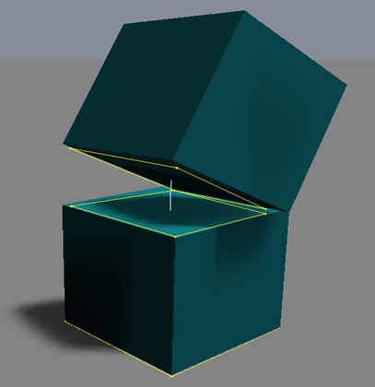
Collision Detection between Convex Polyhedra
Notes:
Why shall we use the SAT?
The SAT is versatile algorithm and can tell us things like :
Whether two convex polyhedra overlap
The touching features
The penetration distance
The direction in which we need to resolve the penetration (axis of minimum penetration)

Slide 3
Talk Outline
Show examples of convex polyhedra and define convexity
Use simple sphere-sphere collision detection to introduce concept Minkowski difference
Develop a Separating Axis Test (SAT) between convex polygons/polyhedra (2D and 3D)
Use Gauss Maps of convex polyhedra to optimize the SAT in 3D
Show an efficient implementation
Notes:
Before we start I will give you a quick talk outline

Slide 4
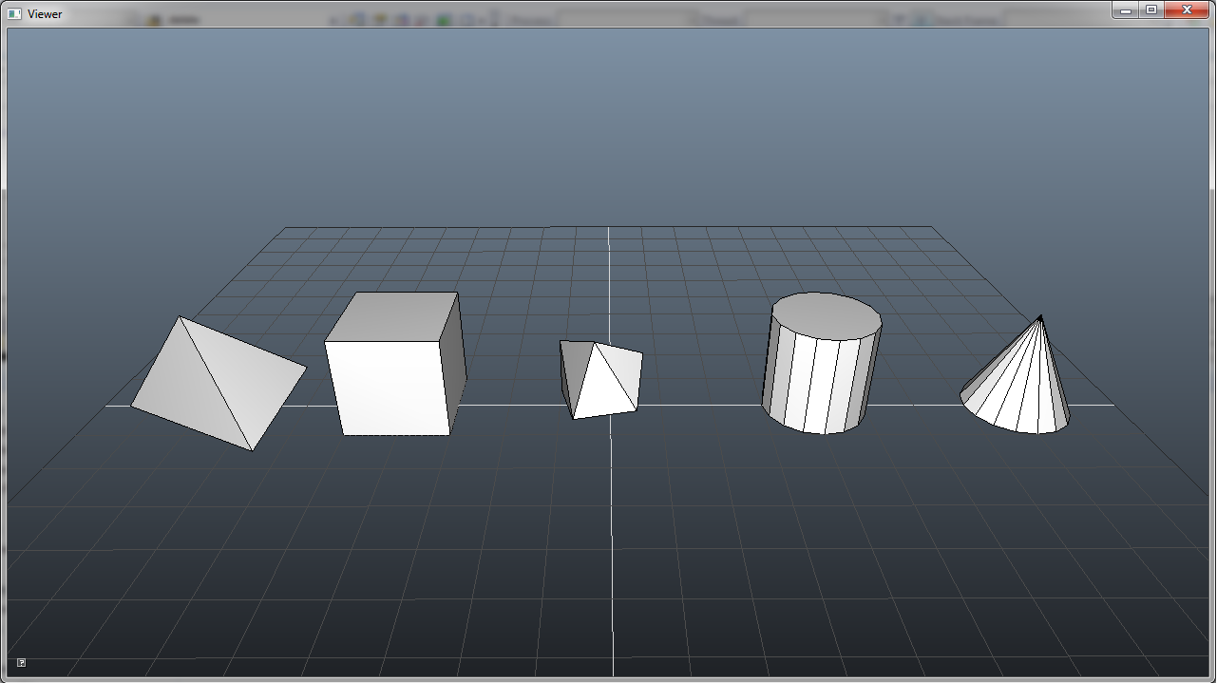
Examples of Convex Polyhedra
Notes:
Before we start some examples of convex polyhedra (tetrahedron, box and a convex hull)
Notice cylinder and cone as approximation for quadric shapes!

Slide 5
Convexity
Convex
Concave
Notes:
The line between any two points inside a convex shape must be completely contained ➔ The shape is completely behind each face plane if convex

Slide 6
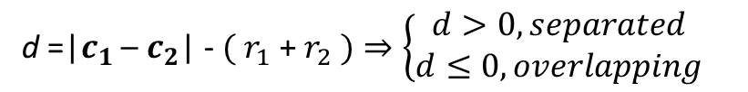




Overlap between Spheres
$$c_{2}$$
$$c_{1}$$
$$r_{2}$$
$$r_{1}$$
d =|$c_{1}$ – $c_{2}$| - $( r_{1}$ + $r_{2} )⇒\left\{\begin{matrix}d>0, separated \\ d≤0, overlapping\end{matrix}\right.$
Notes:
We will start with a simple overlap test between two spheres
Two spheres overlap if the distance between the centers is less then the sum of the radii.

Slide 7
The Separating Axis
Shape A
Shape B
Min A
Max A
Min B
Max B
Notes:
Project both spheres onto axis through center points
Then test intervals for overlap
If interval not overlapping, we say we detected a separating axis
The axis through the center points is the only possible separating axis because of the sphere symmetry

Slide 8
Minkowski Difference between two Spheres
Sphere B
A - B
Sphere A
Notes:
I would also like to use this example to introduce the concept of Minkowski difference
What is the Minkowski Difference between two spheres?
Handwaveingly: Inflate A up by the radius of B
Shrink B to a point

Slide 9
Minkowski Difference between two Spheres (2)
Shape B
A - B
o
Shape A
P
o
If two convex shapes overlap the Minkowski difference must contain the origin!
Notes:
Why is this a good idea?
Mathematically: Subtract all points of B from all points of A
It can be shown: If two convex shapes overlap the Minkowski difference must contain the origin!
Explanation: If you subtract all points in B from all points in A and they share a common point one of the differences must be the zero vector
Another way of thinking about this is: By subtracting each point in B from each point in A and there are no two points with zero distance, then the shapes must be disjoint

Slide 10



Overlap between Point and Sphere
A + (-B)
o
$$c_{M}$$
$$r_{M}$$
s =|$c_{M}$- o| - $r_{M}$
The original problem is transformed into a point inside sphere problem.
Notes:
Why is this a good idea?
The Minkowski difference between two spheres transforms the original problem into a point inside sphere problem.
Not big win here, but will become useful for more complex problems later

Slide 11
Overlap between Convex Polygons (2D)
Shape A
Shape B
Notes:
- Now that we understand what separating axes and Minkowski differences are, lets move on to SAT between convex polygons
- Examine the problem in Minkowski space since we cannot write down the solution immediately.

Slide 12
Minkowski Difference between Convex Polygons (2D)
A + (-B)
Shape A
Shape B
Notes:
How do we build the Minkowski difference between two polygons?
Inflate quad by area of flipped triangle
Shrink triangle to point
Need to flip triangle to account for Minkowski difference
The Minkowski difference between two convex polygons is also convex polygon itself

Slide 13
Point inside Convex Polygon
Origin outside -> Separation
Origin inside -> Overlap
Notes:
This transforms the original problem into a point inside convex polygon problem
Simple to solve: If origin is inside the Minkowski difference the original shapes overlap. If it outside, the shapes are separated
This is a possible solution, but we don’t want to build the Minkowski difference explicitly

Slide 14
Face Normals of Minkowski Difference define possible Separating Axes
Shape A
Shape B
A + (-B)
Notes:
It can be shown that the possible separating axes between two convex polygons are the face normals of the Minkowski difference
The faces of the Minkowski difference are the faces of original shapes, but pushed out
So we know the face normals of the Minkowski difference and therefore the possible separating axes
We could now project both shapes onto each possible separating axis and compare the intervals, but I’d like to show you a slightly more efficient and intuitive way

Slide 15
Finding support points
S(v)
v
Notes:
We will need to understand support points to test possible separating axes
A support point is simply the most extreme point into a given direction.
And if the result is not unique any of those points will be fine

Slide 16
SAT: Support Function (2D)
Vector2 Polygon::GetSupport( const Vector2& direction ) const
{
for ( int index = 0; index < m_VertexCount; ++index )
Vector2D vertex = m_Vertices[ index ];
float projection = Dot( vertex , direction );
if ( projection > bestProjection )
bestProjection = projection,
bestVertex = vertex;
return bestVertex;
};
Notes:
I’d like to quickly show a possible implementation to give you an idea how this works (if you are not already familiar with this concept)
Iterate all vertices and project each vertex onto the search direction using the dot product.
Done inside this loop and we keep track of the vertex with the largest projection
Finally we return the best vertex

Slide 17

Testing a Separating Axis (2D)
d = n $∙$ (s – p)
s(-n)
n
p
Notes:
We will now use support points to test a possible separating axis between two convex polygons
We build a plane for each edge on one polygon and find the support point in the opposite normal direction on the other polygon
The distance of that support point to the plane is the separation or penetration for this axis
This is a bit more efficient since we only touch half of the vertices per axis as compared to projecting both shapes and then comparing intervals

Slide 18
SAT: Face Directions (2D)
Query QueryFaceDirections( const Polygon& polygonA, const Polygon& polygonB )
{
for ( int index = 0; index < polygonA .FaceCount; ++index )
Plane planeA = polygonA .GetPlane( index );
Vector vertexB = polygonB .GetSupport( -planeA.Normal );
float distance= Distance( planeA, VertexB );
if (distance > bestDistance )
bestDistance = distance;
bestIndex = index;
return largest distance and associated index of face;
};
Notes:
Let’s write a function that tests all possible separating axes of a polygon
Iterate edges of A and build plane
Find support point in opposite normal direction
The searched distance is then simply the distance of the support point to that plane
This is a signed distance and if it is negative it is actually a penetration
Finally return vertex with largest distance

Slide 19
Example 1: Overlap Test (2D)
bool Overlap( const Polygon& polygonA, const Polygon& polygonB )
{
Query queryA = QueryFaceDirections( polygonA, polygonB ); // Face normals of A
if ( queryA.m_Separation > 0.0f )
return false;
Query queryB = QueryFaceDirections( polygonB, polygonA ); // Face normals of B
if ( queryB.m_Separation > 0.0f )
return false;
// No separating axis found, the polygons must overlap!
return true;
};
Notes:
How do we use this function?
This a simple example which tests the overlap between convex polygons
Possible separating axes are face normals of A and B
Obviously need to use it twice (once for A and once for B) by simply switching arguments
Can exit early if we find separating axis
If no separating axis was found the polygons must overlap

Slide 20
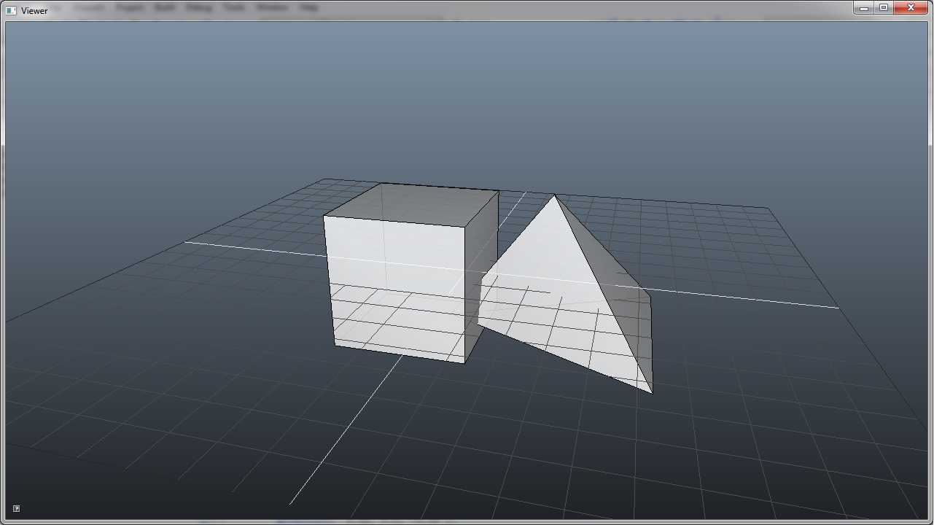
Overlap between two Convex Polyhedra (3D)
Notes:
After some preparation we arrived at actual problem we like to solve today
As in the 2D case we start to investigate problem in Minkowski space

Slide 21
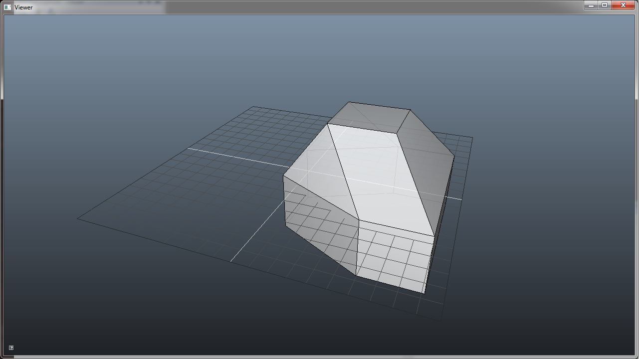
Minkowski Difference between two Convex Polyhedra (3D)
Notes:
In order to build the Minkowski difference between two convex polyhedra I’d like to encourage you to use you imagination from 2D
Inflate polyhedron A by volume of the flipped polyhedron B
B is shrunken to a point
The Minkowski difference between two convex polyhedra is a convex polyhedron itself

Slide 22
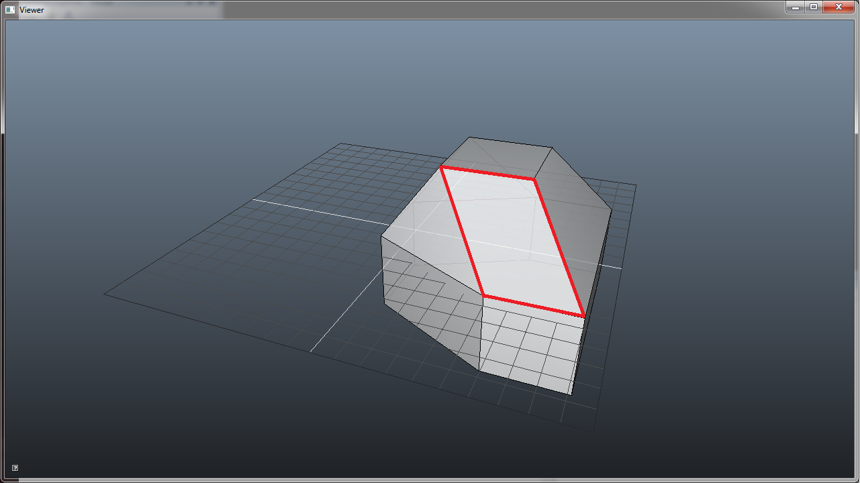
Minkowski Difference: Faces (3D)
Notes:
Remember: The face normals of the Minkowski difference define the possible separating axes
If we inspect the Minkowski difference we can detect conceptually the face planes of polyhedron A and polyhedron B – pushed out (as in 2D)
In 3D we also identify additional faces from sweeping an edge of A along and edge of B. And the normal of such a face is the cross product between the edges
These edge face build parallelograms

Slide 23
Separating Axes between Convex Polyhedra (3D)
The possible separating axes between two convex polyhedra are:
The face normals of polyhedron A (2D & 3D)
The face normals of polyhedron B (2D & 3D)
The cross product between all edge combinations of A and B (3D only)
Notes:
Let’s summarize the possible separating axes between two convex polyhedra:
The face normals of A
The face normals of B
The cross products between all edges of A and all edges of B

Slide 24
Brute-Force Separating Axis Test (3D)
EdgeQuery QueryEdgeDirection( Polyhedron* pPolyA, Polyhedron* pPolyB )
{
for ( int index1; index1 < pPolyA->EdgeCount; ++index1 )
Edge* pEdge1 = pPoly1->GetEdge( index1 );
for ( int index2; index2 < pPolyB->EdgeCount; ++index2 )
Edge* pEdge2 = pPoly2->GetEdge( index1 );
Vector axis = Cross( pEdge1->GetDirection(), pEdge2->GetDirection() )
Interval interval1 = pPolyA->Project( axis );
Interval interval2 = pPolyB->Project( axis );
float separation = Compare( interval1 , interval2 );
};
Notes:
Let’s have a look at a possible brute force implementation
O( n^2 ) in the number of edges
Build cross product to get the possible separating axis
Then we project both polyhedra onto that axis
Need to touch all vertices to do so
Makes the whole test conceptually O( n^3 ) in he complexity of the polyhedra
Not practical -> too slow

Slide 25
Optimizing Edge Tests (3D)
Define the Gauss-Map of a convex polyhedron
Show how we can use the Gauss-Map to quickly prune edge tests
Show how to compute the edge-edge axis separation without computing support points
Notes:
Remember that the faces on the Minkowski difference define the possible separating axes
You might be able to imagine that not all edge pairs actually build a face on the Minkowski difference

Slide 26
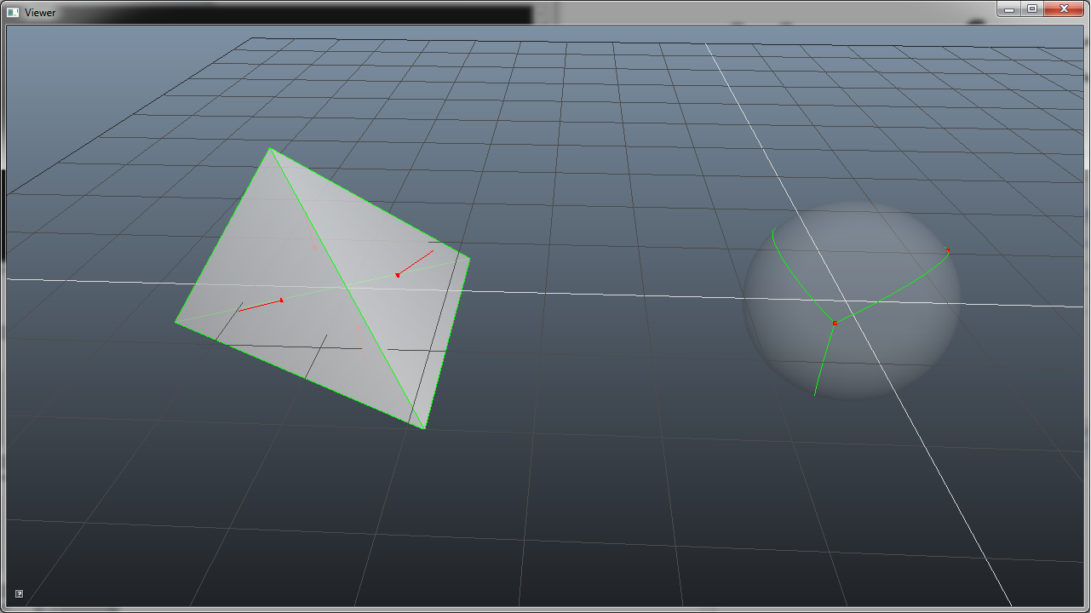
The Gauss Map of a Convex Polyhedron
Notes:
Wikipedia: The Gauss map maps the surface of a convex polyhedron onto the unit sphere:
Let’s have a look how we build a Gauss Map:
We make all face normals n of the polyhedron vertices V(f) on the unit sphere
For each edge adjacent to two faces we connect the associated vertices V(f1) and V(f2) of these faces to a great arc A(e)

Slide 27
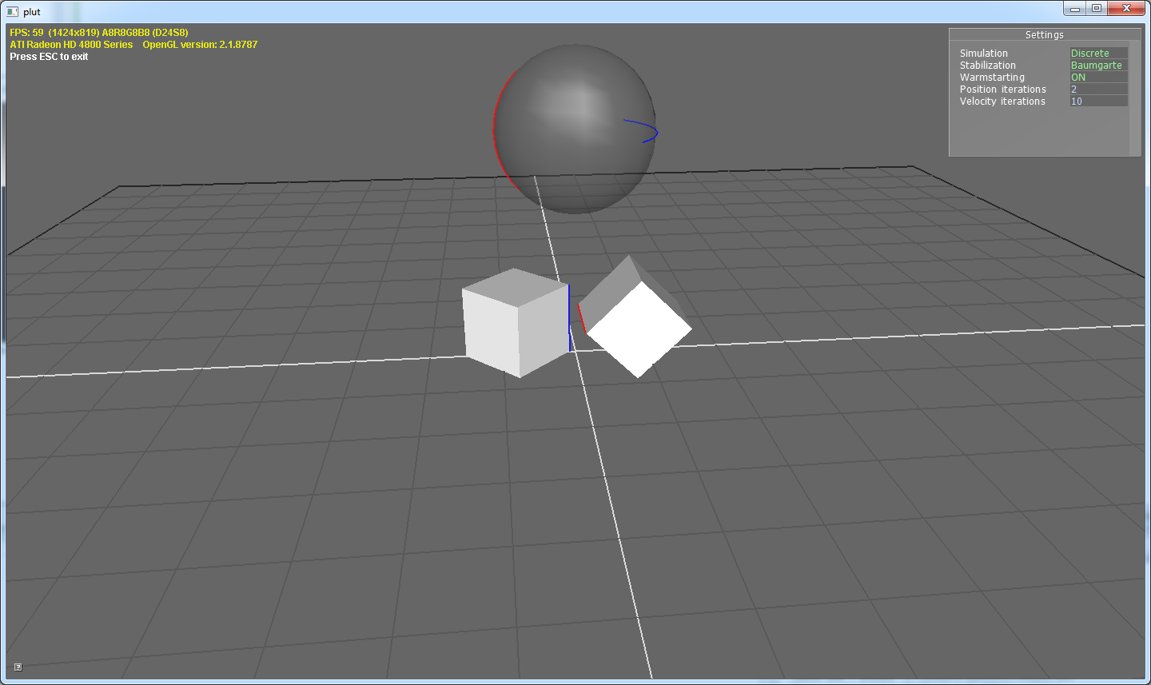
Edges and Arcs
Notes:
Very abstract, but essentially two critical points here to remember:
Faces become vertices
Edges become great arcs

Slide 28
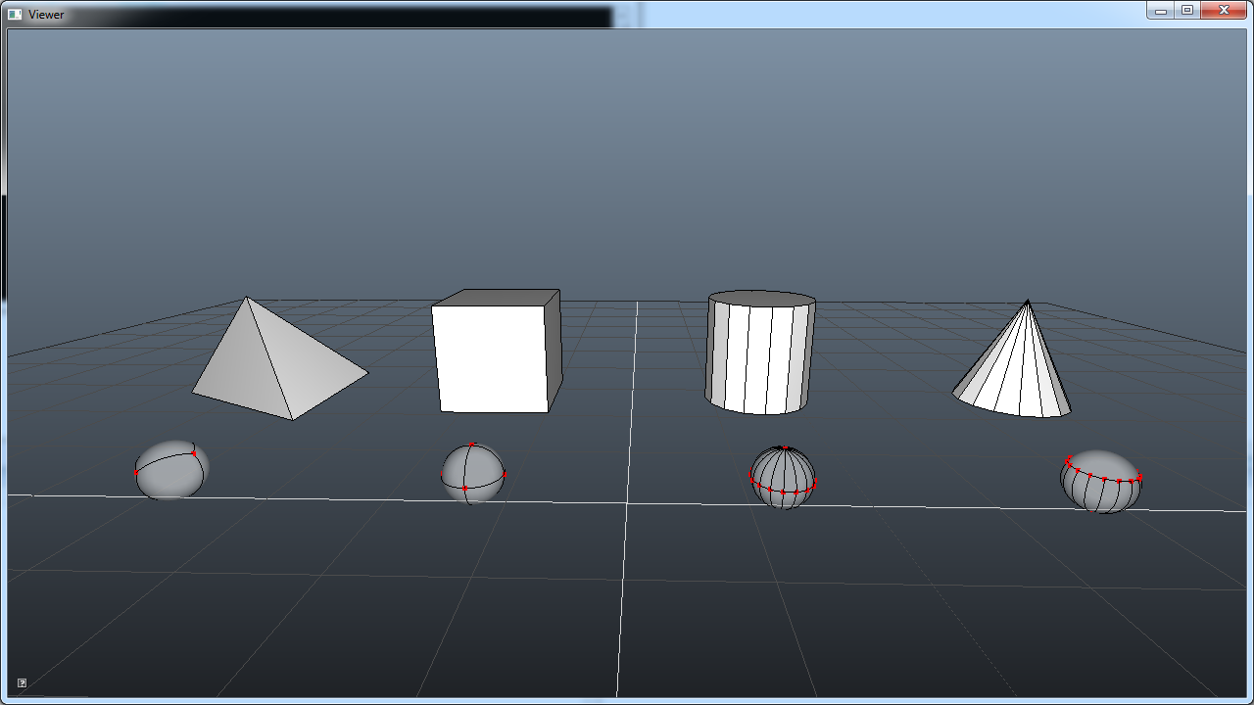
Example Gauss Maps
Notes:
I compiled a bunch of Gauss Maps to get a feeling for this: Try to match some vertices and faces to edges and arcs!

Slide 29
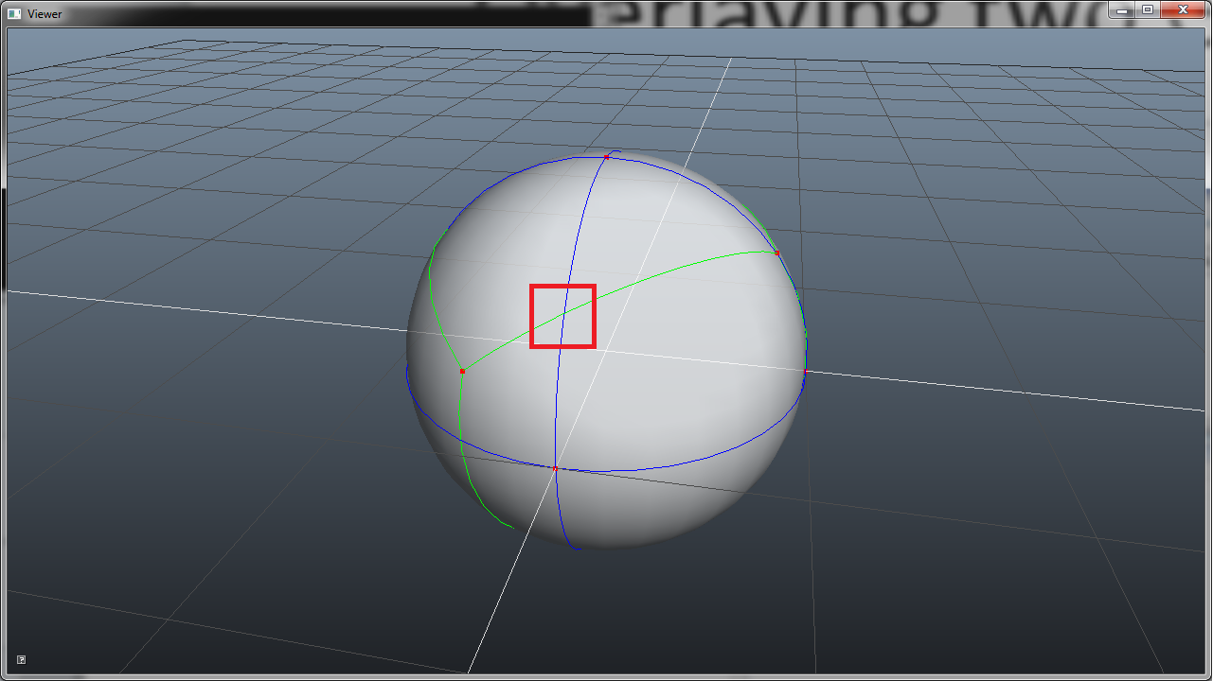
Overlaying Gauss Maps
Two edges build a face on the Minkwoski difference if their two associated arcs intersect!
Notes:
SLOW NOW:
We can build the Gauss-Map of a convex polyhedron so lets overlay two of them on the unit sphere
Remember that vertices on the Gauss Map and faces on the convex poyhedron correspond
Identifying the vertices of the super-positioned Gauss-Maps actually tells us faces on the Minkowski difference
And the faces on the Minkowski difference are the possible separating axes
Let’s Inspect the picture and see what we find :
Face normals of polyhedron A
Face normals of polyhedron B
Intersections of arcs from polyhedron A with arcs of polyhedron B
This leads to a nice conclusion: Two edges only build a face on the Minkwoski difference if their two associated arcs intersect!
Important: We need actually one more step to account for Minkowski difference. I will show this some slides later.

Slide 30
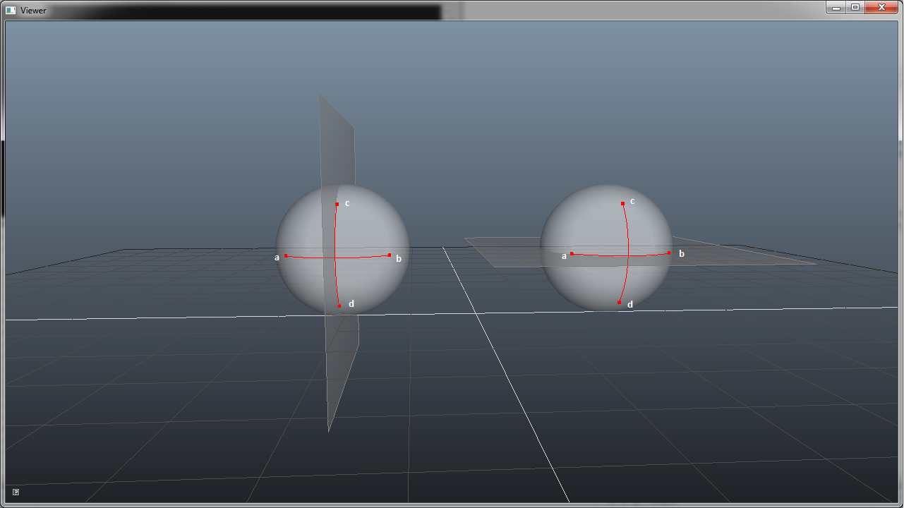
Overlap Test
The vertices A, B and C, D of the arcs are the normals of the adjacent faces of the edges!
Notes:
How do we detect the overlap between two arcs on a sphere”
Funnily: This is a separating axis test itself
The vertices A and B of arc 1 are on different sides of the plane through arc 2
The vertices C and D of arc 2 are on different sides of the plane through arc 1
Important:
The vertices A and B of arc 1 are simply the normals of the faces that share edge 1
The vertices C and D of arc 2 are simply the normals of the faces that share edge 2
So this boils down to very simple plane test, but there is one final gotcha here.

Slide 31
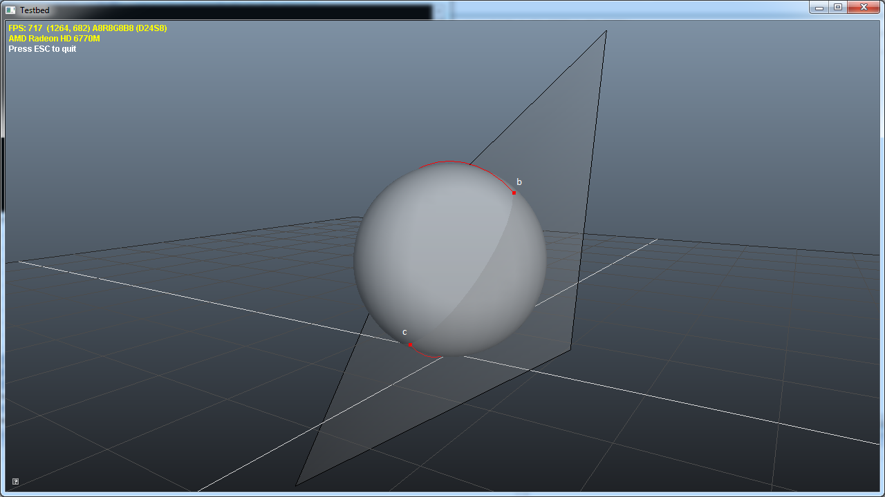
Hemisphere Test
Notes:
Can fail if arcs are on different hemispheres ➔The two arcs must be in the same hemisphere.
To test for the same hemisphere we build a plane through vertex B of arc 1 and vertex C of arc 2.
If the other two vertices (A and D) are on the same side of this plane this arcs are in the same hemisphere
Note: This condition is not satisfied in this example!

Slide 32
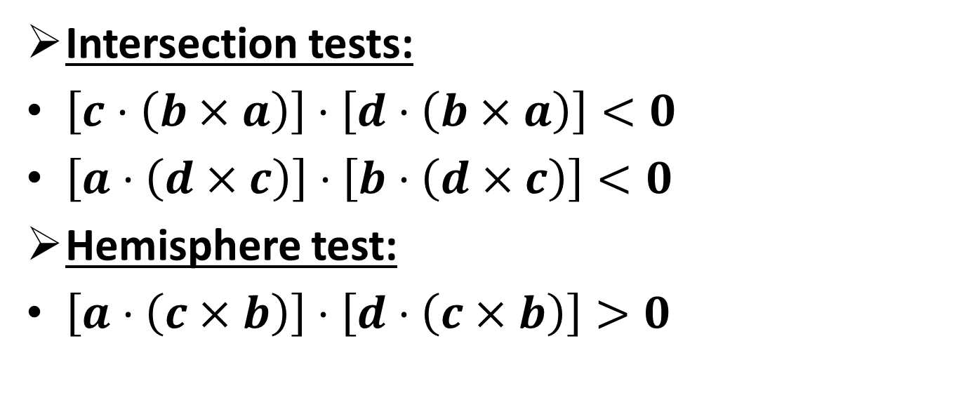
Final Overlap Test: Formulas
Intersection tests:
$\left[c⋅\left(b×a\right)\right]⋅\left[d⋅\left(b×a\right)\right]<0$
$\left[a⋅\left(d×c\right)\right]⋅\left[b⋅\left(d×c\right)\right]<0$
Hemisphere test:
$\left[a⋅\left(c×b\right)\right]⋅\left[d⋅\left(c×b\right)\right]>0$
Notes:
Finally some ugly math.
Remember: A, B, C, and D are the vertices of the two arcs.
Use simple scalar triple product for plane tests
No need for normalization – just checking signs!

Slide 33
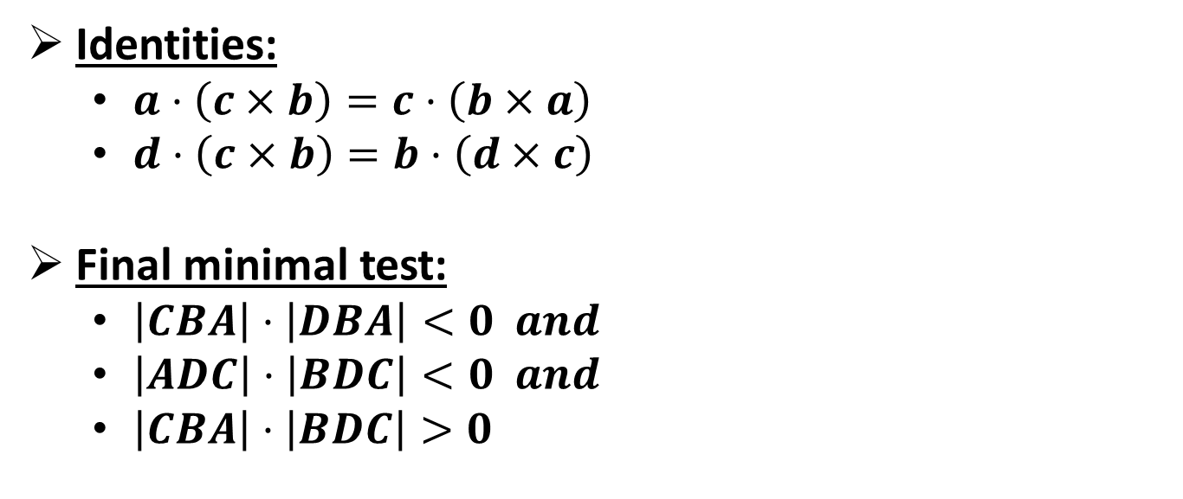
Optimizing Plane Tests
Identities:
$a⋅\left(c×b\right)=c⋅\left(b×a\right)$
$d⋅\left(c×b\right)=b⋅\left(d×c\right)$
Final minimal test:
$\left|CBA\right|$ $⋅\left|DBA\right|<0 and$
$\left|ADC\right|$ $⋅\left|BDC\right|<0 and$
$\left|CBA\right|$ $⋅\left|BDC\right|>0$
Notes:
We can optimize this a bit using the scalar triple product identity
Reuse terms of first two intersection test in hemisphere test
This makes the final test pretty compact

Slide 34
Pseudo Code: Edge Pruning
bool IsMinkowskiFace( Vector3 A, Vector3 B, Vector3 C, Vector3 D )
{
// Test if arcs AB and CD intersect on the unit sphere
Vector3 B_x_A = Cross( B, A );
Vector3 D_x_C = Cross( D, C );
float CBA = Dot( C, B_x_A );
float DBA = Dot( D, B_x_A );
float ADC = Dot( A, D_x_C );
float BDC = Dot( B, D_x_C );
return CBA * DBA < 0 && ADC * BDC < 0 && CBA * BDC > 0;
}
Notes:
We pass the vertices A and B of arc 1 and C and D of arc 2
Remember that the vertices are simply the normals of the adjacent faces of both edges
Build cross and dot products and the finally check the signs of the plane tests

Slide 35




Avoiding Cross Products
$$n_{2}$$
$$e_{1}$$
$$n_{1}$$
$$e_{1}∥\left(n_{1}×n_{2}\right)$$
Notes:
Inspect a shared edge on a convex polyhedron
The edge has same direction as the cross product between the face normals
We can avoid the cross products and use a simple subtraction of the edge vertices instead
No need to normalize

Slide 36



Double Sided Triangle
$$n_{1}$$
${n_{1}∥n_{2}⇒n}_{1}$ $×n_{2}=0$
$$n_{2}$$
Notes:
Extreme case:
Cross product is zero vector for double sided triangle
This would break our plane tests
When using edge directions this works again

Slide 37
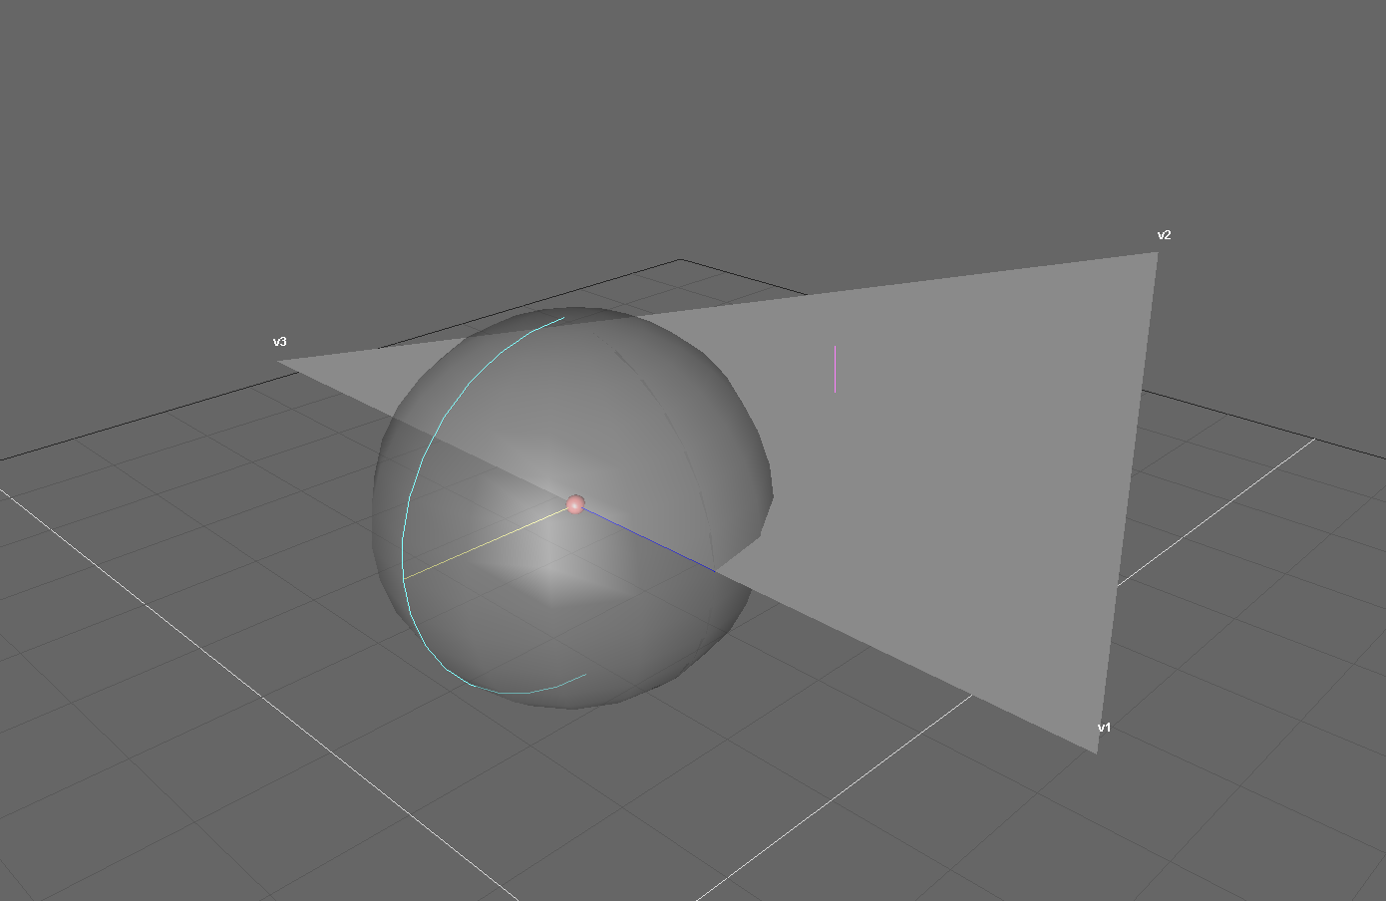
Triangle Gauss Map
Notes:
Here is another picture to help understanding this:
Even though the cross product is not defined in this configuration, we still can setup the plane through the associated arc of a triangle edge.
If you look at the picture you should see that the edge is orthogonal to a plane through the corresponding arc and defines the plane normal that we seek

Slide 38
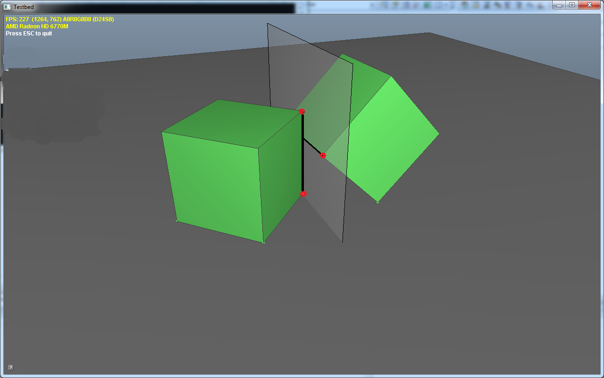
Optimized Edge-Edge Distance
Notes:
Now that we can prune edge pairs that don’t build a face on the Minkowski difference we need a method to compute the distance between the remaining edge combinations
The Gauss Map essentially defines the directions that the corresponding feature might get in contact with
Obviously if two arcs overlap and build a Minkowski face the colliding features must be supporting edges
The Gauss map does not only allow us to prune edge combinations. It also allows us to compute the distance between the edges efficiently.
Build the plane through one edge (with the edge cross product as the normal)
Compute the distance of any vertex on the other edge to that plane
As opposed to the brute force version this is now O(1) – no need for support points!

Slide 39
Consistent Normal Orientation
v
n
c
if (dot( n, v – c ) < 0 ) n = -n
Notes:
Small gotcha here: We need a well defined normal direction to get the sign of the distance right
E.g. from A toward B
Simple compare the normal against the vector from centroid to any of the two edge vertices and flip if necessary

Slide 40
Half-Edge Mesh
Twin( e )
Head( e )
Tail( e )
Half-Edge e
Next( e )
Prev( e )
Face( e )
Notes:
So after quite some theory lets investigate one possible implementation
There are endless possibilities to describe a convex polyhedron.
Personally I use the half-edge mesh which is an edge centric mesh representation.
Allows to efficiently access the two associated faces of a shared edge.

Slide 41
SAT: Edge Directions (3D)
EdgeQuery QueryEdgeDirection( Polyhedron* pPolyA, Polyhedron* pPolyB )
{
for ( int indexA; indexA < pPolyA->EdgeCount; indexA += 2 )
HalfEdge* pEdgeA = pPolyA->GetEdge( indexA );
for ( int indexB; indexB < pPolyB->EdgeCount; indexB += 2 )
HalfEdge* pEdgeB = pPolyB->GetEdge( indexB );
if ( BuildMinkowskiFace( pEdgeA, pEdgeB ) )
float separation = Distance( pEdgeA, pEdgeB, pPolyA );
// Keep track of largest separation and associated edges
return indices of edge pair with minimum separation and distance
};
Notes:
Finally let’s look at optimized for version of the SAT using the Gauss Map
We iterate over all edge combination and discard all combinations that don’t build a face on the Minkowski difference
If we detect an edge combination that realizes a potential separating axis we can now compute the distance between these two edges in constant time
Remember that this was the bottleneck in the brute force version
Hint: If you use a half-edge data structure store two half edges (edge and twin) after each other. This allows us to iterate unique edges efficiently! In the slide every second edge is skipped for this reason!

Slide 42
SAT: Edge Pruning (3D)
bool BuildMinkowskiFace( HalfEdge* pEdgeA, HalfEdge* pEdgeB )
{
// Extract face normals which define the vertices of the two arcs!
Vector3 a = pEdgeA->GetNormal1();
Vector3 b = pEdgeA->GetNormal2();
Vector3 c = pEdgeB->GetNormal1();
Vector3 d = pEdgeB->GetNormal2();
// Negate normals c and d to account for Minkowski difference!
return IsMinkowskiFace( a, b, -c, -d );
};
Notes:
We extract the associated normals of each edge and call the IsMinkowskiFace() function.
In order to account for the Minkowski difference we need to negate one pair of normals.

Slide 43
SAT: Edge-Edge Distance (3D)
float Distance( HalfEdge* pEdgeA, HalfEdge* pEdgeB, Polyhedron* pPolyA )
{
Vector3 edgeA = pEdgeA->Direction();
Vector3 pointA = pEdgeA->Head();
Vector3 edgeB = pEdgeB-> Direction();
Vector3 pointB = pEdgeB->Head();
if ( AreEdgesParallel( edgeA , edgeB ) ) return –FLT_MAX; // Skip parallel edges
Vector3 normal = NormalizedCross( edgeA , edgeB );
if ( Dot( normal, pointA - pPolyA->Centroid() );
normal = -normal; // Assure normal points from A -> B
return Dot( normal, pointB – pointA ); // No need to compute support points: O(1)
};
Notes:
Finally we have two edges that define a possible separating
Skip parallel edges, because they can also not build a face on the Minkowski difference
Assure consistent normal orientation to get a correct sign for distance calculation
Finally build plane through edge A and compute distance of a vertex on edge B to that plane

Slide 44
Overlap Test (3D)
bool Overlap( Polyhedron* pPolyA, Polyhedron* pPolyB )
{
FaceQuery faceQueryA = QueryFaceDirections( pPolyA, pPolyB ); // Faces A (as 2D)
if ( faceQueryA > 0.0f ) return false;
FaceQuery faceQueryB = QueryFaceDirections( pPolyB , pPolyA ); // Faces B (as 2D)
if ( faceQueryB > 0.0f ) return false;
EdgeQuery edgeQuery = QueryEdgeDirections( pPolyA, pPolyB ); // Edges A & B
if ( edgeQuery > 0.0f ) return false;
return true;
};
Notes:
As we did in 2D a simple example of the overlap test in 3D
Face directions same as in 2D
Also need to test edge combinations in 3D – otherwise test is not complete which might result in false positives since we would skip possible separating axes

Slide 45
SAT Comparison: Brute-Force vs. Gauss Map
Convex hulls of random points on sphere:
4 Vertices: 2x speed-up
8 Vertices: 6x speed-up
16 Vertices: 20x speed-up
32 Vertices: 40x speed-up
No extra memory needed
Notes:
Speed-up is essentially what you would expect when optimizing an algorithm from O(n^3) to O(n^2)
This makes this test actually a candidate for collision detection between small convex hulls
This algorithm is heavily used in production code and not just theory!

Slide 46
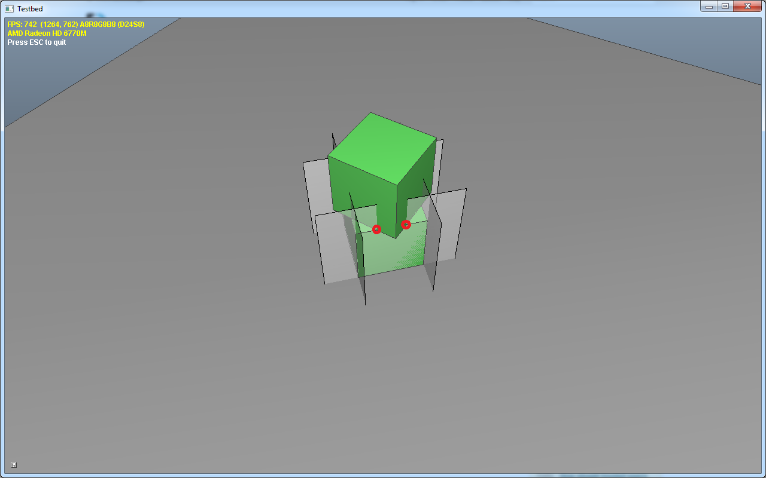
Face Contact (3D)
Notes:
Since this is the physics tutorial I’d also like to talk about contact creation using the SAT:
Create a contact between the features that define the axis of minimum penetration.
If axis of minimum penetration comes from face
Clip one face against the side planes of the other.

Slide 47
Face Contact (3D) - Overview
Identify axis of minimum penetration using the SAT (this defines the reference face)
Find the most anti-parallel face the on other shape (this defines the incident face)
Clip incident face against side planes of reference face
Keep all vertices below reference face
Notes:
Let’s see how this works in a little bit more detail:
I recommend Sutherland-Hodgman clipping in the third step.
Some engines also clip against the reference face in the end, but I cannot recommend this step. This adds additional contact points that don’t add to the manifold stability

Slide 48
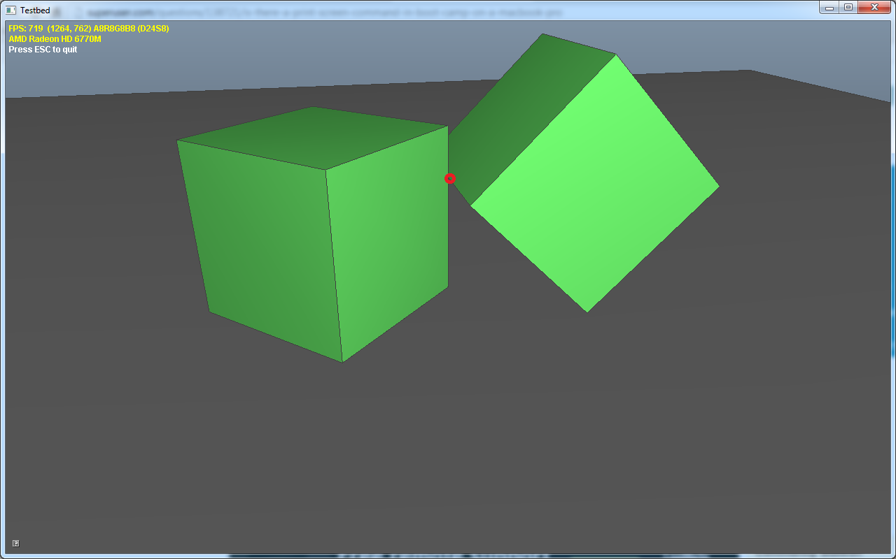
Edge Contact
Notes:
If the axis of minimum penetration is realized by an edge pair compute the closest points between the two edge segments and are done
So you see that the SAT makes contact point creation pretty straight forward

Slide 49
Thanks!
Thanks to Valve!
Thanks to Ted, Sergiy, Ali, Oliver, Erwin and especially Anoush for exhaustive rehearsing!
Special thanks to Erin Catto for sharing these ideas on the Bullet forum!
Notes:
Thinks closes the talk.

Slide 50
Questions?
Notes:
This closes the talk and hopefully there is some time left for questions! Thank you very much…

Slide 51
References
C. Ericson: “Real-Time Collision Detection”
G. v. d. Bergen: “Collision Detection in Interactive 3D Environments”
S. Migdalsky: “SAT in Narrow Phase and Contact Manifold Construction”
(in Game Physics Pearls)
Y. Choi: “Collision Detection of Convex Polyhedra Based on Duality Transformation” (Minkowski Sum and Gauss Map)
S. Iserloh: “Reframing the Problem” (Minkowski Sum)
G. Rhodes: “Computational Geometry” (Half-Edge Mesh)
M. McGuire: “The Half-Edge Data Structure” (FlipCode)
E. Catto: “Contact Manifolds” (GDC 2007)
Notes:
Here are some papers that might help you to better understand this presentation.

