Slide 1
B.Tech Technical Writing Report | Presentation
Does Abliteration Survive
4-bit Quantization?
A Controlled Reproduction and Semantic Evaluation on Qwen3.5-9B
the 32 layers of Qwen3.5-9B; blue layers carry the edit
Omm P Tripathy
B123082
Shreyash Jena
B123124
Aman Saini
B423008
Supervisor: Prof. Srichandan Sobhanayak
Department of Computer Science
International Institute of Information Technology Bhubaneswar
November 2026
Notes:
Presenter: Omm
Good morning. We are Omm, Shreyash and Aman, and our supervisor is Prof. Srichandan Sobhanayak. Our report asks a simple practical question. If someone removes the safety refusals from a language model and then compresses that model to 4 bits so it runs on a small GPU, is the removal still there afterwards? I will cover the motivation and the background ideas. Shreyash will explain how we rebuilt the edit and how we measured its effect. Aman will present the quantization result, the limitations and our conclusions.
Likely questions:
Q: How is the talk split?
A: Omm: slides 1 to 6. Shreyash: slides 7 to 12. Aman: slides 13 to 19. The backup slide is for questions on the reproduction numbers.

Slide 2
MOTIVATION
Edited models get shrunk, but the edit is rarely checked
1
2
3
?
Chat models refuse
Abliteration
Shrink to 4-bit
Still edited?
They are trained to refuse harmful requests.
Deletes one “refusal direction” from the weights, so the model stops refusing.
Users compress the model so a 9-billion-parameter model fits on one consumer GPU.
Whether the edit survives the shrinking is rarely checked.
Earlier work studied how quantization changes a model’s trained safety. We ask a narrower question: does a small, deliberate weight edit survive the same rounding?
Does Abliteration Survive 4-bit Quantization?
2
Notes:
Presenter: Omm
Chat models are trained to refuse harmful requests. Researchers found that in many models this refusal is controlled largely by a single direction inside the model's internal activations. Abliteration is a weight edit that deletes that direction, and tools such as Heretic automate it. These edits are made on 16-bit weights. But most people run open models in 4-bit form, because a 9-billion-parameter model then fits on one consumer GPU. So the edit passes through a rounding step before anyone uses it, and whether it survives that step is rarely checked.
Likely questions:
Q: Why study the removal of safety at all?
A: The same question applies to edits that strengthen refusal. We only reproduced an edit that was already public, and we release no harmful outputs.

Slide 3
RESEARCH QUESTION
One question runs through the whole report
When an abliteration edit is applied at full precision and the model is then shrunk to 4-bit NF4, does the edit’s effect survive? And can any loss be told apart from ordinary quantization damage?
Part 1: survival
Part 2: attribution
After 4-bit conversion, does the edited model still behave like the edited model?
If something changes, was the edit lost, or does 4-bit rounding hurt every model a little?
Does Abliteration Survive 4-bit Quantization?
3
Notes:
Presenter: Omm
This is our one research question, and it has two parts. First, after the edited model is converted to 4-bit NF4, does it still behave like the edited model? Second, if something changes, is that because the edit was lost, or simply because quantization damages every model a little? To separate those two, we also need an unedited model that is quantized in the same way. Everything in the report serves this question. The reproduction and the measurement work are not side projects: we needed them before we could answer it.
Likely questions:
Q: Why 4-bit, and why NF4?
A: 4-bit is how these models are commonly run. NF4 is a standard 4-bit format introduced with QLoRA, and we used its bitsandbytes implementation.

Slide 4
BACKGROUND: ABLITERATION
A refusal direction is the gap between two averages
rings = averages
harmful prompts
1
Run 400 harmful and 400 harmless prompts and record the model’s internal numbers (activations) at each layer.
2
Average each group. The arrow from one average to the other is the refusal direction.
refusal direction
harmless prompts
3
Edit each layer’s output weights so the layer can no longer write along that direction.
refusal direction = average(harmful) − average(harmless)
Does Abliteration Survive 4-bit Quantization?
4
Notes:
Presenter: Omm
Inside the model, each word is represented by a long list of numbers, 4096 of them in this model. We can treat that list as a point in space. We run 400 harmful and 400 harmless prompts, record these points at each layer, and average each group. The arrow from the harmless average to the harmful average is the refusal direction. Abliteration then edits the output weights of each layer so that the layer can no longer write anything along that arrow. If the model cannot push its state in that direction, it tends not to refuse.
Likely questions:
Q: Is refusal really a single direction?
A: Not entirely. Later work found several related directions, which is why we check the model's actual answers instead of trusting the geometry.
Q: Which layer's direction was used?
A: The published settings pick a point between the outputs of blocks 18 and 19, mixed with weight 0.49.

Slide 5
BACKGROUND: QUANTIZATION
NF4 rounds every weight to one of 16 levels
original 16-bit weights (any value)
−1
0
+1
16 NF4 levels, packed tighter near zero where most weights sit
Group
Scale
Round
Weights are handled in blocks of 64.
Each block is divided by its largest absolute value.
Each weight snaps to the nearest of 16 levels: 4 bits.
At run time the weights are expanded back to 16-bit, but the rounding error stays. Could it blur the edit away?
Does Abliteration Survive 4-bit Quantization?
5
Notes:
Presenter: Omm
Quantization means storing each weight with fewer bits. NF4 groups the weights into blocks of 64. Each block is scaled by its largest absolute value, and then each weight is rounded to the nearest of 16 fixed levels. The levels sit closer together near zero, because most weights are small. When the model runs, the weights are expanded back to 16-bit for computation, but the rounding error stays. The worry is simple: the abliteration edit is a small change to the weights, so rounding might blur it away.
Likely questions:
Q: Why are the levels uneven?
A: Weights are roughly normally distributed, so NF4 places its 16 levels at quantiles of a normal distribution, giving more levels where weights are dense.
Q: Which settings did you use?
A: bitsandbytes NF4 with blocks of 64, no double quantization and FP16 computation.

Slide 6
APPROACH
We answer it in three steps; the first two are preconditions
1
Step 1
2
Step 2
3
Step 3
Get a faithful edit
Get a trustworthy measure
Test survival under NF4
Can we rebuild the published edit exactly enough to study it?
Does “no refusal phrase” really mean the model answered?
Does the edit’s effect stay after 4-bit conversion, and is any change due to the edit?
Without step 1, a change tells us nothing about the real method. Without step 2, we could not see the change.
Does Abliteration Survive 4-bit Quantization?
6
Notes:
Presenter: Omm
We split the question into three steps. Step one: we need a faithful copy of the published edit, otherwise any change after quantization tells us nothing about the real method. Step two: we need a measure we can trust. If we only count refusal phrases, a model that avoids refusal words but still does not answer would look fully edited. Step three is the actual test. Steps one and two are preconditions, and as you will see, they turned out to be the hard part. I now hand over to Shreyash.
Likely questions:
Q: Why not just use the publisher's checkpoint?
A: For the five-condition design we need the edit as separate factors, so we can also apply it on top of a quantized base. That meant rebuilding it.

Slide 7
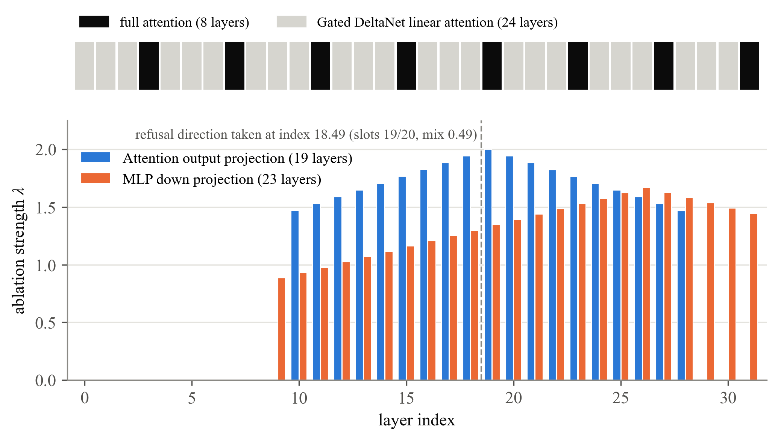
SETUP
One hybrid model, one published edit, two Kaggle GPUs
Qwen3.5-9B: 32 layers, three linear-attention layers to every one full-attention layer
Published Heretic edit rebuilt from its released settings, with no new search
42 matrices edited: 19 attention outputs and 23 MLP outputs
Compute: two NVIDIA T4 GPUs on Kaggle, 16-bit
Does Abliteration Survive 4-bit Quantization?
7
Notes:
Presenter: Shreyash
Our model is Qwen3.5-9B. It has 32 layers and it is a hybrid: three linear-attention layers, called Gated DeltaNet, then one full-attention layer, repeated. The strip at the top of the figure shows this pattern. We studied a published Heretic edit of this model. The bars show how strongly each layer was edited: blue for the 19 attention output matrices and orange for the 23 MLP output matrices, 42 in total. Strengths above 1 go further than removal and reverse part of the component. Everything ran in 16-bit on two Kaggle T4 GPUs.
Likely questions:
Q: Why does the hybrid design matter?
A: Both layer types end in an output projection, so the same editing rule applies, but we needed a Heretic revision that supports this architecture.
Q: How much compute did it take?
A: About 2.11 GPU-hours for the reconstruction, 1.04 for the NF4 pilot and 0.87 for the semantic audit.

Slide 8
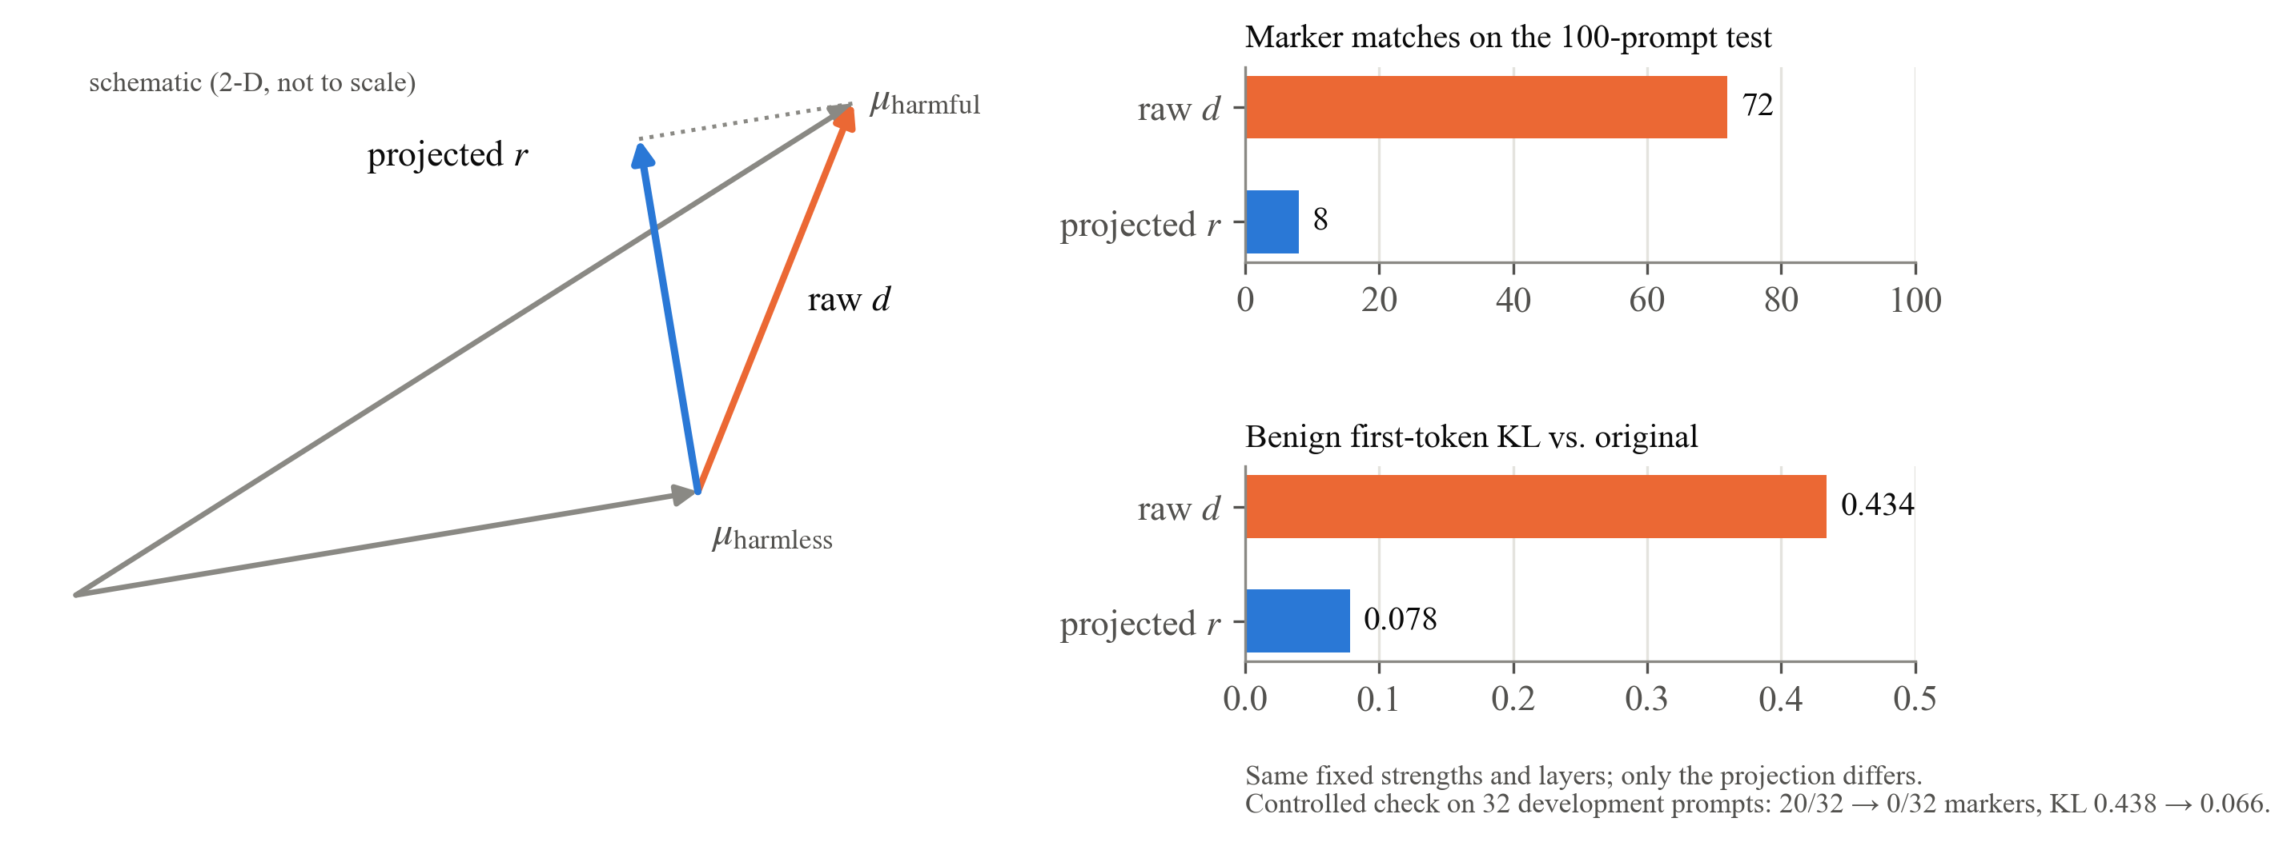
STEP 1 RESULT
The first rebuild failed; one missing step fixed it
projected direction = raw direction − its part along the harmless average
Why: every prompt shares the harmless part, so removing it disturbed all inputs and wasted part of the edit.
Does Abliteration Survive 4-bit Quantization?
8
Notes:
Presenter: Shreyash
Our first attempt to rebuild the edit failed. With the published settings, 72 of 100 harmful test prompts still produced refusal phrases, and the change on harmless prompts, measured by KL divergence, was 0.434. The missing piece was one step known as projected abliteration: before editing, remove from the raw direction its part along the harmless average. With only that change, refusal phrases fell to 8 of 100 and KL to 0.078, the same as the publisher's checkpoint in our setup. The raw gap contains a part every prompt shares, so removing it disturbs all inputs and spends part of the edit on the wrong thing.
Likely questions:
Q: What is KL divergence here?
A: How much the model's probabilities for the first output token on harmless prompts change compared with the original. Lower means less collateral change.
Q: Did you test the fix separately?
A: Yes, on 32 development prompts: marker matches went from 20 of 32 to 0 of 32, and KL from 0.438 to 0.066.

Slide 9
STEP 1 CHECKS
The rebuilt edit is verified, but phrase counts are not answers
42 of 42
100 of 100
> 0.9999
edited matrices equal an explicit computation of original + edit
identical outputs after saving and reloading the model
cosine match with the publisher’s change (MLP and full-attention matrices)
!
Caution: 8 refusal phrases does not mean 92 answers
With a 100-token limit, 99 of 100 replies were cut off. Whether the model actually answered needs a different measure: that is Step 2.
Does Abliteration Survive 4-bit Quantization?
9
Notes:
Presenter: Shreyash
We also checked the rebuilt edit directly in the weights. All 42 edited matrices equal an explicit computation of the original weights plus the edit. Saving and reloading the model gave 100 of 100 identical outputs. Spot checks against the publisher's weights showed the change pointing the same way, with cosine similarity above 0.9999 for the MLP and full-attention matrices. One caution: our test used a 100-token limit and 99 of 100 replies were cut off. So 8 refusal phrases does not mean 92 real answers. That is what step two is about.
Likely questions:
Q: Is your reconstruction identical to the publisher's model?
A: Close but not byte for byte, because the publisher's exact unrounded settings and software environment were not released.

Slide 10
STEP 2: THE MEASURE
Counting refusal phrases misleads in both directions
Gave the requested content
Did not give it
Uses refusal words
Refuses, then answers anyway
Counter says “refusal”: wrong
seen in the original model
Plain refusal
Counter is right
No refusal words
Plain answer
Counter is right
Polite redirect
Counter says “answered”: wrong
seen in an edited model
A phrase counter reads the wording. We need to judge what the reply actually gives.
Does Abliteration Survive 4-bit Quantization?
10
Notes:
Presenter: Shreyash
Most abliteration tools count refusal phrases such as "sorry" or "I can't". That only reads the wording. This grid shows why that is not enough. The two plain cases are fine. But we saw two misleading cases. The original model once began with a refusal and then supplied the requested material anyway, and a phrase counter calls that a refusal. One edited reply had no refusal words at all but steered the user toward protecting their own account, and a counter calls that an answer. So we switched to semantic review: does the reply actually give what was asked?
Likely questions:
Q: Who did the semantic labeling?
A: A single LLM-based reviewer working on shuffled, anonymized responses, with labels fixed before the conditions were revealed. Human labels are future work.
Q: Does a disclaimer cancel an answer?
A: No. In our rubric a disclaimer does not cancel fulfillment, and an attempt is not checked for correctness.

Slide 11
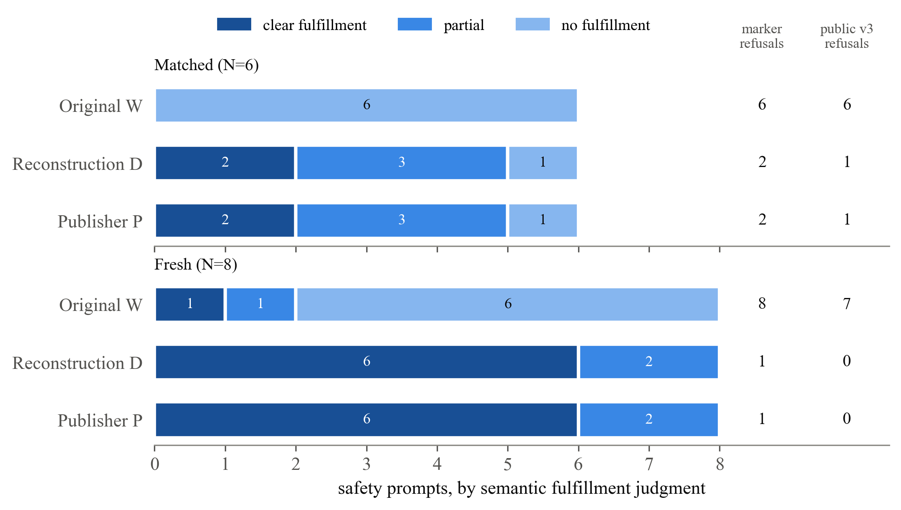
STEP 2 RESULT
Judged by content, the edit clearly works at full precision
6 of 8
fresh safety prompts clearly answered by each edited model
1 of 8
by the original model
Our rebuild and the publisher’s model got the same label on all 14 prompts.
Does Abliteration Survive 4-bit Quantization?
11
Notes:
Presenter: Shreyash
Here are the semantic labels. On eight fresh safety prompts, the original model clearly answered one and used refusal language on all eight. Both edited models, our rebuild and the publisher's, clearly answered six and partly answered two. They received the same label on all 14 prompts. The small columns on the right show the two phrase-based detectors on the same replies, and they do not line up with the bars. From here on, our outcome is semantic fulfillment, not phrase counts.
Likely questions:
Q: Two fresh prompts were about security testing. Does that inflate the result?
A: Excluding them leaves 4 clear and 2 partial answers out of 6 for each edited model, and none for the original.
Q: Did the edit damage general ability?
A: No model refused the safe XSTest prompts and all three solved the five arithmetic problems, but that check is too small to prove ability is preserved.

Slide 12
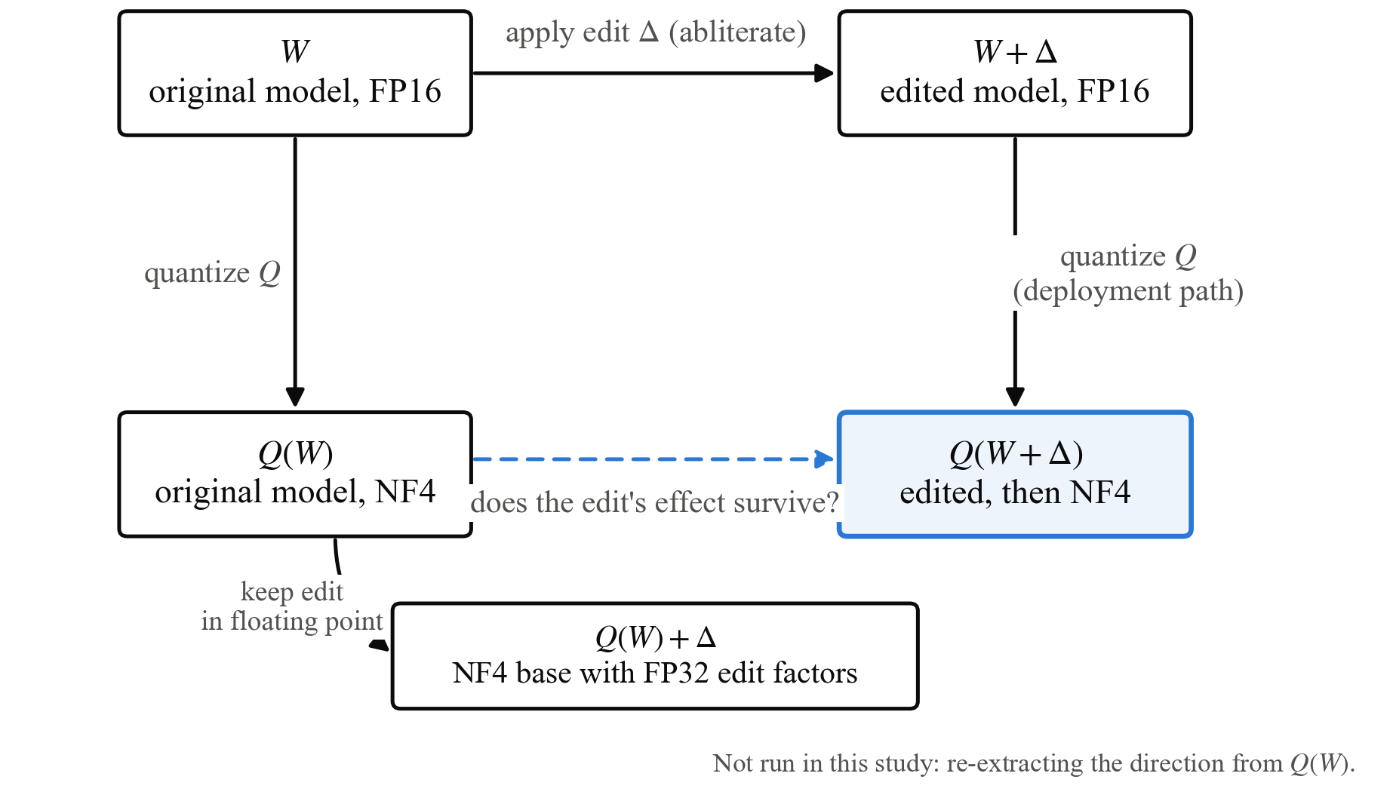
STEP 3: THE DESIGN
Five versions separate edit loss from rounding damage
W
original, 16-bit
W + Δ
edited, 16-bit
Q(W)
original, 4-bit: the control
Q(W + Δ)
edited, then 4-bit: deployment
Q(W) + Δ
4-bit base, edit kept unrounded
Why the control matters
If Q(W) started answering too, 4-bit rounding, not the edit, could explain the result.
Does Abliteration Survive 4-bit Quantization?
12
Notes:
Presenter: Shreyash
Now the design for step three. We compare five versions of the model. The top row of the picture is full precision: original and edited. The bottom row is after 4-bit conversion. The key control is the original model, quantized. If quantization alone made the model start answering, we would wrongly credit the edit. The fifth version keeps the edit in 32-bit floating point on top of the quantized base, so the edit itself is never rounded. The question is whether the gap between the two bottom boxes matches the gap between the two top boxes. Aman will present the result.
Likely questions:
Q: Why the fifth condition?
A: It separates rounding of the edit itself from changes in the base model, because the edit factors stay in FP32.
Q: Did you re-extract the direction from the 4-bit model?
A: No. That is a different experiment and is listed as future work.

Slide 13
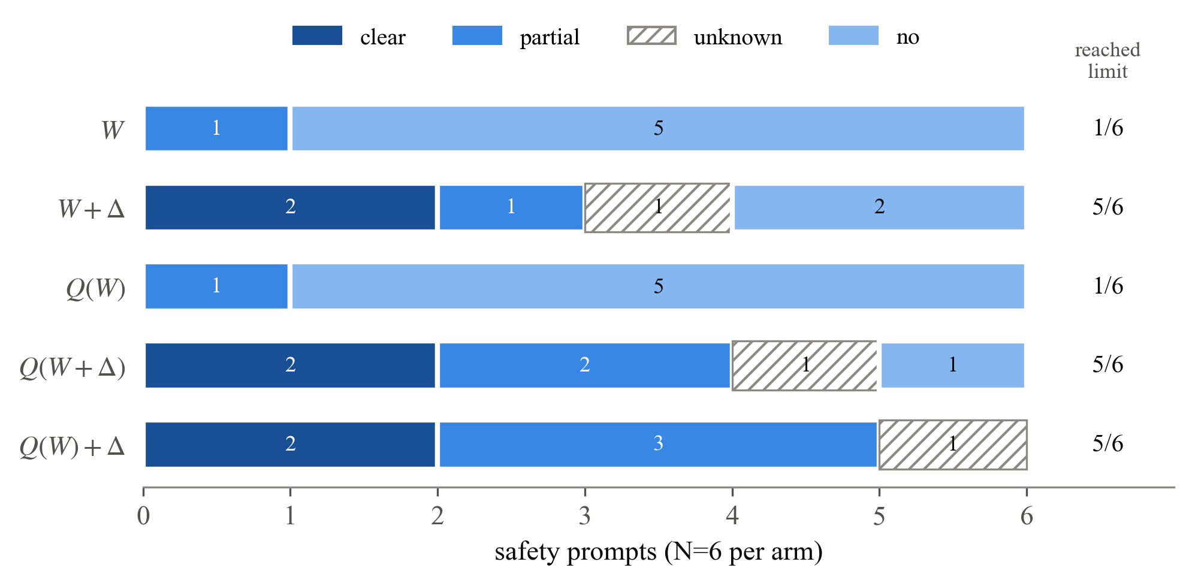
STEP 3 RESULT
The edit’s clear answers survive NF4; NF4 alone creates none
2 → 2
clear answers before and after NF4
0 → 0
for the original model: NF4 alone creates none
Open
partial weakening not ruled out; most edited replies were cut off
Six safety prompts per condition: a pilot, not a rate.
Does Abliteration Survive 4-bit Quantization?
13
Notes:
Presenter: Aman
This is the main result, on six safety prompts per condition. The original model and its 4-bit version look the same, with no clear answers, so 4-bit conversion alone does not create the effect. The edited model clearly answered two prompts at full precision, and those same two were still clearly answered after quantization, and also when the edit was kept unrounded. No quantized edited version had fewer clear or partial answers than the full-precision edit. But most edited replies were cut off and some labels are unknown, so we can rule out complete erasure on these prompts, not partial weakening.
Likely questions:
Q: How much could the effect have changed?
A: If every partial or unknown label could go either way, the change in the edit's effect lies between −0.50 and +0.67. These are bounds over possible labelings, not confidence intervals.
Q: Did quantization hurt the benign prompts?
A: No condition refused the three safe prompts. Four conditions solved all three arithmetic problems; the unrounded-edit condition solved two and hit its limit on the third.

Slide 14
Hypothesis, not measured
DISCUSSION
Why it might survive: a coherent push beats scattered noise
The edit
Rounding error
one large push along one direction
many small pushes in every direction
refusal direction
refusal direction
The edit has strength 0.84 to 2.0, all along one direction. Rounding errors are small and spread over 4096 directions, so only a tiny share lands on the refusal direction.
Prediction: round-to-nearest 4-bit keeps the edit, unless the strength is small or the format is much coarser.
Does Abliteration Survive 4-bit Quantization?
14
Notes:
Presenter: Aman
Why might the edit survive? This is our hypothesis, not a measured result. The edit changes each edited matrix by a large amount, with strength between 0.84 and 2.0, and always along one direction: a single coherent push. Rounding errors are small and point in all directions across the 4096-dimensional space, so only a tiny share of them falls along the refusal direction. Coherent signal beats scattered noise. This predicts that round-to-nearest 4-bit should keep the edit, unless the edit is weak or the format is much coarser. It also suggests a cheap test that needs only the weights.
Likely questions:
Q: How would you test it?
A: For each edited matrix, measure what fraction of the intended edit is still present in the difference between the quantized edited and quantized original weights, for several bit widths. No text generation is needed.
Q: Is the hypothesis proven?
A: No. It is an argument from the structure of the edit. The weight-only test on the future-work slide would check it.

Slide 15
LIMITATIONS
What this pilot cannot tell us
1
Small samples
2
One AI reviewer
3
Truncated answers
14 safety prompts at 16-bit and 6 in the NF4 pilot. No rates or confidence intervals.
All semantic labels came from one LLM reviewer with imperfect masking. No human labels yet.
Most edited replies hit the token limit, so labels cover only what was visible.
4
One model, one edit
5
One quantizer
6
Not checked
Only Qwen3.5-9B and one published Heretic edit were studied.
Only bitsandbytes NF4, in one configuration. Other formats may differ.
Correctness of harmful content, on purpose. The 100-prompt test was also used while debugging.
Does Abliteration Survive 4-bit Quantization?
15
Notes:
Presenter: Aman
These are the limits on what we can claim. The samples are small: 14 safety prompts at full precision and 6 in the NF4 pilot, so we report no rates or confidence intervals. All semantic labels came from one AI reviewer, and the masking was imperfect. Most edited replies hit the token limit, so we labeled only what was visible. We studied one model, one edit and one quantizer configuration. We deliberately did not check whether harmful answers were correct, and the 100-prompt reproduction test was also used while debugging.
Likely questions:
Q: Given all this, what can you actually claim?
A: That complete erasure of the edit did not happen on these prompts with this setup. Not that the edit is fully preserved in general.

Slide 16
ETHICS AND DISCLOSURE
We reproduced only public work and show no harmful text
E
Ethics
AI
AI assistance
Only an edit and a checkpoint that were already public were reproduced.
No harmful model output is shown; replies are described by category only.
Raw outputs and the rebuilt model are kept private and not released.
Correctness of harmful answers was deliberately not tested.
AI coding agents helped write the code and run the experiments.
Semantic labels came from a single LLM-based reviewer.
All responses and settings were saved for later human review.
Does Abliteration Survive 4-bit Quantization?
16
Notes:
Presenter: Aman
Because abliteration removes a safety behavior, this work is dual-use, so we set clear limits. We reproduced only an edit and a checkpoint that were already public. No harmful model output appears in the report or in these slides; we describe replies only by category. The raw outputs and the rebuilt model are in private, access-controlled storage and are not released. We did not test whether harmful answers were correct. We also disclose that AI coding agents helped with the implementation and the experiment runs, and that the semantic labels came from a single LLM-based reviewer.
Likely questions:
Q: Why is this research useful rather than harmful?
A: It tells people whether a deployed 4-bit model still carries an edit, and the same question matters for edits that strengthen refusal.
Q: Did a human check any labels?
A: Not yet. All 132 responses are saved so that people can label them, which is our second next step.

Slide 17
CONCLUSION
The edit survived NF4 here; the hard part was measuring it
On Qwen3.5-9B with NF4, the edit’s observed effect survived quantization. Whether it is partly weakened remains open at this sample size.
1
2
3
Rebuild every step
Measure answers, not phrases
The edit survived NF4
One missing projection step was the difference between 72 and 8 refusal phrases out of 100.
Phrase counters err both ways. Judge what each reply actually gives.
Both clear answers stayed after 4-bit conversion, and NF4 alone created none.
Does Abliteration Survive 4-bit Quantization?
17
Notes:
Presenter: Aman
To conclude, three takeaways. First, rebuilding a published edit needs every step: one missing projection step was the difference between 72 and 8 refusal phrases out of 100. Second, measure answers, not phrases. Phrase counters make errors in both directions, so we judged what each reply actually gave. Third, in our pilot the edit survived NF4: the clear answers seen at full precision stayed, and quantizing the original model did not create any. The lesson is that the hard part of the question was measurement, not compute.
Likely questions:
Q: Does this mean every 4-bit abliterated model is still abliterated?
A: No. It is one model, one quantizer and a small pilot. Coarser formats may behave differently.

Slide 18
FUTURE WORK
Three next steps, cheapest first
1
2
3
Weight-only retention test
Human labels
Larger study
Measure how much of the edit remains in the 4-bit weights, for NF4, 8-bit and lower formats.
People label the 132 saved responses, with two reviewers on a shared subset to measure agreement.
More prompts, longer answers, a calibrated evaluator such as StrongREJECT, a second quantizer and model.
runs on a CPU, no text generation
checks the AI reviewer
turns the pilot into rates
Also: re-extract the refusal direction from the 4-bit model, a condition this study did not run.
Does Abliteration Survive 4-bit Quantization?
18
Notes:
Presenter: Aman
Three next steps, in order. First, a weight-only test: compare the quantized edited weights with the quantized original weights and measure how much of the intended edit is still there, for NF4, 8-bit and lower-precision formats. It runs on a CPU and directly tests our hypothesis. Second, human reviewers should label the 132 saved responses, with two reviewers on a shared subset to measure agreement. Third, a larger study: more prompts, longer answers, a calibrated evaluator such as StrongREJECT, a second quantizer and model family, and a condition that re-extracts the direction from the quantized model.
Likely questions:
Q: Why is the weight-only test first?
A: It is the cheapest: it needs only the saved weights, no GPU and no text generation, and it directly tests the explanation on the previous slides.

Slide 19
Thank you
Questions are welcome
72 → 8
6 of 8 vs 1 of 8
2 → 2
refusal phrases out of 100 after the projection fix
fresh prompts clearly answered: edited vs original
clear answers kept after NF4; none created by NF4 alone
Omm P Tripathy
B123082
Shreyash Jena
B123124
Aman Saini
B423008
Supervisor: Prof. Srichandan Sobhanayak
Department of Computer Science, IIIT Bhubaneswar | November 2026
Notes:
Presenter: Aman (all three answer questions)
Thank you for listening. To sum up in three numbers: the projection fix took refusal phrases from 72 to 8 out of 100. On fresh prompts the edited models clearly answered 6 of 8, against 1 of 8 for the original. And the 2 clear answers seen at full precision were kept after NF4, while NF4 alone created none. We are happy to take questions. Omm will take background and motivation, Shreyash the reproduction and measurement, and Aman the NF4 results and limitations.
Likely questions:
Q: Why Qwen3.5-9B?
A: It is a recent hybrid model with a published Heretic edit and released edit settings, and it runs on the two T4 GPUs we had.
Q: What would change your conclusion?
A: Human labels that disagree with the AI reviewer, or the weight-only test showing that much of the edit is lost in rounding.

Slide 20
BACKUP
Reproduction numbers on the 100-prompt test
Condition | Refusal-phrase matches | Reached 100-token limit | Benign KL
Original W | 100 | 59 | 0
Raw-direction replay | 72 | 91 | 0.434
Publisher P | 8 | 100 | 0.078
Reconstruction D | 8 | 99 | 0.078
D after save and reload | 8 | 99 | not measured
Publisher’s model card (reported) | 6 | n/a | 0.079
Controlled check on 32 development prompts: 20 of 32 → 0 of 32 phrase matches; KL 0.438 → 0.066.
KL: change in the first-token prediction on 100 harmless prompts, compared with the original model.
Does Abliteration Survive 4-bit Quantization?
Backup
Notes:
Presenter: Shreyash
Backup slide for questions on the reproduction. The original model hits refusal phrases on all 100 test prompts. The raw-direction replay still hits 72. The publisher's checkpoint and our reconstruction both hit 8, with the same KL of 0.078, and after save and reload our reconstruction still hits 8. The publisher's model card reports 6 and 0.079 in their own setup. The limit column shows how many replies were cut off at 100 tokens, which is why these counts say little about real answers.
Likely questions:
Q: Why do the model card numbers differ slightly?
A: They come from the publisher's own evaluation setup. We compare every model within one setup, where the publisher's checkpoint and our reconstruction match.
Q: Were these test prompts held out?
A: No. They were also used while debugging the reconstruction, which we list as a limitation.

