Slide 1
Seismological
Software Developments at LMU Munich
Robert Barsch
Notes:
Today I'm going to talk about my dissertation named “Web-based ...”, which was funded by the DFG.

Slide 2
Table of Contents
  SeisHub
  ObsPy
  Scientific Applications
    BayernNetz
    Exupéry VFRS
Notes:
After a short motivation I'm going to introduce the new seismological database SeisHub which has been developed during this project.
I will talk about the database design, some technical details and the advantages and disadvantages of this database.
The development of SeisHub triggered the new seismological programming library ObsPy, which will be covered in another section.
Finally I'll give two scientific applications for SeisHub and ObsPy. The first one would be BayernNetz, the local seismological network, and secondly a project called Exupery - Vulcano Fast Response System, which is funded by the German Ministry for Education and Research (BMBF) within the Geotechnologien project.
I'll will finish with the conclusion.

Slide 3
Table of Contents
  SeisHub
  ObsPy
  Scientific Applications
    BayernNetz
    Exupéry VFRS

Slide 4
SeisHub
Native, document-centric XML database
  RESTful Web service (HTTP, HTTPS),
  Standard relational database as back-end
  Both worlds: SQL for querying and manipulating data and any standard connected to XML, e.g. XSLT or XSD
  Not restricted to seismology at all
Extended to a “classical” seismic database
  Index of local, file-based waveform archive (MiniSEED, GSE2, SAC, ...)
    Meta Data: Gaps, overlaps, quality and timing information
    Waveform previews (30s)
  XML resource types for handling inventory data (XML-SEED) and events (QuakeML based)
  Remote waveforms access (ArcLink)
Notes:
The points indicated in the slide before suggest that it is time to reconsider the software requirements for seismic databases and processing tools from scratch.
The software package SeisHub developed during this study aims to overcome many of the problems on the database side.
So the goal of my project ...

Slide 5
SeisHub: Technical Details
  Python-based, standalone web service
  Platform independent, open source (GPL)
  Implementation of various web protocols, like HTTP, SSH, SFTP
  Plug-in architecture: Dynamic discovering and loading of modules and support for Python .egg files
  Development remarks:
    Test-driven development proven software, so far → ca. 250 test cases
    Well-documented source code
    Subversion
    Trac: ticket system and project wiki
Notes:
Unlike other research projects which produce some kind of software SeisHub's source code was actually available from the very beginning of the project (I wont call any names)

Slide 6
SeisHub: Database Design
Indexing
  Generated using a XPath expression, type and additional options
  Simple creation + reindexing via web interface
  Various build-in types (datetime, bool, numeric, double, float, etc..)
  ProcessorIndex: custom processing
Searching
  XPath-like query on XML catalog object (restricted to indexes)
  SQL on database object
Mapper: predefined queries & output format bound to an fixed URL
FileSystemResource: integrates a file system directory (read only)
Notes:
This slide summarizes SeisHub's database design.
Again primary data is stored into the file system. Waveform data is stored in a local continuous waveform archive in the MiniSEED format. But SeisHub also allows to store other data too, usually large mostly but not necessarily binary datasets, which can't be handled without external tools.
Derived data and meta data are stored into a XML/Relational database hybrid.
That means that the actual data is packed into a XML document

Slide 7
SeisHub: Database Design
Data storage
  Primary data → file system
    Continuous waveform archive (MiniSEED, GSE2, SAC ...)
    Other data via (GeoTIFF, GPS time series, etc.) file system
  Meta Data → Web service on top of a XML/relational database hybrid
    Data is packed into a XML document → Data structure is within the document, no need for a predefined database schema
    XML resources are archived into a BLOB field
    Only searchable values are indexed
    Pointers to primary data
Notes:
This slide summarizes SeisHub's database design.
Again primary data is stored into the file system. Waveform data is stored in a local continuous waveform archive in the MiniSEED format. But SeisHub also allows to store other data too, usually large mostly but not necessarily binary datasets, which can't be handled without external tools.
Derived data and meta data are stored into a XML/Relational database hybrid.
That means that the actual data is packed into a XML document

Slide 8
SeisHub: Database Design
Data access
  HTTP/HTTPS: REST web service
    XML documents have a fixed resource identifier (URL's)
    Data transformation via XML Style Sheets on request (?output=...)
    Data validation via Schema (XML Schema, RelaxNG, Schematron) on resource upload
    Document properties like related meta data or indexes
  SFTP: XML documents mapped into a virtual file system
Notes:
This slide summarizes SeisHub's database design.
Again primary data is stored into the file system. Waveform data is stored in a local continuous waveform archive in the MiniSEED format. But SeisHub also allows to store other data too, usually large mostly but not necessarily binary datasets, which can't be handled without external tools.
Derived data and meta data are stored into a XML/Relational database hybrid.
That means that the actual data is packed into a XML document

Slide 9
SeisHub: Advantages
Technical:
  Sharing data over the network, but no firewall problems (HTTP / HTTPS)
  License free, open source, internet standards
  Platform independent, most basic client is a standard browser
  XML:
    Data validation on upload (XML schemas)
    Data transformation on request (XML stylesheets)
  Querying: SQL or XPath
Scientist:
  May modify there data provided as XML document at any time without corrupting the underlying database
  May dynamically add or delete search indexes, schemas and stylesheets

Slide 10
SeisHub: Disadvantages
Technical:
  Slower than “common” solutions
    XML parsing during validation and indexing
    Data overhead (XML verbosity)
  Infrastructure
Scientist:
  Seismologist != IT nerds
Notes:
(direct access to a relational database)

Slide 11
Table of Contents
  SeisHub
  ObsPy
  Scientific Applications
    BayernNetz
    Exupéry VFRS

Slide 12
ObsPy
  Python toolbox for seismologists
  Modular architecture
    Waveform data: GSE2, MiniSEED, SAC, WAV, Q/ASCII
    Inventory data: Dataless SEED, XML-SEED, RESP
    Data request clients: ArcLink/WebDC, DHI/Fissures, SeisHub
    Various pickers, filters and plot routines
    Waveform indexer
    [ToDo] Orfeus Web service client (Events, Waveforms)
Notes:
The development of SeisHub triggered the foundation of the seismological library ObsPy for the Python programming language
Wide spectrum of sophisticated tools for working with seismic data such as waveform, inventory or event-related data
Many submodules were directly influenced by the development of SeisHub and most of the ObsPy's core classes are now standard dependencies of SeisHub
Noteworthy modules developed by the author for SeisHub are:
ArcLink/WebDC client
Conversion tool between Dataless SEED and XML-SEED
RESTful Web service client for SeisHub

Slide 13
ObsPy
Open source (LGPL or GPL)
6 core developers
Platform independent (Win, Mac, Linux) and tested
Test-driven development (TDD), currently 308 unit tests (http://tests.obspy.org)
Reliance of well-known third-party libraries (numpy, scipy, matplotlib)
Reusing well established code, e.g. libmseed, GSE UTI
Automatic generated API documentation
Binary distributions: Python Package Index (PyPI), Windows Installer & Debian packages
Source code & community webpage containing tutorials, installation instructions, ticket system
http://www.obspy.org

Slide 14

SeisHub & ObsPy: Demonstration
Notes:
Complete functionality from arclink via python scripts – helps to automated the download of data via script

Slide 15
Table of Contents
  SeisHub
  ObsPy
  Scientific Applications
    BayernNetz
    Exupéry VFRS

Slide 16
BayernNetz
  Seismological network of the Bavarian Seismological Service (Erdbebendienst Bayern)
  Designed for monitoring local seismic activity in Bavaria and bordering regions for events of ML >= 2.0
  Data is collected, archived and analyzed at the Geophysical Observatory in Fürstenfeldbruck
  Currently 23 SP + 3 BB + 2 BB (GRSN) stations
  Waveform data received from BB stations are transmitted in real time to ORFEUS, GEOFON and BGR
  Neighboring networks may also access data directly
Notes:
SP == Short Period
The broad band instrument senses most frequencies equally well; the long-period and short period instruments are called "narrow" band, because they preferentially sense frequencies near 1/(15 s) and 1 hertz respectively. The yellow region is the low end of the frequency range audible to most humans (we can hear waves around 20 hertz to 20,000 hertz).

Slide 17
BayernNetz: SeisHub & ObsPy
SeisHub (experimental)
  parallel to the GIANT database since spring 2009
  Events retrieved from Earthworm (real time system) and Pitsa (manually) are automatically stored into SeisHub in QuakeML based format
  Automated indexing of the MiniSEED waveform archive
  Stations available in XML-SEED
ObsPy: seismological Python library and SeisHub client
Current Tasks
  Adaption of existing programs and scripts
  Development of a suitable graphical applications using SeisHub as a data back-end
Notes:
In order to displace the GIANT/Pitsa combination in near future.
But not part of this thesis

Slide 18
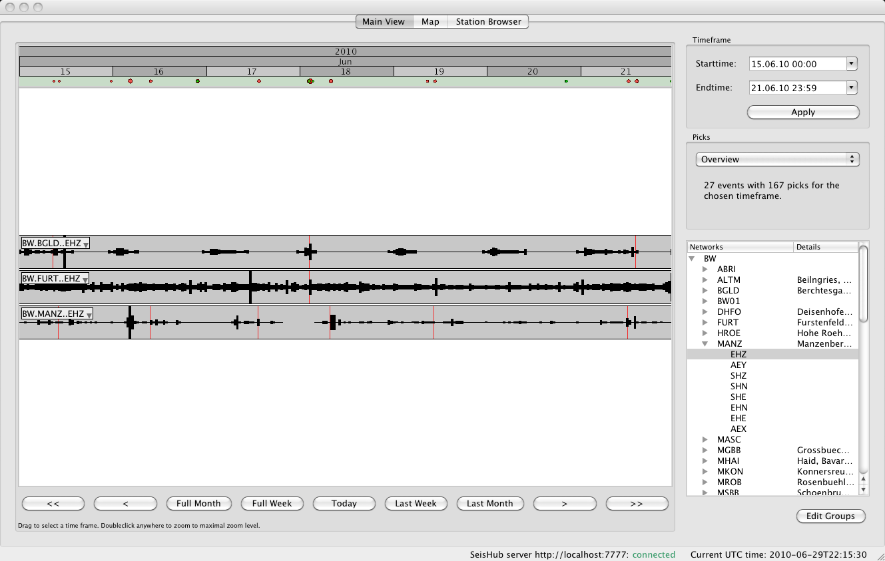
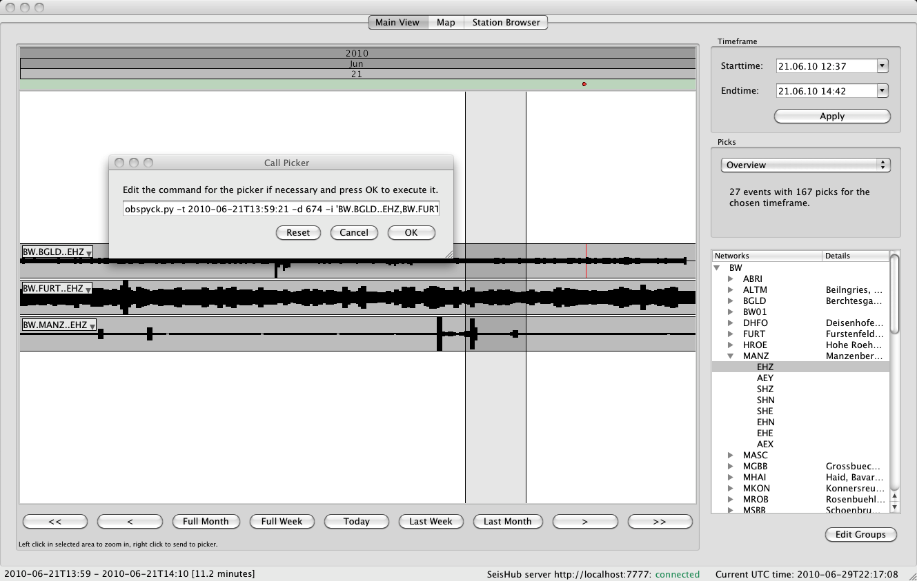
SeisHub Viewer

Slide 19
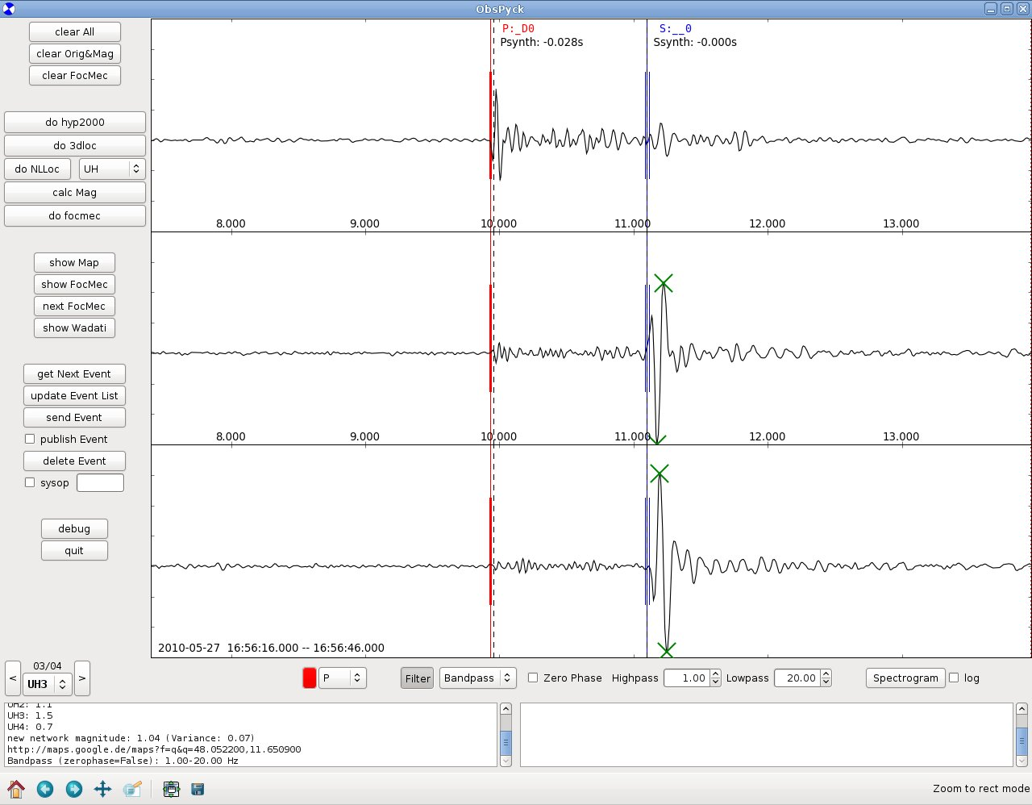
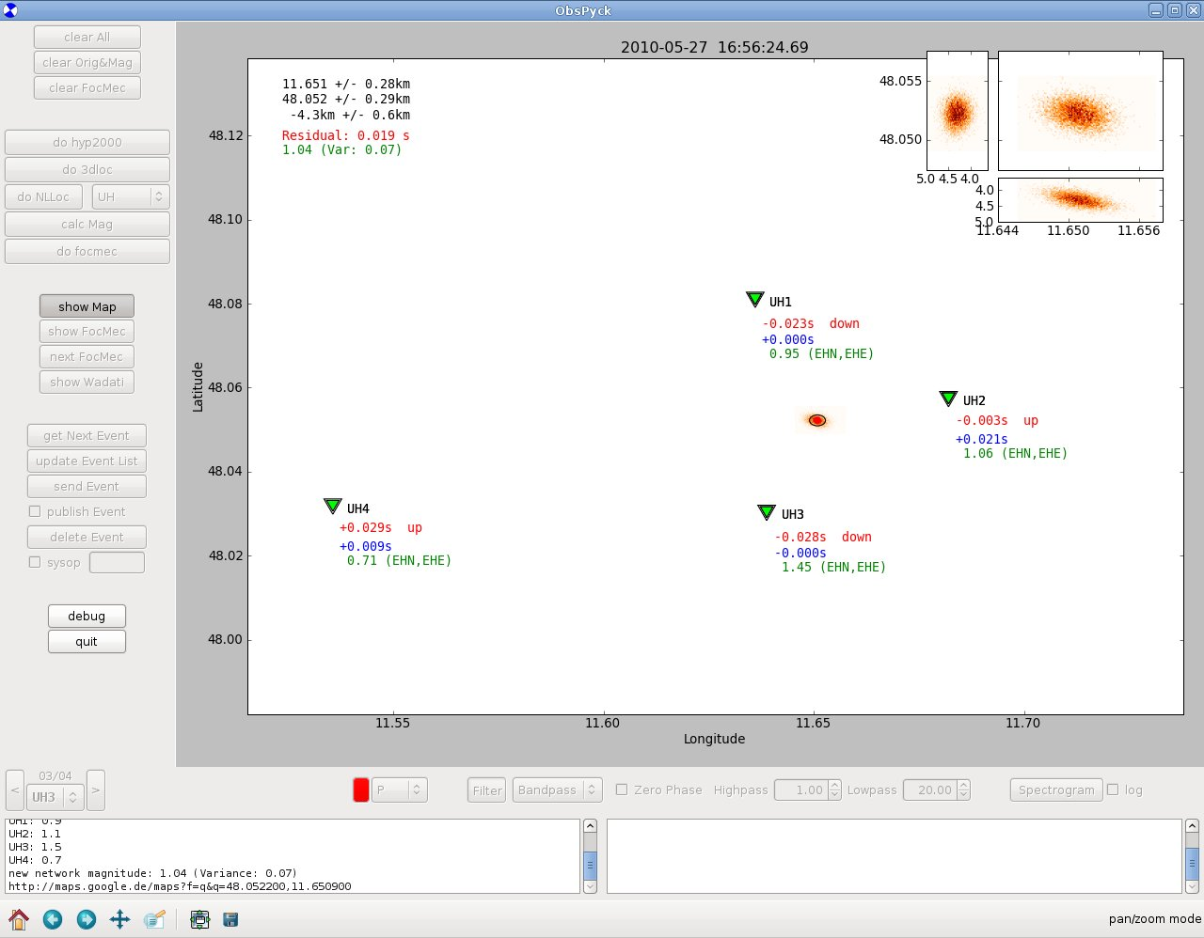
ObsPyck

Slide 20
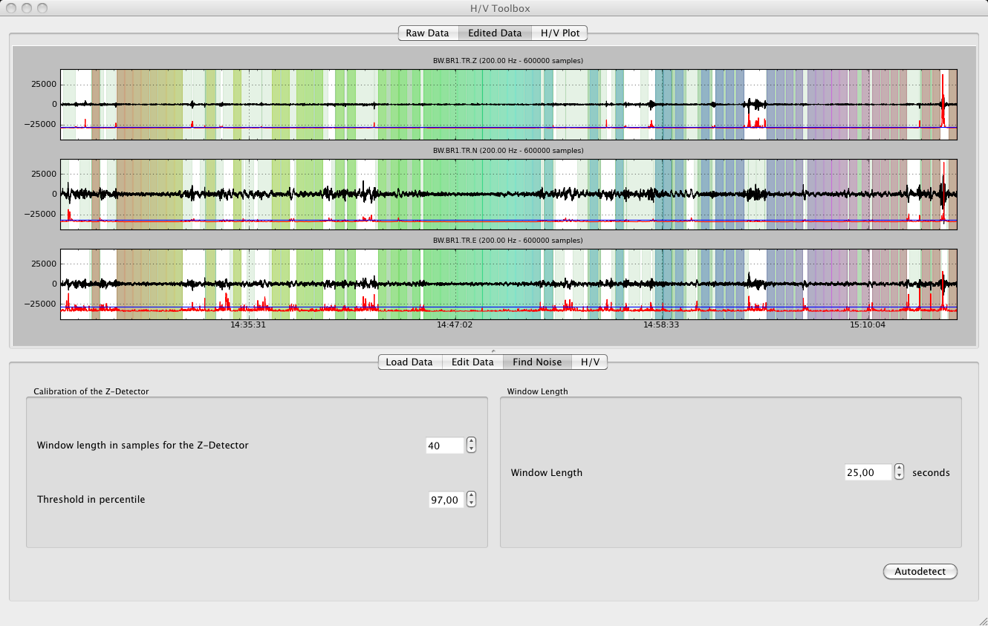
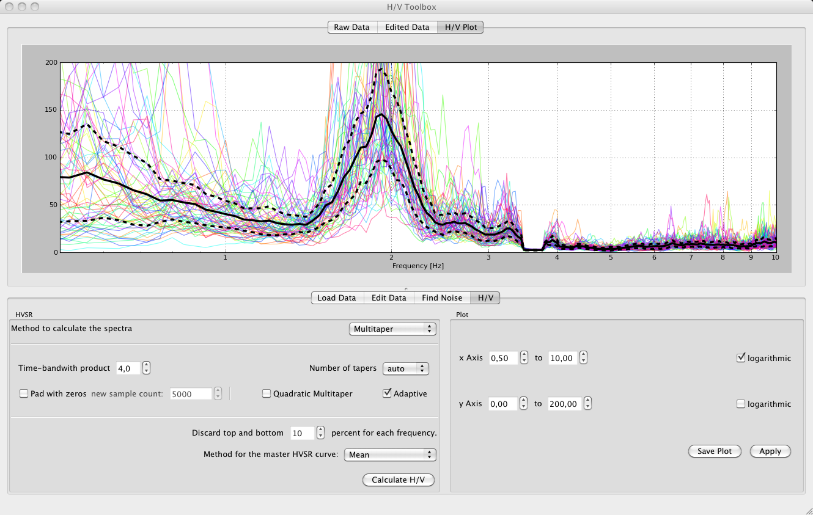
H / V Toolbox

Slide 21
Exupéry VFRS
Volcano Fast Response System (VFRS): mobile monitoring system in case of a volcanic crisis or volcanic unrest
funded by the German Ministry for Education and Research (BMBF) within the “Geotechnologien” project
Involves nine different research institutions allover Germany
Primary goals
  stable communication basis for stations in the field
  expert system allowing scientists and local authorities to assess the data through a web-based GIS interface on top of a single centralized database
Perfect demonstrator for the flexibility of SeisHub as geophysical database:
  event-based and continuous data,
  ground-based measurements and satellite data
  time series (1D), images (2D), and models (3D)
Notes:
Novel to store but also access all those data within a single centralized database system
Stationary or remote sensing

Slide 22
Exupéry VFRS: Database Test Setups
Prototype at BGR / Hannover since spring 2009
  Satellite data automatically fetched from the respective data providers and included into the database
  Ground-based data only tested with sample data
Second Exupéry prototype setup tested under field conditions at the Azores from 04/2009 – 09/2009
  over 20 seismic stations (only 4 triggered events)
  ground measurements of deformation and gas flux
  only ground-based data collected due to limited Internet bandwidth
  data synchronized at daily base with the BGR setup
Notes:
→ due to the lack of real data at this point
Internet bandwith – the system has to cope with such environments

Slide 23
Exupéry VFRS: Demonstration

Slide 24
Thank You!

