Slide 1
Seismological
Software Developments at LMU Munich
ObsPy & SeisHub
Robert Barsch & Tobias Megies
Notes:
Today I'm going to talk about my dissertation named “Web-based ...”, which was funded by the DFG.

Slide 2
Table of Contents
  SeisHub
  ObsPy
  Scientific Applications
Notes:
After a short motivation I'm going to introduce the new seismological database SeisHub which has been developed during this project.
I will talk about the database design, some technical details and the advantages and disadvantages of this database.
The development of SeisHub triggered the new seismological programming library ObsPy, which will be covered in another section.
Finally I'll give two scientific applications for SeisHub and ObsPy. The first one would be BayernNetz, the local seismological network, and secondly a project called Exupery - Vulcano Fast Response System, which is funded by the German Ministry for Education and Research (BMBF) within the Geotechnologien project.
I'll will finish with the conclusion.

Slide 3
Table of Contents
  SeisHub
  ObsPy
  Scientific Applications

Slide 4
SeisHub
Native, document-centric XML database
  RESTful Web service (HTTP, HTTPS),
  Standard relational database as back-end
  Both worlds: SQL for querying and manipulating data and any standard connected to XML, e.g. XSLT or XSD
  Not restricted to seismology at all
Extended to a “classical” seismic database
  Index of local, file-based waveform archive (MiniSEED, GSE2, SAC, ...)
    Meta Data: Gaps, overlaps, quality and timing information
    Waveform previews (30s)
  XML resource types for handling inventory data (XML-SEED) and events (QuakeML based)
  Remote waveforms access (ArcLink)
Notes:
The points indicated in the slide before suggest that it is time to reconsider the software requirements for seismic databases and processing tools from scratch.
The software package SeisHub developed during this study aims to overcome many of the problems on the database side.
So the goal of my project ...

Slide 5
SeisHub: Technical Details
  Python-based, standalone web service
  Platform independent, open source (GPL)
  Implementation of various web protocols, like HTTP, SSH, SFTP
  Plug-in architecture: Dynamic discovering and loading of modules and support for Python .egg files
  Development remarks:
    Test-driven development proven software, so far → ca. 250 test cases
    Well-documented source code
    Subversion
    Trac: ticket system and project wiki
Notes:
Unlike other research projects which produce some kind of software SeisHub's source code was actually available from the very beginning of the project (I wont call any names)

Slide 6
SeisHub: Database Design
Data storage
  Primary data → file system
    Continuous waveform archive (MiniSEED, GSE2, SAC ...)
    Other data via (GeoTIFF, GPS time series, etc.) file system
  Meta Data → Web service on top of a XML/relational database hybrid
    Data is packed into a XML document → Data structure is within the document, no need for a predefined database schema
    XML resources are archived into a BLOB field
    Only searchable values are indexed
    Pointers to primary data
Notes:
This slide summarizes SeisHub's database design.
Again primary data is stored into the file system. Waveform data is stored in a local continuous waveform archive in the MiniSEED format. But SeisHub also allows to store other data too, usually large mostly but not necessarily binary datasets, which can't be handled without external tools.
Derived data and meta data are stored into a XML/Relational database hybrid.
That means that the actual data is packed into a XML document

Slide 7
SeisHub: Database Design
Data access
  HTTP/HTTPS: REST web service
    XML documents have a fixed resource identifier (URL's)
    Data transformation via XML Style Sheets on request (?output=...)
    Data validation via Schema (XML Schema, RelaxNG, Schematron) on resource upload
    Document properties like related meta data or indexes
  SFTP: XML documents mapped into a virtual file system
Notes:
This slide summarizes SeisHub's database design.
Again primary data is stored into the file system. Waveform data is stored in a local continuous waveform archive in the MiniSEED format. But SeisHub also allows to store other data too, usually large mostly but not necessarily binary datasets, which can't be handled without external tools.
Derived data and meta data are stored into a XML/Relational database hybrid.
That means that the actual data is packed into a XML document

Slide 8
SeisHub: Database Design
Indexing
  Generated using a XPath expression, type and additional options
  Simple creation + reindexing via web interface
  Various build-in types (datetime, bool, numeric, double, float, etc..)
  ProcessorIndex: custom processing
Searching
  XPath-like query on XML catalog object (restricted to indexes)
  SQL on database object
Mapper: predefined queries & output format bound to an fixed URL
FileSystemResource: integrates a file system directory (read only)
Notes:
This slide summarizes SeisHub's database design.
Again primary data is stored into the file system. Waveform data is stored in a local continuous waveform archive in the MiniSEED format. But SeisHub also allows to store other data too, usually large mostly but not necessarily binary datasets, which can't be handled without external tools.
Derived data and meta data are stored into a XML/Relational database hybrid.
That means that the actual data is packed into a XML document

Slide 9
SeisHub: Advantages
Technical:
  Sharing data over the network, but no firewall problems (HTTP / HTTPS)
  License free, open source, internet standards
  Platform independent, most basic client is a standard browser
  XML:
    Data validation on upload (XML schemas)
    Data transformation on request (XML stylesheets)
  Querying: SQL or XPath
Scientist:
  May modify there data provided as XML document at any time without corrupting the underlying database
  May dynamically add or delete search indexes, schemas and stylesheets

Slide 10
SeisHub: Disadvantages
Technical:
  Slower than “common” solutions
    XML parsing during validation and indexing
    Data overhead (XML verbosity)
  Infrastructure
Scientist:
  Seismologist != IT nerds
Notes:
(direct access to a relational database)

Slide 11
Table of Contents
  SeisHub
  ObsPy
  Scientific Applications

Slide 12
ObsPy
  Python toolbox for seismologists
  Goal: facilitate rapid application development for seismology
  Modular extensible architecture
    Waveform data: GSE2/GSE1, MiniSEED, SAC, SEG-Y, SH Q/ASCII, SEISAN, IRIS TSPAIR & SLIST, WAV
    Inventory data: Dataless SEED, XML-SEED, RESP
    Data request clients: ArcLink/WebDC, IRIS DHI/Fissures, SeisHub, IRIS Web Service, NERIES Web Service
    Signal processing: Filters, triggers, instrument correction, rotation, array analysis, beamforming
    Plotting: spectrograms, beachballs and waveforms
    Waveform indexer
Notes:
The development of SeisHub triggered the foundation of the seismological library ObsPy for the Python programming language
Wide spectrum of sophisticated tools for working with seismic data such as waveform, inventory or event-related data
Many submodules were directly influenced by the development of SeisHub and most of the ObsPy's core classes are now standard dependencies of SeisHub
Noteworthy modules developed by the author for SeisHub are:
ArcLink/WebDC client
Conversion tool between Dataless SEED and XML-SEED
RESTful Web service client for SeisHub

Slide 13
ObsPy
Open source (LGPL or GPL)
6 core developers
Platform independent (Win, Mac, Linux) and tested
Test-driven development (TDD), currently ~500 unit tests (http://tests.obspy.org)
Reliance on well-known third-party libraries (numpy, scipy, matplotlib)
Reusing well established code, e.g. libmseed, GSE UTI
Automated build of API documentation from source
Binary distributions: PyPI (http://pypi.python.org) & Windows Installer
Source code & community webpage containing tutorials, installation instructions, ticket system, mailing lists
http://www.obspy.org

Slide 14

ObsPy: Demonstration
Notes:
Complete functionality from arclink via python scripts – helps to automated the download of data via script

Slide 15
ObsPy: Master Plan
Limited number of human resources & imbalance between number of researchers and software engineers
“Our” solutions:
  outsource the problem by growing our own community ;)
  focus on young researchers/students - “dogfooding”
  small entry barriers
  make people feel responsible for modules
  fast developer rights to interested prospects
  proper infrastructure, e.g. communication, development, automated testing, documentation, LMU independent
Goal: overall increasing of productivity and sustainability

Slide 16
Table of Contents
  SeisHub
  ObsPy
  Scientific Applications

Slide 17
BayernNetz
  Seismological network of the Bavarian Seismological Service (Erdbebendienst Bayern)
  Designed for monitoring local seismic activity in Bavaria and bordering regions for events of ML >= 2.0
  Data is collected, archived and analyzed at the Geophysical Observatory in Fürstenfeldbruck
  Currently 23 SP + 3 BB + 2 BB (GRSN) stations
  Waveform data received from BB stations are transmitted in real time to ORFEUS, GEOFON and BGR
  Neighboring networks may also access data directly
Notes:
SP == Short Period
The broad band instrument senses most frequencies equally well; the long-period and short period instruments are called "narrow" band, because they preferentially sense frequencies near 1/(15 s) and 1 hertz respectively. The yellow region is the low end of the frequency range audible to most humans (we can hear waves around 20 hertz to 20,000 hertz).

Slide 18
BayernNetz: SeisHub & ObsPy
SeisHub
  Replaced previously used GIANT database
  Events retrieved from Earthworm (real time system) are automatically stored into SeisHub in a QuakeML-based format
  Manual phase picking & event localization via ObsPyck (replacing PITSA)
  Automated indexing of the MiniSEED waveform archive (SeedLink)
  Stations available in XML-SEED
ObsPy: seismological Python library and SeisHub client
Notes:
In order to displace the GIANT/Pitsa combination in near future.
But not part of this thesis

Slide 19
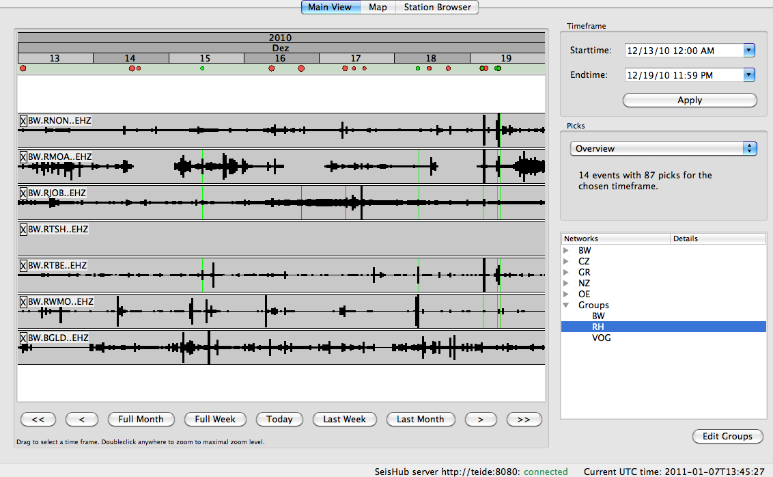
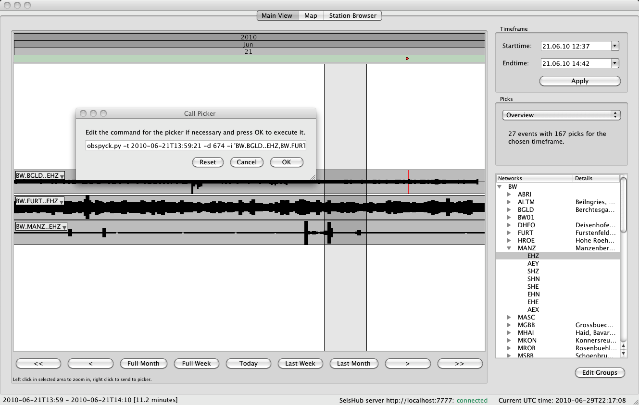
SeisHub Viewer

Slide 20
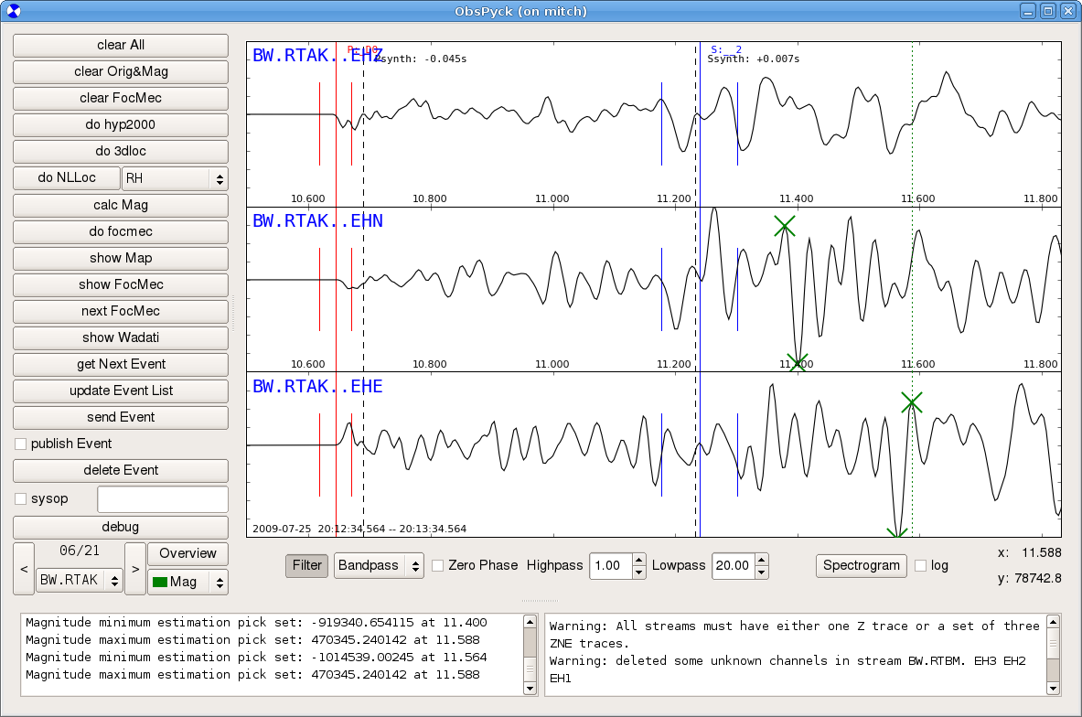
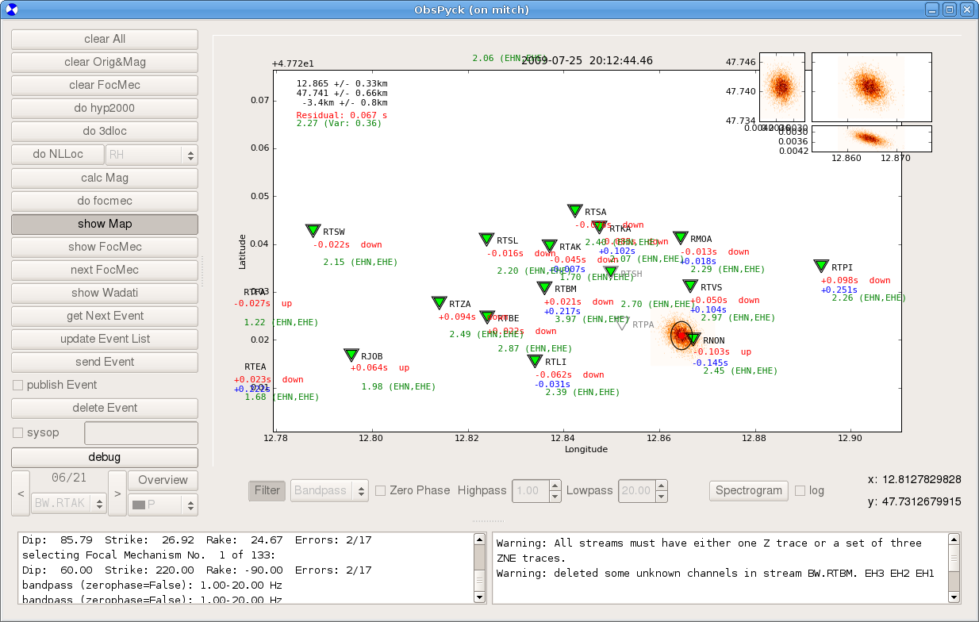
ObsPyck

Slide 21
Exupéry VFRS
Volcano Fast Response System (VFRS): mobile monitoring system in case of a volcanic crisis or volcanic unrest
funded by the German Ministry for Education and Research (BMBF) within the “Geotechnologien” project
Involves nine different research institutions allover Germany
Primary goals
  stable communication basis for stations in the field
  expert system allowing scientists and local authorities to assess the data through a web-based GIS interface on top of a single centralized database
Perfect demonstrator for the flexibility of SeisHub as geophysical database:
  event-based and continuous data,
  ground-based measurements and satellite data
  time series (1D), images (2D), and models (3D)
Notes:
Novel to store but also access all those data within a single centralized database system
Stationary or remote sensing

Slide 22
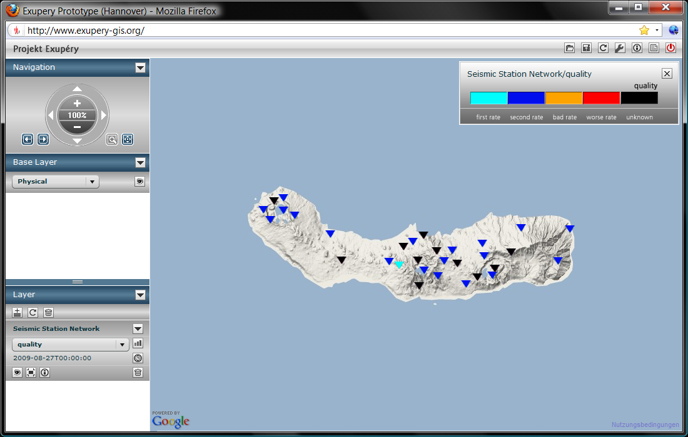
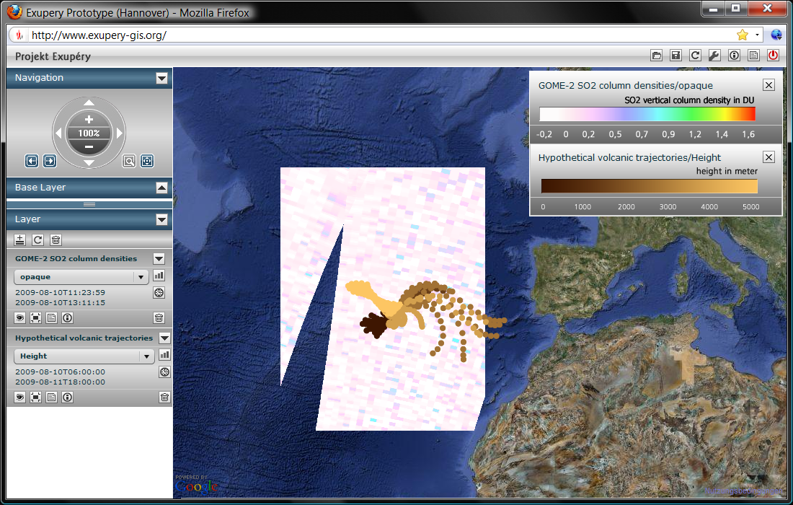
Exupéry VFRS

Slide 23
Thank You!

