Slide 1


Accelerating bulk material property prediction using machine learning for molecular dynamics
Nicholas Sepp Löfgren
Examiner: Ferenc Tasnádi
Supervisor: Rickard Armiento

Slide 2

Motivation
Introduction | Background | Method | Results | Discussion | Conclusion
What if this information was easily found and widely available?
Notes:
Because that could help with finding new materials [SLIDE]

Slide 3
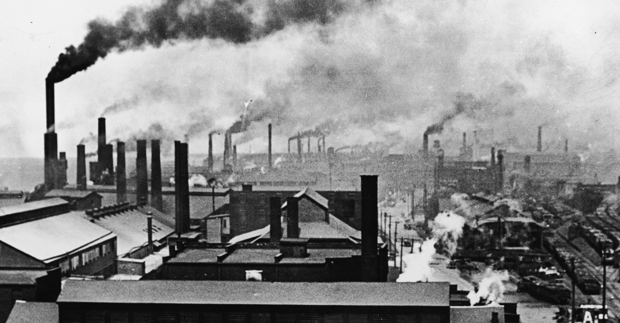
Motivation
Introduction | Background | Method | Results | Discussion | Conclusion
Materials with desired properties are essential for emerging technologies [1, 9].
Properties such as: efficiency, cost, environmental impact, length of life, safety and more.
Technologies such as: catalysts, battery materials, detector materials for ionizing radiation and more.
Simulations are essential for theoretical materials science [1].
Construct databases containing the properties of essentially any material that can be simulated [1, 9].
Machine learning potentials have shown great promise [17, 33].
Notes:
Finding new materials with desired properties are essential for the emergence of new technologies and industries [1, 9].
Properties such as: efficiency, cost, environmental impact, length of life, safety and more.
Technologies such as: catalysts, battery materials, detector materials for ionizing radiation and more.
Simulations are essential for theoretical materials science, which due to recent progress in computational methods and power, are often run in high-throughput [1].
Ambition is invoked to construct databases containing the properties of essentially any material that can be simulated, synthesized and is reasonably long-lived [1, 9].
Machine learning potentials have shown great promise in previous work to accelerate traditional simulation methods [17, 33].

Slide 4
Aim
Introduction | Background | Method | Results | Discussion | Conclusion
Explore the use of machine learning (ML) potentials in molecular dynamics (MD) simulations for accelerating the prediction of equilibrium properties of bulk materials.
Implement highly modifiable simulation software for MD with any chosen potential, be it a classical or ML potential.
Investigate simulation accuracy and equilibrium property convergence by comparing to ab-initio MD for two straightforward systems, bulk Aluminium and Silicon.
Notes:
Furthermore, part of the aim was to use this developed software to investigate simulation accuracy and equilibrium property convergence of this ML approach by comparing to ab-initio MD […]

Slide 5
Research questions
Introduction | Background | Method | Results | Discussion | Conclusion
Is it possible to use an interatomic potential obtained from a ML model trained on training data obtained from DFT to predict the next positions of the atoms for the next time step in a MD simulation with sufficient accuracy to accelerate Density Functional Theory (DFT) simulations?
Investigate simulating the movement of atoms systems using ML potentials. How well do calculated bulk material properties such as specific heat capacity, total energy and mean squared displacement using a ML approach compare with values obtained from ab-initio simulation methods based on DFT?
Investigate how the ML potential approach performs for a metal and a semi-conductor, in particular Aluminium and Silicon, in terms of potential energy and force predictions. To which extent does the utility of the ML potentials allow for simulating different types of materials?

Slide 6
Background

Slide 7
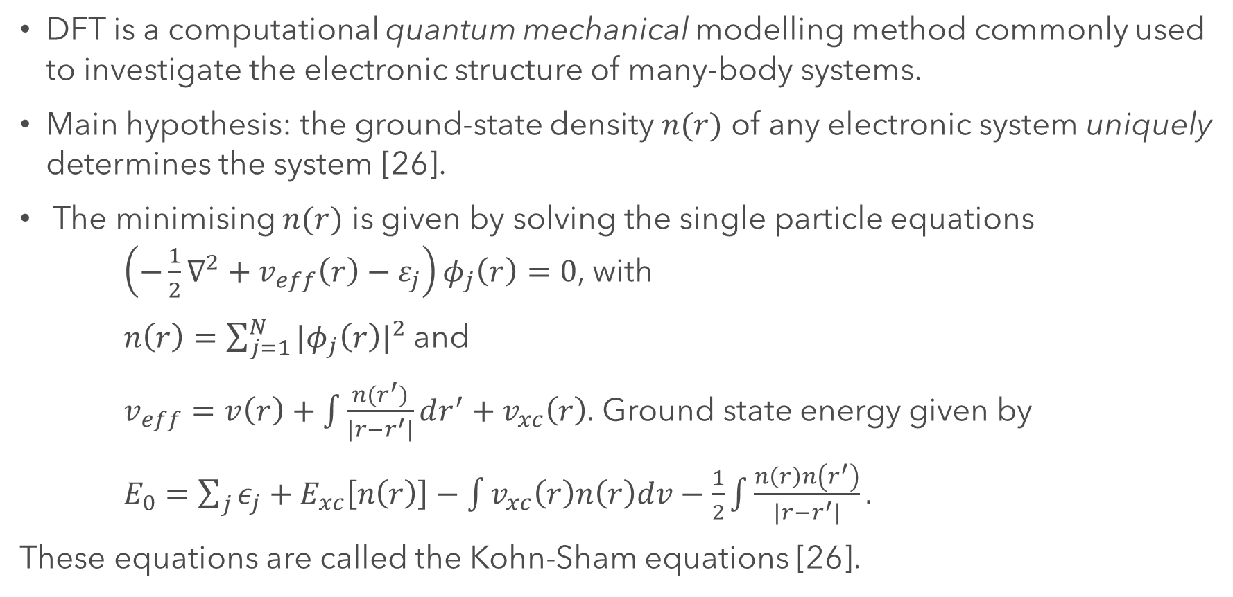
Density functional theory
Introduction | Background | Method | Results | Discussion | Conclusion
DFT is a computational quantum mechanical modelling method commonly used to investigate the electronic structure of many-body systems.
Main hypothesis: the ground-state density $n(r)$ of any electronic system uniquely determines the system [26].
The minimising $n(r)$ is given by solving the single particle equations $\left(−\frac{1}{2}∇^{2}+v_{eff}\left(r\right)−ε_{j}\right)φ_{j}\left(r\right)=0$, with
$n\left(r\right)=\sum_{j=1}^{N}{{|φ_{j}\left(r\right)|}^{2}}$ and
$v_{eff}=v\left(r\right)+\int{\frac{n(r^{′})}{|r−r^{′}|}dr^{′}}+v_{xc}\left(r\right).$ Ground state energy given by
$E_{0}=\sum_{j}{ε_{j}}+E_{xc}\left[n\left(r\right)\right]−\int{v_{xc}\left(r\right)n\left(r\right)dv}−\frac{1}{2}\int{\frac{n\left(r\right)n\left(r^{′}\right)}{\left|r−r^{′}\right|}}.$
These equations are called the Kohn-Sham equations [26].
Notes:
DFT is a very accurate method, but it does require quite a bit of computation.
DFT is a computational quantum mechanical modelling method used in physics, chemistry and materials science to investigate the electronic structure of (principally the ground state) of many-body systems.
Veff is an effective external potential where the system of noninteracting particles is moving and vxc( r) is the local exchange-correlation potential. Vxc depends functionally on the entire density distribution n(r).
Furthermore, if one neglects the terms Exc and vxc, the KS eqs. (2.7)-(2.9) reduce to the selfconsistent Hartree equations and furthermore, the KS equations can be regarded as the formal exactification of the Hartree equations.

Slide 8
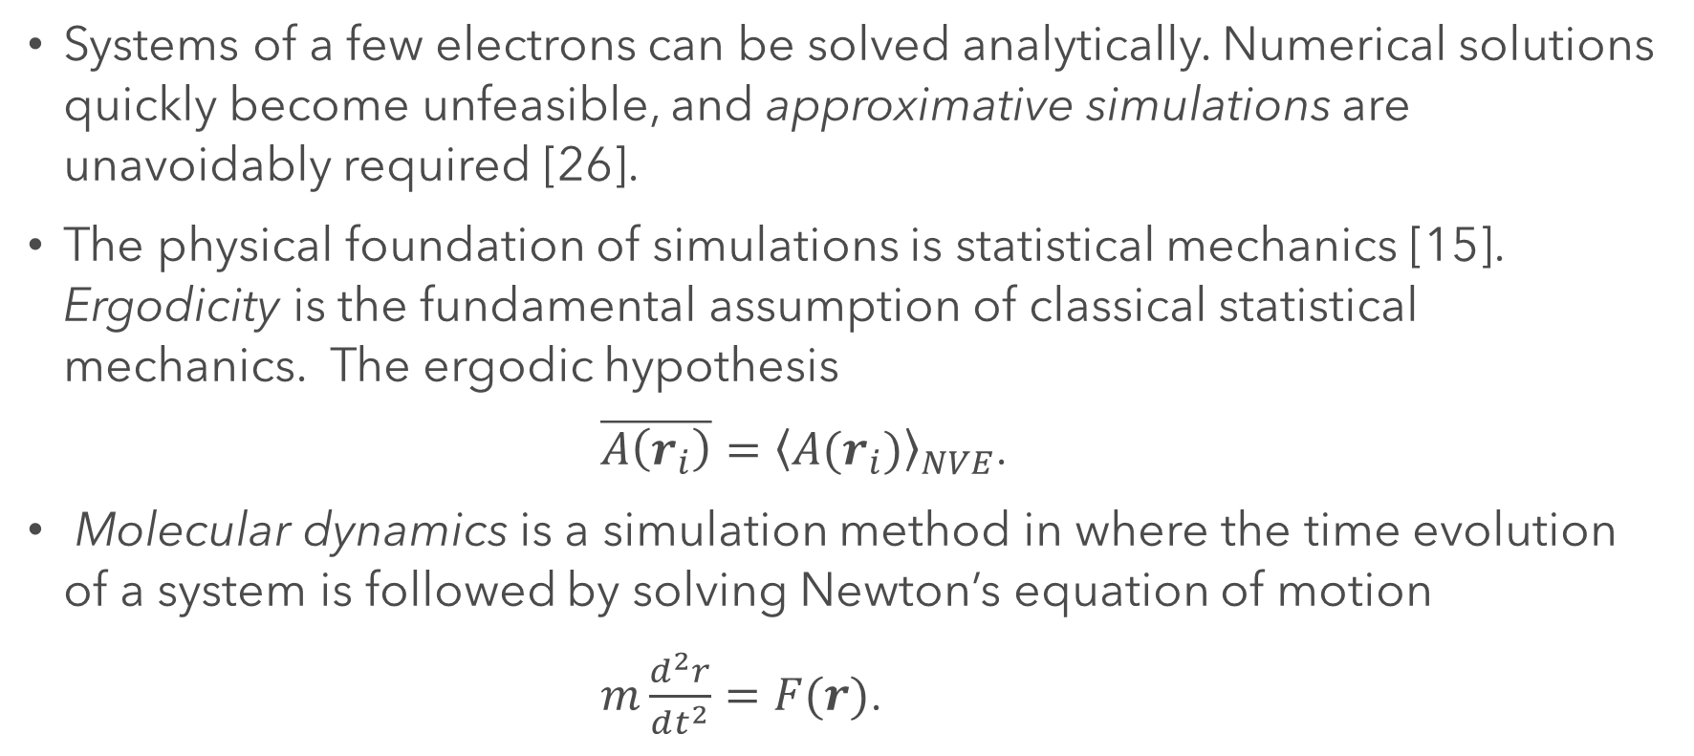
Molecular dynamics simulations
Introduction | Background | Method | Results | Discussion | Conclusion
Systems of a few electrons can be solved analytically. Numerical solutions quickly become unfeasible, and approximative simulations are unavoidably required [26].
The physical foundation of simulations is statistical mechanics [15]. Ergodicity is the fundamental assumption of classical statistical mechanics. The ergodic hypothesis
$\overline{A\left(r_{i}\right)}={\left\langle A(r_{i})\right\rangle }_{NVE}$.
Molecular dynamics is a simulation method in where the time evolution of a system is followed by solving Newton’s equation of motion
$m\frac{d^{2}r}{dt^{2}}=F(r)$.
Notes:
Simulations help in understanding the basic mechanisms of physics and can verify that the current models are correct and sufficient. Experiments provide detailed information about initial and final states, but basically no information about transient processes. This gap can be bridged by simulations, which also offer a great opportunity for visualisation of transient states. Small systems of electrons can be solved analytically but because of the “exponential wall” when increasing the electrons in a system, analytical solutions quickly become unfeasible and simulations are unavoidably required
and the ergodic hypothesis is the basis of computer simulations,
Ergodicity is the fundamental assumption of classical statistical mechanics, and the ergodic hypothesis is the basis of computer simulations, which states that the average of a property $A$ over time equals the average over the statistical ensamble for the same property i.e.
Systems of a few electrons can be solved analytically but because of the “exponential wall” for numerical solutions quickly become unfeasible, and approximative simulations are unavoidably required [26].

Slide 9
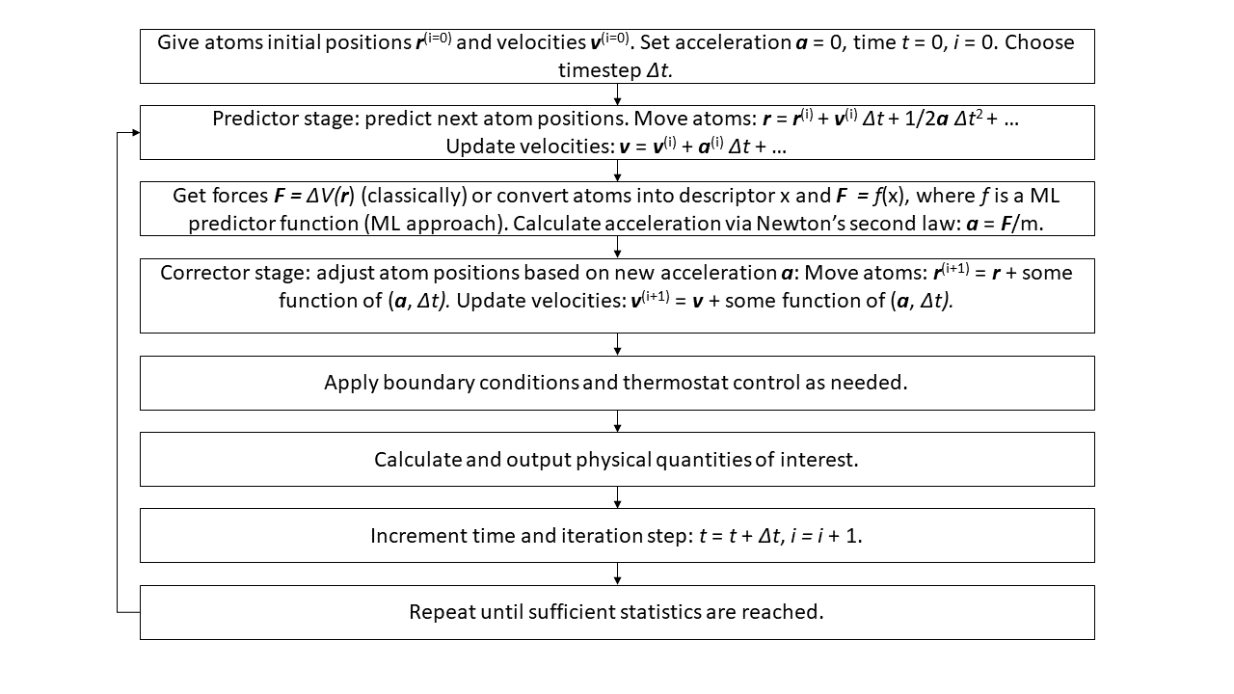
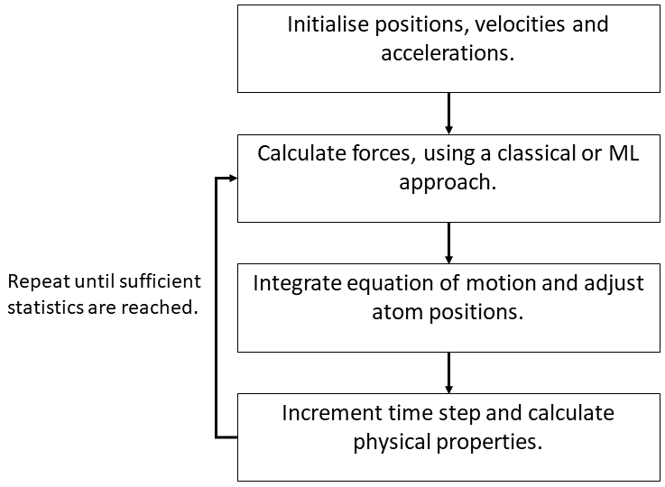
Molecular dynamics scheme
Introduction | Background | Method | Results | Discussion | Conclusion
Notes:
Ergodicity is the fundamental assumption of classical statistical mechanics, and the ergodic hypothesis is the basis of computer simulations, which states that the average of a property $A$ over time equals the average over the statistical ensamble for the same property i.e.
As a curiosity, MD has also been termed Laplace’s vision of Newtonian mechanics of predicting the future by animating nature’s forces, which is connected to the concept of causal determinism derived from Newtonian mechanics as formulated by Laplace in his book

Slide 10
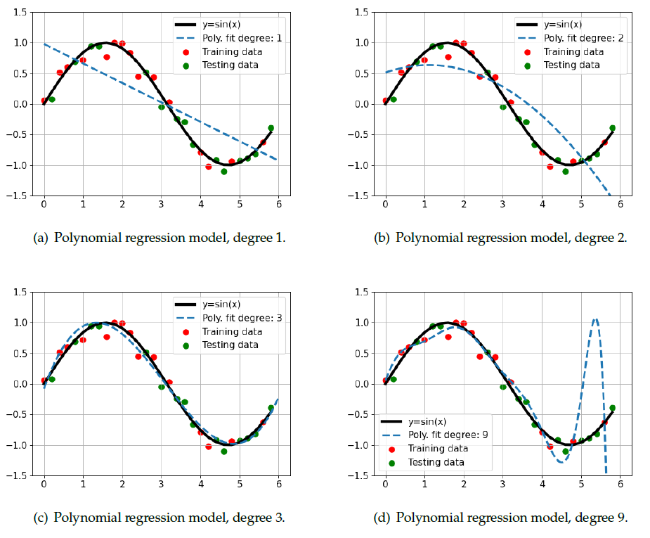
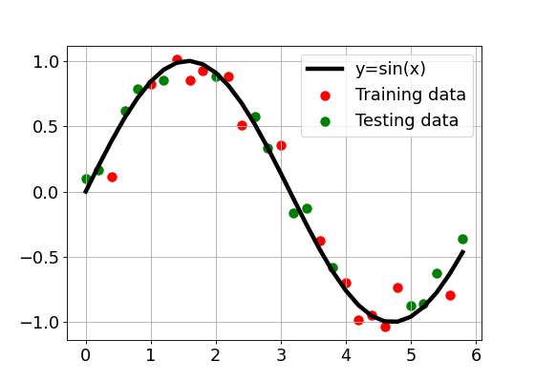
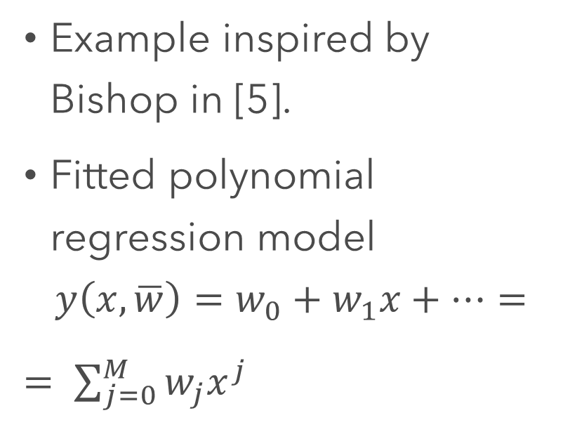
Machine learning
Introduction | Background | Method | Results | Discussion | Conclusion
Example inspired by Bishop in [5].
Fitted polynomial regression model
$$y\left(x, \overline{w}\right)=w_{0}+w_{1}x+…=$$
$= \sum_{j=0}^{M}{w_{j}x^{j}}$
Notes:
Another important component of this work is machine learning. And to sort of illustrate important concepts of ML, I will present a simple ML example inspired by Bishop.
Every ML process unavoidably requires data.

Slide 11
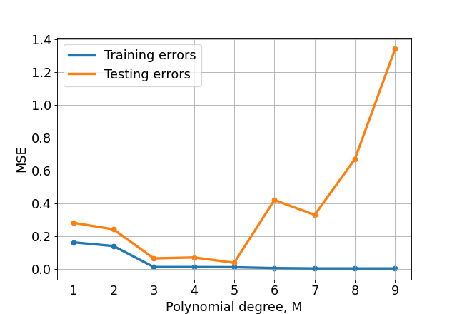
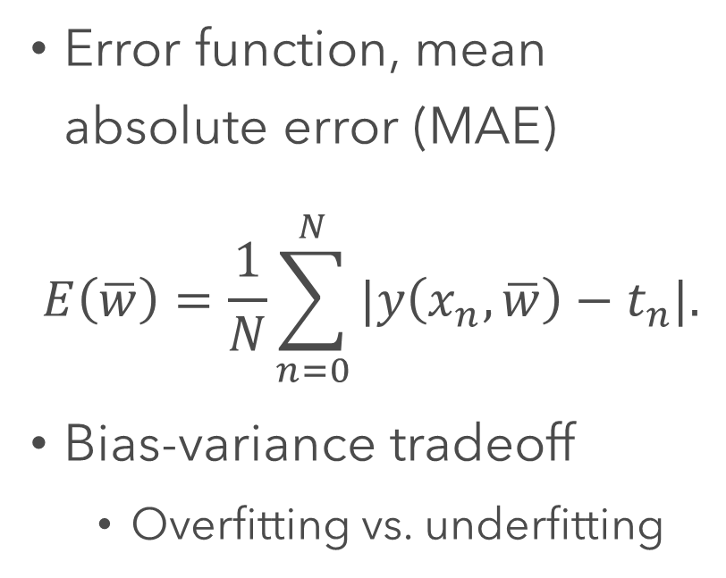
Machine learning
Introduction | Background | Method | Results | Discussion | Conclusion
Error function, mean absolute error (MAE)
$$E\left(\overline{w}\right)=\frac{1}{N}\sum_{n=0}^{N}{|y\left(x_{n},\overline{w}\right)−t_{n}|.}$$
Bias-variance tradeoff
Overfitting vs. underfitting
MAE
Notes:
Visually changed error metric.
The bias-variance tradeoff is the property of a model that the variance of the parameter estimates across samples can be reduced by increasing the bias in the estimated parameters and vice versa.

Slide 12
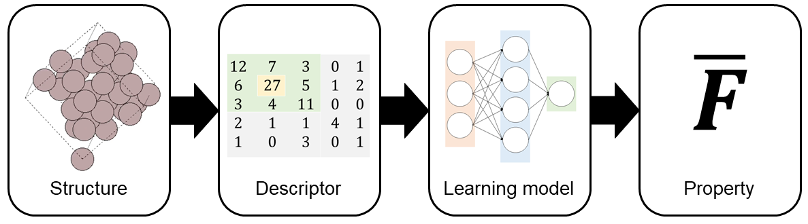
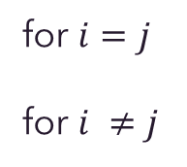
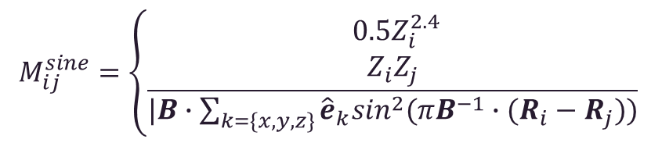
Machine learning and descriptors
Introduction | Background | Method | Results | Discussion | Conclusion
The ML models Moment Tensor Potential (MTP) and Kernel Ridge Regression (KRR) are studied [38].
KRR is a matrix based regression model, which requires a kernel function.
There are different instances of MTPs with different amounts of free parameters.
Descriptors are an essential component of ML in materials science [19].
A descriptor is a feature transformation for atomistic system that encodes the system so that it can be interpreted by a ML model.
Different descriptors can be used for KRR models, e.g. the Sine Matrix descriptor.
The MTPs use a proprietary descriptor.
General ML workflow.
$$M_{ij}^{sine}=\left\{\begin{aligned}0.5Z_{i}^{2.4} \\ \frac{Z_{i}Z_{j}}{|B∙\sum_{k=\{x,y,z\}}{{\hat{e}}_{k}\sin^{2}(πB^{−1}∙(R_{i}−R_{j}))}} \end{aligned}\right.$$
for $i=j$
for $i ≠j$
The sine matrix descriptor’s matrix elements.
MTP code by Shapeev et al.
Notes:
Lägg till en slide om KRR?
Säg explicit att MTPs är mottagen från Shapeev och team.
MTP 06 and 10 are studied, with 21 and 40 free parameters respectively for monoatomistic systems.

Slide 13
Method

Slide 14
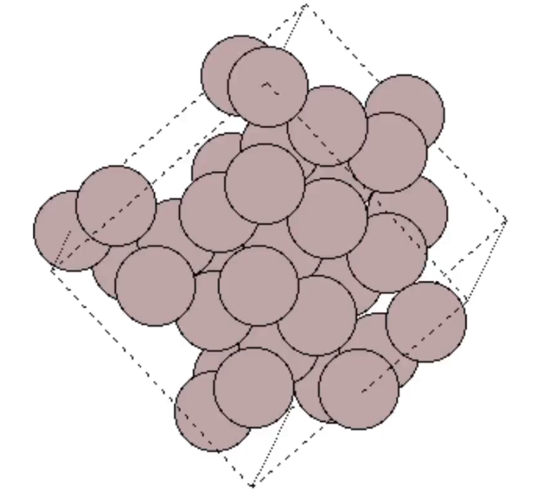
Data
Introduction | Background | Method | Results | Discussion | Conclusion
The data sets used are sets of 10,000 time steps of the simulated time evolution of Aluminium and Silicon, with a time step length of 1 fs. These simulations are done in the NVT ensamble using DFT methods, using the simulation software Vienna Ab Initio Simulation Package (VASP).
32 Aluminium atoms.
Data sets by Gambino and Klarbring [16].

Slide 15
Developed simulation software
Introduction | Background | Method | Results | Discussion | Conclusion
The developed software is developed mainly in the languages Python 3.6.4 and bash. The corresponding repository contains
~ 4500 lines of Python
bash files, data storage, settings files, trained and untrained potentials etc.
Essential packages: Atomic Simulation Environment (ASE), Machine-Learning Interatomic Potentials (MLIP), DScribe, and Quantum Machine Learning (QML).

Slide 16
Molecular dynamics and calculators
Introduction | Background | Method | Results | Discussion | Conclusion
Introduction | Background | Method | Results | Discussion | Conclusion
ASE has tools to run MD. ASE has a class of calculators that can take atomic numbers and positions from an ASE Atoms object and calculate the energy and forces, that are used in MD.
Implement subclasses of the ASE Calculator class that calculate the energy and forces by converting the atomistic system into an appropriate descriptor and using a ML model on it to predict the energy and forces.
MTP 06 and 10 are studied, which have 21 and 40 free parameters respectively for monoatomistic systems.
The most direct implementation of KRR is studied. DScribe is used to convert Atoms objects into Sine Matrix descriptors used by the KRR models.
Notes:
Calculations are typically done with classical potentials such as Lennard-Jones.
The MD is run in the NVT ensamble using the Langevin thermostat.

Slide 17
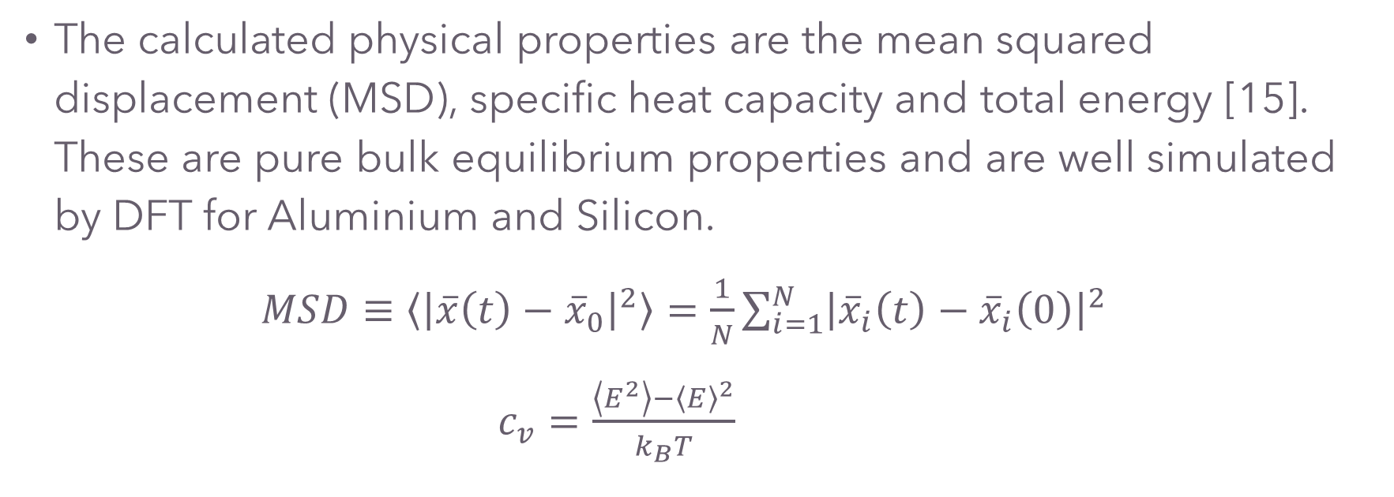
Calculated physical properties
Introduction | Background | Method | Results | Discussion | Conclusion
The calculated physical properties are the mean squared displacement (MSD), specific heat capacity and total energy [15]. These are pure bulk equilibrium properties and are well simulated by DFT for Aluminium and Silicon.
$MSD≡\left\langle {\left|\overline{x}\left(t\right)−{\overline{x}}_{0}\right|}^{2}\right\rangle =\frac{1}{N}\sum_{i=1}^{N}{{\left|{\overline{x}}_{i}\left(t\right)−{\overline{x}}_{i}\left(0\right)\right|}^{2}}$
$c_{v}=\frac{\left\langle E^{2}\right\rangle −{\left\langle E\right\rangle }^{2}}{k_{B}T}$
Notes:
Flytta till bakgrund
Definera offset

Slide 18
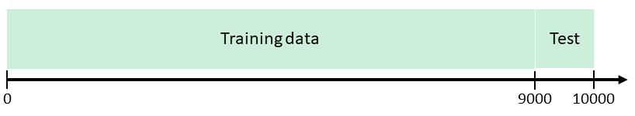
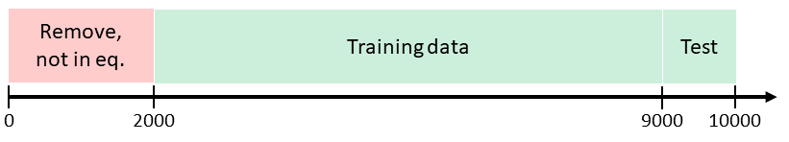
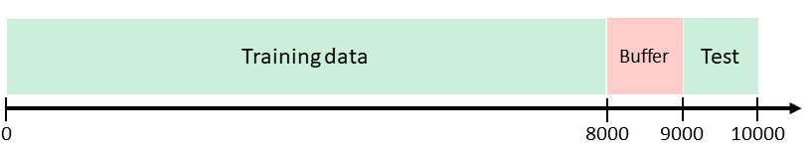
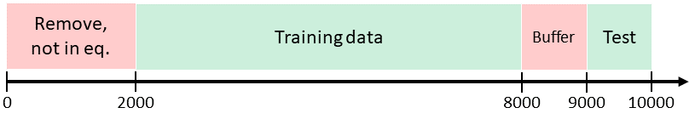
Data divisions
Introduction | Background | Method | Results | Discussion | Conclusion
1.
Use all available data if possible.
The initial time steps are not in equilibrium.
Uncorrelate training and testing data, introduce buffer.
Remove non-equilibrium time steps with buffer.
Parameters: eq. and offset.
2.
3.
4.
Notes:
Problem: training on time steps after initial 2000 time steps might give more accurate predictions, but it is a loss of time spent simulating expensive ab-initio MD.

Slide 19
Results

Slide 20
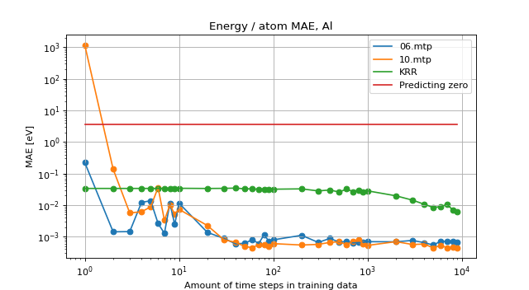
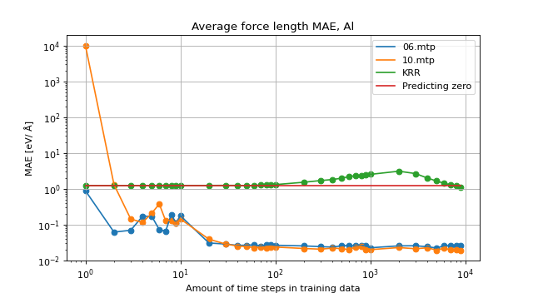
Potentials training: Aluminium
Introduction | Background | Method | Results | Discussion | Conclusion
Energy per atom and forces MTPs outperform baseline of predicting zero only after a few time steps and they converge after around 30 and 20 time steps respectively. The KRR models do not converge after being trained on all available data.
Notes:
This is explained by the fact that predicting zero for the average force length i.e. no atomic moment is a more reasonable prediction than predicting zero for energy per atom, which is reasonably not zero.

Slide 21
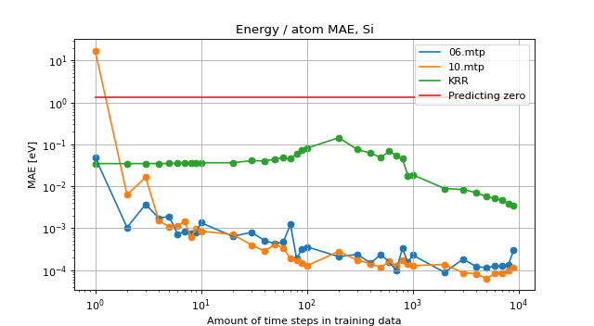
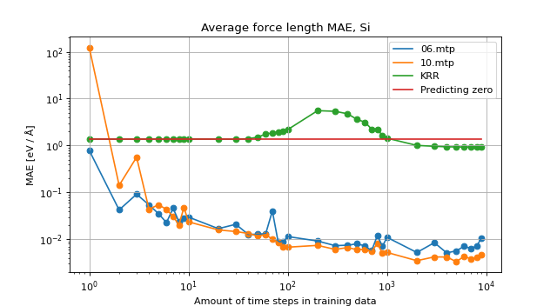
Potentials training: Silicon
Introduction | Background | Method | Results | Discussion | Conclusion
Energy per atom and forces MTPs outperform baseline of predicting zero only after a few time steps and they converge after around 100 time steps. The slope is less steep. The KRR models do not converge after being trained on all available data.
Notes:
The most direct implementation of KRR.
When looking at these results, it was decided to continue the work using MTPs.

Slide 22
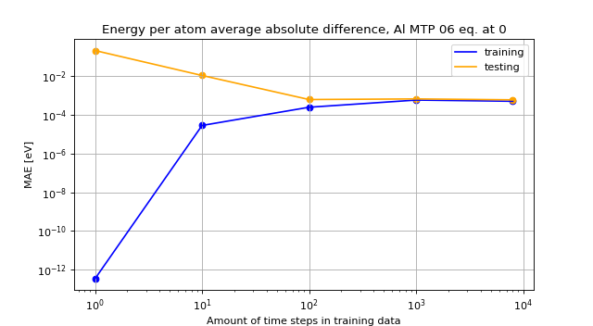
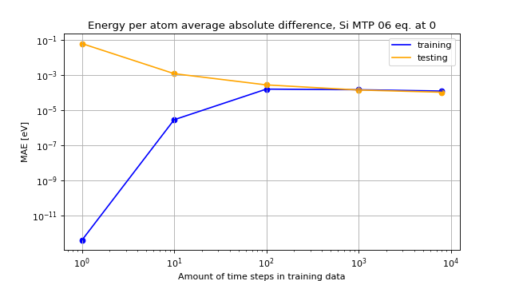
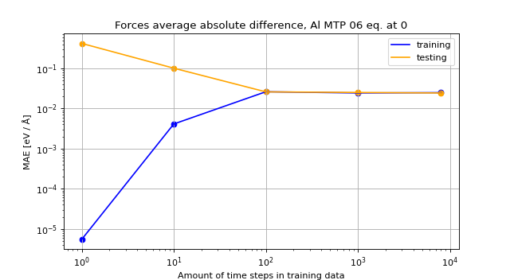
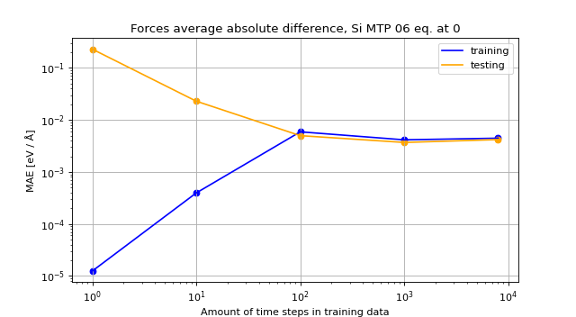
Training vs. testing
Introduction | Background | Method | Results | Discussion | Conclusion
The training and testing curves meet definitely at 1000 time steps, at this point the model has learned what it can from the data. This is observed for both MTP 06 and 10, both energy and forces, and both Aluminium and Silicon.

Slide 23
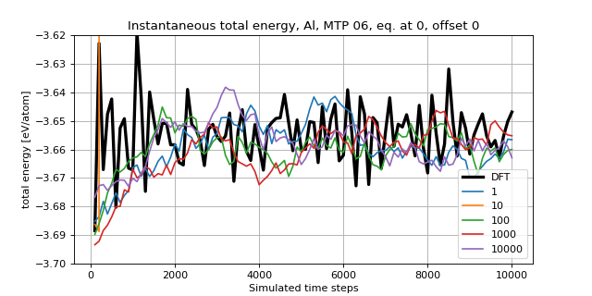
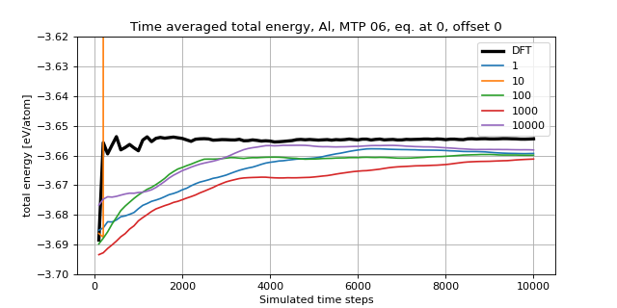
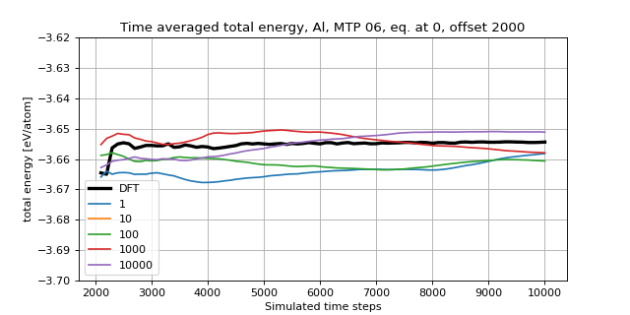
Aluminium simulations: total energy
Introduction | Background | Method | Results | Discussion | Conclusion

Slide 24
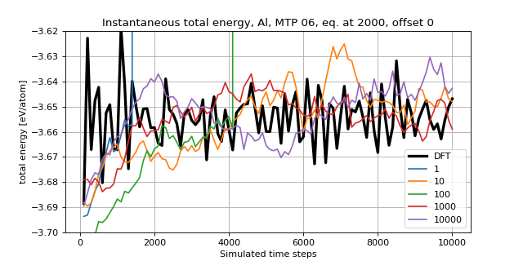
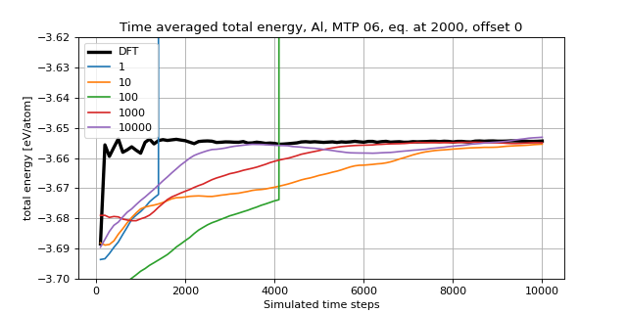
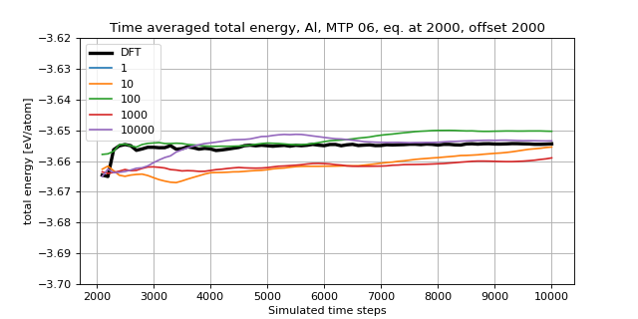
Al: total energy, trained from 2000 (=eq.)
Introduction | Background | Method | Results | Discussion | Conclusion

Slide 25
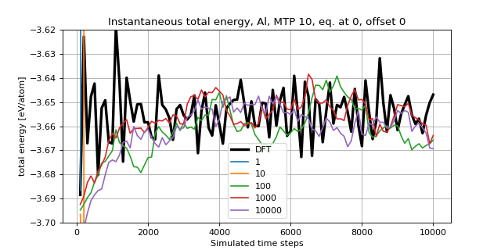
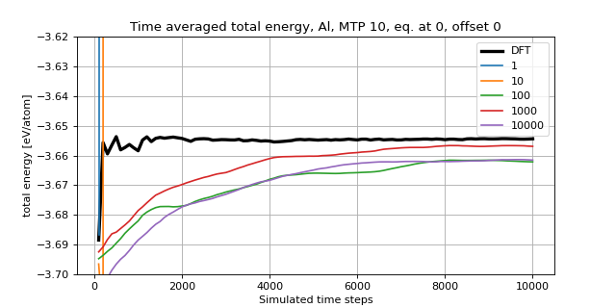
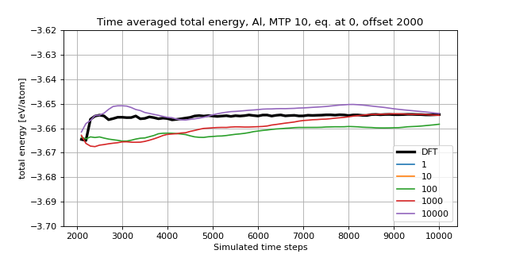
Al: total energy, MTP 10 trained from 0
Introduction | Background | Method | Results | Discussion | Conclusion

Slide 26
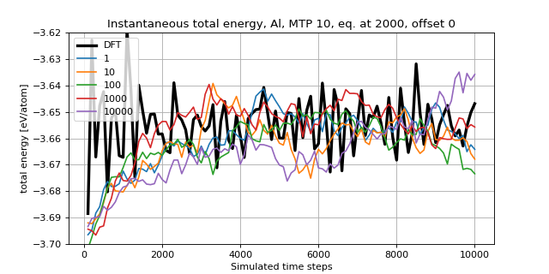
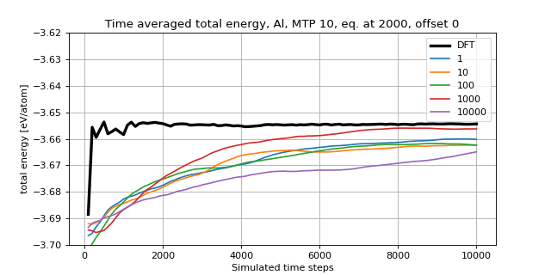
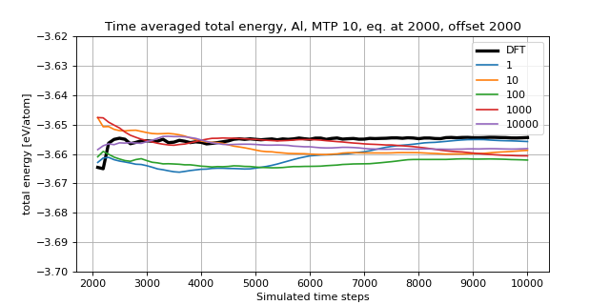
Al: tot energy, MTP 10 trained from 2000
Introduction | Background | Method | Results | Discussion | Conclusion

Slide 27
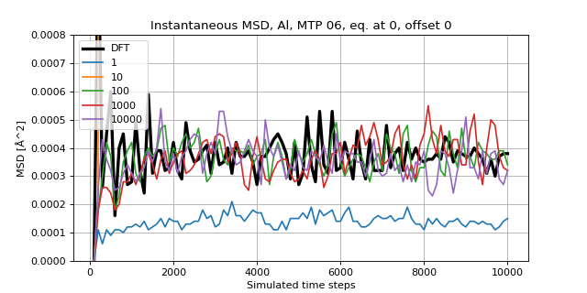
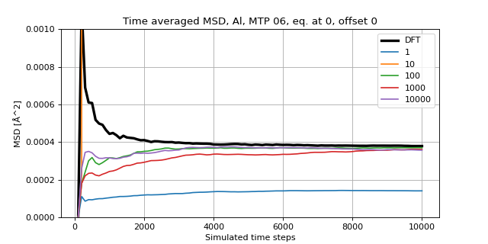
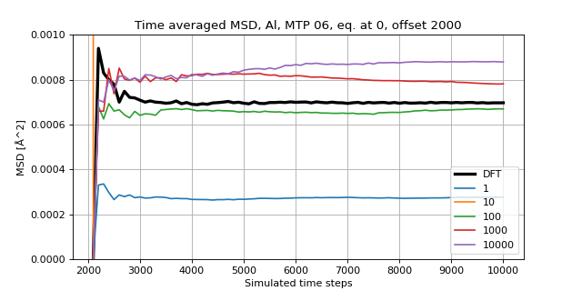
Aluminium simulations: MSD
Introduction | Background | Method | Results | Discussion | Conclusion
Notes:
Worth to note regarding offset 2000: the atom which is compared to is chosen somewhat randomly which should cause the different convergences.

Slide 28
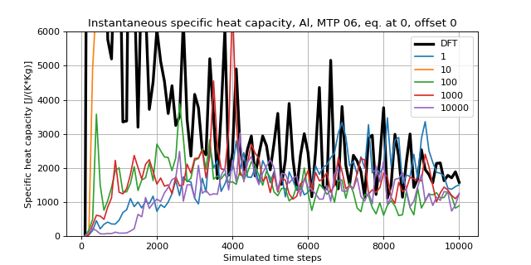
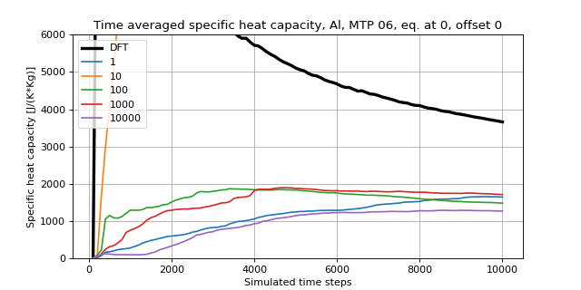
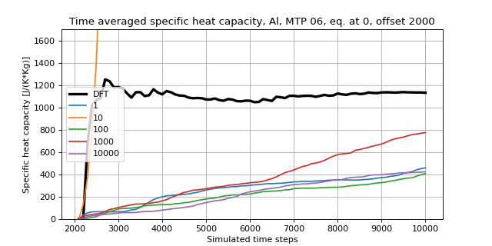

Aluminium simulations: $c_{v}$
Introduction | Background | Method | Results | Discussion | Conclusion
Introduction | Background | Method | Results | Discussion | Conclusion

Slide 29
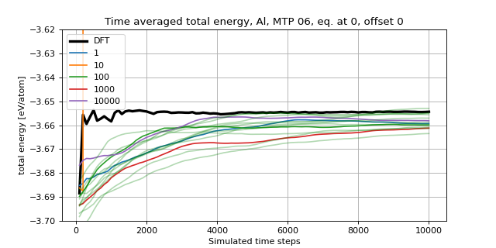
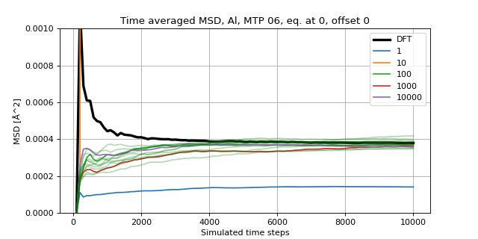
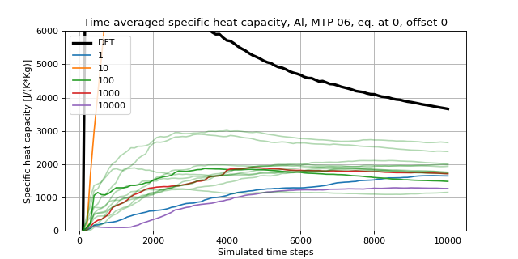
Aluminium simulations: variance
Introduction | Background | Method | Results | Discussion | Conclusion

Slide 30
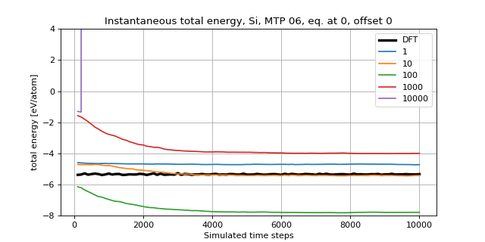
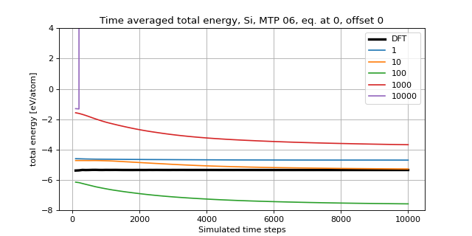

Silicon simulations: total energy
Introduction | Background | Method | Results | Discussion | Conclusion

Slide 31



Silicon simulations: MSD
Introduction | Background | Method | Results | Discussion | Conclusion

Slide 32
Discussion, conclusion and outlook

Slide 33
Discussion
Introduction | Background | Method | Results | Discussion | Conclusion
The KRR implemented is the most direct possible implementation. No reduction of redundancy of the data is done.
A main observation is that the MTP 06 and 10 perform similarly. Hypothesis that the free parameters in MTP 06 are enough to learn the behaviour of Aluminium to a degree that the additional free parameters in MTP 10 do not contribute.
Training on time steps starting from 0 or 2000 does not seem to make a significant difference for the calculated physical properties.
The simulations variance is partly explained by the Langevin thermostat controlling the temperature and the random initialization for MTP parameters. Another factor is that DFT for small supercells, the systems may “lock into” certain phonon modes, in essence they get fixated into specific oscillatory states.
Notes:
Third point: One would imagine that training potentials on time steps in equilibrium would increase their performance. This has however not been observed.

Slide 34
Discussion: Silicon
Introduction | Background | Method | Results | Discussion | Conclusion
Hypothesis: different instances of Silicon crystals melt during simulation and reform into different crystal structures with different potential energies, causing the simulations to converge to different energies and MSDs.
Saved the positions of the atoms during simulations and compared their equilibrium lattice positions, which seemed to differ from simulation to simulation.
The effect of small supercells locking into certain phonon modes might be a significant factor.

Slide 35

Conclusion
Introduction | Background | Method | Results | Discussion | Conclusion
Running MD with trained MTPs has yielded total energies and MSDs for Aluminium that are comparable to those yielded by DFT with errors in the orders of magnitudes of meV and ${10}^{−5} Å^{2}$ respectively.
The question of how further accurate the MTPs need to be to simulate the specific heat capacity accurately has been raised.
The Silicon simulations have not yielded reasonable physical properties and require more consideration.
The problem of Silicon crystals melting and reforming into crystals with different potentials energies needs to be remedied.
This is a testament for how simulating a semiconductor like Silicon has been more challenging than simulating a simple metal like Aluminium.

Slide 36
Conclusion and outlook
Introduction | Background | Method | Results | Discussion | Conclusion
In conclusion, the MTPs appear promising for accelerating the speed at which high-throughput property calculations can be made.
Subsequently accelerating the discovery of new materials and the paradigm of data-driven materials design in general.
In the future, continued studies regarding Silicon’s reforming, and Aluminium simulations’ variance are needed. Extend MTPs for more physical properties. Study possible KRR implementations closer.

Slide 37
Thank you for your attention

Slide 38
References
[1] Rickard Armiento. “Database-Driven High-Throughput Calculations and Machine Learning models for Materials Design”. In: Lecture Notes in Physics (2020), pp. 377-395.
[5] Christopher Bishop. Pattern Recognition and Machine Learning. Springer, Jan. 2006.
[9] Stefano Curtarolo, Gus L. W. Hart, Marco Boungiorno Nardelli, Natalio Mingo, Stefano Sanvito, and Ohad Levy. “The High-Throughput highway to computational materials design”. In: Nature Materials 12.3 (Mar. 2013), pp. 191-201.
[15] Daan Frenkel and Berend Smit. Understanding Molecular Simulation. Academic Press, 2001.
[16] Davide Gambino and Johan Klarbring. Private communication. 2021.
[17] Konstantin Gubaev, Evgeny V. Podryabinkin, Gus L. W. Hart, and Alexander V. Shapeev. “Accelerating high-throughput searches for new alloys with active learning of interatomic potentials”. In: Computational Materials Science 156 (2019), pp. 148-156.
[18] Lauri Himanen, Marc O. J. Jäger, Eiaki V. Morooka, Filippo Federici Canova, Yashavi S. Ranawat, David Z. Gao, Patrick Rinke and Adam S. Foster. “DScribe: Library of descriptors for machine learning in materials science”. In: Computer Physics Communications 247 (2020).
[26] W. Kohn. “Nobel Lecture: Electronic structure of matter – wave functions and density functionals”. In: Rev. Mod. Phys. 71 (5 Oct 1999), pp. 1253-1266.
[33] I. I. Novoselov, A. V. Yanilkin, A. V. Shapeev, and E. V. Podryabinkin. “Moment tensor potentials as a promising tool to study diffusion processes”. In: Computational Materials Science 164 (2019), pp. 46-56.
[38] Alexander Shapeev. “Moment Tensor Potentials: A Class of Systematically Improvable Interatomic Potentials”. In: Multiscale Modeling Simulation 14 (Dec. 2015).

