Slide 1
Nomis & XYZ Partnership Journey
XXX XX, 20XX

Slide 2
Agenda
Executive Summary
Current State Assessment
Nomis Partnership Overview
XYZ Performance
Market Insights*
Pricing Strategy for the Future
Industry Best Practices
Recommendations
Working session
agenda
Depends on the need of the client
Notes:
Nomis Partnership
What is the partnership
What has happened in the partnership
What are we working on to enhance the partnership
Market Insights*
Only have this section if ICON joins the meeting

Slide 3
Executive Summary
Title
Aaaa
Aaaa
Dddd
Dddd

Slide 4
Current State Assessment

Slide 5
Work since last review
Sample
Value 1 MMM DD, YYYY
Value 2 MMM DD, YYYY
Objective
To determine impact of using price optimization on the bank’s business results
Results
NPO outperformed BAU by $3.9mm in annual Net Interest Income, while holding volume constant
Objective
To determine impact of using price optimization on the bank’s business results
Results
NPO outperformed BAU by $3.9mm in annual Net Interest Income, while holding volume constant
Notes:
The page is to summarize the latest analysis, recommendations, implementation and results. Time line varies, based on the last review.

Slide 6
Deep Dive into Work 1
Sample
Objective
To justify investment in price optimization technology
To determine the exact impact of a change in pricing using price optimization on the bank’s business results
Structure
Divide IB footprint into two representative groups
Control—Business As Usual rates
FL + AR + TN + TX + SC (39% footprint)
Test—NPO optimized rates
LA + AL + GA (61% footprint)
Scope
Products: HELOC, HELOAN
Client Type: MC, EA, PC
Measurement period: 9/22/17—12/31/17
Rate changes
Test region had following pricing changes:
Added granularity (pricing by State and Amount)
Rates determined through price optimization to increase both volume and profit

Slide 7
Price Optimization Test & Control - Rate Changes
Sample
Rate optimization conducted to increase both Volume and Profit
Rates lowered by weighted average 13bps from BAU rates
$14mm
$30mm
$32mm
$38mm
$1mm
$5mm
*Volume is one-month booked-$
Rates optimized based on segment price elasticity as well as profitability

Slide 8
Preliminary price optimization business case
Sample
Incremental benefit of Lifetime Risk Adj. Return:
RAR benefit in Test region during Test period = $982,127
Scaled to entire footprint → $982,127/ 61% ≈ $1.61mm
Scaled to annual benefit → $1.61mm/ 28% ≈ $5.75mm
Return on Investment (ROI) of 13-to-1 (based on 5 year investment)

Slide 9
Deep Dive into Work 1
Sample
Objective
To justify investment in price optimization technology
To determine the exact impact of a change in pricing using price optimization on the bank’s business results
Structure
Divide IB footprint into two representative groups
Control—Business As Usual rates
FL + AR + TN + TX + SC (39% footprint)
Test—NPO optimized rates
LA + AL + GA (61% footprint)
Scope
Products: HELOC, HELOAN
Client Type: MC, EA, PC
Measurement period: 9/22/17—12/31/17
Rate changes
Test region had following pricing changes:
Added granularity (pricing by State and Amount)
Rates determined through price optimization to increase both volume and profit

Slide 10
Price Optimization Test & Control - Test Results
Sample
Overall results
HELOC
HELOAN***
KPI | Test | Control | Incremental Benefit
Bookings $ | $137,389,009 | $124,520,547 | $12,868,462 | +10.3%
Risk Adj. Ret. $ | $ 11,520,221 | $ 10,538,094 | $ 982,127 | +9.3%
NIM % | 3.01% | 2.97% | 0.04%
KPI | Test | Control | Incremental Benefit
Bookings $ | $94,743,468 | $86,165,441 | $8,578027 | +9.9%
Risk Adj. Ret. $ | $ 8,635,899 | $ 7,698,441 | $937,459 | +3.7%
NIM % | 3.23% | 3.11% | 0.12%
* Results exclude Sabadell
branches
** Control values have been
scaled. Calculation details
in Appendix
*** HELOAN includes HELOAN-B
KPI | Test | Control | Incremental Benefit
Bookings $ | $42,645,541 | $39,081,001 | $3,564,540 | +9.1%
Risk Adj. Ret. $ | $ 2,884,322 | $ 2,886,337 | -$2,015 | -0.07%
NIM % | 2.09% | 2.40% | -0.31%

Slide 11
Preliminary price optimization business case
Sample
Incremental benefit of Lifetime Risk Adj. Return:
RAR benefit in Test region during Test period = $982,127
Scaled to entire footprint → $982,127/ 61% ≈ $1.61mm
Scaled to annual benefit → $1.61mm/ 28% ≈ $5.75mm
Return on Investment (ROI) of 13-to-1 (based on 5 year investment)

Slide 12
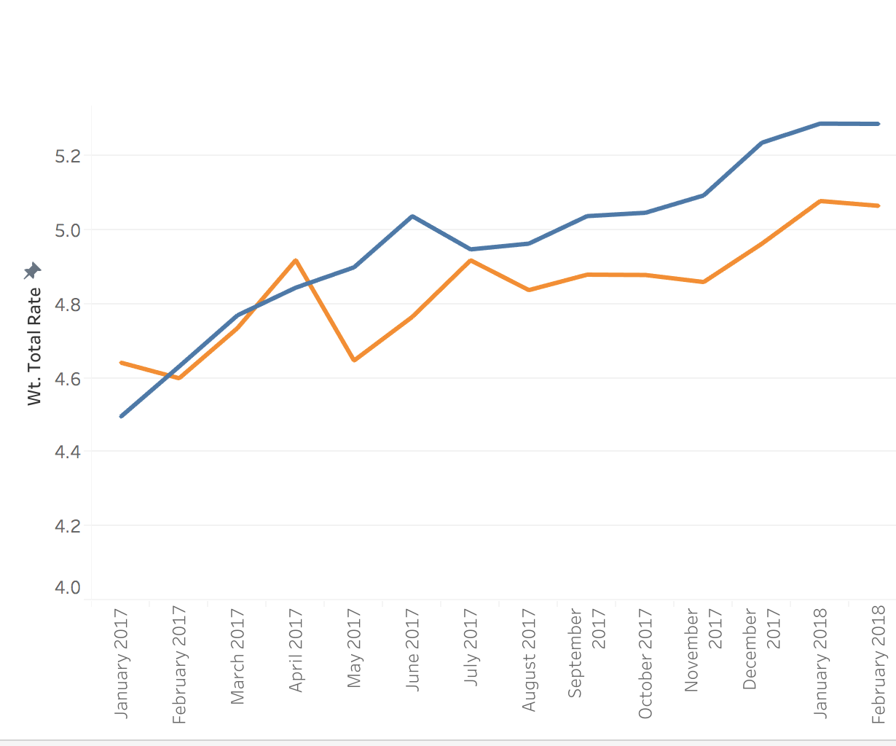
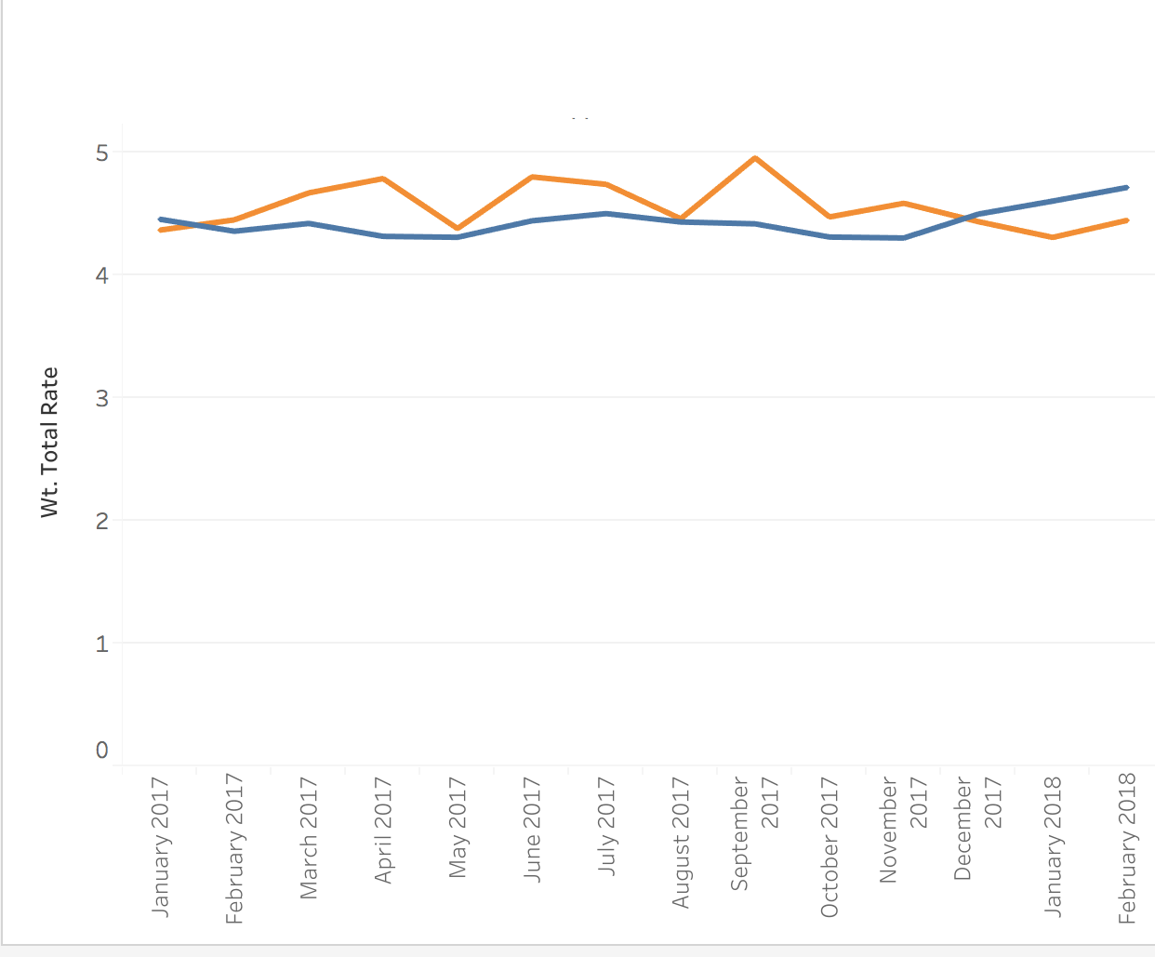

Comparing IBERIABANK Rates to their competitors
Sample
HELOC: Wt. avg rate by Month
HELOAN: Wt. avg rate by Month
IBERIABANK prices remain less than 20bps under competitors
Up to December 2017 IBERIABANK prices were above market for HELOAN

Slide 13
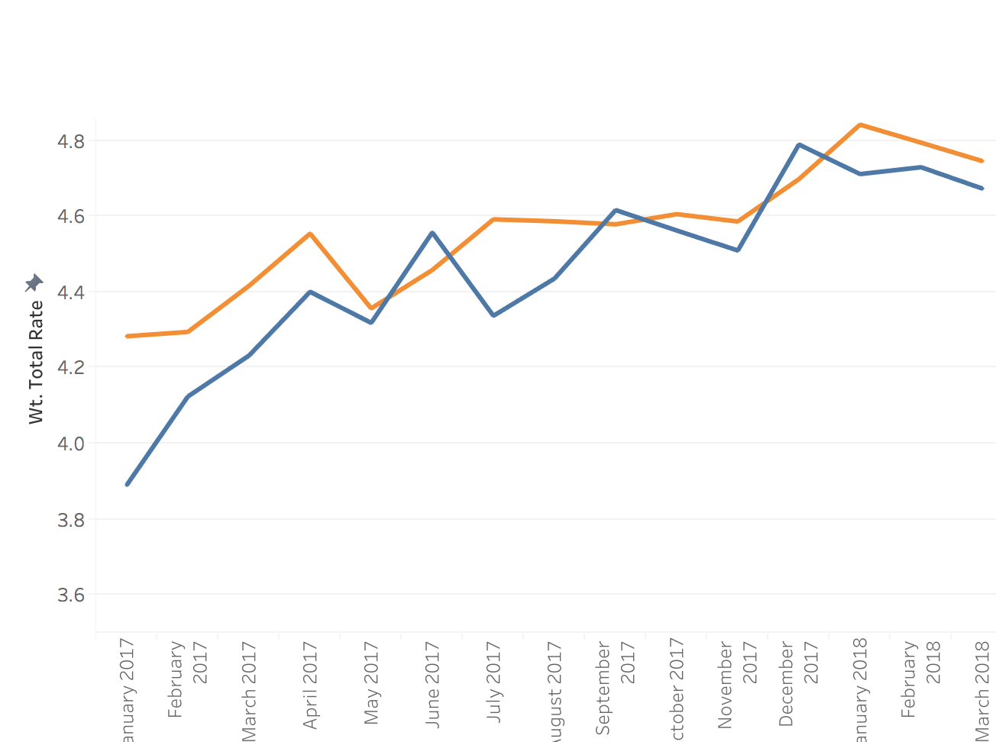
Comparing IBERIABANK Rates to their competitors
Sample
When comparing HELOC rates for the Wealth Segments (PC, EA) IBERIABANK rates are more in line with the market.
This will allow IBERIABANK to grow their Wealth segment while limiting impact to profitability

Slide 14
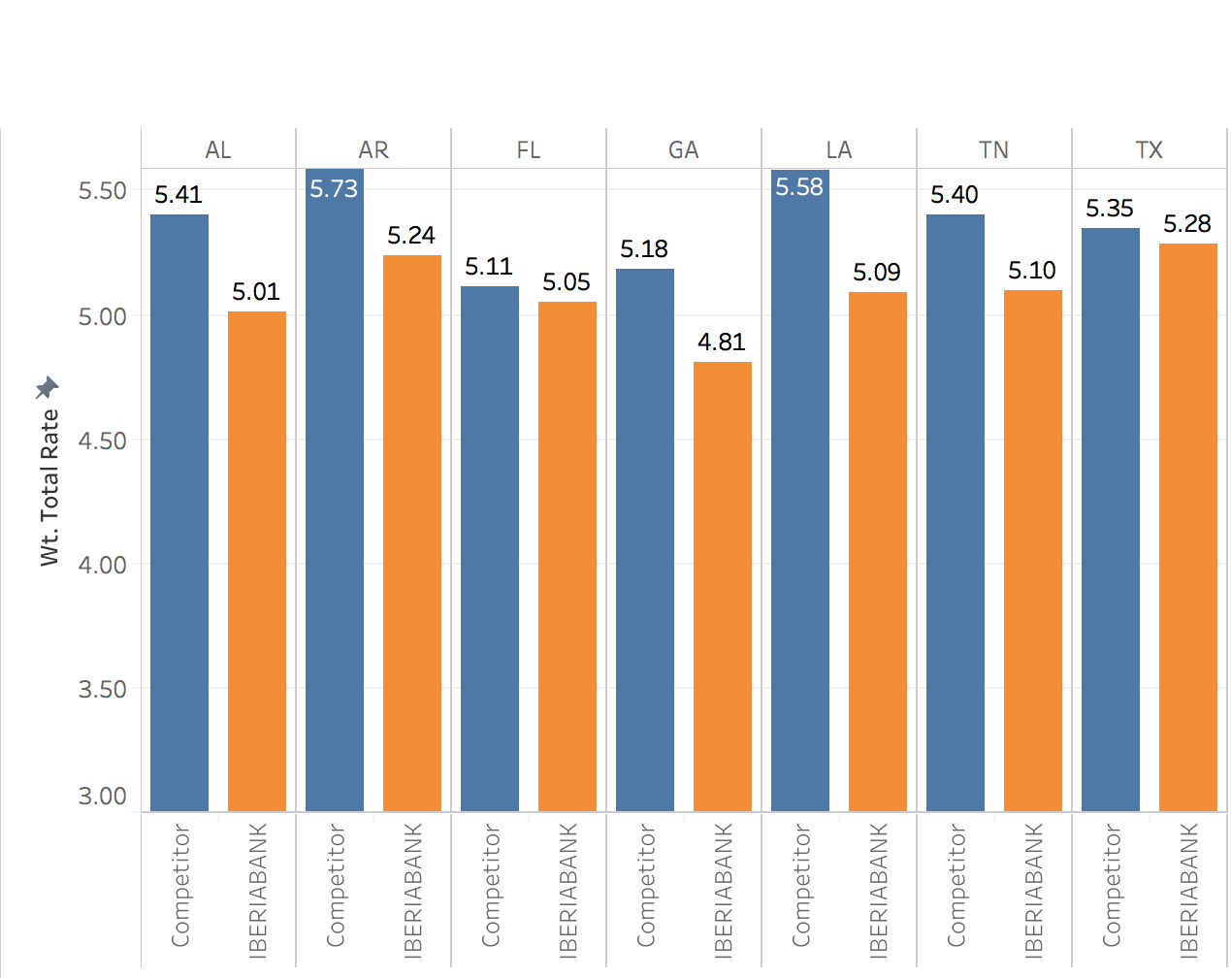
Competitor Rates
Sample
With the exception of Florida and Texas , IBERIABANK rates are positioned more than 10 bps lower their competitors for HELOC YTD

Slide 15
CSA: Key Takeaways/Next Steps
Key takeaways
Overall differentiate pricing through the Nomis Price Optimizer is making Iberia $5.75mm in lifetime RAR and $12.8mm in volume annually
Next Steps
Set up regular optimization cadence to continue capture the benefit of NPO
Nomis to provide accuracy reports (Forecast to Actuals) once Feb 22 rates season

Slide 16
Pricing Strategy for the Future

Slide 17
Industry Overview
Sample
Banking Industry Focuses
Becoming the digital relationship manager
Growing the balance sheet
Relationship pricing based on customer life time value
Aligning HE and Mortgage product
Home Equity Focuses
Effectively using Intro/Promo Rate
Managing the portfolio
Profitably growing balances
Minimizing balance run-off and attrition
Positioning product in a rising rate environment

Slide 18
Customer Report (like RAG)

Slide 19
Industry Best Practices
 | XYZ Current practice | Best Practice / Ideal State | Next Steps / Recommendations
Drive new business | Optimized Go-To Rate with pricing differentiated by segment | Optimize Go-To Rate with segmented Intro rate Offers | Intro Rate Offers
Grow & Maintain Portfolio | Front line driven retention and balance growth | Targeted offers for utilization stimulation and limiting attrition | Portfolio analysis Data enhancement campaigns for response modeling
Product Position | Limited exceptions allowed per month | Personalized pricing based on relationship and customer needs | Aligning lending products under single pricing strategy
Notes:
Remember to make sure to tie to our pillars, change as needed
x

Slide 20
Comprehensive plan to combat balance run-off
Optimize Go-to Rates
Leverage the Nomis Price Optimizer for Home Equity to optimize the profit volume trade-off on new originations
Define Intro Offers
Offer segmented intro offers that will increase take-up and initial draw behavior
Stimulate Utilization
Use segment level price sensitivity score to target customers who have shown propensity to utilize in the past and are most likely to respond to a rate offer to increase utilization
Use a segment level price sensitivity score to identify existing customers who would respond to an offer for a balance transfer
Retain Balances
Target clients with the highest propensity to attrite with a proactive offer to retain their balances
Engage Customers
Define the path to customer centric, omni-channel pricing based on bank objectives, strategy and technology capabilities (current and future)
2
1
4
5
3

Slide 21



The Nomis vision: evolution of pricing in retail banking
Disconnected product selling
Needs-based conversation and coherent product suites
Consistent omni-channel experience
Personal Loans
Mortgage
Deposits
Mortgage
Auto Finance
Home Equity
Auto Finance
Home Equity
Personal Loans
Deposits
Product-centrlc
Customer-centric
Moment-centric

Slide 22
The journey to customer centric pricing
Nomis Pricing Platform can enable the bank with the technology to bridge the gap between current state capabilities and future state design
Product Centric Pricing
Personalized Pricing
Customer Centric Pricing
Mortgage
Auto Finance
Home Equity
UPL
Mortgage
Auto Finance
Home Equity
Deposits
Personal Loans
Deposits
ANALYZE AND OPTIMIZE
Pricing determined by siloed portfolio goals
Pricing recognizes full client value and enterprise-wide strategy
Real-time decisions and prices made in alignment with the enterprise-wide strategy
MANAGE AND EXECUTE
Limited, LOB specific recognition of client needs or value when determining offers
Product bundles tailored to client needs
Offers determined by client’s needs, preferences and real-time situation
PRESENT AND FINALIZE
Streamlined sales conversations within each LOB but disconnected across enterprise
Seamless sales conversations across all products and channels
engagement via omni-channel interactions
Notes:
Globally Nomis has identified and played a part in implementing the journey from market generic prices through to customer centric pricing, through a consistent 4 phases of pricing maturity
Starting with market generic, market generic is where rates are defined at the national level based entirely on competitor information and few analytics
Product centric is the ability to incorporate product attributes into the price setting process, although banks have typically achieved this, they have struggled to operationalize it due to limitations and disconnect in their end-to-end pricing capabilities. Before moving towards personalized/CC pricing, this E2E process has to be streamlined, no bank has managed to progress beyond product centric until connecting the back office and the front-line.
Personalized pricing, is the ability to tailor a price at the customer level based on a combination of product and customer attributes used to either analytically optimize rates, or set rules to adjust pricing accordingly. Personalized pricing capabilities allow the bank to both consider pricing at the enterprise level, and start to collect customer centric data (based on test and learn), which are critical to move to the next phase
Customer centric pricing, is the ability to define a price in the context of the clients needs, preferences, behaviours, life-stage and real-time situation that’s still in-line with bank objectives
Currently, Banks trailing the market average are largely due to the inability to operationalize granular pricing strategies

Slide 23
Guiding Principles
Customer Centric Pricing, and the associated recommendations to execute this objective, is based on three guiding principles:
I want to … Fulfill a financial need, through channels convenient to me Pay a fair price for offerings personalized to my needs Feel like I am in control, while receiving advice I trust
I want to … Assess and serve customers’ needs, efficiently Have the information, guidelines and autonomy to make good decisions Earn a good living
CUSTOMER
BANKER
Wants to … Grow profitably, creating win-win value Serve customers with world-class product, pricing and experience Invest in data, analytic & tech infrastructure that is future-proof
BANK
Notes:
Customer centric pricing is not just about the customer! It’s about finding the sweet spot, a win-win, between the customer, bank and banker
In order to be successful on the journey, an E2E platform that considers the bank’s objective, the customer’s preferences needs and behaviours, and facilitates the right conversation by empowering the banker is key

Slide 24
Appendix

Slide 25
Results of Rate Change
Volume
1
Initial price
Optimal interest rate
2
2
Total Bookings ($)
1
Profit Dollars
Rate
2
=
1
×
NII ($)
Profit Margin
1
Rate
NIM %
2
Rate
Rates decreased increasing volume and lowering margin. The increased volume outpaced the decrease in margin, resulting in higher overall profit

Slide 26
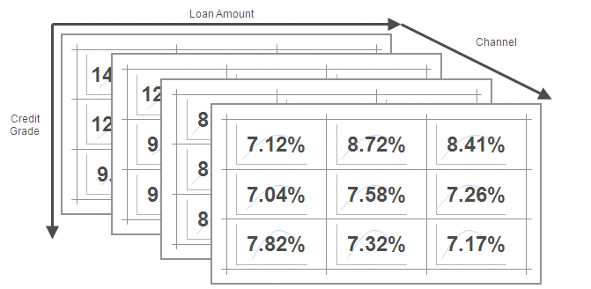
Optimizing Across Thousands of Segments
Expanding the optimization from a single cell to the portfolio-level requires building price-sensitive demand models for each segment as well as managing goals and constraints across hundreds of cells
Notes:
26
26

Slide 27
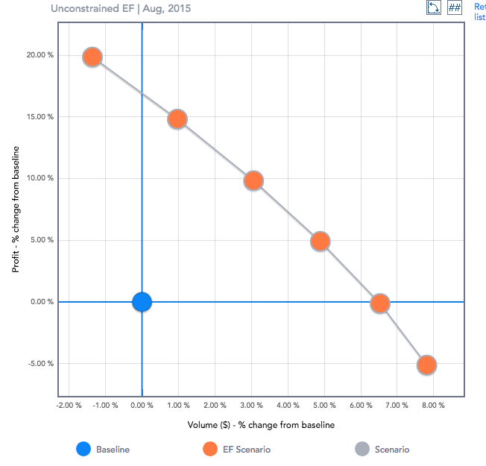
Efficient Frontier: Achieving Strategic Goals optimization
The Efficient Frontier is the set of scenarios that offer the highest return for a given level of volume
Scenarios that lie below the efficient frontier are sub-optimal
NPO balances the tradeoffs between higher margin and higher volume among price elastic and inelastic customer segments
Points in this region have higher profit and higher balances
Current
Operating
Point
Notes:
27
27

