Slide 1

MINI PROJECT
Under the gudience of :
P.JANARDHANA REDDY
M-TECH,PHD
BY:
T.OBUL SAI R200823
Ch.PRANAI R200782
K.SREE BADRINATH R200316

Slide 2
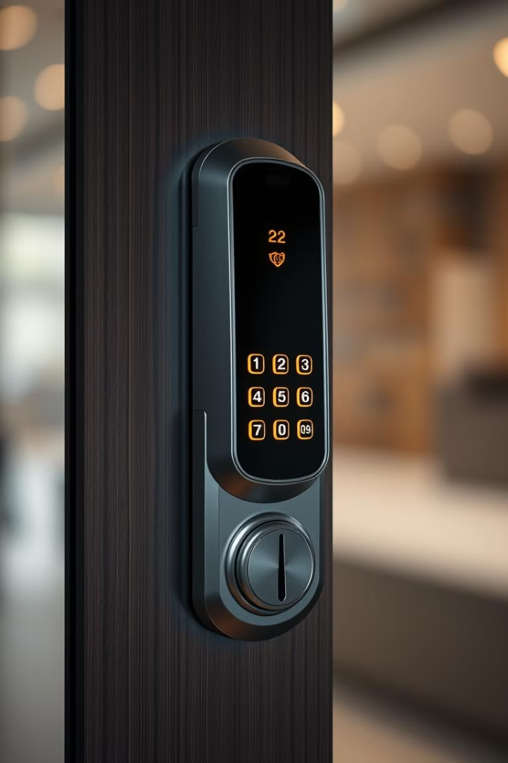
Smart Lock with OTP Authentication using Arduino
This presentation will explore the creation of a smart lock that leverages OTP (One-Time Password) authentication for enhanced security, employing the versatility of the Arduino platform.
NJ
by N Jayanth

Slide 3

Introduction to Smart Locks and OTP Authentication
1
Smart Locks
2
OTP Authentication
3
Key Benefits
Smart locks are a modern advancement in home security, offering convenience and enhanced protection through digital access control.
One-Time Password (OTP) authentication is a robust security measure that generates unique, time-sensitive codes, preventing unauthorized access.
Combined, these technologies offer a secure and user-friendly solution for controlling access to your home or building.

Slide 4
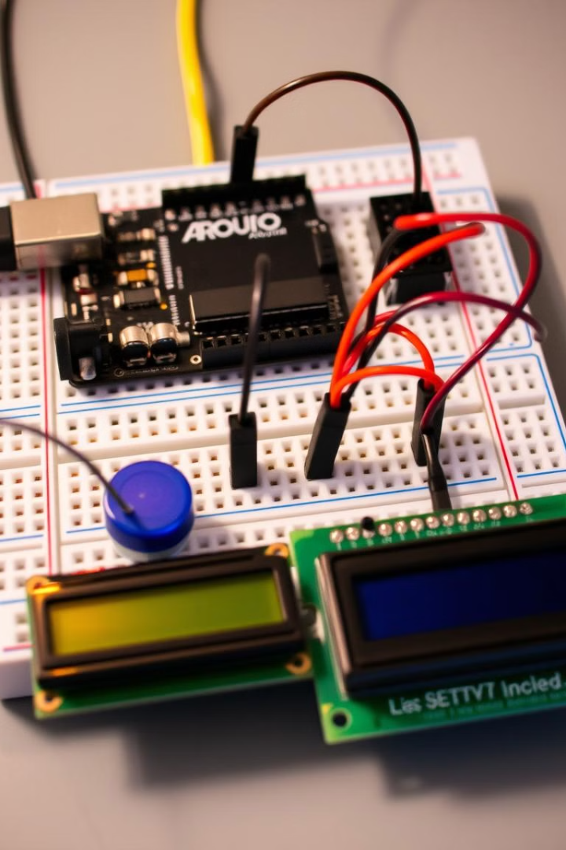
Hardware Components: Arduino, Servo Motor, LCD Display
Arduino
Servo Motor
The Arduino serves as the brain of the system, controlling the logic and communication for OTP generation and lock operation.
The servo motor acts as the actuator, physically opening and closing the lock mechanism in response to authentication verification.
LCD Display
The LCD display provides user feedback, displaying the OTP code for authorization and system status messages.

Slide 5
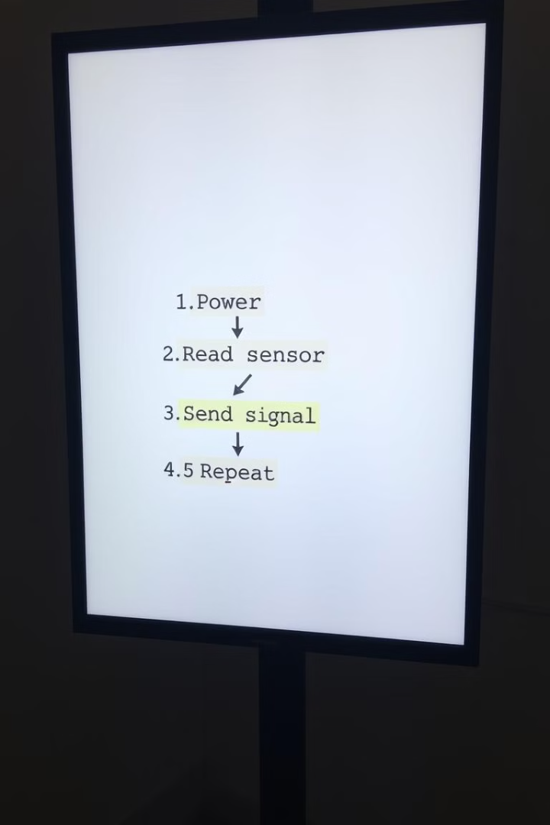
Software Design: Arduino Sketch, OTP Generation Algorithm
1
OTP Generation
A robust OTP generation algorithm is implemented, creating unique codes based on a seed value, time, and other factors.
2
Code Structure
The Arduino sketch is designed to handle user input, OTP generation, communication, and servo motor control.
3
Serial Communication
Serial communication is used to transmit the generated OTP from the Arduino to a separate device, such as a smartphone.

Slide 6




OTP Validation and Servo Motor Control
OTP Input
Validation
Servo Motor Control
The user enters the generated OTP code on their smartphone, which is then transmitted back to the Arduino.
The Arduino compares the received OTP with the generated code. If they match, access is granted.
The servo motor is activated, unlocking the lock mechanism, allowing access to the secured area.

Slide 7
Secure Communication: Implementing Encryption and Decryption
Encryption
Decryption
Security Protocols
Encryption is used to secure communication channels between the Arduino and the smartphone, ensuring that data is protected from unauthorized access.
Upon reaching the Arduino, the received encrypted data is decrypted using a shared secret key, allowing the system to validate the OTP and unlock the door.
Standard security protocols like AES (Advanced Encryption Standard) can be implemented to ensure robust encryption.

Slide 8
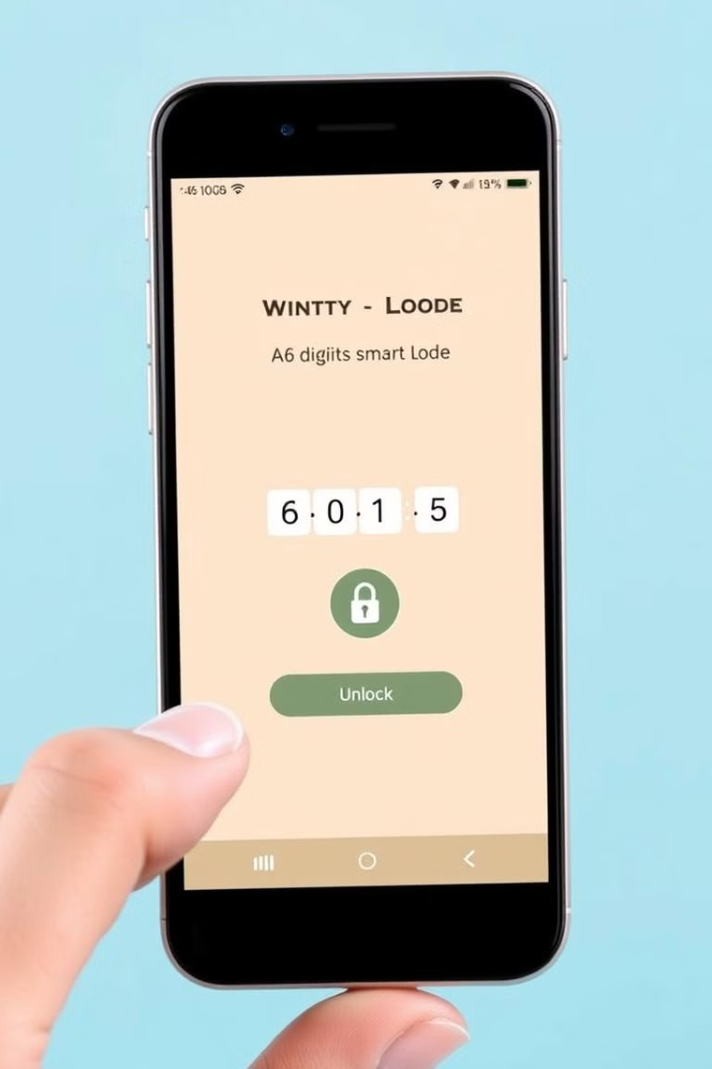



User Interface and Accessibility Features
User-Friendly Interface
The user interface should be intuitive and easy to navigate for users of all technical abilities.
Accessibility Features
Consider accessibility features like voice commands or braille displays for visually impaired users.
Remote Control
Remote control functionality allows users to manage their smart lock from anywhere with internet access.

Slide 9

Conclusion and Future Enhancements
Conclusion
This project showcases the potential of Arduino and OTP authentication for building secure and user-friendly smart locks.
Future Enhancements
Future enhancements could include integration with home automation systems, voice control, and advanced security features.

Slide 10
THANK YOU

