Slide 1


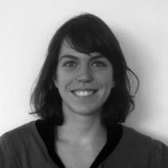

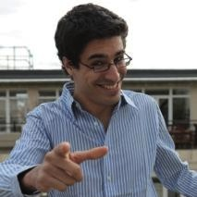


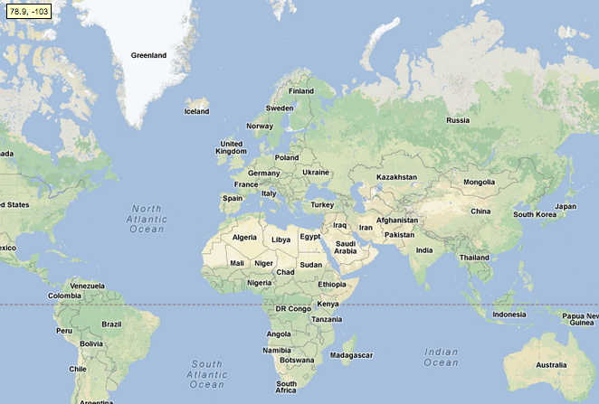





HOW
WORKS
This is Olga. She wants to expand her successful brand of “electronic jackets”
from Russia to the world.
This is Juan, from Rio.
He is a talented fashion marketing consultant, and he is bored to work every day on others’ projects.
We define with Olga
an online challenge enabling
anyone to try to earn the right
to localize Olga’s brand.
Juan hears about us at a Meetup
& decides to check our platform.
On LiveStormer.com, Juan discovers innovations from everywhere.
With his network and skills, he realizes he should be the one launching Olga’s brand in Rio.
As they don’t use many jackets in Rio, he think he might adapt Olga’s innovation to shoes !
Juan applies to localize the brand.
He uses our tools to prove he is
the right guy in the right market:
- Video Pitch - Business plan
- Crowdfunding campaign
- Customer listing - ...
At the same time Olga reviews applications from all over the world, comment them
& share more data to guide applicants.
She finally selects the best opportunities.
Olga starts growing in America, faster than she could have imagined & can rely on local insights!
Juan becomes
a real entrepreneur by localizing Olga’s brand in Rio !

