Slide 1

Group 3 – Final Project
Lakshmi, Manjinder, Toby, Alireza, Tony, Pouria, Suteash, Kien, Alireza, Parsa, Sahar

Slide 2
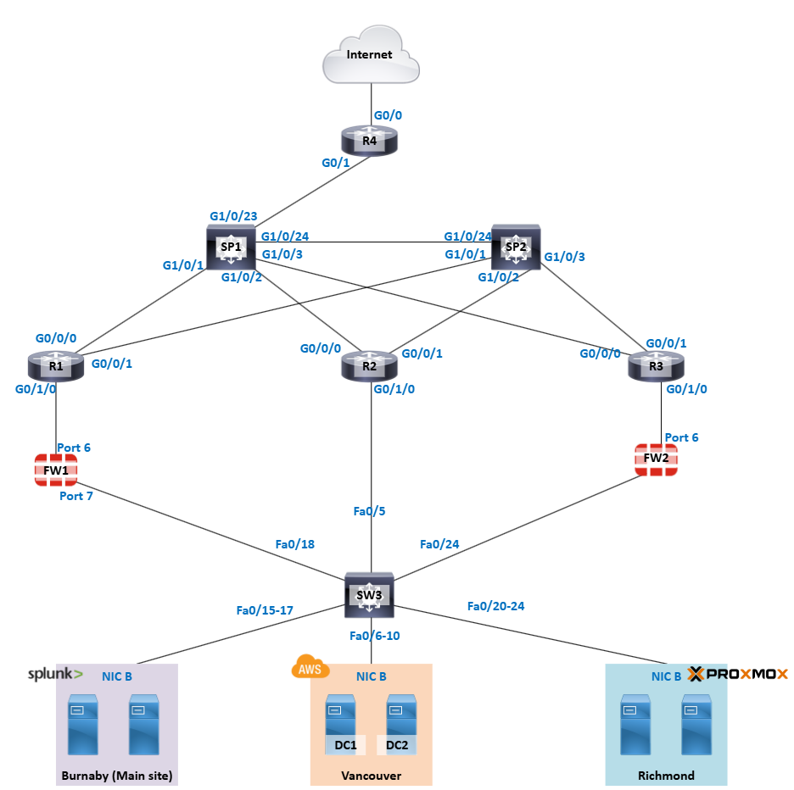
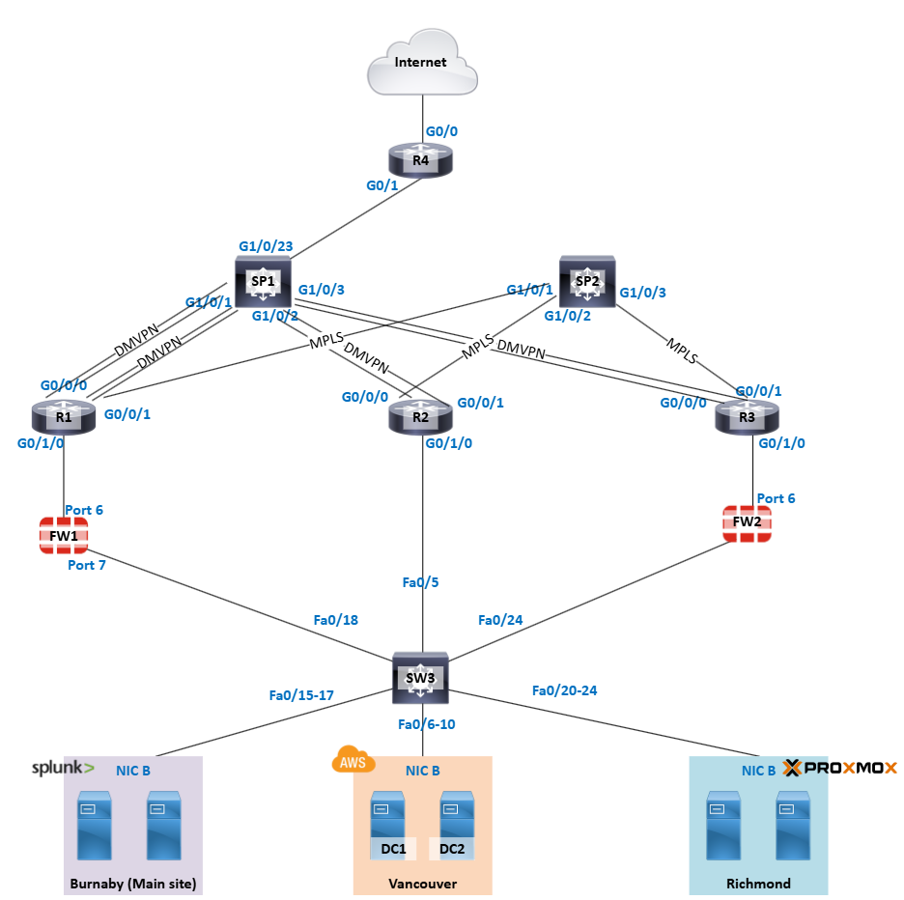
Project Overview
Topology
Physical Topology
Logical Topology

Slide 3
Network
Types
WAN -152.19.0.0/16 - 162.19.0.0/16
LAN -172.19.0.0 /16
Routing
BGP
OSPF

Slide 4
Network Security
IPSec Site-to-Site tunnel
Firewall Policies
Secure encrypted connection between sites
Enables safe data and resource sharing
VPN Rules- Allow secure traffic between local and remote sites.
LAN-to-WAN- Permits internal users to access the internet with NAT and inspection.
Internal Rules- Enable communication between internal segments (e.g., internal6 ↔ internal7).
Security- Most rules have UTM enabled but SSL inspection is disabled.
Implicit Deny- Blocks all unmatched traffic by default.

Slide 5
VPN Rules
-Allow secure traffic between local and remote sites
-Used for replication, file sharing, etc
LAN-to-WAN Rules
-Allow internal users internet access
-NAT and inspection enabled for protection

Slide 6
Windows - Rouzbeh
Created 3 sites
Creating OUs for each departments in each site, assign users in the OUs
Grp policies:
Burnaby,
Vancouver
Richmond
DNS
-Site-specific GPOs applied for DNS configuration (same subnet)
-Integrated with AD for dynamic updates
DHCP
-DHCP scopes created per site to distribute IP addresses.
-DHCP Failover setup provides load balancing and high availability.

Slide 7
Windows -Travis
Cluster
File share server
High Availability: Keeps services running without interruption.​
Load Balancing: Distributes workloads across multiple nodes.
Use Case: Common in enterprise environments for critical services.
Centralized Storage: Easy access and management of files.
Permissions & Security: Controls who can read/write to specific folders.
Protocols Used: SMB/CIFS for Windows environments, NFS for Linux/Unix.

Slide 8
AWS

Slide 9
Challenges

Slide 10
Conclusionn

