Slide 1


Assignment Of Database Management
FACULTY OF CREATIVE MEDIA & INNOVATIVE TECHNOLOGY (FCMIT)
Prepared By:
MOHAMMAD OBYDUR RAHMAN MATRIC NO: 153915771
PRESENTED TO
LECTURER :HASNANI HASSAN

Slide 2
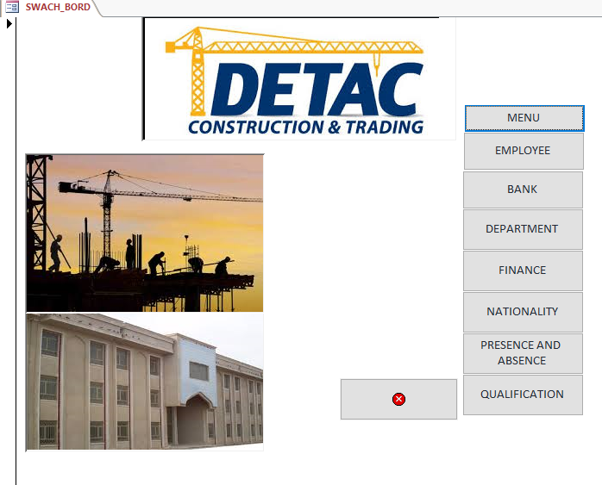
A company DETAC of construction and trading
The main interface

Slide 3
WELCOME

Slide 4
Contact
1- Database Life Cycle (DBLC)
1-1 Database Initial study
1.1.1 Identify problems and obstacles.
5-Operation
1.1.2 Objectives:
1.1.3 Scope and Boundaries:
6- Maintenance and Evaluation
2-1 Database Design
6.1 Create the Physical
Design
2.1 .1 Normalization
2.1.2 ERD
2.1.3 Tables
2.1.4 Queries
2.1.5 FORMS
2.1.6 reports
3- Implementation and loading
3.1 DBMS Software Selection
4-Testing and Evaluation
4.1 Create the Logical
Design

Slide 5
1-Database Life Cycle (DBLC)
Database Initial study
Conceptual Design
Database Design
ER-Diagram / Normalization
Implementation and loading
DBMS Software Selection
Testing and Evaluation
Create the Logical
Design
Operation
Create the Physical
Design
Maintenance and Evaluation

Slide 6
The company situation describes
When examining the current system in this company and found that work in a variety of departments and administration departments are hiring their employees as needed, after recording a full data are the Exchange number for each employee and the follow-up to the employee in terms of attendance and payment of monthly salaries for each of employee.
In this company is dealing with customers by manual work any models is to mobilize and be Questions and reports Manual ,this work was very difficult and it takes a great time for reports and correspondence From here behind us design system that helps this company in the extraction of reports and INQUIRIES easy manner and in a short time
1.1 Database Initial study
In this first stage of the Initial study for a database, we have identified the current study of the operation of the system within the company how and why the current system has failed. The overall objective of this study to the database is as follows:
• Analysis the situation in the company.
• Identify problems and obstacles.
• Setting goals.
• Identify the scope and limits.

Slide 7


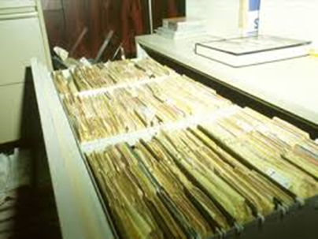
1.1.1 Identify problems and obstacles.
Through the company's existing situation analysis it found that the system depends entirely on the manual system in all transactions company's .
and we found inconsistency in data entry or in hand written orders. This has the effect of not only causing problems with customer service but also marking information unable be used for reporting or finding trends with data discovery . reporting and checking that data is robust can be timely and expensive .this is often an area where significant money can be saved by automation as well as loss and damage to files and documents, whether natural or human factors and repeating the mistakes in queries and reports

Slide 8
1.1.2 Objectives:
1-Conversion of manual system to a computer with the creation of a database covering all the company's transactions Base
2- Improved data access to users
3- Reduced data entry, storage, and retrieval costs.
4- Greater integrity of data and improve security
5- keeping electronic records - making it easier to get the information, and generate reports to meet the tax requirements and the preparation of legal reports
1.1.3 Scope and Boundaries:
In this stage, to determine the scope and limits of the system:
We have identified the scope of the system and designed it according to operational requirements. The entire design data and one or more departments within the organization, including the organization so that helps to identify the required data structures, and the type and number of entities base, and the actual size of the database according to the required data

Slide 9



2-1 Database Design
In this second stage, we have designed the sample database that will support the company's operations and goals. It is the most important stage (DBLC): to make sure that the proposed system will meet the requirements of the user and the system.
The dependence on that:
• The easy-relevant for the analysis and design of a larger system, the database design process.
Input system must be according to the required output
The establishment of procedures that will help in the conversion of data within the database to useful information.

Slide 10
2.1 .1 Normalization
Normal Form (NF)
Employees= nu_EM, name_EM, date_bir_EM, gender_EM, nat_EM, mar_EM, pass_EM, add_EM, pho_EM, qual_EM,Major,accou_EM { nu_ban, name_ban, add_ban, phon_ban, email_ban, un_cont, name_Dep, phon_Dep, addr_Dep, date_st_work, date_end_work, durat_cont, salary, date_pr_abs, case_pr_abs }.
First Normal Form (1NF)
Employees= (nu_EM, name_EM, date_bir_EM, gender_EM, nat_EM, mar_EM, pass_EM, add_EM, pho_EM, qual_EM, major, accou_EM, nu_ban, name_ban, add_ban, phon_ban, email_ban, un_cont, name_Dep, phon_Dep, addr_Dep, date_st_work, date_end_work, durat_cont, salary, date_pr_abs, case_pr_abs ).

Slide 11
Second Normal Form (2NF)
Data_employees= (EM_NUM , name_EM, date_bir_EM, gender_EM, nat_EM, mar_EM, pass_EM, add_EM, pho_EM, qual_EM, major, accou_EM, nu_ban)
Bank= (nu_ban, name_ban, add_ban, phon_ban, email_ban,
Finance_EMPL= (un_cont, durat_cont, date_st_work, date_end_work, salary, data_cont, un_EM, date_pr_abs, case_pr_abs)
Department= (nu_dep, name_Dep, phon_Dep, addr_Dep,).

Slide 12
Third Normal Form (3NF)
Data_employee= (EM_nu, EM_NAME, EM_date_bir, EM_gender, EM_NAT, EM_MAR, EM_pass, EM_add , EM_phon, EM_qual, BAN_NUM, EM_Accou)
Nationality= (NAT_NUM, NAT_NAME)
Qualification= (QUAL_NUM, QUAL_NAME)
Bank= (BAN_NUM, EM_NUM, BAN_ADDR, phon_ban, Email_ban )
Finance_EMPL= (Cont_NUM, EM_NUM, date_cont, Dep_NU, date_st_work, date_end_work, salary )
Pres_absen= (EM_NUM, Date_pr_ads, Case_pr_abs)
Department= (Dep_NUM, Dep_NAM, Dep_phon, Dep_ADDR).

Slide 13
Data Dictionary
Table of Data_employee
No. | Field Name | Type | Length | Key
1 | EM_NUM | Auto Number | Long Integer | Primary Key
2 | EM_NAME | Text | 50
3 | EM_date_bir | Date/Time | Short Time
4 | EM_gender | Yes/No
5 | EM_NAT | Short text | 20
6 | EM_MAR | Yes/No
7 | EM_pass | Number | 10
8 | EM_add | Text | 25
9 | EM_phon | Number | 25
10 | EM_qual | Number | Long Integer
11 | BAN_NUM | Number | Long Integer
12 | EM_Accou | Number | 25

Slide 14
Table of Nationality
No. | Field Name | Type | Length | Key
1 | NAT_NUM | Auto Number | Long Integer | Primary Key
2 | NAT_NAME | Text | 40
Table of Qualification
No. | Field Name | Type | Length | Key
1 | QUAL_NUM | Auto Number | Long Integer | Primary Key
2 | QUAL_NAME | Text | 40

Slide 15
Table of Bank
No. | Field Name | Type | Length | Key
1 | BAN_NUM | Auto Number | Long Integer | Primary Key
2 | BAN_NAME | Text | 50
3 | BAN_ADDR | Text | Long Integer
4 | phon_ban | Number | Long Integer
5 | Email_ban | Text | 50
Table of Department
No. | Field Name | Type | Length | Key
1 | Dep_NUM | Auto Number | Long Integer | Primary Key
2 | Dep_NAM | Text | 50
3 | Dep_phon | number | 50
4 | Dep_ADDR | number | Long Integer

Slide 16
Table of Finance_Empl
No. | Field Name | Type | Length | Key
1 | Cont_NUM | Auto Number | Long Integer | Primary Key
2 | EM_NUM | number | Short Time
3 | date_cont | Date/Time | Short Time | Foreign key
4 | Dep_NU | number | Long Integer | Foreign key
5 | date_st_work | Date/Time | Short Time
6 | date_end_work | Date/Time | Short Time
7 | salary |  | number
Table of Pres_absen
No. | Field Name | Type | Length | Key
1 | EM_NUM | Number | Long Integer | Primary Key
2 | Date_pr_ads | Date/Time | Short time | Foreign key
3 | Case_pr_abs | Yes/No | - | foreign key

Slide 17
Cont..
ER-Diagram
After the normalization process was reached following entities and the relationship between them are shown in the following figure1

Slide 18
ERD
Cont_NUM
Cashing
1
FINANCE_EMPL
EM_NUM
Date_pr_ads
Date_end_work
Case_pr_abs
1
EM_NUM
EM_date_bir
Dep_NUM
Date_st_work
PRES_ABSEN
EM_NAME
EM_gender
Date_cont
M
EM_NUM
EM_NAT
follow up
1
Salary
work in
1
EM_MAR
Data_Employee
EM_qual
M
EM_pass
1
registered
BAN_NUM
EM_add
EM_phon
EM_Accou
Department
M
Dep_NUM
1
have
M
Dep_NAM
Dep_phon
Dep_ADDR
Banks
have
BAN_NUM
Email_ban
1
BAN_NAME
BAN_ADDR
phon_ban
1
Qualification
Nationality
QUAL_NUM
QUAL_NAME
NAT_NUM
NAT_NAME

Slide 19
Implementation and loading
At this stage, the database contains a series of instructions that create separate tables, attributes, fields, views, indexes, security constraints, and storage performance and design guidelines.
DBMS Software Selection
It has been selected ACCESS database to be a project company database design.
Testing and Evaluation
The system was tested after the database design and the introduction of the logical data were evaluated after obtaining positive results.

Slide 20
Operation
At this stage, the database will be passed the evaluation stage, is considered ready for action. At this point, the database, the management, users, and application programs constitute a complete information system. The beginning of the operational phase always begins the process of evolution of the system.
Maintenance and Evaluation
At this stage, there must be fully prepared to carry out routine maintenance work within the database.
Some of the required periodic maintenance work include:
• preventive maintenance (backup).
• Corrective Maintenance (PCR).
• Maintenance of adaptive (enhanced performance, adding entities and attributes).
• Set the access and maintenance of the new and old users permissions.

Slide 21
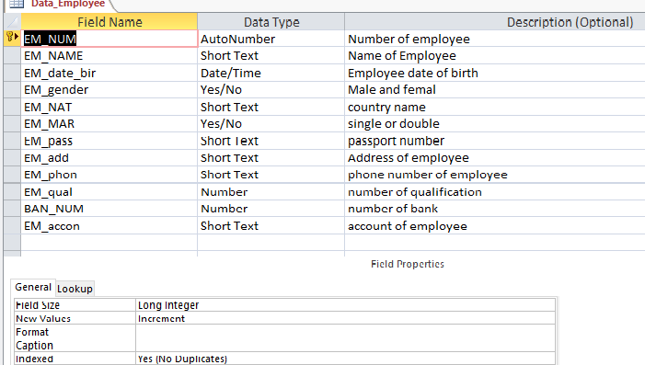
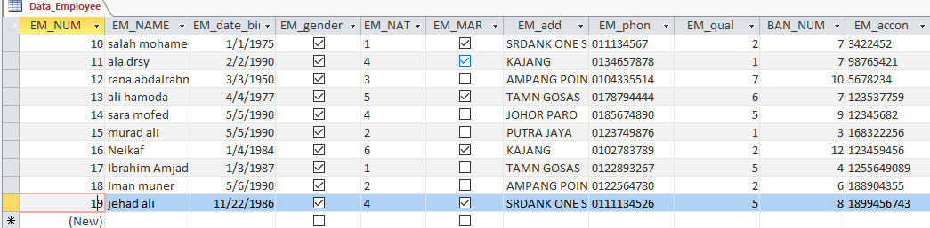
1-Data employee
Database deign Tables and database sheet view

Slide 22
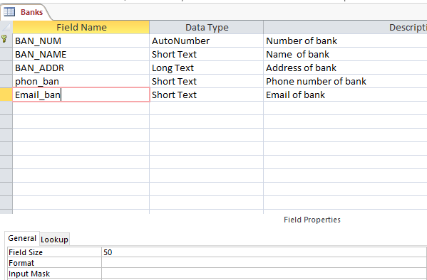
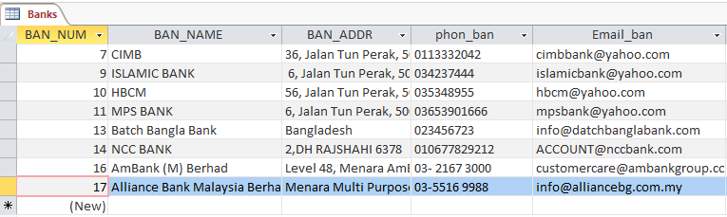
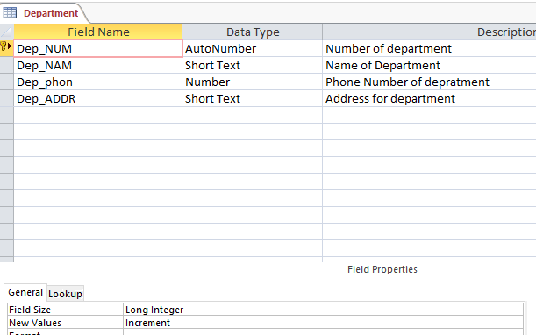
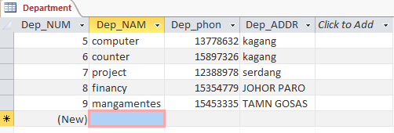
2-Banks
3-Department

Slide 23
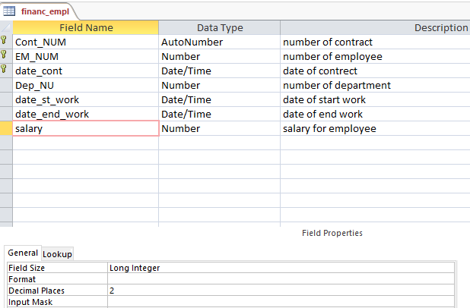
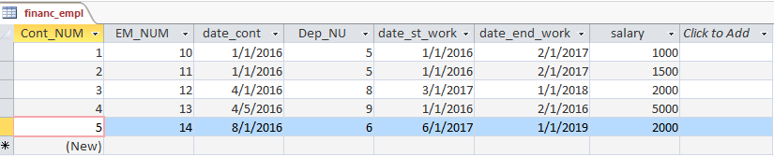
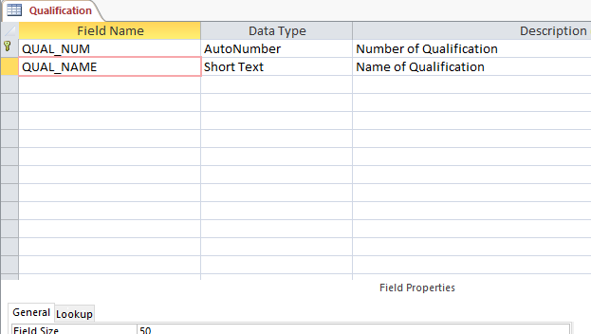
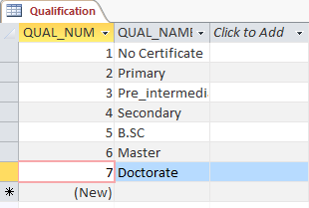
4-finance_empl
5-Qualification

Slide 24
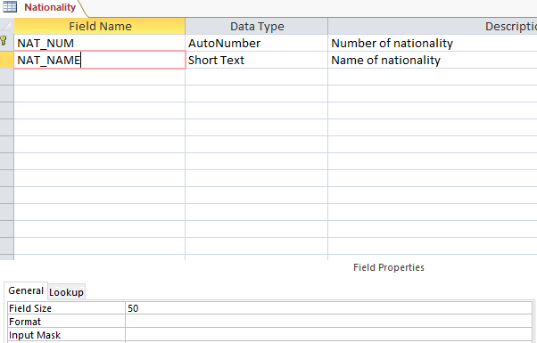
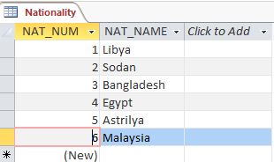
6-Nationality

Slide 25
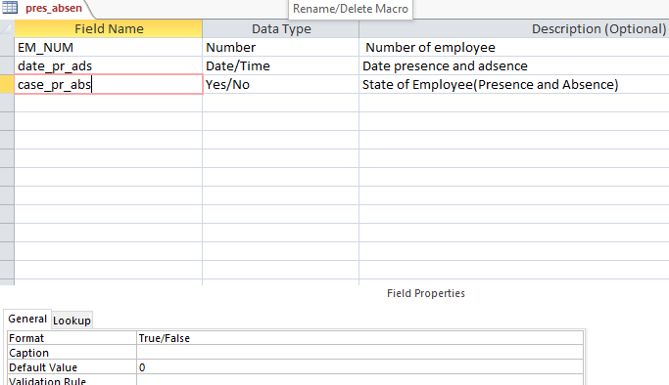
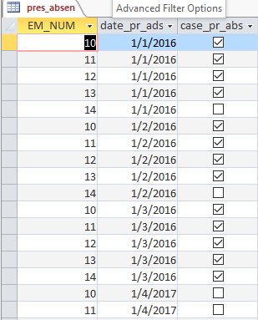
7-Pres_absen

Slide 26
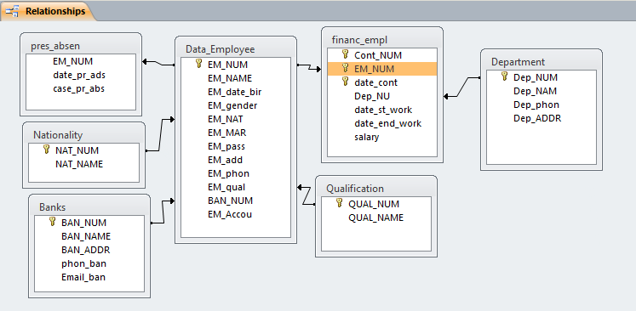
Relationship
A relationship, in the context of databases, is a situation that exists between two relational database tables when one table has a foreign key that references the primary key of the other table Relationships allow relational databases to split and store data in different tables, while linking disparate data items.

Slide 27
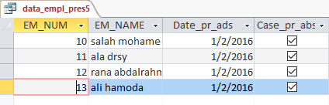
Queries
1-Data_empl _pres5
SELECT Data_Employee.EM_NUM, Data_Employee.EM_NAME, pres_absen.Date_pr_ads, pres_absen.Case_pr_abs
FROM Data_Employee, pres_absen
WHERE ( Data_Employee.EM_NUM = pres_absen.EM_NUM) and (pres_absen.Date_pr_ads=#1-2-2016#) and ( pres_absen.Case_pr_abs=true );

Slide 28

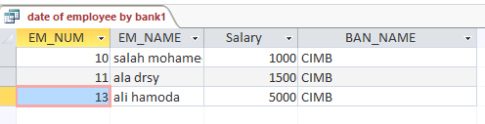
3-Data of employee by bank
2-Dataa _empl_date_end
SELECT Data_Employee.EM_NUM, Data_Employee.EM_NAME, financ_empl.Cont_NUM, financ_empl.Date_end_work
FROM Data_Employee, financ_empl
WHERE ( financ_empl.EM_NUM = Data_Employee.EM_NUM) and (financ_empl.Date_end_work=#1-1-2018#);
SELECT Data_Employee.EM_NUM, Data_Employee.EM_NAME, financ_empl.Salary, Banks.BAN_NAME
FROM Data_Employee, financ_empl, Banks
WHERE (Banks.BAN_NUM = Data_Employee.BAN_NUM) and ( financ_empl.EM_NUM = Data_Employee.EM_NUM) and Banks.BAN_NAME='cimb';

Slide 29
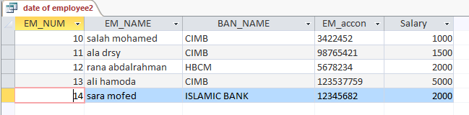
4-Data_employee by qual
SELECT Data_Employee.EM_NUM, Data_Employee.EM_NAME, Banks.BAN_NAME, Data_Employee.EM_accon, financ_empl.Salary
FROM Data_Employee, Banks, financ_empl
WHERE (( Data_Employee.BAN_NUM = Banks.BAN_NUM) and ( financ_empl.EM_NUM = Data_Employee.EM_NUM ));

Slide 30
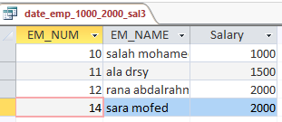
5-Data employee by salary
SELECT Data_Employee.EM_NUM, Data_Employee.EM_NAME, financ_empl.Salary
FROM Data_Employee, financ_empl
WHERE (financ_empl.EM_NUM = Data_Employee.EM_NUM) and (Salary
BETWEEN 1000 and 2000);

Slide 31
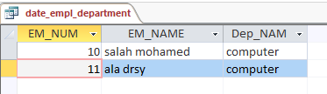
6-Data_empl_department
SELECT Data_Employee.EM_NUM, Data_Employee.EM_NAME, Department.Dep_NAM
FROM Data_Employee, Department, financ_empl
WHERE (Department.Dep_NUM = financ_empl.Dep_NU) and
( financ_empl.EM_NUM = Data_Employee.EM_NUM ) and (Department.Dep_NAM="computer");

Slide 32
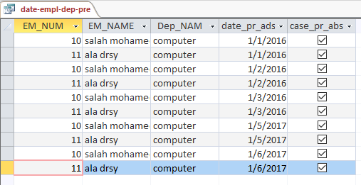
7-Data_empl_dep_pre
SELECT Data_Employee.EM_NUM, Data_Employee.EM_NAME, Department.Dep_NAM, pres_absen.date_pr_ads, pres_absen.case_pr_abs
FROM Data_Employee, Department, pres_absen, financ_empl
WHERE ( Department.Dep_NUM = financ_empl.Dep_NU)and ( Data_Employee.EM_NUM = pres_absen.EM_NUM) and (financ_empl.EM_NUM = Data_Employee.EM_NUM) and (Department.Dep_NAM="computer") and (pres_absen.Case_pr_abs=true);

Slide 33
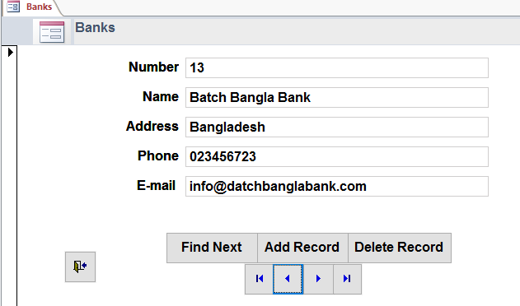
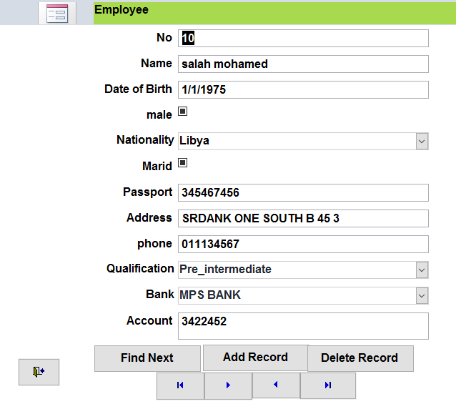
FORMS
1-Form Data of Banks
2-Form Data of Employee

Slide 34
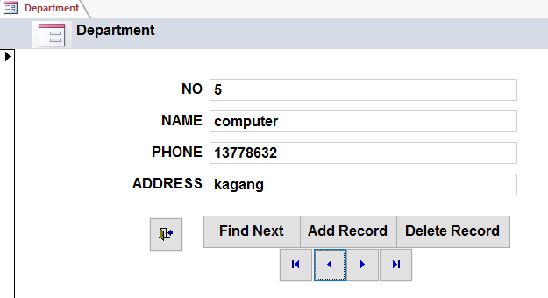
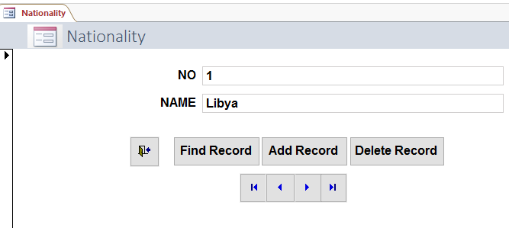
3-Form of Department
4-From of Nationality

Slide 35
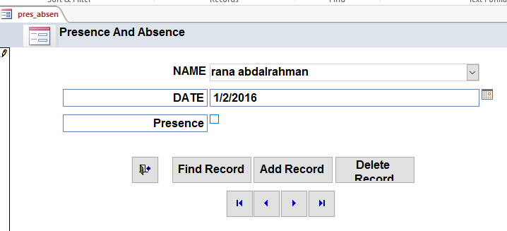
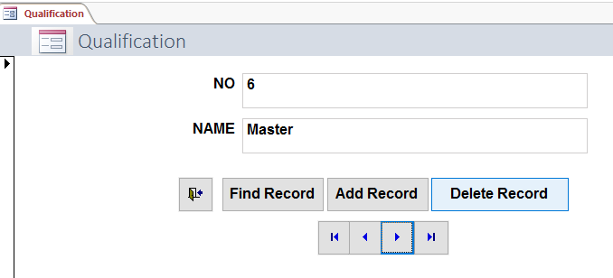
5-Form of presence and absent
6-Form of Qualification

Slide 36
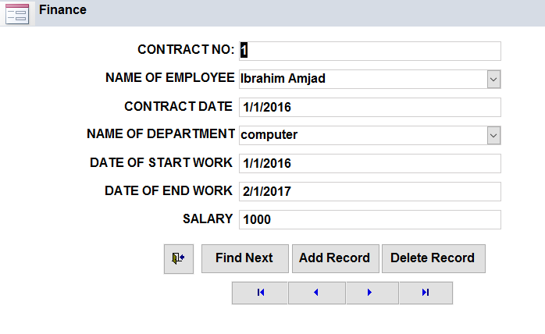
7-Form of financ

Slide 37
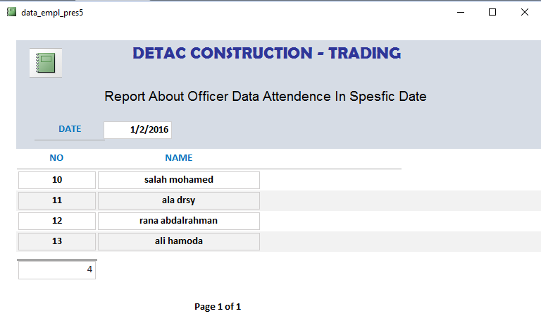
1- Report About Officer Data Attendance In Specific Date
reports

Slide 38
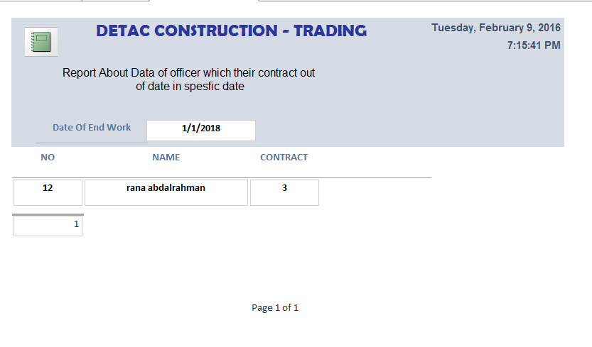
2- Report About Data of officer which their contract out of date in specific date

Slide 39
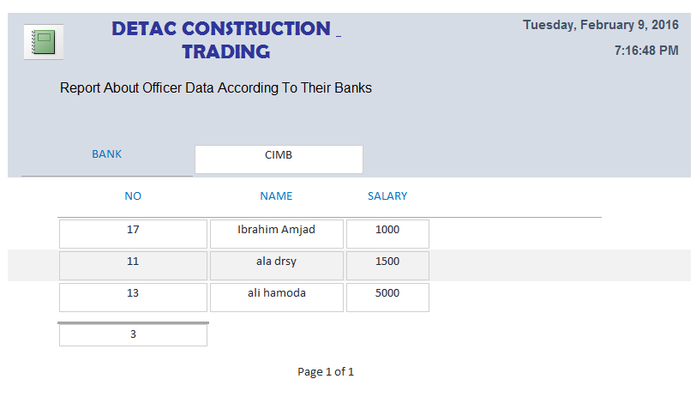
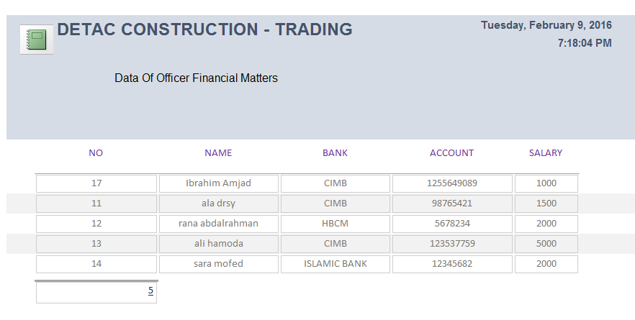
3- Report About Officer Data According To Their Banks
4- Data Of Officer Financial Matters

Slide 40
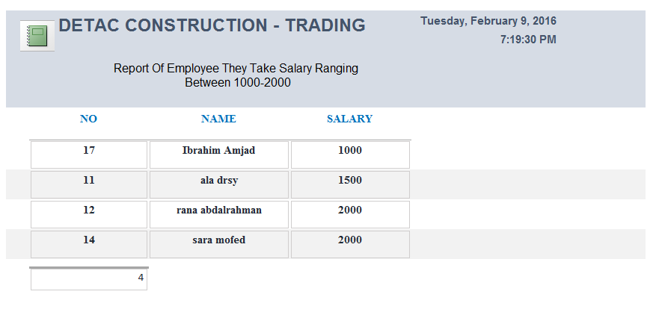
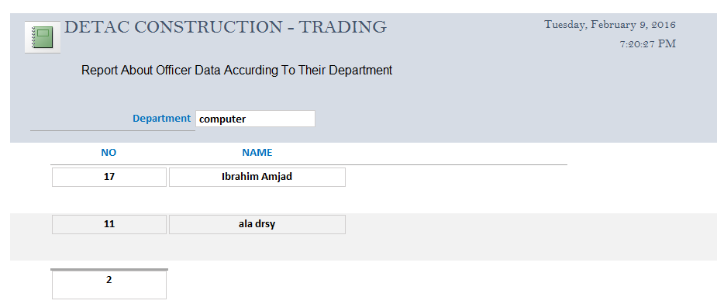
5- Report Of Employee They Take Salary Ranging Between 1000-2000
6- Report About Officer Data According To Their Department

Slide 41
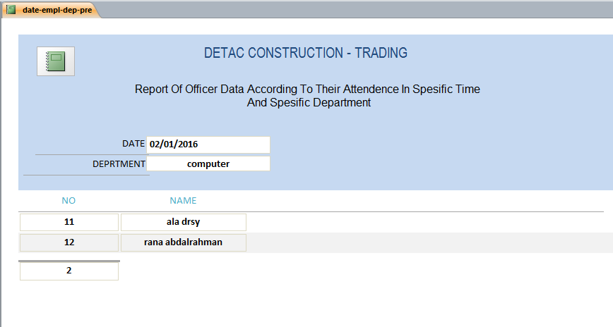
7- Report Of Officer Data According To Their Attendance In Specific Time And Specific Department

Slide 42
Thank you

