Slide 1
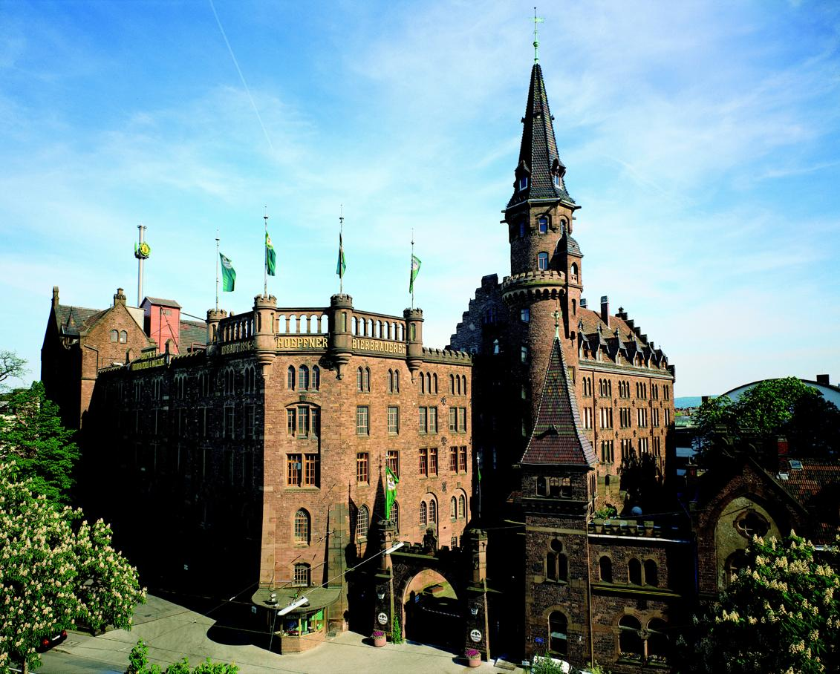
aicas technology
Deep Learning
Applications in the
Embedded Space
Mike Elliott
Software Engineer
aicas GmbH

Slide 2
Learning
A computer program is said to learn from experience E with respect to some task T and some performance measure P, if its performance on T, as measured by P, improves with experience E.
  Tom Mitchell (1997)
Tasks
  Classification
  Quantization
Deep Learning
  Use of multiple layers of nonlinear processing

Slide 3
Machine Learning
At the highest level, is a computer process that extracts specific features from data to solve predictive problems:
  Self-driving cars
  Classifying objects such as tumors
  Detecting pedestrians
  Detecting anomalies to prevent network intrusion or fraud
  Scanning social media sentiment and perception for marketing purposes
  Image interpretation

Slide 4
Algorithms
Linear Regression
Logistic Regression
Neural Network (deep learning)
  Modeled on biological neuron (dendrites, soma, axon)
Convolved Neural Network (CNN)
  Synthesized vision
    Multi-stage Hubel-Weisel architecture
    Work on a cat's primary visual cortex (1962)
Training and inference

Slide 5
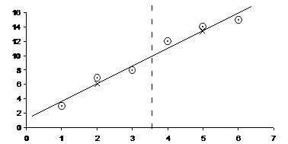
Linear Regression
Quantization
  Predict housing price
  Multiple features
  Square footage, number of floors, etc.
Plot some points
  Lay a meter stick on the points to find the straight line
    Okay, least squares does better
  Multiple dimensions

Slide 6
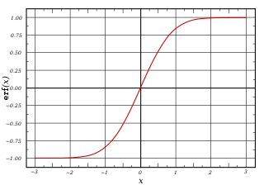
Logistic Regression
Classification
  Is the tumor malignant?
  Is this image a 7?
Yields a probability
Sigmoid function
  Easy to calculate derivative
The term regression is retained for historical reasons

Slide 7
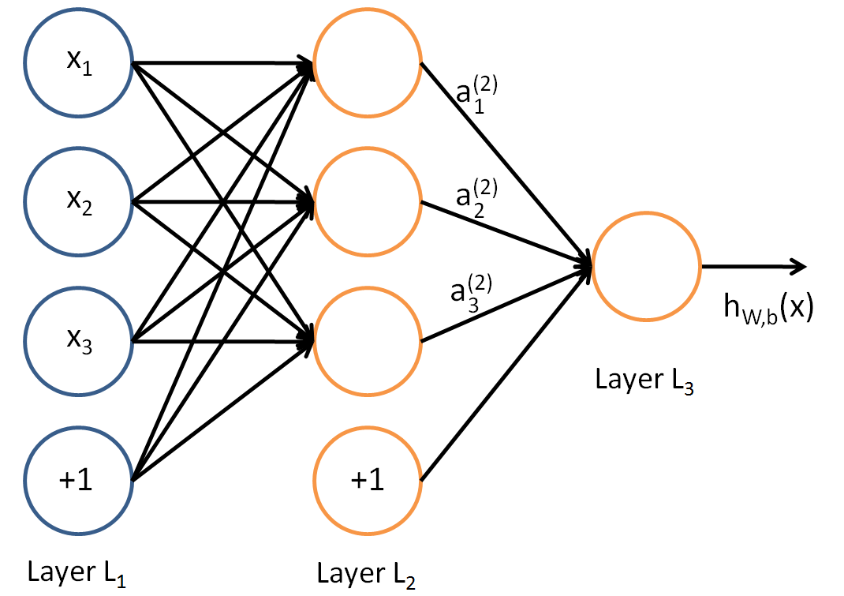
Neural Network
Modeled on actual neural tissue
  Dendrites, soma, axon
Multi-layer perceptron
  Input Layer
  Hidden Layer (or layers)
  Output Layer
Convolutional Neural Network (image recognition)
Training through back propagation and gradient descent

Slide 8
Languages
Algorithm Development
  Octave, Matlab, R, Python (NumPy)
Production
  C/C++
    OpenCL, CUDA
  Java (or any JVM language)
    Java, Scala, Clojure, etc.
    OpenCL, CUDA

Slide 9
Hardware Constraints
Power, Cooling, Memory
  Ideally on the order of 1 W
Processor
  CPU (Central Processing Unit)
  GPGPU (General Purpose Graphical Processing Unit)
  FPGA (Field Programmable Gate Array)
  ASIC (Application Specific Integrated Circuit)
Sensors
  I/O bandwith

Slide 10
GPGPU
Well understood
  CUDA (NVidia)
  OpenCL (Apple)
  Parallelism inherent
  Every processor executes every instruction
Power hungry
Adjunct to CPU
  Limited data bandwidth

Slide 11
FPGA
Can reduce power consumption by 1 or 2 orders of magnitude
Parallelization with Digital Signal Processors (DSPs)
  More power efficient than signal processing on CPUs
High I/O rate and bandwidth
  1000+ pins
Block RAM can be used for an internal feature model
Dynamically configure hardware at startup/runtime
  Switch image filters

Slide 12
Software Development Considerations
Ease of programming
Ease of deployment
Ease of maintenance
Systems training
Simulation
Portability
  Code
  Data
    Trained model

Slide 13
Real-Time Constraints
Determinism
  Deadlines, jitter, latency
Task partitioning
Security
  Civil airspace: DO-326, DO-355, DO-356
Safety
  Civil airspace: DO-178C, DO-322
  Automotive: ISO 26262
Inherent language safety is important

Slide 14

Latency and Pixel Streaming
DSP/GPU
Gaussian
Blur
Gaussian
Blur
Programmable Logic
Image Sensor
Image Sensor
Gaussian
Blur
Gaussian
Blur
Subtract
Subtract
CPUs
CPUs
DDR
DDR

Slide 15


Performance and Scaling
GoogLeNet @ batch = 1 |  | Xilinx ZU9 | Xilinx ZU5 | Nvidia TX1
 | Images/s | 370.0 | 155.0 | 70
 | Power (W) | 7.0 | 4.5 | 7.9
 | Images/s/watt | 53.0 | 34.5 | 8.9
6x
Images/sec/watt
42x Frames/sec/watt
CV:: StereoLBM @1080p |  | Xilinx ZU9 | Xilinx ZU5 | nVidia TX1
 | Frames/s | 700 | 296 | 28
 | Power (W) | 4.8 | 3.3 | 7.9
 | Frames/s/watt | 145.8 | 89.7 | 3.5
Machine
Learning
Inference
Computer
Vision
CV:: LK Dense Optical Flow @720p |  | Xilinx ZU9 | Xilinx ZU5 | nVidia TX1
 | Frames/s | 170 | 73 | 7
 | Power (W) | 4.8 | 3.3 | 7.9
 | Frames/s/watt | 35.4 | 22.1 | 0.9

Slide 16
Inference Models and Analysis
Training can be (and usually is) separate from inference
CNNs only capture spatial patterns in data.
  If data is just as useful when exchanging columns, CNNs are wrong
Tuning
  Number of features, size of features
  Window size, window stride
  Number of neurons
  How many layers and what type

Slide 17
Model Training
Can be computationally expensive
  Parallel processing – FPGA, GPGPU
Distributed processing
  Map reduce (Hadoop)
Real-Time training
  Unsupervised learning
  Not only feedback, but an interpretation of correctness

Slide 18
CNN/DNN toolkits
Deeplearning4j (Skymind)
  Ready to run now using Real-time Java
Caffe (Berkeley Vision and Learning Center)
CNTK (Microsoft)
Theano (University of Montreal, et. al.)
TensorFlow (Google)
Torch (Ronan Collobert)

Slide 19
References
Scaling up Machine Learning (various)
Deep Learning Demystified (Rohrer)
Stanford CS 231 Course Notes (Karpathy)
UMich EECS 598 Course Notes (Lee)
The Black Magic of Deep Learning (Markou)
Conv Nets, a Modular Perspective (Olah)
Neural Information Processing Systems (NIPS) Proceedings

Slide 20

Product Lines

Slide 21
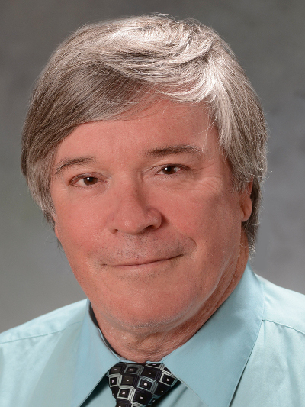
Presenter
Michael Elliott is a software engineer with a deep passion for modern software practice, embedded systems architectures and safety- and security-critical software. His recent work has involved embedded systems running Java Virtual Machines (JVMs) and JVM languages with a focus on both safety critical aspects of software and image recognition with convolutional neural networks. Additionally, Mike was a member of the committee creating the standard for software used in aircraft operating in civil airspace (DO-178C) and modern software practices in airborne software (DO-332) along with airborne security standards including DO-326 and DO-355.
Mike has a Bachelor of Science in Information and Computer Science from the University of California, Irvine and a Master of Science in Software Engineering from Edinburgh University, Edinburgh, Scotland.
Michael Elliott
aicas GmbH Emmy-Noether-Str. 9 76131 Karlsruhe Germany
elliott@aicas.de
+49 721 663 968-63 +1 562 645-3355

