Slide 1

Visualization and Analysis –
Tutorial Presentation for Feedback
Date: 26 November 2025
Group Id: A-199 Name of Student Presenting: Danial Zaf.

Slide 2
Part 1: VISUALISATION

Slide 3
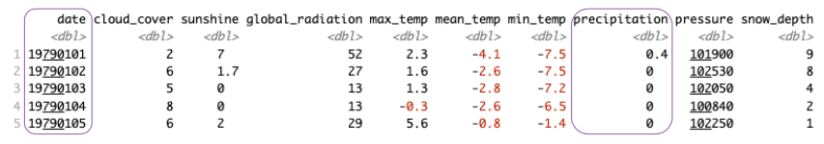
We are using the dataset DS134 - london_weather.csv to answer our Research Question “Is there a difference in the mean of daily precipitation among the seasons in London from 1979 to 2020?”
The database has 10 columns and 15,341 Rows. We will use precipitation(mm) and date columns.
Independent Variable: date ==> Season (Nominal) | Dependent Variable: precipitation (Interval)

Slide 4
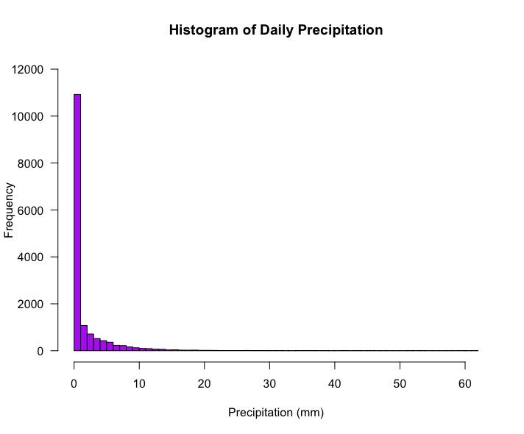
Variable precipitation(mm) is not normally distributed.

Slide 5
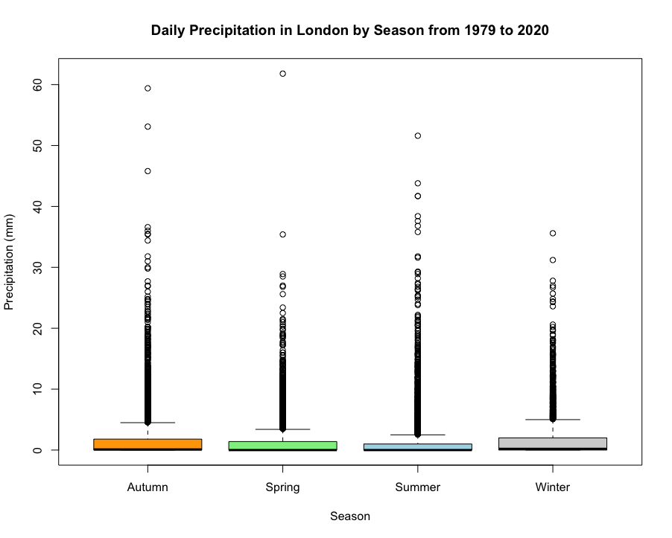
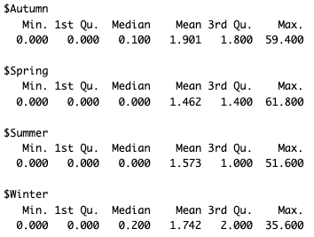

Slide 6
Part 2: Analysis (building on your Visualizations)

Slide 7
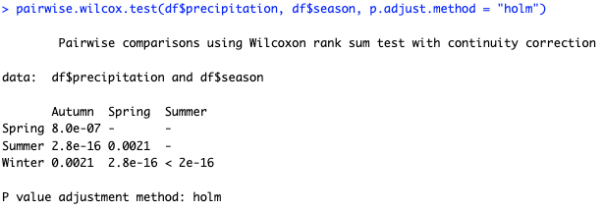
Null hypothesis (H₀​): There is no difference in the mean of daily precipitation among the seasons in London.
Alternative hypothesis (H₁​): There is a difference in the mean of daily precipitation among the seasons in London.
This means that precipitation patterns in London from 1979 to 2020 are specific to each of the four seasons.

Slide 8
Winter | 1
Spring | 8.0e-07 Very significant difference | 1
Summer | 2.8e-16 Very significant difference | 0.0021 significant difference | 1
Autumn | 0.0021 significant difference | 2.8e-16 Very significant difference | < 2e-16 Very significant difference | 1
 | Winter | Spring | Summer | Autumn

Slide 9
