Slide 1
SchanArchive processing
MATLAB

Slide 2
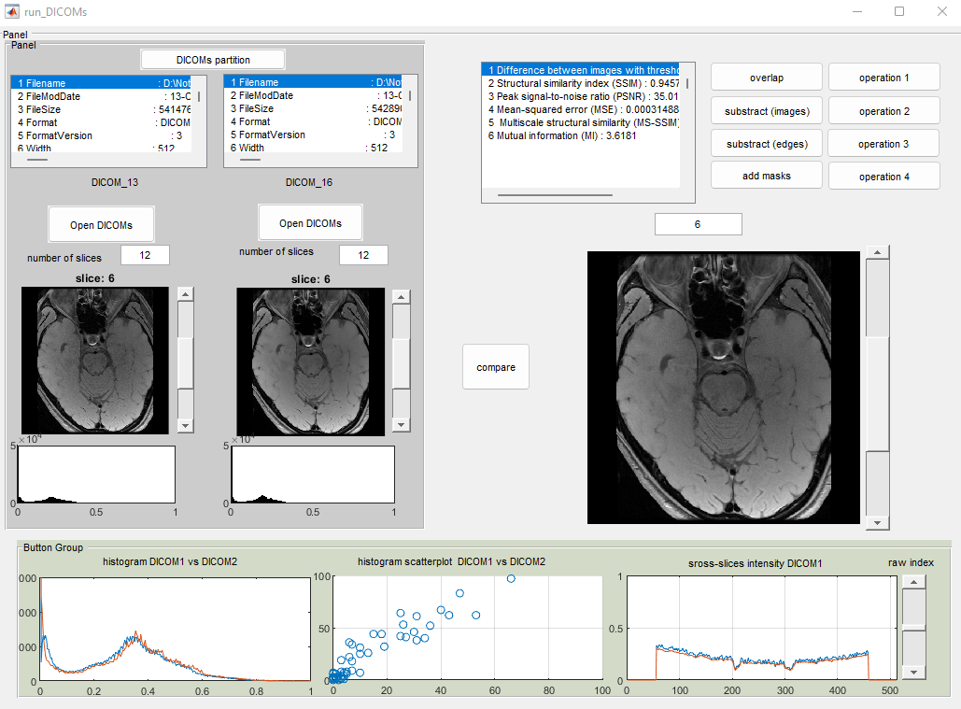
MATLAB GUI for DICOMs comparison
Step 1.
Perform partition of the dcm-files into separated folders. This step is not required if partition was previously done
Visualisation:
Overlap of images
Subtract images
Subtract edges using Canny operator
Add mask to the images
Subtract edges using Sobel operator (operation 1)
Subtract images version 2 (operation 2)
Divide one image by second one (operation 3)
Wiener filtering and subtraction (operation 4)
Step 2.
Open partitions that need to be compared
Step 3.
Button ‘compare’ activate all functions for numerical and visual analysis
Numerical parameters:
Number of pixels left after subtraction binary images (0.1 threshold was used)
Structural similarity index (SSIM)
Peak signal-to-noise ratio (PSNR)
Mean-squared error (MSE)
Multiscale structural similarity (MS-SSIM)
Mutual information (MI)

Slide 3
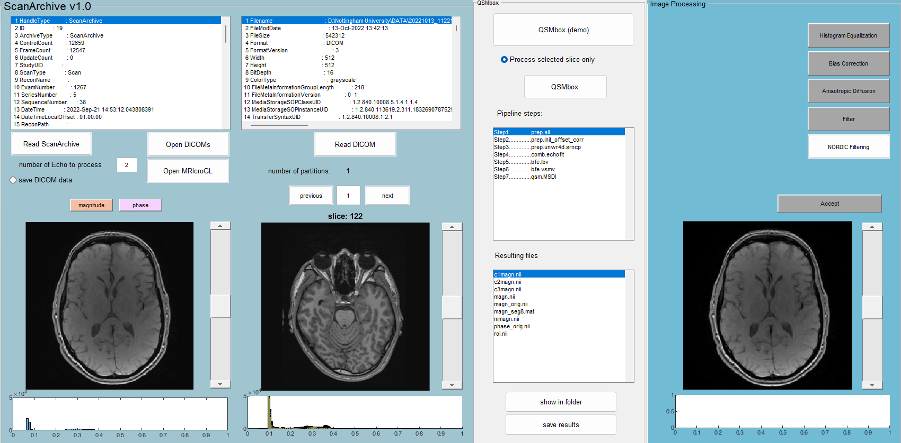
MATLAB GUI for ScanArchive
run_ScanArchive.m
run_ScanArchive.fig
Apply QSMbox pipeline
Apply image operations
Load DICOM files
Load ScanArchive

Slide 4
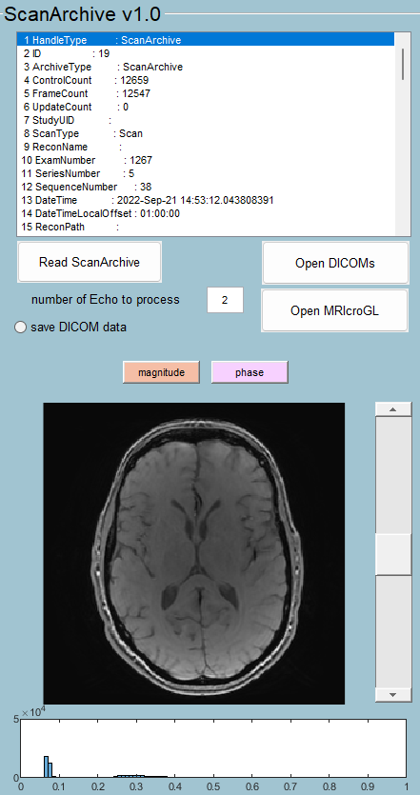
MATLAB GUI: Load ScaArchive
Read ScanArchive processes the largest file in the folder with extension .h5
Number of Echoes need to be selected before Loading SchanArchive
“Save DICOM data” need to be selected before Load ScanArchive
‘Open DICOMs’ open folder with saved files
‘Open MRIcroGL’ open folder with MRIcroGL
‘magnitude’ can be applied after loading SchanArchive and shows magnitude space of the ScanArchive
‘phase’ can be applied after loading SchanArchive and shows phase space of the ScanArchive

Slide 5
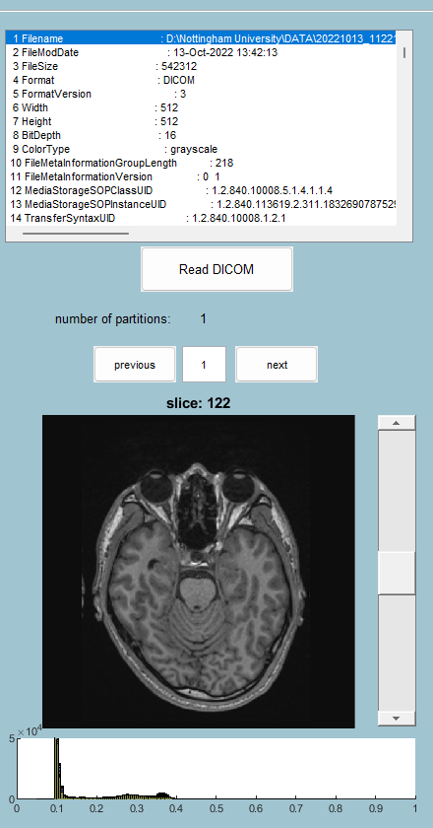
MATLAB GUI: Load DICOM files
‘Read DICOMs’ read all dcm-files from selected folder. This operation includes files partition. During first partition mat-file with generated information about partitions would be saved in corresponding folder and used for next time to speed up process.
‘previous’ and ‘next’ can be used to select required partition to view in GUI

Slide 6
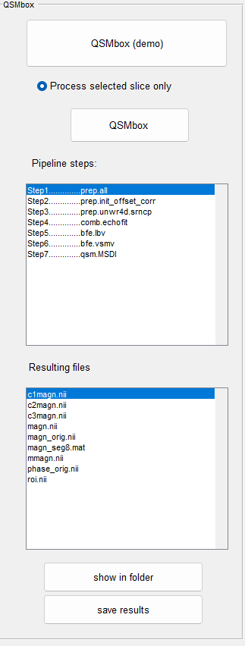
MATLAB GUI: QSMbox
‘QSMbox’ can be applied after Load ScanArchive. Parameters from the header of the ScanArchive would be used to calculate automatically next parameters: input echo times, voxel resolution, input field strength, strength field direction and phase scaling factor.
If ‘Press selected slice only’ selected, QSMbox (demo) will be performed only for segment of volume that has 6 slices including slice shown in the first window.
‘QSMbox(demo)’ has predefined pipeline steps that can be changed only in code
‘QSMbox’ requires manual interaction to select nii-files (magnitude and phase) and parameters for processing mentioned previously
Results would be saved in separate folder and can be viewed by clicking on ‘show in folder’
‘save results’ store header information into excel file ‘Book_SchanArchive’ and all resulting files copy into new folder that has unique name associated with patient ID.

Slide 7
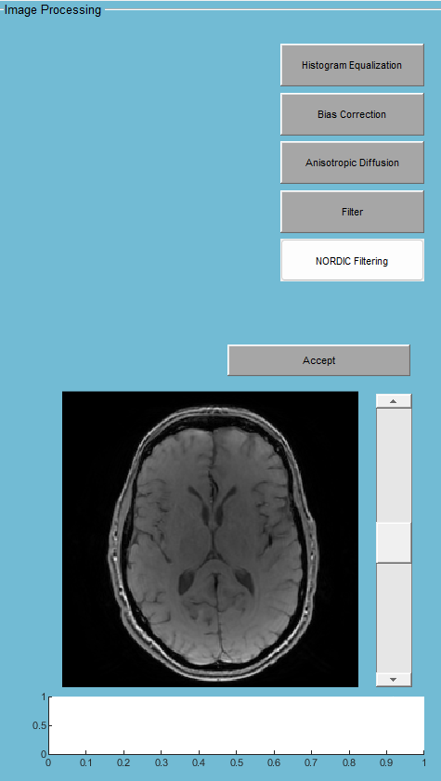
MATLAB GUI: Image operations
Image operations includes next filters: histogram equalisation, bias correction, anisotropic diffusion, Nordic filter, etc.
NORDIC Filtering performs noise reduction and can be applied to the SchanArchive that was already loaded
If filtering results is good enough it can be applied to the original image by clicking on ‘Accept’. Thus, corrected image can be saved and processed in QSMbox.

Slide 8
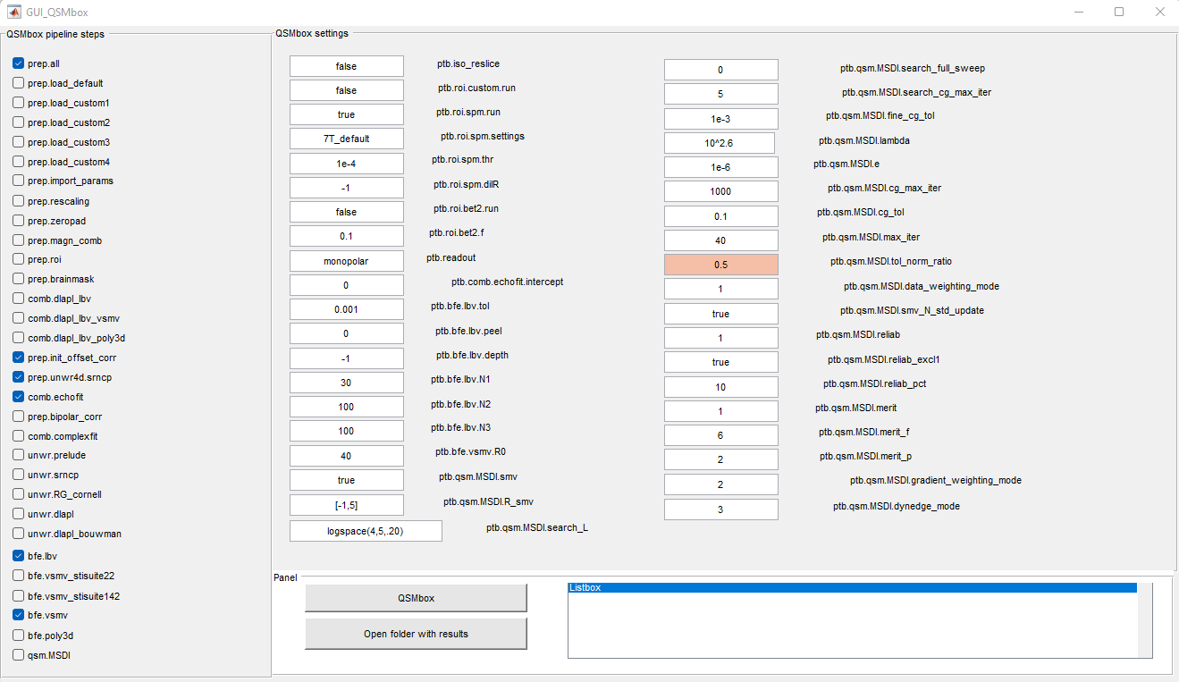
MATLAB GUI for QSMbox
Step 2
Processing parameters required to optimize performance of the image segmentation and analysis. Field highlighted with red is tolerance level that can significantly increase computation time
Step 1
Select pipeline steps. The default steps would be already selected and can be unselected
Step 3
Run QSMbox
Step 4
Show results in folder

Slide 9
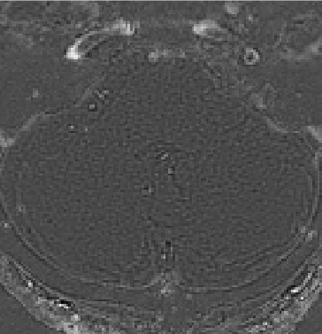
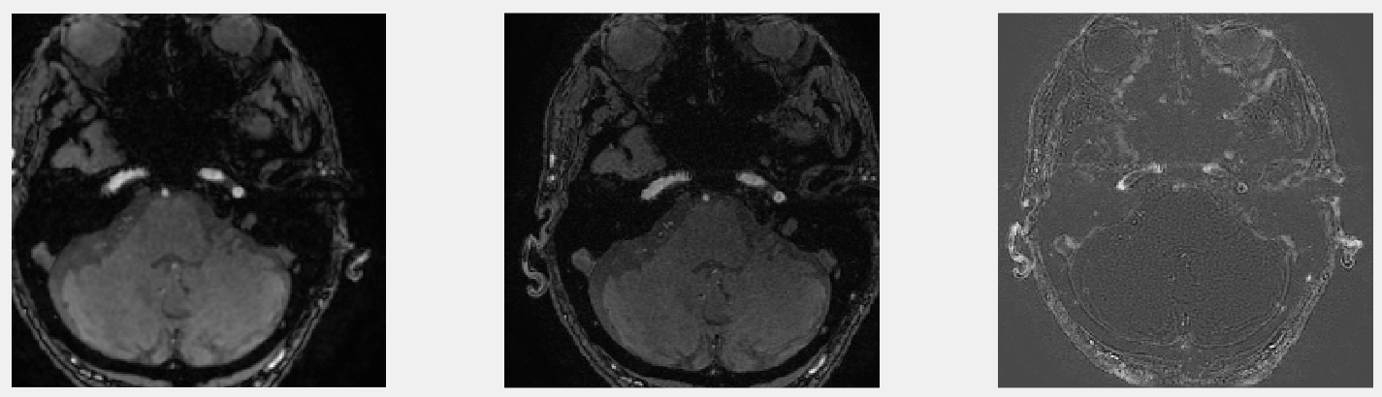
Hanning filtering
%%%% filter %%%%%%%%%%%%%%%%%%%%%%%%%%%%%%%%%%%%%%%%%%%%%%%%%%%%
w = hanning(size(kSpace,1))*hanning(size(kSpace,2))';
FFT = fftshift(fft2(w)); % complex matrix
FFT_abs = abs(FFT); % absolut values of fft
imagesc(1+log10(FFT_abs)) % show fft results
filter = ifft2(ifftshift(FFT)); % you need fft not fft_abs
%%%%%%%%%%%%%%%%%%%%%%%%%%%%%%%%%%%%%%%%%%%%%%%%%%%%%%%%%%%%%%%%%
filter applied
no filter applied
subtraction

Slide 10
Parameters in ScanArchive
parameter name | series 5 value | comments
’3DQuantitizationErrorScaleFactor’ archive.DownloadData.rdb_hdr_rec.rdb_hdr_3dscale | 4 | scale3d
’CompressedSensingAccelerationFactor’ | 1
’CompressedSensingPhaseAccelerationFactor’ | 100
’CompressedSensingSliceAccelerationFactor’ | 100
’NoPhaseWrapFactor’ | 1
’Recon2DScaleFactor’ | 0.5
’DeRingingScaleFactor’ | 0.3
’3DApplicationScaleFactor’ | 1
‘ProcessingAppCollection’ | ‘Cartesian3D’
‘Gradwarp3dOn’ | false
archive.DownloadData.rdb_hdr_rec.rdb_hdr_3dradial_cfg | 0
archive.DownloadData.rdb_hdr_exam.ex_no | 1144
archive.DownloadData.rdb_hdr_series.echo1_alpha | 0
archive.DownloadData.rdb_hdr_series.echo1_beta | 0
archive.DownloadData.rdb_hdr_series.pure_lambda | 10
archive.DownloadData.rdb_hdr_rec.rdb_hdr_3dwin_type | 0
archive.DownloadData.rdb_hdr_rec.rdb_hdr_3dwin_apod | 0.1
archive.DownloadData.rdb_hdr_rec.rdb_hdr_3dwin_q | 0
archive.DownloadData.rdb_hdr_rec.rdb_hdr_rc_zres | 64 | reconZRes
archive.DownloadData.rdb_hdr_rec.rdb_hdr_pure_derived_cal_reapodization | 12 | winApodization3d (?)
archive.DownloadData.rdb_hdr_rec.rdb_hdr_phase_scale | 1
archive.DownloadData.rdb_hdr_image.slthick | 0.8 | SpacingBetweenSlices
‘ChannelWeights’ | Vector of values | noiseValues
archive.DownloadData.rdb_hdr_rec.rdb_hdr_combined_coil_map_thres, archive.DownloadData.rdb_hdr_rec.rdb_hdr_coil_map_smooth_factor, archive.DownloadData.rdb_hdr_rec.rdb_hdr_coil_map_2_filter_width

Slide 11
Parameters in ScanArchive
parameter name | series 5 value | comments
archive.DownloadData.rdb_hdr_rec.rdb_hdr_da_xres | 256 | numPointsPerArm
archive.DownloadData.rdb_hdr_rec.rdb_hdr_da_yres-1 | 128 | numArms
archive.DownloadData.rdb_hdr_rec.rdb_hdr_im_size | 256 | imageSize
archive.DownloadData.rdb_hdr_rec.rdb_hdr_dab(1).stop_rcv - archive.DownloadData.rdb_hdr_rec.rdb_hdr_dab(1).start_rcv + 1 | 44 | numChannels
archive.Slices | 64 | numSlices
archive.DownloadData.rdb_hdr_rec.rdb_hdr_slblank | 1 | kissoffs
numSlices-2*kissoffs | 62 | numProcessedSlices
kissoffs + 1 | 2 | zStart
numSlices - kissoffs | 63 | zEnd
~bitget(archive.DownloadData.rdb_hdr_rec.rdb_hdr_data_format, 3) | 0 | isChopDataInZ
archive.DownloadData.rdb_hdr_rec.rdb_hdr_asl_perf_weighted_scale | 32 | perf_scaling_factor

Slide 12
References
title | reference
NORDIC filter | https://github.com/SteenMoeller/NORDIC_Raw
QSMbox | https://gitlab.com/acostaj/QSMbox

Slide 13
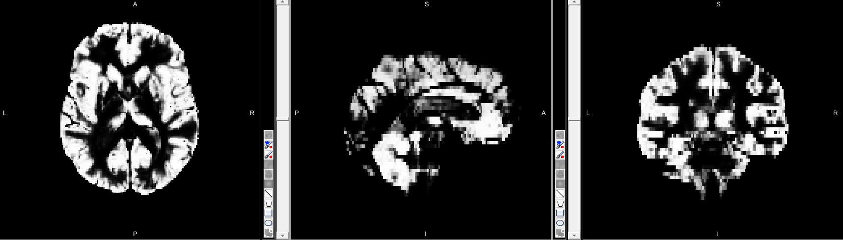
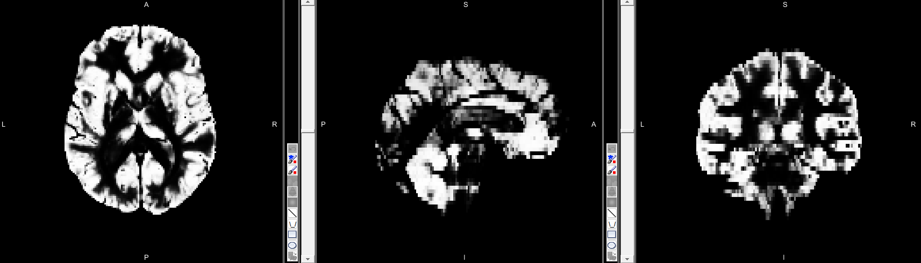
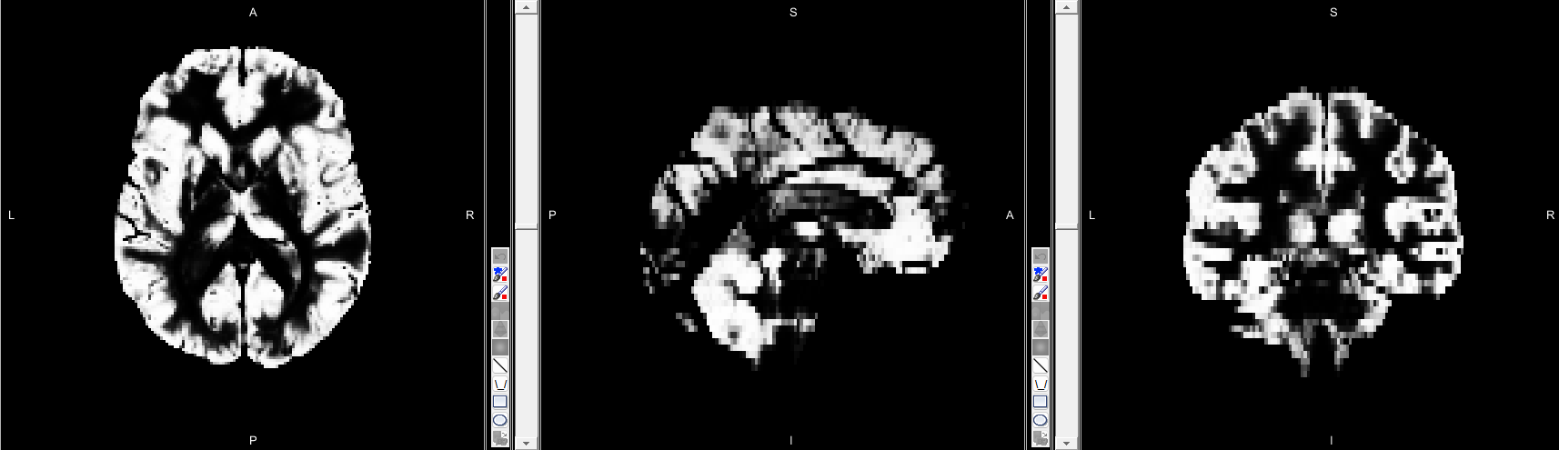

Time comparison QSMbox-phase unwrapping
% pipeline_time_v10=104.724218 seconds; Total processing time: 6 minutes.
% pipeline_time_v6=1.411926 seconds; Total processing time: 6 minutes.
% pipeline_time_v4=1.534730 seconds; Total processing time: 5 minutes.
% pipeline_time_v3=1.382642 seconds; Total processing time: 5 minutes.
Method v3
Method v6
Method v4
Method v10

Slide 14
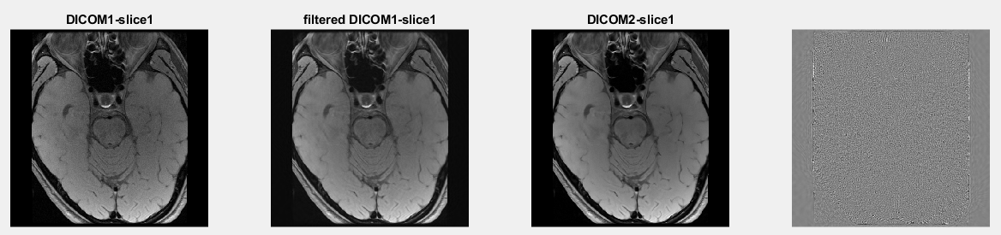
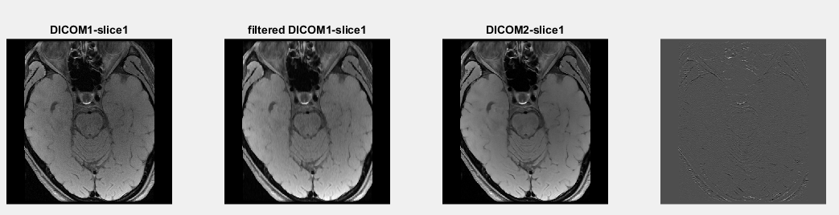
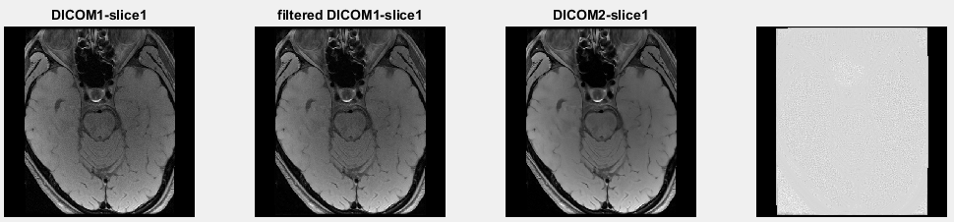
Noise removal from MRI
ACT Filter
Rank-Order Filter
LMMSE Filter

