Slide 1
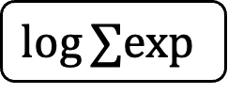
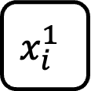

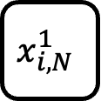
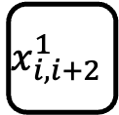
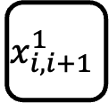

$$x_{i}^{1}$$
+
$$x_{i,i+1}^{1}$$
$$log⁡∑\text{exp}$$
+
𝞂
$$x_{i,i+2}^{1}$$
-
$$log⁡∑\text{exp}$$
$$x_{i,N}^{1}$$
Number hiddel layer neurons: ${∝2}^{N−i}$

