Slide 1
On the Minimum Quartet Tree Cost problem for the quartet method of hierarchical clustering
Sergio Consoli
European Commission, Joint Research Centre (JRC)
Ispra (VA), Italy
[name.surname]@ec.europa.eu
BENQODHI 2026 Workshop 2026, 10-11 Sept
Disclaimer: The views and opinions expressed in this presentation are those of the presenter and do not necessarily reflect the policies and opinions of the European Commission.

Slide 2
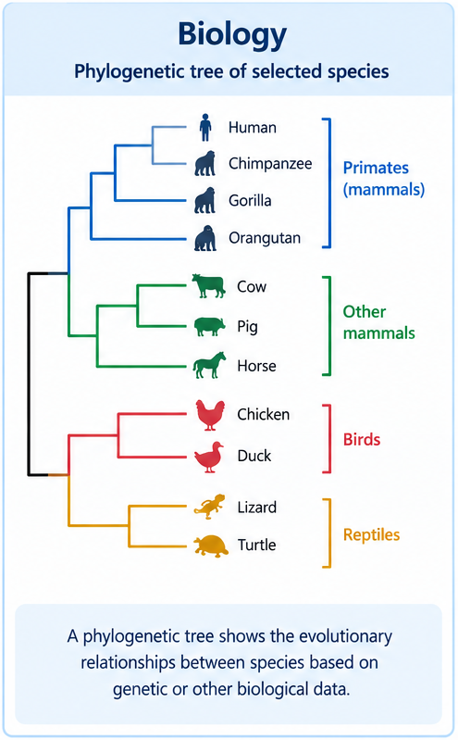
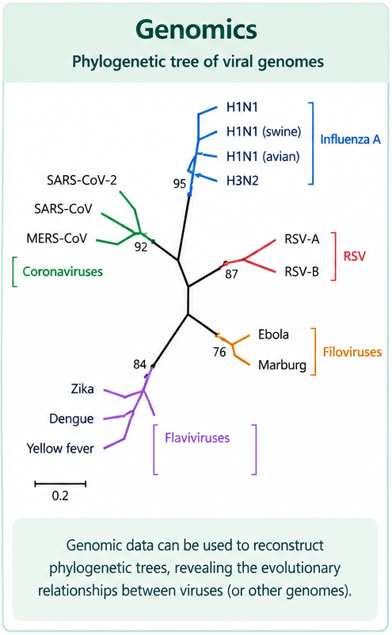
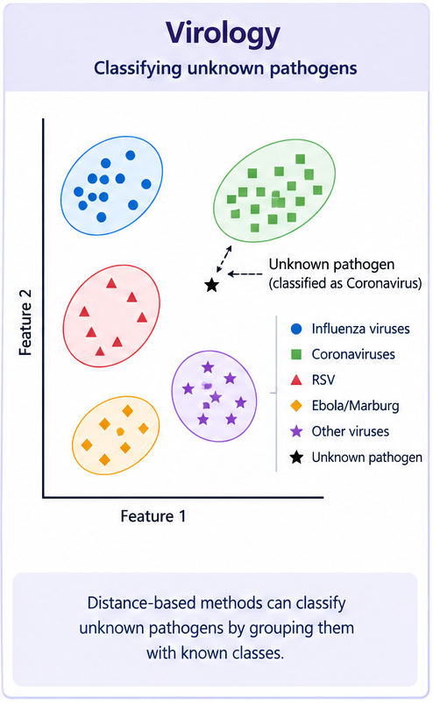
Preliminaries
The minimum quartet tree cost (MQTC) problem → mathematical paradigm of the quartet method of hierarchical clustering (Cilibrasi and Vitányi, 2007)
novel hierarchical clustering method for non tree-like (non-phylogeny) data in various domains, or for heterogeneous data across domains
Quartet Method : given a set of objects and their pairwise distances, determine a visual representation of the data
it computes and visualizes a hierarchy of clusters of the objects
it is robust, gives unique results in the limit, and does not require a priori the number of clusters to be produced
Many applications:
Biology, genomics, virology (populate phylogenetic trees, classify unknown pathogens into groups/classes, …)

Slide 3
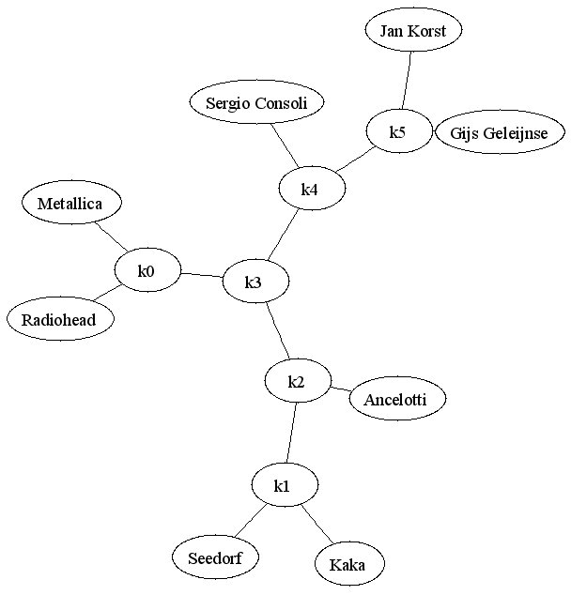
Quartet method
INPUT: given n elements, a symmetric distance matrix n x n
OUTPUT: a full unrooted binary tree (or trivalent tree, or boron tree) with n leaves
 | Kaka | Jan Korst | Ancelotti | Seedorf | Sergio | Radiohead | Gijs | Metallica
Kaka | 0.00 | 1.00 | 0.30 | 0.20 | 0.80 | 1.00 | 0.90 | 1.00
Jan Korst | 1.00 | 0.00 | 1.00 | 1.00 | 0.20 | 0.80 | 0.05 | 0.90
Ancelotti | 0.30 | 1.00 | 0.00 | 0.40 | 0.60 | 1.00 | 0.80 | 0.95
Seedorf | 0.20 | 1.00 | 0.40 | 0.00 | 0.89 | 0.99 | 0.90 | 1.00
Sergio | 0.80 | 0.20 | 0.60 | 0.89 | 0.00 | 0.93 | 0.30 | 1.00
Radiohead | 1.00 | 0.80 | 1.00 | 0.99 | 0.93 | 0.00 | 0.90 | 0.05
Gijs | 0.90 | 0.05 | 0.80 | 0.90 | 0.30 | 0.90 | 0.00 | 0.55
Metallica | 1.00 | 0.90 | 0.95 | 1.00 | 1.00 | 0.05 | 0.55 | 0.00
Why full binary trees? Because they have a rich internal structure: many differentiated paths between the leaves
GOAL: find the full binary tree with n leaves that much agrees with the distance matrix (according to a certain cost function)
Notes:
each leaf → one element in the matrix
UNROOTED: No root node and no distinction between parent and child nodes
FULL BINARY: each internal node has degree exactly 3 (as the boron atom)
n leaves (nodes with valency 1) → (n – 2) internal nodes (nodes with valency 3)

Slide 4
Definitions
  Tree possible internal nodes:
  Terminal node: connected with 2 leaves and 1 internal node
  Transition node: connected with 1 leaf and 2 internal nodes
  Cross node: connected with 3 internal nodes (no leaves)
a
  degree = 1
d
g
  degree = 2
  degree = 3
  Cost associate to a single quartet topology (i.e. simplest full binary tree with n=4 leaves and n-2=2 internal nodes, e.g. ab|cd):
a
c
b
ab | cd
d

Slide 5
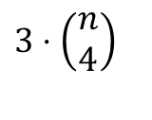
Mathematical paradigm
Given n elements, consider all the set of 4 elements from our set of n elements
There are such sets
For each set of 4 elements, there are exactly three possible combinations
Thus, given n elements, the total number of possible quartet topologies is:
a
ab | cd
c
a
ac | bd
b
a
ad | bc
b
b
d
c
d
d
c
$$3⋅\left(\begin{matrix}n \\ 4\end{matrix}\right)$$

Slide 6
Consistency
Given n elements, consider the class T of full binary trees obtained placing the n elements as leaf nodes (i.e. (n-2) internal nodes)
Given a tree t∈T, we say that t is consistent to the quartet “ab|cd” if and only if the path from a to b does not cross the path from c to d
  N.B. Precisely one of the three possible quartet topologies for any set of 4 leaves is consistent for a given tree t∈T
Thus, for each t∈T, there exists precisely
consistent quartet topologies (one for each set of 4 elements) embedded in t

Slide 7
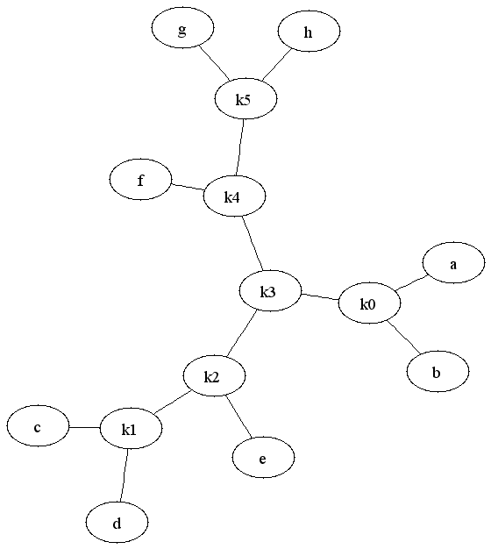

Consistency examples
  t is consistent to the quartet “ab|cd”
  t is NOT consistent to the quartet “af|ge”

Slide 8
Minimum Quartet Tree Cost problem
DEF. Cost associated to t∈T : sum of the costs of its embedded quartet topologies
DEF. MINIMUM QUARTET TREE COST (MQTC) PROBLEM
Given n elements and their pairwise distances, find the tree t∈T with the minimum total cost C_{t}
NP-hard optimization problem (Cilibrasi and Vitany, 2005; 2007)

Slide 9
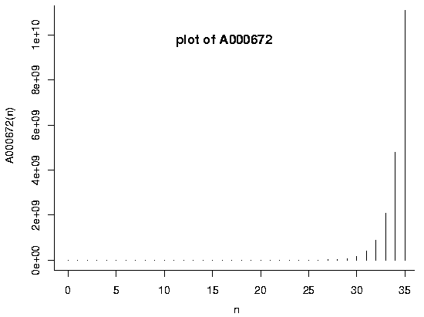
Computational complexity
  1. Given a distance matrix with n elements, how many different full binary trees with n leaves (n - 2 internal nodes) is possible to generate?
    This sequence is referred in Sloane and Plouffe (1995)'s Encyclopedia of Integer Sequences to as A000672.
    Exponential growth (Sloane’s A000672)
n leaves | 4 | 5 | 6 | 7 | 8 | 9 | 10 | 11 | 12 | 13 | 14 | 15 | 16 | 17 | 18 | 19 | 20 | … | 30
topologies | 1 | 1 | 2 | 2 | 4 | 6 | 11 | 18 | 37 | 66 | 135 | 265 | 552 | 1132 | 2⋅10³ | 5⋅10³ | 11⋅10³ | … | 32⋅10⁶
  2. Given a distance matrix with n elements, for each different full binary tree, considering all the possible permutations of its leaves (elements in the matrix), is it possible to find the best solution obtained by the considered binary tree?
    Factorial growth:

Slide 10
Normalization of the cost function
Calculate the worst (maximal) cost M:
Calculate the best (minimal) cost m:
M upper bound, m lower bound for C_{t} :
In most of cases, the best cost m cannot be really attained by any boron tree t, especially for a large number of elements n → INCONSISTENCY
Normalized tree score S(t):

Slide 11
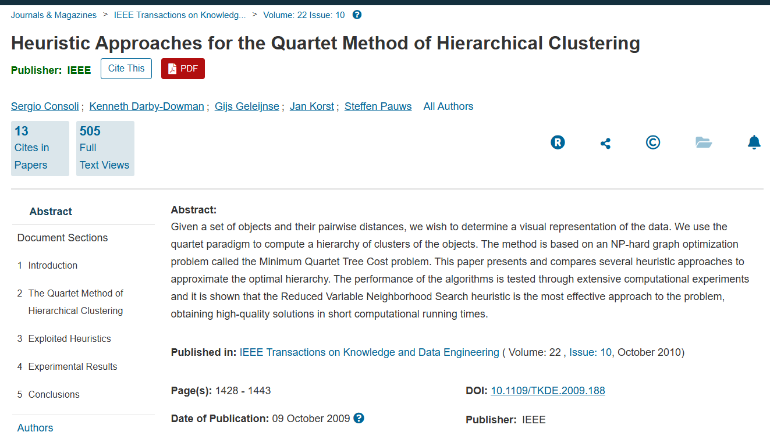


MQTC approximate optimization routines
  Randomized Hill-Climbing, Greedy Randomized Adaptive Search Procedure, Genetic Programming, Particle Swarm Optimization, Simulated Annealing, Variable Neighborhood Search
    S. Consoli, J. Korst, S. Pauws, and G. Geleijnse, 2020. Improved metaheuristics for the quartet method of hierarchical clustering. Journal of Global Optimization, 78(2), 241-270
    S. Consoli and N. I. Stilianakis, 2017. A quartet method based on variable neighbourhood search for biomedical literature extraction and clustering. International Transactions in Operational Research,24(3), 537-558
    Consoli S, Darby-Dowman K, Geleijnse G, Korst J, Pauws S (2010) Heuristic approaches for the quartet method of hierarchical clustering. IEEE Transactions on Knowledge and Data Engineering 22(10):1428– 1443

Slide 12
Variable Neighbourhood Search (VNS)
  VNS is based on dynamically changes neighbourhood structures during the search process (Hansen and Mladenović, 2001)
  Search for new solutions in increasingly distant neighbourhoods of the current solution, jumping only if a better solution is found
  DEF. N_{k}(x) → set of solutions in the k^{th} neighbourhood of x
  Shaking phase
    Apply k consecutive base moves
      Base move: change the physical structure of the full binary tree
    k_{max} = maximum size of the shaking phase →
      maximum number of consecutive base moves
  Local search phase
    First-improvement strategy
    One-neighbourhood structure:
      Considers internal nodes with Manhattan distance = 1
      Performs a basic move among the two selected internal nodes
N_{k}
N₂
N₁
x
...

Slide 13
Variable Neighbourhood Search (VNS)
Initialisation
Select the set of neighbourhood structures N_{k}
Find an initial solution x
Repeat until stopping condition is met
  Set k=1
  Repeat until k=k_{max}
    Shaking: Generate a random point x’ in N_{k}(x)
    Local Search: x’’ is the obtained optimum
    Move or not:
      If x’’ is better than x then x←x’’ and k=1
      Otherwise k=k+1
N_{kmax}
N₁
N₂
x
...
N_{k}
x
x’
X’’>X
x’’
X’’<=X
N_{k+1}
x
N_{k}
N_{k}(x’’)
x
x’
x’’
Notes:
13

Slide 14
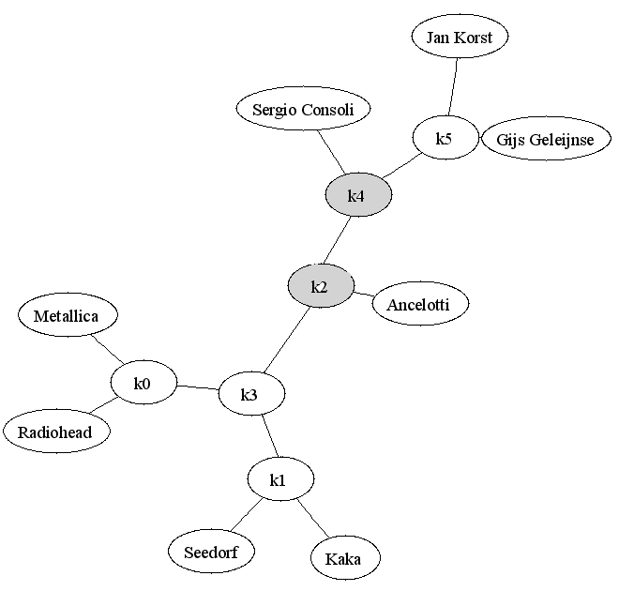
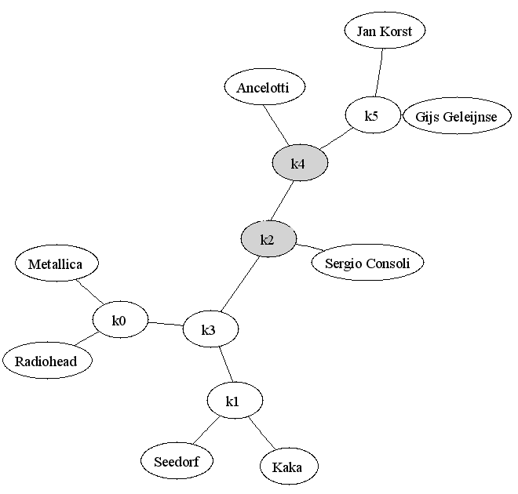
Base moves
Two consecutive transition nodes
→ Exchange the leaves attached

Slide 15
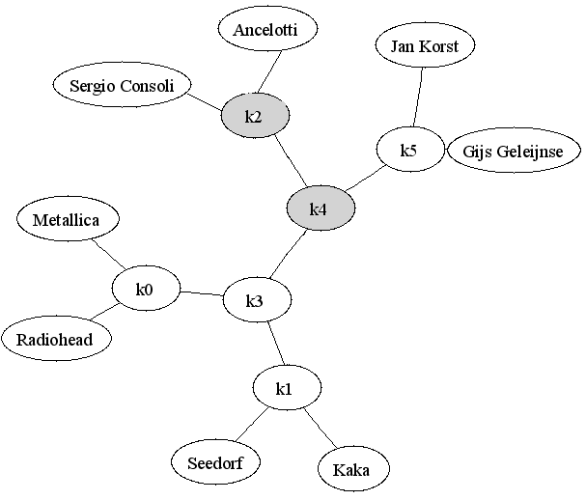
Base moves
Two consecutive transition nodes
→ Transform in one terminal node and one cross node

Slide 16
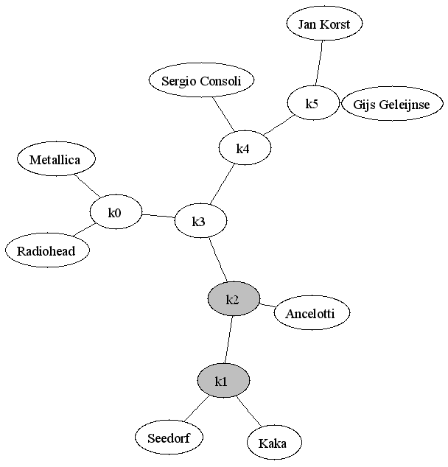
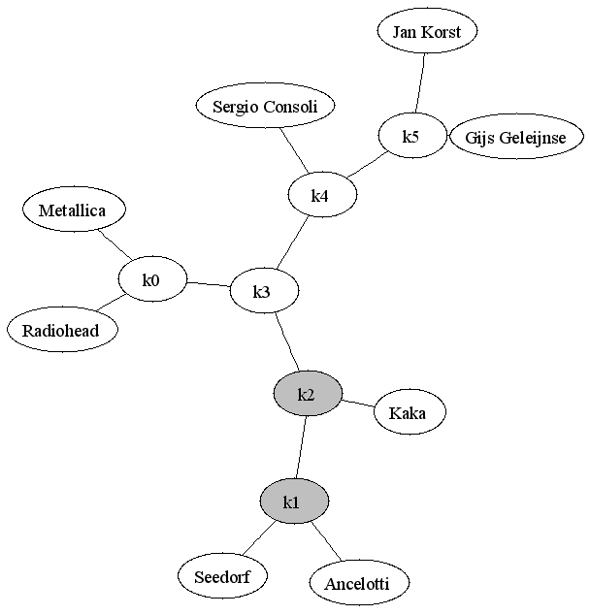
Base moves
One terminal node and one transition node
→ Exchange the leaf of the transition node with one of the terminal node

Slide 17

Base moves
One terminal node and one transition node
→ Exchange the leaf of the transition node with one of the terminal node

Slide 18
Base moves
One terminal node and one cross node
→ Transform into two transition nodes

Slide 19
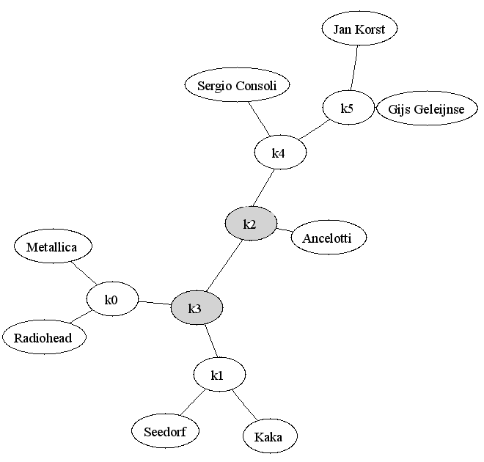
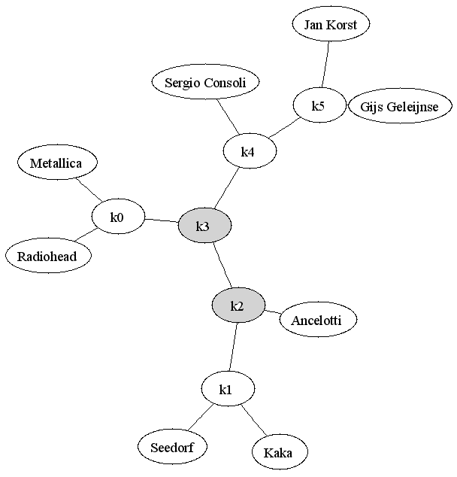
Base moves
One transition node and one cross node
→ Move the transition node in one of the other two branches of the cross node

Slide 20
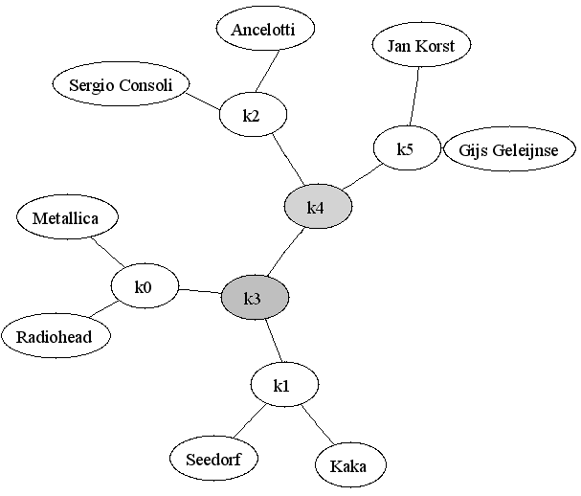
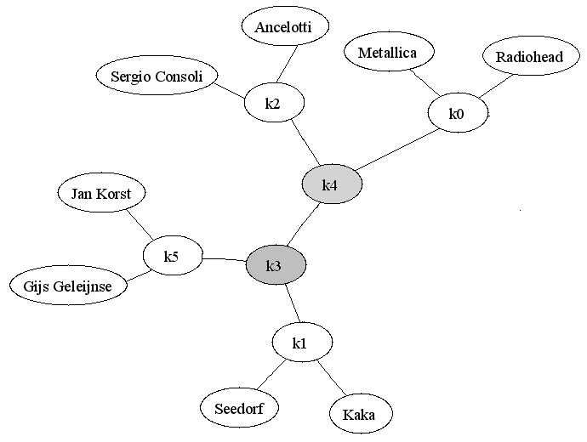
Base moves
Two consecutive cross nodes
→ Try to exchange one of the subtree rooted at one cross node with another subtree rooted at the other cross node

Slide 21
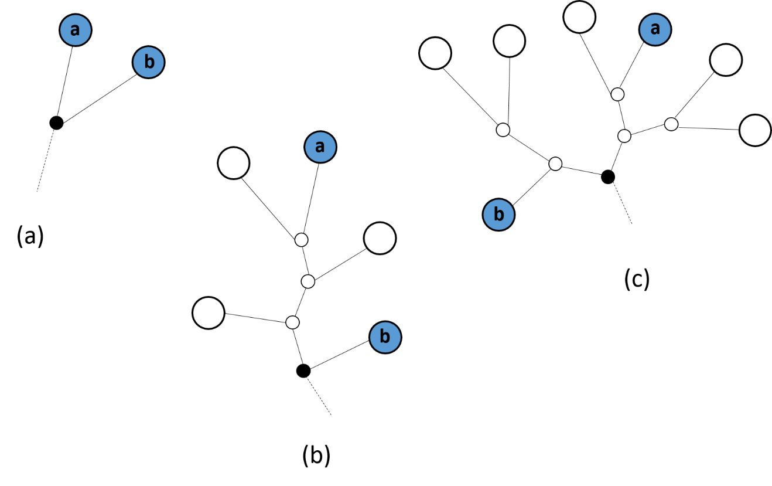
Improved greedy constructive heuristic
MQTC metaheuristics → initial solution at random, or selecting flat structure
Greedy constructive heuristic → initial starting solutions already of good quality and requiring short computational running time
It brings improvement of the overall performance of the MQTC heuristics deployed afterwards to the problem
None of the two objects are already connected in t′, and therefore they are joined together by means of a terminal node (i.e. the dotted internal node in the figure);
One of the two objects, in the example a, is already included as a leaf in t′, and therefore the other object b is linked to the subgraph in t′ containing a by means of a transition node (i.e. the dotted internal node in the figure);
Both objects are already included in t′ but they belong to two different subgraphs, and therefore these two subgraphs containing respectively a and b are connected together by means of a cross node

Slide 22
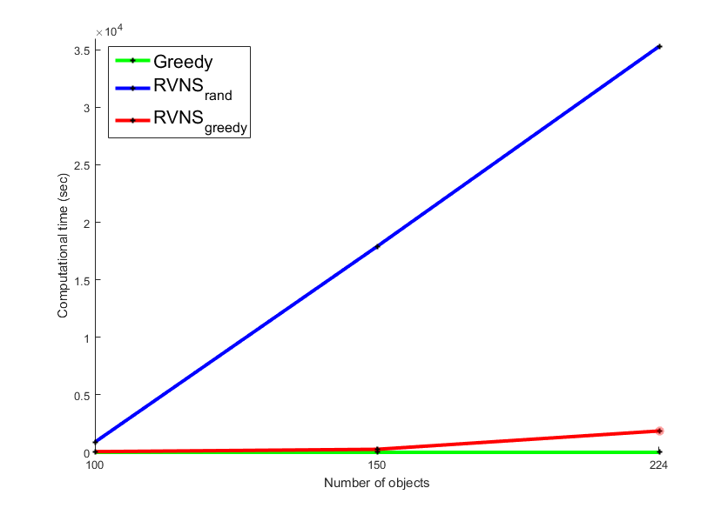

Slide 23
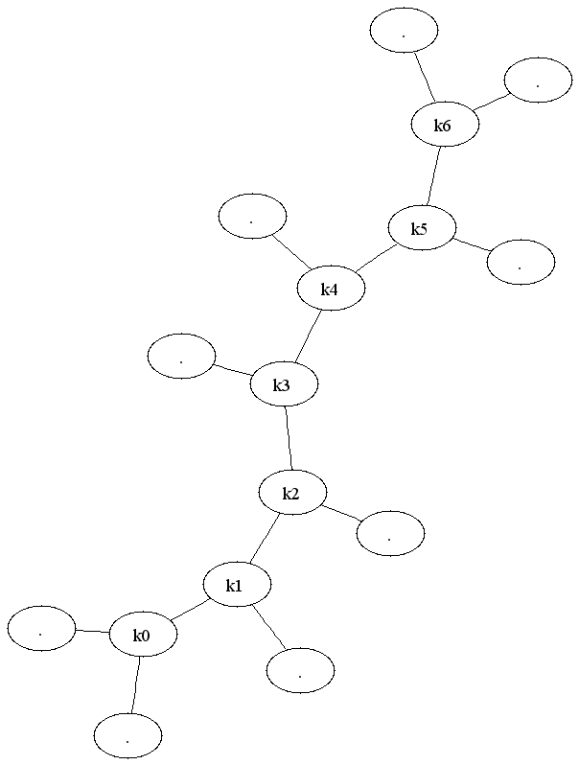
Exact approach
INPUT: distance_matrix(n,n)
t(structure) ← INITIALIZATION(n);
best_t ← t;
While ( t(structure) != NULL )
  t ← ASSIGN_LEAVES(leaves[n]);
  C(t) ← EVALUATE_COST_FUNCTION(t);
  If( C(t) < C(best_t) ) 1) best_t ← t;
  Repeat
    t ← NEXT_PERMUTATION(leaves[n]);
    C(t) ← EVALUATE_COST_FUNCTION(t);
    If( C(t) < C(best_t) ) 1) best_t ← t;
  Until( NO_FURTHER_PERMUTATIONS(t,leaves[n]) )
  t(structure) ← NEXT_STRUCTURE(t);
OUTPUT: best_t
    S. Consoli, J. Korst, S. Pauws, and G. Geleijnse, 2019. An exact algorithm for the minimum quartet tree cost problem. 4OR: A Quarterly Journal of Operations Research, 17(4), 401-425

Slide 24
Data representation
Complete matrix (e.g. with n = 9 leaves):
 | k₀ | k₁ | k₂ | k₃ | k₄ | k₅ | k₆ | 7 | 8 | 9 | 10 | 11 | 12 | 13 | 14 | 15
k₀ | STRUCTURE SUBMATRIX |  |  |  |  |  |  | LEAVES SUBMATRIX
k₁
k₂
k₃
k₄
k₅
k₆
7 | LEAVES SUBMATRIX |  |  |  |  |  |  | COEFFICIENTS SUBMATRIX
8
9
10
11
12
13
14
15
Initial Structure Submatrix (flat structure)
 | k₀ | k₁ | k₂ | k₃ | k₄ | k₅ | k₆
k₀ | 1 | 1 | 0 | 0 | 0 | 0 | 0
k₁ | 1 | 2 | 1 | 0 | 0 | 0 | 0
k₂ | 0 | 1 | 2 | 1 | 0 | 0 | 0
k₃ | 0 | 0 | 1 | 2 | 1 | 0 | 0
k₄ | 0 | 0 | 0 | 1 | 2 | 1 | 0
k₅ | 0 | 0 | 0 | 0 | 1 | 2 | 1
k₆ | 0 | 0 | 0 | 0 | 0 | 1 | 1

Slide 25
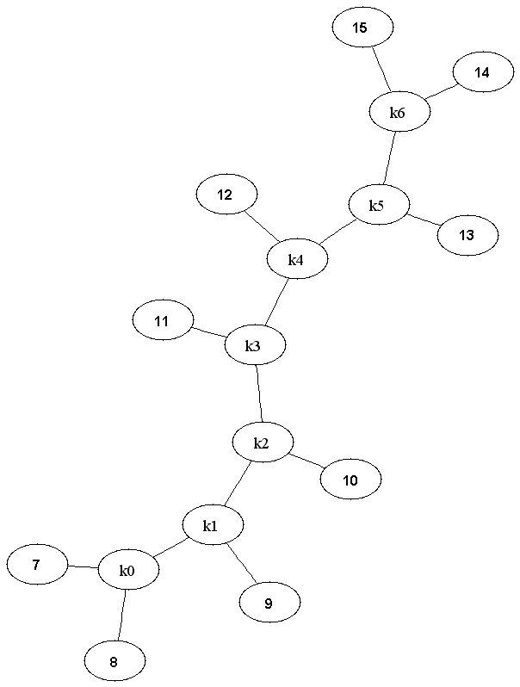
Exact approach
INPUT: distance_matrix(n,n)
t(structure) ← INITIALIZATION(n);
best_t ← t;
While ( t(structure) != NULL )
  t ← ASSIGN_LEAVES(leaves[n]);
  C(t) ← EVALUATE_COST_FUNCTION(t);
  If( C(t) < C(best_t) ) 1) best_t ← t;
  Repeat
    t ← NEXT_PERMUTATION(leaves[n]);
    C(t) ← EVALUATE_COST_FUNCTION(t);
    If( C(t) < C(best_t) ) 1) best_t ← t;
  Until( NO_FURTHER_PERMUTATIONS(t,leaves[n]) )
  t(structure) ← NEXT_STRUCTURE(t);
OUTPUT: best_t

Slide 26

Assign leaves
Modify the leaves submatrix:
 | k₀ | k₁ | k₂ | k₃ | k₄ | k₅ | k₆ | 7 | 8 | 9 | 10 | 11 | 12 | 13 | 14 | 15
k₀ | 1 | 1 | 0 | 0 | 0 | 0 | 0 | 1 | 1 | 0 | 0 | 0 | 0 | 0 | 0 | 0
k₁ | 1 | 2 | 1 | 0 | 0 | 0 | 0 | 0 | 0 | 1 | 0 | 0 | 0 | 0 | 0 | 0
k₂ | 0 | 1 | 2 | 1 | 0 | 0 | 0 | 0 | 0 | 0 | 1 | 0 | 0 | 0 | 0 | 0
k₃ | 0 | 0 | 1 | 2 | 1 | 0 | 0 | 0 | 0 | 0 | 0 | 1 | 0 | 0 | 0 | 0
k₄ | 0 | 0 | 0 | 1 | 2 | 1 | 0 | 0 | 0 | 0 | 0 | 0 | 1 | 0 | 0 | 0
k₅ | 0 | 0 | 0 | 0 | 1 | 2 | 1 | 0 | 0 | 0 | 0 | 0 | 0 | 1 | 0 | 0
k₆ | 0 | 0 | 0 | 0 | 0 | 1 | 1 | 0 | 0 | 0 | 0 | 0 | 0 | 0 | 1 | 1
7 | 1 | 0 | 0 | 0 | 0 | 0 | 0 | 1 | 0 | 0 | 0 | 0 | 0 | 0 | 0 | 0
8 | 1 | 0 | 0 | 0 | 0 | 0 | 0 | 0 | 1 | 0 | 0 | 0 | 0 | 0 | 0 | 0
9 | 0 | 1 | 0 | 0 | 0 | 0 | 0 | 0 | 0 | 1 | 0 | 0 | 0 | 0 | 0 | 0
10 | 0 | 0 | 1 | 0 | 0 | 0 | 0 | 0 | 0 | 0 | 1 | 0 | 0 | 0 | 0 | 0
11 | 0 | 0 | 0 | 1 | 0 | 0 | 0 | 0 | 0 | 0 | 0 | 1 | 0 | 0 | 0 | 0
12 | 0 | 0 | 0 | 0 | 1 | 0 | 0 | 0 | 0 | 0 | 0 | 0 | 1 | 0 | 0 | 0
13 | 0 | 0 | 0 | 0 | 0 | 1 | 0 | 0 | 0 | 0 | 0 | 0 | 0 | 1 | 0 | 0
14 | 0 | 0 | 0 | 0 | 0 | 0 | 1 | 0 | 0 | 0 | 0 | 0 | 0 | 0 | 1 | 0
15 | 0 | 0 | 0 | 0 | 0 | 0 | 1 | 0 | 0 | 0 | 0 | 0 | 0 | 0 | 0 | 1
Evaluate the cost function:
Find all the quartets embedded in t
Consider the n x n symmetric distance matrix, sum the costs d_{i,j} of each embedded quartet:
→Coefficients evaluated by means of an efficient procedure
$$\left(\begin{matrix}n \\ 4\end{matrix}\right)$$

Slide 27

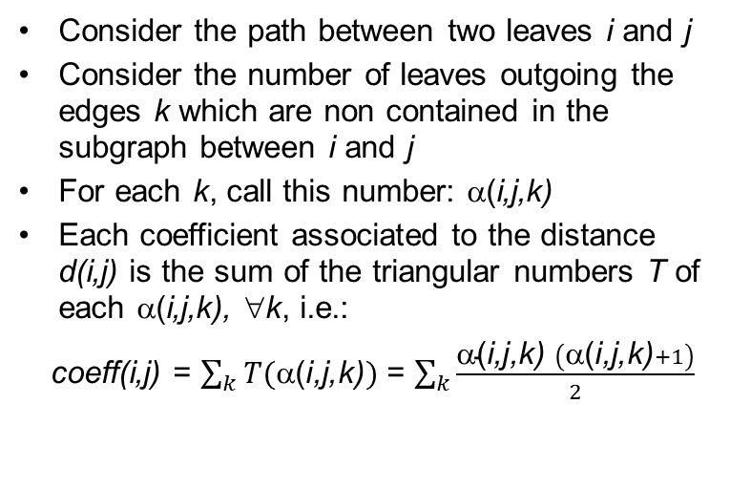
Evaluate the cost function
→Coefficients evaluated by means of an efficient procedure (polynomial)

Slide 28
Evaluate the cost function
Evaluate the coefficients using backtracking
Insert them in the coefficients submatrix:
 | k₀ | k₁ | k₂ | k₃ | k₄ | k₅ | k₆ | 7 | 8 | 9 | 10 | 11 | 12 | 13 | 14 | 15
k₀ | 1 | 7 | 0 | 0 | 0 | 0 | 0 | 1 | 1 | 0 | 0 | 0 | 0 | 0 | 0 | 0
k₁ | 2 | 2 | 6 | 0 | 0 | 0 | 0 | 0 | 0 | 1 | 0 | 0 | 0 | 0 | 0 | 0
k₂ | 0 | 3 | 2 | 5 | 0 | 0 | 0 | 0 | 0 | 0 | 1 | 0 | 0 | 0 | 0 | 0
k₃ | 0 | 0 | 4 | 2 | 4 | 0 | 0 | 0 | 0 | 0 | 0 | 1 | 0 | 0 | 0 | 0
k₄ | 0 | 0 | 0 | 5 | 2 | 3 | 0 | 0 | 0 | 0 | 0 | 0 | 1 | 0 | 0 | 0
k₅ | 0 | 0 | 0 | 0 | 6 | 2 | 2 | 0 | 0 | 0 | 0 | 0 | 0 | 1 | 0 | 0
k₆ | 0 | 0 | 0 | 0 | 0 | 7 | 1 | 0 | 0 | 0 | 0 | 0 | 0 | 0 | 1 | 1
7 | 1 | 0 | 0 | 0 | 0 | 0 | 0 | 1 | 21 | 15 | 10 | 6 | 3 | 1 | 0 | 0
8 | 1 | 0 | 0 | 0 | 0 | 0 | 0 | 21 | 1 | 15 | 10 | 6 | 3 | 1 | 0 | 0
9 | 0 | 1 | 0 | 0 | 0 | 0 | 0 | 15 | 15 | 1 | 11 | 7 | 4 | 2 | 1 | 1
10 | 0 | 0 | 1 | 0 | 0 | 0 | 0 | 10 | 10 | 11 | 1 | 9 | 6 | 4 | 3 | 3
11 | 0 | 0 | 0 | 1 | 0 | 0 | 0 | 6 | 6 | 7 | 9 | 1 | 9 | 7 | 6 | 6
12 | 0 | 0 | 0 | 0 | 1 | 0 | 0 | 3 | 3 | 4 | 6 | 9 | 1 | 11 | 10 | 10
13 | 0 | 0 | 0 | 0 | 0 | 1 | 0 | 1 | 1 | 2 | 4 | 7 | 11 | 1 | 15 | 15
14 | 0 | 0 | 0 | 0 | 0 | 0 | 1 | 0 | 0 | 1 | 3 | 6 | 10 | 15 | 1 | 21
15 | 0 | 0 | 0 | 0 | 0 | 0 | 1 | 0 | 0 | 1 | 3 | 6 | 10 | 15 | 0 | 1

Slide 29
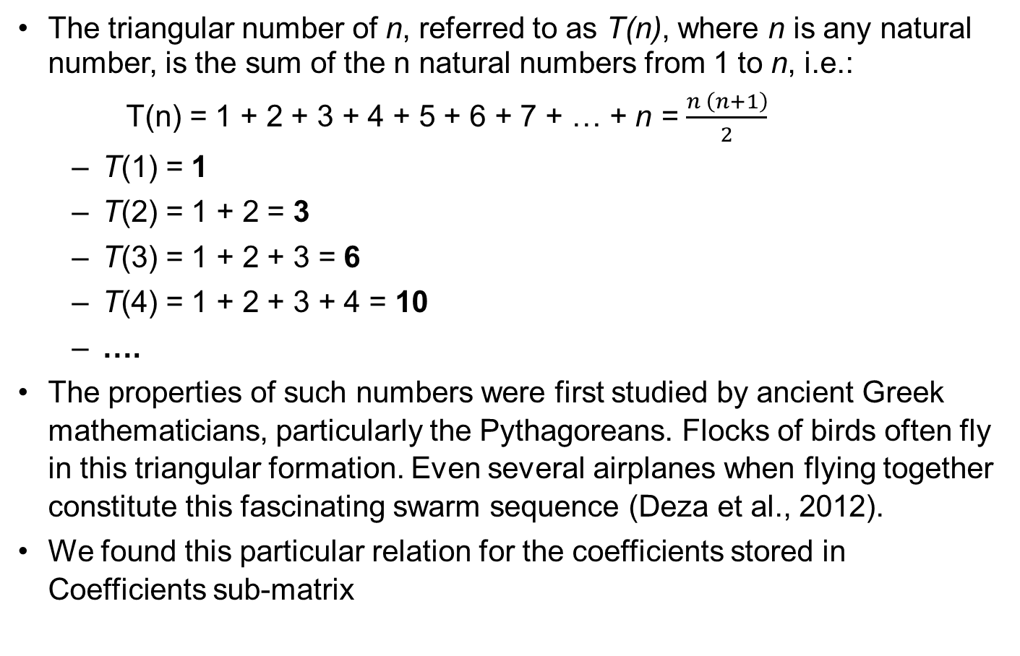
Triangular numbers

Slide 30
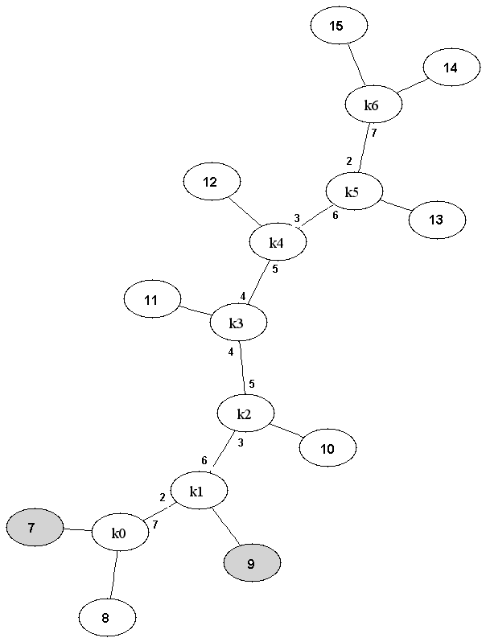
Exact approach
INPUT: distance_matrix(n,n)
t(structure) ← INITIALIZATION(n);
best_t ← t;
While ( t(structure) != NULL )
  t ← ASSIGN_LEAVES(leaves[n]);
  C(t) ← EVALUATE_COST_FUNCTION(t);
  If( C(t) < C(best_t) ) 1) best_t ← t;
  Repeat
    t ← NEXT_PERMUTATION(leaves[n]);
    C(t) ← EVALUATE_COST_FUNCTION(t);
    If( C(t) < C(best_t) ) 1) best_t ← t;
  Until( NO_FURTHER_PERMUTATIONS(t,leaves[n]) )
  t(structure) ← NEXT_STRUCTURE(t);
OUTPUT: best_t
 | k₀ | k₁ | k₂ | k₃ | k₄ | k₅ | k₆ | 7 | 8 | 9 | 10 | 11 | 12 | 13 | 14 | 15
k₀ | 1 | 7 | 0 | 0 | 0 | 0 | 0 | 1 | 1 | 0 | 0 | 0 | 0 | 0 | 0 | 0
k₁ | 2 | 2 | 6 | 0 | 0 | 0 | 0 | 0 | 0 | 1 | 0 | 0 | 0 | 0 | 0 | 0
k₂ | 0 | 3 | 2 | 5 | 0 | 0 | 0 | 0 | 0 | 0 | 1 | 0 | 0 | 0 | 0 | 0
k₃ | 0 | 0 | 4 | 2 | 4 | 0 | 0 | 0 | 0 | 0 | 0 | 1 | 0 | 0 | 0 | 0
k₄ | 0 | 0 | 0 | 5 | 2 | 3 | 0 | 0 | 0 | 0 | 0 | 0 | 1 | 0 | 0 | 0
k₅ | 0 | 0 | 0 | 0 | 6 | 2 | 2 | 0 | 0 | 0 | 0 | 0 | 0 | 1 | 0 | 0
k₆ | 0 | 0 | 0 | 0 | 0 | 7 | 1 | 0 | 0 | 0 | 0 | 0 | 0 | 0 | 1 | 1
7 | 1 | 0 | 0 | 0 | 0 | 0 | 0 | 1 | 21 | 15 | 10 | 6 | 3 | 1 | 0 | 0
8 | 1 | 0 | 0 | 0 | 0 | 0 | 0 | 21 | 1 | 15 | 10 | 6 | 3 | 1 | 0 | 0
9 | 0 | 1 | 0 | 0 | 0 | 0 | 0 | 15 | 15 | 1 | 11 | 7 | 4 | 2 | 1 | 1
10 | 0 | 0 | 1 | 0 | 0 | 0 | 0 | 10 | 10 | 11 | 1 | 9 | 6 | 4 | 3 | 3
11 | 0 | 0 | 0 | 1 | 0 | 0 | 0 | 6 | 6 | 7 | 9 | 1 | 9 | 7 | 6 | 6
12 | 0 | 0 | 0 | 0 | 1 | 0 | 0 | 3 | 3 | 4 | 6 | 9 | 1 | 11 | 10 | 10
13 | 0 | 0 | 0 | 0 | 0 | 1 | 0 | 1 | 1 | 2 | 4 | 7 | 11 | 1 | 15 | 15
14 | 0 | 0 | 0 | 0 | 0 | 0 | 1 | 0 | 0 | 1 | 3 | 6 | 10 | 15 | 1 | 21
15 | 0 | 0 | 0 | 0 | 0 | 0 | 1 | 0 | 0 | 1 | 3 | 6 | 10 | 15 | 0 | 1

Slide 31
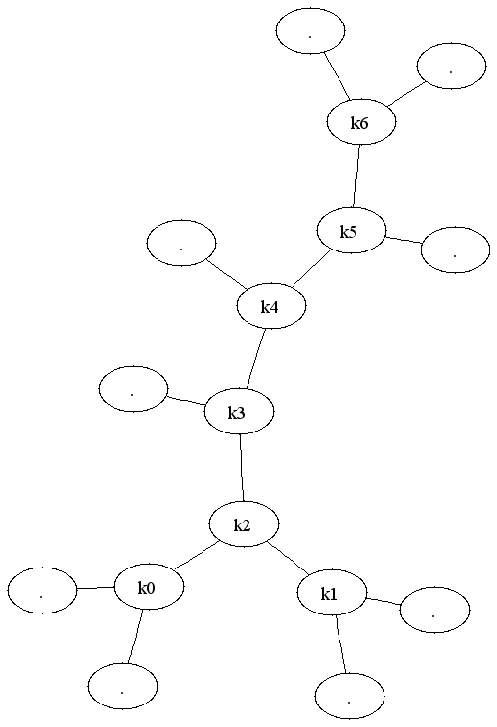
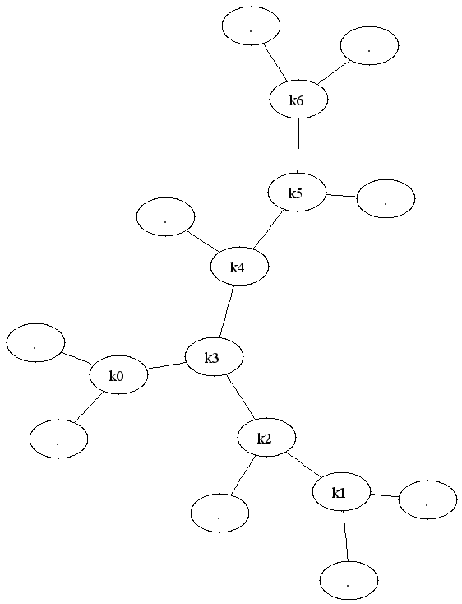
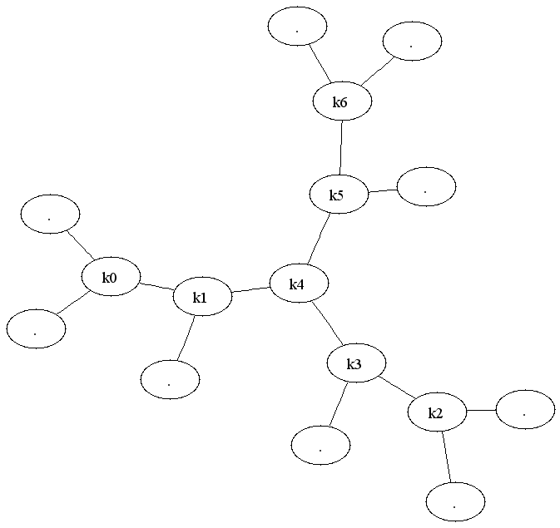
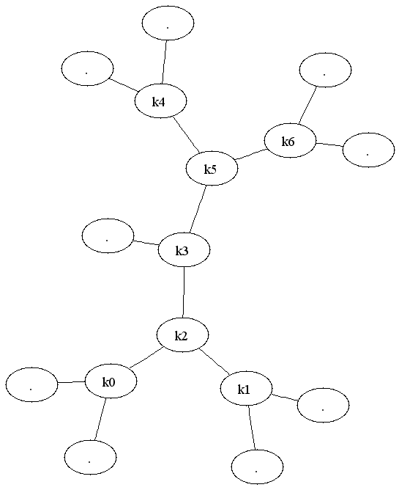
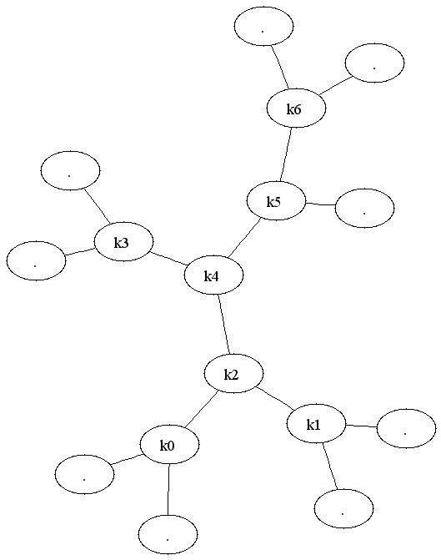
Exact approach
INPUT: distance_matrix(n,n)
t(structure) ← INITIALIZATION(n);
best_t ← t;
While ( t(structure) != NULL )
  t ← ASSIGN_LEAVES(leaves[n]);
  C(t) ← EVALUATE_COST_FUNCTION(t);
  If( C(t) < C(best_t) ) 1) best_t ← t;
  Repeat
    t ← NEXT_PERMUTATION(leaves[n]);
    C(t) ← EVALUATE_COST_FUNCTION(t);
    If( C(t) < C(best_t) ) 1) best_t ← t;
  Until( NO_FURTHER_PERMUTATIONS(t,leaves[n]) )
  t(structure) ← NEXT_STRUCTURE(t);
OUTPUT: best_t
E.g. of the 6 different boron tree structures with 9 leaves

Slide 32
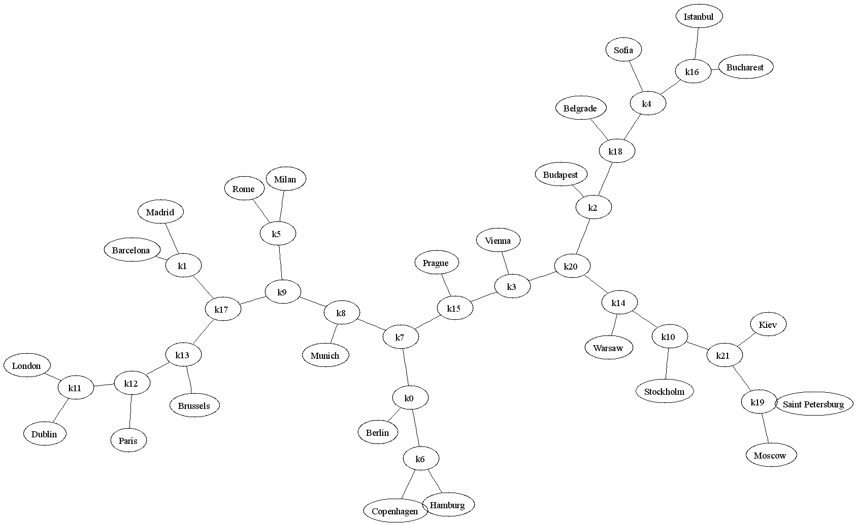
Example

Slide 33
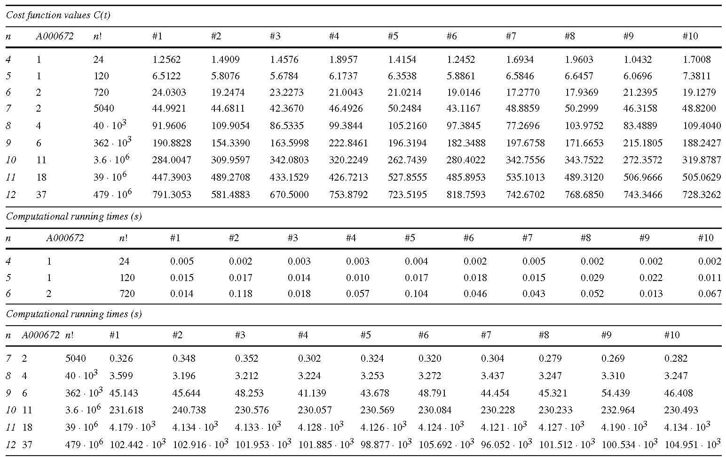
Generated first exact benchmark for the MQTC problem

Slide 34
Conclusions
We have introduced the MQTC problem, the mathematical paradigm at the base of the quartet method of hierarchical clustering
Discussed the best metaheuristics to date
Presented details of an exact solution approach
  Exact solutions for small problem instances (first existing benchmark)
The construction mechanisms of the MQTC algorithms seem to be rather suitable for a quantum algorithmic implementation
  Very interesting concepts and insights which may be useful for the construction of efficient quantum computing methods for the problem, obtained either by improving the MQTC metaheuristics to date, or by hybridization with the exact solution approach

Slide 35
References
Cilibrasi R, Vitányi PMB (2005) Clustering by compression. IEEE Transactions on Information Theory 51(4):1523–1545
Cilibrasi R, Vitányi PMB (2007) The Google similarity distance. IEEE Transactions on Knowledge and Data Engineering 19(3):370–383
Costa, L. R., Aloise, D., Mladenovi´c, N., 2017. Less is more: basic variable neighborhood search heuristic for balanced minimum sum-of-squares clustering. Information Sciences 415 - 416, 247 – 253.
S. Consoli, J. Korst, S. Pauws, and G. Geleijnse, 2019. An exact algorithm for the minimum quartet tree cost problem. 4OR: A Quarterly Journal of Operations Research, 17(4), 401-425
S. Consoli and N. I. Stilianakis, 2017. A quartet method based on variable neighbourhood search for biomedical literature extraction and clustering. International Transactions in Operational Research,24(3), 537-558
Consoli S, Darby-Dowman K, Geleijnse G, Korst J, Pauws S (2010) Heuristic approaches for the quartet method of hierarchical clustering. IEEE Transactions on Knowledge and Data Engineering 22(10):1428– 1443
S. Consoli, J. Korst, S. Pauws, and G. Geleijnse, 2020. Improved metaheuristics for the quartet method of hierarchical clustering. Journal of Global Optimization, 78(2), 241-270
Deza E., Deza M. M. (2012) Figurate numbers. World Scientic Publishing, Singapore.
Sloane N. J. A., Plouffe S. (1995) The Encyclopedia of Integer Sequences. Academic Press, San Diego, CA.

Slide 36

Thank you
Any questions?
You can find me sergio.consoli@ec.europa.eu
© European Union 2020
Unless otherwise noted the reuse of this presentation is authorised under the CC BY 4.0 license. For any use or reproduction of elements that are not owned by the EU, permission may need to be sought directly from the respective right holders.
Notes:
Update/add/delete parts of the copy right notice where appropriate.
More information: https://myintracomm.ec.europa.eu/corp/intellectual-property/Documents/2019_Reuse-guidelines%28CC-BY%29.pdf

