Slide 1

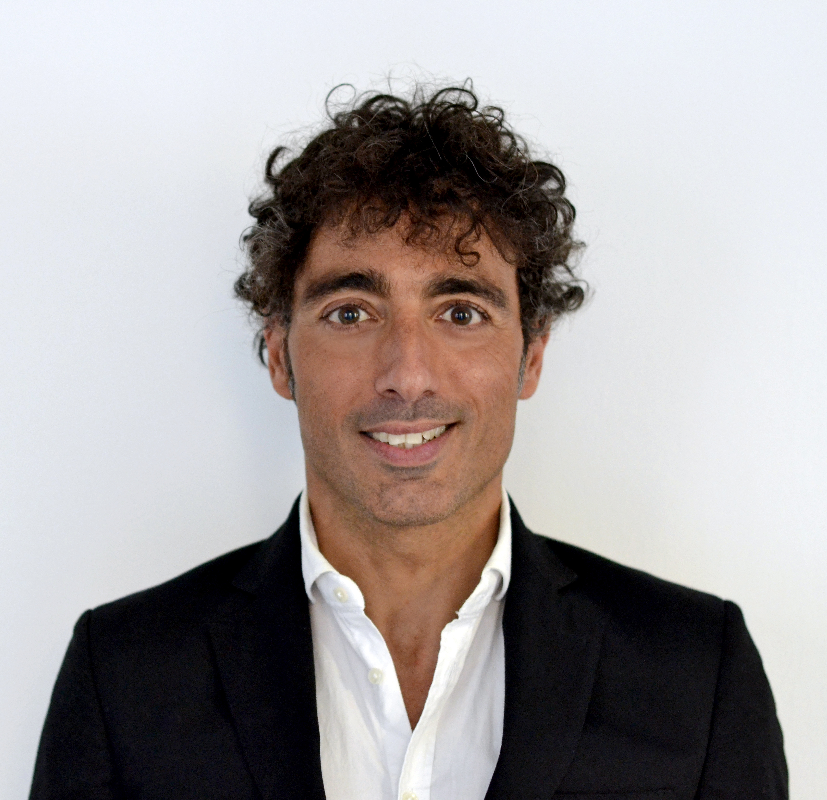
From Healthcare to Smart Grids: Exploring Optimization Problems and Quantum Solutions
Diego Reforgiato Recupero
Department of Mathematics and Computer Science, University of Cagliari
Cagliari, Italy
diego.reforgiato@unica.it

Slide 2

Collaboration Agreement
Collaboration Agreement n. 36805 between JRC and UNICA
from 19/12/2023 to 19/12/2026
Latest Collaborative Works in 2026:
- Beyond classical models: LLM-driven survival analysis for breast cancer prognosis using European cancer registry data. Sergio Consoli, Dimitris Katsimpokis, Antonello Meloni, Diego Reforgiato Recupero and Matthijs Sloep. BMC Medical Informatics and Decision Making 26, 321 (2026). https://doi.org/10.1186/s12911-026-03619-6
- LLM-Guided Genetic Search for the Home Healthcare Routing and Scheduling Problem. Roberta Angioni, Sergio Consoli, Silvia Maria Massa, Diego Reforgiato Recupero, Daniele Riboni. Accepted to ACMGoodIT 2026
- Evaluating Knowledge Graph-Grounded Retrieval-Augmented Generation for Biomedical Question Answering: A Preliminary Analysis. Roberta Angioni, Sergio Consoli, Silvia M. Massa, Daniele Riboni and Diego Reforgiato Recupero, accepted to RAGE-KG 2026 (ISWC 2026)
- BioKG-RAG: Integrating Biomedical Ontologies for Knowledge-Grounded Retrieval-Augmented Generation. Sergio Consoli, Lorenzo Bertolini, Roberta Angioni, Silvia M. Massa, Daniele Riboni and Diego Reforgiato Recupero, accepted as demo paper to ISWC 2026
- Toward Safe Healthcare LLMs: Alignment Faking, Introspection, and Control. Antonello Meloni, Antonio Puertas-Gallardo, Sergio Consoli, Lorenzo Bertolini, Mario Ceresa and Diego Reforgiato Recupero. Accepted to ELMKE 2026 (ISWC 2026)

Slide 3


Outline
Home Care Routing and Scheduling Problem (HHCRSP)
Classical solution
Problem of scheduling flexible energy loads
Quantum solution

Slide 4
HHCRSP
Minimization problem with the goal to organize home visits for a diverse team of caregivers, ensuring they reach patients spread across the area within their scheduled appointment times
It can be defined on a graph where the node set C⁰=C∪{0}
C is the set of patients
0 is the office
V is the set of caregivers
a_{V,S} is a binary parameter equal to 1 if v is qualified to perform service type s ∈ S
The complexity lies in the division of patients based on the service requirements: (single service VS double service)
Double services enforce temporal dependencies, some can be performed simultaneously, some are linked by precedence according to:
Simultaneous services: two caregivers must start their respective service operations at the exact same time
Service with precedence: here, the second operation must start within a specific time lag after the start of the first operation
Time slots are modeled via time windows [e_{i},l_{i}] for each patient i. If a caregiver arrives before e_{i} they must wait until the window opens. Services starting after l_{i} are feasible but incur a tardiness penalty z_{i,s}. Therefore, t_{i,s} is the actual starting time and z_{i,s} is the tardiness of that service.
Caregivers must return to the depot after finishing their visits with each patient node being visited only once per route and caregivers cannot perform two consecutive services for the same patient

Slide 5
HHCRSP
Optimization goal is:
Min Z = ƛ₁D+ ƛ₂T+ ƛ₃T^{max}
where
D is the total distance traveled by the fleet,
T is the total tardiness representing the aggregate lateness of all services relative to the patients’ preferred time windows,
T^{max} is the maximum tardiness, representing the single highest delay observed in the schedule among all patients. It prevents scenarios where a minority of patients suffer extreme delays.
Weights ƛ₁, ƛ₂, ƛ₃ allow the planner to flexibly prioritize between minimizing distance traveled and service quality. They are fixed (1/3 in the paper for the three of them)

Slide 6
Toy Instance
5 patients • 3 heterogeneous caregivers
Patient requirements
Sets & service types
Qualification | N | P | H
v₁ | 1 | 0 | 0
v₂ | 0 | 1 | 0
v₃ | 0 | 0 | 1
Pt. | Services | Rule | Window
1 | N | Single | 08:30–09:00
2 | N + P | Simultaneous | 09:15–09:45
3 | P | Single | 09:50–09:55
4 | N + H | Precedence | 10:15–11:00
5 | H | Single | 11:30–11:40
Patients: C = {1,2,3,4,5} Depot: 0 Caregivers: V = {v₁,v₂,v₃} Services: N = Nursing, P = Personal care, H = Physiotherapy
Durations: N 30 min • P 25 min • H 40 min
Double-service constraints: Patient 2 → t₂,N = t₂,P | Patient 4 → 20 ≤ t₄,H − t₄,N ≤ 40 min
Let’s assume one travel-cost unit corresponds to approximately one minute travel
Symmetric Travel-time Matrix distance matrix
Tardiness: z_{ᵢ,s} = max(0, t_{ᵢ,s} − lᵢ) (max of tardiness of that service minus the latest preferred service start time) Objective: min Z = λ₁D + λ₂T + λ₃Tmax Example weights: λ₁=1, λ₂=10, λ₃=20
From/To | 0 | 1 | 2 | 3 | 4 | 5
0 | – | 10 | 20 | 30 | 25 | 20
1 | 10 | – | 15 | 25 | 30 | 35
2 | 20 | 15 | – | 20 | 25 | 30
3 | 30 | 25 | 20 | – | 25 | 20
4 | 25 | 30 | 25 | 25 | – | 15
5 | 20 | 35 | 30 | 20 | 15 | –
Notes:
Double service constraints are provided in input
For example, if the patient's preferred window is 10:15–11:00, then
$$e_{i}=10:15, l_{i}=11:00.$$
If service N starts at 10:50, $z_{iN}=0$. If service H starts at 11:10, $z_{iH}=10$minutes.
The version we solved assumes equal weights in the travel-time matrix and 2 hours of interval for each patient

Slide 7
One Feasible Solution
Routes, synchronized starts, precedence lag, tardiness and objective value
v₁ — Nursing
0 → 1 → 2 → 4 → 0
D=75
Synchronization at P2
P1 08:30–09:00 | P2 09:15–09:45 | P4 10:20–10:50
v₁ starts N at 09:15 v₂ starts P at 09:15 ⇒ exact simultaneous start
v₂ — Personal care
0 → 2 → 3 → 0
D=70
P2 09:15–09:40 | P3 10:00–10:25 (5 min late)
Precedence at P4
v₃ — Physiotherapy
0 → 4 → 5 → 0
N starts 10:20 H starts 10:50 Lag = 30 min ∈ [20,40]
D=60
P4 10:50–11:30 | P5 11:45–12:25 (5 min late)
5 min for patient 3 service P and 5 min for patient 5 service H
Performance of this solution
Metric | Value
Total distance D | 205
Total tardiness T | 10 min
Maximum tardiness Tmax | 5 min
Z = 1(205) + 10(10) + 20(5) = 405

Slide 8
BRKGA: the Genetic Baseline
The algorithm searches in a random-key chromosome space; a decoder builds feasible HHCRSP schedules.
1 Random population
Chromosomes are vectors of random keys in [0,1).
2 Decode
Greedy cheapest-insertion builds a feasible schedule.
3 Evaluate
Fitness = weighted distance + total tardiness + max tardiness.
4 Evolve
Elite preservation + biased multi-parent crossover + mutants.
5 Diversify
Islands/migration + Implicit Path Relinking (IPR).
6 Stop
After 2 × |C| generations without improvement.
Core idea: evolve priorities, not routes directly.
Notes:
Chromosome has 1 key per patient + 2 auxiliary keys

Slide 9
How a BRKGA chromosome becomes a schedule (first 3 phases)
Each chromosome is a vector of random keys in [0,1). Each patient is associated with one key, whose value can change during the evolutionary process and determines the priority with which that patient is considered by the decoder.
For |C| patients, chromosome length = |C| + 2.
Example chromosome
P1 0.72
P2 0.15
P3 0.91
P4 0.44
P5 0.63
Hull 0
Balance 1
Last 2 keys → convex-hull & workload-balancing heuristics (control keys are either 0 or 1 meaning are active or not). Hull=1 tries to follow a perimeter by suggesting patients closer to the given patient wheras balance tries to balance caregivers
First |C| keys → patient insertion priority / sequence
DECODER Greedy cheapest insertion
For each patient/task: • test qualified caregiver(s) • test feasible insertion positions
Respect constraints: • time windows • synchronization / precedence
Choose insertion minimizing: ⅓D + ⅓T + ⅓Tmax
Feasible HHC schedule
Notes:
Decoder creates the solution for each chromosome. First keys with bigger values.
For example it starts with P3 and checks which caregivers has the lowest cost of assignment (as long as the constraints are satisfied)

Slide 10
How BRKGA evolves the population (last three phases)
ELITE SET Best chromosomes
BIASED CROSSOVER Fitter parents have more influence
OFFSPRING New random-key chromosomes
NON-ELITE SET Remaining chromosomes
Elites are copied directly to the next generation.
Mutation / random mutants maintain diversity.
IPR explores paths between elite chromosomes.
Repeated evolution → decode → evaluate → keep improving the best schedule
Notes:
First level I have the two sets of solution
Second level I choose among the parents which can give good info
Third level I generate new chromosomes by keeping in mind the parents

Slide 11
Decoder logic for double services
Feasibility is handled by the decoder rather than left to the genetic operators.
SIMULTANEOUS SERVICE
PRECEDENCE SERVICE
Both caregivers start when both are available:
Start-time difference must satisfy:
tᵢ,v₁,s₁ = tᵢ,v₂,s₂ = max(arrival₁, arrival₂)
δᵢmin ≤ t₂ − t₁ ≤ δᵢmax
If one caregiver arrives earlier, that caregiver waits.
If caregiver 2 is too late, delay service 1: t₁ = max(arrival₁, arrival₂ − δᵢmax)
Result: chromosomes can be searched freely while the decoder constructs constraint-respecting schedules.

Slide 12
Hybrid LLM-BRKGA: what changes?
BRKGA remains the optimization engine; the LLM adds semantic, instance-aware guidance.
Genetic Step BRKGA
State Extraction
LLM Semantic Analysis
Targeted Perturbation
Elite Reinjection
The LLM does NOT generate the final schedule and does NOT replace the decoder.
It inspects a compact summary of the current best solution — especially high-cost caregiver routes and patient proximity groups — and identifies spatial outliers / hotspots that may deserve reassignment.
LLM = strategic director | BRKGA + decoder = feasibility & evolutionary search
Notes:
LLM works once for each generation
It takes the best current chromosome (solution), and related information (i.e., geographics), and decides which keys should be changed. We might end up generating several chromosomes at each step by using the 3 strategies in the next slide

Slide 13
From LLM recommendation to genetic perturbation
The recommendation is translated into a targeted ruin-and-recreate operation on selected genes.
INPUT TO LLM • high-cost routes • patient proximity groups
LLM OUTPUT Limited subset of patients whose assignment should change
OPTIMIZER + DECODER Generate perturbed candidate chromosomes
Three perturbation mechanisms are used to generate a family of different perturbed chromosomes from the current best chromosome.
Allele biasing Key ≈ 1 → earlier insertion Key ≈ 0 → later insertion
Randomization Assign new random keys to explore new positions
Combinatorial variants Test combinations of the reinsertion patterns
If decoded candidate beats current best → inject it in place of a worst chromosome
Notes:
These are the three ways our LLM-BRKGA generates candidate perturbations after the LLM has identified which patients should be reconsidered.
Allele biasing — the key associated with the patient indicated by the LLM is included the first time with high value and second time with low value (2 new chromosomes generated)
Randomization — instead of deliberately pushing the key high or low, give the selected patient's gene a new random value:
Combinatorial variants — when the LLM identifies multiple patients, the algorithm generates different combinations of these perturbations rather than trying only one modification
Each generation uses one (Allele or Randomization). For example if LLM identifies P3 and P5, we use combinatorial variants (two new generation, first with allele high value for P3 and low for P5 and the second with low value for P3 and high for P5)

Slide 14
Avoiding stagnation: elite-group shaking
A second diversification mechanism activates when significant improvement stalls.
Search stagnates
SHAKE ELITE SET controlled perturbations
Re-evaluate population
In the HHCRSP experiments: • elite chromosomes: adjacent swaps • non-elite population: fresh random keys • historical best may be reinserted
Trigger logic: • ignore improvements ≤ 0.05 • maximum 6 shakes • after sustained stagnation → stop
Stopping rule: 2 × |C| generations without significant improvement
Purpose: restore genotypic diversity without discarding the strongest solutions.
Notes:
elite-group shaking is an additional mechanism introduced in the proposed LLM-BRKGA 1) search stagnates: When the number of generations without improvement reaches the shaketrigger threshold, shaking is activated 2) shake elite set: The elite set is the group of best chromosomes (best solutions) currently in the population. Instead of leaving all these good solutions unchanged, the shaking operator deliberately modifies a subset of them.
3) reevalaute: After changing the chromosomes, they have to be decoded again into HHCRSP schedules and evaluated using the objective function

Slide 15
BRKGA vs. LLM-BRKGA
The hybrid method adds structured perturbations while preserving the baseline's feasibility mechanism.
Aspect | BRKGA | LLM-BRKGA
Search engine | Random-key GA + decoder | Same BRKGA + decoder
Guidance | Objective-driven stochastic search | Adds LLM spatial/semantic guidance
Perturbation | Mutants, IPR, migration | + targeted ruin-and-recreate
Stagnation | Baseline stopping logic | + elite-group shaking
Feasibility | Decoder | Same decoder
Main intent | Robust combinatorial search | Steer search toward promising structures
Key message: let the GA guarantee feasible search; use the LLM to suggest where to search more intelligently.
Notes:
GA = genetic algorithm

Slide 16
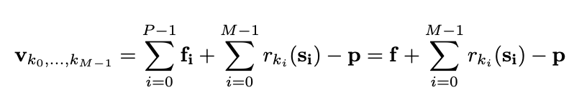
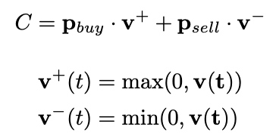
Smart Grid
Prosumer is a smart—grid user able to consume and produce energy. It can provide flexibility, that is, the possibility of adapting their energy consumption in time and/or amount. We focus only on temporal flexibility, i.e., the possibility
of shifting energy consumption over time without changing the total amount of energy consumed.
Day is divided into a fixed number of time units (either 24 or 96, that is each 15 minutes)
Energy consumption of a prosumer is generated by different devices. Some (i.e., computers, lights) are fixed. Others (i.e., smart washing machines, dish-washers) can be programmed to operate with a certain time window and are considered shiftable.
v is the consumption of a prosumer in a day. It is indicated as v(0), v(1), …, v(T), where T is the number of time units considered. Each v_{i} is a vector of consumptions of the devices. Fixed loads are represented as f₀, …, f_{P-1} and shiftable loads are s₀,…,s_{M-1}
We represent the amount of energy produced by a prosumer with p
The possibility of shifting a load is represented by the rolling operator r_{k}. Given a vector
a = (a(0),a(1),...,a(T−1)),
r_{k} shifts its components by k positions to the right rolling over the last one. In other words:
r_{k}(a) = (a((−k) mod T),a((1−k) mod T),...,a((T−1−k) mod T))
V is therefore represented as
p_{buy} (p_{sell}) is the vector of length T for the unit price at each time unit at which the prosumer buys (sells) energy. The total cost of energy for the prosumer across the day is the cost of purchasing energy minus the cost of selling energy

Slide 17
Problem Formulation — Prosumer Load Shifting
Choose when flexible electrical loads operate in order to minimize the prosumer's daily net energy cost.
Day divided into T time units (e.g., T = 24 hourly slots)
Fixed consumption f ∈ ℝᵀ
Energy production p ∈ ℝᵀ
Shiftable loads
Rolling operator
s₀, …, s_{M}₋₁ ∈ ℝᵀ Each load i can be shifted by kᵢ time units.
rₖ(sᵢ) shifts the consumption profile of load i by k positions in time.
Decision variables:
Net consumption for a configuration k: vₖ = f + Σᵢ rₖ_{ᵢ}(sᵢ) − p
kᵢ ∈ {0,…,T−1}, i = 0,…,M−1
Positive vₖ(t): buy from grid Negative vₖ(t): surplus sold to grid

Slide 18
Objective Function and Optimization Problem
Buying and selling use different time-dependent tariffs.
Buying tariff p_{ᵇᵘʸ} ∈ ℝᵀ
Selling tariff p_{ˢᵉˡˡ} ∈ ℝᵀ
Net profile vₖ ∈ ℝᵀ
Split net consumption:
Daily net energy cost C(k₀,…,k_{M₋₁}) = p_{ᵇᵘʸ} · vₖ⁺ + p_{ˢᵉˡˡ} · vₖ⁻
vₖ⁺(t) = max(0, vₖ(t)) vₖ⁻(t) = min(0, vₖ(t))
The second term is non-positive: revenue from selling surplus energy reduces total cost.
OPTIMIZATION PROBLEM Find k* = (k₀*,…,k_{M₋₁}*) ∈ {0,…,T−1}ᴹ that minimizes C(k₀,…,k_{M₋₁})
Search-space size = Tᴹ → exponential growth with the number M of shiftable loads.
Notes:
4 devices and 5 time units I need
GOAL è trovare k* che è un vettore di 4 valori
(1,2,3,4) esempio (primo device lo shifto di 1 unita a destra; secondo di 2 unità a dx, etc.) (posso avere 5 ma non da 6 in su per questo esempio)

Slide 19
Quantum Solution — Grover-Based Minimum Search
Repeatedly search for a load-shift configuration whose energy cost is lower than the current best.
1. Encode configurations k = (k₀,…,k_{M}₋₁)
2. Prepare superposition of possible shifts
3. Set current threshold τ (best cost found so far)
Quantum search loop
ORACLE Mark states with C(k) < τ
GROVER Amplify marked configurations
MEASURE Obtain candidate k_cand
IMPROVES? C(k_cand) < τ
Repeat search with the improved threshold
YES → update k_best ← k_cand τ ← C(k_cand)
NO →repeat with more iterations (amplify a higher number of times)
Key idea: Grover search does not directly “compute the minimum”; it amplifies configurations that are better than the current threshold, which is progressively lowered.
Notes:
T^M sono tutte le possibili configurazioni
L’Oracle marca gli stati inferiori alla soglia ma senza dirmi quali. Per sapere quali li misuro dopo averli amplificati.

Slide 20
Initialization - Quantum Encoding of Load-Shift Configurations
Each possible schedule of the M shiftable loads is mapped to a computational-basis state.
Classical configuration k = (k₀,…,k_{M}₋₁)
q = ⌈log₂T⌉ qubits for each shift kᵢ
N = Mq qubits for one configuration
Quantum representation
Initial quantum state
(k₀,…,k_{M}₋₁) → |k₀⟩ ⊗ ··· ⊗ |k_{M}₋₁⟩
Prepare a uniform superposition (Hadamard) so every configuration initially has the same measurement probability.
Example M = 5 loads, T = 4 shifts q = 2 → N = 10 qubits → 2¹⁰ = 1024 states
|s⟩ = 1/√(2ᴺ) Σₖ |k⟩
Goal: amplify low-cost configurations before measurement.
Notes:
Se abbiamo T=4 e M=5 servono 2 bit per ogni shift (i.e., per ogni device) quindi 10 qubits

Slide 21
Oracle 1 - Threshold Oracle: Which Configurations Are Better?
The oracle marks a configuration if its cost is below the current threshold τ.
Configuration |k⟩
Compute C(k)
Compare C(k) < τ ?
Phase flip if TRUE
Registers used by the oracle
Reversible oracle structure
|k⟩
shift configuration (Mq size)
|k⟩|0⟩ᵥ|0⟩_{C}|0⟩_{F} → |k⟩|0⟩ᵥ|C(k)⟩_{C}|[C(k)<τ]⟩_{F}
|0⟩_{v}
work register for net consumption vₖ(t) (enough qbits to contain the maximum consumption, plus one for negative values)
Apply Z to flag → multiply marked state by −1
|0⟩_{C}
accumulated cost C(k) (enough qbits to contain the maximum cost, plus one for negative values)
|0⟩_{F}
1-qubit comparison flag (1 bit)
Uncompute comparison + cost → auxiliary registers return to |0⟩
Final effect: |k⟩ → (−1)^{[C(k)<τ]} |k⟩
The oracle changes the phase of configuration ∣k⟩ depending on whether its cost is better than the current threshold τ.

Slide 22
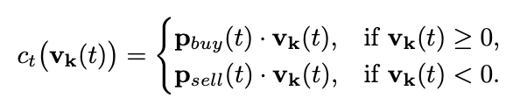
Oracle 2 - How the Oracle Computes the Energy Cost
The cost is accumulated sequentially over the T time slots using reversible arithmetic.
For each time t, compute net consumption
Cost accumulation
C(k) = Σₜ cₜ(vₖ(t))
vₖ(t) = f(t) + Σᵢ rₖᵢ(sᵢ)(t) − p(t)
Choose tariff from the sign of vₖ(t) vₖ(t) ≥ 0 → pᵇᵘʸ(t) | vₖ(t) < 0 → pˢᵉˡˡ(t)
We keep the cost register in the Fourier basis during accumulation, enabling additions through controlled phase rotations.
Add contribution cₜ(vₖ(t)) to the cost register
QFT → successive additions → inverse QFT
Then uncompute vₖ(t) and reuse the work register.
After all T slots: |k⟩|0⟩ᵥ|C(k)⟩_{C}

Slide 23
Oracle 3 - How to compute the FLAG register
The flag is at the beginning |0>
For each time t, compute net consumption
|C(k)- τ>_{C} |0>_{F}
Flag qbit becomes the sign qbit of C register (0 if positive or 1 if negative)
Z gate is used on qbit flag (we change flag sign when flag is 1)
Z|F⟩= (−1)^{F} |F>
Uncompute flag and cost registers. Only k register is left with sign changed iff flag was 1

Slide 24
Grover Amplification
The oracle identifies improving states; the diffusion operator increases their probability of being measured.
As seen before, Oracle Oτ phase-flip states with C(k) < τ
Diffusion D reflect amplitudes about their mean
Marked states become more likely to be measured
One Grover iteration
Why not use a fixed number of iterations?
Gτ = D · Oτ
The correct number depends on how many configurations satisfy C(k) < τ. That number is unknown and changes every time τ improves.
Too few iterations → weak amplification | Too many → probability can decrease again
We use an adaptive randomized number of Grover iterations.

Slide 25
The whole algorithm - Adaptive Quantum Minimum Finding
Each round searches for a configuration better than the best one found so far.
1. Choose initial k_best and compute τ = C(k_best)
2. Set μ = 1 and choose r ∈ {0,…,μ−1} randomly
3. Prepare superposition and apply Gτ exactly r times
4. Measure k_cand and compute C(k_cand) classically
If C(k_cand) < C(k_best) k_best ← k_cand τ ← C(k_cand) μ ← 1
If there is NO improvement keep τ and increase search range: μ ← min{⌈8μ/7⌉, μmax} with μmax=ceil(sqrt(S)) with S=number of configurations in search space
Repeat until the maximum number of search rounds is reached (chosen a priori, currently under analysis)
Important: the method is probabilistic — a finite run does not guarantee that the global minimum is measured.

Slide 26


