Slide 1

Mirage: an OCaml Exokernel
Anil Madhavapeddy
University of Cambridge
with Dr. Thomas Gazagnaire (OcamlPro), Dr. Richard Mortier (Nottingham), Dr. Steven Hand (Cambridge), and Prof. Jon Crowcroft (Cambridge)
Computer Laboratory, 15 JJ Thomson Avenue, Cambridge, UK

Slide 2

Motivation: Layers
Application
Threads
Processes
OS Kernel
Hardware

Slide 3




Motivation: Layers
Application
Threads
Language Runtime
Processes
OS Kernel
Hardware

Slide 4



Motivation: Layers
Application
Threads
Language Runtime
Processes
OS Kernel
Hypervisor
Hardware

Slide 5
Motivation: In Search of Simplicity
Application
Threads
Language Runtime
Processes
Linux Kernel
Mar 1994: 176,250 LoC
May 2010: 13,320,934 LoC
OS Kernel
Hypervisor
Hardware

Slide 6
Architecture: Exokernel
Application
Threads
Language Runtime
Processes
Application
OS Kernel
Language Runtime
Hypervisor
Hypervisor
Hardware
Hardware

Slide 7
Architecture: Workflow
Application
Develop
Threads
Deploy
Language Runtime
Processes
Application
OS Kernel
Language Runtime
Hypervisor
Hypervisor
Hardware
Hardware

Slide 8
Layer 1: Separation Kernel
Assume { Xen, KVM, L4 } exists
  Abstract Hardware I/O interfaces
  Resource Isolation for memory
  CPU Concurrency and Timers
Application
Language Runtime
Hypervisor
Hardware

Slide 9
Layer 1: Minimal OS “signature”
module Console : sig
type t
val create : unit -> t
val write : t -> string -> unit
end
Application
Language Runtime
let rec fib n =
if n < 2 then 1 else fib(n-1) + fib(n-2)
let _ = fib 40
Hypervisor
Hardware

Slide 10
Layer 1: A simple “hello world” kernel
Xen runs para-virtualized kernels that cooperate with the hypervisor.
  Most code runs unmodified
  Privileged instructions go via Xen hypercalls
Application
Linked to a small C library to make a kernel
  Boots in 64-bit mode directly, with starting memory all mapped.
  Is approximately 50-100KB in size.
Language Runtime
Hypervisor
Hardware

Slide 11



Mirage: 64-bit Xen Memory Layout
OS Text and Data
Network Buffers
Single 64-bit address space
Specialize regions of memory
No support for:
  Dynamic shared libraries
  Address Space Randomization
  Multiple runtimes (for now)
Reserved
OCaml minor heap
OCaml major heap

Slide 12

Mirage: Network Buffers
OS Text and Data
Network Buffers
IP Header
TCP Header
Reserved
Transmit packet data
IP Header
OCaml minor heap
TCP Header
OCaml major heap
Receive packet data

Slide 13

Mirage: x86 superpages for OCaml heap
OS Text and Data
Network Buffers
Reduces TLB pressure significantly.
Is_in_heap check is much simpler
Q: Improve GC/cache interaction using PAT registers?
Q: co-operative GC?
Reserved
OCaml minor heap
OCaml major heap

Slide 14
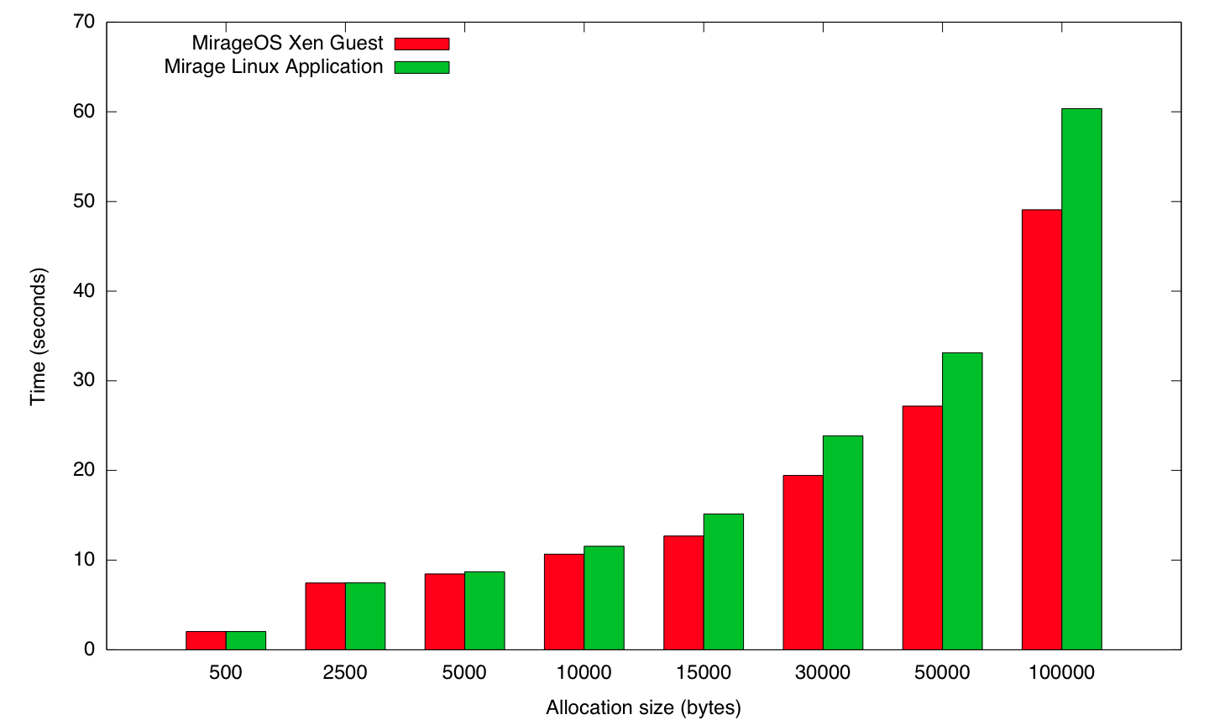
MirageOS: memory performance vs PV Linux

Slide 15
Layer 2: Concurrency and Parallelism
Thread
Thread
Thread
Thread
Thread
Thread
Thread
Thread
Thread
Thread
Thread
Thread
Thread
Thread
Process
Process
Process
Process
Process
Kernel
Kernel
Hypervisor
Core
Core
Core
Core
Core
Core
Core
Core
Core

Slide 16
Layer 2: Concurrency
Xen provides an low-level event interface.
No need for interrupts: a perfect fit for co-operative threading!
  We always know our next timeout (priority queue)
  So adapted the LWT threading library
Block 5s

Slide 17
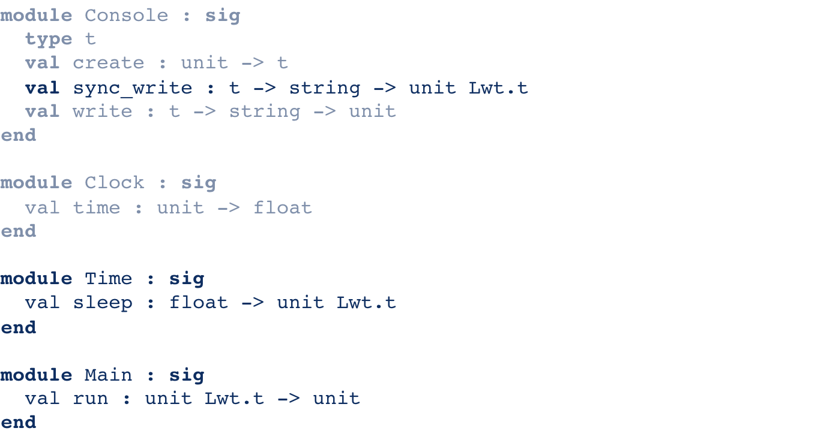
Layer 2: OS Signature with Timing

Slide 18
…and parallelism?
Xen divides up cores into vCPUs, LWT multiplexes on a single core
Mirage “process” is a separate OS, communicating via event channels
Open Question: parallelism model (JoCaml, OPIS, CIEL futures)
vCPU 1
Mem 1
SHM
Mem 2
vCPU 2

Slide 19
Layer 3: Abstract I/O
module type FLOW = sig
type t
type mgr
type src
type dst
val read : t -> view option Lwt.t
val write : t -> view -> unit Lwt.t
val close : t -> unit Lwt.t
module type DATAGRAM = sig
type mgr
type src
type dst
type msg

Slide 20
Layer 3: Abstract I/O
module type FLOW = sig
type t
type mgr
type src
type dst
val read : t -> view option Lwt.t
val write : t -> view -> unit Lwt.t
val close : t -> unit Lwt.t
val listen : mgr -> src ->
(dst -> t -> unit Lwt.t) ->
unit Lwt.t
val connect : mgr -> src -> dst ->
(t -> unit Lwt.t) -> unit Lwt.t
end
module type DATAGRAM = sig
type mgr
type src
type dst
type msg
val recv : mgr -> src ->
(dst -> msg -> unit Lwt.t) ->
unit Lwt.t
val send : mgr -> dst -> msg ->
unit Lwt.t
end

Slide 21
Layer 3: Concrete I/O Modules
module TCPv4 : sig
type t
type mgr = Manager.t
type src = (ipv4_addr option * int)
type dst = (ipv4_addr * int)
val read : t -> view option Lwt.t
val write : t -> view -> unit Lwt.t
val close : t -> unit Lwt.t
val listen : mgr -> src ->
(dst -> t -> unit Lwt.t) ->
unit Lwt.t
val connect : mgr -> src -> dst ->
(t -> unit Lwt.t) -> unit Lwt.t
end
module Shmem : sig
type t
type mgr = Manager.t
type src = domid
type dst = domid
val read : t -> view option Lwt.t
val write : t -> view -> unit Lwt.t
val close : t -> unit Lwt.t
val listen : mgr -> src ->
(dst -> t -> unit Lwt.t) ->
unit Lwt.t
val connect : mgr -> src -> dst ->
(t -> unit Lwt.t) -> unit Lwt.t
end

Slide 22
Layer 3: Multiple OS modules
Stdlib
OS (Unix)
Istring
Time
Clock
Console
Ethif
Main
Istring
Time
Clock
Console
Ethif
Main
OS (Xen)

Slide 23
Layer 3: Multiple OS modules
Stdlib
OS (Unix)
Istring
Time
Clock
Console
Ethif
Main
Kernel bindings
Gnttab
Evtchn
Ring
Xenbus
Xenstore
Istring
Time
Clock
Console
Ethif
Main
OS (Xen)
Xen
bindings

Slide 24
Layer 3: Standard Library Combinations
OS (Unix)
Net (socket)
Unix/socket
(ELF binary)
Stdlib
Net (direct)
Unix/direct
(ELF binary)
Application
OS (Xen)
Xen/direct
(microkernel)

Slide 25
Layer 3: Ocamlbuild Compilation
Mirage kernel
xen.lds
ocamlopt -output-obj
minios.a
asmrun.a
cmx
a
cmi
cmx
a
cmi
ml
mli
camlp4
ml
mli
camlp4
Stdlib
Application

Slide 26
Layer 3: Ethernet I/O
I/O arrives via shared-memory Ethernet frames, and parsed via a DSL
We have Ethernet, ARP, ICMP, IPv4, DHCP, TCPv4, HTTP, DNS, SSH in pure OCaml.
Performance in user-space is excellent (EuroSys 2007), now benchmarking under Xen.
Zero-copy, bounds optimisation is vital to performance.
Ethernet
IP
TCP
Data

Slide 27
Meta Packet Language (MPL)
packet tcp {
source_port: uint16;
dest_port: uint16;
sequence: uint32;
ack_number: uint32;
offset: bit[4] value(offset(header_end) / 4);
reserved: bit[4] const(0);
cwr: bit[1] default(0);
ece: bit[1] default(0);
urg: bit[1] default(0);
ack: bit[1] default(0);
psh: bit[1] default(0);
rst: bit[1] default(0);
syn: bit[1] default(0);
fin: bit[1] default(0);
window: uint16;
checksum: uint16;
urgent: uint16 default(0);
header_end: label;
options: byte[(offset * 4) - offset(header_end)] align(32);
data: byte[remaining()];
}
OCaml output can both construct and parse packets from this DSL.
Melange: Towards a ‘Functional’ Internet
EuroSys 2007, Madhavapeddy et al.

Slide 28
Research Directions
A more general solution that can handle ABNF, XML, JSON, etc.
  Yakker (AT&T Research)
  http://github.com/attresearch/yakker
  Dependently typed DSLs (Idris)
    http://github.com/edwinb/Idris
  LinearML (quasi-linear, reference-counted ML)
    http://github.com/pika/LinearML
Goals:
  10GB/s type-safe network I/O.
  Specify file-systems in this way also.

Slide 29
Research Directions
Platforms
  Bytecode: Simple interpreted runtime
  ELF binary: Native code binary running in user-space
  Kernel module: Native code binary running in kernel mode
  Javascript: Web browser via ocamljs or js_of_ocaml
  JVM: virtual machine via ocamljava
  8-bit PIC: via ocamlpic
  Microkernel: Xen / KVM / VMWare
Optimisation
  Whole OS compilation
  LLVM – needed badly for interoperability, not performance
  Profiling

Slide 30
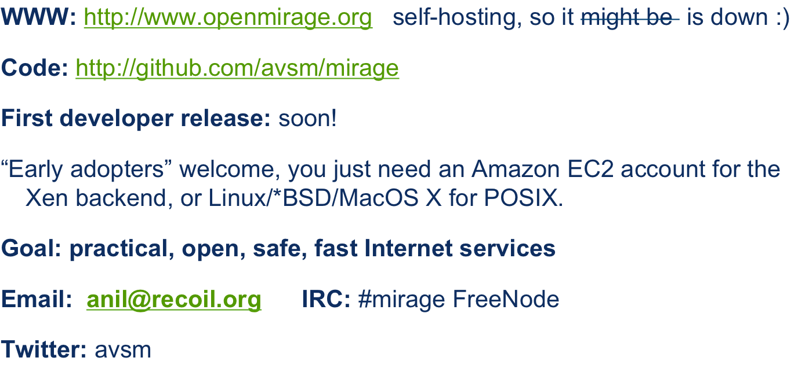
Mirage: roadmap
This work is supported by Horizon Digital Economy Research, RCUK grant EP/G065802/1

Slide 31

Backup Slides

Slide 32
Mirage: concurrency using LWT
Advantages:
  Core library is pure OCaml with no magic
  Excellent camlp4 extension to hide the bind monad.
  Function type now clearly indicates that it blocks.
Open Issues:
  Creates a lot of runtime closures (lambda lifting, whole program opt?)
  Threat model: malicious code can now hang whole OS

Slide 33
Moving on from the Socket API (ii)
type packet =
| Stream | Datagram
type direction =
| Uni | Bi
type consumption =
| Blaster | Congestion
val target : packet -> direction -> consumption -> ip_addr -> sockaddr
module Flow : sig
type t
val read: t -> string -> int -> int -> int Lwt.t
val write: t -> string -> int -> int -> int Lwt.t
val connect: sockaddr -> (t -> unit Lwt.t) -> unit Lwt.t
val listen: sockaddr -> (sockaddr -> t -> unit Lwt.t) -> unit Lwt.t
end

Slide 34
Mirage: Typed Memory Allocators
OS Text and Data
Buddy Allocator
dyn_init(type)
dyn_malloc(type, size)
dyn_realloc(size)
dyn_free(type)
Network Buffers
Reserved
Page Grant Allocator
grant_alloc_page(type)
grant_free_page(type)
OCaml minor heap
Heap Allocator
heap_init(type, pages)
heap_extend(type, pages)
heap_shrink(type, pages)
OCaml major heap

Slide 35
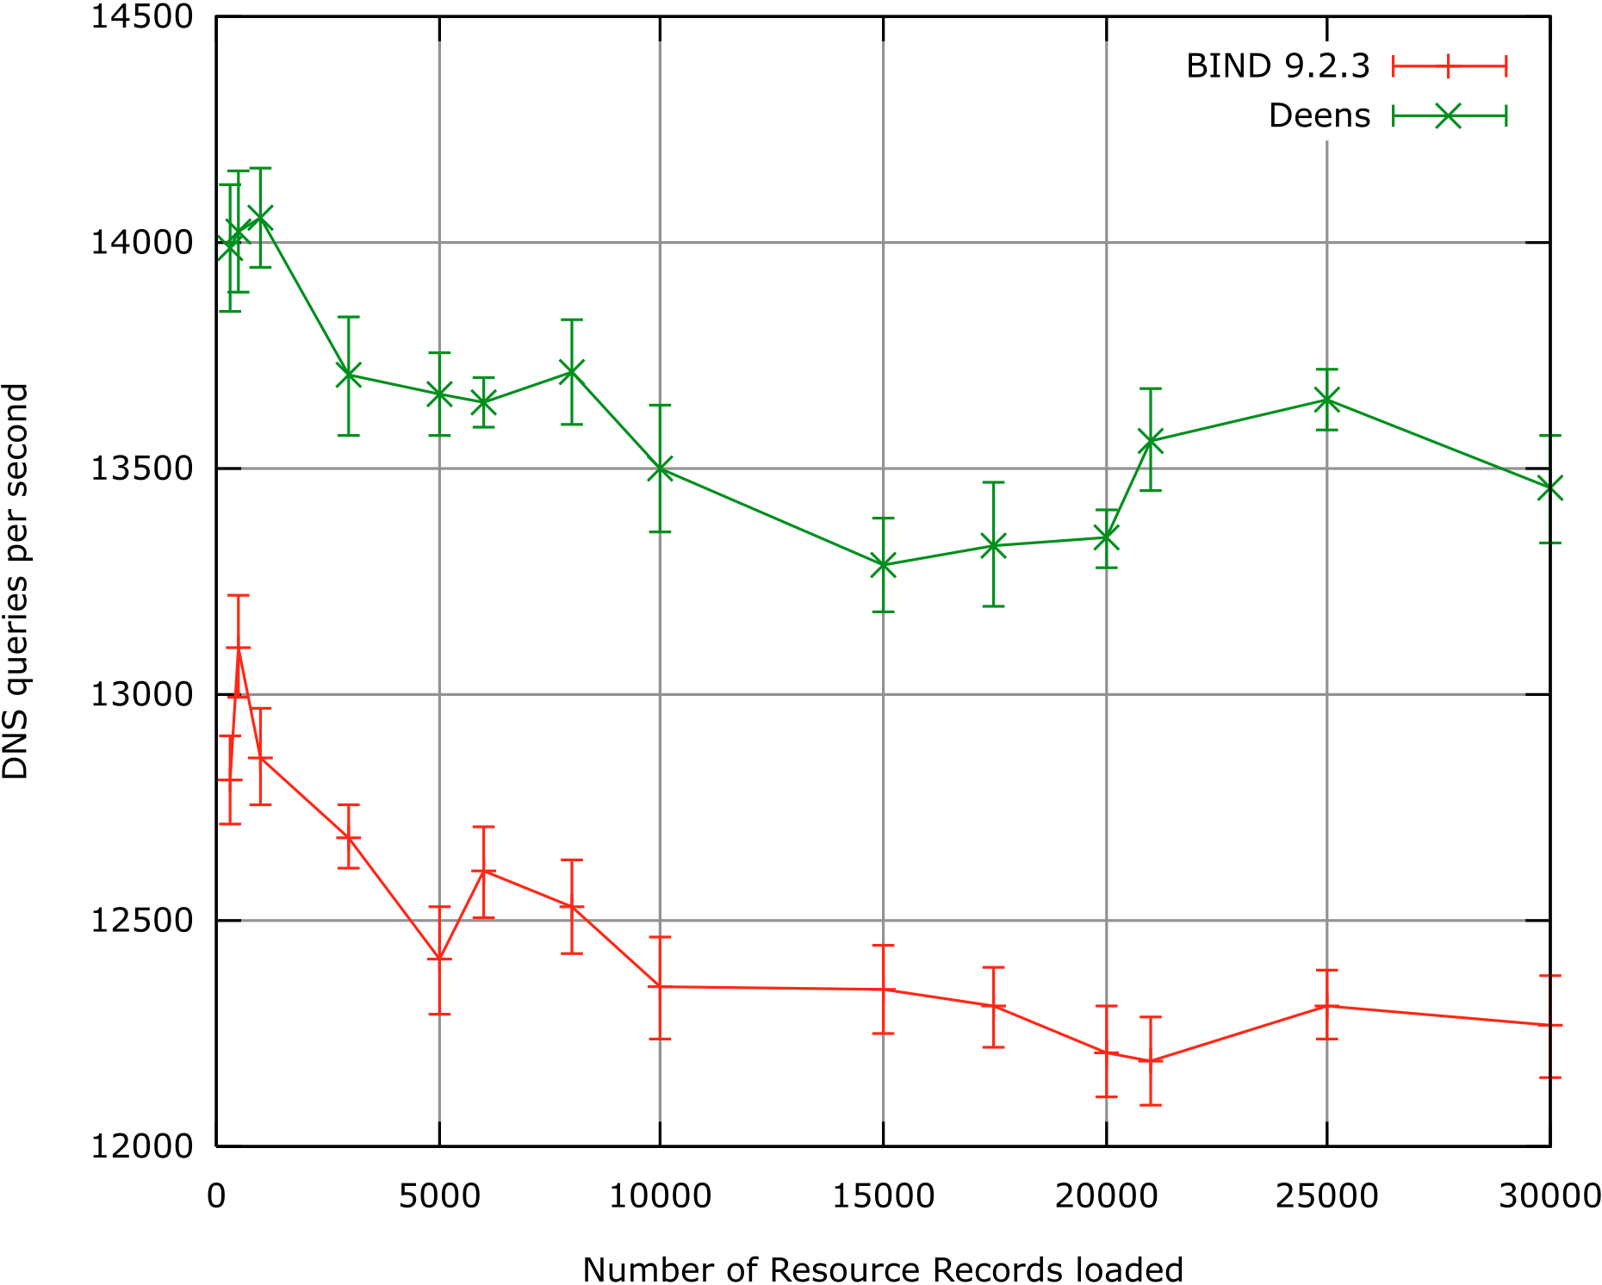
DNS: Performance of BIND (C) vs Deens (ML)

Slide 36
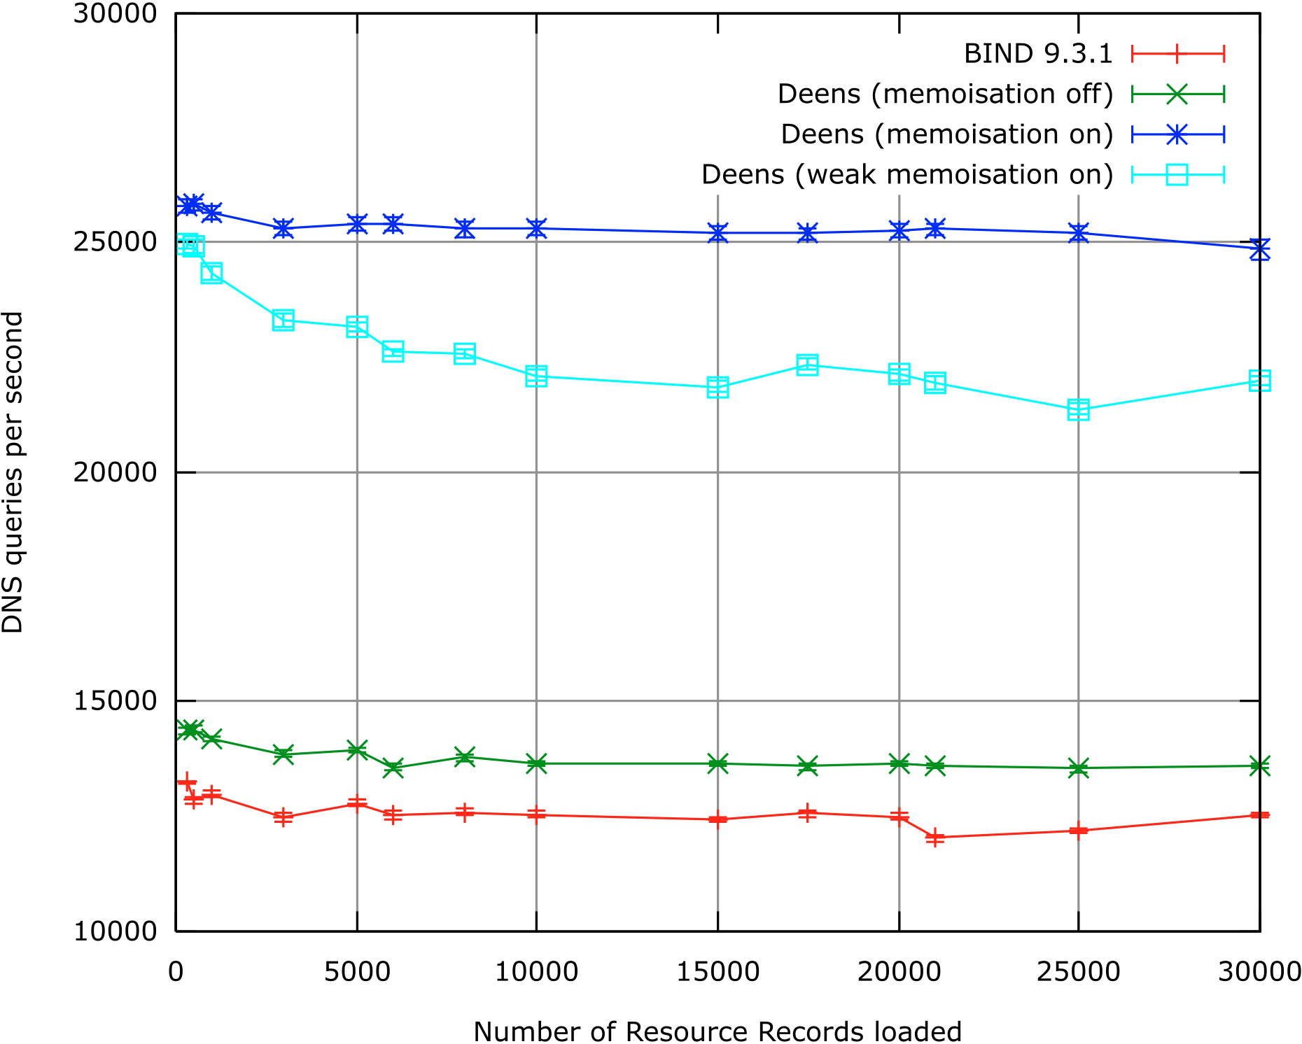
DNS: with functional memoisation

Slide 37
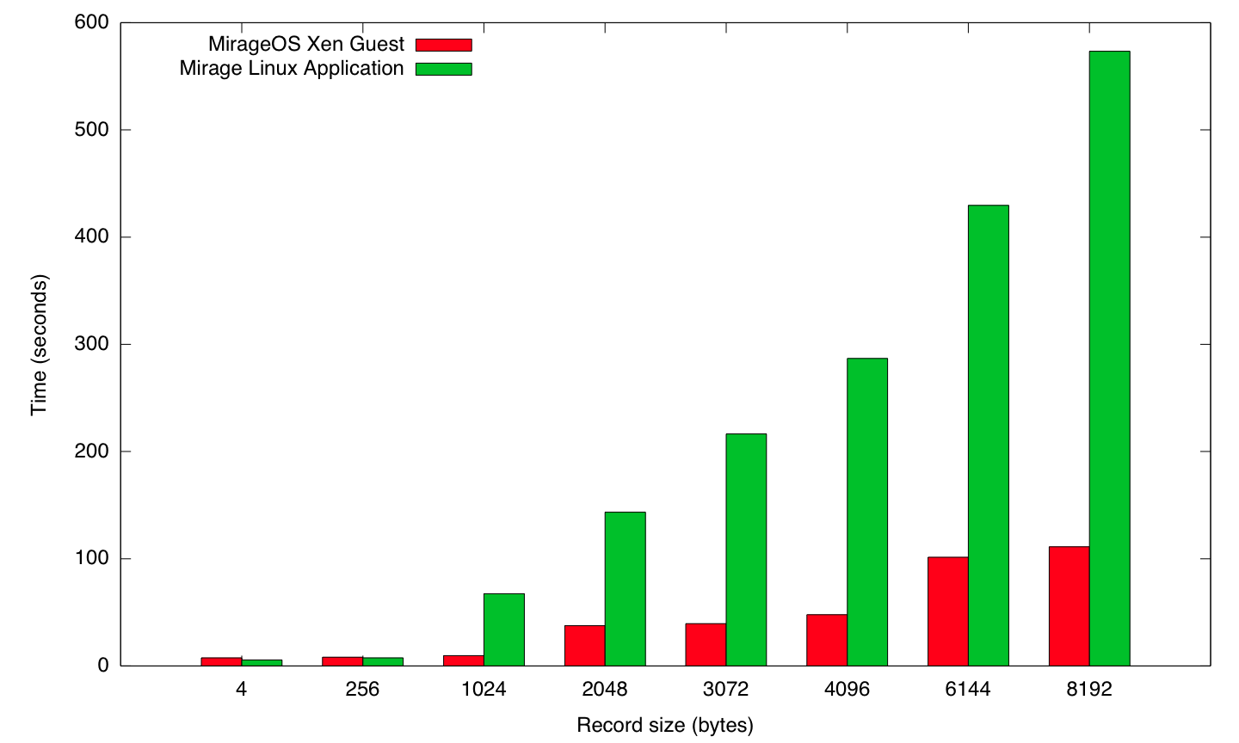
SQL performance vs PV Linux

