Slide 1

Reactive Extensions Workshop
Ryan Riley & Wes Dyer

Slide 2
Logistics
30 minute sections
10 minutes presentation
10 minutes coding
10 minutes discussion
New partner every section
Prizes for best code during each section

Slide 3
Where can I get them?
Install with NuGet
Download at MSDN Data Developer Center

Slide 4
Outline
Introduction to Rx
A Unified Programming Model
The Power of Rx
RxJS
Schedulers
Event Processing
Reactive Coincidence
Continuations Everywhere
Programming the Cloud

Slide 5
introduction to rx
like events but much better

Slide 6
The Reactive Extensions
Rx is …
a set of types representing asynchronous data streams
a set of operators to query asynchronous data streams
a set of types to parameterize concurrency
Rx = Observables + LINQ + Schedulers

Slide 7

Reactive Programming
In computing, reactive programming is a programming paradigm oriented around data flows and the propagation of change.
http://en.wikipedia.org/wiki/Reactive_programming

Slide 8




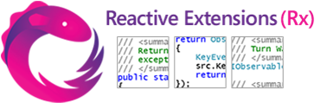



Why should I care?
GPS
RSS feeds
Stock tickers
Social
media
UI events
Server management

Slide 9
Reactive Programming using Events
Declare
event Action<int> E;
Publish
E(42);
Subscribe
E += x => Console.WriteLine(x);

Slide 10
Reactive Programming using Rx
Declare
ISubject<int> S = new Subject<int>();
Publish
S.OnNext(42);
Subscribe
S.Subscribe(x => Console.WriteLine(x));

Slide 11
The Reactive Extensions
Rx is …
a set of types representing asynchronous data streams
a set of operators to query asynchronous data streams
a set of types to parameterize concurrency
Rx = Observables + LINQ + Schedulers

Slide 12
A Little Example
class Program {
event Action<int> E;
static void Main() {
var p = new Program();
p.E += x => Console.WriteLine(x);
p.E(1);
p.E(2);
p.E(3);
}
}
class Program {
ISubject<int> S = new Subject<int>();
static void Main() {
var p = new Program();
p.S.Subscribe(x => Console.WriteLine(x));
p.S.OnNext(1);
p.S.OnNext(2);
p.S.OnNext(3);
}
}

Slide 13
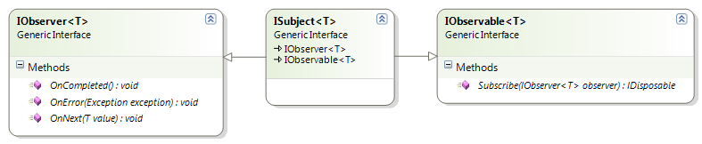
Separate Publish from Subscribe
Publish
Both
Subscribe

Slide 14
First-Class “Events”
An object is first-class when it:
can be stored in variables and data structures
can be passed as a parameter to a subroutine
can be returned as the result of a subroutine
can be constructed at runtime
has intrinsic identity (independent of any given name)
http://en.wikipedia.org/wiki/First-class_object

Slide 15
First-Class “Events”
// stored
IObservable<string> textChanged = …;
// passed
void ProcessRequests(IObservable<string> input) {…}
// returned
IObservable<int> QueryServer() {…}

Slide 16
Punctuation
class IObserver<in T>
{
void OnNext(T value);
void OnError(Exception error);
void OnCompleted(); }

Slide 17

Contract
Grammar: OnNext* [OnCompleted | OnError]
Serialized execution of observer’s methods
0
1
2
0
1
0
1
2
0
1
2
Notes:
Guaranteed sequential or

Slide 18
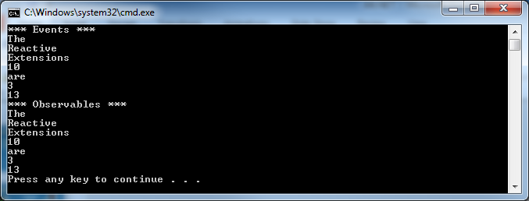
Challenge: Simple Transformation
Implement Events.LengthChanged
Implement Observables.LengthChanged
Output should be:
Notes:
Does the code correctly add/remove multiple handlers?
Is the code thread-safe?
Can the code be refactored into a method?
Can the code be generalized?

Slide 19
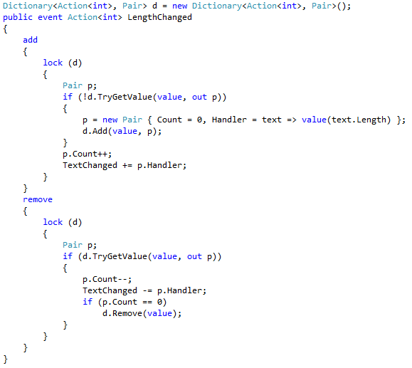
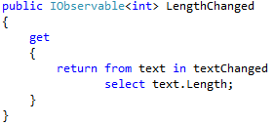
Answer
Events
Observables

Slide 20
Bridging from the Existing World
query asynchronous data streams

Slide 21
The Reactive Extensions
Rx is …
a set of types representing asynchronous data streams
a set of operators to query asynchronous data streams
a set of types to parameterize concurrency
Rx = Observables + LINQ + Schedulers

Slide 22
Empty
// complete immediately
Observable.Empty<int>();

Slide 23
Return
// return 1 value
Observable.Return(1);
1

Slide 24
Throw
// throw an exception
Observable.Throw(new Exception());

Slide 25
Never
// never complete
Observable.Never<int>();

Slide 26
Range
// return three values starting with 0
Observable.Range(0, 3);
0
1
2

Slide 27
ToEnumerable / ToObservable
// enumerable to observable
Enumerable.Range(0, 3).ToObservable();
// observable to enumerable
Observable.Range(0, 3).ToEnumerable();
0
1
2

Slide 28
Generate
// observable for loop
Observable.Generate(
0,
i => i < 3,
i => i + 1,
i => i * i
);
0
1
4

Slide 29
Create
// anything you please
Observable.Create<int>(observer =>
{
IDisposable b = new BooleanDisposable();
new Thread(() =>
{
for (int i = 0; i < 3 && !b.IsDisposed; ++i)
observer.OnNext(i);
observer.OnCompleted();
return () => {};
}).Start();
return b;
});
0
1
4

Slide 30
Using Events
class Program {
static void Main() {
Label lbl = new Label();
Form frm = new Form {
Controls = { lbl }
};
frm.MouseMove += (s, args) => {};
}
}
class Program {
static void Main() {
Label lbl = new Label();
Form frm = new Form {
Controls = { lbl }
};
var mouseMoves = Observable
.FromEventPattern<MouseEventHandler,
MouseEventArgs>(
x => frm.MouseMove += x,
x => frm.MouseMove -= x);
mouseMoves.Subscribe(evt => {});
}
}

Slide 31
LINQ to Events
class Program {
static void Main() {
Label lbl = new Label();
Form frm = new Form {
Controls = { lbl }
};
frm.MouseMove += (sender, args) =>
{
if (args.Location.X ==
args.Location.Y)
{
lbl.Text =
args.Location.ToString();
}
};
Application.Run(frm);
}
}
class Program {
static void Main() {
Label lbl = new Label();
Form frm = new Form {
Controls = { lbl }
};
var mouseUps = …;
var mouseMoves = …;
var specificMoves =
from up in mouseUps
from move in mouseMoves
let location = move.EventArgs.Location
where location.X == location.Y
select new { location.X, location.Y };
using (specificMoves
.Subscribe(evt => lbl.Text = evt.ToString()))
{
Application.Run(frm);
}
}
}

Slide 32
Challenge
Complete DictionarySuggest
Create an Observable from the TextChanged event
Create an Observable from an asynchronous web request
Combine these two observables to react to text input changes to return web service results

Slide 33
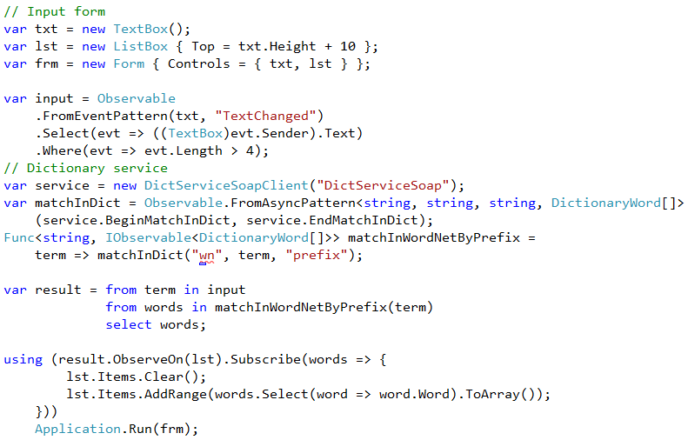
Answer

Slide 34
The Power of Rx
taking control

Slide 35
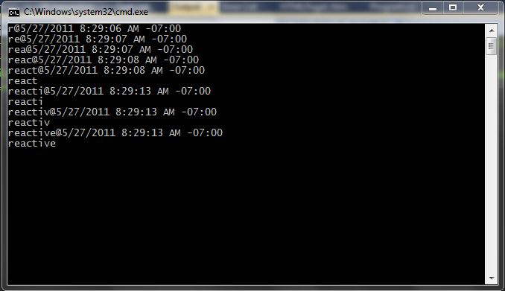
Monitoring
// anything you please
var input = Observable
.FromEventPattern(txt, "TextChanged")
.Select(evt => ((TextBox)evt.Sender).Text)
.Timestamp()
.Do((Timestamped<string> evt) => Console.WriteLine(evt))
.Select(evt => evt.Value)
.Where(evt => evt.Length > 4)
.Do(evt => Console.WriteLine(evt));

Slide 36
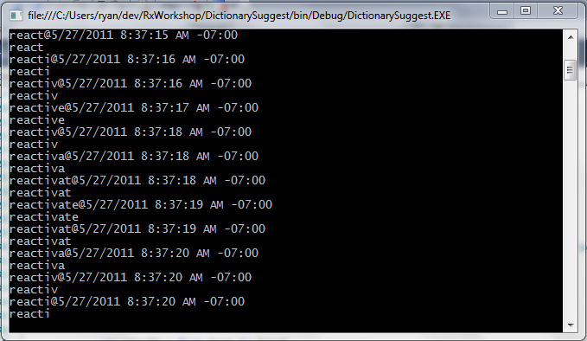
Too Many Events

Slide 37
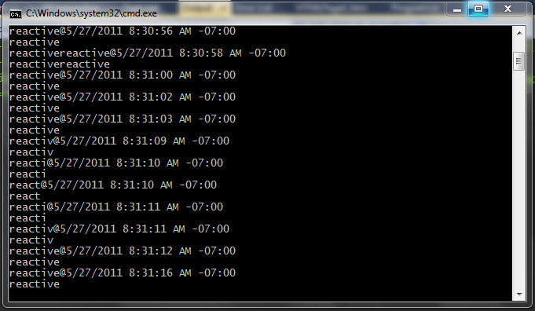
Duplication

Slide 38
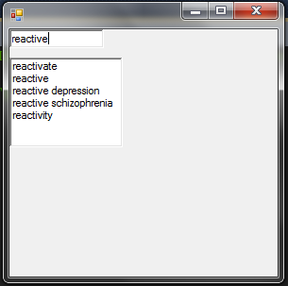
Race Condition

Slide 39
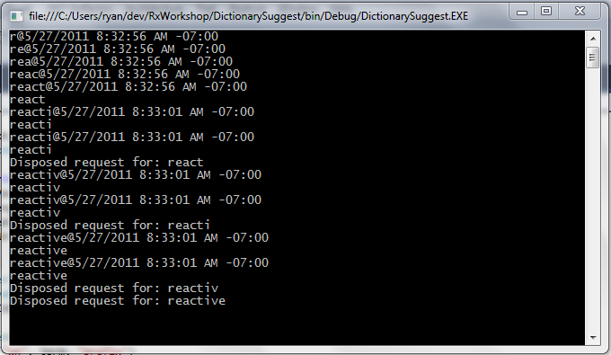
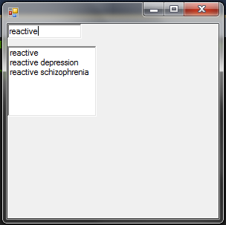
Challenge
Find and apply the operators to fix these issues in DictionarySuggest

Slide 40
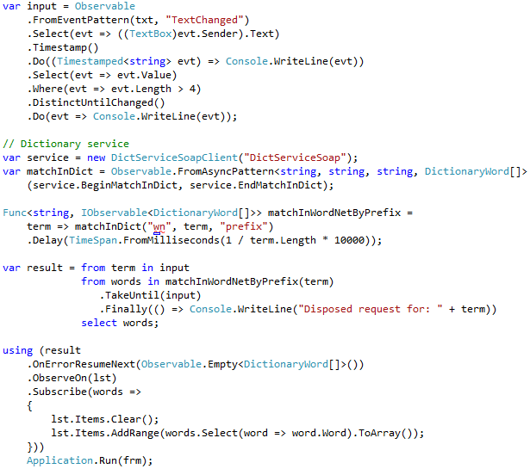
Answer

Slide 41
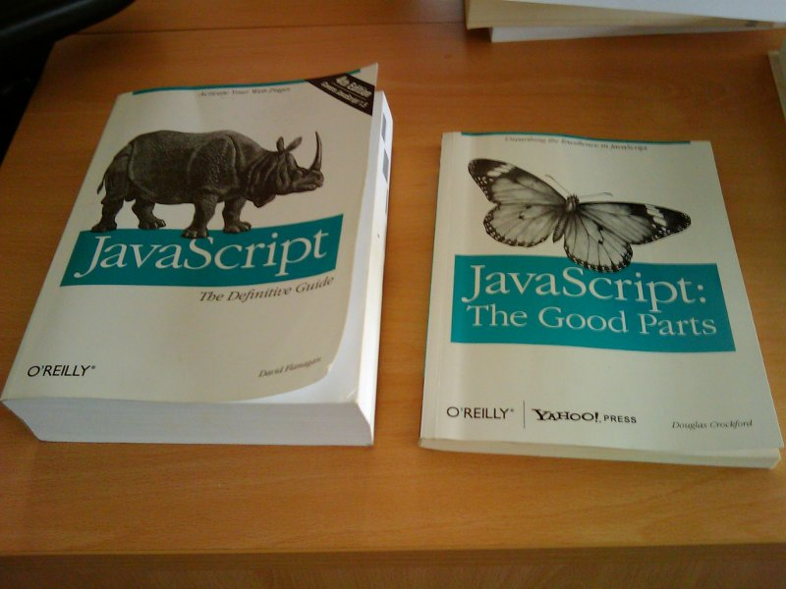
JavaScript
Notes:
Discuss: Using Rx for web clients – same library with an Rx prefix, library integration
Demo: run through demos from the Bridging from the Existing World section
Demo: jQuery integration
Image from http://www.skorks.com/wp-content/uploads/2010/04/javascript.jpg

Slide 42
Challenge
Port DictionarySuggest to RxJS

Slide 43
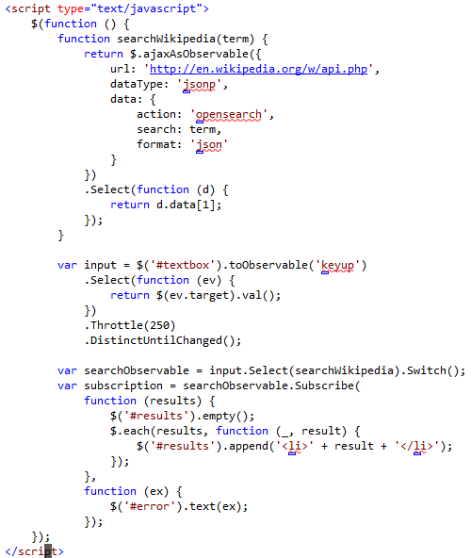
Answer

Slide 44
Schedulers
parameterizing concurrency

Slide 45
The Reactive Extensions
Rx is …
a set of types representing asynchronous data streams
a set of operators to query asynchronous data streams
a set of types to parameterize concurrency
Rx = Observables + LINQ + Schedulers

Slide 46
Parameterizing Concurrency
Observable.Timer(TimeSpan.FromSeconds(5))
Which timer?
System.Threading.Timer?
System.Timers.Timer?
System.Windows.Forms.Timer?
System.Windows.Threading.Timer?
Sleep on the current thread?
… ?

Slide 47
Scheduler Abstraction
execution context
clock
execution policy

Slide 48
Scheduler Interface
interface IScheduler
{
DateTimeOffset Now { get; }
IDisposable Schedule(Action work);
IDisposable Schedule(TimeSpan dueTime, Action work); IDisposable Schedule(DateTimeOffset dueTime, Action work); }

Slide 49
Operational Layering
var xs = Observable.Range(1, 10,
Scheduler.ThreadPool);
var q = from x in xs
where x % 2 == 0
select -x;
q.Subscribe(Console.WriteLine);
Operators

Slide 50
Operational Layering
var xs = new RangeObservable<int>(1, 10,
Scheduler.ThreadPool);
var q = new SelectObservable<int>(
new WhereObservable<int>(
xs,
x => x % 2 == 0),
x => -x);
q.Subscribe(
new LambdaObserver<int>(Console.WriteLine));
Operators
Observables

Slide 51
Operational Layering
var n = 0;
Scheduler.ThreadPool.Schedule(self => {
if (n < 10) {
if ((n + 1) % 2 == 0)
Console.WriteLine(-(n + 1));
n++;
self();
}
});
Operators
Observables
Schedulers

Slide 52
Operational Layering
var n = 0;
Action<object> work = null;
work = _ =>
{
if (n < 10) {
if ((n + 1) % 2 == 0)
Console.WriteLine(-(n + 1));
n++;
ThreadPool.QueueUserWorkItem(null, work);
} };
ThreadPool.QueueUserWorkItem(null, work);
Operators
Observables
Schedulers
Native Concurrency

Slide 53
One Interface to Rule Them All
Name | Execution Context | Execution Policy | Clock
ThreadPool | Thread Pool | ASAP | Machine Time
Dispatcher | UI Thread | Priority FIFO | Machine Time
EventLoop | Dedicated Thread | FIFO | Machine Time
Immediate | Current Thread | Immediate | Machine Time
Remote | Another Process | FIFO | Remote Machine Time

Slide 54
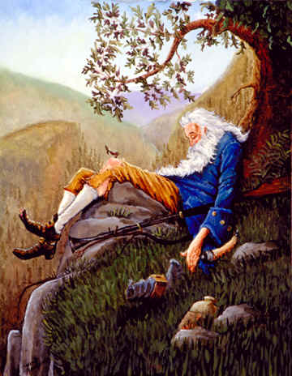
The Problem of Time
Operations can take a long time
Observable.Timer(TimeSpan.FromYears(1000))

Slide 55
The Problem of Time
Some operators have time-based semantics
Observable.Timer(TimeSpan.FromSeconds(1))
.Buffer(TimeSpan.FromSeconds(1))
0
1
2
3
4
5
6
1s
1s
1s
1s
1s
1s
1s
0
1
2
3
4
5
6
1s
1s
1s
1s
1s
1s
1s

Slide 56
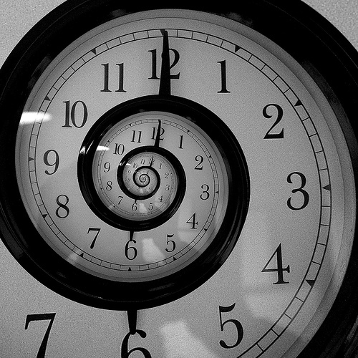
The Problem of Time
When testing reactive programs, time is the problem.
…virtual time is the solution.

Slide 57
Schedulers Revisited
Name | Execution Context | Execution Policy | Clock
ThreadPool | Thread Pool | ASAP | Machine Time
Dispatcher | UI Thread | Priority FIFO | Machine Time
EventLoop | Dedicated Thread | FIFO | Machine Time
Immediate | Current Thread | Immediate | Machine Time
Remote | Another Process | FIFO | Remote Machine Time
Test | Current Thread | FIFO | Virtual Time

Slide 58
Unit Testing with Schedulers
TestScheduler scheduler = new TestScheduler();
IObservable<string> input = scheduler.CreateObservable(
OnNext(300, “wes”),
OnNext(400, “ryan”),
OnCompleted(500));
var results = scheduler.Run(() =>
input.Select(x => x.Length));
results.AssertEqual(
OnNext(300, 3),
OnNext(400, 4),
OnCompleted(500));

Slide 59
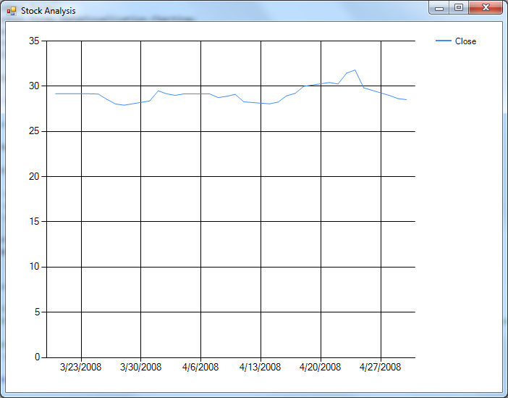
Challenge: Historical Data
Implement MainForm.GetQuotes
Implement MainForm.GetQuery
Notes:
How did you create an observable in GetQuotes?
Did GetQuotes have any specific knowledge of what type of scheduler it uses?
Did Query have any specific knowledge of how the observable it uses was produced?
Why can we return IObservable<object> from Query?
What does MyHistoricalScheduler.Run do?
Ext.BindToChart contains an operator called ObserveOn, what does this do? What happens if we remove it?

Slide 60
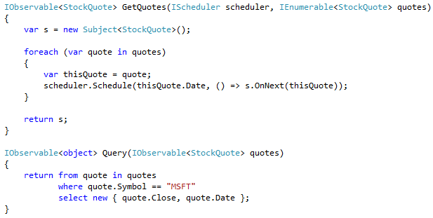
Answer

Slide 61
event processing
the power of LINQ

Slide 62
The Reactive Extensions
Rx is …
a set of types representing asynchronous data streams
a set of operators to query asynchronous data streams
a set of types to parameterize concurrency
Rx = Observables + LINQ + Schedulers

Slide 63

Event Processing
Given: Stream of stock ticks
Find: 10% daily price increase

Slide 64
Windowing
MSFT
27.01
INTC
21.75
MSFT
27.96
MSFT
31.21
INTC
22.54
INTC
20.98
MSFT
30.73
Group by symbol: GroupBy(t => t.Symbol)

Slide 65
Aggregation
MSFT
INTC
27.01
27.96
31.21
30.73
21.75
22.54
20.98
Aggregate each day with previous day: Buffer(2, 1)

Slide 66

Filtering
MSFT
INTC
27.01
27.96
27.96
31.21
31.21
30.73
21.75
22.54
22.54
20.98
Filter by price increase > 10%: Where(w => PriceIncrease(w) > .1)

Slide 67
Reduce
MSFT
INTC
27.96
31.21
Reduce to a single stream: Merge()

Slide 68
Done!
27.96
31.21

Slide 69
LINQ: Event Processing
source
group
from tick in stockTicks
group tick by tick.Symbol into symbolStream
from window in symbolStream.Buffer(2, 1)
let increase = PriceIncrease(window)
where increase > .1
select new { symbol = symbolStream.Key, increase };
aggregate
filter
apply
reduce

Slide 70
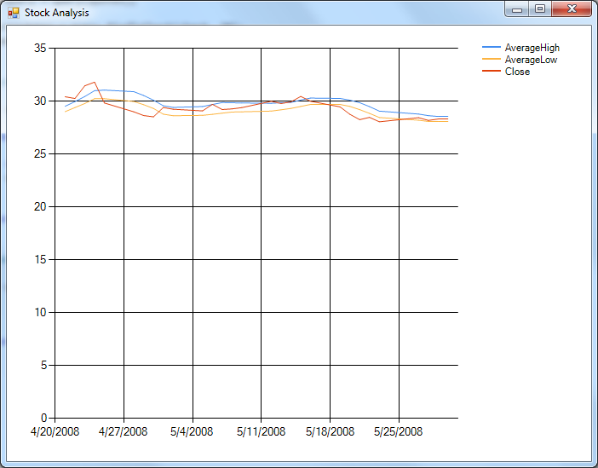
Challenge: Event Processing
Change MainForm.Query to compute the Average High and Average Low over the past 5 trading days as well as the current Close and Date
Notes:
Were you able to reuse most of your previous code?
Could you create more complex queries from the results of your new query?
What would you do if you wanted to capture the last 5 days and not the last 5 trading days?
What really is the power of LINQ?

Slide 71
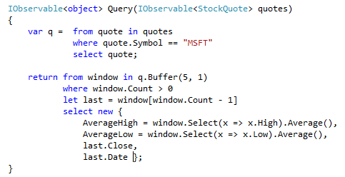
Answer

Slide 72
Reactive coincidence
streaming windows

Slide 73
The Reactive Extensions
Rx is …
a set of types representing asynchronous data streams
a set of operators to query asynchronous data streams
a set of types to parameterize concurrency
Rx = Observables + LINQ + Schedulers

Slide 74
Event Duration
0
1
2
vs
0
1
2

Slide 75
An Example
left
right
left

Slide 76
Representing Duration
begin
begin
end
end
Window

Slide 77
Store

Slide 78
Reactive Coincidence
Which people are at the store while it is opened?
5/5
5/6
moe
larry
curley

Slide 79
Reactive Coincidence
Which people are at the store while it is opened?
5/5
5/6
moe
larry
moe
curley

Slide 80
LINQ Join
from opening in storeOpenings
join person in personArrives
on opening.Close equals person.Leaves into g
select new { opening.Day, People = g };

Slide 81
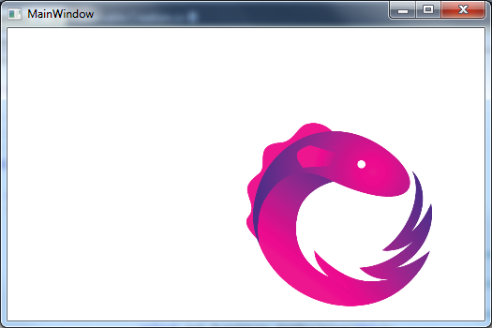
Challenge: Drag and Drop
Change query in MainForm.MainForm to compute a stream of deltas when the mouse is down
Notes:
Which event has a duration?
Which event stream defines the windows?
Which event stream defines the data?
Can an event stream without duration define the windows?
Given a stream of points how can we compute deltas?
Did you consider the initial point where the mouse button was clicked?

Slide 82
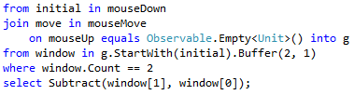
Answer

Slide 83
Programming the cloud
a glimpse into the future

Slide 84
The Reactive Extensions
Rx is …
a set of types representing asynchronous data streams
a set of operators to query asynchronous data streams
a set of types to parameterize concurrency
Rx = Observables + LINQ + Schedulers

Slide 85

Distributed Queries
Cloud
query
results

Slide 86
Distributed Queries
Observable.Timer(
TimeSpan.FromSeconds(1),
Scheduler.Azure)
.ObserveLocally()
.Subscribe(Console.WriteLine);
Send the query to the cloud
Send the results back

Slide 87
Distributed Parameters
Pass-by-Value
[Serializable] class MyType { … }
Pass-by-Reference
class MyType : MarshalByRefObject { … }

Slide 88
Distributed Scheduling
Pass by value or reference?
var x = 42;
scheduler.Schedule(() =>
Console.WriteLine(x));
class Closure {
public int x;
public void M() {
Console.WriteLine(x);
}
}
var closure = new Closure();
closure.x = 42;
scheduler.Schedule(closure.M);

Slide 89
Scheduler Interface Revisited
interface IScheduler {
…
IDisposable Schedule<T>(T state, Action<T> work);
…
}

Slide 90
Distributed Scheduling
var x = 42;
scheduler.Schedule(
x,
state =>
Console.WriteLine(state));
static void M(int state) {
Console.WriteLine(state);
}
var x = 42;
scheduler.Schedule(
x,
M);
No closures!!!

Slide 91
Nested Scheduling
scheduler.Schedule(42, x =>
scheduler.Schedule(x + 1, y =>
Console.WriteLine(y)));

Slide 92

Distributed Scheduling
cloud
Scheduler

Slide 93
Scheduler Interface Rerevisited
interface IScheduler {
…
IDisposable Schedule<T>(T state,
Action<IScheduler, T> work);
…
}

Slide 94
Nested Scheduling
scheduler.Schedule(42, (s, x) =>
s.Schedule(x + 1, y =>
Console.WriteLine(y)));

Slide 95

Fan-out Scheduling
Scheduler
Scheduler
Scheduler
Scheduler
Scheduler
Scheduler
Scheduler

Slide 96
Fan-out Scheduling
var d = scheduler.Schedule(42, (s, x) => {
var d1 = s.Schedule(x + 1, Console.WriteLine);
var d2 = s.Schedule(x + 2, Console.WriteLine);
});
How do we make d depend on d1 & d2?

Slide 97
Scheduler Interface Rererevisited
interface IScheduler {
…
IDisposable Schedule<T>(T state,
Func<IScheduler, T, IDisposable> work);
…
}

Slide 98
Fan-out Scheduling
var d = scheduler.Schedule(42, (s, x) => {
var d1 = s.Schedule(x + 1, Console.WriteLine);
var d2 = s.Schedule(x + 2, Console.WriteLine);
return new CompositeDisposable(d1, d2);
});

Slide 99
Easy Recursive Scheduling
scheduler.Schedule(42, (state, self) =>
{
Console.WriteLine(state);
self(state + 1); });

Slide 100
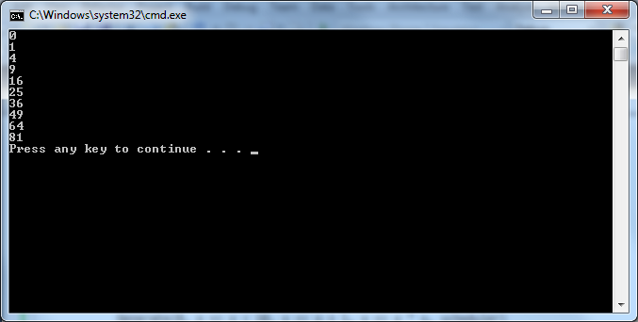
Challenge: AppDomains
Change Program.Main to use the AppDomainScheduler
Reimplement GenerateObservable.Subscribe
Notes:
What are the two basic parameter passing mechanisms in distributed systems?
How are they indicated?
Why don’t closures work in distributed systems?
Regarding the scheduler interface…
Why is the state passed in?
Why is a disposable returned by the func?
Why is there a scheduler argument in the func?

Slide 101
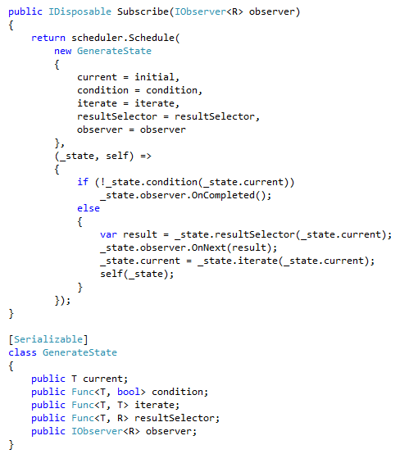
Answer

Slide 102
Continuations Everywhere
continuation-passing style used elsewhere

Slide 103
Ruby
1..10.each do |x| puts x * x end

Slide 104
AJAX
$.ajax({
url: 'http://en.wikipedia.org/w/api.php',
dataType: 'jsonp',
data: {
action: 'opensearch',
search: term,
format: 'json'
},
success: function(msg) {
alert('Data saved:' + msg);
}
});
Notes:
Demo: jQuery.ajax function with callbacks

Slide 105
node.js
var net = require('net');
var server = net.createServer(function (socket) {
socket.write("Echo server\r\n"); socket.pipe(socket);
});
server.listen(1337, "127.0.0.1");

Slide 106
Challenge
Using Rx, build a TCP server that works in a similar manner to node.js.

Slide 107
The Reactive Extensions
Rx is …
a set of types representing asynchronous data streams
a set of operators to query asynchronous data streams
a set of types to parameterize concurrency
Rx = Observables + LINQ + Schedulers

Slide 108
Learn More
Resources
Rx Developer Center
Rx on Channel 9
Projects
ReactiveUI
Fluent State Observer
Reactive ETL
ReactiveOAuth
Reactive Remoting
Extensions to the Extensions
Reactive Extensions – Extensions
Rx Contrib
RxUtilities
Rx Power Toys

