Slide 1

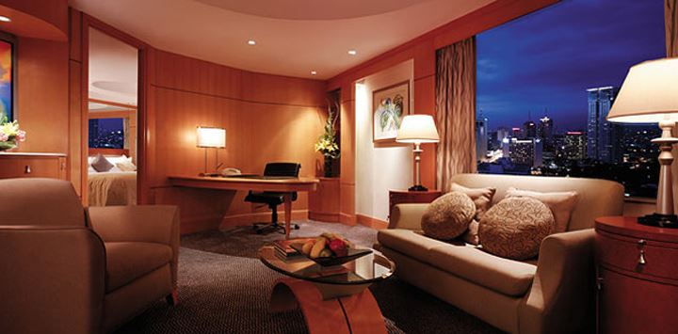
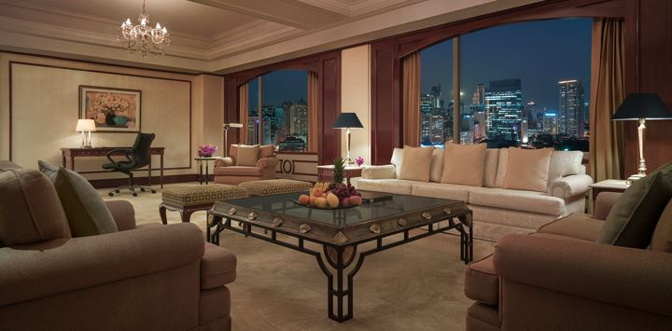
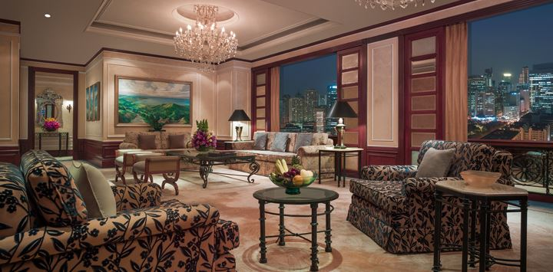
Make room
for a luxurious sanctuary
Makati Shangri-La, Manila, is one of the quintessential Makati hotels in Manila and has 696 of the city’s largest and most
beautifully appointed guestrooms and suites.
Zen waterfalls on each floor welcome guests as they enter their spacious and comfortable rooms. Plush 300-threadcount bed linens and a pillow menu ensure a quality night’s sleep.

Slide 2
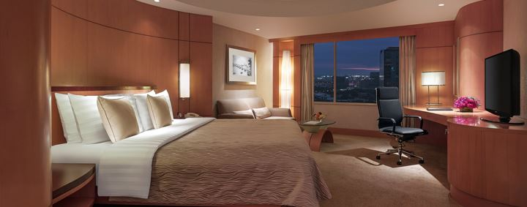
Elegant comfort with magnificent views of Makati
Superior Rooms offer comfort and privacy, with a full array of amenities that make your stay productive and peaceful.
Features
Magnificent views of Makati and Ayala Avenues and the Glorietta Commercial Centre
Indulgent bed with 300-count cotton linen.
A spacious bathroom with separate shower.
Each room offers 38 - 44 sqm / 430 - 473 sqf of luxury.
Complimentary Wi-Fi
Amenities
Media & Entertainment
Complimentary WiFi and broadband Internet access
LCD television
Office Equipment & Stationery
Full-size executive writing desk
International Direct Dial telephone
Voice mail
Electronic safe
Bath & Personal Care
Hair dryer
Shangri-La toiletries
Separate shower & bath
300-count cotton linen
Refreshments
Coffee / tea
Mini-bar
Children's Meal Plan for registered hotel guests
Children of registered hotel guests under the age of 6 can enjoy *buffet meals at no extra cost in the All
Day Dining venue when accompanied by a paying adult; up to 2 children. For more than 2 children under the
age of 6 or children who are 6 years and above but under the age of 12, a 50% discount on the buffet price will be
given. *Buffet is subject to availability.

